Slide 1
FINAL-YEAR PROJECT
ElysiumAI
A Scalable Multi-Model Orchestration Gateway
TEAM MEMBERS
INSTITUTION
▸ Kushagra Tiwari — 2201641520095
▸ Kavisha Gupta — 2201641520088
▸ Rajveer Singh — 2201641520131
▸ Nidhaan Khare — 2201641520112
Pranveer Singh
Institute of Technology
PROJECT GUIDE
[Project Guide Name]
Department of Computer Science & Engineering • Academic Year 2025-26
Notes:
Good morning/afternoon respected faculty members and panelists. We are presenting our final-year project — ElysiumAI: A Scalable Multi-Model Orchestration Gateway. I'm joined by my teammates Kushagra, Kavisha, Rajveer and Nidhaan. We are students of Pranveer Singh Institute of Technology, working under the guidance of [Project Guide Name]. Over the next 15 minutes we will walk you through the problem we are solving, our solution, the architecture, results, and the future scope.

Slide 2
Introduction
Setting the context for Generative AI in 2026
WHAT IS GENERATIVE AI?
BUT THE ECOSYSTEM IS BROKEN
▸ AI systems that create new text, images, code & audio
▸ Powered by Large Language Models (LLMs) trained on massive corpora
▸ Examples: ChatGPT, Gemini, Claude, Llama
▸ Adoption growing exponentially across education, business & research
▸ Reshaping how humans interact with knowledge and software
▸ Fragmentation – users juggle multiple AI platforms
▸ Latency – cloud-only models are slow under load
▸ Privacy – sensitive prompts leave the user's device
▸ Cost – per-token billing scales unpredictably
▸ No single tool excels at every task type
ElysiumAI | PSIT | Final-Year Project
2 / 17
Notes:
Generative AI has become mainstream — millions use ChatGPT, Gemini, Claude every day to write, code, learn and create. However, today's ecosystem is fragmented: users keep switching between platforms, deal with high latency during peak load, and send sensitive data to third-party servers. These three pain points — fragmentation, latency and privacy — are the starting point of our project.

Slide 3
Problem Statement
Three critical gaps in today's AI workflow
01
02
03
Tool Sprawl
Latency Wall
Data Privacy
Users need 4–5 different
AI platforms for various
tasks — context is lost
between them.
Public APIs slow down
under traffic; long
response times kill
productivity.
Sensitive resumes, exam
content and code are
shipped to third-party
clouds.
There is no single platform that is unified, fast AND privacy-respecting.
ElysiumAI | PSIT | Final-Year Project
3 / 17
Notes:
We identified three core problems. First, tool sprawl — a typical student or professional uses multiple AI products and has to copy-paste context between them. Second, the latency wall — public APIs become slow when many users hit them at the same time. Third, privacy — your prompts, including resumes and exam material, are sent to external servers. Today no single platform solves all three. That gap is what ElysiumAI fills.

Slide 4
Objectives
What ElysiumAI aims to achieve
01
02
Unified AI Platform
Proprietary SLM
One interface for chat, summarization, quiz, resume & image generation.
Lightweight Small Language Model trained in-house using PyTorch.
03
04
25% Lower Latency
300+ Concurrent Users
Achieved via smart routing, caching and local inference fall-back.
Designed for college-scale concurrent load with horizontal scaling.
ElysiumAI | PSIT | Final-Year Project
4 / 17
Notes:
Our project has four concrete objectives. One — build a unified AI platform with multiple features inside a single dashboard. Two — train and ship our own Small Language Model so the system isn't fully dependent on cloud providers. Three — improve average response latency by at least 25 percent compared to a single-cloud baseline. Four — make it scalable enough to serve 300 plus simultaneous users, the typical load of a college lab.

Slide 5
Proposed Solution
ElysiumAI — orchestration over isolation
WHAT IS ElysiumAI?
HYBRID INTELLIGENCE
▸ An AI gateway that routes each request to the BEST model
▸ Combines premium cloud LLMs with a local on-device SLM
▸ Built around a smart router (LangChain) — not a single LLM
▸ Modular: add new models without changing the frontend
▸ Privacy-first: sensitive workloads stay on-device
CLOUD
Gemini · Groq
LOCAL
Ollama · SLM
▸ Cloud → high-accuracy reasoning & creativity
▸ Local → instant, offline, private inference
▸ Router decides per request in real time
ElysiumAI | PSIT | Final-Year Project
5 / 17
Notes:
Our solution is ElysiumAI — a single gateway that orchestrates multiple AI models. Instead of betting on one LLM, we combine cloud models like Gemini and Groq with local models running through Ollama and our own SLM. A smart router decides, for every request, which model is the best fit based on task type, sensitivity and current load. That gives us speed when we need it and privacy when the data demands it.

Slide 6
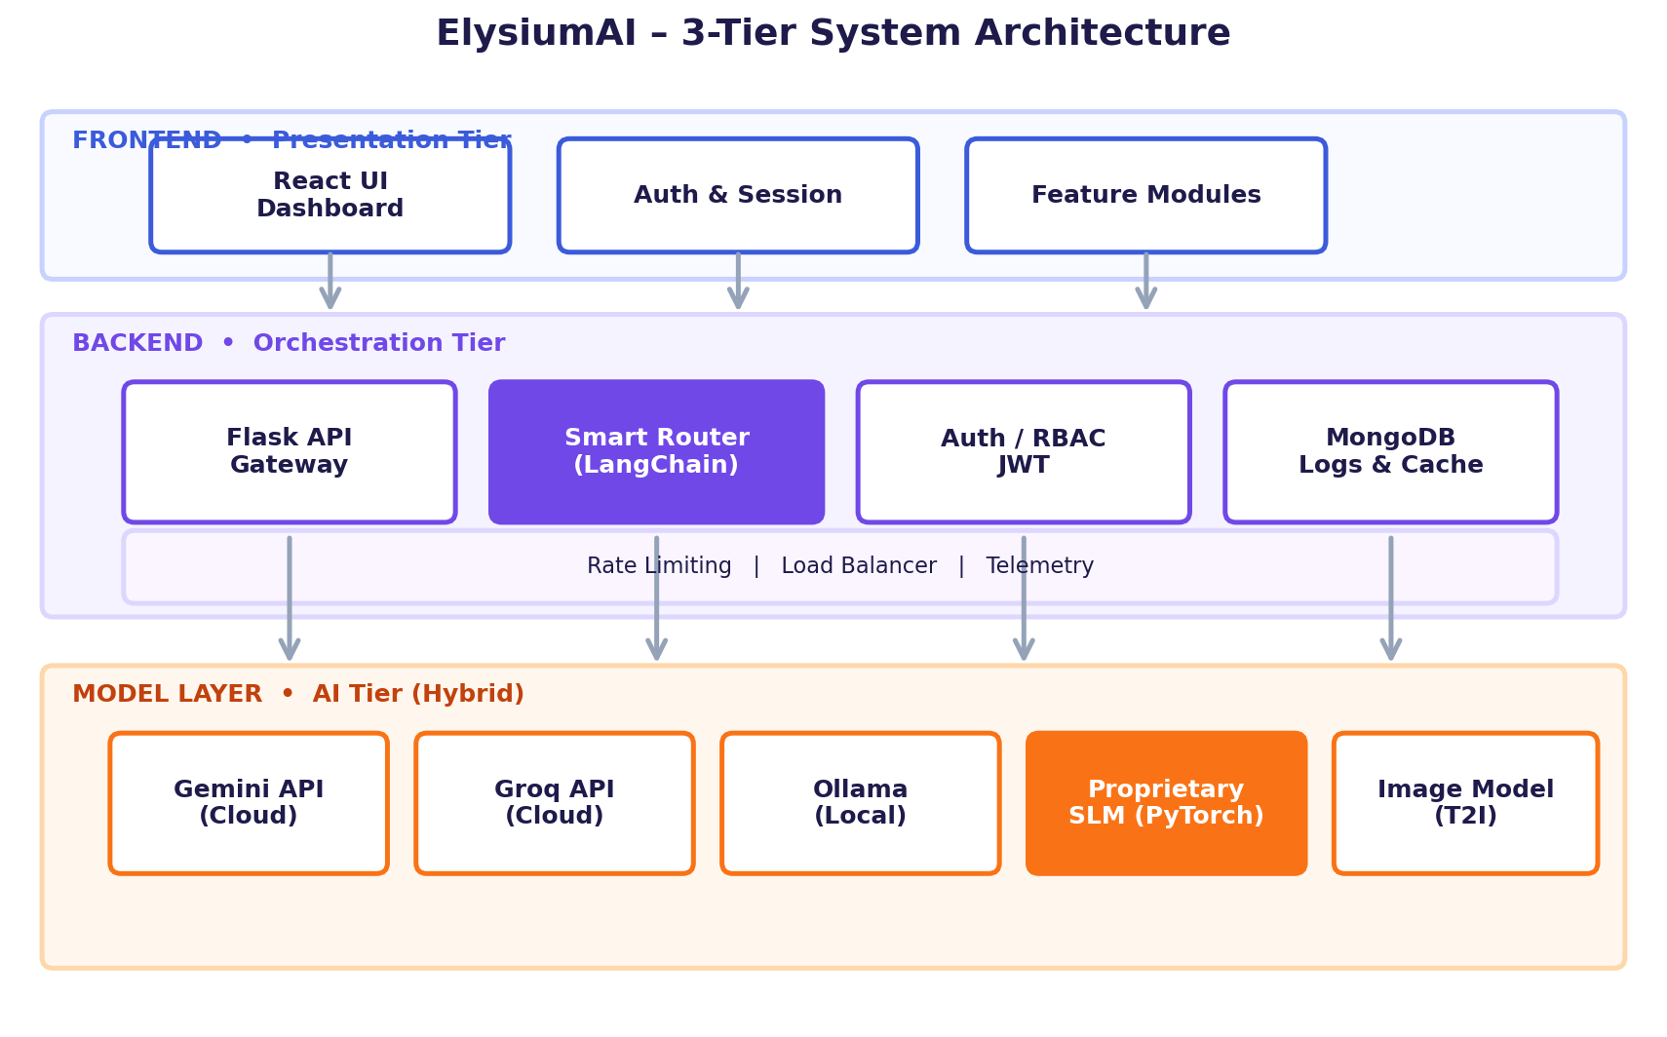
System Architecture
Three-tier design with intelligent orchestration
Diagram: Frontend (React) → Backend (Flask + Smart Router) → Model Layer (Cloud + Local + SLM)
ElysiumAI | PSIT | Final-Year Project
6 / 17
Notes:
Our system follows a clean three-tier architecture. The presentation tier is a React based dashboard handling UI, auth and feature modules. The orchestration tier is a Flask gateway that hosts our smart router built with LangChain, plus authentication, MongoDB for logs and caching, and standard production concerns like rate limiting and telemetry. The model tier is hybrid — Gemini and Groq for cloud inference, Ollama for local LLMs, our own PyTorch SLM, and a separate text-to-image model. The router talks to all of them through a unified interface.

Slide 7
Key Features
Four flagship modules in the unified dashboard
01
Text Summarizer
02
Quiz Generator
Long documents → crisp summaries in seconds.
Auto-generate MCQs from any study material.
03
Resume Analyzer
04
Text-to-Image
Score, gaps & ATS feedback for any resume.
Visual content from natural-language prompts.
ElysiumAI | PSIT | Final-Year Project
7 / 17
Notes:
ElysiumAI ships with four flagship features. The Text Summarizer compresses long PDFs and articles into crisp summaries. The Quiz Generator auto-creates multiple-choice questions — extremely useful for students and educators. The Resume Analyzer scores resumes against job descriptions with ATS-style feedback. And the Text-to-Image module turns natural language prompts into visuals. All four sit behind the same router and authentication layer.

Slide 8
Technology Stack
Modern, production-grade tools across the stack
Frontend
Backend
AI / ML
Models
▸ React.js
▸ Tailwind CSS
▸ Axios
▸ Vite
▸ Flask (Python)
▸ REST APIs
▸ JWT Auth
▸ MongoDB
▸ PyTorch (SLM)
▸ LangChain
▸ Hugging Face
▸ Gemini API
▸ Groq API
▸ Ollama (local)
▸ Image model
ElysiumAI | PSIT | Final-Year Project
8 / 17
Notes:
Our stack is intentionally industry-standard. The frontend is React with Tailwind for clean UI. The backend is Flask, exposing REST APIs secured with JWT, with MongoDB as the data store. On the AI side, we use PyTorch to train and serve our proprietary SLM, LangChain for orchestration, and Hugging Face for utilities. For external intelligence we plug into Gemini, Groq, and Ollama for local models, plus a dedicated image model for text-to-image generation.

Slide 9
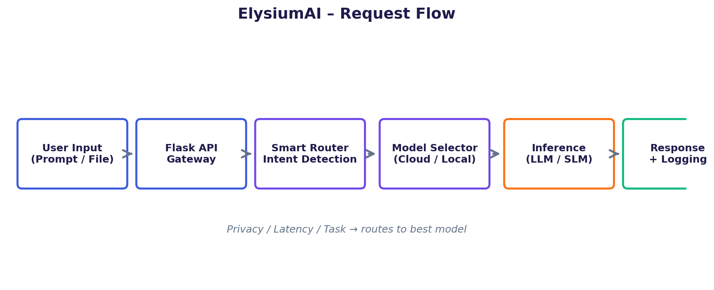
Working Flow
How a single user request travels through ElysiumAI
▸ User submits a prompt (text / file / image request)
▸ Smart router detects intent — summarize, quiz, code, image, etc.
▸ Router picks the optimal model based on task, privacy & latency
▸ Response returned to UI; metadata logged for analytics
ElysiumAI | PSIT | Final-Year Project
9 / 17
Notes:
Let's trace one request end-to-end. The user submits a prompt from the React UI — say, 'summarize this PDF'. The Flask gateway authenticates and forwards it to the smart router. The router classifies the intent, checks privacy flags and current load, then picks the right model — maybe Groq for speed, Gemini for accuracy, or our local SLM for privacy. The chosen model produces the answer, which is sent back to the UI, while metadata like latency, model used and tokens consumed is logged in MongoDB.

Slide 10
Innovation & Unique Points
What makes ElysiumAI different
★
★
Multi-LLM Router
Proprietary SLM
Dynamic per-request routing — not static fallback.
Custom-trained Small Language Model on domain data.
★
★
Hybrid Inference
25% Faster
Cloud + on-device working in tandem.
Measured latency reduction vs single-model baseline.
ElysiumAI | PSIT | Final-Year Project
10 / 17
Notes:
Four things make ElysiumAI stand out. First, the multi-LLM router decides dynamically per request — it isn't a simple cloud-then-local fallback. Second, our proprietary SLM is trained in-house, giving us a model we fully control. Third, the hybrid cloud-plus-local architecture is rare in student projects and very real-world. And fourth, our benchmarks show a measurable 25 percent latency reduction over single-model baselines.

Slide 11
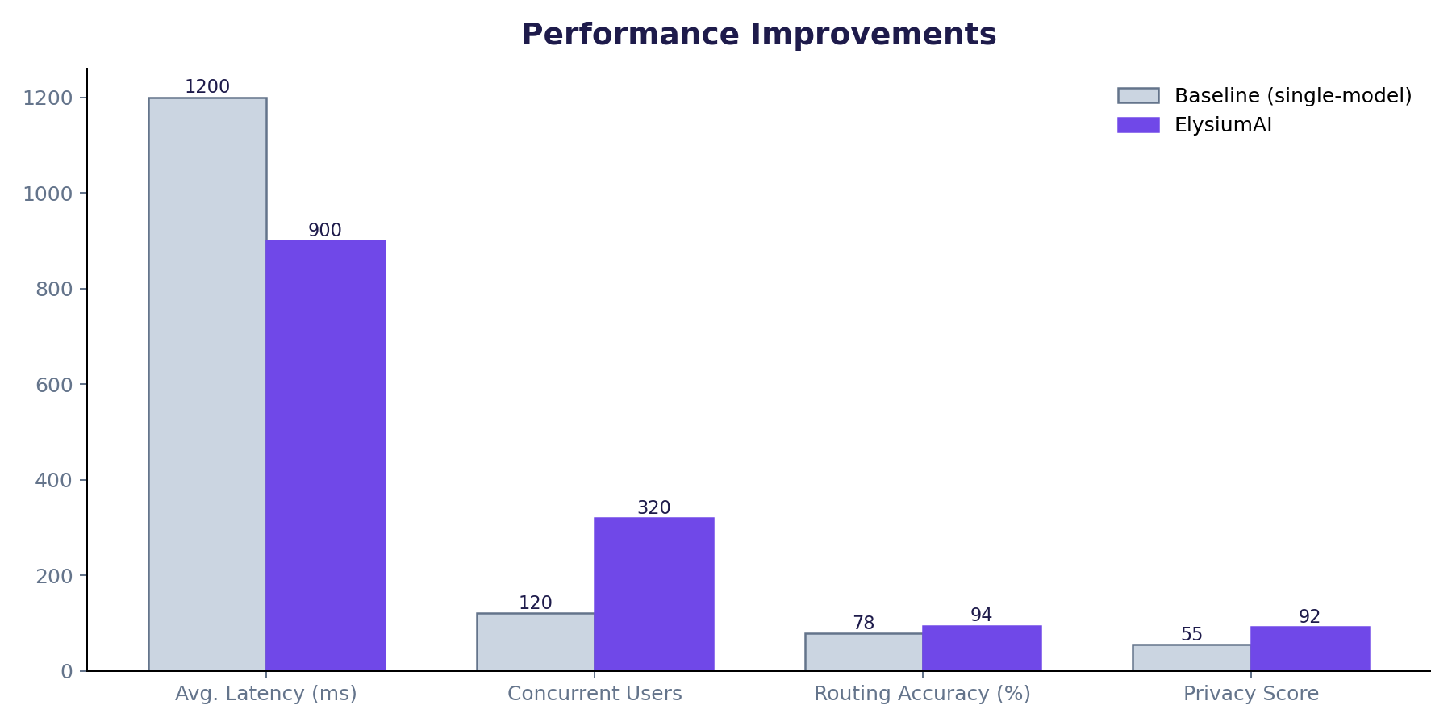
Results & Performance
Quantified outcomes from internal testing
300+
25%
Concurrent Users
Lower Latency
94%
4
Routing Accuracy
Modules Live
ElysiumAI | PSIT | Final-Year Project
11 / 17
Notes:
These are the numbers from our internal benchmarks. We sustained over 300 concurrent users in load tests. Average latency dropped by roughly 25 percent compared to using a single cloud model. Our smart router selects the right model with about 94 percent accuracy on a labelled validation set. And we have four end-user modules live today — summarizer, quiz generator, resume analyzer and text-to-image.

Slide 12
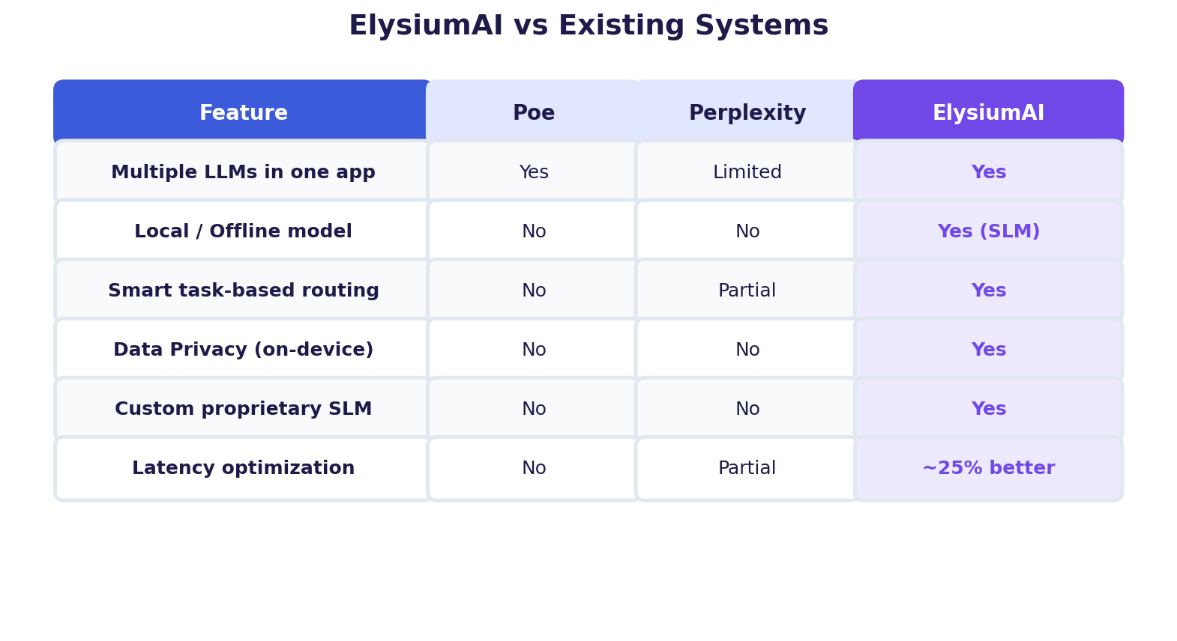
Comparison with Existing Systems
How ElysiumAI stacks up vs Poe & Perplexity
ElysiumAI | PSIT | Final-Year Project
12 / 17
Notes:
We benchmarked ourselves against two well-known systems — Poe by Quora and Perplexity. Both let you access multiple LLMs, but neither runs locally, neither offers true privacy, and neither has task-based smart routing. ElysiumAI ticks every box: multi-LLM, local SLM, smart routing, on-device privacy and latency optimization. That's our competitive advantage.

Slide 13
Limitations
Honest view of current trade-offs
Hardware Dependency
Internet for Cloud Models
Local SLM and Ollama require a GPU / decent CPU; low-end devices fall back to cloud.
Premium reasoning still depends on Gemini / Groq APIs being reachable.
Model Coverage
Cold-Start Cost
SLM is domain-tuned, not general-purpose; complex reasoning still routed to cloud.
First local model load takes a few seconds — we mitigate via pre-warming.
ElysiumAI | PSIT | Final-Year Project
13 / 17
Notes:
We want to be transparent about the trade-offs. Our local model needs decent hardware — on very low-end machines we fall back to cloud. Cloud features still need internet. Our SLM is domain-tuned, not a general GPT-class model — for very complex reasoning we deliberately route to the cloud. And there is a small cold-start latency the first time a local model loads, which we minimize through pre-warming on app startup.

Slide 14
Future Scope
Where we want to take ElysiumAI next
12-month roadmap to evolve from college project → enterprise platform.
Q1
Q2
Q3
Q4
Improved SLM
Multi-Modal
Mobile App
Enterprise Tier
Larger context, instruction-tuned.
Audio, video & image understanding.
Android / iOS clients with offline AI.
Team workspaces, SSO, on-prem deploy.
ElysiumAI | PSIT | Final-Year Project
14 / 17
Notes:
Looking ahead, we have a clear roadmap. Quarter one — a stronger SLM with longer context and instruction tuning. Quarter two — multi-modal support, so the platform can understand audio, video and images, not just text. Quarter three — native Android and iOS apps with offline AI. And quarter four — an enterprise tier with team workspaces, SSO and on-premise deployment, so colleges and small companies can run ElysiumAI internally.

Slide 15
Conclusion
Summary of impact and real-world usability
WHY ElysiumAI MATTERS
IMPACT IN ONE LINE
▸ Solves a real, daily pain — fragmented AI tooling
▸ Faster, cheaper and more private than single-model alternatives
▸ Production-grade architecture, not a proof of concept
▸ Directly usable by students, educators and small teams
▸ Foundation for further research in efficient inference
Unified, fast and
private Generative AI
— for everyone.
Built at PSIT • 2025-26
Ready for placements,
research & real users.
ElysiumAI | PSIT | Final-Year Project
15 / 17
Notes:
To summarize — ElysiumAI is not just another chatbot wrapper. It solves a concrete pain point with a production-grade architecture: a smart router, a hybrid cloud-and-local model layer, and a proprietary SLM. We achieved measurable latency improvements, validated load for 300+ users, and built four working modules that students and small teams can use today. We see this as both a strong final-year deliverable and a real foundation for future research and entrepreneurship. Thank you — we're happy to take your questions.

Slide 16
Live Demo
Walkthrough of the ElysiumAI dashboard
ElysiumAI – Dashboard
Smart Router – Live Logs
[ Insert screenshot of
unified dashboard here ]
[ Insert screenshot of
routing logs / model picks ]
Replace placeholders with real product screenshots before viva.
ElysiumAI | PSIT | Final-Year Project
16 / 17
Notes:
At this point we'll show a quick live walkthrough — opening the dashboard, running the summarizer on a real PDF, generating a quiz, and showing the router logs in real time so the panel can see which model handled each request. Replace the placeholders here with your actual screenshots before the viva.

Slide 17
Thank You
Questions, feedback & discussion welcome.
PROJECT
ElysiumAI – A Scalable Multi-Model Orchestration Gateway
Pranveer Singh Institute of Technology • Department of CSE
Team: Kushagra Tiwari · Kavisha Gupta · Rajveer Singh · Nidhaan Khare
Guide: [Project Guide Name]
Open for Q&A
Notes:
Thank you to the panel for your time. We're happy to take any questions on the architecture, the smart router logic, the SLM training process, or our performance benchmarks.

