Slide 1
CITI Summer Interns 2020
PDF to XML Converter
Business Unit: TTS
Project: PDF to XML Converter
Members:
Bhavya Sharma (IITG)
Kushagra Pandey (IITG)
Srijan Sankrit (IITG)

Slide 2
Problem Statement
To extract business information from a PDF document and convert it into an XML document
This will allow the organisation to compare/ further process data in PDF with data present in Database

Slide 3
DEMO

Slide 4
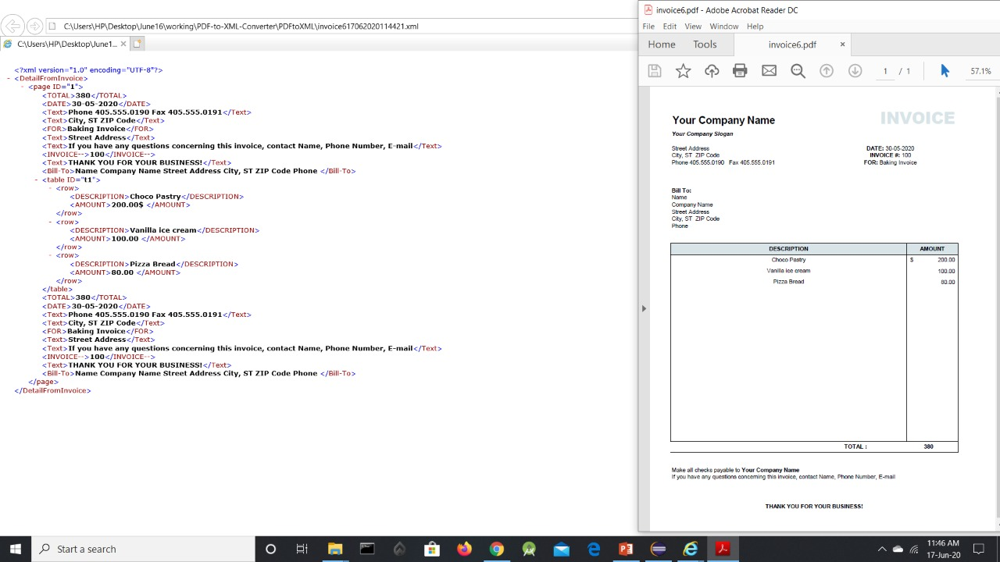
Sample Output 1

Slide 5
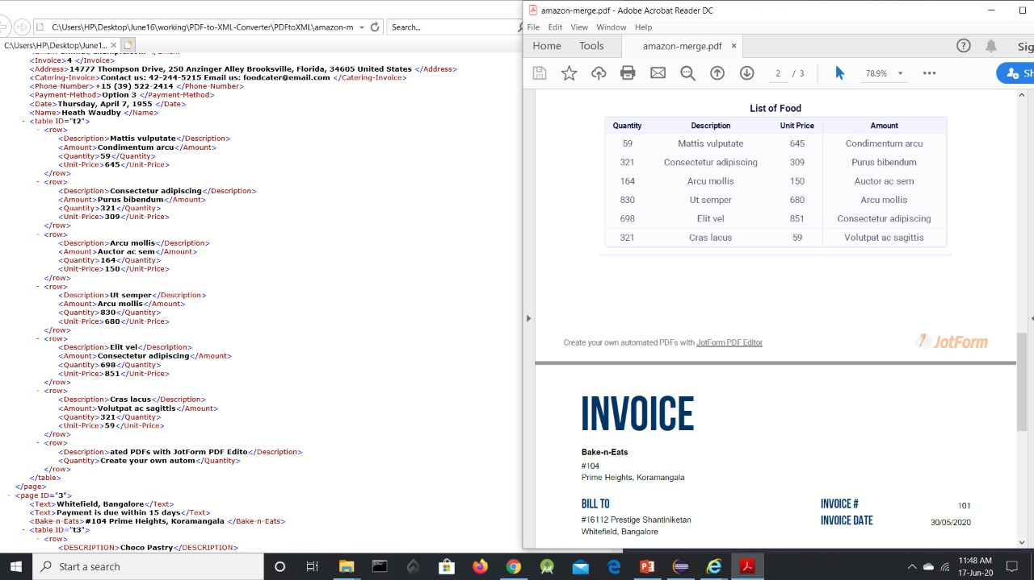
Sample Output 2

Slide 6
Challenges
UNSTRUCTURED TEXT
No semantics
PDF received may be any business document e.g. invoice, transaction statement etc.
NON STANDARD FORMAT
Different vendors may use different terms for “Amount”, “Description”, “Quantity”
Placement of information on PDF page may be different
Items table may have varying number of columns
The preamble and summary may be in format of a table or may be free flowing
INSUFFICIENT METHODS IN PDFBox
PDFBox does not contain direct methods to extract a table from a given PDF

Slide 7
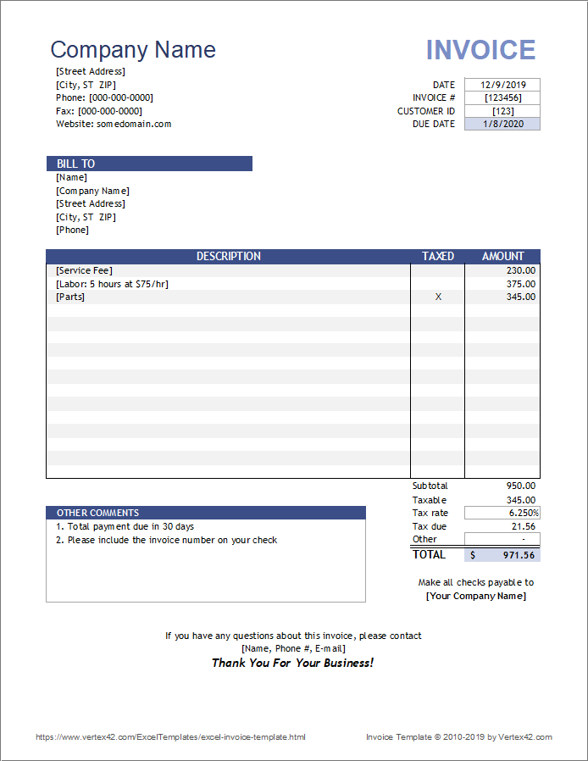
Sample Invoice
PREAMBLE
(May contain Invoice number, Customer ID etc. Can be in a table format or free-flowing)
ITEMS TABLE
(Contains key words such as “Description” and “Amount”. May have 2-6 columns)
SUMMARY
(May contain total amount, comments etc. Can be in a table format or free-flowing)

Slide 8
Proposed Solution
Classify the document as known type of ‘Business Document’
If not classified, treat it as a generic (catch – all) document
Parse the PDF to find the number of tables present.
Parse the miscellaneous info above the main table and create key-value pairs
Parse the table, if present and create key-value pairs
Parse the miscellaneous info below the main table and create key-value pair
Print XML from the parsed info

Slide 9
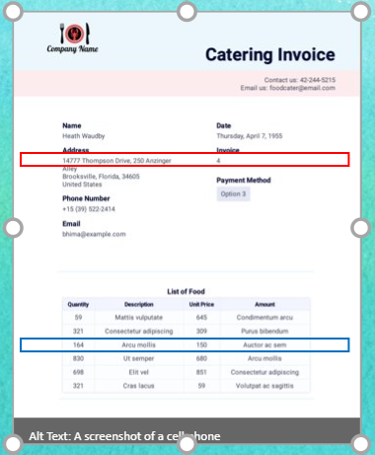
Dividing the PDF into Lines

Slide 10
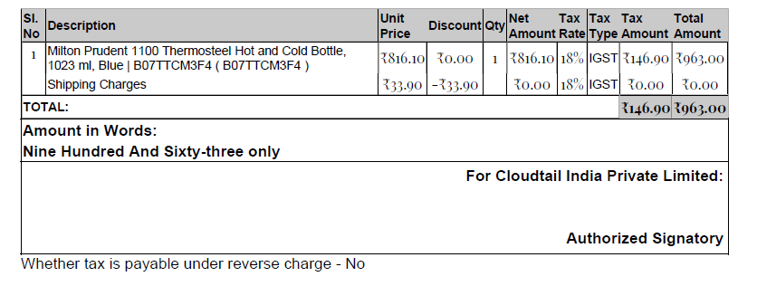
Extracting Business Tables from a PDF
We can use graphical positions of the text chunks and lines to deduce whether a table is present or not
All the data in a single column will have overlapping positions on the X-axis
All the data in a single row will have overlapping positions on the Y-axis

Slide 11
Extracting Generic Tables from a PDF
Table Start Line
Table End Line
We can search for rectangles created in the document using the ‘re’ operator
If more than two consecutive rectangles with the same startY and height are present, it can be considered to be a row
If more than one such row is present, the structure will be identified as a table

Slide 12
Parsing the Preamble and Summary
TEXT POSITION OBJECT
An object which stores a text and its physical position in the PDF Document along with the font type and font size of the text

Slide 13
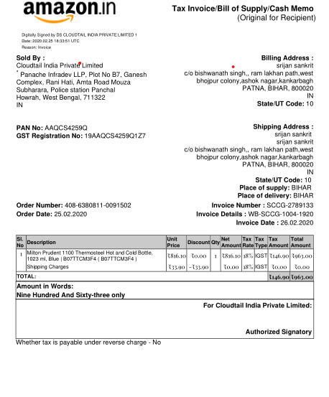
Parsing the Preamble and Summary
Divide the preamble and summary into boxes
If bold words/ colon separator/font change found, divide the box into keys and values

Slide 14
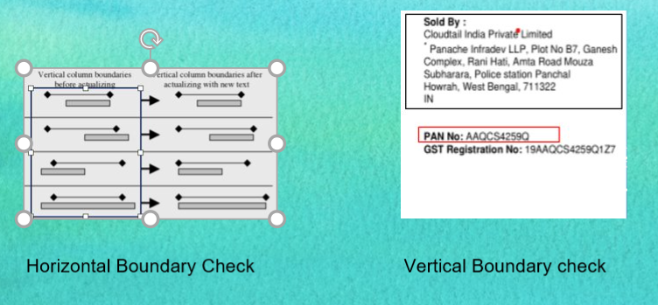
Dividing Preamble into Boxes

Slide 15
XML Creation(Single Page PDF)

Slide 16
XML Creation (Multi Page PDF)

Slide 17
Design

Slide 18
Design Considerations
Maintainability
Separation of concerns
Common code across different types of documents is encapsulated in their own classes
Document type (for e.g., invoice document) specific code is encapsulated in their own classes
Usage of industry standard Object Oriented concepts and design patterns
Extensibility
New types of documents can be supported easily
Flexibility
Key Words and their equivalents can be added without any change in code

Slide 19
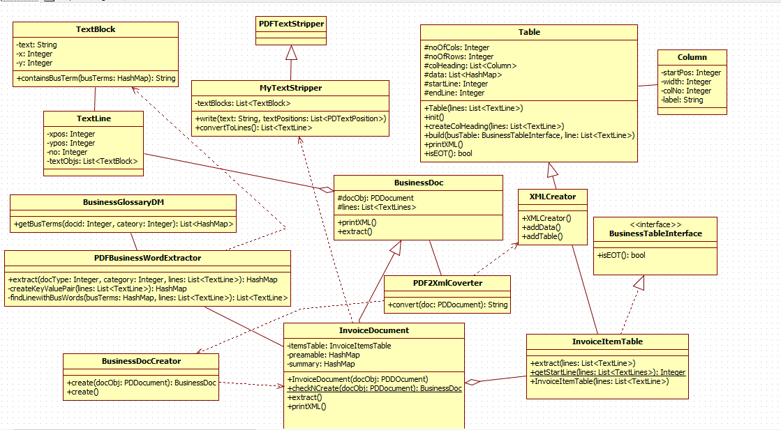
Class Diagram

Slide 20
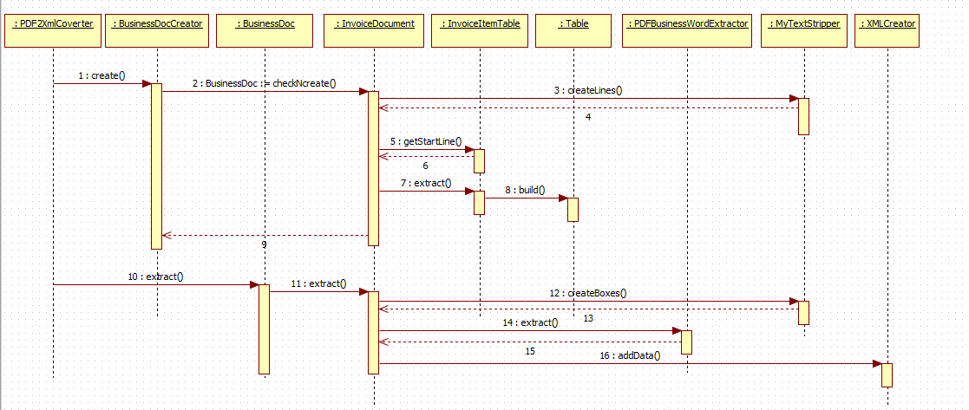
Sequence Diagram

Slide 21
Results of the Project
We have been able to:
1. Extract Table extraction from PDF using specific and generic approach
2. Extract unstructured data from PDF
3. Support multiple pages and password secured files
4. Follow industry standard logging and documentation.

Slide 22
Personal Learnings!

Slide 23
Questions?

Slide 24
Thank You!

