Slide 1
Unsupervised Learning for Parking Detection
Kushajveer Singh
https://kushajveersingh.github.io/
https://medium.com/@kushajreal
https://www.linkedin.com/in/kushaj/
https://github.com/KushajveerSingh

Slide 2
Team Name:- CG_TEAM_JPYFW
Member:- Kushajveer Singh
Jio Artificial Intelligence Hackathon
Smart Parking for Smart Cities of the future
Where should I park my car?

Slide 3
Two main Takeaways
My complete approach is based around these two concepts:
  Modular
  Unsupervised

Slide 4
Why Unsupervised Learning?
Makes the problem much simple and efficient at inference time
You can skip the training step completely
Some prominent figures that laid foundations for Deep Learning, including Yoshua Bengio, Yann LeCun, Geoff Hinton beleive that unsupervised learning is the future
Note:- As the research in this field is still limited we are still forced to use task-specific supervised learning. For example, pose estimation, color detection.

Slide 5
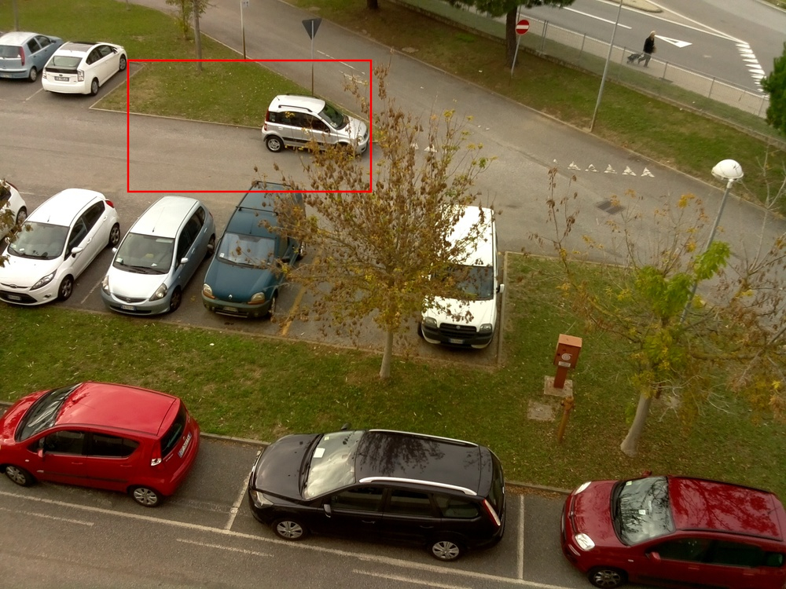
Why I preferred Unsupervised approach?
If I used Supervised Learning than I had to create a model that would learn where are parking spaces in an image.
Problem with this approach. What if there are no indicators of parking space?
I don’t think any feature engineering can
Detect these parking spaces.
Should we consider these in the first place?
I think if we want to make a generalizable
Model than we have to consider these cases.

Slide 6
Second reason, inference cost matters a lot.
Inference cost = Time for Prediction + Cost in Rupees to get that prediction
If we use supervised learning, than the model would have to identify the parking spaces in every image each time we want to get the values for parking vaccancy.
This quickly becomes uneconomical. The reason, if we have one camera and we update our parking vacancy values every 1 minute, then in 1 hour we have to process 60 images in an hour.
Now you can either use some LSTM model to get variable predictions for every image, or use a seperate classifier model
LSTM models are already expensive to train and using a seperate classifier model essentially makes it a two-step process and we can totally avoid the first step using unsupervised learning.

Slide 7
Quick Overview of My Appraoch
There are two ways to solve it, with their own pros and cons
  Use human annotators to store all the parking spaces
        It will be the most accurate model as it will not miss any parking space
        But it is expensive, even a slight change in camera would mess up the parking spaces.
        Difficult to setup for different parking lot spaces
  2) Learn parking spaces automatically
        Can adapt to different parking spaces easily
        But it comes at the expense of missing some parking spaces or inaccurate detections
  Most of the research thus focuses on option 2, as it easy and cheap to deploy. We can easily get new prediction space in case our camera get’s rotated.

Slide 8
How to detect parking spaces?
There are two ways to solve it, with their own pros and cons
  Use human annotators to store all the parking spaces
        It will be the most accurate model as it will not miss any parking space
        But it is expensive, even a slight change in camera would mess up the parking spaces.
        Difficult to setup for different parking lot spaces
  2) Learn parking spaces automatically
        Can adapt to different parking spaces easily
        But it comes at the expense of missing some parking spaces or inaccurate detections
  Most of the research thus focuses on option 2, as it easy and cheap to deploy. We can easily get new prediction space in case our camera get’s rotated.

Slide 9
How to detect parking spaces?
There are two ways to solve it, with their own pros and cons
  Use human annotators to store all the parking spaces
        It will be the most accurate model as it will not miss any parking space
        But it is expensive, even a slight change in camera would mess up the parking spaces.
        Difficult to setup for different parking lot spaces
  2) Learn parking spaces automatically
        Can adapt to different parking spaces easily
        But it comes at the expense of missing some parking spaces or inaccurate detections
  Most of the research thus focuses on option 2, as it easy and cheap to deploy. We can easily get new prediction space in case our camera get’s rotated.

