Slide 1

A MINI PROJECT
Academic year 2019-2023
Department of ‘MECHANICAL’
AAR MAHAVEER ENGINEERING COLLEGE

Slide 2
AAR MAHAVEER ENGINEERING COLLEGE
(Approved by A.I.C.T.E.New Delhi., Affiliated to JNTUH Hyderabad, Accredited by NAAC & NBA)
DEPARTMENT OF MECHANICAL ENGINEERING
A Mini Project On
ROBOTIC ARM USING ARDUINO
Under the Guidance of Under the Coordination of
Mr.NARAYANA Mr.TIRUPATHI
Assistant Professor
Assistant Professor
PRESENTED BY
K NIKHIL(198P1A0302)
K.MANIKANTA(198P1A0303)
K.KUSHAL MANIKANTA(198P1A0304)
M.VIKRAM(198P1A0306)

Slide 3
CONTENTS
Introduction
Highlights
Types
Working
Applications
Advantages
Disadvantages
Conclusion

Slide 4
INTRODUCTION
The word ‘robotics’, meaning the study of robots was coined byIsaac Asimov. Robotics involves elements of both mechanical andelectrical engineering, as well as control theory, computing and nowartificial intelligence (Selig, 1992).
According to the Robot Instituteof America, “A robot is a reprogrammable, multifunctionalmanipulator designed to move materials, parts, tools or specializeddevices through variable programmed motions for the performanceof a variety of tasks”(Robotics Research Group, ) The fact that arobot can be reprogrammed is important: it is definitely acharacteristic of robots.

Slide 5
HIGHLIGHTS
Robotic arms are helping companies reach new levels of productivity through enhanced speed, efficiency, and precision across a variety of applications.
Design is very reliable and effective.
The main objective of this prototype model is to automate the workflow.
Improved efficiency and productivity.
Robotic arms equipped with remote monitoring and analytics technologies

Slide 6

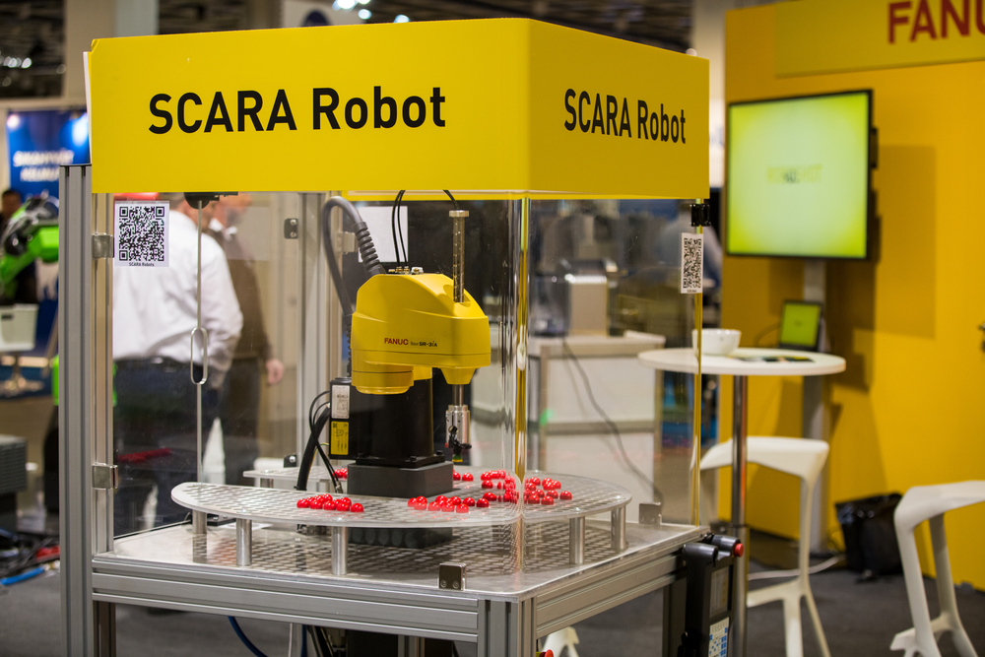
Types Of Arms
These different robot types tend to have similar applications. However, each type has distinctions that typically lead to it being optimized for certain tasks over other robotic arms. Types of robotic arms include:
-SCARA
-Cartesian
-Cylindrical
-Spherical/Polar
-Parallel/Delta

Slide 7
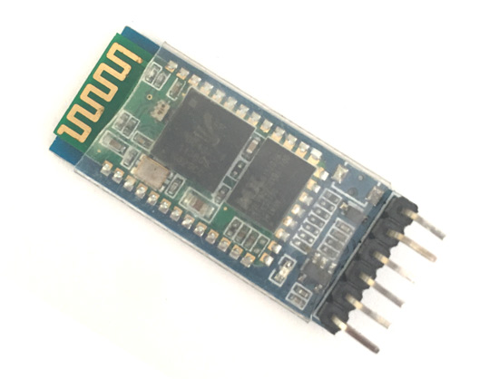
COMPONENTS OF A Robotic Arm
ARDUINO Nano
The Arduino Nano is an open-source microcontroller board based on the Microchip ATmega328P microcontroller and developed by Arduino.cc and initially released in 2010.^{[2][3]} The board is equipped with sets of digital and analog input/output (I/O) pins that may be interfaced to various expansion boards (shields) and other circuits.
Bluetooth module:The HC-05 is a popular module which can add two-way (full-duplex) wireless functionality to your projects. You can use this module to communicate between two microcontrollers like Arduino or communicate with any device with Bluetooth functionality like a Phone or Laptop.

Slide 8
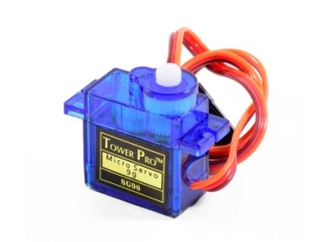
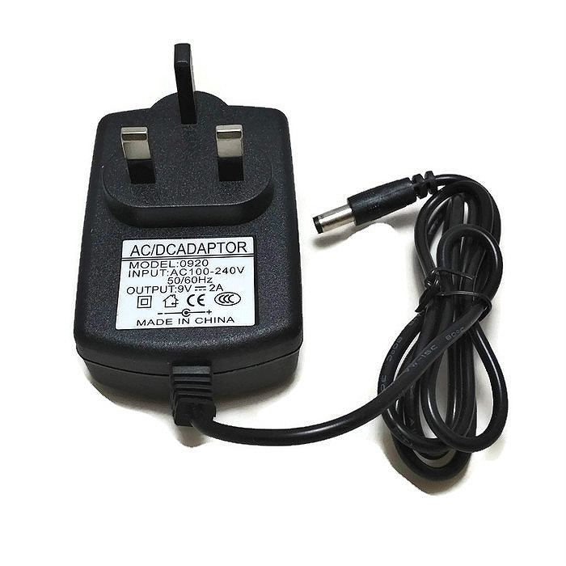
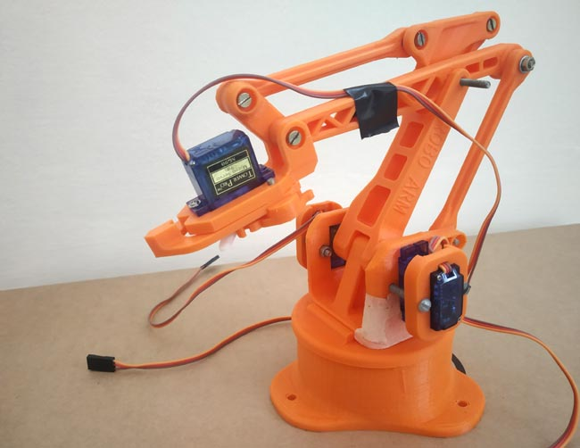
COMPONENTS OF A Robotic Arm
Servo: Servo Motor is a small device that has an output shaft. This shaft can be positioned to specific angular positions by sending the servo a coded signal. As long as the coded signal exists on the input line, the servo will maintain the angular position of the shaft.
Powersupply:
All power supplies have a power input connection, which receives energy in the form of electric current from a source, and one or more power output or cable connections that deliver current to the load.
Acrylic body:
It is 3d printed body which should be assemble.

Slide 9
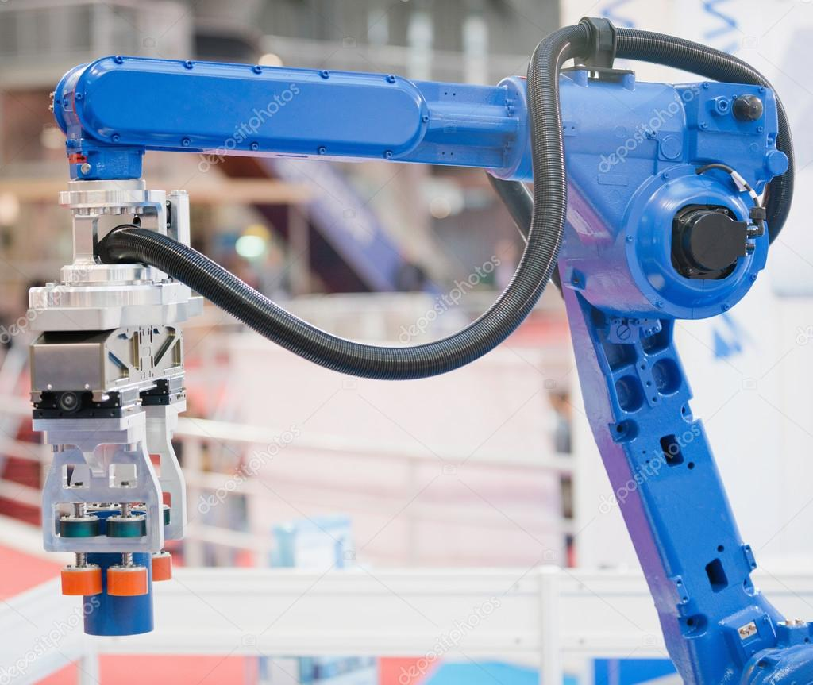
WORKING OF ROBOTIC ARM
Medicines are stocked in racks with appropriate labels
Arm receives Command to select medicine
Moves the end effectors tom desired position and pick up medicines
Moves Arm to dispensing location and drops medicine

Slide 10
APPLICATIONS
By Adhesive Sealing, and Gluing. Robots are designed with numerous configurations .
Machine Tending. Robotic automation for a machine is the process of loading and unloading.
Painting and Spraying. Robots are particularly used in automotive industries to apply paints.
Picking, Packing, and Palletizing. An item in the production line often goes through multiple.
In Food and Agriculture Areas.

Slide 11
ADVANTAGES
Accuracy and Precision.
High Productivity.
Consistent Speed.
Job Creation.
Longer working hours.

Slide 12
DISADVANTAGES
High initial cost
It needs constant monitoring to avoid mechanical faults/malfunction. .
It can perform specific tasks but cannot be comparable to the versatility of the human hand.
Can cause unemployment for manual workers.
Need a large number of sensors and high accuracy to perform the complex tasks .

Slide 13
CONCLUSION
The contribution that robotic arms add to the automation process cannot be quantified. They are the brains, the arms, and the legs of manufacturing, and this role will continue growing in the next century to the point where manufacturing will be handled entirely by industrial robots.

Slide 14
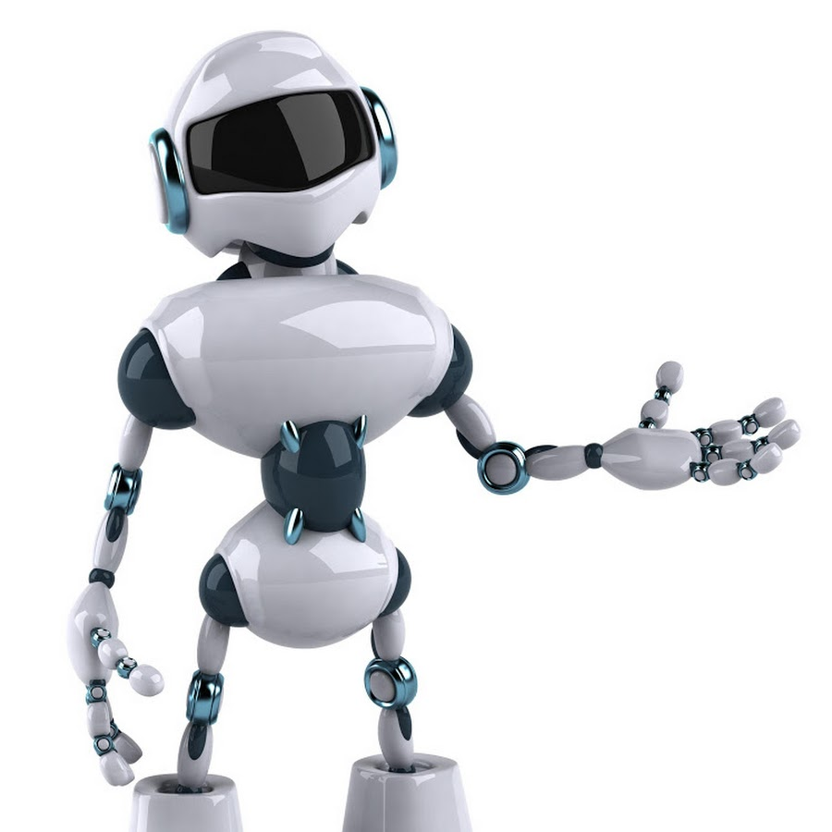
THANK YOU

