Slide 1


M.Tech Program
Advanced Industry Integrated Programs
Jointly offered by University and LTIMindTree
Review II
Smart Label
Model-Assisted Human-in-the-Loop Labeling
Kushal Samirkumar Shah
Knowledge partner | Implementation partner

Slide 2
Smart Label
Introduction
Smart Label provides model-assisted labelling where a model suggests labels and humans validate or correct them.
Key idea is to combine model predictions + human decisions to build a practical, scalable annotation workflow.
It is built using CNNs, HTML, CSS and Flask

Slide 3
Smart Label
Objective
Provide model-generated label suggestions to annotators.
Reduce human effort by automating routine or high-confidence cases.
Prioritize samples for human review using uncertainty or informativeness.

Slide 4
Smart Label
Modules
Model Training & Inference
Resnet18 and MobileNetv2 is used.
Transfer learning to fine-tune both models
Generates two independent predictions and confidence scores.
Active Sampling / Prioritization
Compares the predictions from both ResNet18 and MobileNetV2.
Confidence-based sampling (low-confidence items flagged).

Slide 5
Smart Label
Modules
Human Annotation Interface
Selects the most uncertain samples for human review
Clean, minimal annotation UI with model suggestions visible.
Simple dropdown and Confirm button for quickly correct label.
Deployment
Users (Hematopathologists) will upload the unlabeled images.
Output will be labeled images suggesting the type of blood cell.
Corrected images are stored in folders of there respective type.

Slide 6
Smart Label
Methodology/Modeling Plan
Core Methodology: Ensemble Learning A prediction is only auto-accepted if it passes two sequential checks, ensuring both agreement and high confidence.
Modelling Plan:
Gate 1: Disagreement Check
If model predictions disagree → Flag for HITL (ambiguity trigger)
Gate 2: Confidence Check
If predictions agree:
If avg. confidence < 85% → Flag for HITL (low confidence)
If avg. confidence ≥ 85% → Auto-label

Slide 7
Smart Label
Data preprocessing
Blood Cell Images for Cancer Detection – 5000 images. Divided into 4 classes :
Acute Lymphoblastic Leukemia
Acute Myeloid Leukemia
Chronic Myeloid Leukemia
Normal
Preprocessing & Augmentation:
Validation/Test Sets: Resized to 224x224 pixels and normalized using ImageNet statistics.
Training Set (Data Augmentation): To prevent overfitting and improve model generalization, the following augmentations were applied randomly:
Random Horizontal & Vertical Flips
Random Rotations (up to 20 degrees)
Color Jitter (adjusting brightness, contrast, and saturation)

Slide 8
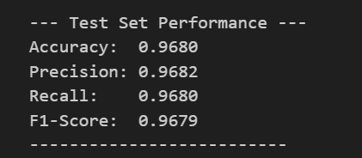
Smart Label
Data preprocessing
Metrics:

Slide 9
Smart Label
Approach/Algorithms/Tools
Algorithms used: Ensemble Learning (Voting Classifier), HITL, Residual Learning(ResNet18), Depth-wise Separable Convolutions (MobileNetv2) and Grad-CAM.
Tools & Frameworks:
Deep Learning Framework: PyTorch
Web Application & HITL: Flask
Numerical & Scientific Libraries: NumPy, OpenCV
Data Analysis & Metrics: Pandas, Scikit-learn
Notes:
Ensemble Learning (Voting Classifier)Combines predictions from multiple models for higher accuracy and reliability.
Human-in-the-Loop (HITL)A workflow that uses model disagreement to intelligently request expert validation.
Inside ResNet-18: Residual Learning (Skip Connections) Enables the training of very deep networks by preventing accuracy degradation.
Inside MobileNetV2: Depth-wise Separable Convolutions Drastically reduces computation and model size, making the network fast and efficient.

Slide 10
Smart Label
Project plan/milestones progress
Phase 1: Foundation & Data Preparation (Completed)
Acquired and pre-processed the cropped single-cell image dataset.
Implemented the stratified train/validation/test split.
Phase 2: Dual Model Training (Completed)
Trained the ResNet18 classification model and evaluated its baseline performance.
Trained the MobileNetv2 classification model to serve as the diverse counterpart.
Packaged the weights for both best-performing models for deployment.

Slide 11
Smart Label
Project plan/milestones progress
Phase 3: Application Development (Current Stage)
Develop the Flask back-end for parallel inference with both models.
Implemented the dual-gate HITL trigger:
Check for model disagreement.
Check for low-confidence agreement (<85%).
Integrated on-demand Grad-CAM generation for all uploaded images.
Phase 4: Deployment (Next)
Launch the Flask app locally with integrated model inference.
Serve the HTML/CSS UI for image upload and HITL interaction.
Test the full workflow with expert users.

Slide 12
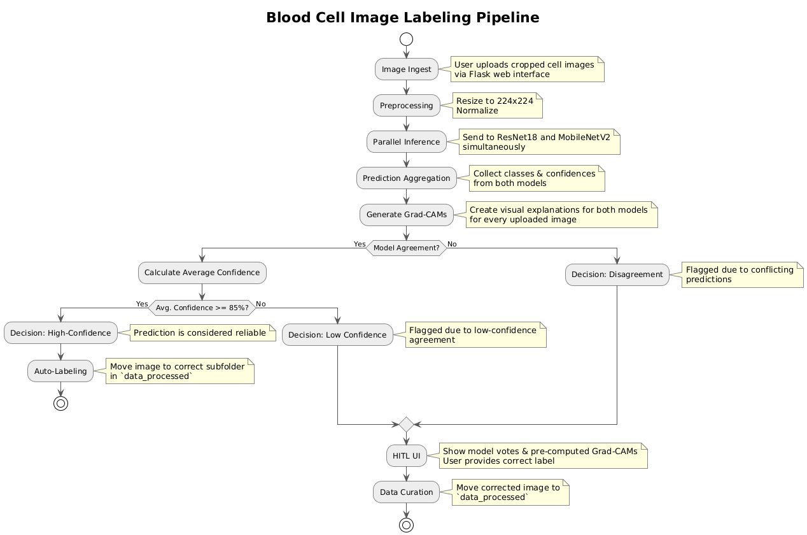
Smart Label
Pipeline Flowchart

Slide 13
Smart Label
THANK YOU

