Slide 1



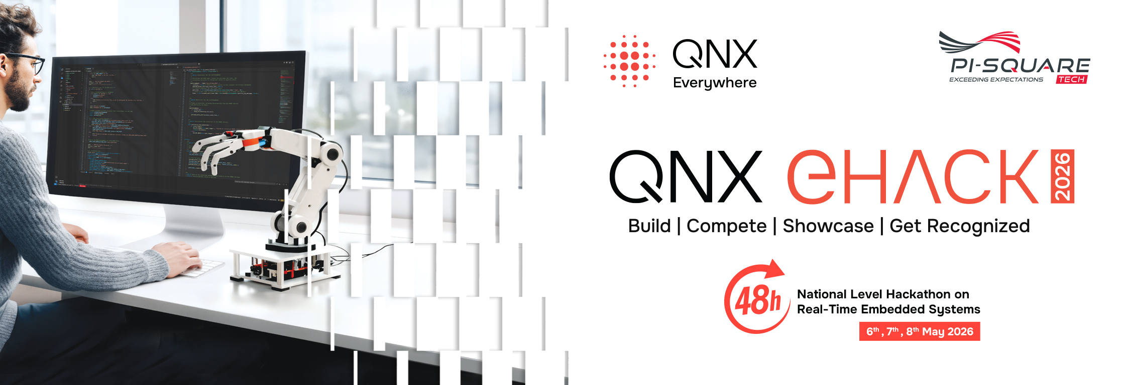
Software-Defined Vehicle & Cockpit safety
National Level Hackathon
Team Dynamo
QNX architecture that isolates heavy infotainment graphics from safety-critical autonomous braking

Slide 2
Design and Execution
Section 01.

Slide 3
Title & Team Identity
Design and Execution
Project Name: Software-Defined Vehicle & Cockpit safety
Theme Selected: Safety-Critical Alerts with Lag less response Team Name & City: Dynamo, Mangalore
Multi-core processing to completely isolate an infotainment display from an autonomous braking system with safety-critical motor responses

Slide 4
Problem Synthesis & Scenario
Design and Execution
The Scenario: In Software-Defined Vehicles, heavy infotainment graphics can starve the CPU, delaying safety-critical sensor responses like pedestrian detection.
Criticality: A microsecond delay in braking when a pedestrian is detected can cause a fatal collision. "Deterministic Execution" is required to guarantee the braking system reacts instantly, regardless of media load.
Success Metric: Maintain sub-millisecond response times for the Guardian braking process while Core 3 runs heavy media graphics.

Slide 5
QNX Architectural Approach
Design and Execution
Microkernel Strategy: Leveraged strict IPC messaging for deterministic sensor-to-brake communication and fork() for automated system resilience.
Resource Isolation (Thread Affinity):
Core 0: Safety Guardian (Isolated Vehicle Braking)
Core 1: HAM Watchdog (Isolated System Supervisor)
Core 2: Sensor Fusion & Telemetry (Ultrasonic, PIR, MPU, Hall, Touch)
Core 3: Infotainment OLED (Isolated Media Player)
Priority Setup: Touch Sensor manually overrides at the highest priority; Guardian runs at high priority; Infotainment relegated to lowest priority.

Slide 6
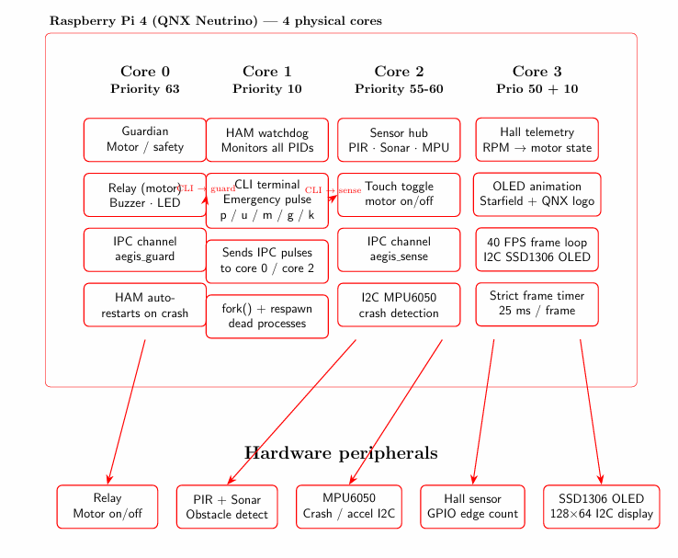
Technical Execution (Hardware & Logic)
Design and Execution
Block Diagram:

Slide 7
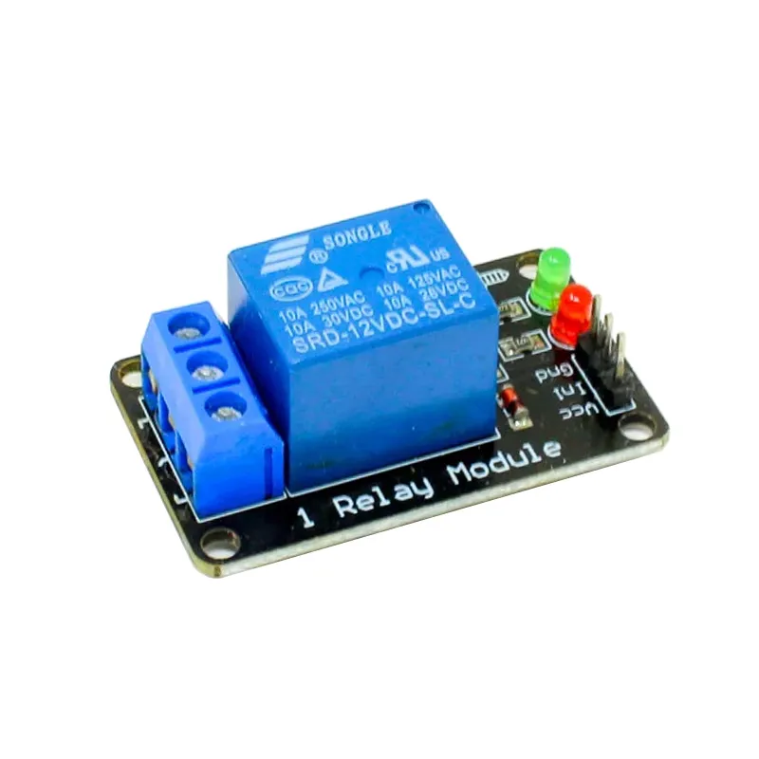
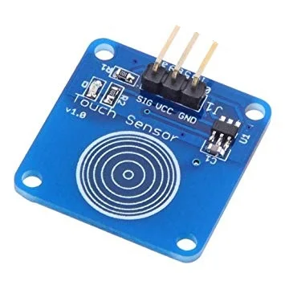
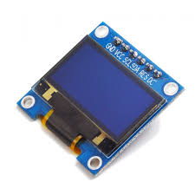
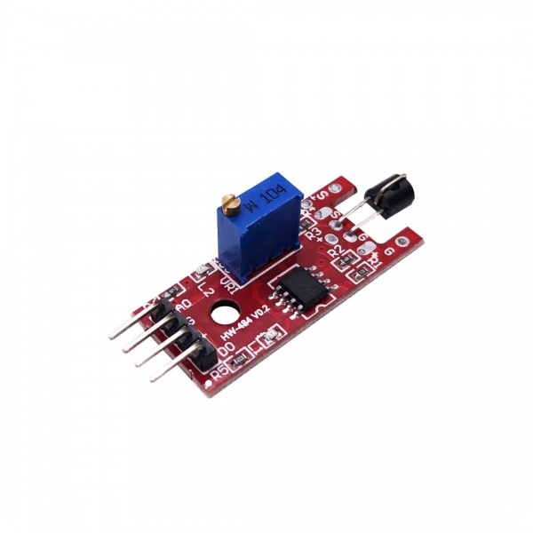
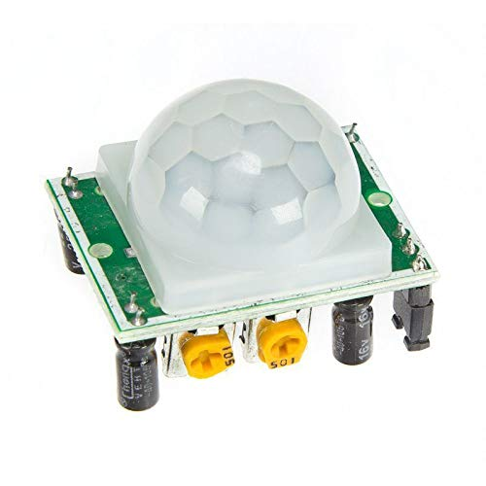
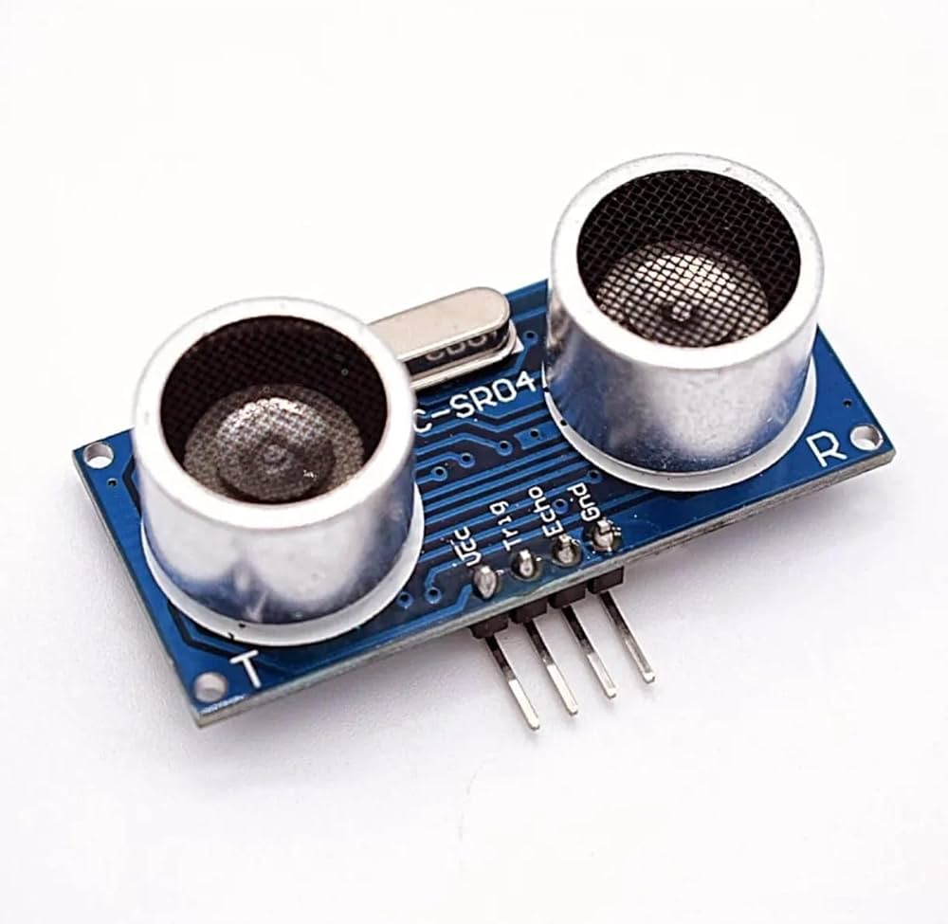
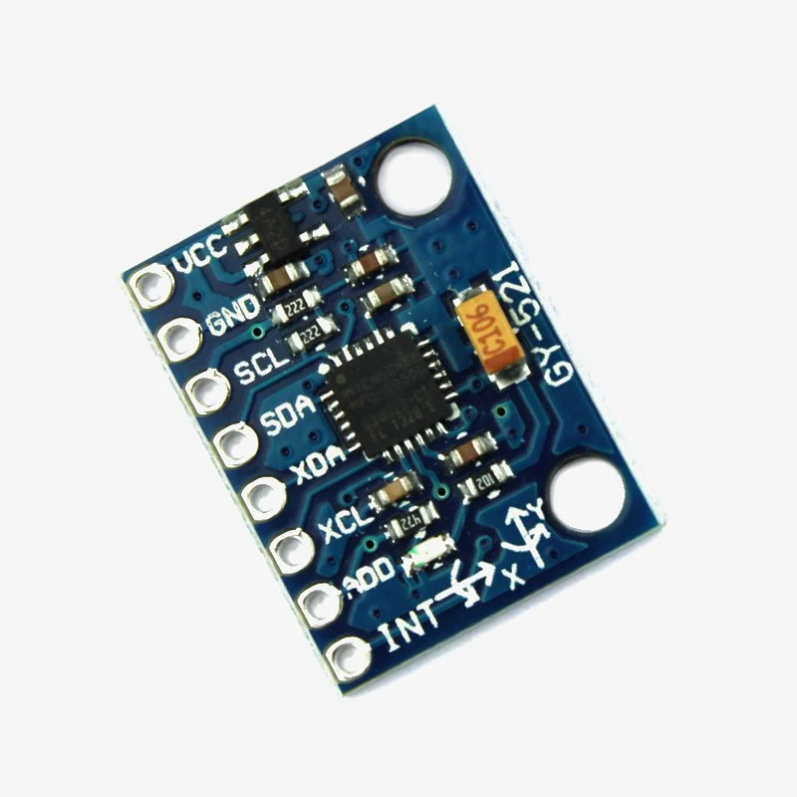
Technical Execution (Hardware & Logic)
Design and Execution
RPi Integration: Which GPIOs, interrupts, or hardware interfaces did you utilize?
Component | Signal | Pi Physical Pin
OLED (I2C) | SDA / SCL | Pin 3 / 5
MPU6050 (I2C) | SDA / SCL | Pin 3 / 5
Ultrasonic | TRIG / ECHO | Pin 16 / 18
PIR Sensor | OUT | Pin 22
Hall Effect | OUT | Pin 11
Touch Sensor | OUT | Pin 12
Motor Relay | IN1 | Pin 13
Buzzer | (+) | Pin 15

Slide 8
Technical Execution (Hardware & Logic)
Design and Execution
The Logic:
Start/Stop: Motor starts idle; toggled manually via the high-priority Touch Sensor.
Smart Polling: Ultrasonic proximity is only read if the Hall Sensor confirms the motor is running.
Sensor Fusion Brakes: Brakes engage only if BOTH Ultrasonic (proximity) and PIR (motion) verify a pedestrian to prevent false triggers.
Crash Sim: MPU detects sudden jerks, triggering an LED to simulate airbag deployment.

Slide 9
Resilience & "The Hack" Response
Design and Execution
The Vulnerability: The "Hack" simulates a catastrophic software failure where the Core 0 Guardian process crashes or dies unexpectedly.
Mitigation Strategy: The HAM (High-Availability Manager) isolated on Core 1 continuously monitors the Guardian. Upon failure, HAM uses fork() to instantly rebuild and restart the Guardian process.
Recovery Data: Achieved near-instant Recovery Time Objective (RTO), ensuring the safety-critical braking system is never offline for more than a few milliseconds.

Slide 10
Demonstration
Section 02.

Slide 11
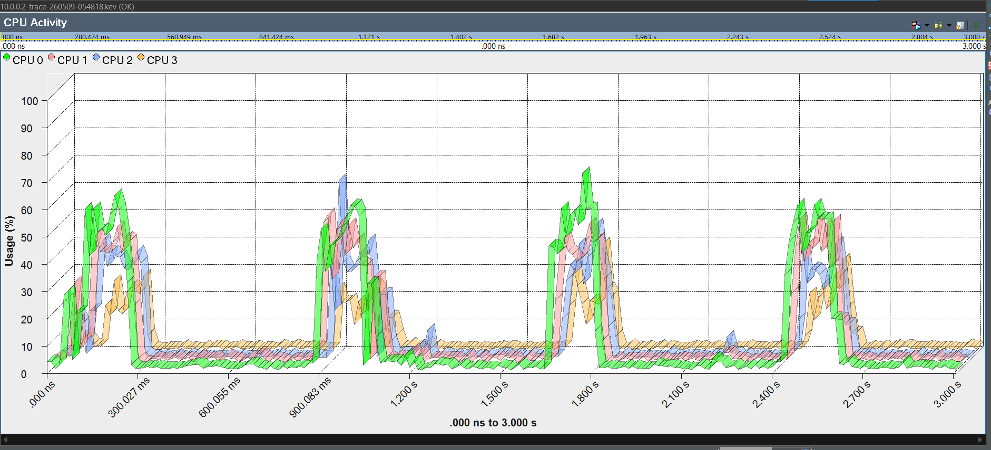
Performance Proof (The Profiler Slide)
Demonstration
System Profiler Screenshot: (Mandatory). Show the CPU usage and thread timing.
Latency Benchmarks: Present your final data for the Key Metric (e.g., "Stable 40µs interrupt response under 90% load").
Analysis: One sentence on what the data proves about your system's determinism.

Slide 12
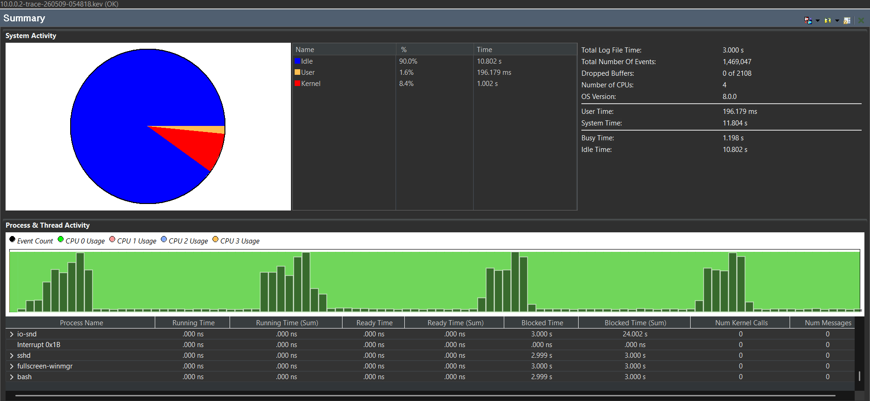
Performance Proof (The Profiler Slide)
Demonstration
System Profiler Screenshot: (Mandatory). Show the CPU usage and thread timing.
Latency Benchmarks: Present your final data for the Key Metric (e.g., "Stable 40µs interrupt response under 90% load").
Analysis: One sentence on what the data proves about your system's determinism.

Slide 13
Future Scalability & Conclusion
Demonstration
Innovation Arbitrage: This architecture directly scales to commercial Automotive Zone Controllers, safely combining Android Automotive UI and ASIL-D ADAS systems on a single SoC.
Learning Outcome: Mastering QNX thread affinities and IPC to implement strict sensor fusion (PIR + Ultrasonic) alongside automated recovery via fork().
Closing Statement: "True SDV safety isn't just about sensor accuracy; it's about guaranteed execution and automated recovery through uncompromising architectural isolation."

Slide 14
Thank you

