Slide 1

DEPARTMENT OF INFORMATION SCIENCE & ENGINEERING
“Voice-based Learning Assistant for Visually Impaired”
Mini Project – 22ISE58
Presentation by,
Kushal K N
1NH22IS075
Mithun Raj Urs T V
1NH22IS086
Under the Guidance of ,
Ms. Rama Bansidhar Dan
Asst. Professor ISE dept

Slide 2
Agenda
Introduction
Problem Statement
Literature Survey
Objectives
Implementation
Design Modules
Flow Chart
Result
Conclusion

Slide 3
Introduction
The Voice-based Learning Assistant is a tool designed to support visually impaired individuals by providing a hands-free, voice-activated learning experience.
This assistant allows users to access educational content, retrieve information from sources like Wikipedia, and navigate features through voice commands.
Leveraging speech recognition and text-to-speech technologies, the assistant ensures that visually impaired users can independently access and interact with learning resources, enhancing accessibility and fostering inclusivity in education.

Slide 4
Problem Statement
To create a voice-based learning assistant for visually impaired students that offers hands-free, audio-guided learning experiences. The assistant enables users to select topics, access educational YouTube content, and perform calculations through voice commands, providing an accessible and effective way to learn and navigate resources without requiring visual input.

Slide 5
Literature Survey
Authors/Year | Methods | Advantages | Limitations
>Sujata Ashish Hande(2022) >Prakash Bilawar(2022) | Android-based applications and Raspberry Pi devices were commonly used for developing accessible applications. | The research underscores how digital voice assistants such as Google Assistant, Alexa, and Siri provide essential accessibility features for visually impaired users, enabling them to perform various tasks through voice commands. | The survey concludes that voice assistants offer essential support to visually impaired individuals, facilitating better interaction with digital content and devices. Future advancements in AI and natural language processing may enable more personalized, context-aware responses, enhancing accessibility further.
>Rohini Khalkar(2019) | Text Messaging: Sends SMS to contacts or specified numbers. Calling: Enables voice-command-based calling. Alarm Setting: Lets users set and control alarms using voice. | Supports processing multiple commands within a single utterance, allowing users to perform complex tasks more efficiently. This feature minimizes the number of interactions needed, streamlining tasks like messaging, calling, or accessing other applications. | The system is designed specifically for the Android OS, limiting its compatibility with other platforms such as iOS or desktop environments. This focus restricts accessibility for visually impaired users who may not use Android devices.
>Ankush Yadav et al.(2020) | The researchers used Google’s Speech Recognition API to convert voice input into text. The system takes voice commands through a microphone, sends them to Google’s cloud for processing, and returns text output. | The assistant performs a wide range of tasks such as sending emails, fetching weather updates, playing media, and opening applications, providing users with convenience and multifunctional utility. | While it supports basic commands for tasks like email, browsing, and media playback, the system may struggle with more complex or customized tasks, and might not handle a wide variety of accents and dialects effectively.

Slide 6
Objectives
Enable Accessible Learning: Provide an easy-to-use voice interface for visually impaired users to access educational content.
Offer Hands-Free Navigation: Allow users to interact with the assistant entirely through voice commands, removing the need for visual navigation.
Retrieve and Read Information Aloud: Fetch information on various topics and read it aloud, making learning convenient and accessible.
Promote Independence: Empower visually impaired users to explore and learn independently without needing assistance.

Slide 7
Implementation
Speech Recognition: Uses speech recognition to capture user voice commands, allowing hands-free interaction.
Wikipedia Integration: Connects with Wikipedia to retrieve accurate information on requested topics.
Text-to-Speech (TTS): Converts retrieved text into speech using TTS, reading information aloud to the user.
User-Friendly Interface: Designed to respond to simple, spoken commands, making it easy for visually impaired users to access and navigate content.
Tools & Technologies:
Python: For backend programming.
Speech Recognition API: To capture voice input.
Text-to-Speech Engine (e.g., pyttsx3): For voice output.

Slide 8
Design Modules
User Input Module:
Function: Captures voice commands from the user.
Description: Uses a microphone to listen for spoken requests, allowing users to ask for information.
Information Retrieval Module:
Function: Fetches information from Wikipedia.
Description: Connects to the Wikipedia API to get summaries and relevant data based on the user’s request.
Text Processing Module:
Function: Prepares the retrieved text for speech.
Description: Processes the information to ensure clarity and relevance before converting it to audio.
Voice Output Module:
Function: Reads the processed text aloud to the user.
Description: Utilizes a text-to-speech engine to convert text into natural-sounding speech for an engaging user experience.
Feedback & Help Module:
Function: Provides assistance and clarifications to users.
Description: Allows users to ask for help or additional information, ensuring a supportive learning environment.

Slide 9
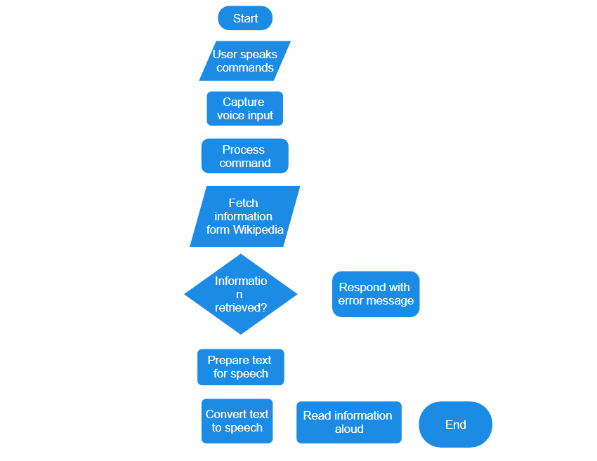
FLOW CHART
no
yes

Slide 10
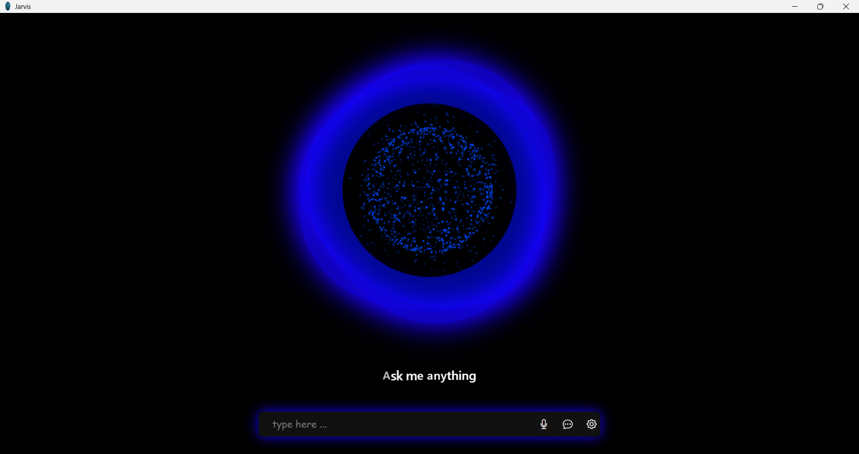
RESULT
Notes:
RESULT

Slide 11


Slide 12
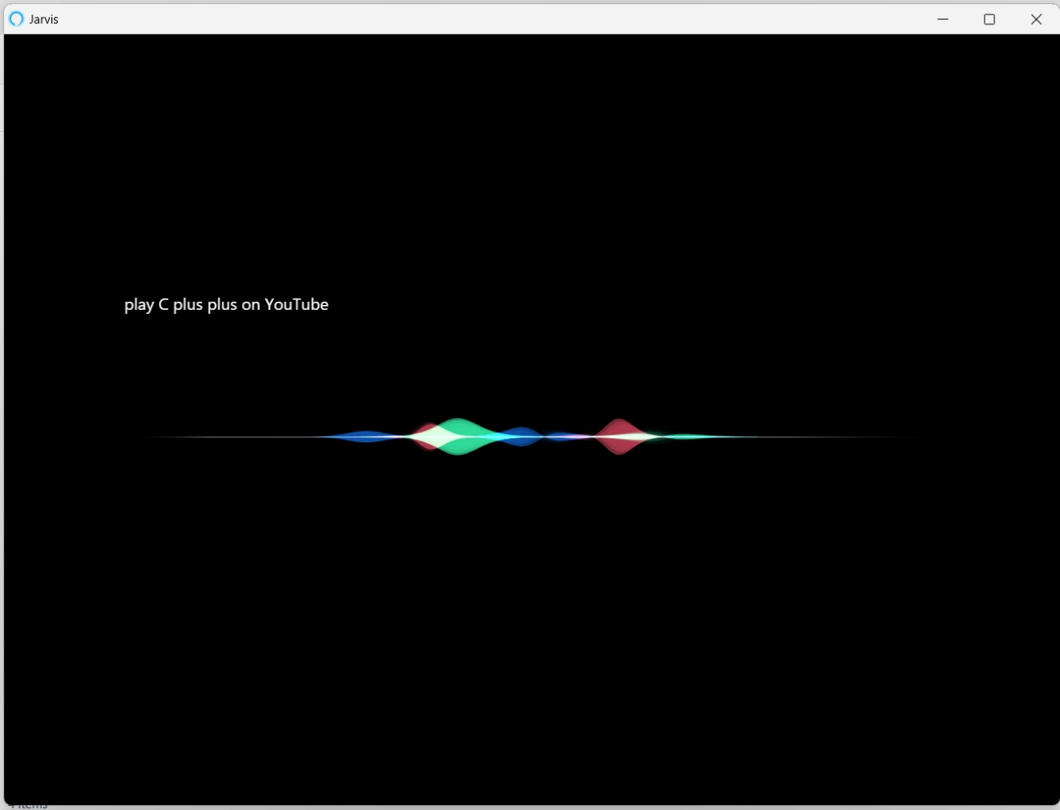

Slide 13
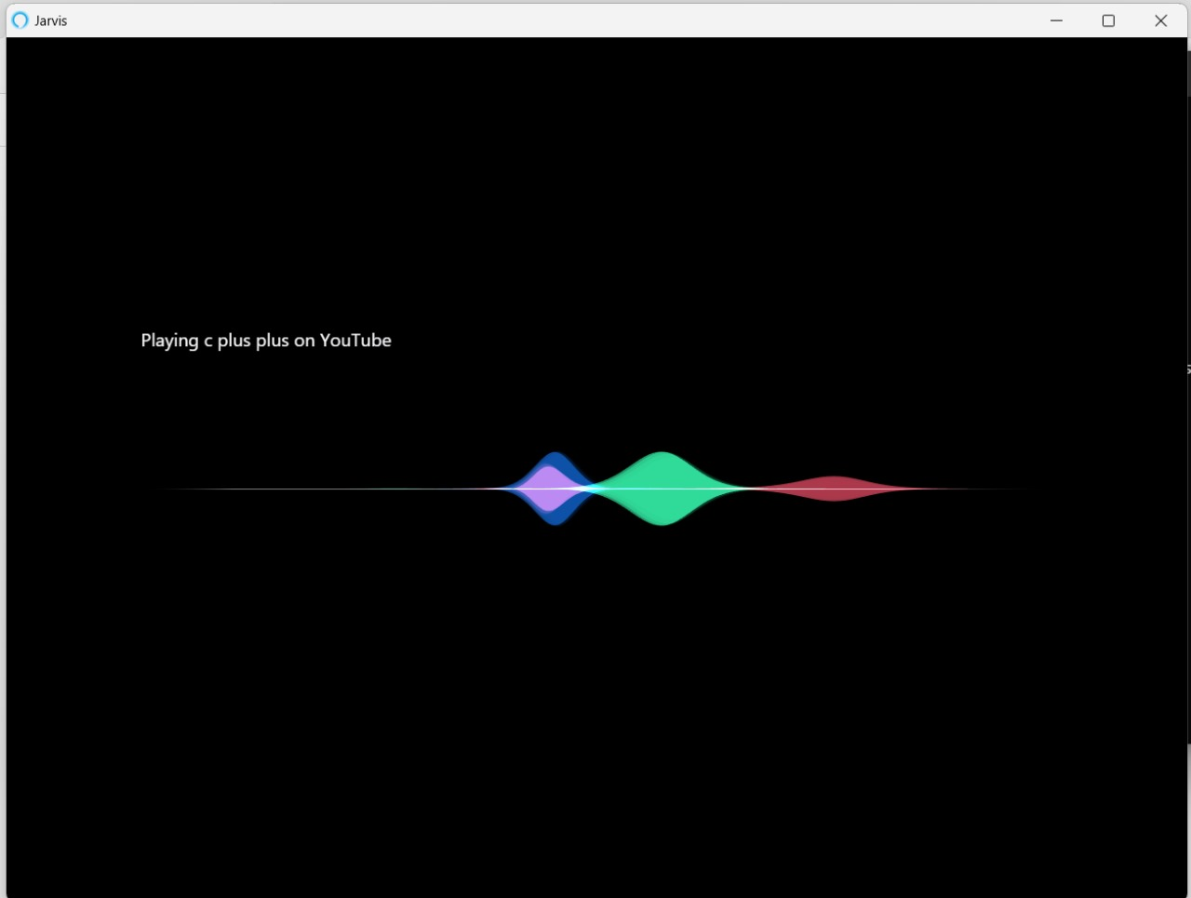

Slide 14
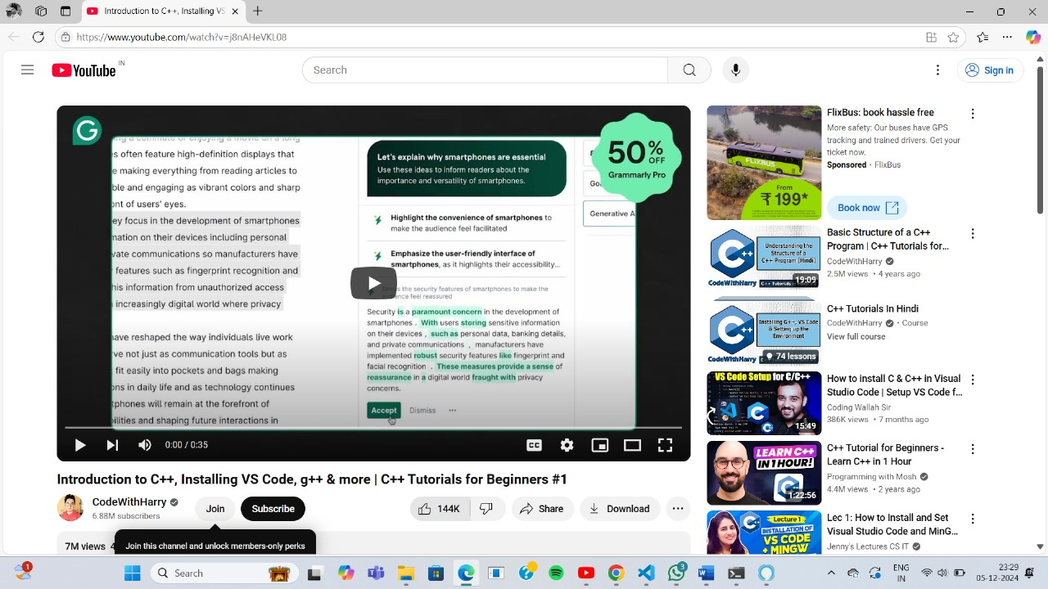

Slide 15
Conclusion
The Voice-based Learning Assistant for Visually Impaired aims to enhance accessibility in education by providing a hands-free, voice-activated platform. By enabling users to retrieve and listen to information easily, the assistant promotes independent learning and engagement with educational content.

Slide 16
Thank you
Queries ?

