Slide 1
Secure Data Hiding in Image Using Steganography
CAPSTONE PROJECT
Presented By: Kushal Pipaliya
Student Name : Kushal Pipaliya
College Name & Department : Uka Tarsadia University &
Babu madhav institute of information technology

Slide 2
OUTLINE
Problem Statement
Technology used
Wow factor
End users
Result
Conclusion
Git-hub Link
Future scope

Slide 3
Problem Statement
Problem: In today's digital world, keeping our communications secure is incredibly important. Traditional ways of sending sensitive information, like emails or messages, can be easily intercepted, leading to data breaches and unauthorized access..
Challenge: The real challenge is finding a way to send data securely without tipping off potential eavesdroppers. While standard encryption methods are effective, they can sometimes attract unwanted attention due to their recognizable patterns.
Solution: Steganography provides a clever solution by hiding information within ordinary files, like images. This makes the data much harder to detect, as it blends seamlessly with everyday digital content..

Slide 4
Technology used
Frontend:
React.js: Framework for building interactive user interfaces.
Libraries:
Lucide-React: Icons for a consistent UI design.
React Hooks: Manage component state and side effects.
Backend:
JavaScript: Core logic for steganography.
SteganographyService: Handles message encoding and decoding.
Canvas API : Used for image manipulation and pixel-level data access.

Slide 5
Wow factors
Innovation:
The application innovatively combines steganography with optional password protection, enhancing security without compromising usability.
Users can choose to add a password to their encoded messages, ensuring that only those with the correct password can extract the hidden data.
User Experience:
The interface is designed to be intuitive and user-friendly, with features like drag-and-drop for image uploads and real-time feedback through toast notifications.
A tutorial mode guides first-time users through the encoding and decoding processes, ensuring they understand how to use the application effectively.
Security:
The optional password protection adds an extra layer of security, making it difficult for unauthorized users to access the hidden message even if they are aware of its presence.

Slide 6
End users
Target Audience:
Individuals: Those who need to send sensitive information securely, such as personal messages or confidential documents.
Organizations: Businesses that require secure transmission of data, such as financial records or proprietary information.
Privacy-conscious Users: People who value their privacy and want to ensure their communications remain confidential.

Slide 7
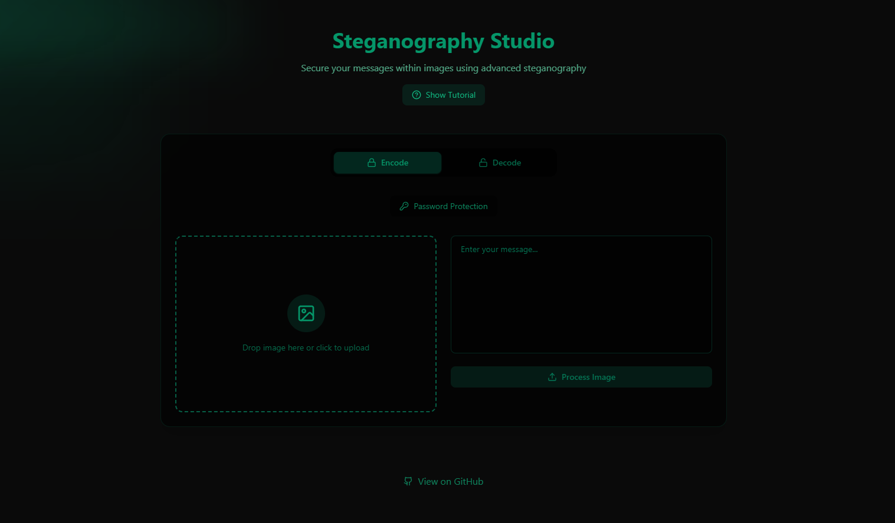
Results

Slide 8
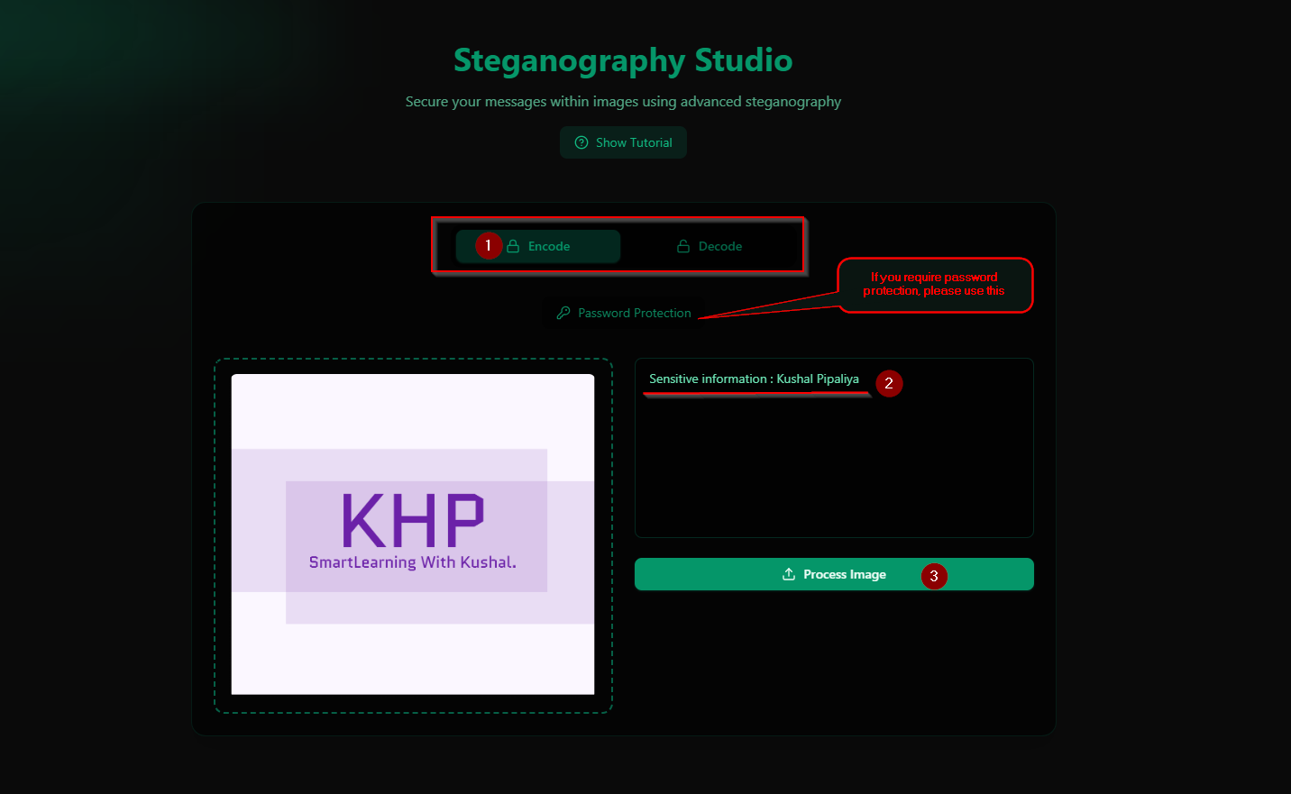
Results

Slide 9
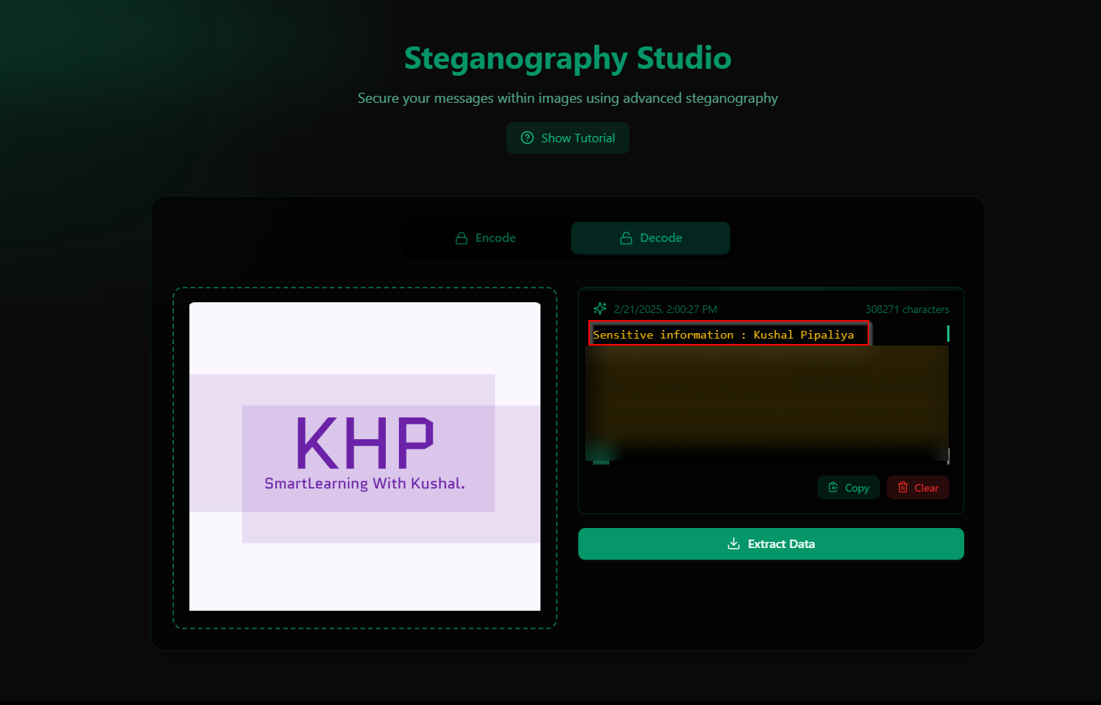
Results

Slide 10
Conclusion
Summary:
The project addresses the need for secure communication by leveraging steganography to hide messages within images.
It provides a practical solution for transmitting sensitive information without drawing attention to the data's presence.
Impact:
The application enhances data privacy by offering a secure and discreet method of communication.
It demonstrates the potential of steganography as a complementary technique to traditional encryption methods.

Slide 11
GitHub Link
GitHub :
https://github.com/Kushal129/Steganography_Tool_Online
Live :
https://steganographybykhp.netlify.app/

Slide 12
Future scope(optional)
Enhancements:
Image Format Support: Expanding the application to support more image formats, such as JPEG and BMP, in addition to PNG.
Advanced Encryption: Integrating advanced encryption algorithms to further enhance the security of the hidden messages.
Mobile Application: Developing a mobile version of the application to provide broader accessibility and convenience for users.
Research:
Exploring AI-driven steganography techniques that can adapt to different types of media and improve the efficiency and security of the embedding process.
Investigating the use of steganography in other file types, such as audio and video, to expand the application's capabilities.

Slide 13
THANK YOU

