Slide 1
Bias and Fairness in Multi-modal Machine Learning
Kushal Partani, Siddharth Chauhan
Mentor: Pooja Rao

Slide 2
Why need fairness in AI models?
Study Design: Trained a machine-learned model to assess job candidates on social variables like communication and professionalism using multimodal analysis of prerecorded video interviews.
Key Finding: Model's predictions were more accurate for men than for women.
Cause of Disparity: Inclusion of predictors related to "powerful speech" behaviors.
Gender Implications: Men were rewarded for these behaviors, while women were penalized, aligning with existing gender stereotypes.
Citations: Study by Muralidhar et al [38], observation of gender stereotypes cited as [34].

Slide 3
How does bias emerge?
Bias and unfairness in machine-learned models often arise from human decisions during the development process.
The data-driven approach of using all available predictors maximizes accuracy but may introduce bias.
If predictors contain encoded information about unrelated traits like gender or age, the model may generalize poorly.
Poor generalization can lead to different prediction accuracies for different groups, raising fairness concerns.

Slide 4
Fairness
In the context of personnel selection and AVIs, the two most relevant aspects of fairness are
Procedural fairness regards the perceived fairness of the elements of the decision-making process and in a measurement context is like measurement bias.
Distributive fairness regards whether the allocation of important resources ,based on the decisions made or resulting from psychological assessment (e.g., hireability), is perceived as fair.

Slide 5
Case Study of AVIs
A prime example of the use of multimodal models in a real, high-stakes decision-making scenario is an automated video interview (AVI).
In AVIs, machine-learned models are trained to make assessments about the hireability of candidates for particular jobs based on prerecorded video interviews.

Slide 6
Why do we need fairness
Some organizations have already begun to incorporate this technology into their hiring workflow and are interested in adopting selection procedures that
help them select high performing employees,
are unlikely to result in lawsuits (coming from bias/fairness concerns),
support diversity and inclusion initiatives.

Slide 7
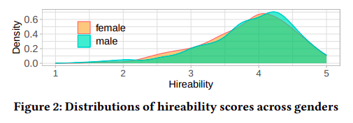
Matching on Gender
Dataset contained men (n=262) and women (n=465). Since the non-binary gender (n=6) representation was insufficient for statistical analysis, they were excluded from the study.
The matching method ensured that an equal number of men and women were present in the data set by down-sampling the majority class (women) to match the minority class (men).
After matching, performed a non-parametric Fligner-Killeen test for whether the variances were equivalent across genders and found the difference to be insignificant (D = 0.029).
Additionally, we performed another test to assess the likelihood that the data was drawn from different distributions and found the distribution difference to be insignificant (D = 0.097), suggesting successful matching.

Slide 8
Feature Extraction
Verbal: Verbal features included n-gram (unigram, bigram and trigram) frequencies and Linguistic Inquiry and Word Count (LIWC) summary categories. All n-gram features were term frequency and inverse document frequency (TF-IDF) weighted, and the bigrams and trigrams with a point-wise mutual information (PMI) less than 4.0 were dropped to remove spurious n-grams.
Paraverbal: The Geneva Minimalistic Acoustic Parameter Set of features were extracted using OpenSmile. These features included loudness, Mel-frequency, jitter and shimmer.
Visual: Visual features were extracted from facial expressions and body motion. Emotient’s FACET was used to extract facial expression features from individual video frames where a face could be detected.

Slide 9
Extraction
5663
Verbal Features
125
Paraverbal Features
250 Visual Features

Slide 10
Approaches used
Goal is to correctly assess the hireability without the ability to predict gender. So, we explore the multi-modal effects on accuracy, bias, and fairness of two model variants designed to reduce gender bias and improve fairness:
predictor gender-norming (i.e., z-scoring) within gender groups
iteratively removing the predictors that contain the most information about gender

Slide 11
Models used
Trained three types of Random Forest models, described as follows:
Baseline Model: All features from the chosen modality were used and were z-normalized across all participants prior to training.
Gender-normed Model: Features were z-normalized separately across men and women before training.
Reduced Features Model: A subset of the features were used for modeling, obtained via an iterative feature elimination procedure aimed at minimizing the predictability of gender.

Slide 12
Feature Reduction for Reduced Features Model
Specifically, for each modality set (verbal, paraverbal and visual), we trained a model in the same manner as the baseline to predict gender (instead of hireability) using all features z-normalized across all participants.
In each iteration, the 10 features with the greatest importance (i.e., feature “weights") were removed and another RF was trained in the same manner on the remaining features.
In each iteration, we evaluated gender predictability using the area under the curve (AU- ROC) measure, and the process continued until no features remained.

Slide 13
Gender Predictability
Predictability of gender for each modality by training in RF and then compared the output to the true gender using AUROC area.
If AUROCs close to 0.5, then we can say model is unable to predict gender.

Slide 14
Extraction
5663
Verbal Features
125
Paraverbal Features
250 Visual Features
After Reduction
3760
Verbal Features
(34% reduction)
8
Paraverbal Features
(94% reduction)
0 Visual Features
(100% reduction)

Slide 15
4/5 rule and Adverse Impact(AI)
Adverse impact (also called disparate impact) regards whether selection ratios (i.e., the number of hires divided by the number of applicants) is substantially different across legally protected groups (e.g., race/ethnicity, gender).
The most common metric for judging adverse impact is the four-fifths rule, or that the selection ratio of one group should not be less than four-fifths the selection ratio of another group .

Slide 16
Metrics Used
The predictions output by the three models for each of the four sets of modalities were evaluated in terms of
Accuracy: Assuming that hiring decisions are made based on the relative rankings of participants rather than the hireability scores themselves, study used Spearman rank-based correlation (ρ) as an accuracy metric.
Bias: To assess gender bias, we use correlational accuracy, or the difference in ρ between men and women.
Fairness: assessed fairness using two metrics: AI ratio and the predictability of gender (AUROC).

Slide 17
Spearman rank-based correlation
It finds a relationship between the two different features that can be described by a monotonic function.
It is robust method as there is no underlying assumption that the distribution for the variables is normal (Gaussian).

Slide 18
Results

Slide 19
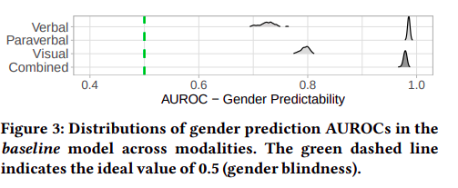
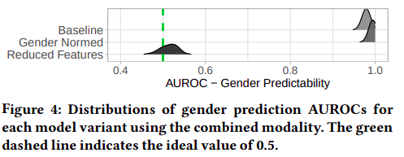
Gender Predictability
The results indicate that all modalities contributed gender information to the baseline models. The verbal baseline and visual baseline models had the lowest AUROCs (0.73 and 0.79 respectively), indicating they had incomplete knowledge of gender.
Gender predictability for the combined baseline and combined gender-normed models were well above the ideal AUROC=0.5 (green dashed line), suggesting that gender-norming predictors via z-scoring did not effectively reduce the amount of gender information in a fully multi-modal setting.

Slide 20
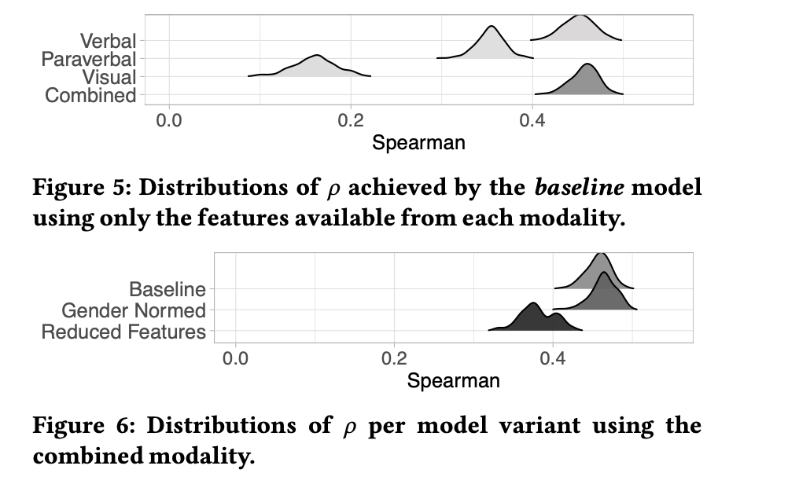
Accuracy
The paraverbal and the Visual modalities underperformed compared to the Verbal modalities when we compared only single modalities for the baseline model.
Figure 6 how the different models performed for the combined modality.
The accuracy metric used here is Spearman Rank based correlation.

Slide 21
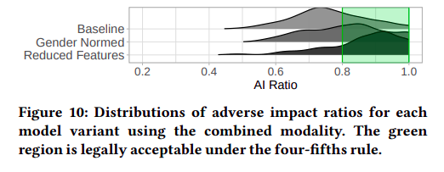
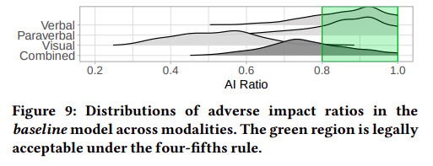
AI Ratio (Distributive Fairness)
In majority of the random trials for verbal baseline and paraverbal baseline , the AI ratio fell within the legally acceptable range. Interestingly, the visual baseline fell short (mean AI ratio of .52) in 99% of the trials, which would be considered clear legal evidence of discrimination in the US.
Figure 10 shows how the bias mitigation strategies impact this measure of distributive fairness when using the combined modality. Gender normalization of the features did improve the mean AI ratio (in spite of its lack of effect on bias), while the combined reduced-features approach improved it even further (.76 to .81 to .87, respectively).

Slide 22
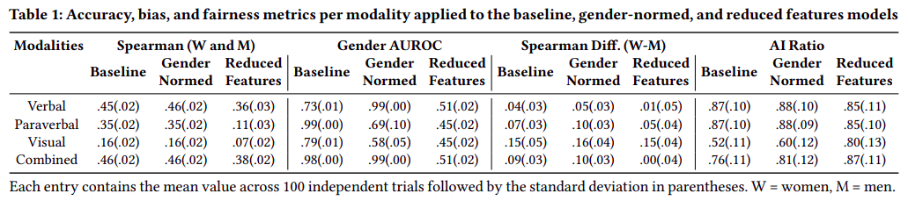
Final Results

Slide 23
Conclusion
Top contenders in terms of accuracy are the baseline and gender-normed models using either the verbal or combined modalities. As mentioned, the gender-normed version does not achieve gender blindness for either modality, nor does the combined baseline version.
This leaves the unimodal verbal baseline which also exhibits diminished (AUROC=0.73), moderate accuracy (ρ =.45), small correlational bias (ρdiff =0.04), and acceptable (AI=0.87).
In some contexts, it may be desirable to trade-off accuracy to improve bias and enhance fairness. In this case, the combined reduced-features model provides the next best accuracy (ρ =0.38), better gender blindness (AUROC=0.51), no correlational bias (ρdiff =0.00), and equivalently acceptable adverse impact (AI=0.87).
The verbal reduced-features model achieves a similar accuracy (ρ =.36), gender blindness (AUROC=.51), low bias (ρdiff =0.01), acceptable adverse impact (AI=.85), and it avoids the risk of including features with irrelevant information when making hireability assessments (such as visual ones) when compared to the combined reduced-features model.
Based on the metrics here, we would consider the reduced-features approach with either the verbal or combined modalities to be better choices than the verbal or combined baseline model.

Slide 24
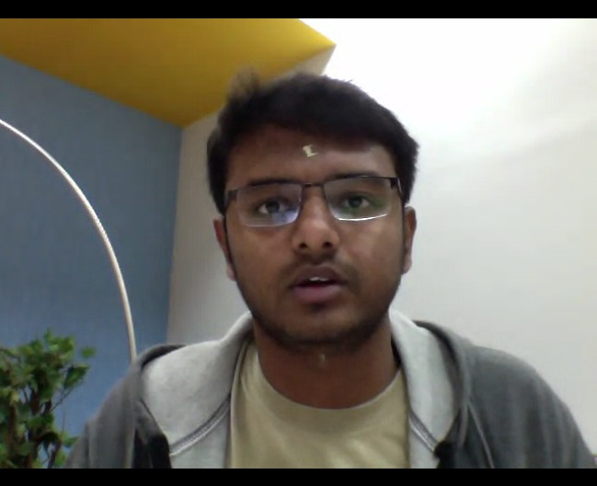
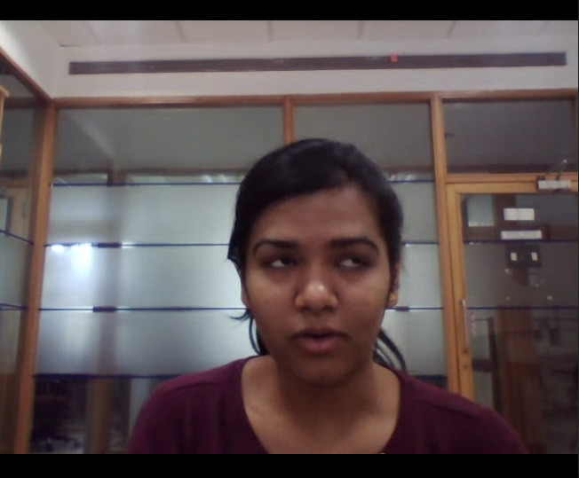
Dataset (IIIT-B Videos)

Slide 25
Dataset Description
We had around 180 IIIT-Bangalore's student's Interview videos.
Each student had answered around 5 questions which depicted their personality.
The other dataset which we had was the UK dataset.
We had the features values for around 350 videos.

Slide 26
Feature Extraction
We extracted OpenSmile and OpenPose features for the dataset.
OpenPose features contained both functional and lld features (low-level descriptors).
These features which we extracted were part of one of the feature set named ComParE_2016.
The basic difference between lld and Functional Features is Low-Level features are the basic features extracted from the audio signal directly such as pitch, loudness and the Functional Features are the features which are extracted after some transformation on the audio signal such as mean, standard deviation.

Slide 27
Feature Reduction
We manually added the label for the gender in the dataset.
We replicated the paper which we read for the feature reduction.
We used the Random-Forest model for predicting the gender.
We removed the top 10 important features which we found by the feature importance in Random-Forest.
We continued this process until the feature importance is less than a threshold.
For now, we kept the threshold value as 65%.

Slide 28
Extraction
6373
OpenSmile - Functional
65
OpenSmile-LLD
709
Visual Features
After Reduction
4223
OpenSmile - Functional
32
OpenSmile-LLD
3
Visual Features

Slide 29
Future Scope
Remove the racial bias present between both the datasets (IIIT-B and UK).
Remove the gender bias using the same method in the UK dataset.
Find a particular threshold value such that the accuracy for predicting the score is not drastically dropped.
We will find the accuracy scores for all the models and all the modalities and compare the results.

