Slide 1

Insightful Vision: Exploring Traditional Computer Vision
Kushal Kusram

Slide 2
What is Computer Vision?
Enabling computers to interpret and understand visual information from digital images or videos, mimicking human vision processes to analyze, process, and extract meaningful insights.

Slide 3
Agenda
Analyzing digital images (videos)
Using classical image processing techniques
Employing feature extraction methods
Applying pattern recognition algorithms
Excluding modern deep learning or AI techniques

Slide 4
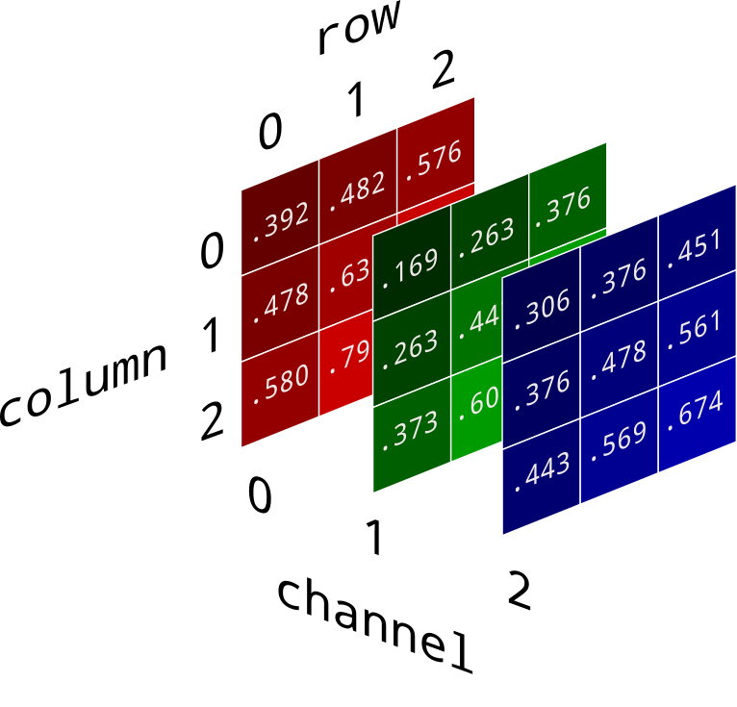
Analyzing Images
An image is a static visual representation, while a video is a sequence of moving images.

Slide 5
Using Classical Image Processing
Feature Extraction – detecting edges, corners, textures.
Image Filtering – manipulting image characteristics
Histogram Analysis – analyzing of pixel intensities
Contour Detection – detecting outlines of objects
Optical Character Recognition – we know this!

Slide 6
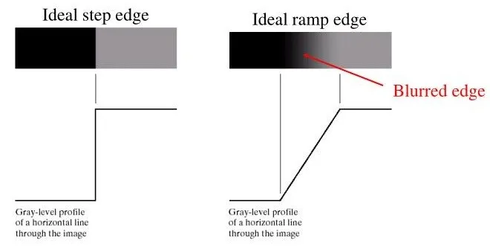
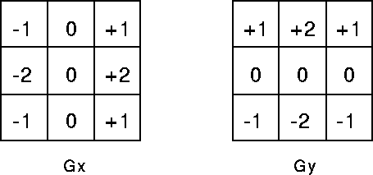
Employing Feature Extraction
Edge Detection
Detects abrupt changes in color or brightness.
Identifies boundaries between objects.
Uses gradient analysis for edge detection.
Enables object detection.

Slide 7
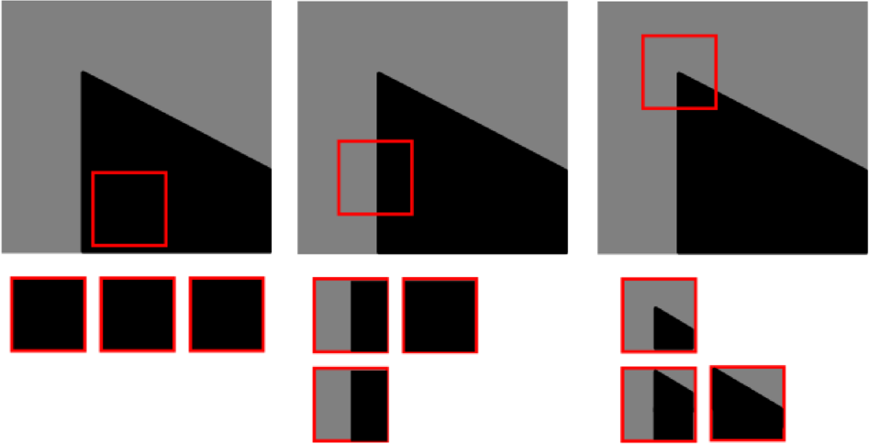
Employing Feature Extraction
Corner Detection
Analyzes pixel neighborhoods to find corners.
Measuring based on the variation in px intesity.
Detecting when two edges meet.

Slide 8
Applying Pattern Recognition
Optical Character Recognition
Pre-processing: Enhance quality and remove noise.
Feature Extraction: Detect edges, corners, features.
Text Segmentation: Identify regions containing text.
Character Recognition: Classify and extract characters from text regions.

Slide 9
Applying Pattern Recognition
Object Detection
Feature Extraction: Identify key visual patterns or characteristics in the image.
Template Matching: Compare these features with predefined templates or patterns.
Localization and Classification: Determine the location and category of objects based on matched features and templates.

Slide 10
Hands-On!

Slide 11
Limitations of Classical CV
Manual feature design often misses relevant details.
Relies on fixed rules, limiting flexibility.
Lacks learning capability for improvement.
Vulnerable to noise and outliers.
Difficult to manually tune to fit a large dataset.

Slide 12
Thank You!

