Slide 1
LOST & FOUND
Lost & Found Management System
Kushal Maharjan • Nhuza Maharjan • Arpita Katuwal • Rohina Tandukar
LOST & FOUND • Project Presentation

Slide 2
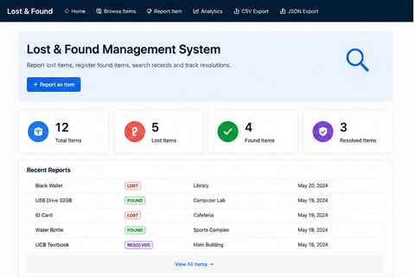
1. Project Overview
A centralized web interface for reporting, browsing and resolving lost-and-found items.
Purpose
Make lost-and-found records easier to report, discover and manage.
Core users
Students, staff, visitors and community members.
Main idea
Keep item information in one organized system instead of scattered notices.
LOST & FOUND • Project Presentation

Slide 3
2. Problem Statement
• Lost and found information is often scattered across messages, notice boards and word of mouth.
• People may not know where to search for an item or how to report one they found.
• Important details can be missed when there is no central record.
• A dedicated system can improve visibility and make recovery easier to track.
Project response
A simple digital platform that brings reporting, browsing and resolution into one workflow.
LOST & FOUND • Project Presentation

Slide 4
3. Objectives
Report
Allow users to submit lost or found item details.
Browse
Provide a searchable list of reported items.
Track
Show item status such as LOST, FOUND and RESOLVED.
Resolve
Support the process of returning items to their owners.
• Provide a clear and simple interface.
• Create a foundation for analytics and future expansion.
LOST & FOUND • Project Presentation

Slide 5
4. System Workflow
01
02
03
04
05
Report Item
Store Record
Browse / Search
Identify Match
Mark Resolved
LOST & FOUND • Project Presentation

Slide 6
5. Dashboard
The dashboard gives an immediate summary of the current records.
• 12 total items
• 5 lost items
• 4 found items
• 3 resolved items
• Recent Reports table gives a quick view of latest activity.
LOST & FOUND • Project Presentation

Slide 7
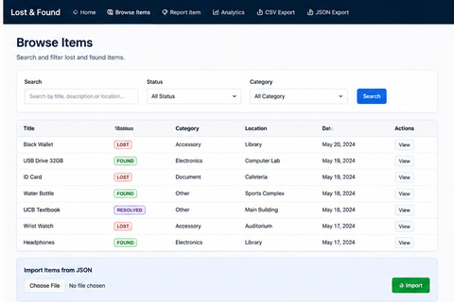
6. Browse Items
Search and filter reported records.
• Search by title, description or location.
• Filter by status.
• Filter by category.
• View item records directly from the list.
• JSON import is available in the shown interface.
LOST & FOUND • Project Presentation

Slide 8
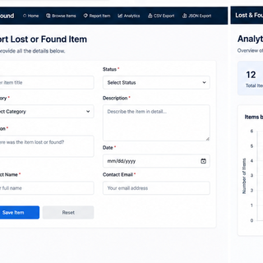
7. Report Lost or Found Item
The reporting form captures the information needed to identify an item.
• Title and status
• Category and description
• Location and date
• Contact name and email
• Save and reset actions
LOST & FOUND • Project Presentation

Slide 9
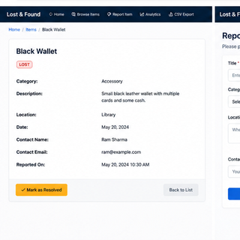
8. Item Details & Resolution
Each record provides the information needed to review a reported item.
• Displays title, status, category and description.
• Shows location and date.
• Includes contact information.
• Records when the item was reported.
• Provides a 'Mark as Resolved' action.
LOST & FOUND • Project Presentation

Slide 10
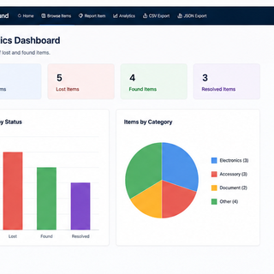
9. Analytics Dashboard
The current UI visualizes the project's records by status and category.
LOST & FOUND • Project Presentation

Slide 11
10. Project Visibility & Impact
Using the actual dashboard counts, the current system has a clear activity profile.
Total records
12
Lost
5
Found
4
Resolved
3
• Lost items represent the largest current status group.
• Found and resolved records show that the system can track progress beyond initial reporting.
• Category analytics make it possible to understand what kinds of items are most frequently reported.
• For a formal visibility study, future versions can collect real user visits, reports, matches and successful recoveries.
LOST & FOUND • Project Presentation

Slide 12
11. Benefits
• Centralizes lost-and-found information in one location.
• Makes reported items easier to discover.
• Provides structured details for each record.
• Tracks status from lost/found to resolved.
• Gives administrators or users a quick dashboard view.
• Creates a base for analytics and future automation.
LOST & FOUND • Project Presentation

Slide 13
12. Limitations & Challenges
• The quality of results depends on accurate information entered by users.
• A larger deployment requires strong authentication, authorization and privacy controls.
• Duplicate or false reports need validation.
• Contact information should be handled securely.
• Real-world effectiveness should be measured through user testing and recovery statistics.
LOST & FOUND • Project Presentation

Slide 14
13. Future Scope
• User login, profiles and role-based administration.
• Image upload and image-based item identification.
• Advanced filters by location, date, category and status.
• Automatic notifications for possible matches.
• Claim verification before marking an item as resolved.
• Interactive map/location support.
• Mobile-responsive interface or dedicated mobile app.
• More detailed analytics: recovery rate, average resolution time and activity trends.
• AI-assisted matching of descriptions and images.
LOST & FOUND • Project Presentation

Slide 15
14. Technology & Project Structure
• The project is maintained in the GitHub repository Project2.0.
• The repository contains the main LOST & FOUND project folder.
• The interface shown uses a clean dashboard-style web application design.
• The system includes pages/views for dashboard, browsing, reporting, item details and analytics.
• Data import/export functionality is visible in the navigation and browse interface.
• The exact framework/database technologies should be listed from the final source configuration used by the team.
LOST & FOUND • Project Presentation

Slide 16
15. Conclusion
LOST & FOUND
A practical management system that organizes reports, improves visibility and provides a clear path from reporting an item to resolving it.
• The current interface already demonstrates a complete basic workflow.
• The dashboard and analytics make project activity easy to understand.
• Future enhancements can turn it into a larger campus or community-wide platform.
LOST & FOUND • Project Presentation

Slide 17
16. References
• KushalMaharjan1, Project2.0 — GitHub repository.
• LOST & FOUND project interface/screenshots supplied by the project team.
• GitHub documentation for repository and version-control concepts.
• Any framework, database or library documentation used by the final implementation should be added to the submission's reference list.
• All numerical charts in this revised presentation use the counts visible in the supplied project UI.
github.com/KushalMaharjan1/Project2.0
LOST & FOUND • Project Presentation

Slide 18
THANK YOU
Questions & Discussion
Kushal Maharjan • Nhuza Maharjan • Arpita Katuwal • Rohina Tandukar
LOST & FOUND • Project Presentation

