Slide 1
Emotion Classification Using Video
Team - 4
Shiven Yadav S - 1RVU23CSE433
Skanda Ramesh Bharadwaja - 1RVU23CSE456
Kushal Pawar B - 1RVU23CSE230
Dhanush Rajesh - 1RVU23CSE144

Slide 2
Problem Statement
Objective:
Develop a Convolutional Neural Network (CNN) model that can accurately classify human facial expressions into one of seven emotion categories using images from the FER dataset.
Problem Description:
Facial emotion recognition is a crucial task in various applications, including human-computer interaction, mental health monitoring, and customer sentiment analysis. Given an image of a human face, the goal is to predict the corresponding emotion class among the following:
Angry
Disgust
Fear
Happy
Neutral
Sad
Surprise

Slide 3
Dataset(s) details
1. Dataset Overview:
The Facial Expression Recognition (FER-2013) dataset is a collection of grayscale facial images labeled with seven different emotions. It is widely used for training machine learning models in facial emotion recognition tasks.
2. Dataset Composition:
Total Images: 35,887 images
Image Size: 48x48 pixels
Color Mode: Grayscale
Number of Classes: 7 (Each image belongs to one of these classes)
Data Split:
Training Set: 28,821 images
Testing Set: 7,066 images

Slide 4
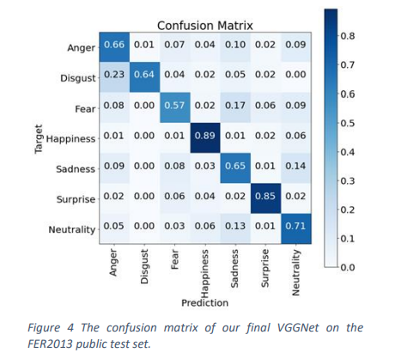
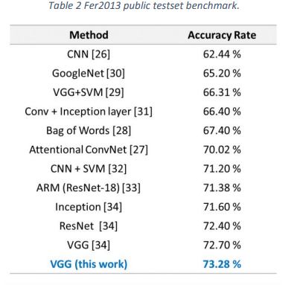
Literature Survey
Khaireddin, Y., & Chen, Z. (2021). Facial Emotion Recognition: State of the Art Performance on FER2013.
Paper Link - https://arxiv.org/pdf/2105.03588
Models - CNN, Architecture - VGGNet
Datasets - FER-2013

Slide 5
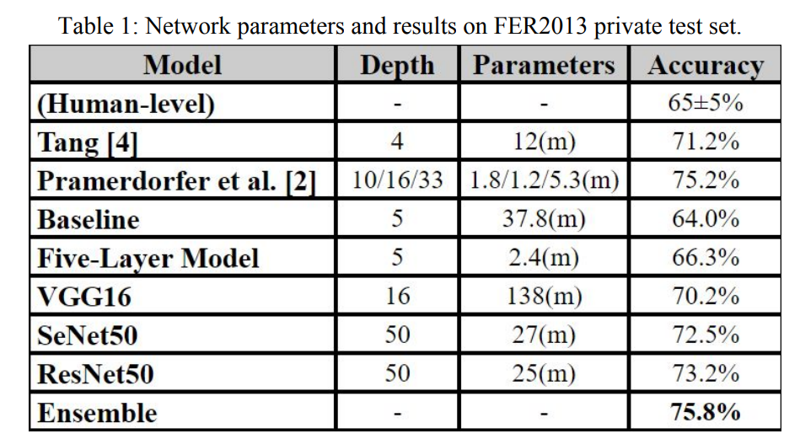
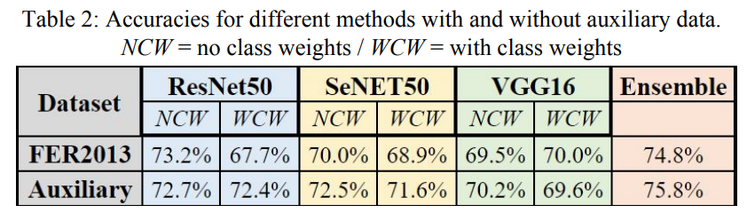
Literature Survey
Khanzada, A., Bai, C., & Celepcikay, F. T. (2020). Facial Expression Recognition with Deep Learning: Improving on the State of the Art and Applying to the Real World. Stanford University. Retrieved from
Paper link - https://cs230.stanford.edu/projects_winter_2020/reports/32610274.pdf
Models - CNN, ResNet50, SeNet50, VGG16
Datasets - FER2013(Main), Extended Cohn-Kanade(CK+), JAFFE

Slide 6
Model Description
1. Model Architecture
Framework: TensorFlow/Keras
Type: Convolutional Neural Network (CNN)
Input Shape: (48, 48, 1) (Grayscale images)
Layers Used:
Conv2D: 32, 64, 128 filters with ReLU activation
MaxPooling2D: Reducing spatial dimensions
Dropout: Preventing overfitting (0.25, 0.5 dropout rates)
Flatten: Converting feature maps into a 1D vector
Dense: 1024 neurons (ReLU), followed by output layer (7 classes, Softmax)
2. Compilation & Training Configuration
Loss Function: Categorical Cross Entropy (for multi-class classification)
Optimizer: Adam (learning rate = 0.0001)
Metric: Accuracy
3. OpenCV Integration
Disabling OpenCL in OpenCV for performance consistency

Slide 7
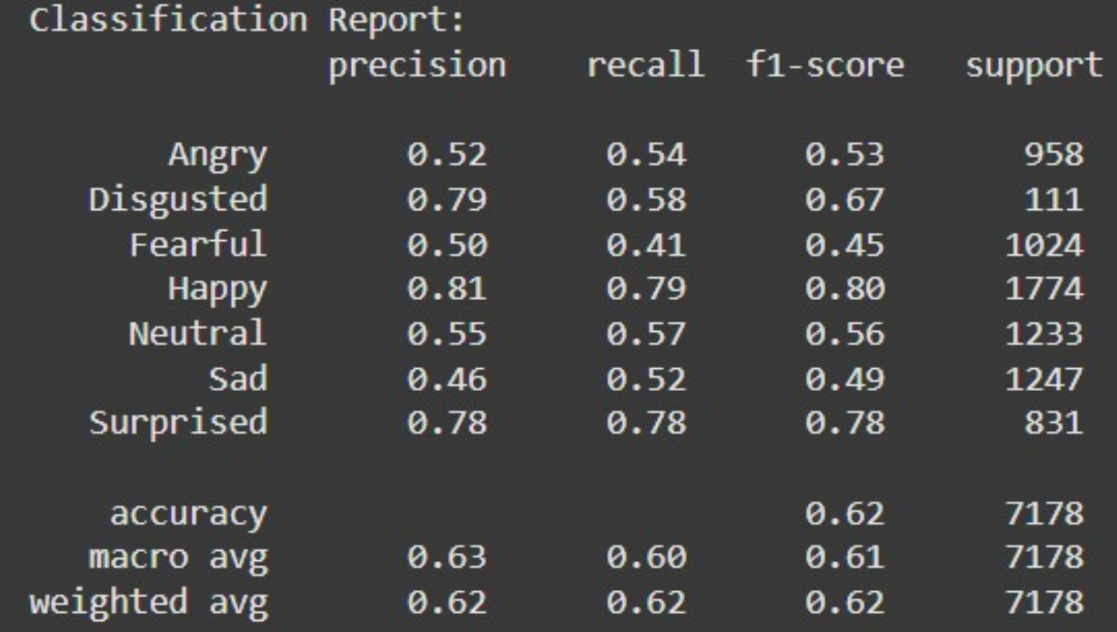
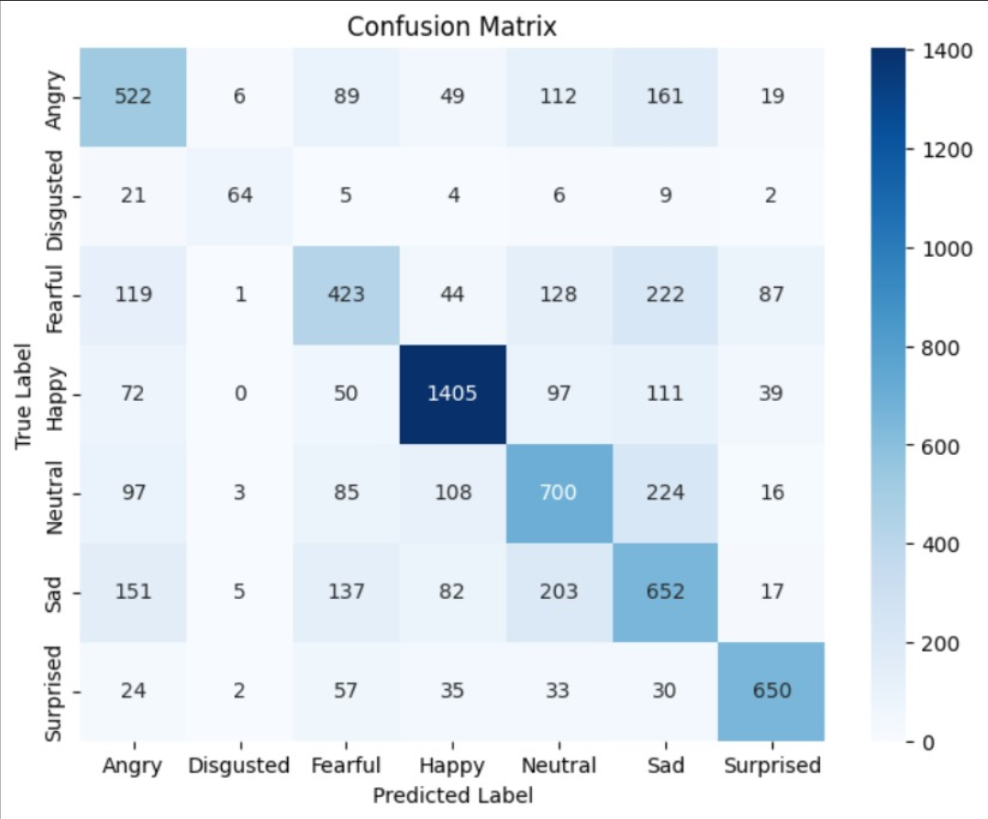
Preliminary Results
Overall Accuracy: 62%
Best Performing Classes: Happy (F1-score: 0.80), Surprised (0.78), Disgusted (0.67).
Weakest Classes: Fearful (0.45 F1-score) and Sad (0.49)
Confusion Observed: Fearful and Sad emotions are frequently misclassified, with overlap among Neutral, Angry, and Sad categories.

Slide 8
Further Plan
Enhancing Model Performance:
Implement ensemble learning (bagging, boosting, stacking) to improve classification accuracy.
Fine-tune hyperparameters (learning rate, dropout rates, optimizer selection) for better generalization.
Handling Class Imbalance:
Use data augmentation (flipping, rotation, brightness adjustments) for underrepresented emotions.
Apply class-weighted loss functions to balance training.
Cross-Dataset Generalization:
Test the model on different datasets (AffectNet, RAF-DB) to improve real-world adaptability.

Slide 9
Thank you

