Slide 1

Project 5 :SECURE SOCKET LAYER PROTOCOL
SIDDAGANGA INSTITUTE OF TECHNOLOGY, TUMKUR
DEPARTMENT OF COMPUTER SCIENCE ENGINEERING
Team
Kushala R 1SI18CS049
A M Siri 1SI18CS139
Prerana R Shetty 1SI18CS077
Sinchana P 1SI18CS109
Under the guidance of
Mrs.Shwetha A N
Assistant Professor
Dept Of CSE
SIT

Slide 2
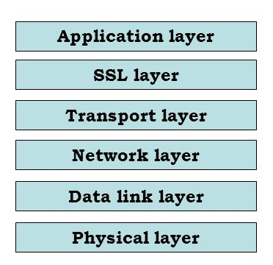
Visualize different state transitions that happen as part of SSL protocol and how handshake is completed along with various parameters that are exchanged.
Input: Packet Capture of SSL.
PROBLEM STATEMENT
What is SSL?
    Secure Socket Layer
    Security to data that is transferred between web browser and server.
    Encrypts the link to ensure privacy, and free from breaches
Where is SSL?
    Application layer <SSL> Transport Layer

Slide 3
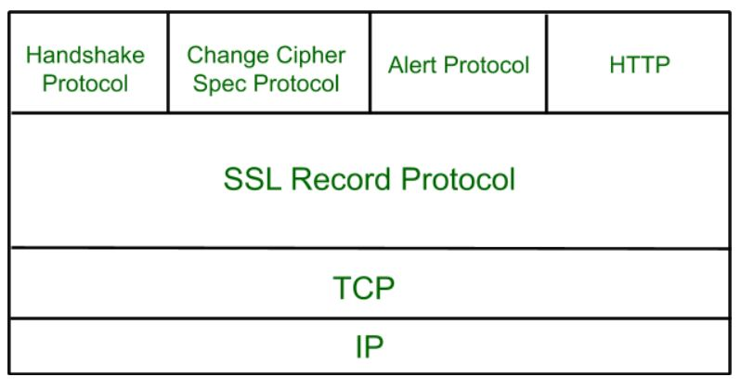
Protocols under SSL

Slide 4
Deep Dive into Protocols
Handshake Protocol
    Establish sessions
    Allows client and server authentication
SSL Record Protocol
    Confidentiality
    Message Integrity
Change-Cipher Protocol
    Consists of a single message (1 Byte )
    Pending state to be copied into current state
Alert Protocol
    Conveys SSL-related alerts to the peer entity

Slide 5

HANDSHAKE PROTOCOL
Used to establish sessions.
Allows client and server to authenticate with each other by sending a series of messages to each other.
Uses 4 phases to complete its cycle.
Phase-1:
- Both Client and Server send hello-packets to each other.
- In this IP session, cipher suite and protocol version are exchanged for security purpose.
Phase-2:
- Server sends its certificate and Server-key-exchange.
- Server ends the phase-2 by sending Server-hello-end packet.
Phase-3:
- In this phase Client replies to the server by sending its certificate and
  Client-exchange-key.
Phase-4:
- Change-cipher suite occurrs and after this Handshake Protocol ends.

Slide 6
client hello
client hello
SERVER
CLIENT
SERVER
CLIENT
Phase 1
server hello
server hello
Server Certificate
Client Certificate Request
Server Key Exchange
Server Certificate
Client Certificate Request
Server Key Exchange
Phase 2
Server hello done
Client Certificate
Client Key Exchange
Client Certificate
Client Key Exchange
Phase 3
Change cipher spec
Finished
Change cipher spec
Finished
Phase 4
Change cipher spec
Finished

Slide 7
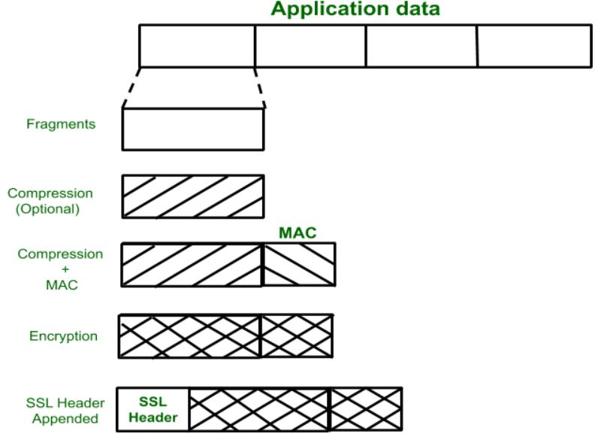
SSL Record Protocol
Application data is divided into fragments.
The fragment is compressed and encrypted MAC (Message Authentication Code) is generated by algorithms like SHA .
MD5 is appended.
After that encryption of the data is done and in last SSL header is appended to the data.

Slide 8
Onto Analysis

