Slide 1
Insights
The data has Userid,Tweetid,Tweets and label.
The Userid,Tweetid doesn't seems to play a very important role in the assignment, so have not considered these features while training the model.
The tweets i.e text in the dataset plays a very important role here. Depending on the sentiment present in the Tweet they are categorized in to ADR_label (1,0).
Approaches I have considered:
I have used XGBoost as a machine learning approach to classify the tweets.
Deep learning approach LSTM is applied to do the classification.
Better approaches:
BERT model can be used in the place of LSTM. Better insight on the context of the tweet can be achieved.

Slide 2
My approach to this problem is very straight forward. I strongly believe from the dataset that labels are on the basis of tweets. Hence analyzing the sentiment with basic approach and classify the tweets to appropriate labels.
Sequence based or prediction based embedding can be used to solve. To keep the things simple have used sequence based. I have just used Tokenization to create the embedding's.
I have created 2 notebooks to present XGBoost and LSTM approach.
I have found class imbalance in the dataset. I did not do any under sampling, over sampling method to handle the class imbalance. As text sentiment plays role I like to ignore this case as of now in my approach. In the later stage involving evaluation this can be considered.
Challenges
The problem I analyzed was very straight forward. I faced the confusion while creating a sequence to pass an input to the model. As I had various options.
Improvements
As LSTM uses linear layers it consumes large amount of memory to process the data sequentially. We can improvise this using BERT which uses transformer architecture.

Slide 3
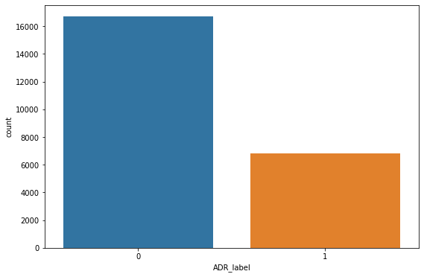
Text Pre-processing
No null values found in the dataset.
The below figure shows the ratio of target classes.

Slide 4
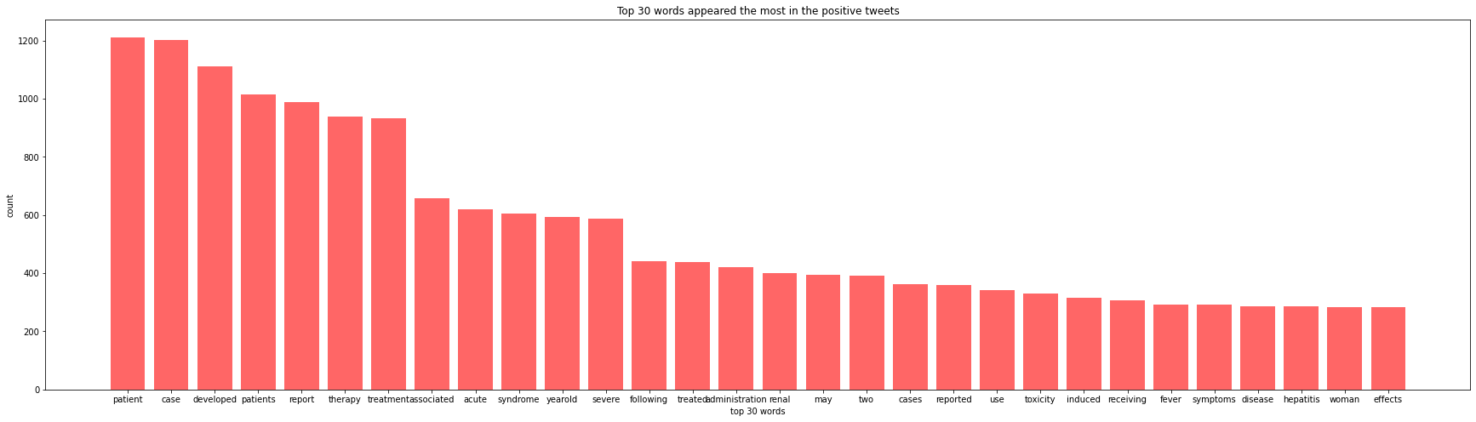
I have removed the stop words, special characters from the tweets as a part of pre-processing.
Maximum length of tweet is observed to be 66.
I have tried to get the insight on the words hence created positive, negative sentiment corpus and have found the top words in both the corpus.

Slide 5
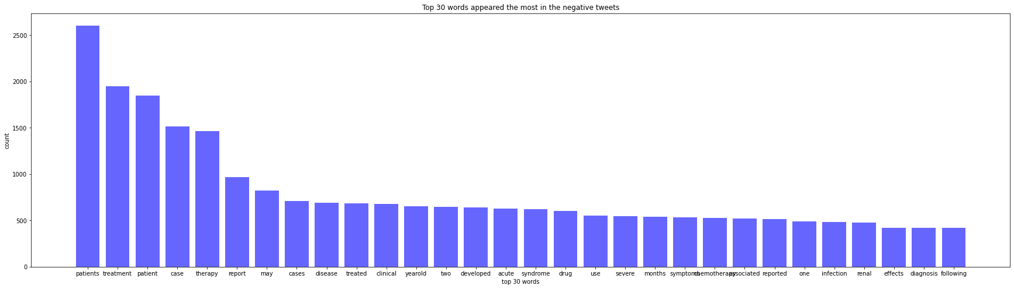

Slide 6
First approach for classification
The text in the tweet is converted to sequences using tokenizers and pad_sequences to feed the input the model.
With plain XGBoost without building any pipeline to tune the hyper-parameters the model gave the below accuracy.
Reason I choose XGBoost
I like the way XGBoost works. Its one of my top algorithm. Applying this I have got better results for my agricultural works so I have chosen this.
XGBoost is a decision-tree-based ensemble Machine Learning algorithm that uses a gradient descent framework. Boosting is where errors are minimized by gradient descent algorithm. XGBoost and Gradient Boosting Machines (GBMs) are both ensemble tree methods that apply the principle of boosting weak learners using the gradient descent architecture. By applying this below are the results.
Accuracy: 0.8499149659863946.
The other metrics precision, recall, f1 score is also calculated.

Slide 7
Second approach for classification
LSTM for classification
My first intention was to classify the tweet using BERT. But I took the opportunity to use LSTM to keep the approach simple and a better approach than neural network and RNN which over comes vanishing gradient problem.
They were created as the solution to short-term memory. They have internal mechanisms called gates that can regulate the flow of information.
These gates can learn which data in a sequence is important to keep or throw away. By doing that, it can pass relevant information down the long chain of sequences to make predictions. Almost all state of the art results based on recurrent neural networks are achieved with these two networks.

Slide 8
Methodology
I have generated sequence of embedding as input to the model. I have added padding and truncation while generating the input sequence.
LSTM, bi-directional layer with dense and dropout is used as layers.
Have considered sequential model.
Activation function as ‘relu’. (Relu considered to be the best hidden layer activation function)
Output layer activation is chosen to be sigmoid as we have binary classification problem.
Have used loss function to be binary-cross entropy. This compares each of the predicted probabilities to actual class output which can be either 0 or 1.
To avoid overfitting have used drop out layer along with early stopping of the model to ensure the accuracy.
The accuracy of this model: 0.87.

