Slide 1
Name:-Kushal Banik Emp ID:-2157964 Email:- Kushal.Banik2@cognizant.com Phn:- 7980859303
Movie Booking App Backend

Slide 2
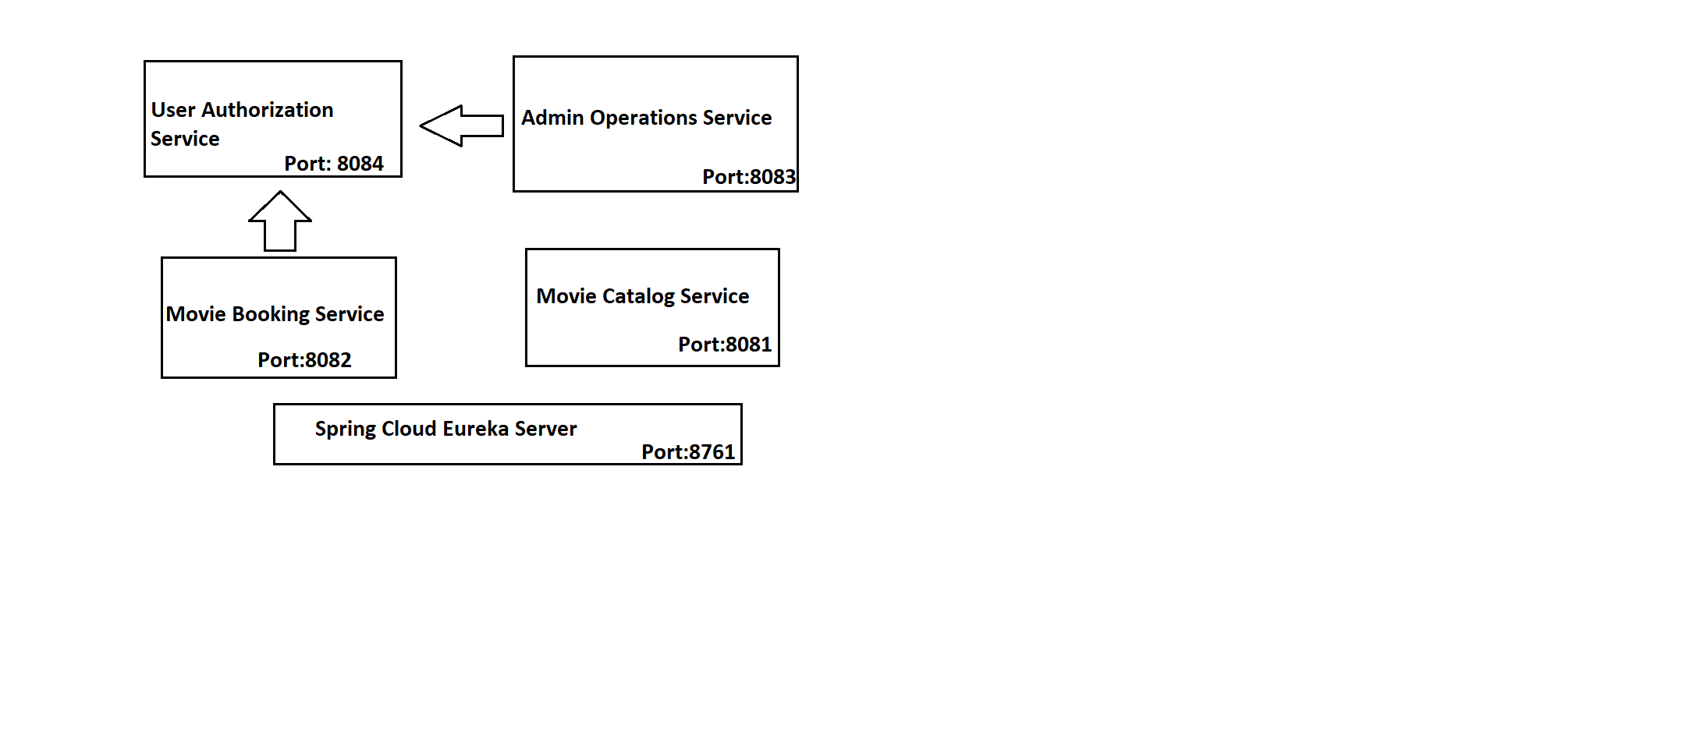
Microservice Architecture:-

Slide 3
User Authorization Service EndPoints:-
The Endpoints Related to User Authorization for Providing Authentication and Defining the Role of User

Slide 4
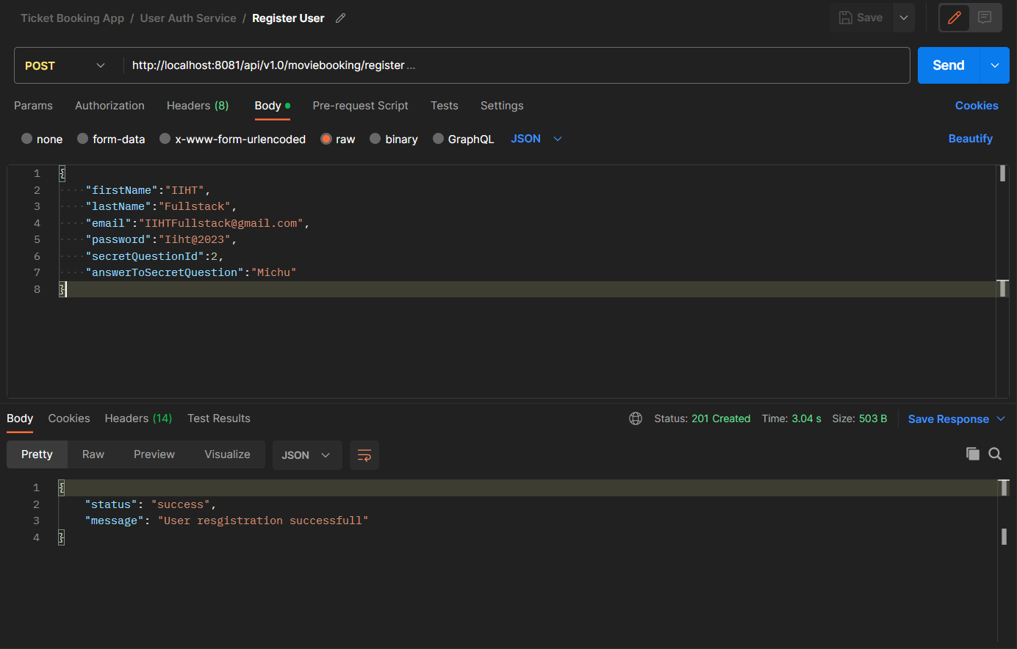
Register New User:-

Slide 5
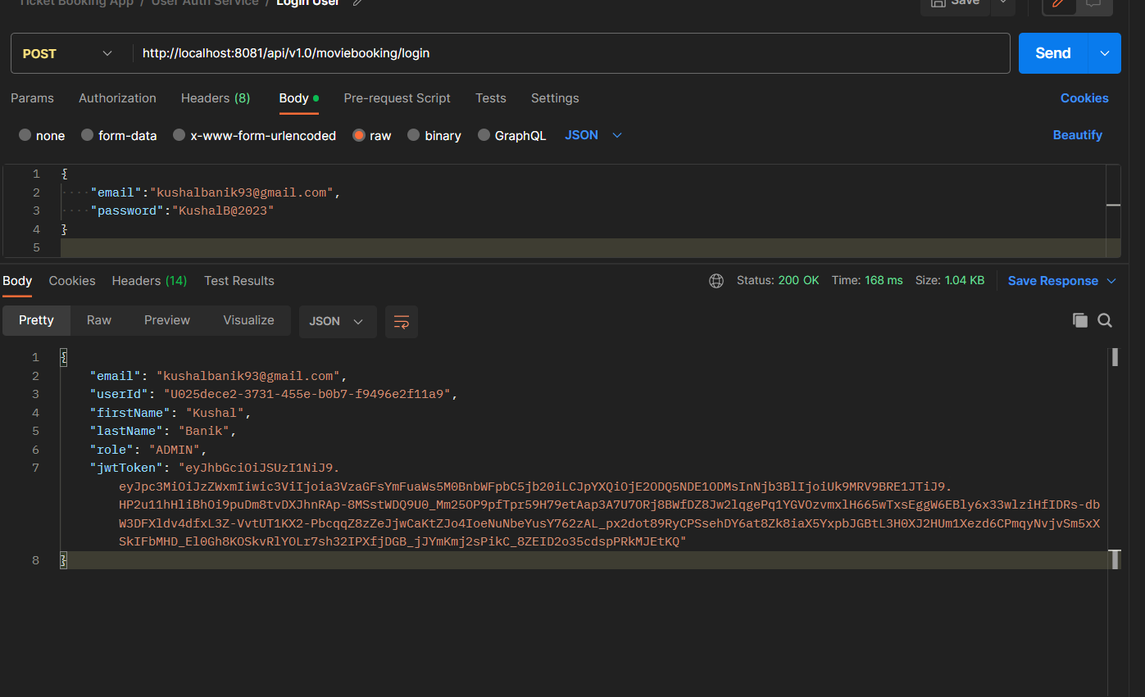
Login Existing User:-

Slide 6
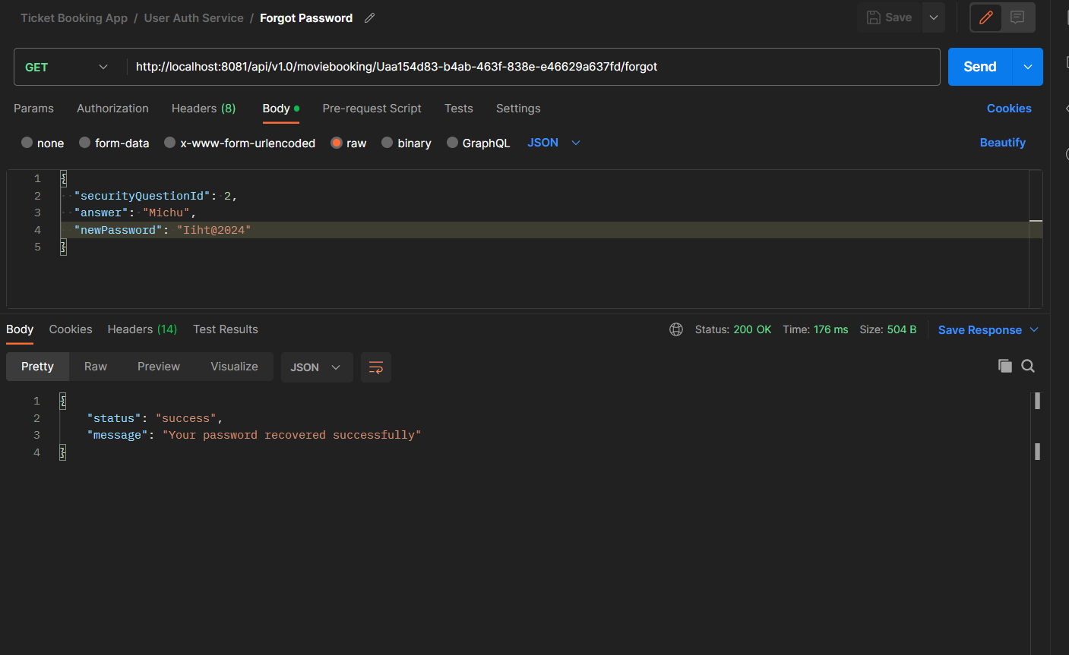
Forgot Password For Existing User:-

Slide 7
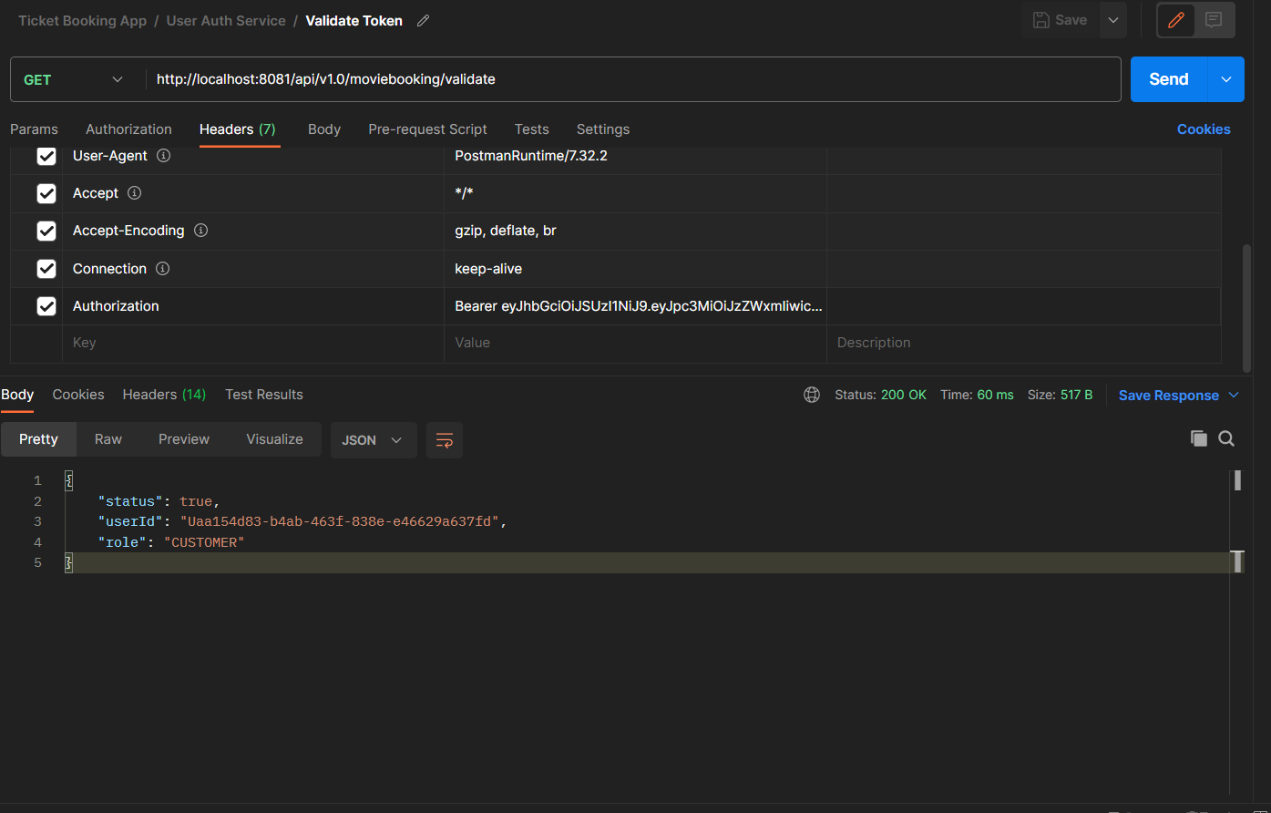
Validating The User Token:-

Slide 8
Endpoints Related to Movie Catalog Service:-
This Microservice Offers User to do all movie related operations like searching and others

Slide 9
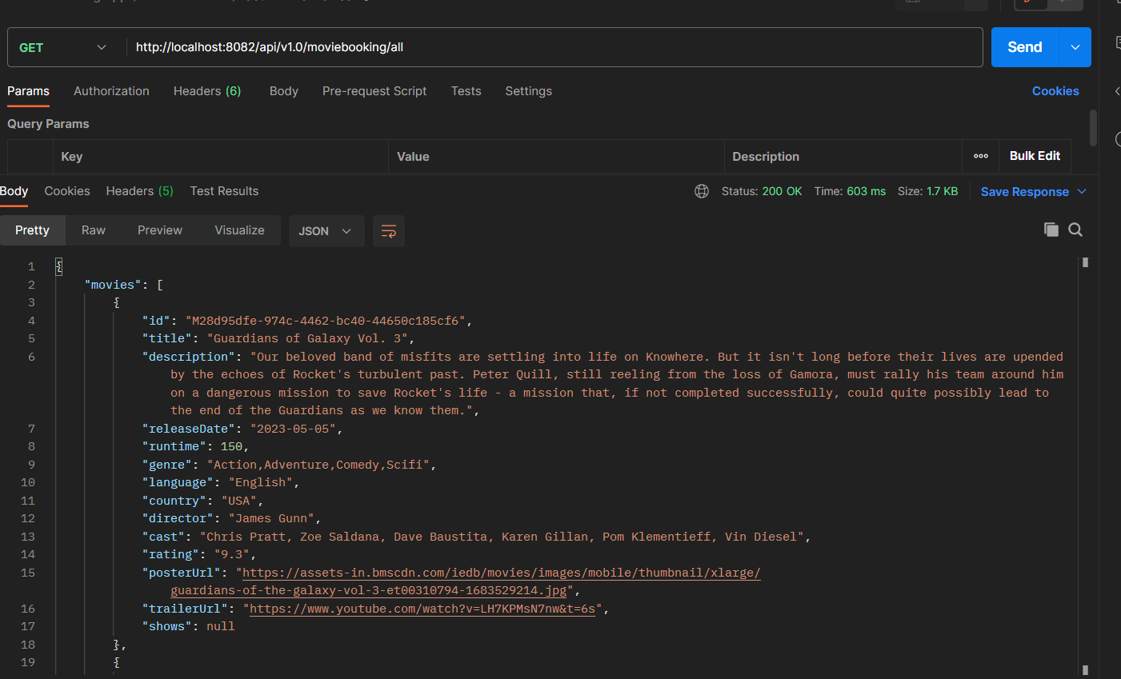
Fetching All The Movies:-

Slide 10
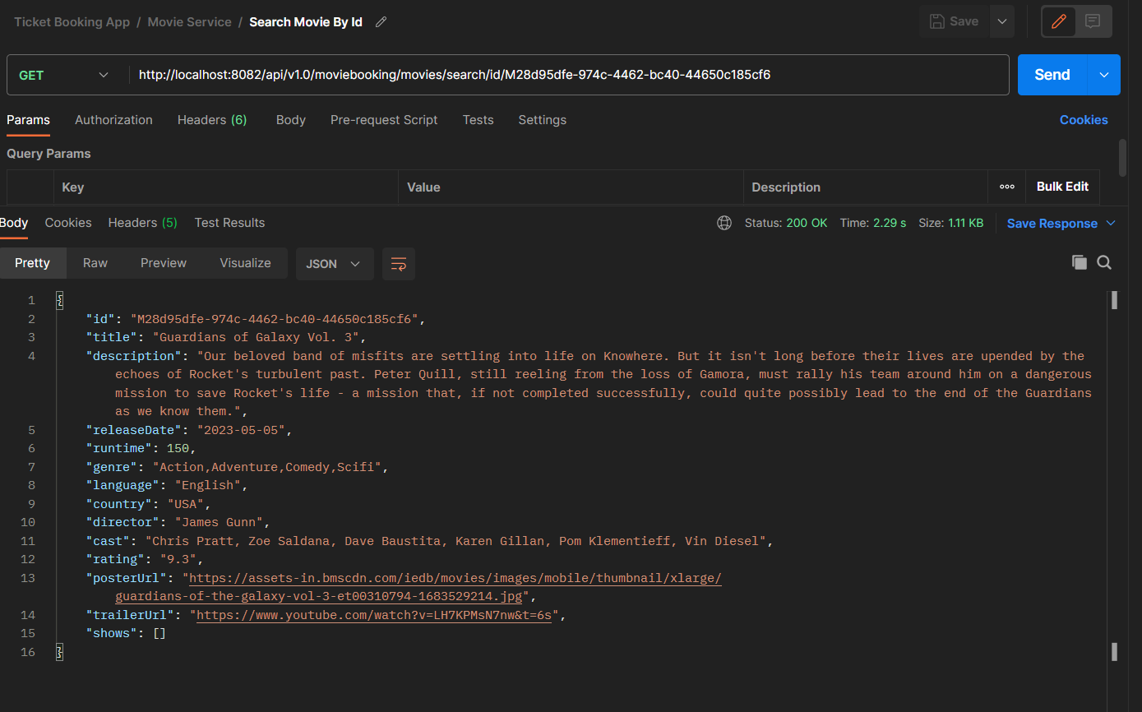
Get Movie By Id:-

Slide 11
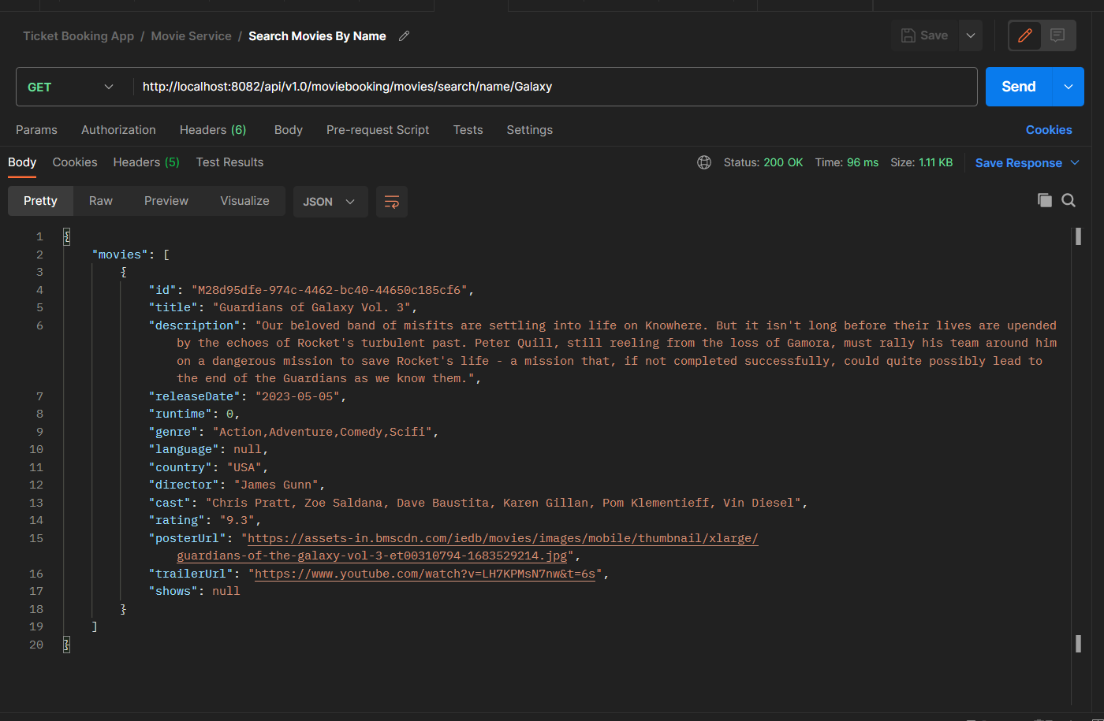
Search Movie By Title Name:-

Slide 12
Movie Booking MicroService:-
This Microservice is related to movie booking

Slide 13
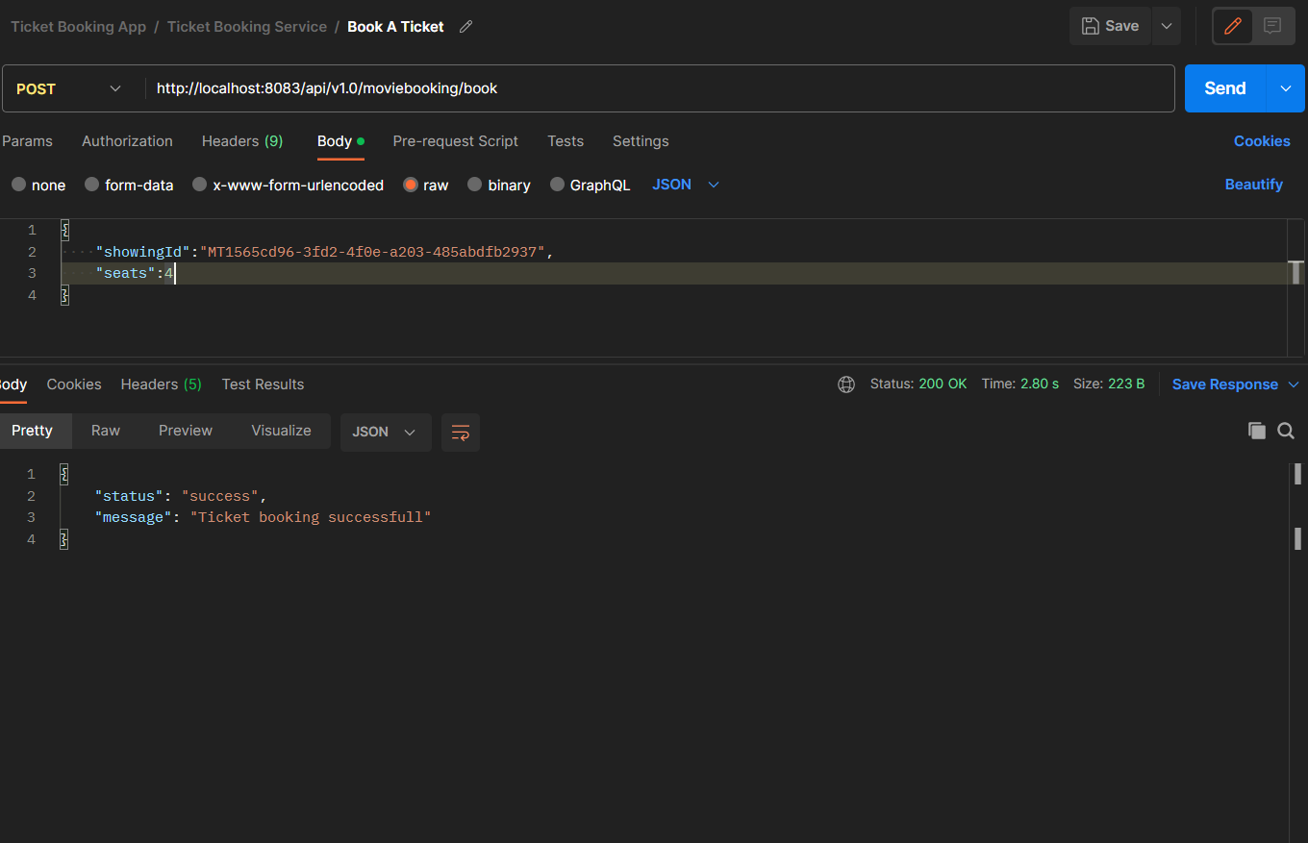
Book a Show:-

Slide 14
Admin Service
Admin Microservice is for all Admin Related operations like Create or Delete any movie
Updating The status of ticket

Slide 15
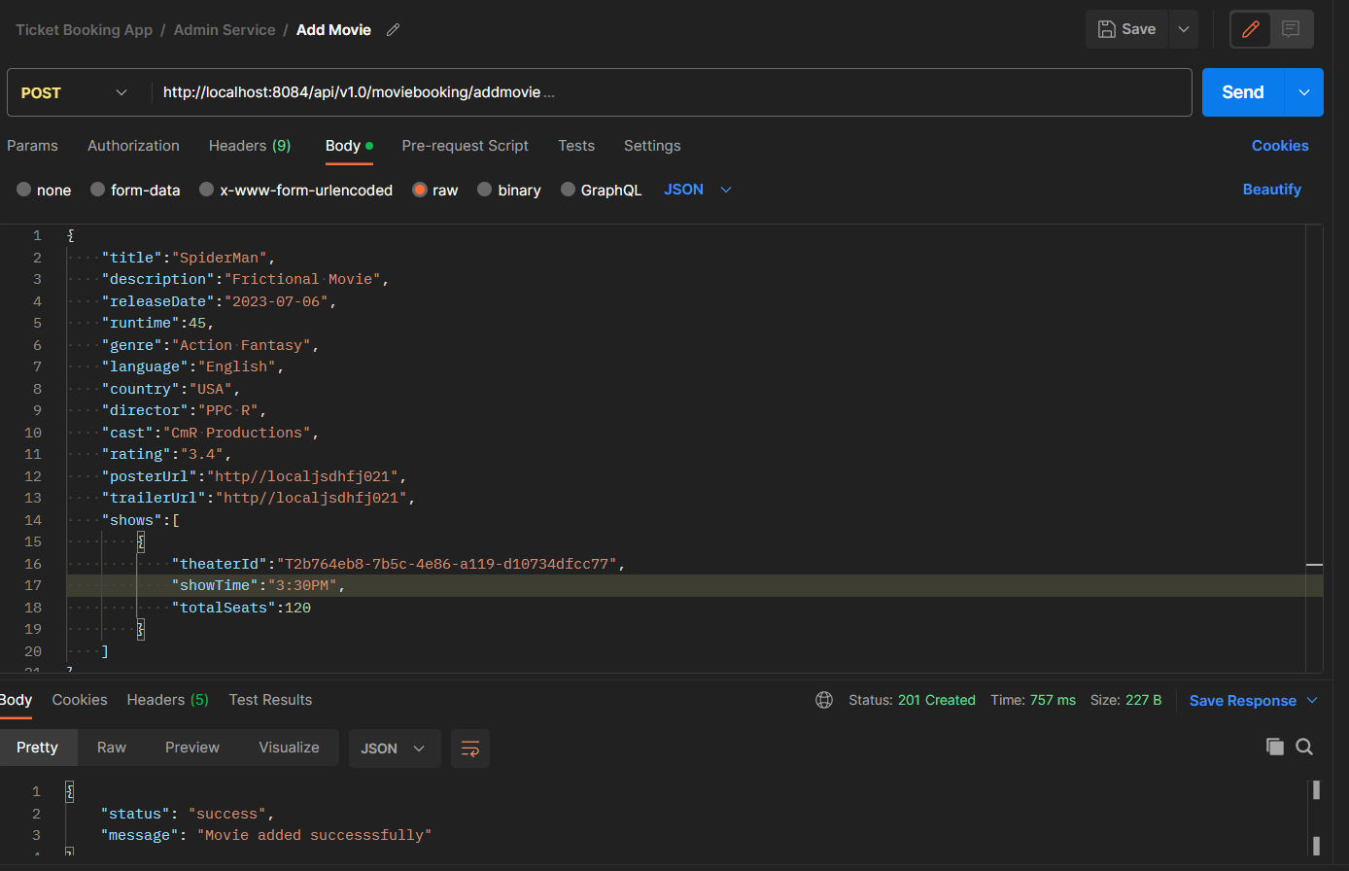
Add Movie:-

Slide 16
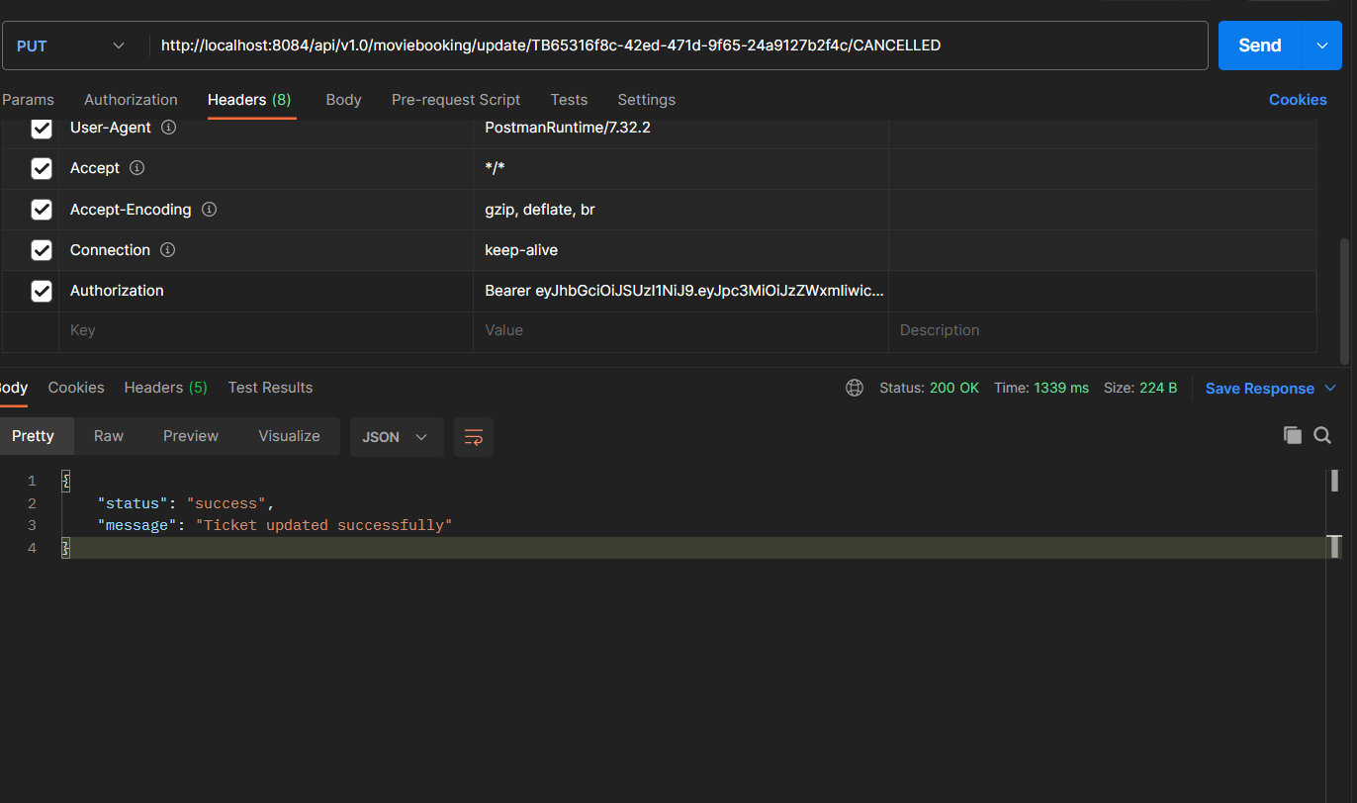
Update Ticket Status:-

Slide 17
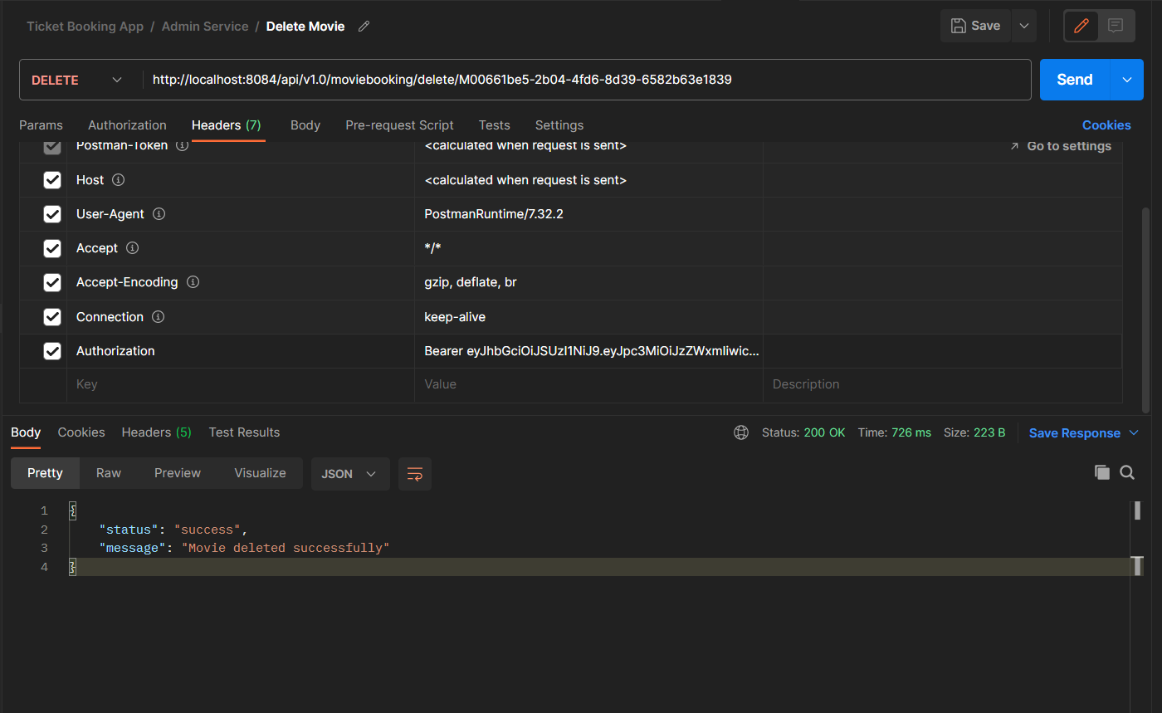
Delete Movie:-

Slide 18
Kafka Architecture:-
Here Kafka is used to Notify that admin has created a new Movie
We have 3 brokers kafka
The Admin service is kafka producer here
The Movie Catalog service is Kafka consumer here

Slide 19
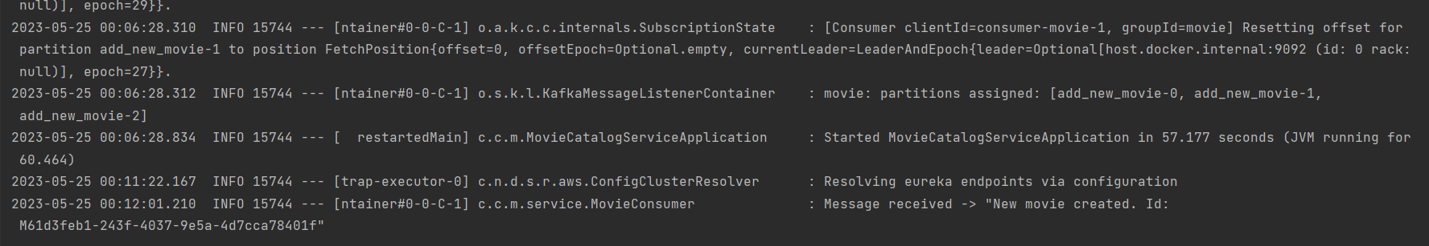
Movie Creation Alert:-

Slide 20
Microservice Paramerts Monitoring:-
Promethus For JVM based Parameters Monitoring
Grafana For Visualizing promethus using graph
Logstash for collecting all the logs
ElasticSearch for Storing all the Logs
Kibana For Visualization of the logs
Spring Cloud Eureka For Service Discovery

Slide 21
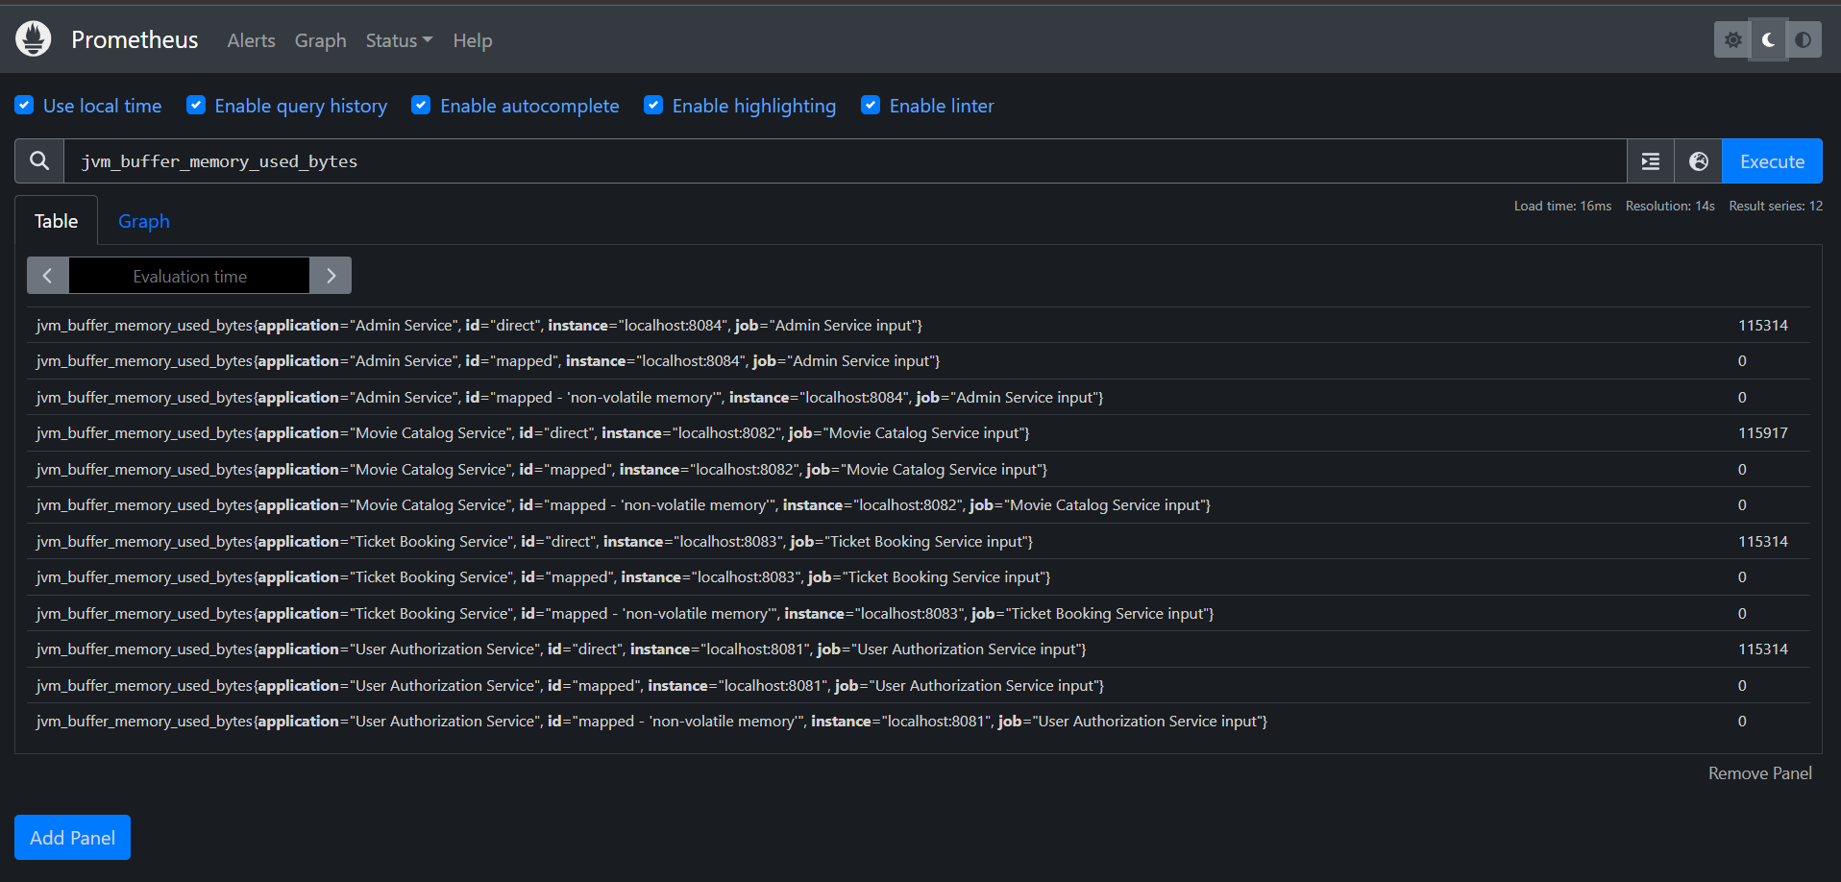
Prometheus For JVM Based Parameters Monitoring

Slide 22
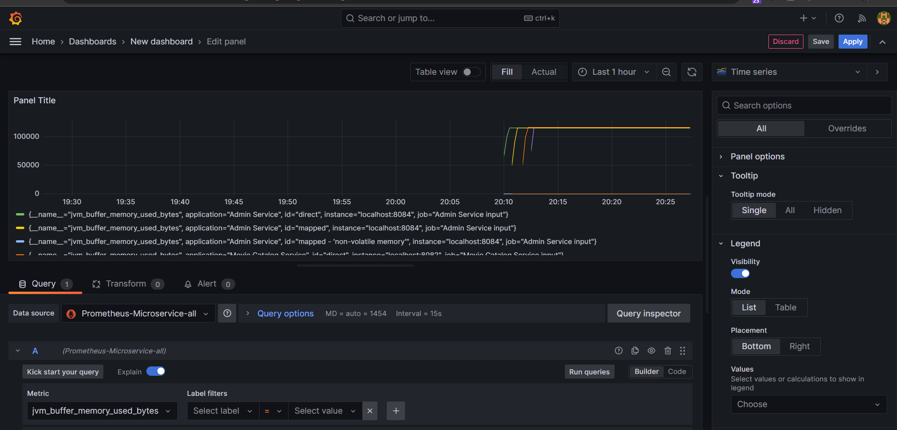
Grafana For Visualizing Prometheus

Slide 23
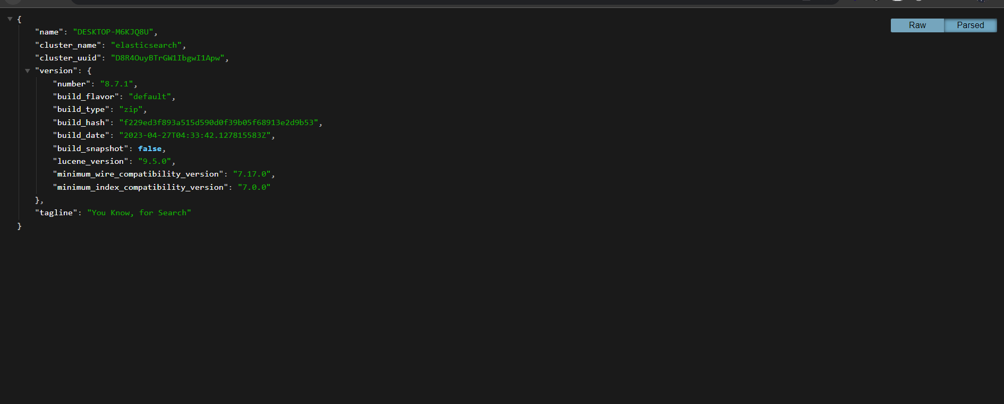
ElasticSearch For Storing All The logs

Slide 24
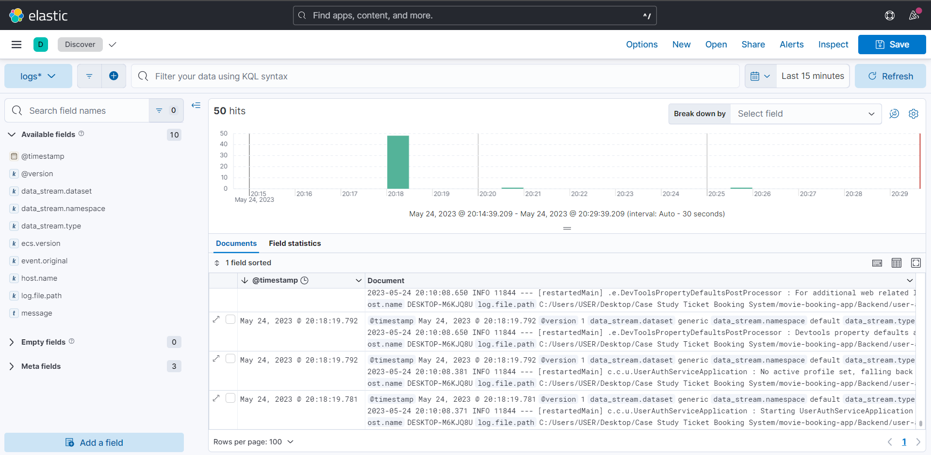
Kibana For Centralized Logging Visualization

Slide 25
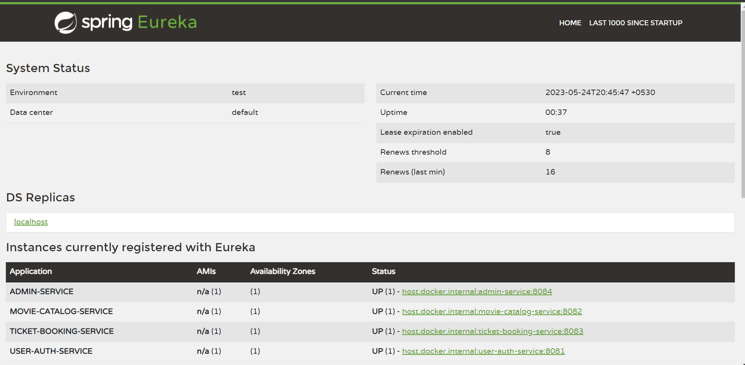
Spring Cloud For Service Discovery

Slide 26
Unit Testing:-
Unit testing is one of the most important task for any application
I have performed unit testing for the service and controller layer
So we will look into each of the microservices and unit tests associated with them

Slide 27
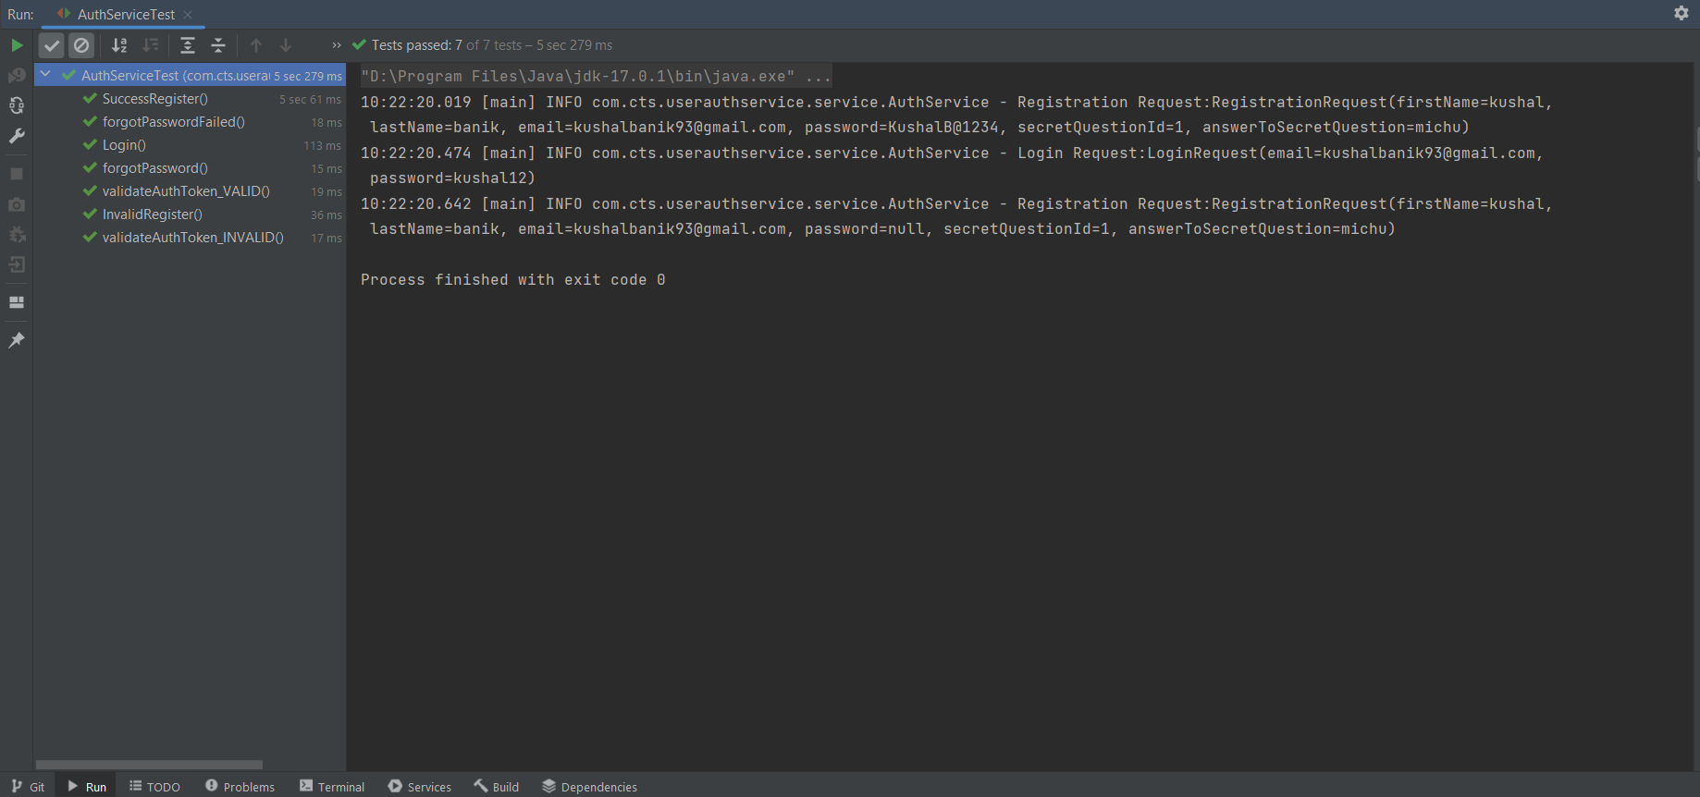
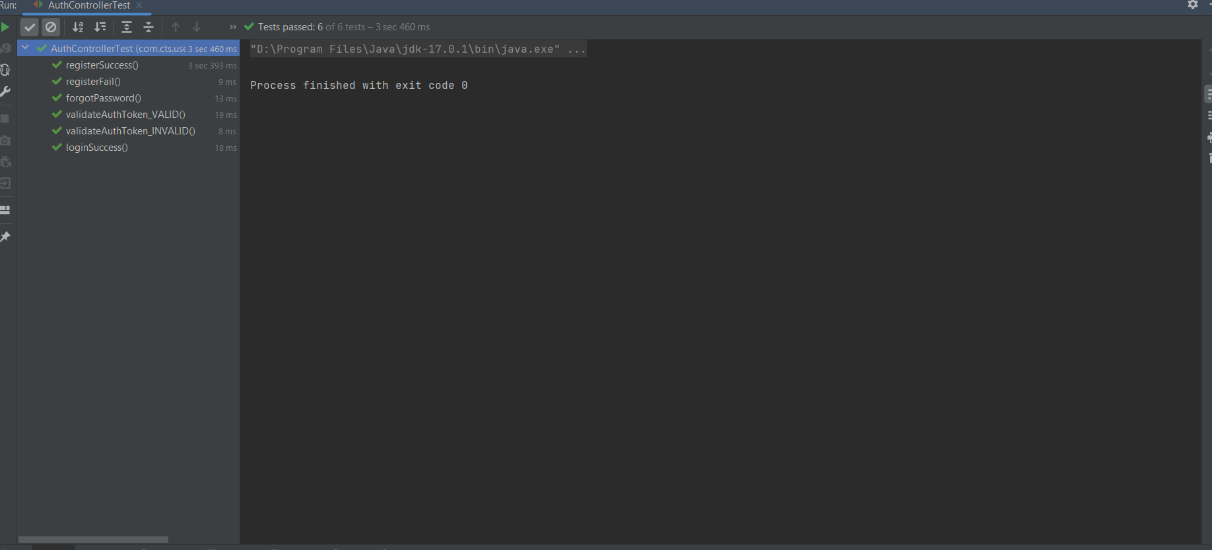
Authentication Microservice:-

Slide 28
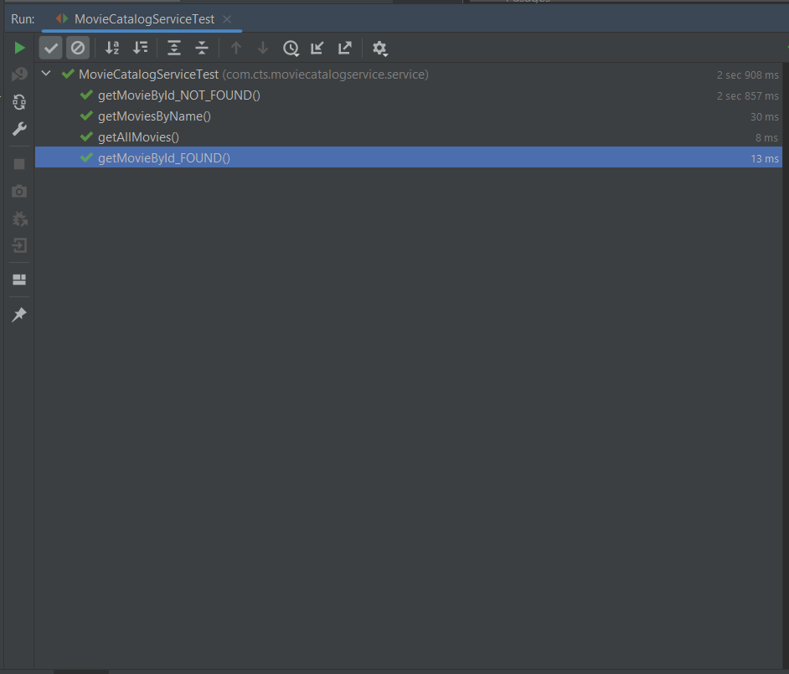
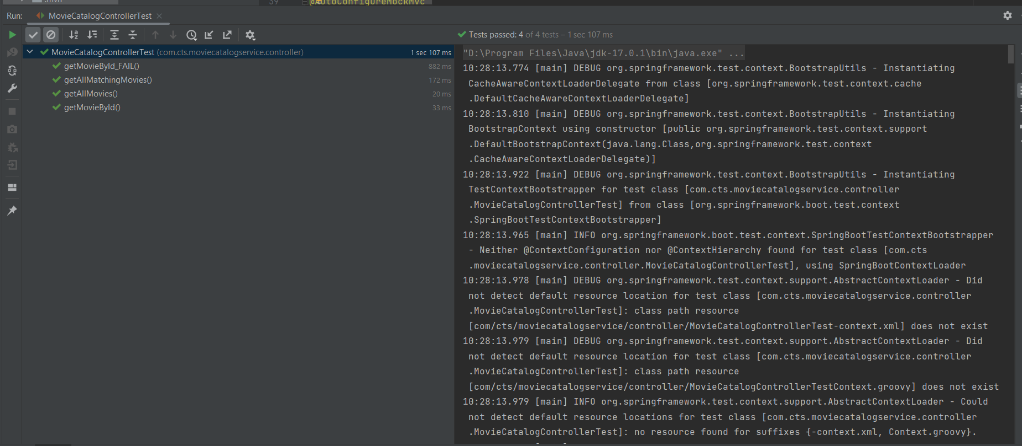
Movie Catalog Service Tests

Slide 29
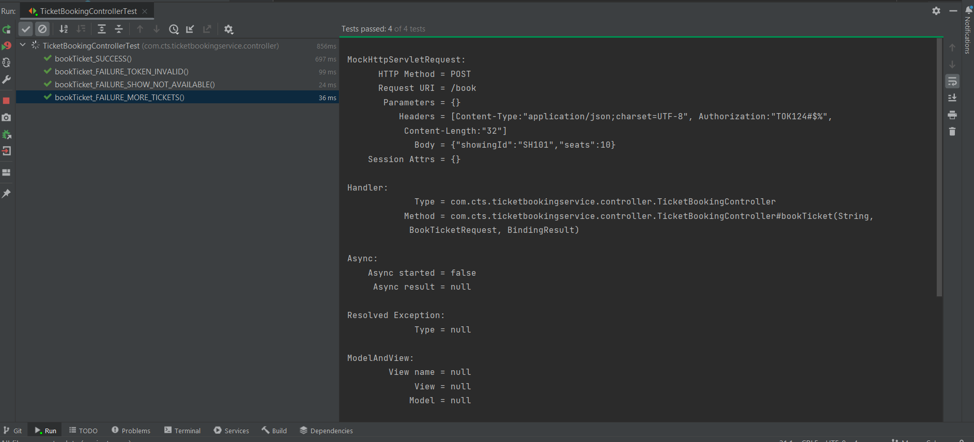
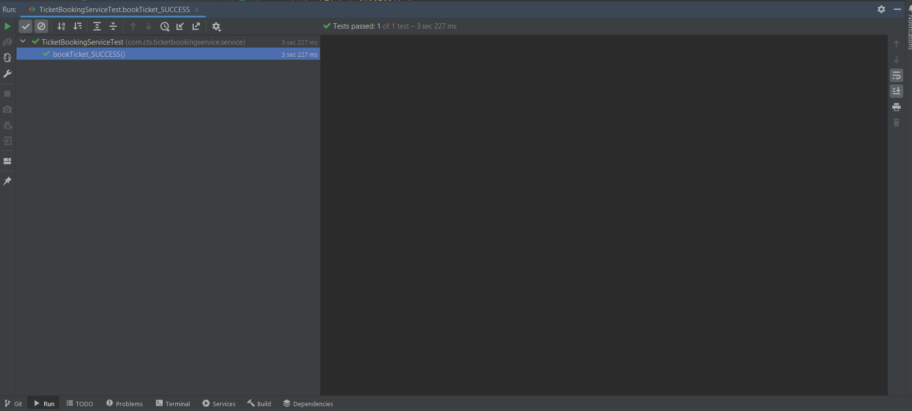
Ticket Booking Microservice:-

Slide 30
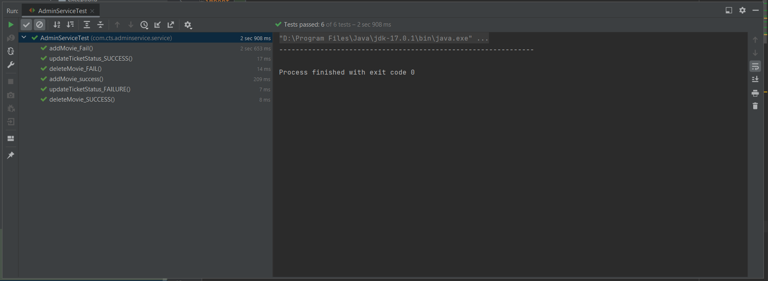
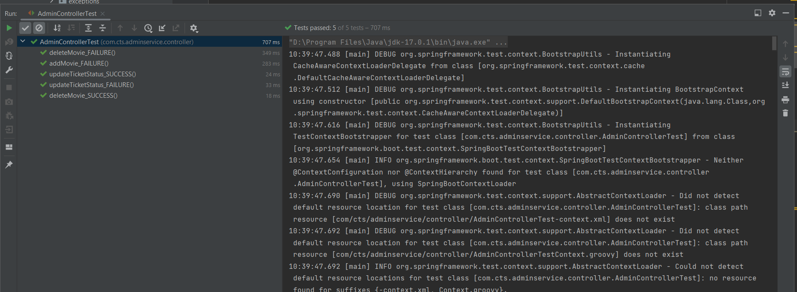
Admin Microservice

Slide 31
Thank You

