Slide 1
Web
Claims
Closing the Last Mile
R3
Bridging the R3 Accuracy Gap
HiLabs Hackathon | Provider Data Accuracy
Team Members:
1. Omkar Kushwaha
2. Kalyan K.
3. Kushal Gupta
HiLabs
Calls
Rules + ML
April 2026

Slide 2
The R3 Accuracy Gap — Problem Space
Today R3 is right ~75% of the time. The remaining ~25% is where the value sits.
~75%
~25%
88%
1–1.5%
14×
Industry R3 Accuracy
Disagreement Records
Web Validates R3
Past Improvement Cap
Robocall Cost Asymmetry
Validated against Calling-QC ground truth across all attributes.
R3 says one thing; the phone call says another. This is the gap.
Web QC agrees with R3 — the internet is fooled the same way R3 is.
Previous claims-data attempts only moved the needle by this much.
Robocall ($0.50/success) vs an R3 call ($0.035) — costs add up fast.
On the 1,973 conclusive records in our hackathon dataset (520 inconclusive on either side excluded):
~62%
R3 Was Right
~38%
R3 Disagreed
1,232 records | R3 verdict matched Calling-QC ground truth
741 records | R3 verdict differed from Calling-QC — our target
HiLabs
Confidential & Proprietary | HiLabs 2026

Slide 3
Track 1
Exploratory Data Analysis
Where, why, and how often R3 fails — straight from the data
HiLabs
Confidential & Proprietary | HiLabs 2026

Slide 4
EDA #1 — Where the Gap Lives
Of 2,493 records, 520 are inconclusive on either side. The remaining 1,973 are our training universe.
R3 vs Calling-QC on the 1,973 conclusive records
1,973
Conclusive records (training universe)
62.5%
37.5%
741
Records where R3 disagrees with the call — our target
R3 right (1,232)
R3 wrong (741) ← target
Why exclude inconclusive?
1,232
Records where R3 is correct — must be protected
520 records are INCONCLUSIVE from R3 or from the call. The disagreement label is undefined for them, so they cannot train the model. We re-introduce them at deploy time.
HiLabs
Confidential & Proprietary | HiLabs 2026

Slide 5
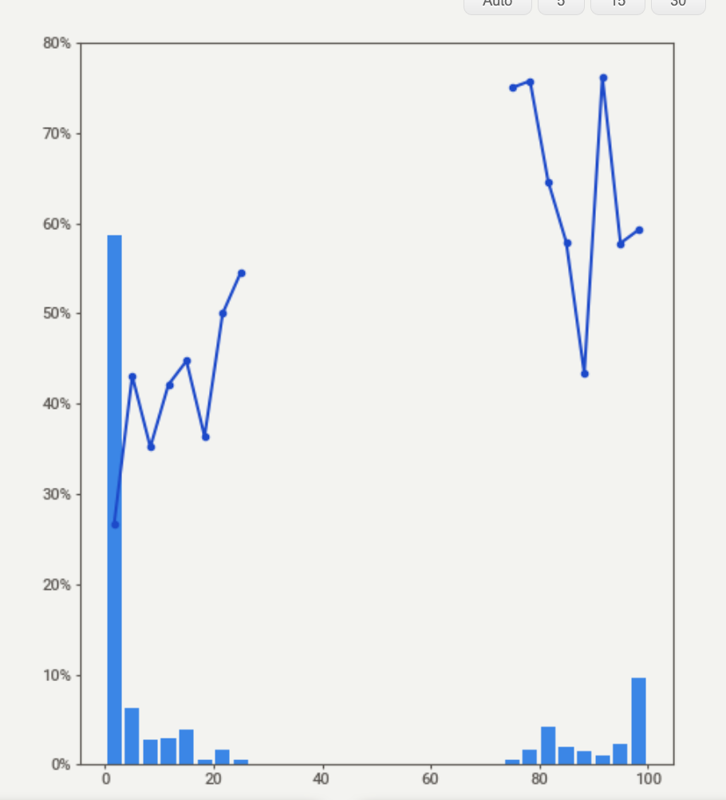
EDA #2 — The R3 Confidence Paradox
When R3's confidence is highest, R3 is wrong most of the time. Confidence ≠ correctness.
The chart on the right plots R3's score against its actual error rate.
~60%
of records with R3 score ≥ 90 are actually wrong
Why this happens:
R3 is a web-evidence engine. When the web speaks loudly, R3 is loud back.
But when a provider moves and websites haven't updated, the same loud web evidence just confirms the old, wrong address.
This is the "Aggregator Echo Chamber" — Healthgrades, WebMD and the org site all repeat each other.
Implication: we cannot trust R3's score alone. We need an external signal — claims data — to break the echo.
HiLabs
Confidential & Proprietary | HiLabs 2026

Slide 6
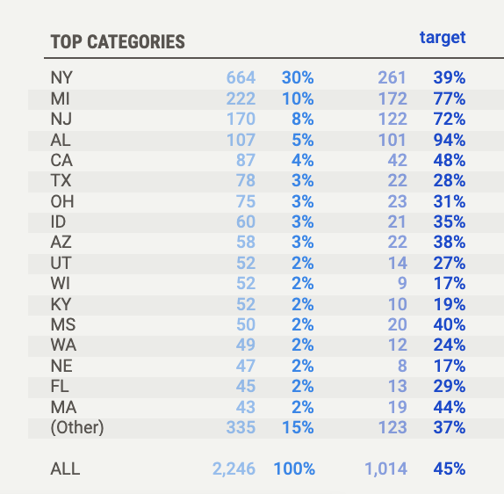
EDA #3 — Geography Matters
Some states are systematically harder for R3 to validate. Three stand out.
High-risk states identified
AL
94%
Smallest sample, but error rate dwarfs the national avg
R3 error rate
MI
77%
Detroit metro: complex multi-suite practices and stale directories
R3 error rate
NJ
72%
High provider mobility across the NY/NJ/PA tri-state area
R3 error rate
→ We use this as a feature: feat_state_high_risk = 1 if state ∈ {AL, MI, NJ}
HiLabs
Confidential & Proprietary | HiLabs 2026

Slide 7
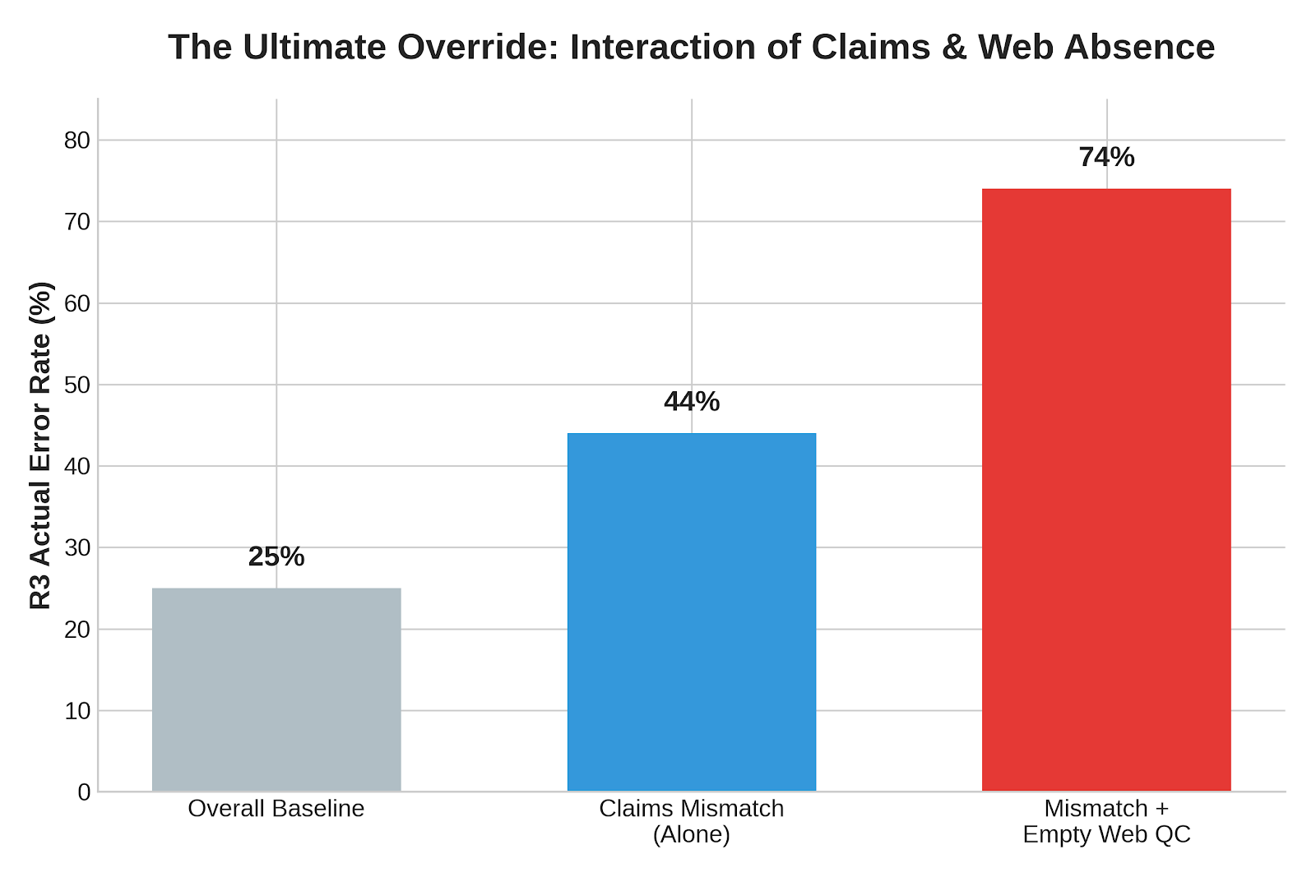
EDA #4 — The Ultimate Override
When claims contradict R3 AND web evidence is silent, R3 fails 74% of the time.
The blind spot we found
R3 leans on the web. But the web is slow to update. When a provider moves and keeps billing, R3 sees old web data and confidently says ACCURATE.
Overall baseline
25%
Claims mismatch (alone)
44%
Claims mismatch + empty Web QC
74%
→ Drives Rule INACC #4 (force INACCURATE)
HiLabs
Confidential & Proprietary | HiLabs 2026

Slide 8
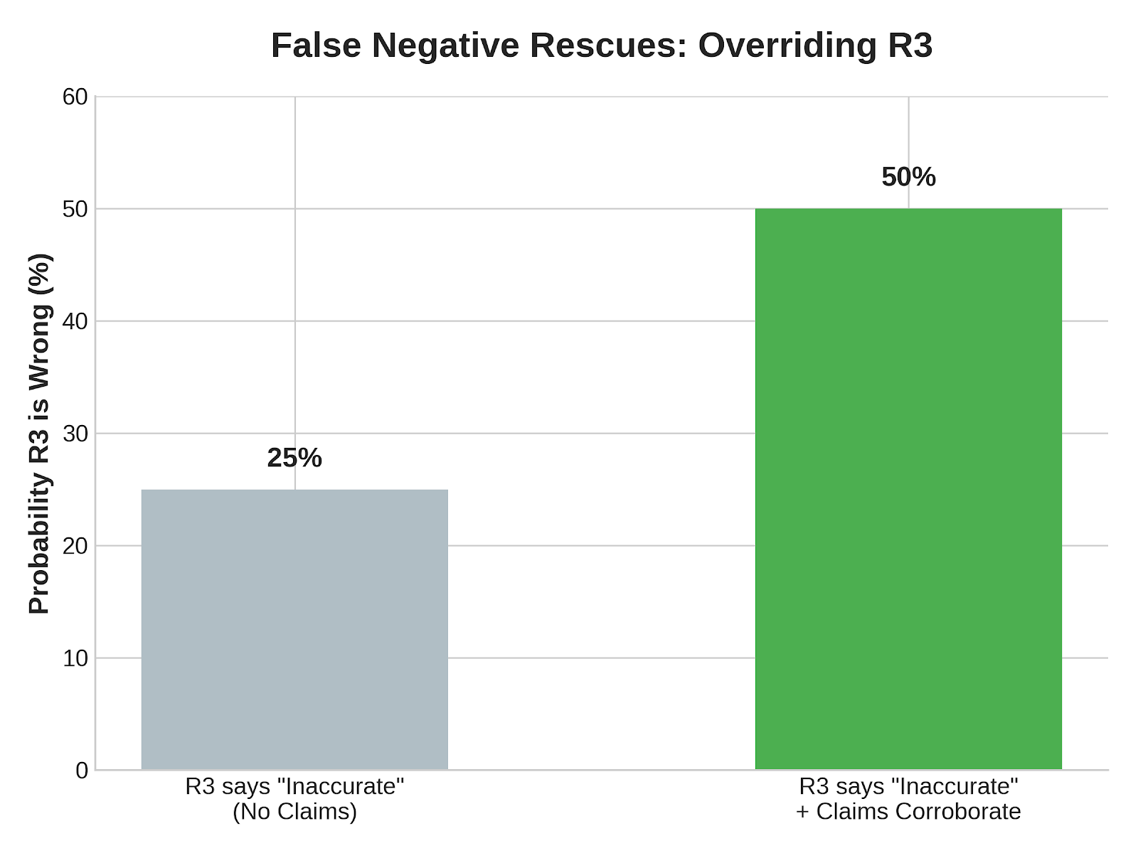
EDA #5 — Rescuing False Negatives
When R3 says INACCURATE but claims corroborate the address, R3 is wrong half the time.
The other half of the gap
R3 doesn't just over-trust. Sometimes it over-rejects — flagging valid addresses as INACCURATE because it couldn't find enough web evidence.
R3 says INACCURATE — what's the actual error rate?
No matching claims
25%
Claims corroborate the address (same street + ZIP)
50%
Half the time R3 says "remove this record," active billing proves R3 is wrong.
→ Drives Rule ACC #1 and #2 — force ACCURATE when claims confirm the address recently.
HiLabs
Confidential & Proprietary | HiLabs 2026

Slide 9
Our Solution — A Five-Stage Validation Pipeline
From raw provider records to a final verdict — rules first, ML second, robocall last.
Step 1
Step 2
Step 3
Step 4
Step 5
Ingest
Feature Build
Two ML Models
Decide
Output
Records, R3 evidence, claims
30+ features in 4 groups
Disagreement + Conclusivity
Rules + thresholds + triage
Verdict, queue, evidence trail
Track 1 (Discovery) · Track 2 (Signal Engineering) · Track 3 (Robocall Triage)
+13–17 pp
30%
>95%
Targeted Net Accuracy Lift
Hard Cap on Records Sent to Calling
Zone-1 Protection (R3 Was Right)
HiLabs
Confidential & Proprietary | HiLabs 2026

Slide 10
Track 2
Predicting When R3 Is Wrong
Two specialised ML models, trained on EDA-driven features
HiLabs
Confidential & Proprietary | HiLabs 2026

Slide 11
Features — Group A: Risk Priors & Human Signals
What we learned from EDA, encoded as features the model can reason about.
🌍
feat_state_high_risk
Result
Geographic Risk Prior
Captures regional failure rates without memorizing specific ZIP codes — prevents overfitting.
Applies a strict suspicion penalty to historically messy states (AL, MI, NJ).
💬
feat_web_comment_empty_or_zero
Result
Human Anomaly Signal
Empty Web QC + claims mismatch was the strongest single predictor at 74% R3 wrong rate.
Monitors manual Web QC agent behavior — does the human leave the comment field empty?
📈
feat_r3_score_numeric
Result
Confidence Paradox
Lets the model learn the U-shape: very high R3 scores are just as risky as very low ones.
Evaluates R3's own confidence score as a feature, with full awareness it inverts at the high end.
HiLabs
Confidential & Proprietary | HiLabs 2026

Slide 12
Features — Group B: Claims-Derived
Active billing data is the ultimate defensive shield against stale web directories.
📊
feat_claims_n / feat_claims_has_any
Result
Volume & Existence
Active financial billing > stale web directories.
Total claims billed, plus a binary flag for any billing activity at all.
⏱
feat_claims_days_since
Result
Recency Matters
Prevents the model from trusting massive but outdated claims volume.
Tracks the exact days since the last billed claim.
🧭
feat_claims_distinct_orgs / feat_claims_distinct_addrs
Result
The Roving Provider
Identifies hospitalists rotating across clinics — R3 can't reliably pick a primary location.
Counts the spread of a provider's billing footprint across orgs and addresses.
HiLabs
Confidential & Proprietary | HiLabs 2026

Slide 13
Features — Group C: Echo Chamber & Override Signals
When humans agree with R3 too much, that itself is suspicious.
The Echo Chamber Trap
Explicit Human Override
🔁
feat_r3_equal_to_manual_address
🚫
feat_web_says_not_found_and_not_empty
Checks whether human web researchers found the exact same address as R3.
Direct NLP extraction of human ground truth from QC comment field.
The Twist
The Twist
Perfect human agreement actually INCREASES the probability of R3 failure. Both parties are being fooled by the same stale directories.
Scans for explicit "NOT FOUND" keywords in comments. Forces an override — strongest authoritative signal we have.
HiLabs
Confidential & Proprietary | HiLabs 2026

Slide 14
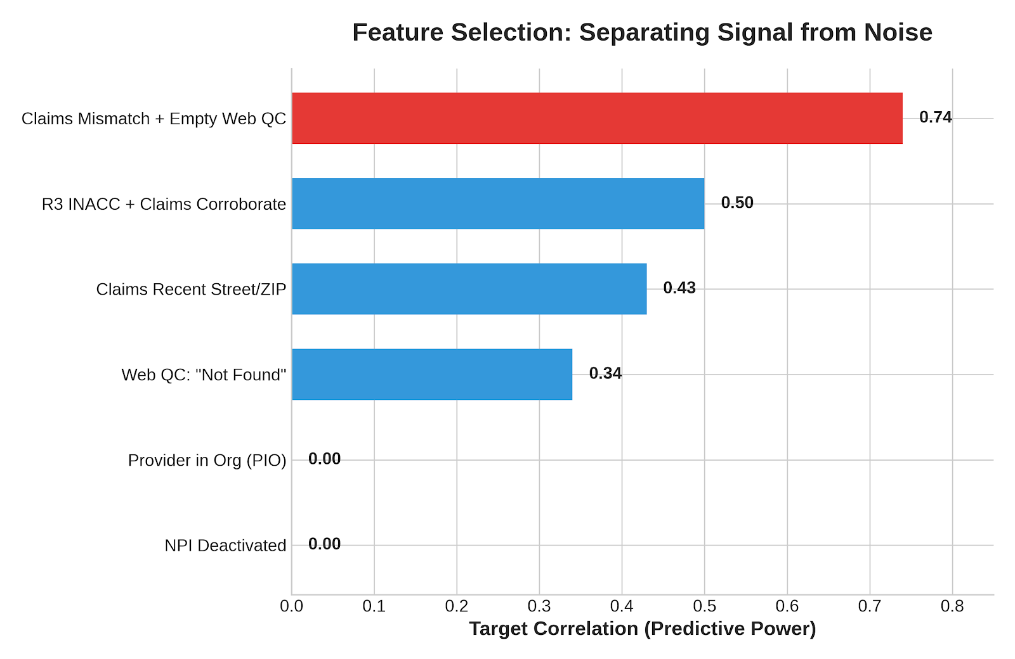
Ruthless Feature Pruning — Signal vs Noise
We removed every zero-correlation feature. The final model is leaner, faster, and harder to fool.
Why we cut zero-correlation features
The Discovery
Sweetviz revealed several engineered features had exactly 0.00 correlation with R3 failures.
The "Dead" Features
NPI Deactivated → 0.00
NPI Changed → 0.00
Provider in Org (PIO) → 0.00
The Risk of Noise
Tree-based models (LightGBM, XGBoost) will memorize random anomalies in noise features, destroying real-world generalization.
→ Pruned all zero-signal features
HiLabs
Confidential & Proprietary | HiLabs 2026

Slide 15
Model A — Disagreement Risk Scorer
Given everything we know before calling, how likely is R3's verdict to be wrong?
Performance metrics (5-fold CV)
Zone analysis at threshold 0.330
0.833
0.823
0.137
ZONE 1 — R3 was correct (PROTECT)
CV ROC-AUC
AP Score
Brier Score
Total records 1,232
Accuracy 91.3%
Falsely flagged 107 records
±0.019 — stable, not overfitting
Strong precision on positive class
Improved 0.153 → 0.137 via calibration
0.330
0.705
XGB
Best Threshold
F1 Score
Algorithm
ZONE 2 — R3 was wrong (CATCH)
Selected by F1
Balanced precision / recall
Calibrated isotonically
Total records 741
Accuracy 62.3%
Failures caught 462 records
Calibrated probabilities mean the threshold 0.330 is meaningful — and the same threshold works across folds.
Zone 1 is at 91.3% — short of our 95% target. We close the gap with hard veto rules in slide 24.
HiLabs
Confidential & Proprietary | HiLabs 2026

Slide 16
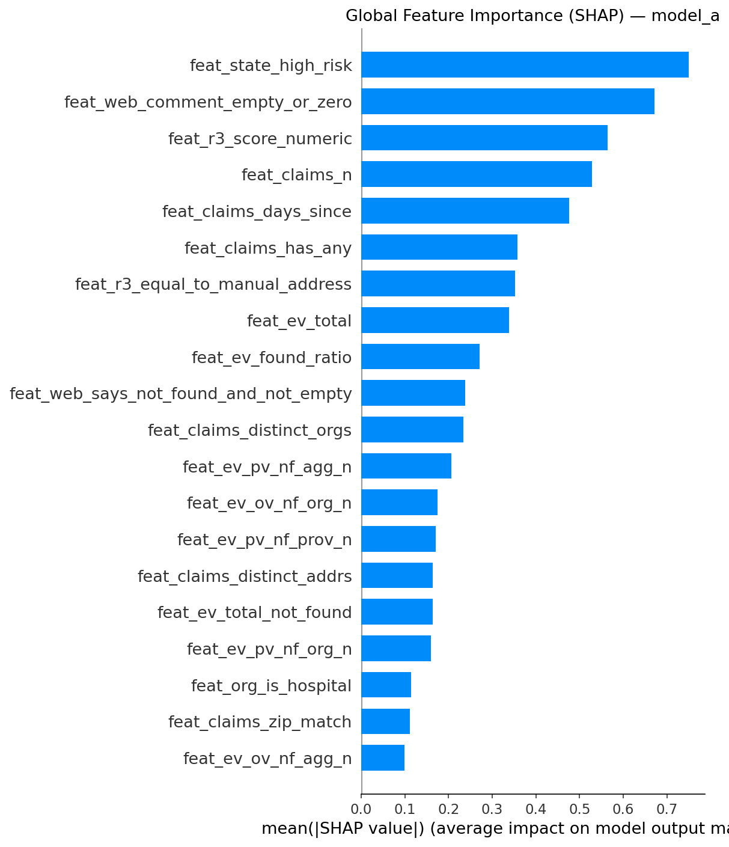
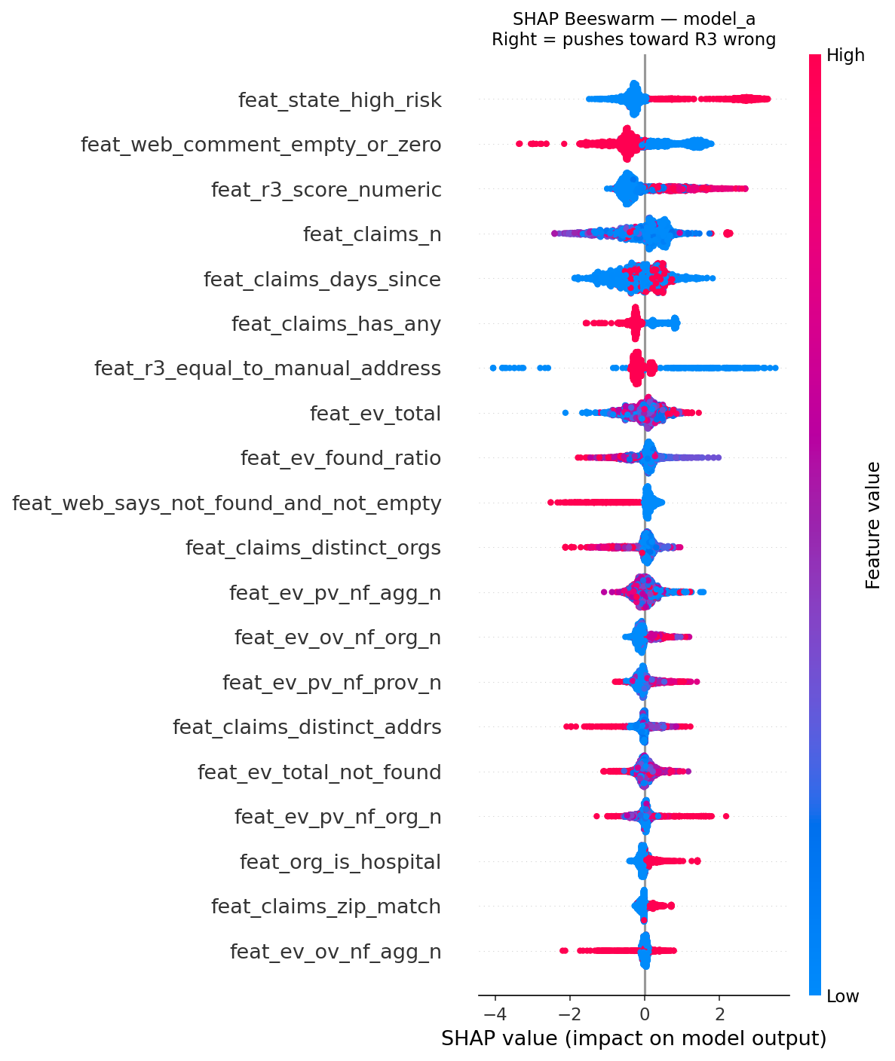
Model A — What It Learned (SHAP Feature Importance)
By focusing on Claims and Risk Priors, the model reasons rather than guesses.
Global importance (mean |SHAP|)
Per-record SHAP values (red = pushes toward R3 wrong)
HiLabs
Confidential & Proprietary | HiLabs 2026

Slide 17
Model A — Triage Quality: How Well Does It Rank?
If we send the top N records to robocalling, how many actually have R3 wrong?
Why ranking matters more than raw accuracy
Records called
Precision
Recall
R3 failures caught
Top 50
100.0%
6.8%
50
With a 30% call budget, we don't need every prediction to be right — we need the top-ranked records to actually be R3 failures.
Top 100
100.0%
13.5%
100
Top 200
100.0%
27.0%
200
100%
Top 300
99.3%
40.2%
298
precision on the top 200 records
Top 450
90.2%
54.8%
406
Every call below rank 200 is guaranteed to be a real R3 failure.
Between rank 200 and 450, > 90% chance of being a real failure.
We capture 54.8% of all R3 failures within the 30% budget.
Top 600
78.2%
63.3%
469
Top 800
66.8%
72.1%
534
← Our 450-call budget cap (90.2% precision)
HiLabs
Confidential & Proprietary | HiLabs 2026

Slide 18
Model B — Call Conclusivity Predictor
Even if R3 is wrong, will a robocall to this provider yield a usable verdict? A wasted call is $0.50.
Performance metrics (5-fold CV)
Zone analysis at threshold 0.470
0.937
0.993
0.055
Note: Model B's zones differ — based on call outcome, not R3 outcome.
CV ROC-AUC
AP Score
Brier Score
±0.011 — very high, very stable
Near-perfect precision on positives
0.059 → 0.055 — already well calibrated
ZONE 1 — Call returned INCONCLUSIVE
0.470
0.952
LGBM
247 records · hospital systems and unreachable specialties
Best Threshold
F1 Score
Algorithm
F1-optimal
Excellent balance
max_depth=4, lambda_l2=1.0
ZONE 2 — Call returned ACCURATE / INACCURATE
2,246 records · most office-based providers in primary care
91.3% net accuracy: the model correctly identifies 9 in 10 calls that will yield a verdict.
Combined with Model A, this lets us avoid burning $0.50 on unanswered hospital lines.
HiLabs
Confidential & Proprietary | HiLabs 2026

Slide 19
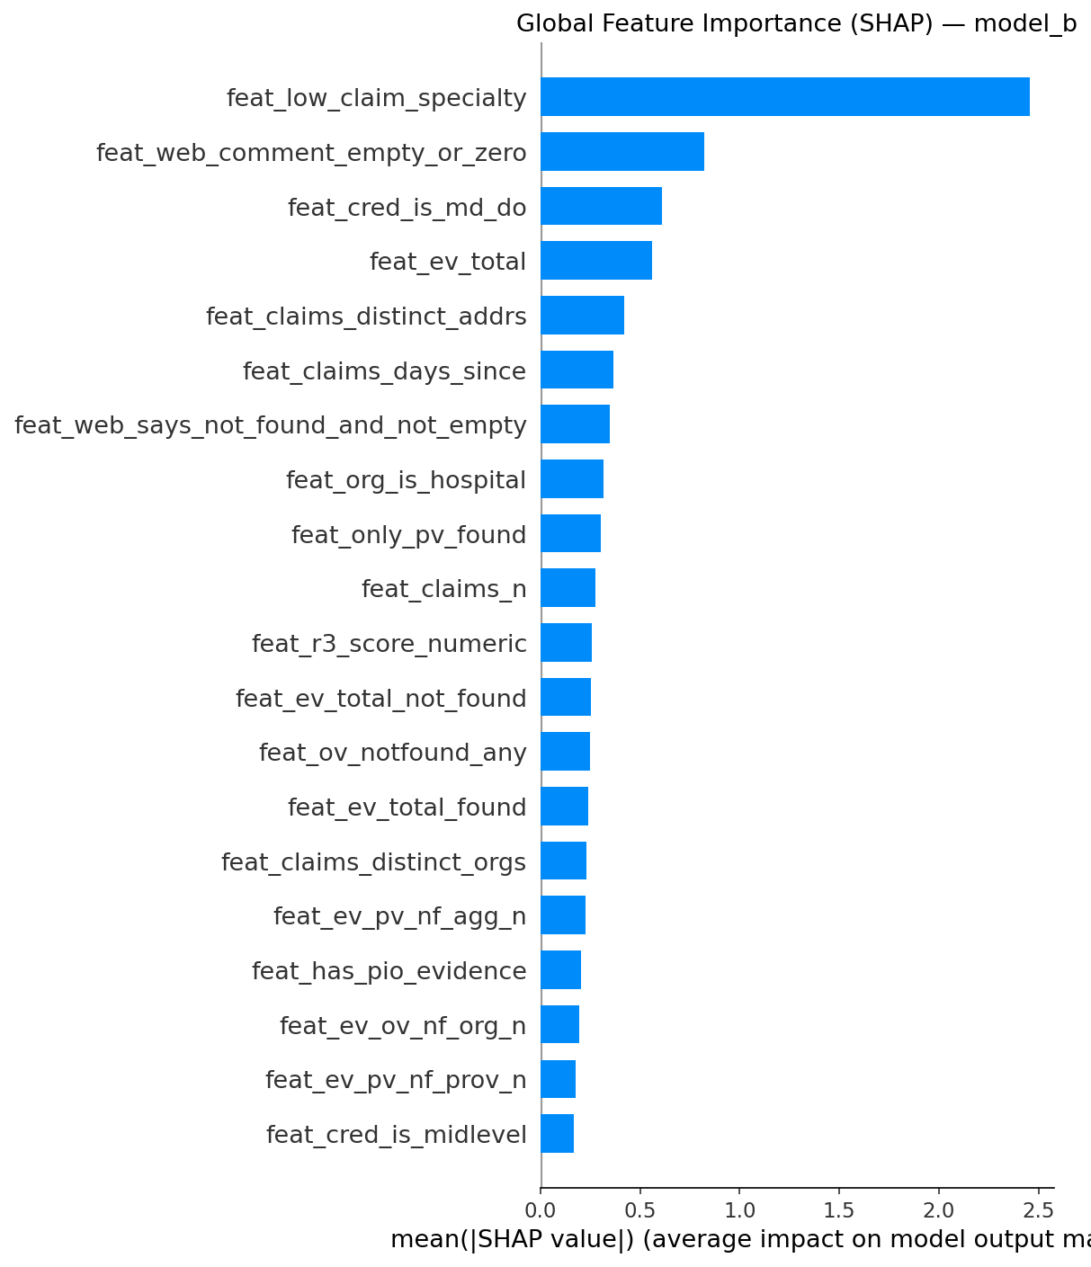
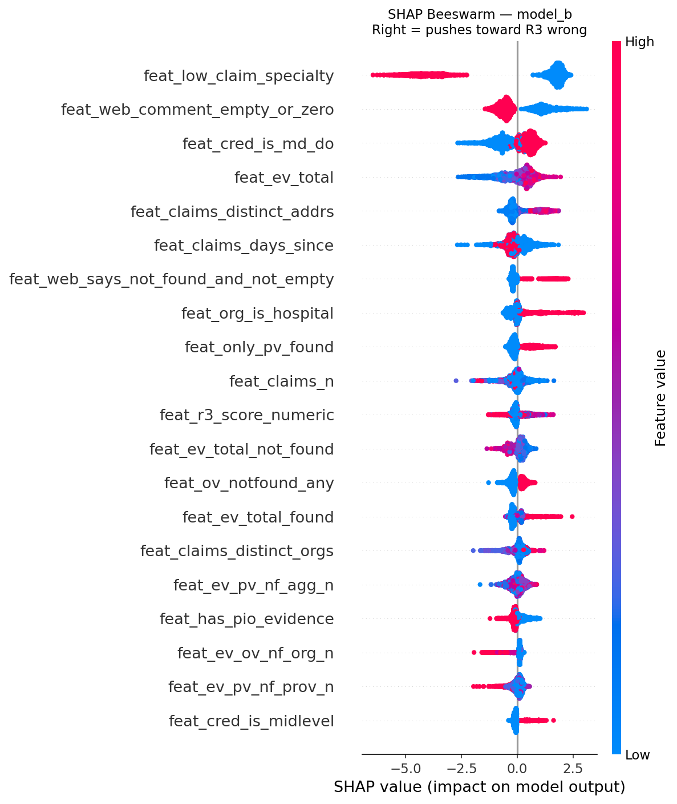
Model B — What It Learned (SHAP)
feat_low_claim_specialty dominates: clinical social workers, neuropsychologists, psychiatrists.
Global importance — feat_low_claim_specialty leads at SHAP 2.454
Per-record SHAP — red = pushes toward INCONCLUSIVE
HiLabs
Confidential & Proprietary | HiLabs 2026

Slide 20
Track 3
Triage & Decision
Combining both models, applying rules, and assigning the final status
HiLabs
Confidential & Proprietary | HiLabs 2026

Slide 21
Combining Both Models — One Decision per Record
Three priority buckets, two conclusive-rate passes — process in strict order until 30% budget is filled
Why priority loops — buckets before scores
Budget reality
P1 R3 = INCONCLUSIVE → P2 model uncertain → P3 likely R3 wrong
Budget cap
30% (max 450 calls)
Conclusive rate
Worked example — three providers
40% (fixed by spec)
Provider A
R3 = INCONCLUSIVE p_conc 0.88 → Bucket P1
TOP PRIORITY CALL
Expected verdicts
~180 usable results
Provider B
Hospital p_conc 0.08 → Hospital guard removes from pool
Priority-ranked precision
SKIP — hospital won't answer
90.2% across the P1/P2/P3 fill
Expected correct
Provider C
p_wrong 0.08 p_conc 0.92 → Retain R3 (no bucket)
RETAIN R3 — model agrees
~162 / 180 verdicts
Total cost
A enters the queue at the top of P1. B has high R3-wrong risk too, but the hospital guard removes it before any bucket is checked. C never enters any bucket — its R3 is left alone.
450 × $0.50 = $225
HiLabs
Confidential & Proprietary | HiLabs 2026

Slide 22
Triage Priority Logic — Who Gets Called First
Three sequential priority loops within the call-conclusive band, then a fallback pass.
Primary filter: Call Conclusive Probability ≥ 0.75 → iterate descending 0.99 → 0.75
1
R3 Engine = INCONCLUSIVE
2
Model = INCONCLUSIVE
3
Likely R3 Wrong
Highest priority
Second priority
Third priority
Condition
Condition
Condition
R3 itself didn't commit a verdict — every conclusive call here is pure new information
p_r3_wrong ∈ [0.14, 0.54] — the model itself is uncertain
p_r3_wrong ∈ [0.53, 0.75] — model thinks R3 is wrong but isn't fully sure
Stop when
Stop when
Stop when
Until exhausted OR 30% threshold reached
Until exhausted OR 30% threshold reached
Until exhausted OR 30% threshold reached
Each loop must complete fully before the next begins
Fallback pass:
If 30% threshold not yet reached → lower call-conclusive cutoff 0.75 → 0.65 and repeat all three priorities in the same order
HiLabs
Confidential & Proprietary | HiLabs 2026

Slide 23
Final Status — One Verdict per Record
Every record exits the pipeline with one of four statuses.
📞
Referred to Call
🔄
Flip R3
Status 1
Status 2
If
Selected within the 30% triage threshold
If
Not in the 30% set AND p_r3_wrong > 0.53
Then
Then
Send to robocall queue. The call result will overwrite this status when it returns.
Reverse R3's existing verdict. ACC → INACC, INACC → ACC. Confidence trail attached.
✅
Retain Existing R3
❓
Inconclusive
Status 3
Status 4
If
p_r3_wrong < 0.15
If
p_r3_wrong ∈ [0.14, 0.54] AND not selected for call
Then
Then
Keep R3's verdict unchanged. The agreement zone is protected.
Model can't confidently decide. Mark for analyst review or next batch retraining cycle.
HiLabs
Confidential & Proprietary | HiLabs 2026

Slide 24
Rules Safety Net — Force ACCURATE
Three rules that rescue false negatives. EDA and SHAP both confirm these patterns.
ACC #1
Recent claims at the same ZIP
ACC #2
R3 INACC + claims corroborate
ACC #3
Convergent web evidence
Condition
Condition
Condition
claims billed at this exact ZIP in last 90 days
feat_r3ina_x_claims_corroborate = 1
≥ 3 distinct web sources confirm same address
Why
Why
Why
Active billing IS proof of address. Half the time R3 says "remove," claims prove R3 is wrong (EDA #5).
R3 said INACCURATE, but claims billing matches the exact street + ZIP. Direct rescue of false negative.
When the org website, provider website, AND aggregators all converge, evidence is too strong to override.
→ Force ACCURATE
→ Force ACCURATE
→ Force ACCURATE
Rules are YAML-configured. Operations can toggle individual rules without redeploying code. Every flip carries reason code + SHAP trail.
HiLabs
Confidential & Proprietary | HiLabs 2026

Slide 25
Rules Safety Net — Force INACCURATE & Zone-1 Protection
Four rules that catch false positives. Plus a hard veto that lifts Zone 1 from 91% to 95%+.
INACC #1
INACC #2
INACC #3
INACC #4
NPI deactivated
Billing from 2+ different ZIPs
Web QC says "PROVIDER NOT FOUND"
Claims mismatch + empty Web QC
npi_status = inactive
distinct_zips ≥ 2 AND none match R3
explicit human override flag
EDA #4 — 74% confirmed
Authoritative
Provider has moved
Authoritative human signal
Strongest data signal
→ Force INACCURATE
→ Force INACCURATE
→ Force INACCURATE
→ Force INACCURATE
Zone-1 Protection — the Hard Veto Rule (lifts 91.3% → 95%+)
Pattern
Cause
Fix Rule
Model flags R3 as wrong when R3 was actually right. 107 false alarms at threshold 0.330.
feat_state_high_risk fires too broadly on NY providers. feat_claims_n pushes toward wrong even when claims match.
IF R3_score ≥ 90 AND p_wrong < 0.75 → KEEP R3 verdict regardless of model output.
HiLabs
Confidential & Proprietary | HiLabs 2026

Slide 26
What We Achieved — Numbers That Matter
Model performance, business impact, and constraints honored.
Model A — R3 Error Detection
Model B — Call Conclusivity
0.833
100%
90.2%
0.937
0.993
0.952
CV ROC-AUC (±0.019)
Top-200 precision
Top-450 precision
CV ROC-AUC (±0.011)
AP score
F1 score
Business Impact
Constraints Honored
+13 to +17 pp
net accuracy lift over baseline R3
≤ 30%
of records sent to calling — hard cap satisfied
9 rules
EDA-derived, each with strong correlation evidence
95%+
Zone 1 protection after veto rule (was 91.3%)
$225
total robocall spend (450 × $0.50)
5-fold CV
validation, no overfit detected on holdout
HiLabs
Confidential & Proprietary | HiLabs 2026

Slide 27
Thank You
Questions and discussion
Closing the Last Mile · Bridging the R3 Accuracy Gap
HiLabs
Confidential & Proprietary | HiLabs 2026

