Slide 1
Web
Claims
Closing the Last Mile
R3
Bridging the R3 Accuracy Gap
HiLabs Hackathon | Provider Data Accuracy
Team Members:
1. Omkar Kushwaha
2. Kalyan K.
3. Kushal Gupta
HiLabs
Calls
Rules + ML
April 2026

Slide 2
The R3 Accuracy Gap — Problem Space
Today R3 is right ~75% of the time. The remaining ~25% is where the value sits.
~75%
~25%
88%
1–1.5%
14×
Industry R3 Accuracy
Disagreement Records
Web Validates R3
Past Improvement Cap
Robocall Cost Asymmetry
Validated against Calling-QC ground truth across all attributes.
R3 says one thing; the phone call says another. This is the gap.
Web QC agrees with R3 — the internet is fooled the same way R3 is.
Previous claims-data attempts only moved the needle by this much.
Robocall ($0.50/success) vs an R3 call ($0.035) — costs add up fast.
On the 1,973 conclusive records in our hackathon dataset (520 inconclusive on either side excluded):
~62%
R3 Was Right
~38%
R3 Disagreed
1,232 records | R3 verdict matched Calling-QC ground truth
741 records | R3 verdict differed from Calling-QC — our target
HiLabs
Confidential & Proprietary | HiLabs 2026

Slide 3
Our Solution — A Five-Stage Validation Pipeline
From raw provider records to a final verdict — rules first, ML second, robocall last.
Step 1
Step 2
Step 3
Step 4
Step 5
Ingest
Feature Build
Two ML Models
Decide
Output
Records, R3 evidence, claims
30+ features in 4 groups
Disagreement + Conclusivity
Rules + thresholds + triage
Verdict, queue, evidence trail
Track 1 (Discovery) · Track 2 (Signal Engineering) · Track 3 (Robocall Triage)
HiLabs
Confidential & Proprietary | HiLabs 2026

Slide 4
Track 1
Exploratory Data Analysis
Where, why, and how often R3 fails — straight from the data
HiLabs
Confidential & Proprietary | HiLabs 2026

Slide 5
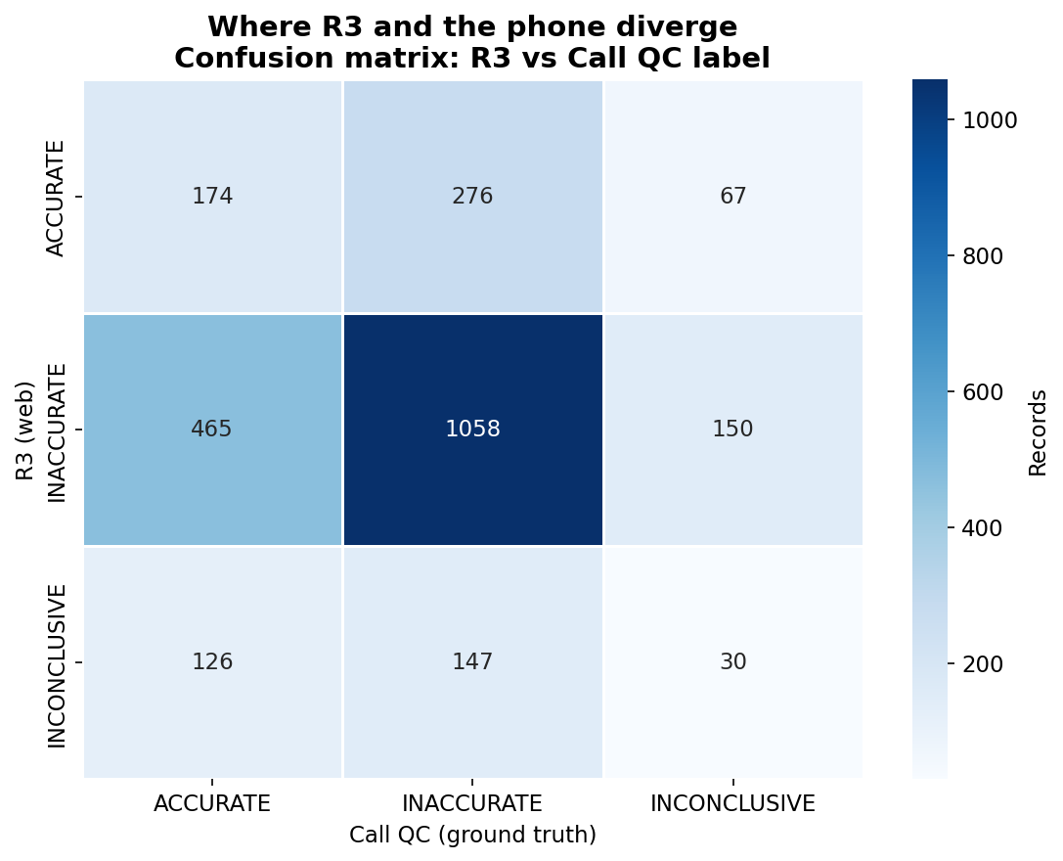
EDA #1 — Where R3 and the phone diverge
The confusion matrix vs Calling-QC ground truth: agreement sits on the diagonal, the gap sits off it.
WHAT THE DATA SHOWS
465
records R3 removed that the phone says are ACCURATE (false removals)
276
records R3 kept that the phone says are INACCURATE (missed-bad)
741 of 1,973 conclusive records disagree — this is our target.
HiLabs
Confidential & Proprietary | HiLabs 2026

Slide 6
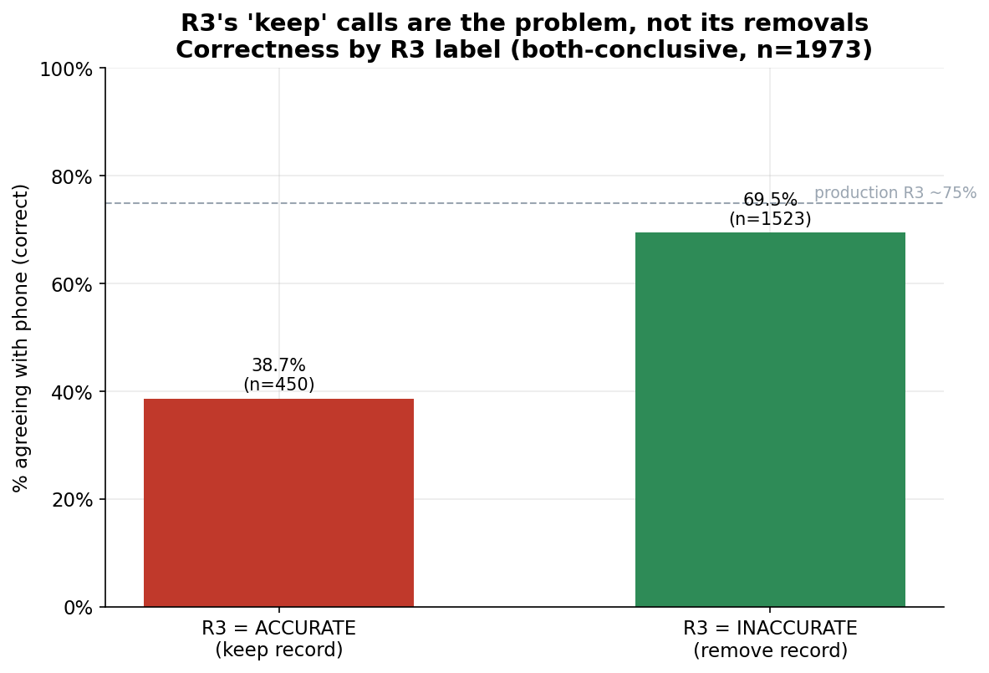
EDA #2 — R3's “keep” calls are the weak spot
When R3 says ACCURATE it is right far less often than when it says INACCURATE.
WHAT THE DATA SHOWS
38.7%
R3 correct when it says ACCURATE / keep (n=450)
69.5%
R3 correct when it says INACCURATE / remove (n=1,523)
R3's removals are trustworthy; its keeps are not.
HiLabs
Confidential & Proprietary | HiLabs 2026

Slide 7
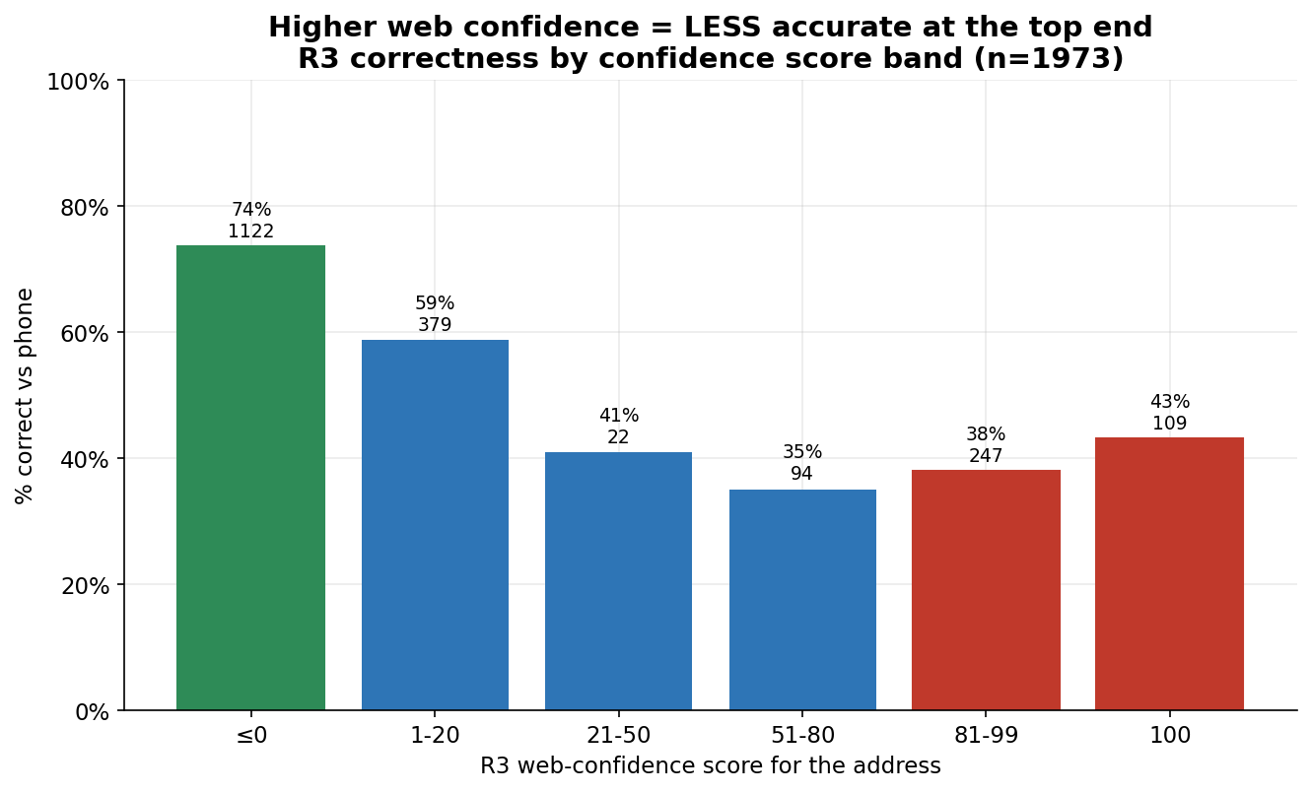
EDA #3 — Higher web-confidence, lower accuracy
R3's confidence score inverts at the top end: the loudest web evidence is the least reliable.
WHAT THE DATA SHOWS
43%
correct at web-confidence score = 100 (n=109)
74%
correct at web-confidence score ≤ 0 (n=1,122)
We cannot trust R3's score alone — we need an external signal.
HiLabs
Confidential & Proprietary | HiLabs 2026

Slide 8
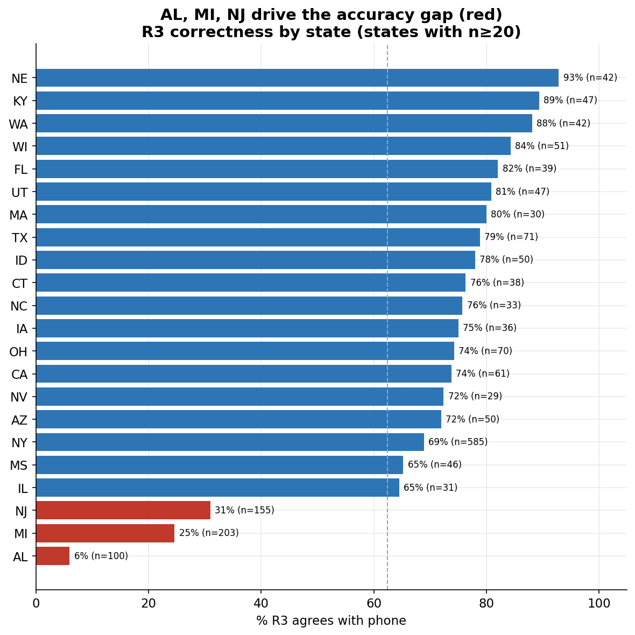
EDA #4 — Three states drive the accuracy gap
R3 agreement collapses in AL, MI and NJ, far below the >88% seen in the best states.
WHAT THE DATA SHOWS
6%
R3 agrees with phone in AL (n=100)
25%
MI (n=203)
31%
NJ (n=155)
→ feature: feat_state_high_risk = 1 if state ∈ {AL, MI, NJ}
HiLabs
Confidential & Proprietary | HiLabs 2026

Slide 9
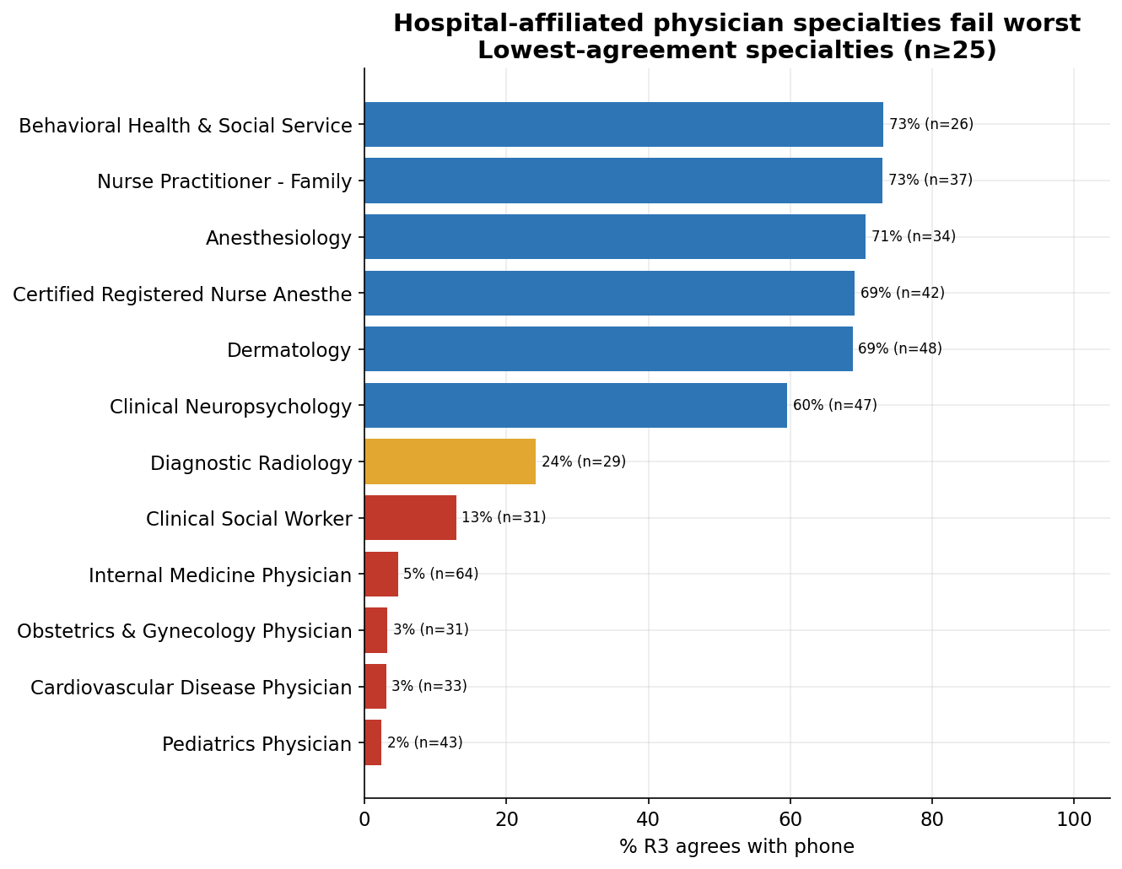
EDA #5 — Hospital-affiliated specialties fail worst
Specialties that rotate across sites break web validation — agreement falls to single digits.
WHAT THE DATA SHOWS
2%
Pediatrics (n=43)
3%
Cardiology / OB-GYN (n=33 / 31)
5%
Internal Medicine (n=64)
→ feature: is_hospital_affiliated_specialty
HiLabs
Confidential & Proprietary | HiLabs 2026

Slide 10
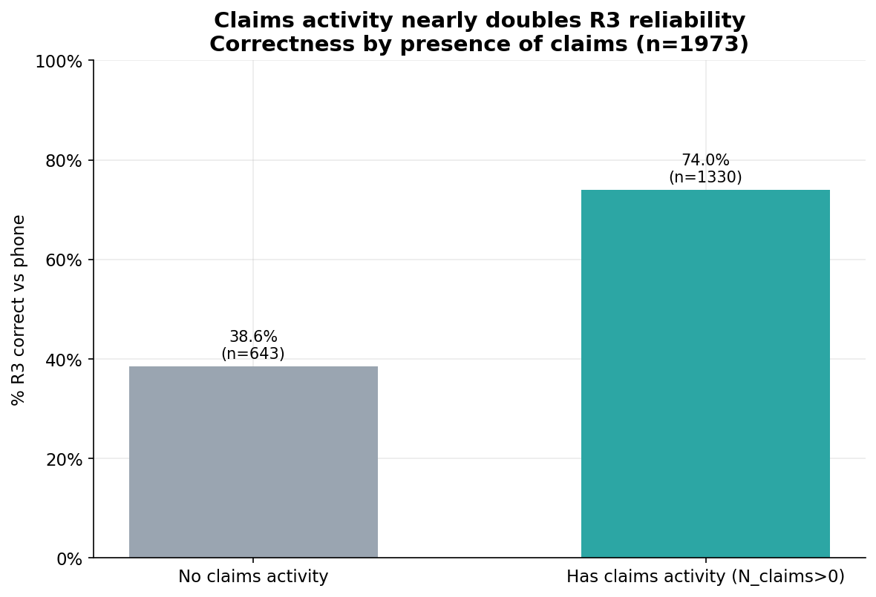
EDA #6 — Claims presence nearly doubles reliability
Any active billing activity makes R3 far more likely to agree with the phone.
WHAT THE DATA SHOWS
74.0%
R3 correct when the provider has claims (n=1,330)
38.6%
R3 correct with no claims activity (n=643)
Claims presence is the cheapest passive signal we have.
HiLabs
Confidential & Proprietary | HiLabs 2026

Slide 11
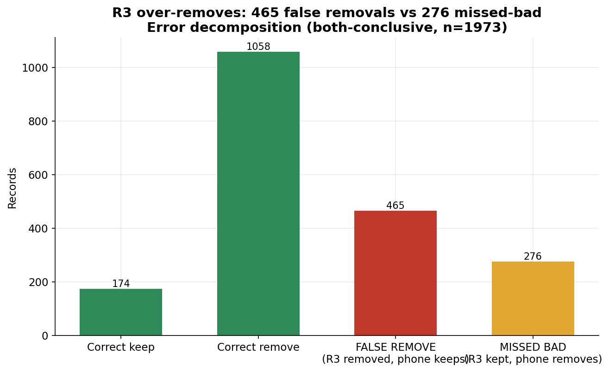
EDA #7 — R3 over-removes
Decomposing the 741 errors: R3 is biased toward deleting records rather than keeping them.
WHAT THE DATA SHOWS
465
false removals (R3 removed, phone keeps)
276
missed-bad (R3 kept, phone removes)
The correction strategy must protect valid records first.
HiLabs
Confidential & Proprietary | HiLabs 2026

Slide 12
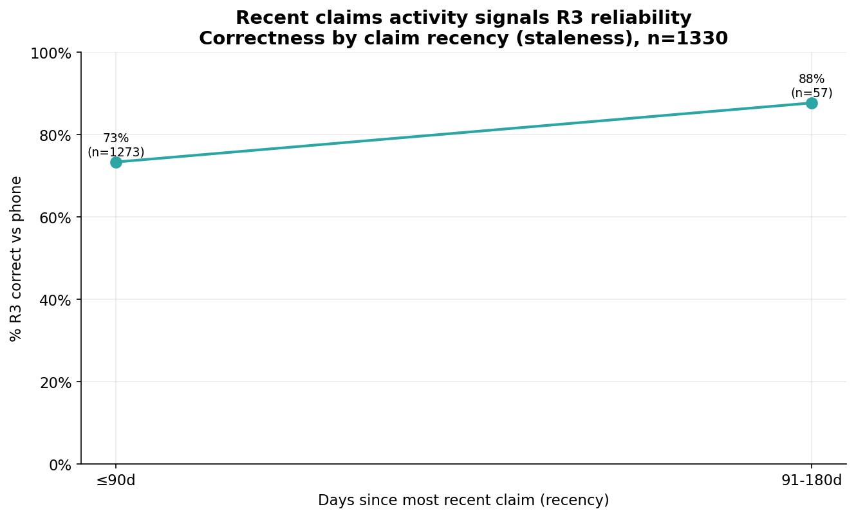
EDA #8 — Recent claims signal a fresh address
Records with recent billing stay well above the ~62% baseline, motivating a staleness score.
WHAT THE DATA SHOWS
73%
correct when last claim ≤ 90 days (n=1,273)
88%
correct at 91–180 days (small n=57)
→ days-since-claim staleness feature, anchored to the 2026-04-30 data pull.
HiLabs
Confidential & Proprietary | HiLabs 2026

Slide 13
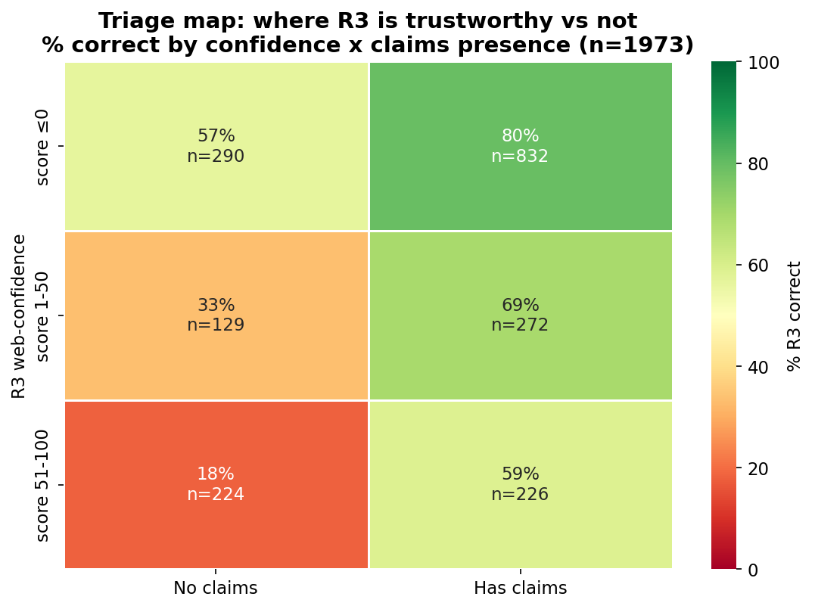
EDA #9 — Triage map: where R3 is (un)trustworthy
Crossing web-confidence with claims presence isolates the confidently-wrong danger zone.
WHAT THE DATA SHOWS
18%
correct: high confidence + no claims (n=224) — call these first
80%
correct: low confidence + has claims (n=832)
→ bridges to Track 3 robocall triage.
HiLabs
Confidential & Proprietary | HiLabs 2026

Slide 14
Our Solution — A Five-Stage Validation Pipeline
From raw provider records to a final verdict — rules first, ML second, robocall last.
Step 1
Step 2
Step 3
Step 4
Step 5
Ingest
Feature Build
Two ML Models
Decide
Output
Records, R3 evidence, claims
30+ features in 4 groups
Disagreement + Conclusivity
Rules + thresholds + triage
Verdict, queue, evidence trail
Track 1 (Discovery) · Track 2 (Signal Engineering) · Track 3 (Robocall Triage)
30%
Hard Cap on Records Sent to Calling
HiLabs
Confidential & Proprietary | HiLabs 2026

Slide 15
Track 2
Predicting When R3 Is Wrong
Two specialised ML models, trained on EDA-driven features
HiLabs
Confidential & Proprietary | HiLabs 2026

Slide 16
Features — Group A: Risk Priors & Human Signals
What we learned from EDA, encoded as features the model can reason about.
🌍
feat_state_high_risk
Result
Geographic Risk Prior
Captures regional failure rates without memorizing specific ZIP codes — prevents overfitting.
Applies a strict suspicion penalty to historically messy states (AL, MI, NJ).
📈
feat_r3_score_numeric
Result
Confidence Paradox
Lets the model learn the U-shape: very high R3 scores are just as risky as very low ones.
Evaluates R3's own confidence score as a feature, with full awareness it inverts at the high end.
HiLabs
Confidential & Proprietary | HiLabs 2026

Slide 17
Features — Group B: Claims-Derived
Active billing data is the ultimate defensive shield against stale web directories.
📊
feat_claims_n
Result
Volume & Existence
Active financial billing > stale web directories.
Total claims billed, plus a binary flag for any billing activity at all.
⏱
feat_claims_days_since
Result
Recency Matters
Prevents the model from trusting massive but outdated claims volume.
Tracks the exact days since the last billed claim.
🧭
feat_claims_distinct_orgs / feat_claims_distinct_addrs
Result
The Roving Provider
Identifies hospitalists rotating across clinics — R3 can't reliably pick a primary location.
Counts the spread of a provider's billing footprint across orgs and addresses.
HiLabs
Confidential & Proprietary | HiLabs 2026

Slide 18
Model A — Disagreement Risk Scorer
Given everything we know before calling, how likely is R3's verdict to be wrong?
Performance metrics (5-fold CV)
0.833
0.823
LightGBM
CV ROC-AUC
AP Score
Algorithm
Zone analysis at threshold 0.330
±0.019 — stable, not overfitting
Strong precision on positive class
Calibrated isotonically
0.330
0.705
ZONE 1 — R3 was correct (PROTECT)
Best Threshold
F1 Score
Total records 1,232
Accuracy 91.3%
Falsely flagged 107 records
Selected by F1
Balanced precision / recall
Calibrated probabilities mean the threshold 0.330 is meaningful — and the same threshold works across folds.
HiLabs
Confidential & Proprietary | HiLabs 2026

Slide 19
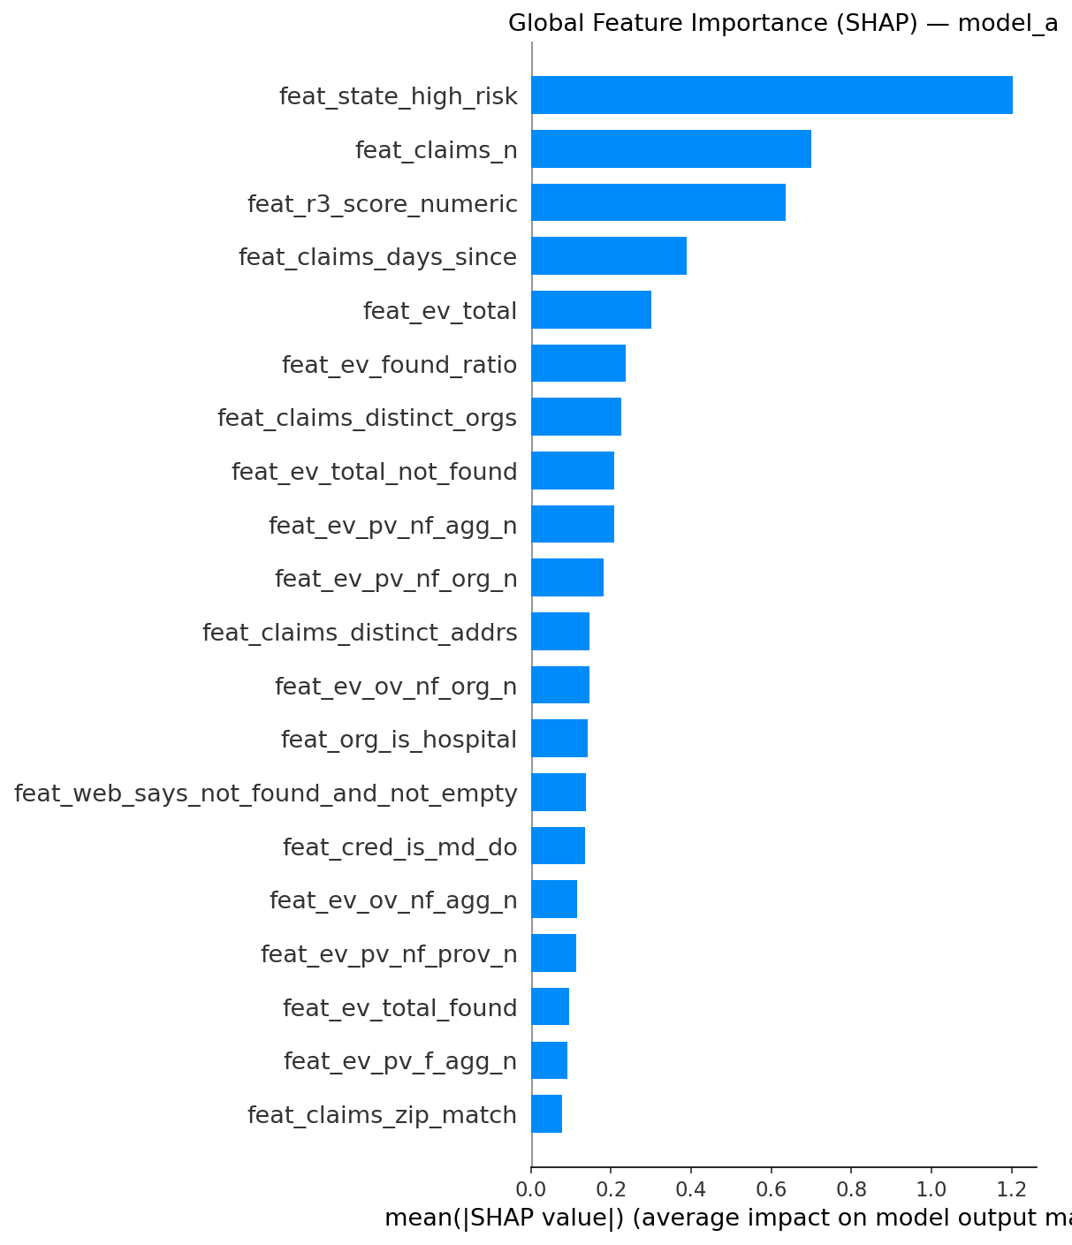
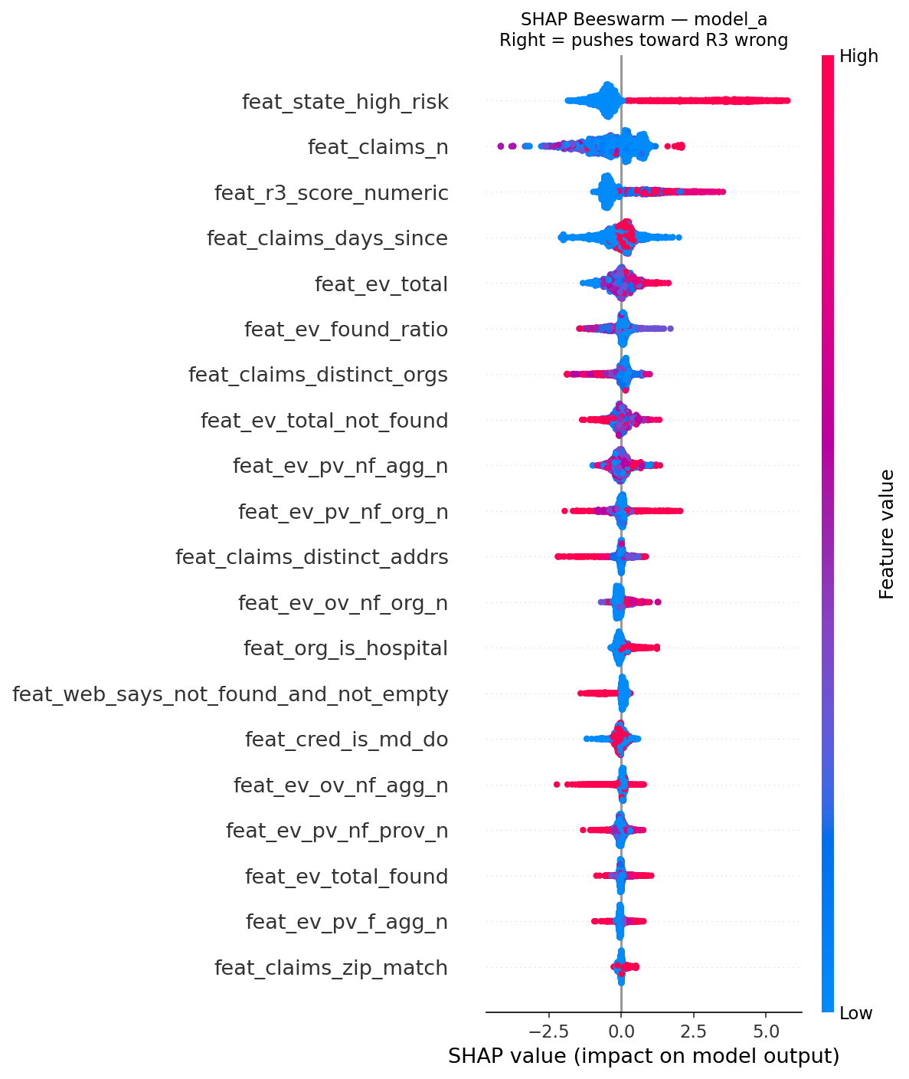
Model A — What It Learned (SHAP Feature Importance)
By focusing on Claims and Risk Priors, the model reasons rather than guesses.
Global importance (mean |SHAP|)
Per-record SHAP values (red = pushes toward R3 wrong)
HiLabs
Confidential & Proprietary | HiLabs 2026

Slide 20
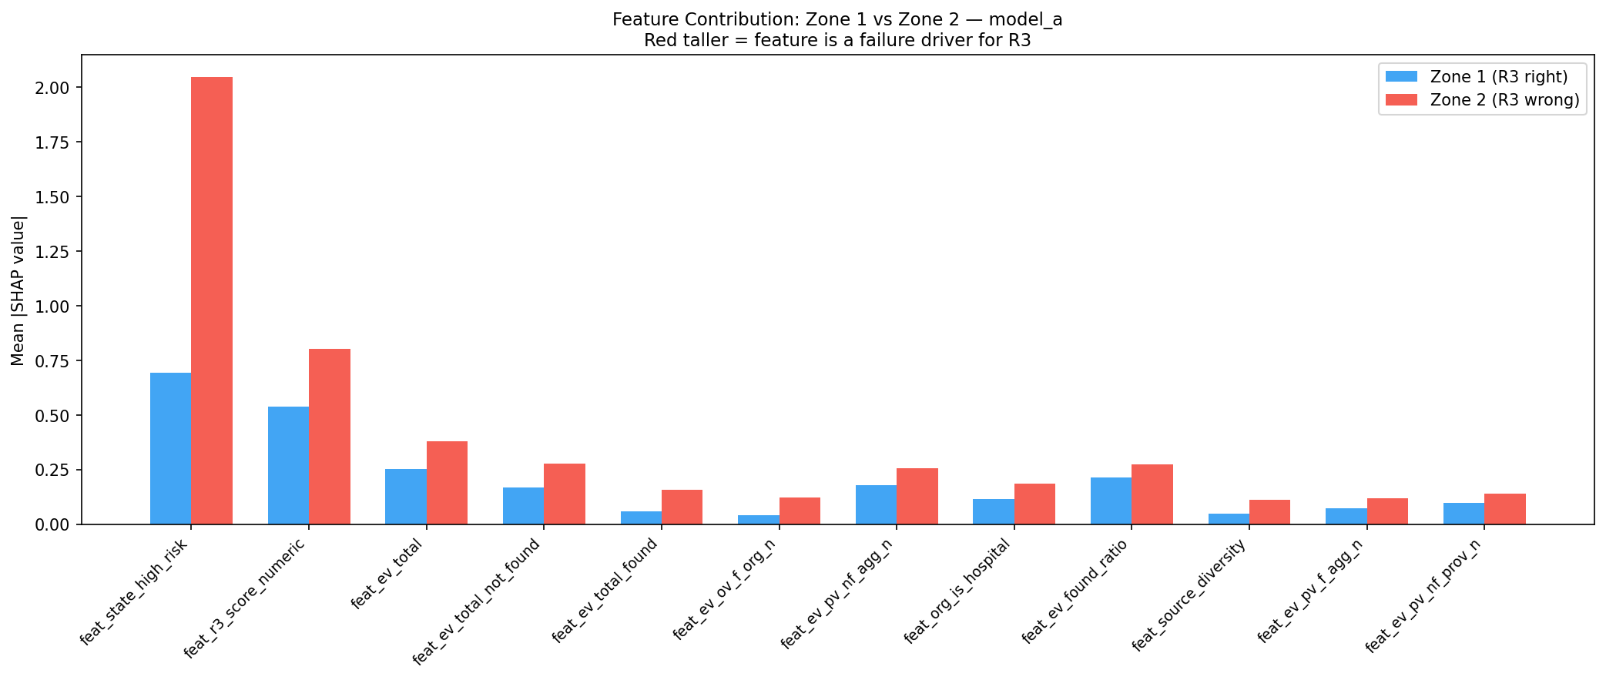
Ruthless Feature Pruning — Signal vs Noise
We removed every zero-correlation feature. The final model is leaner, faster, and harder to fool.
Why we cut zero-correlation features
The Discovery
Sweetviz revealed several engineered features had exactly 0.00 correlation with R3 failures.
The "Dead" Features
NPI Deactivated → 0.00
NPI Changed → 0.00
Provider in Org (PIO) → 0.00
The Risk of Noise
Tree-based models (LightGBM, XGBoost) will memorize random anomalies in noise features, destroying real-world generalization.
→ Pruned all zero-signal features
HiLabs
Confidential & Proprietary | HiLabs 2026

Slide 21
Model B — Call Conclusivity Predictor
Even if R3 is wrong, will a robocall to this provider yield a usable verdict? A wasted call is $0.50.
Performance metrics (5-fold CV)
Zone analysis at threshold 0.470
0.937
0.993
0.055
Note: Model B's zones differ — based on call outcome, not R3 outcome.
CV ROC-AUC
AP Score
Brier Score
±0.011 — very high, very stable
Near-perfect precision on positives
0.059 → 0.055 — already well calibrated
ZONE 1 — Call returned INCONCLUSIVE
0.470
0.952
LGBM
247 records · hospital systems and unreachable specialties
Best Threshold
F1 Score
Algorithm
F1-optimal
Excellent balance
max_depth=4, lambda_l2=1.0
ZONE 2 — Call returned ACCURATE / INACCURATE
2,246 records · most office-based providers in primary care
91.3% net accuracy: the model correctly identifies 9 in 10 calls that will yield a verdict.
Combined with Model A, this lets us avoid burning $0.50 on unanswered hospital lines.
HiLabs
Confidential & Proprietary | HiLabs 2026

Slide 22
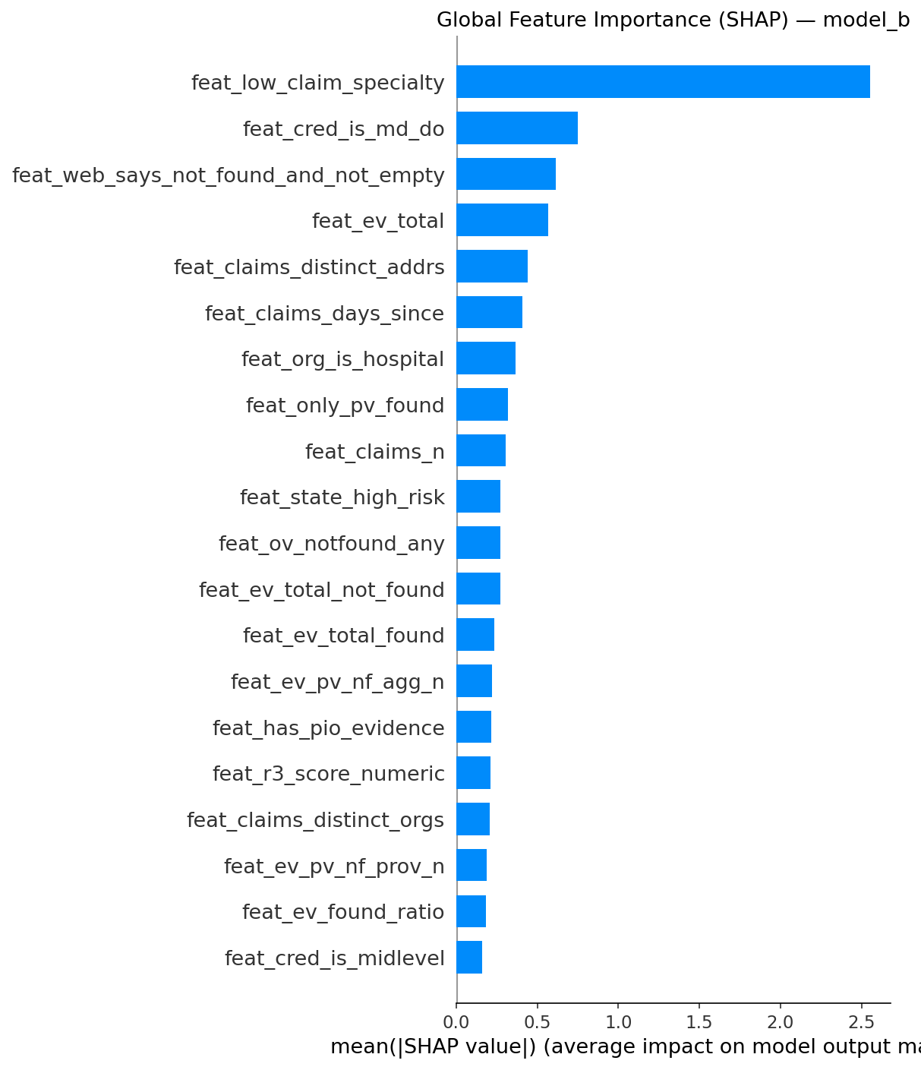
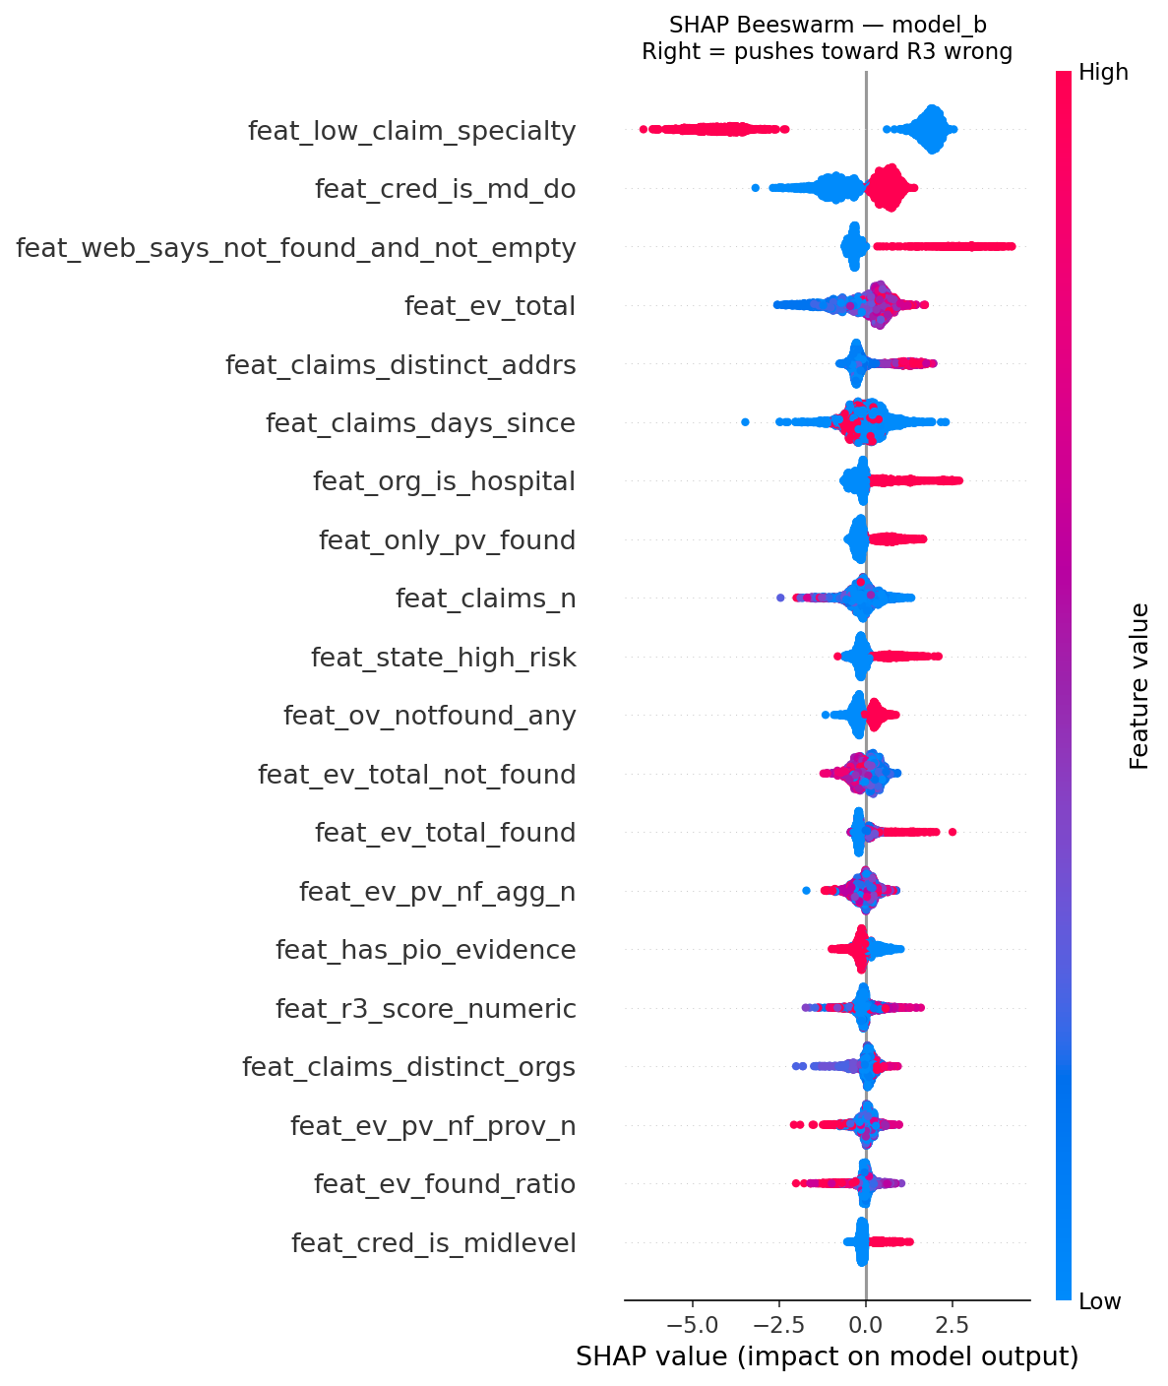
Model B — What It Learned (SHAP)
feat_low_claim_specialty dominates: clinical social workers, neuropsychologists, psychiatrists.
Global importance — feat_low_claim_specialty leads at SHAP 2.454
Per-record SHAP — red = pushes toward INCONCLUSIVE
HiLabs
Confidential & Proprietary | HiLabs 2026

Slide 23
Track 3
Triage & Decision
Combining both models, applying rules, and assigning the final status
HiLabs
Confidential & Proprietary | HiLabs 2026

Slide 24
Combining Both Models — One Decision per Record
Three priority buckets, two conclusive-rate passes — process in strict order until 30% budget is filled
Priority Loops at Glance
Budget reality/Constraint
P1 R3 = INCONCLUSIVE P2 model uncertain P3 likely R3 wrong
Budget cap
30%
Worked example — three providers
Conclusive rate
40% (fixed by spec)
Provider A
R3 = INCONCLUSIVE p_conc 0.88 → Bucket P1
TOP PRIORITY CALL
Call cost
$0.50
Provider B
Hospital p_conc 0.08 → Hospital guard removes from pool
SKIP — hospital won't answer
Provider C
p_wrong 0.08 p_conc 0.92 → Retain R3 (no bucket)
RETAIN R3 — model agrees
HiLabs
Confidential & Proprietary | HiLabs 2026

Slide 25
Triage Priority Logic — Decision Flow
Three strict sequential loops (call conclusive prob >= 0.75), with a fallback pass (0.65) if the 30% cap is not yet reached.
Legend
Legend
START — Provider records with both model output
Process step
Primary filter
Decision
Keep records with Call Conclusive Prob >= 0.75
YES — exit
LOOP 1 | Priority 1 — R3 engine output = INCONCLUSIVE
Iterate Call Conc. Prob 0.99 down to 0.75 add records to call queue
NO — next
30%
cap
reached?
YES
STATUS 1
Fallback
Referred to Call
NO
LOOP 2 | Priority 2 — Model inconclusive p_r3_wrong in [0.14, 0.54]
FALLBACK
Iterate Call Conc. Prob 0.99 down to 0.75 add records to call queue
Selected records enter the robocall queue
Lower
cutoff
0.75->0.65
Repeat
Loops 1-3
ranked by Call Conclusive Prob descending
30%
cap
reached?
YES
After all loops: records NOT in the 30% set receive one of these final statuses:
NO
Flip R3
Retain R3
Inconclusive
LOOP 3 | Priority 3 — Likely R3 wrong p_r3_wrong in [0.53, 0.75]
p_r3_wrong > 0.53
p_r3_wrong < 0.15
p_r3_wrong in [0.14, 0.54]
Iterate Call Conc. Prob 0.99 down to 0.75 add records to call queue
Key rules
30%
cap
reached?
30% hard cap on call queue
Loops are strictly sequential — each must fully complete before the next begins
Within each loop, records are sorted by Call Conc. Prob descending (0.99 first)
YES
NO
HiLabs
Confidential & Proprietary | HiLabs 2026

Slide 26
Final Status — One Verdict per Record
Every record exits the pipeline with one of four statuses.
📞
Referred to Call
🔄
Flip R3
Status 1
Status 2
If
Selected within the 30% triage threshold
If
Not in the 30% set AND p_r3_wrong > 0.53
Then
Then
Send to robocall queue. The call result will overwrite this status when it returns.
Reverse R3's existing verdict. ACC → INACC, INACC → ACC. Confidence trail attached.
✅
Retain Existing R3
❓
Inconclusive
Status 3
Status 4
If
p_r3_wrong < 0.15
If
p_r3_wrong ∈ [0.14, 0.54] AND not selected for call
Then
Then
Keep R3's verdict unchanged. The agreement zone is protected.
Model can't confidently decide. Mark for analyst review or next batch retraining cycle.
HiLabs
Confidential & Proprietary | HiLabs 2026

Slide 27
Rules Safety Net (Hypothesis)
These rules that can rescue the model discrepancy. EDA and SHAP both confirm these patterns.
Recent claims at the same address
Convergent web evidence
INACC #1
ACC #1
ACC #2
NPI deactivated
Condition
Condition
npi_status = inactive
claims billed at this exact address in last 30 days
≥ 3 distinct web sources confirm same address along with claims
Authoritative
→ Force INACCURATE
Why
Why
Active billing IS proof of address. Half the time R3 says "remove," claims prove R3 is wrong (EDA #5).
When the org website, provider website, AND aggregators all converge, and claims also matches, evidence is too strong to override.
INACC #2
Billing from 2+ different ZIPs
distinct_zips ≥ 2 AND none match R3
→ Force ACCURATE
→ Force ACCURATE
→ Force ACCURATE
Provider has moved
→ Force INACCURATE
Rules are YAML-configured. Operations can toggle individual rules without redeploying code. Every flip carries reason code + SHAP trail.
HiLabs
Confidential & Proprietary | HiLabs 2026

Slide 28
Final Output Report
Output after both model and triage decision, and constraints honored.
R3 Label | R3 Wrong Confidence | Call Conclusive Confidence | Call Priority Rank | Decision | Decision Reason Code | Final Status
INACCURATE | 0.92 | 0.91 |  | FLIP | HIGH_CONF_PASSIVE_FLIP | ACCURATE
ACCURATE | 0.95 | 0.98 |  | FLIP | HIGH_CONF_PASSIVE_FLIP | INACCURATE
INACCURATE | 0.31 | 0.93 | 15 | CALL | VERIFY_BY_CALL | SEND_TO_CALL
INACCURATE | 0.39 | 0.99 | 13 | CALL | VERIFY_BY_CALL | SEND_TO_CALL
INCONCLUSIVE | 0.38 | 0.46 |  | INCONCLUSIVE | R3_INCONCLUSIVE_CALL_UNLIKELY | INCONCLUSIVE
INACCURATE | 0.06 | 0.97 |  | TRUST | HIGH_CONF_FLIP_VERIFY_BY_CALL | INACCURATE
INACCURATE | 0.09 | 0.97 |  | TRUST | HIGH_CONF_FLIP_VERIFY_BY_CALL | INACCURATE
Confidential & Proprietary | HiLabs 2026

Slide 29
Track 1: Problem Discovery and Pattern Analysis (Mandatory)
Objective: Systematically analyze the ~400 disagreement records and identify structural
patterns that explain why R3 (and the web) disagree with Calling QC.
Key Questions to Investigate (non-exhaustive):
• Are certain specialties or provider types disproportionately represented in the
disagreement set?
Ans -
• Do specific geographies or specialties show higher misalignment rates?
Ans -
• Is there a time-decay pattern? Do recently updated records disagree more or less than
stale ones?
• What does the claims data tell you about these providers? Are they actively billing from
the address R3 validated, or from a different one?
Out of 100 records/provider in the base data file, I got 90 providers who has submitted the claim out of which the 70 providers address was exactly matching with the base data with no additional address in the claim, 5 providers had the address matching with claim but they had another address as well in the claim, and 6 providers had no matching address – what does r3 result says here.
• Are there identifiable failure archetypes such as providers who moved recently, group
practices with multiple locations, telehealth-primary providers with virtual addresses, or
shared medical spaces?
Deliverable: A structured analysis with a proposed segmentation taxonomy of disagreement
patterns, supported by data. Each segment should suggest a different resolution strategy.

Slide 30
Thank You
Questions and discussion
Closing the Last Mile · Bridging the R3 Accuracy Gap
HiLabs
Confidential & Proprietary | HiLabs 2026

