Slide 1

ML-Driven Design of a Microstrip
Patch Antenna
A surrogate model + genetic algorithm pipeline for inverse antenna design
(TEAM 8)
Team members: Karthik Jasti · Kushal J
SRN: PES1UG23CS285 · PES1UG23EC154
Guide: Dr. Sayyed Arif Ali
Department: Electronics & Communication Engineering
Notes:
Title slide. Introduce the team and the one-line pitch: we built an ML surrogate plus a genetic algorithm to design a patch antenna for 2.45 GHz using our own HFSS-generated data.

Slide 2

1
Introduction
Problem
Objective
Applications
Designing a patch antenna means finding dimensions that resonate at a target frequency. Traditional trial-and-error simulation in HFSS is slow — each design takes minutes to solve.
Build a fast ML surrogate that predicts antenna performance instantly, then use a genetic algorithm to search backwards for the geometry that meets a target — inverse design.
2.45 GHz Wi-Fi / ISM band, IoT devices, Bluetooth, and any compact wireless system needing a low-cost printed antenna.
Why this matters
An accurate surrogate turns a minutes-long HFSS solve into a millisecond prediction.
A genetic algorithm can then explore thousands of candidate designs that would be infeasible to simulate directly.
The result: automated, target-driven antenna design instead of manual tuning.
Notes:
Frame the problem as slow manual design, the objective as fast surrogate + GA inverse design, and the application as the 2.45 GHz band.

Slide 3
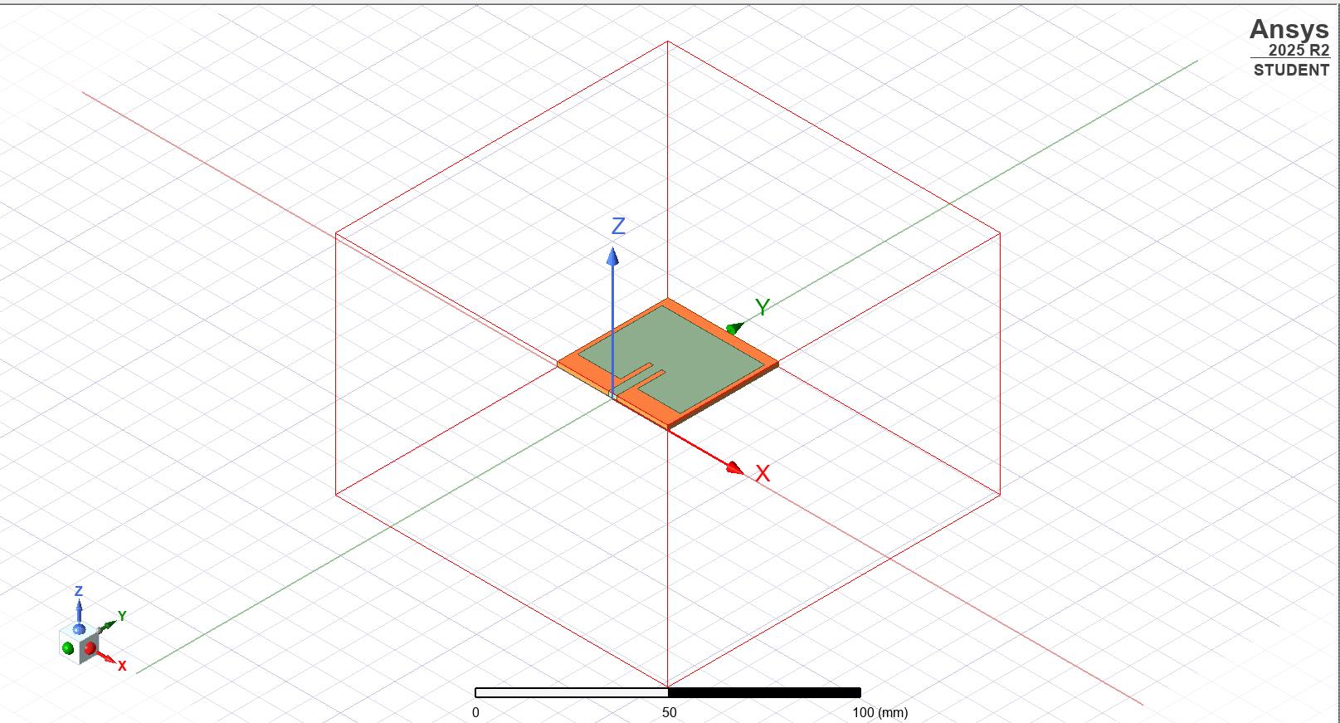
2
Background & Antenna Concepts
Microstrip patch antenna
A metal patch on a grounded dielectric substrate; radiates broadside when the patch length ≈ half a wavelength in the substrate.
Resonance & S11
S11 (return loss) measures impedance match. A deep negative dip means the antenna accepts power efficiently at that frequency.
Inset feed
Recessing the feed into the patch tunes the input impedance to match a 50 Ω line.
Surrogate modelling
An ML model trained on simulation data acts as a fast stand-in for the full-wave solver.
HFSS model of the inset-fed patch on its radiation boundary
Notes:
Cover the physics briefly: patch resonance, S11 as the match metric, inset feed for impedance, and the idea of a surrogate. Point at the HFSS geometry.

Slide 4
3
Design Requirements
Target frequency
Substrate
Conductor
Match target
2.45 GHz
FR-4
Copper
S11 < −10 dB
Wi-Fi / ISM band
εr = 4.4, h = 1.6 mm
t = 0.035 mm
at 2.45 GHz
Swept design variables (the ML search space)
Patch length l
Patch width w
25mm → 30 mm (11 values, 0.5 mm step)
Primary control of resonant frequency — sets the half-wavelength condition.
28mm → 33 mm (11 values, 0.5 mm step)
Controls input impedance and bandwidth; swept jointly with length.
Notes:
State the fixed specs (2.45 GHz, FR-4, copper) and the two swept variables l and w that define the design space the ML model learns.

Slide 5
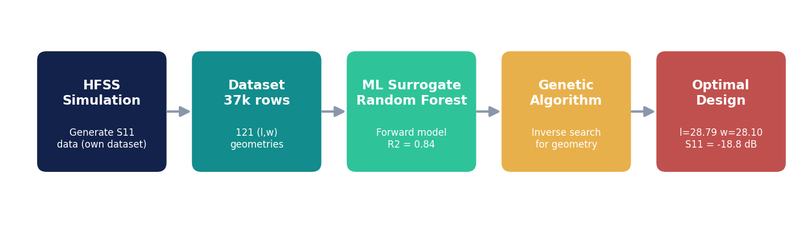
4
Design Methodology & Workflow
Tools: Ansys HFSS 2025 R2 (data generation) · Python + scikit-learn (Random Forest surrogate) · PyGAD (genetic algorithm) · Cursor (pipeline development)
Notes:
Walk left-to-right through the pipeline: HFSS generates data, we train a Random Forest surrogate, the GA searches it for the best geometry. Name the tools.

Slide 6
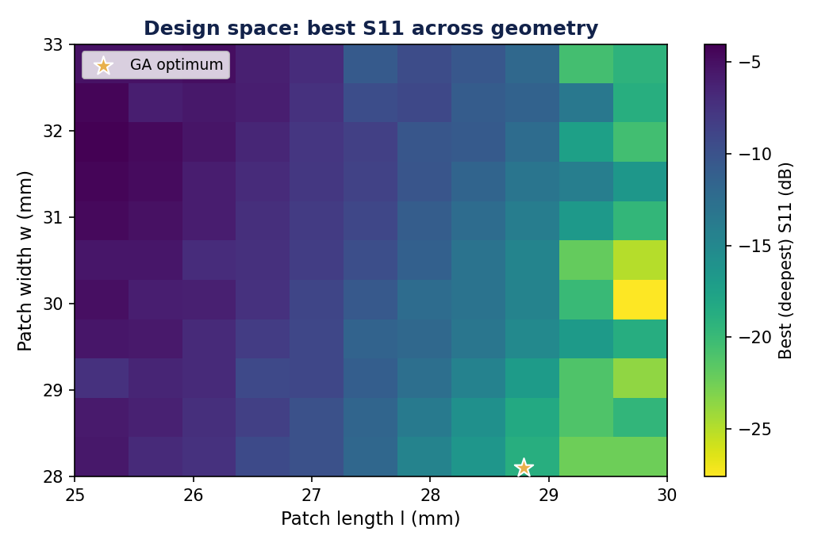
5
Antenna Design & Dataset Generation
37,026
rows generated
121
unique (l, w) geometries
51
frequency points (1.8–2.8 GHz)
1
self-owned dataset (not prebuilt)
Design space: best S11 across all l × w geometries (★ = GA optimum)
Full factorial l × w sweep — captures how length and width interact, not just one at a time.
Notes:
Explain that we generated our own dataset in HFSS — a full l×w factorial sweep, 37k rows over 121 geometries. This is what makes the project ours rather than using a prebuilt set.

Slide 7
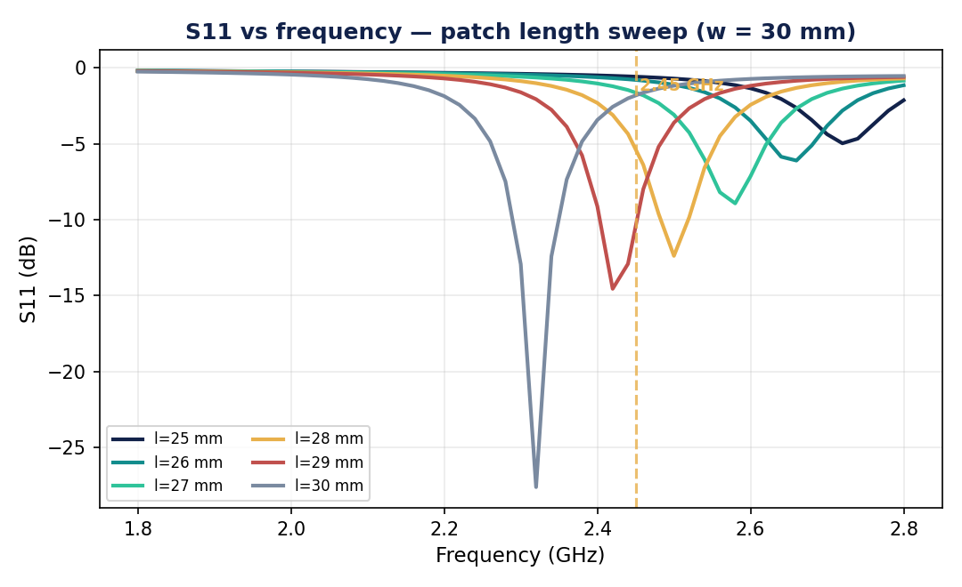
6
Results I — S11 / Return Loss
Resonant dips track geometry
Changing patch length moves the resonance across the band — confirming l is the primary frequency control.
Deep matches achieved
Best designs reach below −20 dB return loss (>99% power accepted).
Target band bracketed
The design space spans 2.45 GHz — essential so the GA can find a matched design inside it.
Impedance bandwidth
The −10 dB bandwidth around resonance defines the usable operating range.
S11 vs frequency — the resonant dip shifts as patch length changes
Notes:
Results part 1: S11. Show dips shifting with length, note the deep matches below -20 dB, and that the band covers 2.45 GHz. Mention VSWR and impedance bandwidth follow from S11.

Slide 8
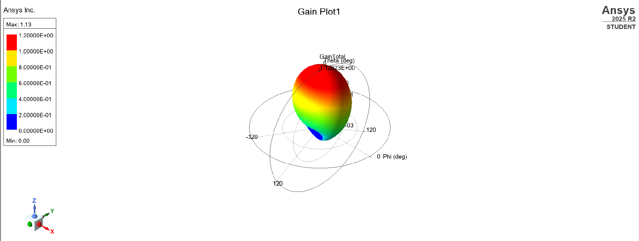
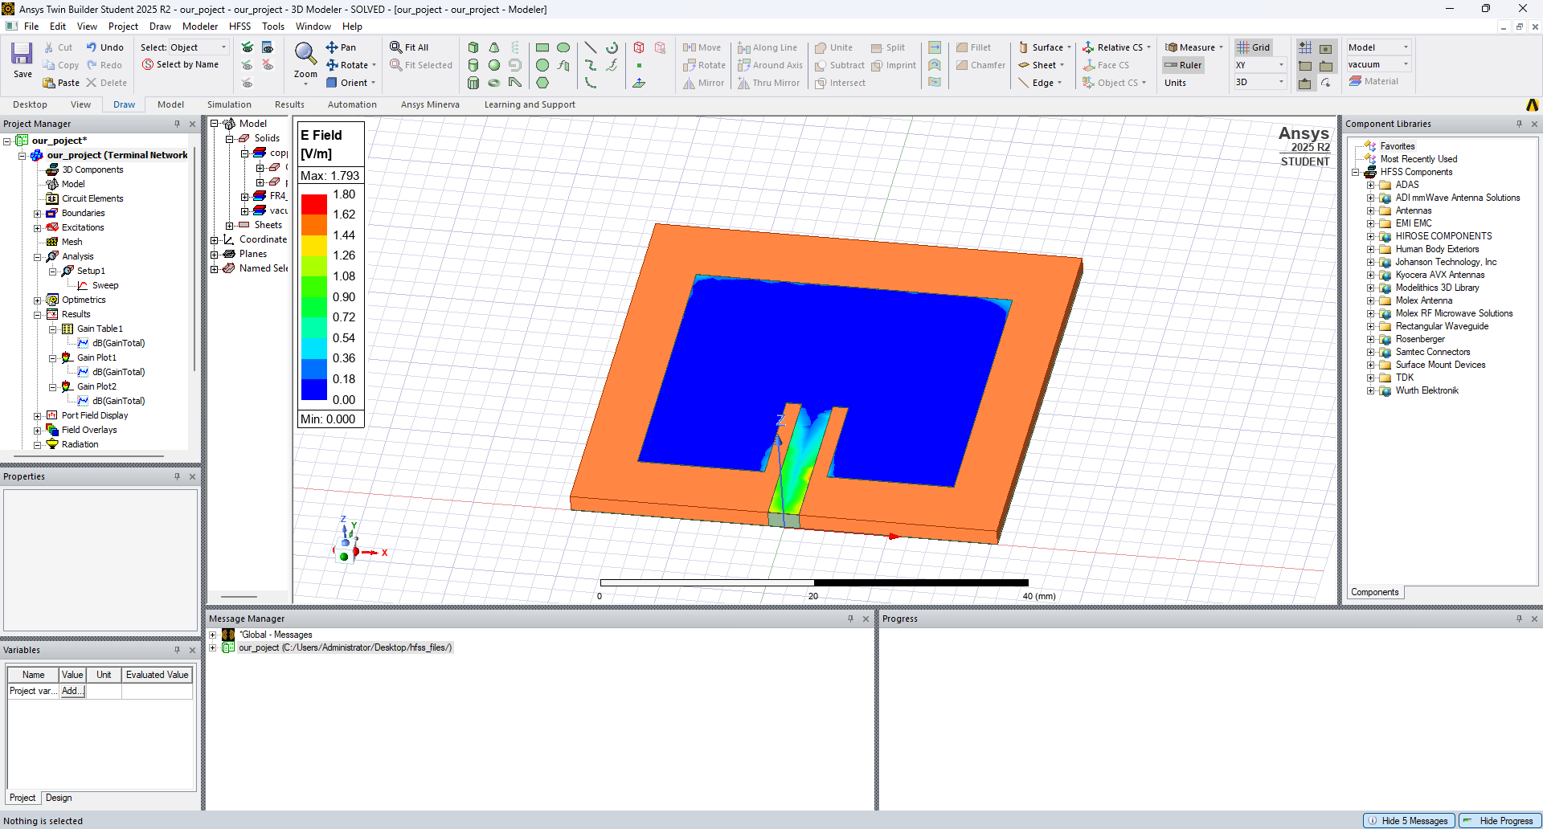
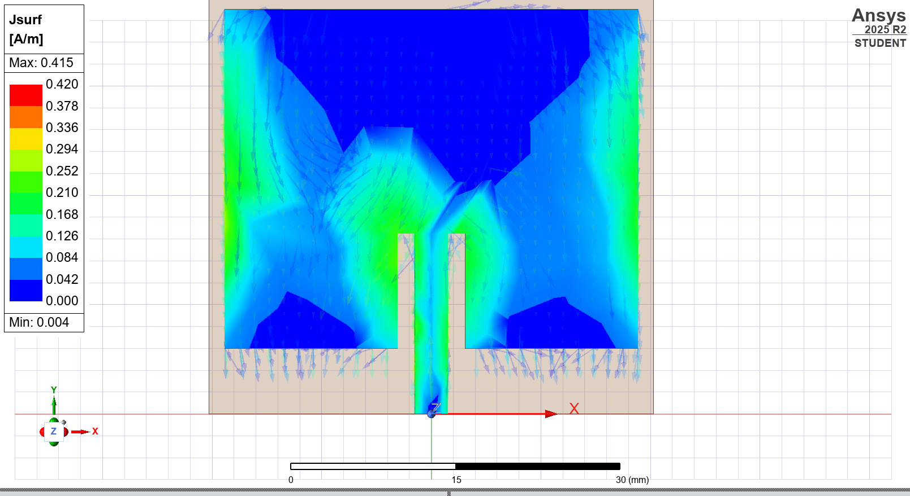
7
Results II — Gain, Pattern & Fields
3D gain pattern — broadside main lobe
E-field distribution on the patch
Surface current distribution
Clean broadside radiation with directivity ≈ 5.4 dBi — typical for a single patch element.
FR-4 substrate loss reduces total efficiency, as expected for a low-cost dielectric.
Surface current concentrated along the feed and patch centre confirms correct dominant-mode operation.
Notes:
Results part 2: radiation. Broadside lobe, ~5.4 dBi directivity, efficiency limited by FR-4 loss, current pattern confirms the mode. These come from the gain dataset and HFSS field plots.

Slide 9
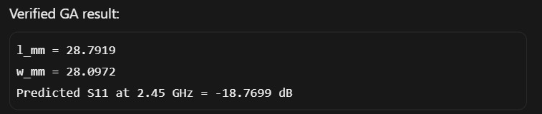
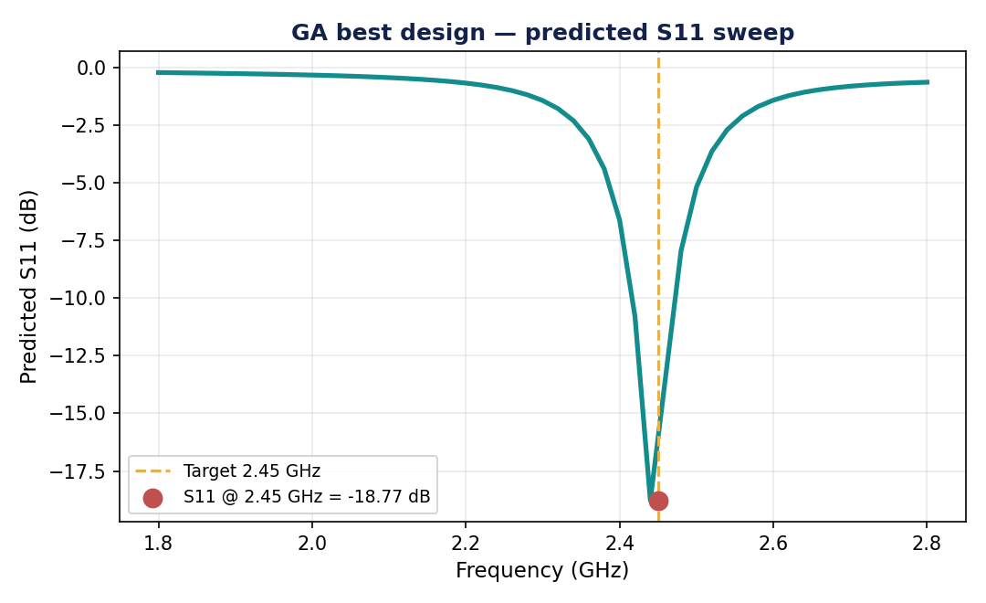
8
Discussion — ML Surrogate & GA
Surrogate performance (honest, geometry-split)
Genetic algorithm result
R²
MAE
RMSE
0.84 ± 0.03
0.25 dB
1.02 dB
Forward vs inverse
The surrogate predicts performance from a design (forward). The GA inverts this — it searches geometry to hit a target, using the surrogate as a fast fitness function.
Avoiding inflated scores
We split data by antenna geometry (GroupKFold), not by row — so the model is tested on unseen designs. A naïve row-split would leak and fake a higher R².
GA-optimised design: S11 dip lands on 2.45 GHz
Notes:
Discussion: the surrogate hits R2 0.84 under honest geometry-split validation. The GA found l=28.79, w=28.10 matched at 2.45 GHz. Explain forward vs inverse and why GroupKFold matters (no leakage).

Slide 10
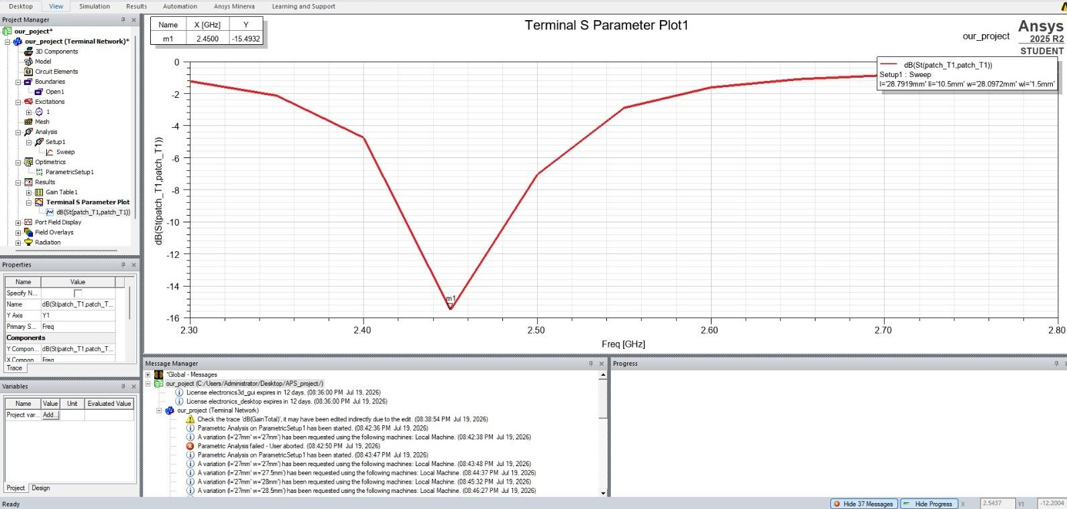
9
Validation — Closing the Loop in HFSS
The GA's optimal geometry was re-simulated in full-wave HFSS to confirm the surrogate's prediction — not just trust the model, but verify it in the real solver.
Predicted vs Verified
Surrogate prediction −18.77 dB HFSS verified −15.49 dB
What this proves
Both predicted and simulated S11 show a deep match at exactly 2.45 GHz. The ML + GA pipeline did not just optimise a model — it produced a geometry that works in the real full-wave solver. This is the end-to-end validation of the whole approach.
HFSS re-simulation of GA design (l = 28.79mm, w = 28.10 mm) — marker m1 at 2.45 GHz
Full-wave HFSS confirms a strong match at the 2.45 GHz target.
Notes:
This is the key slide: we closed the loop. The GA's chosen geometry, when re-simulated in real HFSS, resonates at 2.45 GHz (m1 = -15.49 dB). Predicted -18.77 vs verified -15.49 - both strong matches at the target. This proves the pipeline designs antennas that actually work, not just models that score well.

Slide 11

Conclusion & Future Scope
Key findings
Future scope
Built our own HFSS dataset and a validated surrogate (R² = 0.84) on unseen geometries.
The GA performs true inverse design — finding a 2.45 GHz-matched patch automatically.
Closed the loop: the GA's design was re-simulated in HFSS and confirmed at 2.45 GHz (−15.49 dB).
Confirmed voltage/power/phase are irrelevant for a single passive antenna (verified numerically).
Radiation results (broadside lobe, ≈5.4 dBi) agree with independent HFSS/CST analysis.
Complete the gain dataset across geometries → add gain as a second GA objective.
Multi-objective (Pareto) optimisation: S11 + gain + bandwidth.
Extend to a two-element array — where phase & voltage steering genuinely matter.
Optimise for wider impedance bandwidth, not just a single-frequency match.
Key references
Balanis, Antenna Theory: Analysis and Design · Ansys HFSS 2025 R2 documentation · scikit-learn & PyGAD libraries · Related ML-antenna literature listed on the next slide.
Notes:
Wrap up: what we achieved, honest validation, and the roadmap (gain objective, multi-objective, array, closing the loop with a confirmation simulation). Fill in real references.

Slide 12
11
References
Related work — ML & genetic algorithms for antenna design
[1] I. Merino-Fernandez, J. del Pino, S. Khemchandani, “Design of rectangular patch antennas through machine learning,” Scientific Reports, vol. 15, art. 33605, 2025. https://doi.org/10.1038/s41598-025-18939-2
[2] D. Sarkar, P. P. Shome, T. Khan, S. R. Rengarajan, “Application of Genetic Algorithm and Deep Neural Network for UWB Antennas,” 4th URSI Atlantic Radio Science Meeting (AT-RASC), Gran Canaria, 19–24 May 2024.
[3] A. Gupta, S. A. Ali, A. Haadi, M. Wajid, A. Srivastava, “Radiation Pattern Synthesis of a Millimeter-Wave Array Antenna using Deep Learning,” 2025 8th Int. Conf. on Image Information Processing (ICIIP), IEEE, pp. 539–544. https://doi.org/10.1109/ICIIP63302.2025.11346382
Foundational: C. A. Balanis, Antenna Theory: Analysis and Design (Wiley) · Ansys HFSS 2025 R2 documentation · scikit-learn, PyGAD
Notes:
Three closely related papers: Merino-Fernandez (ML for patch antenna design - almost identical to our approach), Sarkar (GA + DNN for UWB - the GA + ML pairing), and Gupta (deep learning for mmWave array pattern synthesis - relevant to our array extension). These situate our work in the current literature.

Slide 13
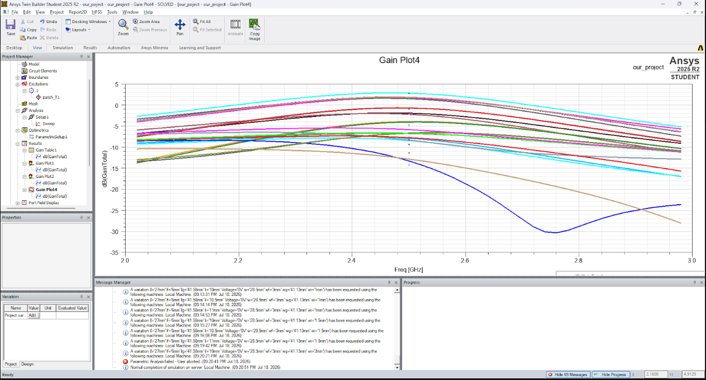
Backup
Backup — Gain vs Frequency (Parametric)
What this shows
Boresight gain peaks near 2.4–2.6 GHz at roughly 0 to +3 dB for most geometries — typical single-patch behaviour. The steep dips are pattern nulls at that observation angle, not antenna failure.
Status
This parametric gain run covers a limited set of geometries. Gain is therefore kept out of the GA fitness until a fuller sweep is generated — see Future Scope.
Total gain (dB) vs frequency across geometry variations — HFSS / Twin Builder
Notes:
Backup slide for Q&A on gain. Boresight gain peaks near the band at 0-3 dB. Steep dips are pattern nulls, not failures. Gain is not yet in the GA because this run covers few geometries - that is why it is a backup, not a main result.

