Slide 1
Project Presentation of CO-OP Project at Industry (Module-2) (22CS421)
On
Assessing the Global Technical Debt Crisis
Garvit Pruthi, 2210991566
Kushalpreet Kaur, 2210991836
Ritika, 2210992167
Vartika Yadav, 2210992515
Supervised By
Dr. Rajat Takkar
Department of Computer Science and Engineering,
Chitkara University, Punjab

Slide 2
Introduction
The software world in 2026 is going through a change known as the "Great Rebuild" because of coding fixes over the years that have added up to a huge problem.
This accumulated problem has led to 61 billion lost workdays globally.
Technical debt refers to the cost of taking shortcuts when coding, which seems like a good idea initially but causes problems later.
This used to be a departmental issue, but it is now affecting the whole economy and stopping new ideas from happening.
The "Great Rebuild" is the industry's reaction to this problem, aiming to make software better and more sustainable.
‹#›

Slide 3
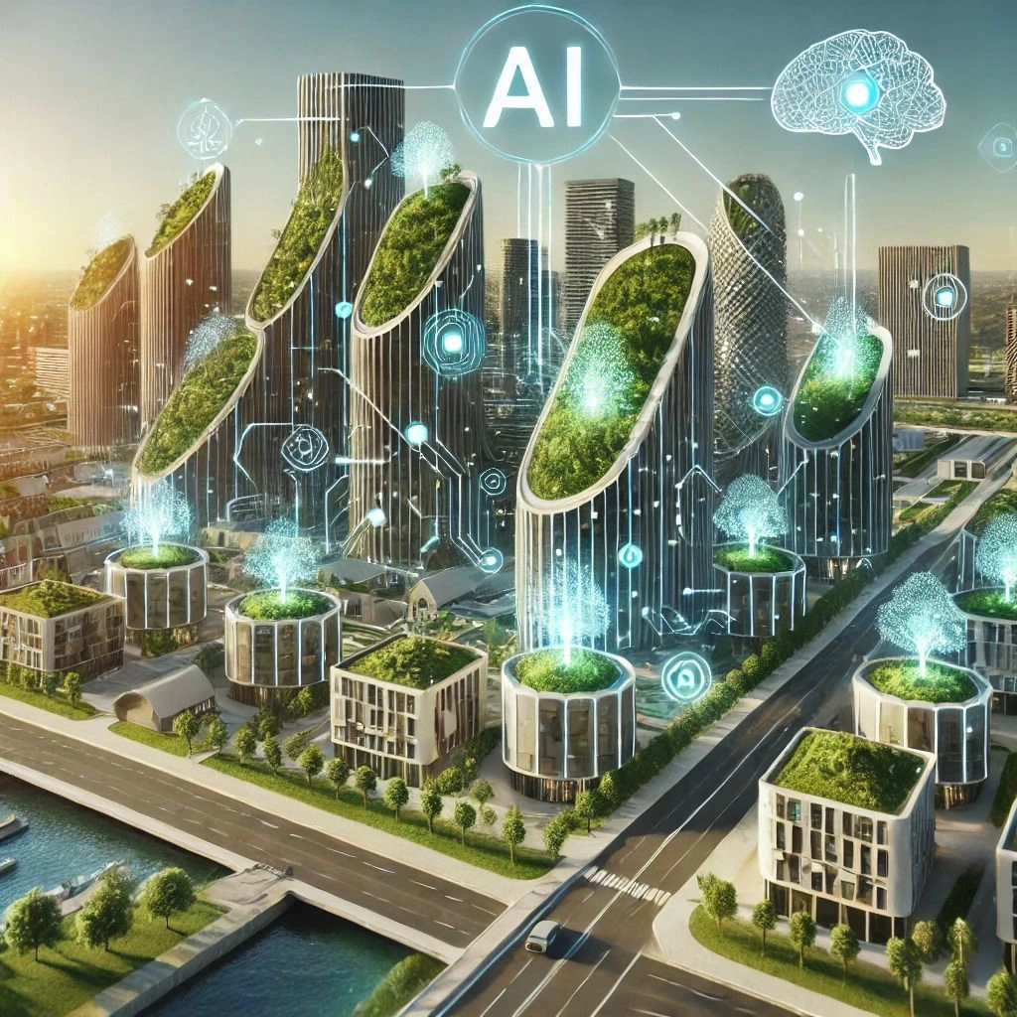
The Legacy of the 2022-2025 AI Gold Rush
From 2022 to 2025, companies rushed to add Generative AI, focusing on being first to market rather than ensuring well-built systems.
This led to deploying AI-generated code with little human review or validation.
These systems were hard to maintain because they were not well-structured and lacked clear documentation.
Companies are now stuck with this legacy AI code and spend nearly 85 percent of their time just keeping it running.
Only companies that aggressively fix their debt can survive the transition to truly autonomous AI.
‹#›

Slide 4
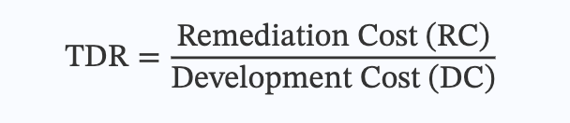
Theoretical Framework: The TDR
The Technical Debt Ratio (TDR) measures if a system is sustainable.
It is found using the formula: TDR = Remediation Cost (RC) / Development Cost (DC).
In 2021, big companies had a TDR of around 0.15 to 0.20, but by 2026, the TDR jumped to 0.45 in a lot of areas.
This high ratio means almost half of a developer's time is spent dealing with shortcuts.
This causes a "Maintenance Death Spiral," where all engineering time is spent fixing problems, stopping the company from coming up with new ideas.
‹#›

Slide 5
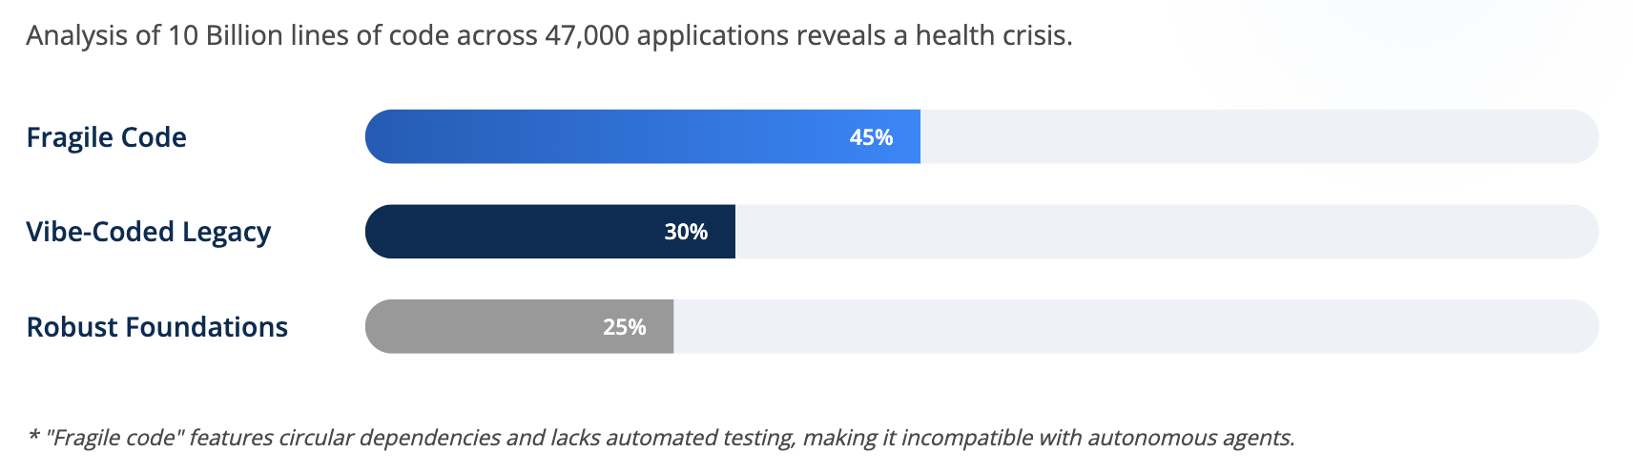
Global Production Code Status
Research analyzed 10 billion lines of code across 47,000 applications from 17 countries to understand global software health.
Findings show that 45 percent of the code used in production environments around the world is considered "fragile".
Fragile code is too complicated, has circular dependencies, lacks automated tests, and is likely to fail with autonomous AI agents.
30 percent of this fragile code is "vibe-coded" legacy, meaning it was made by Large Language Models between 2022 and 2025 and put to use without being properly fixed.
‹#›

Slide 6
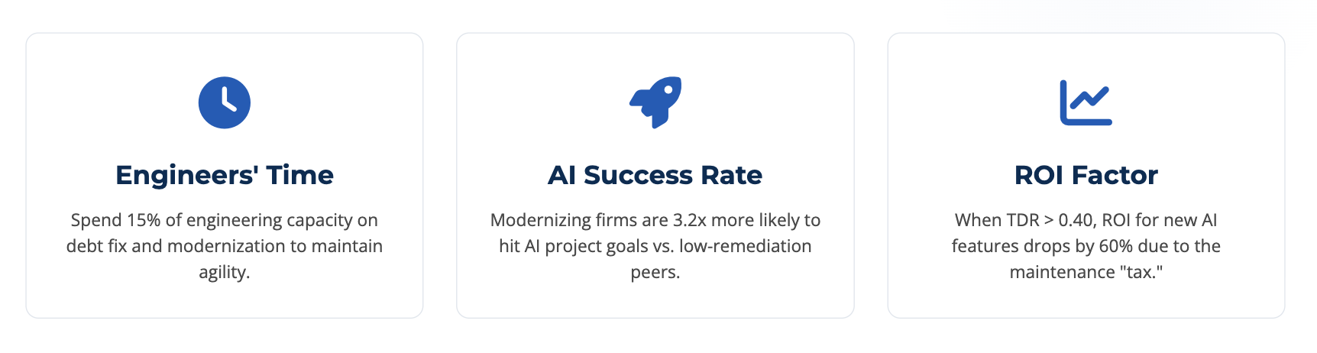
The 15% Remediation Rule
Companies should spend 15% of their engineering time on fixing technical debt and making their systems more modern.
When organizations follow this rule, they are 3.2 times more likely to meet their goals for AI projects than companies using 5% or less.
When the TDR gets above 0.40, the Return on Investment (ROI) for AI features drops by about 60% due to a high maintenance tax.
To keep important systems like healthcare and supply chains running safely, continuous modernization is required.
‹#›

Slide 7
Geographic Disparities & Future Outlook
Established markets like the U.S. and Europe have higher technical debt because older infrastructure was quickly combined with AI.
Emerging markets like India and Southeast Asia are building with modern standards, resulting in an average technical debt ratio 25% lower than in established countries.
Technical debt is highly risky for critical infrastructure; 60% of healthcare leaders report it has slowed down AI-driven tools, and supply chains face a 15% efficiency loss.
The tech industry must deal with the 61 billion workday burden and move to an AI-native future built on a solid, long-lasting foundation.
‹#›

Slide 8
Thank You
‹#›

