Slide 1
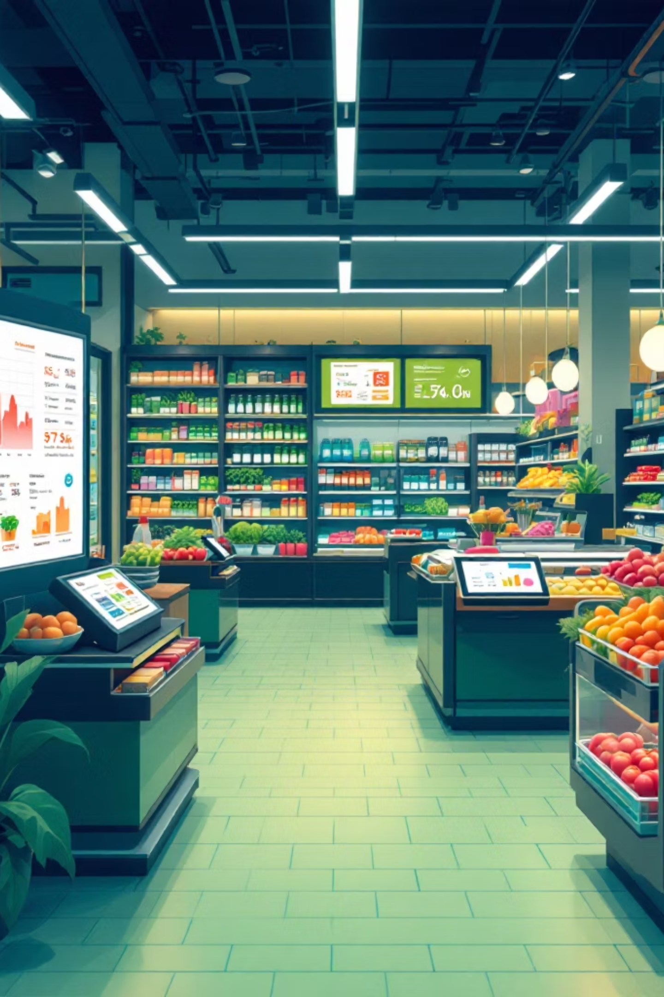

AI-Powered Retail Analytics & Inventory Optimization
From 32 Million Transactions to Actionable Intelligence, and Automated Pipeline
Natarajan , Rustam , Yash , Duy Nguyen, Kushal , Rajkumar

Slide 2
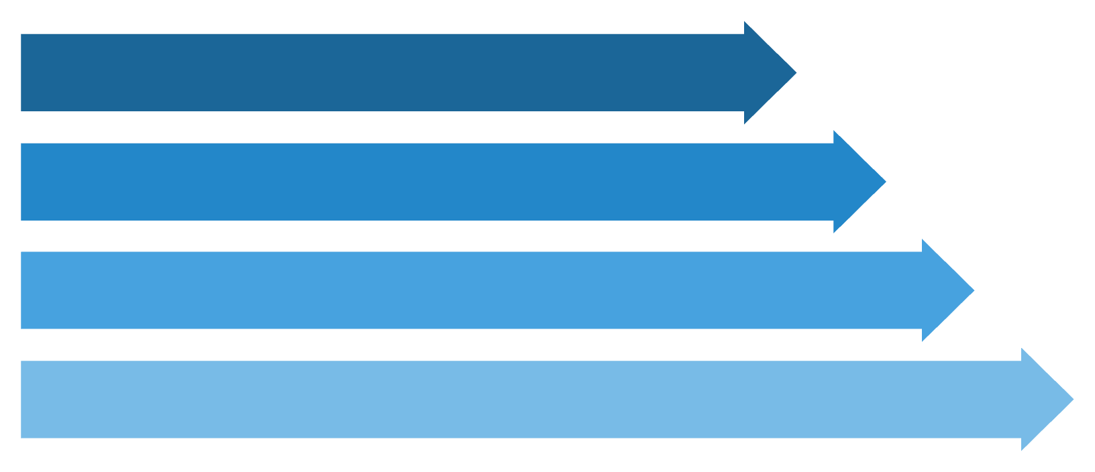
Overview & Business Problem
Problem
Business Questions
A grocery retailer manually produces weekly inventory insights Manually - export CSVs, analyzing in Excel.
1. Which products sell the most?
3–4 hours per report cycle
No Predictive insights
Discovering stock outs after they occur
2. Which products will customers buy again?
3. When do customers shop the most?
4. How should stores manage inventory?

Slide 3
Technology Stack
Python
Machine Learning
Google Colab
Data Cleaning & Feature Engineering
XG Boost & Logistic Regression
Compute & ML Pipelines
Power BI
Gemini AI Agent
N8n
Dashboard & Reports
Insights Generation
Pipeline Automation

Slide 4

Dataset and Data Preparation
Source
Challenges Found & Addressed
Kaggle - Instacart grocery shopping Dataset
Null Values: 206K null values in 'days_since_prior_order' were identified
Large File Size: 'order_products.csv' exceeded 500 MB; → requires dtype downcasting
Duplicate Records: Duplicate (order_id, product_id) pairs were removed to ensure data integrity.
Out-of-Range Values: Invalid 'order_hour' (0–23) and 'day_of_week' (0–6) entries were validated and corrected
32.4M
3.4M
Order Records
Customer Orders
Total transactions analyzed
Unique customer shopping baskets
49,688
Products
Unique items available for purchase

Slide 5
Universal 5-Step Cleaning Pipeline
Standardize Column Names
Remove Empty Rows
Remove duplicates
Eliminated rows that are entirely blank or contain only whitespace.
Removed exact duplicate rows across the entire dataset.
Transformed column names to lowercase with underscores for uniformity.
Fill Nulls
Outlier Removal
Replaced nulls with 0
Applied IQR × 1.5 method to remove outliers specifically from ML feature columns.

Slide 6
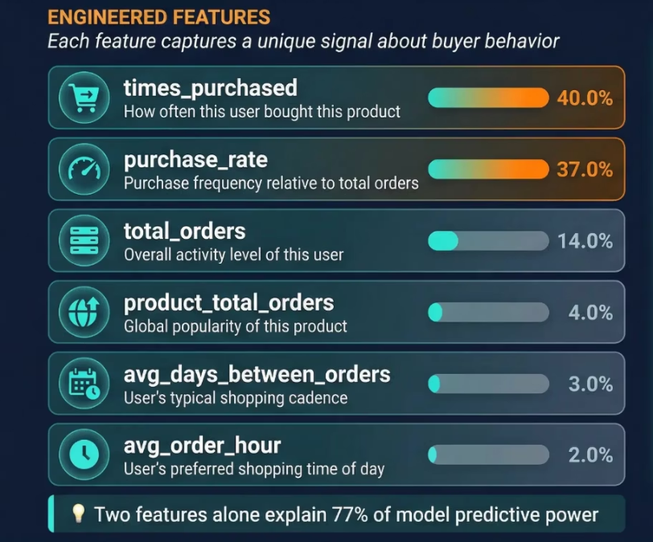
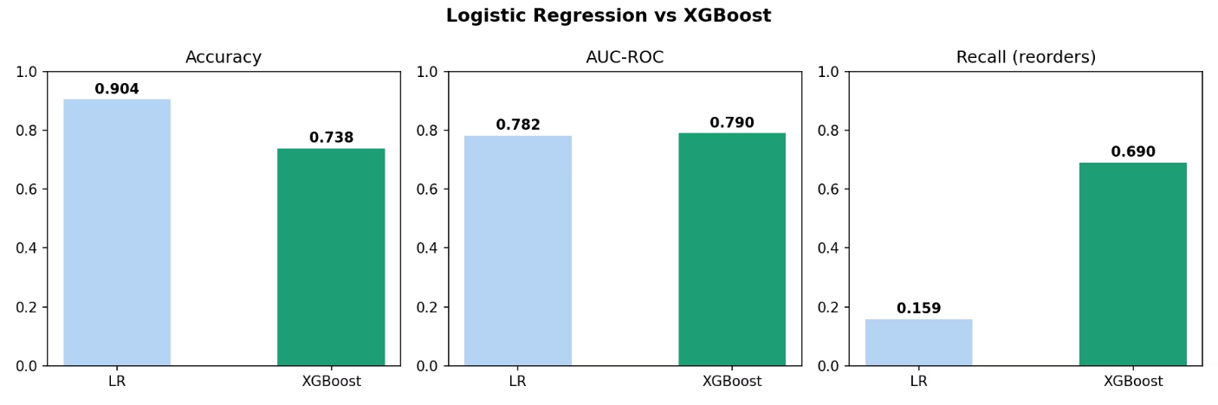
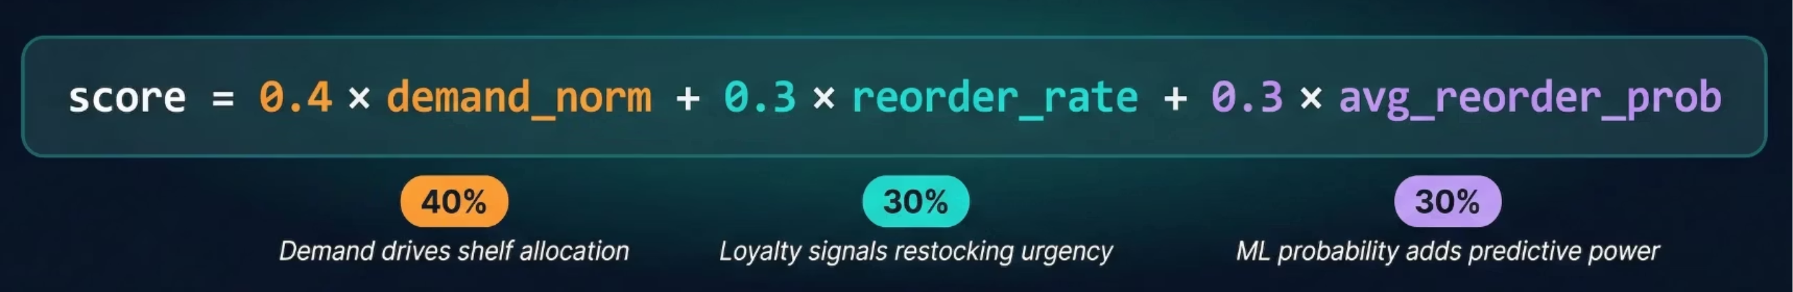
Feature Engineering & Machine Learning
Turning 32M Transactions into 6 Predictive signals
Model Comparison
Accuracy : LR scores 90.4% but predicts non-reorder almost every time — misleadingly high on imbalanced data
AUC-ROC : XGBoost 79% vs LR 78% — XGBoost better at distinguishing reorders from non-reorders
Recall (Reorders) : XGBoost catches 69% of reorders vs LR's 15.9%
Inventory Priority Scoring System
High Priority
Score ≥ 0.66
Medium Priority
Score 0.33–0.66
Low Priority
Score < 0.33

Slide 7
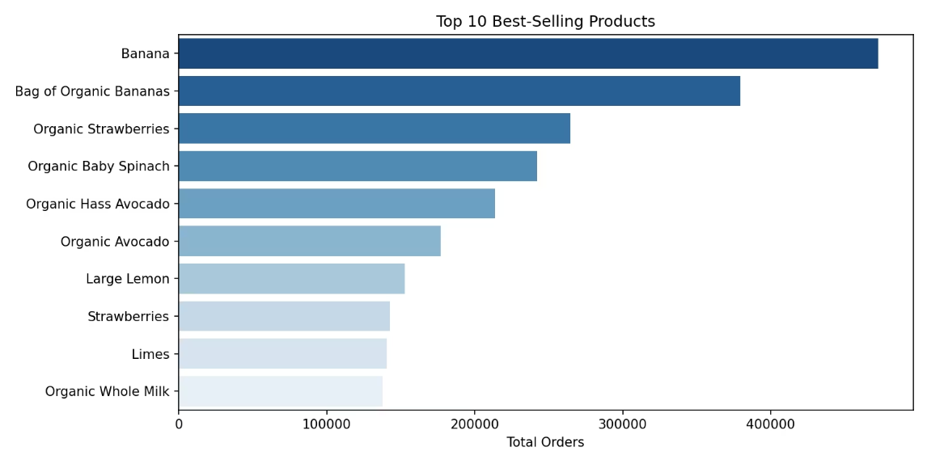
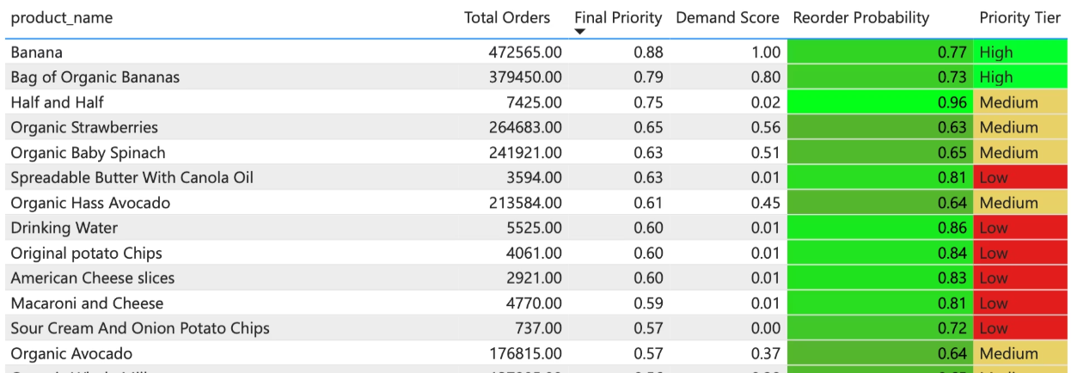
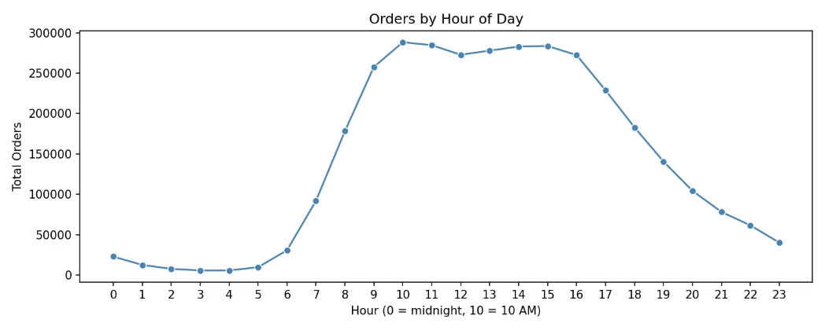
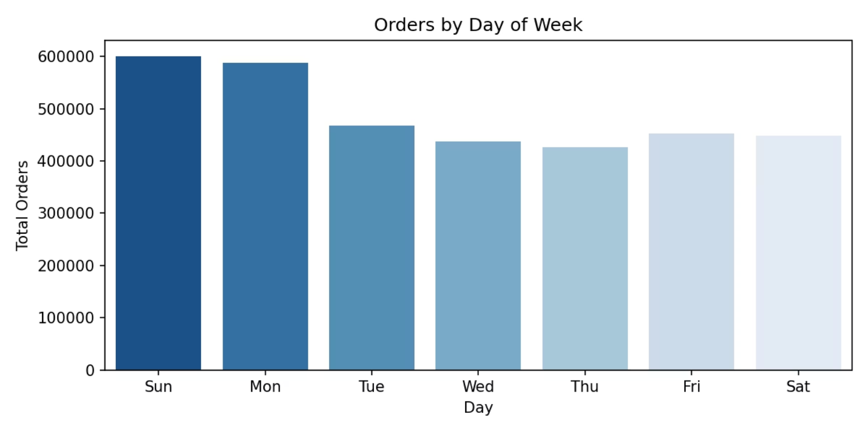
Solution for Business Questions
Q1. Top Selling Products
Q2. Most Reordered products
Q3. Peak shopping hours

Slide 8
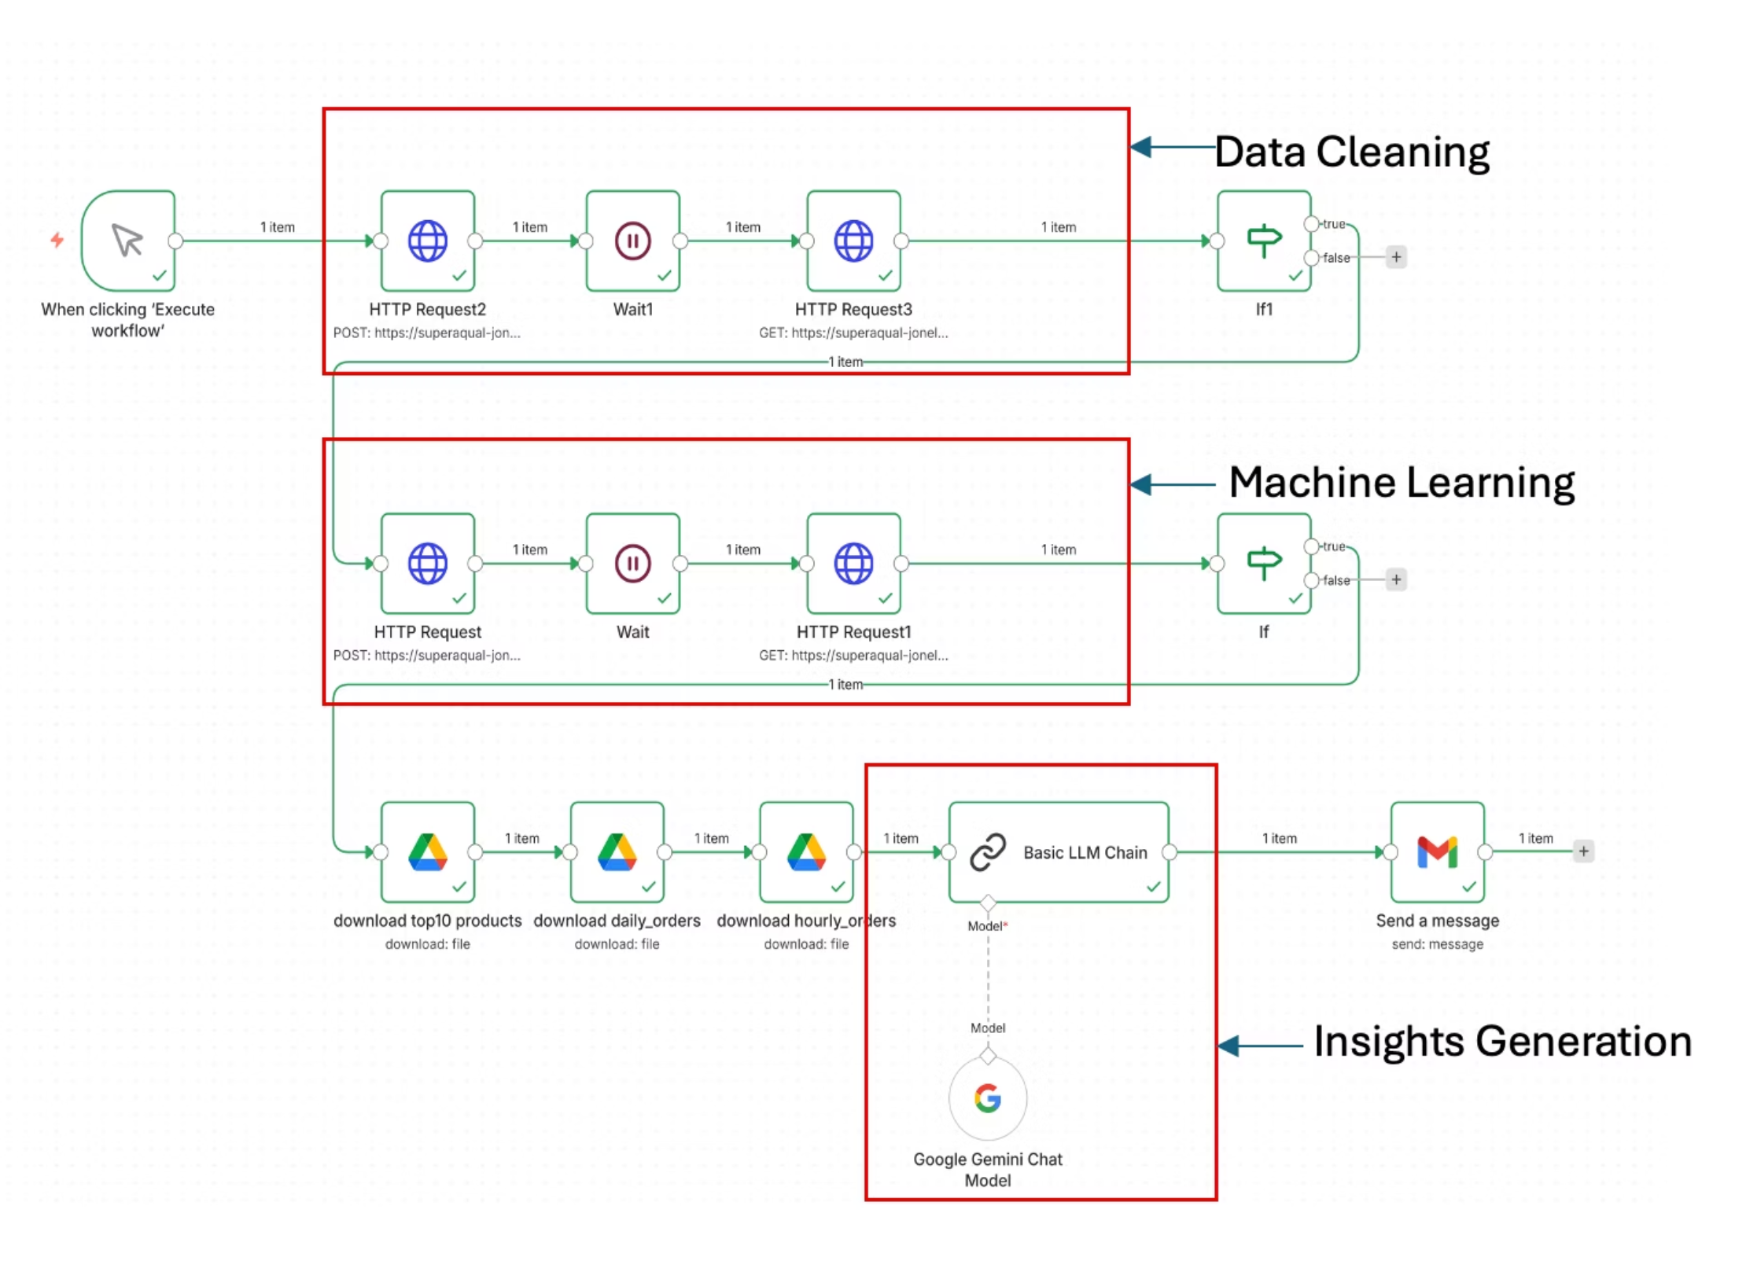

n8n Automation Pipeline & Architecture
Trigger Run by Click
Data cleaning
Machine Learning
Gemini AI Agent
Gmail

Slide 9
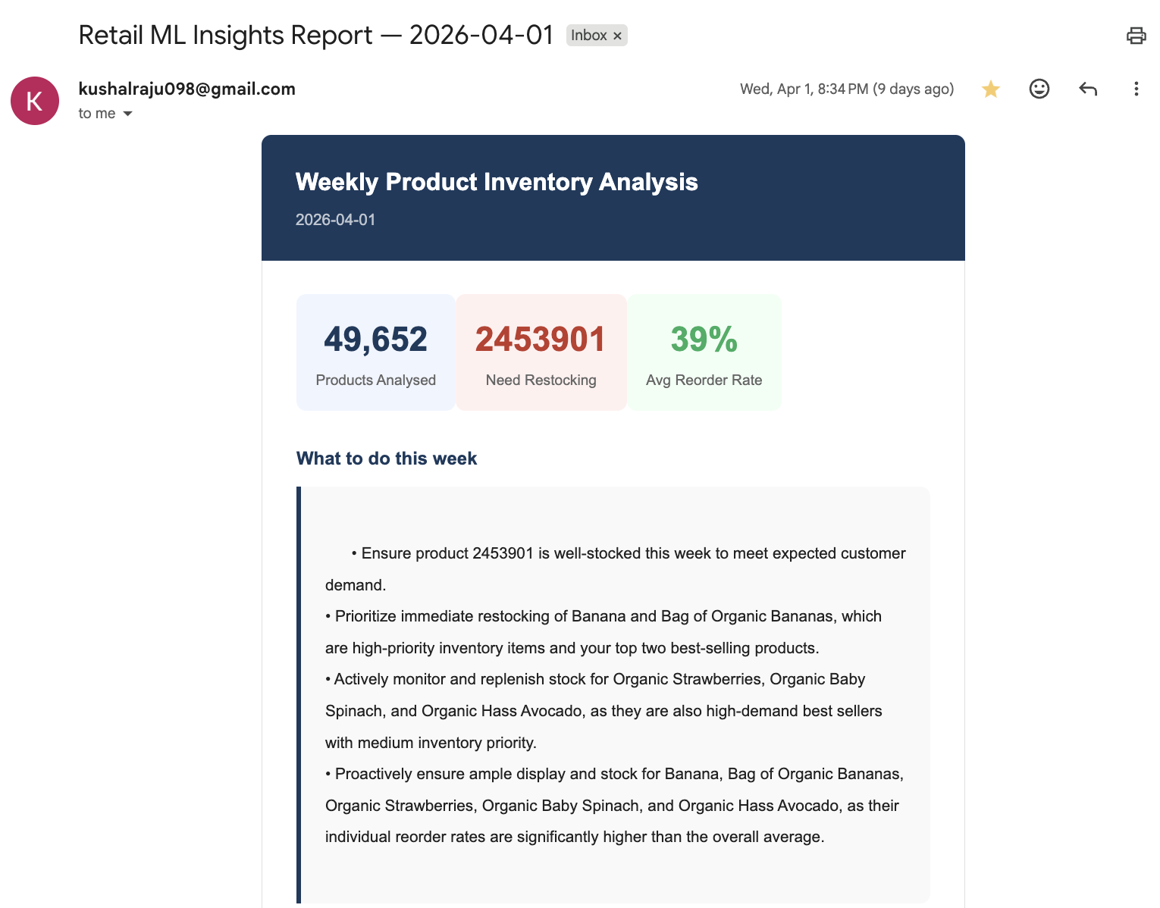
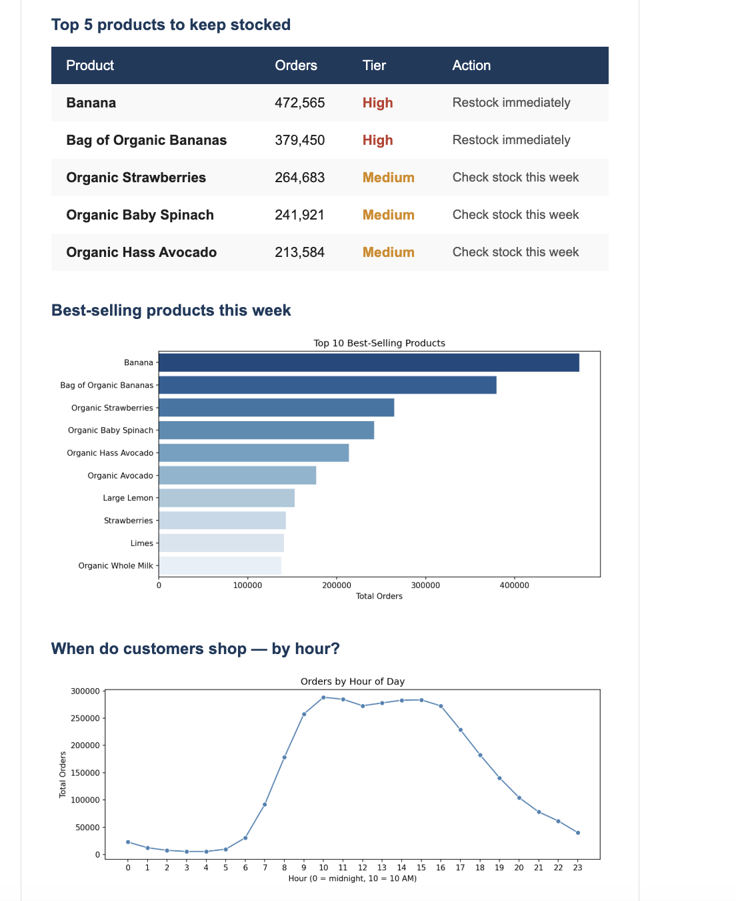
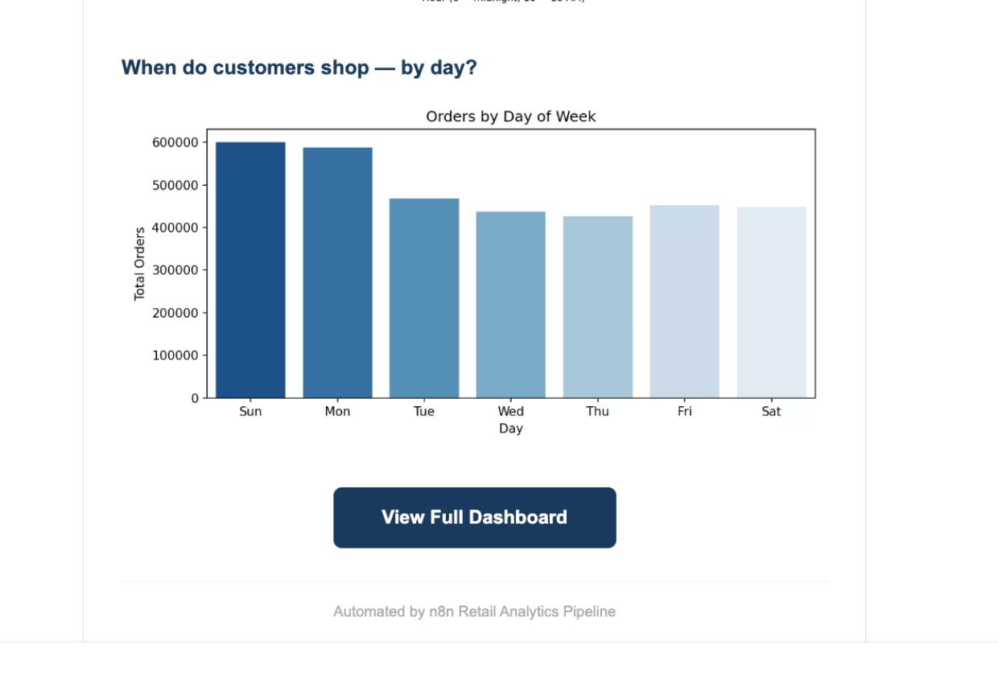
Q4. Inventory Insights From AI Agent

Slide 10
Conclusion & Future Enhancements
What we Built
Future Enhancements
End-to-end automated analytics pipeline from raw CSV to manager email
XGBoost model — AUC-ROC 0.790, Recall 69% on reorder prediction
5-step universal cleaning pipeline — handles any CSV automatically
Power BI dashboard answering all 4 business questions interactively
n8n + Gemini AI — plain-English insights, less manual effort
Deploy to Google Cloud Run — eliminate Colab session management
Scheduled trigger — fully event-driven pipeline
Try with Transformer models for seasonal product patterns
Real-time POS streaming — up-to-the-minute inventory alerts
Multi-store deployment with department-level trend analysis

Slide 11

Thank You!
Natarajan, Rustam, Yash, Duy Nguyen, Kushal, Rajkumar

