Slide 1


E-LIBRARY SYSTEM
Digital Library

Slide 2

Table of Contents!
Overview
Challenges
Analysis
Conclusion
Introduction & Goals
Problems
and solutions
Needs,Essentials & Process
Digital Transformation Improving Library Services

Slide 3

01
OVERVIEW
Introduction & Goals

Slide 4



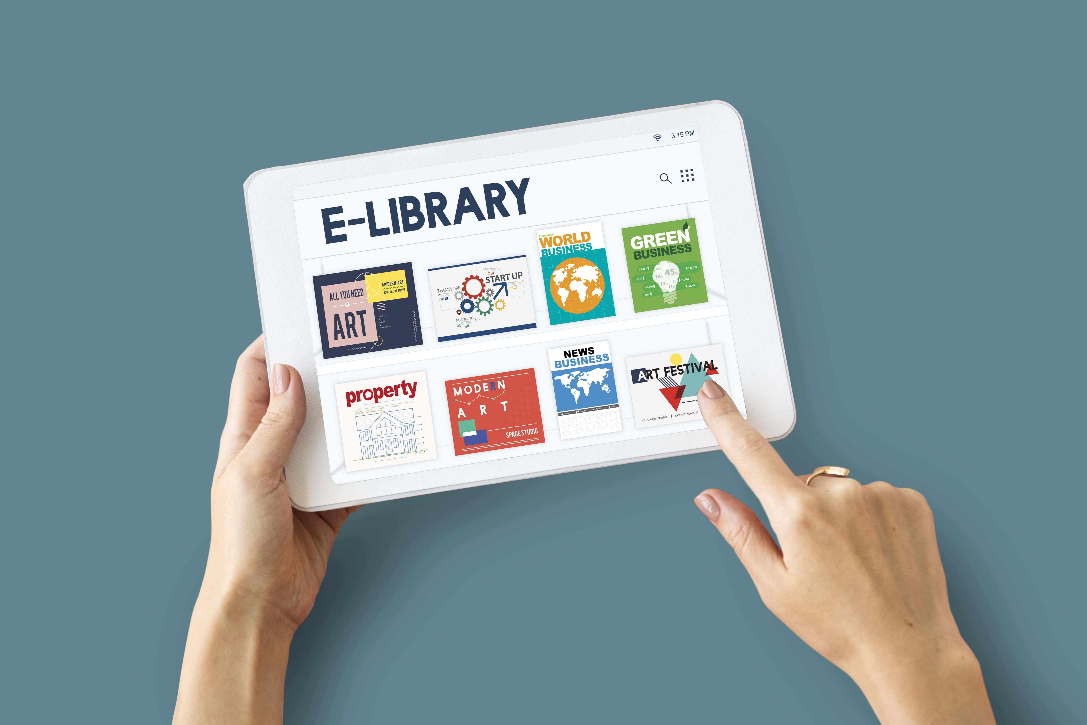
Introduction
E-Library is all about organizing, managing the library and library oriented tasks.
The main aim of this project is providing an easy to handle and automate library management system.

Slide 5
Goals
Book Sharing
Resources Stock
Online Reading
Curriculum notes & question paper availabilities

Slide 6
02
Analysis
Needs,Essentials & Process

Slide 7



Requirements
VsCode
Ms Office
Photoshop
Laptop
Pendrive
Printer

Slide 8

FrontEnd
HTML
CSS
JavaScript

Slide 9
BackEnd
PHP
MYSQL

Slide 10


Process
Step 1
Step 2
Step 3
Step 4
Requirement Gathering
Testing
Planning & Analysis
Design

Slide 11
This is a gantt chart
 | Week 1 | Week 2 | Week 3 | Week 4
Planning
Research
Analyzing
Coding
Report

Slide 12
03
Challenges
Problems & Solution

Slide 13


Problem
Solution
Manual insertion of resources by a programmer which makes website static.
Attaching a MYSQL database which allows for dynamic updates.

Slide 14



Learn the difference
Admin
User
Admin has full authority for updating, deleting resources and responsible for various changes.
User has only the authority of getting access to the resources.

Slide 15
Problems in traditional libraries
1. Limited space for physical books
1. Unlimited storage capacity
2. High maintenance costs
2. Lower maintenance costs
3. Difficulty in keeping track of physical books
3. Efficient book tracking through database management
Solutions in Digital libraries

Slide 16

Progress Check
E-Library
Study Page
Books
Showcase
Study notes & papers
Helping Focusing in study with pomodoro timer technique and to do list
Collection of Books that can be accessible through the internet
Projects, Arts and other learning materials
Users can view, download various notes and resources easily

Slide 17
04
Conclusion
Digital Transformation Improving Library Services

Slide 18
Conclusions
However, implementation requires proper planning, training, and technical support.
It also needs continuous maintenance and updates to ensure its relevance and usability.
Overall, online library management systems are a useful tool for modern libraries.
A)
Easy access to resources
Efficient organization of information
B)
C)
Improved Accuracy & Security of Data

Slide 19
—Steve Jobs
Out of the box
"The only way to do great work is to love what you do.”

Slide 20
Thanks
Do you have any questions?
Email us at:
librariansupervisor@gmail.com
Keep
Learning

