Slide 1
UDP Chat Application using Swift, SwiftUI and Wireshark
Computer Networks Project
Student name: Kushalkumar Thakar
Student Id: 5155617
Course name: Computer Networks (COSC-5906-S01)
Instructor name: Ajmery Sultana
Date: 22 July 2026

Slide 2
Project Overview
CONTENT
A peer-to-peer chat application that lets two devices or simulators exchange text messages using the User Datagram Protocol.
Understand UDP socket programming.
Send and receive UDP datagrams.
Study IP Address and Port number
Capture and analyze packet using Wireshark.
Compare UDP and TCP
SwiftUI Client A
UDP Datagram
SwiftUI Client B

Slide 3
Problem Statement
MOTIVATION
Production chat system normally use TCP, TLS, or Web Sockets because reliable delivery matters
This project intentionally uses UDP to demonstrate connectionless communication
UDP has low overhead and can transmit message quickly.
UDP does not guarantee delivery, ordering, or retransmission.
UDP | Observe
No handshake | Packet appearance without connection
Low overhead | Small transport header
No reliability | Lost messages are not resent

Slide 4
Technologies used
TOOLCHAIN
Technology | Role in the project
Swift | Network logic and application control flow
SwiftUI | Chat interface for input and message display
Apple Network Framework | UDP listener and UDP connections
Xcode | Development, build, and simulator testing
Wireshark | Packet capture and protocol analysis

Slide 5
UDP Fundamentals
TRANSPORT LAYER
Connectionless transport protocol
No handshake
No delivery guarantee
No retransmission
No ordering guarantee
No flow control
Low overhead
Preserves message boundaries
Common UDP Uses
DNS
Online gaming
Voice calls
Live video
Real-time communication
Message 1
Message 2
Message 3

Slide 6
Application Architecture
SYSYTEM DESIGN
SwiftUI Chat View
Component | Responsibility
View | Display messages and collects user input
ViewModel | Manages state and chat events
Network Services | Sends and receives UDP packets
Message Model | Stores sender, text, time and direction
Chat ViewModel
UDP Network Service
UDP Datagram
Peer Chat Client

Slide 7
Message Communication Flow
DATAGRAM LIFECYCLE
SwiftUI Chat View
Chat ViewModel
UDP Network Service
UDP Datagram
Peer Client
User enters a message.
SwiftUI passes the text to the viewModel.
viewModel call the UDP network service.
Text is converted into Data.
UDP datagram is sent to the destination endpoint.
Receiver gets the datagram.
Data is converted back into text.
Message appears in chat.

Slide 8
IP Addresses and Port Number
ADDRESSING
An endpoint combines a device address and an application port.
Source: 192.168.1.10:5000 Destination: 192.168.1.11:5001
IP address identifies the destination device.
Port number identifies the destination application.
Local port receives incoming messages.
Peer port is the destination when sending.
Client | IP address | Port
Client A | 192.168.1.10 | 5000
Client B | 192.168.1.11 | 5001
Bonjour or UDP broadcasting can be used for automatic peer discovery

Slide 9
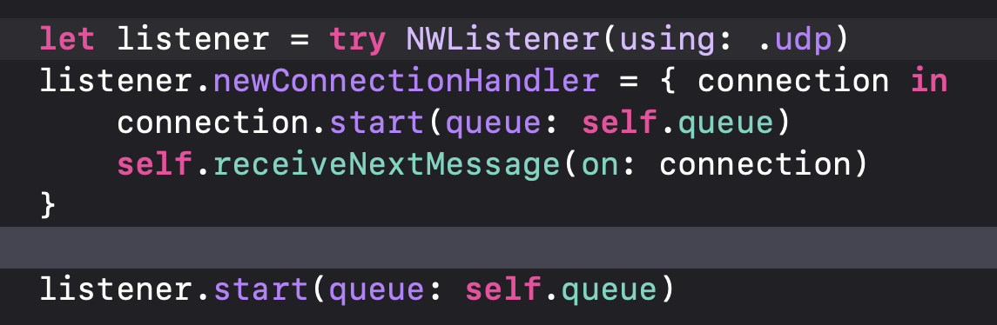
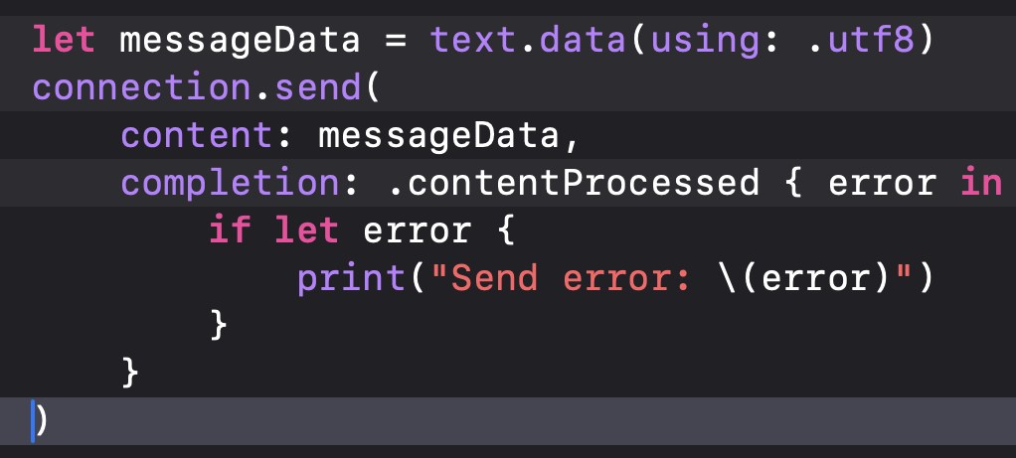
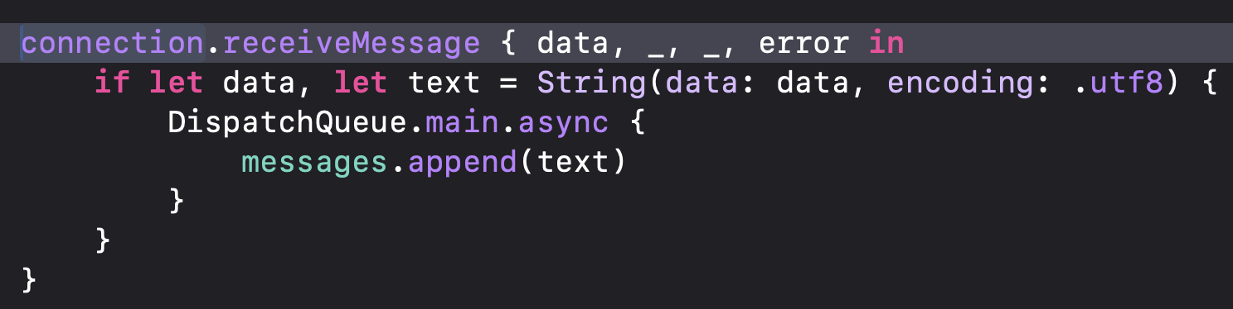
Important Swift Implementation
SOCKET PROGRAMMING
Each message is sent as an independent UDP datagram.
Network callbacks run off the main thread.
SwiftUI state must be updated on the main thread.
Create a UDP Listener
Send one datagram
Receive and update UI

Slide 10
Wireshark Packet Capture
PACKET CAPTURE
Open Wireshark
Select the correct network interface
Start capture packets
Run both chat clients
Send chat messages
Apply a UDP display filter
Filter | Purpose
UDP | Show UDP packets
UDP.port == 5000 | Filter one UDP port
Ip.addr == 192.168.1.10 | Filter one host
Udp && frame contains “Hello” | Find message payload

Slide 11
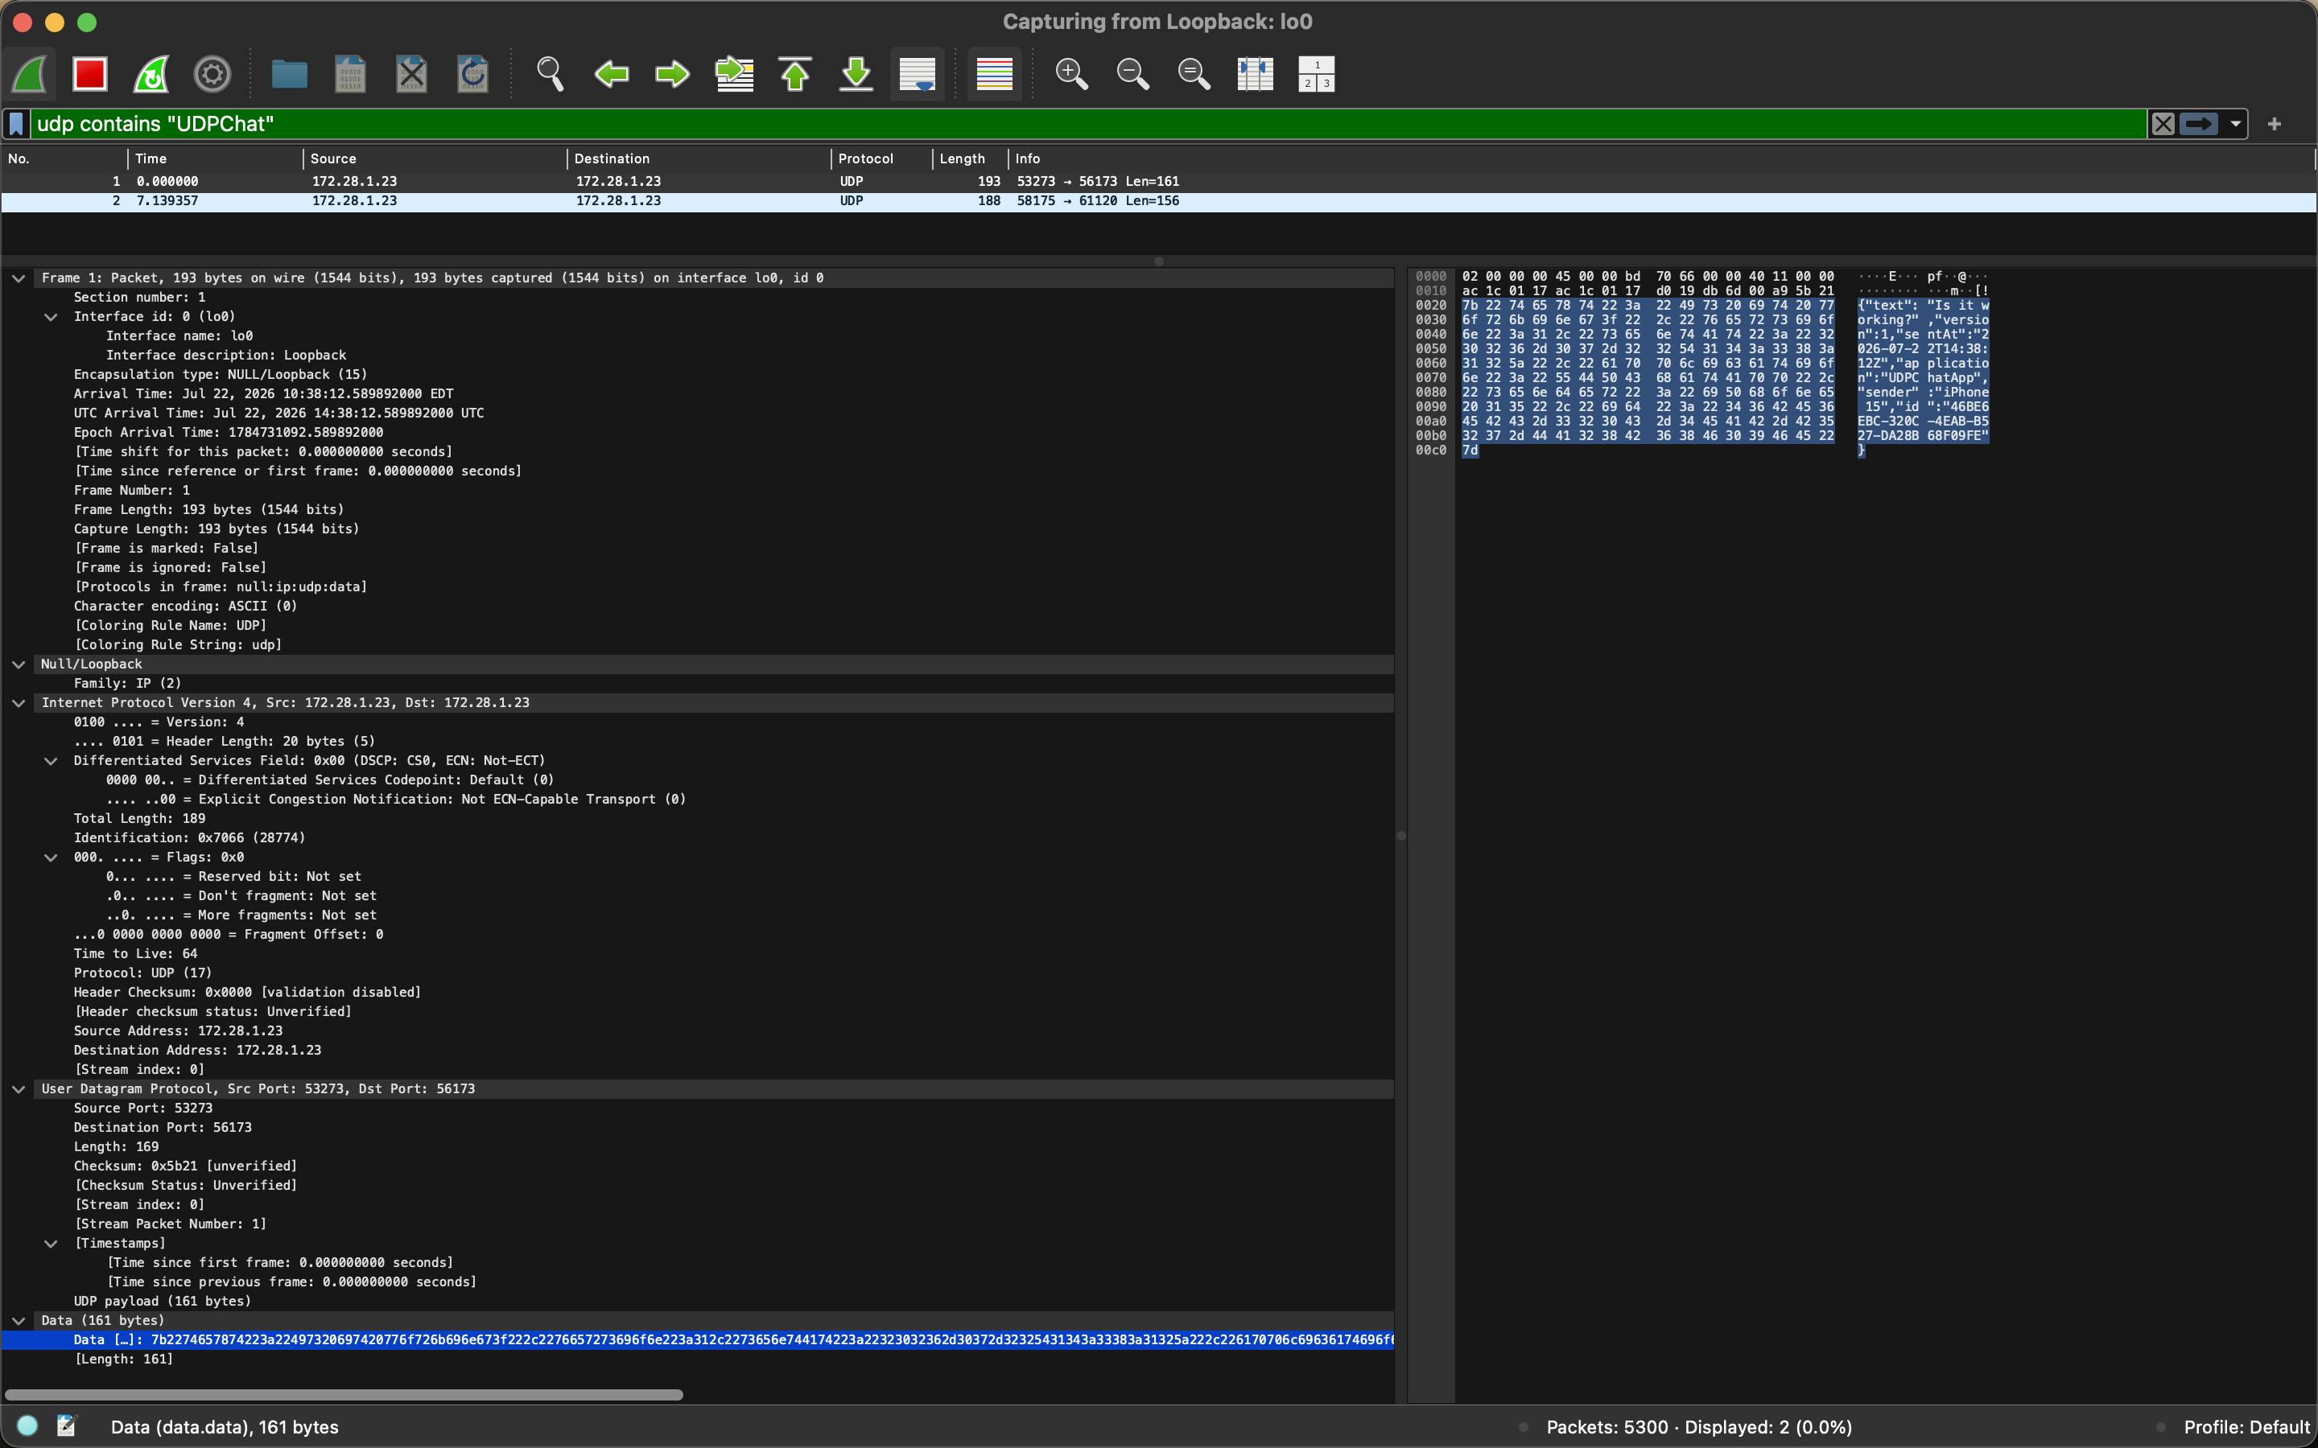

Slide 12
Wireshark Packet Capture
PACKET CAPTURE
Layer | Field to identify
Ethernet/Loopback | Source, destination, frame length
IP | Source IP, destination IP, TTL, protocol, total length
UDP | Source port, destination port, length and checksum
Application | Readable chat-message payload
Example payload: Hello from the Client A
Unencrypted UDP payload may be readable in Wireshark

Slide 14
Testing and Results
VALIDATION
Test Case | Expected result | Observed result
Receiver active | Message appears | Passed
Reply from second client | Datagram return | Passed
Receiver closed | Message may be lost | No delivery confirmation
Rapid messages | Independent packets | Multiple datagram visible
Larger message | Payload visible | Captured in Wireshark
Wireshark capture | UDP header visible | Port and payload visible
Message are transmitted as independent datagram.
No connection setup occurs.
Source and Destination port are visible.
Messages may be lost if the receiver is unavailable.
The sender receives no delivery confirmation.

Slide 15
Challenges, Limitation, and Improvements
PROTOCOL COMPARISON
Challenges
Running two clients on one computer.
Finding the correct interface
Simulator networking behavior.
Updating SwiftUI from background callbacks
Avoiding port conflicts.
Handling local-network permission.
Limitations
No delivery guarantee
No acknowledgements
No retransmission
No encryption
No authentication
No message history
Limited NAT traversal
Future improvements
Bonjour peer discovery
UDP broadcast discovery
Message ID’s
Acknowledgement packets
Retry mechanism
Sequence numbers
Duplicate detection
Encryption
Group chat
TCP comparison

Slide 16
Conclusion and Demo
WRAP UP
The Project demonstrate how UDP enables fast, connectionless, communication between network clients.
UDP socket communication.
IP addressing and port usage.
Connectionless message exchange.
Packet capture and analysis.
UDP speed and low overhead.
UDP reliability limitations.
How to run the code and capture in Wireshark
Launch two clients
Send a message from Client A
Receive it on Client B
Reply from Client B
Open Wireshark and filter UDP traffic
Identify IP address, port, UDP header, and payload

Slide 17
Thank you

