Slide 1
BDM Capstone Project
Lead time Optimization of Madpackers
Kushan Sharma
21f3000848

Slide 2
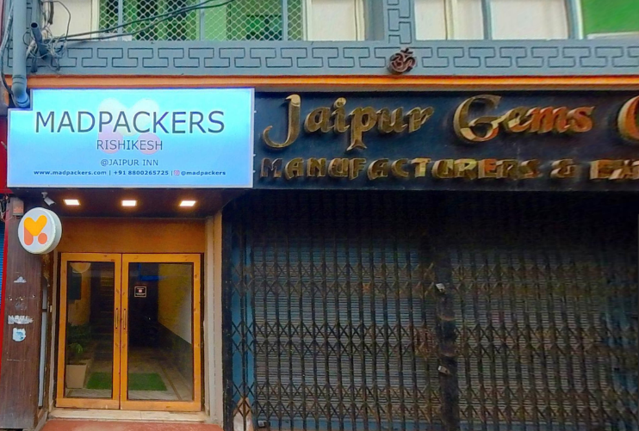
About the Organization
Established in 2014, Madpackers was founded with an idea to create a chain of backpacking hostels that are safe as well as affordable
It serves under the hospitality sector and largely caters to youngsters and solo travelers.
The key visionaries behind this idea are Mayank Srivastav and Narender Sondhi.
It started its operations in Delhi and over the years expanded to other locations like Rishikesh, Amritsar, Agra, Bir, Dharamkot, Jibhi, Khajuraho, Manali, and Pushkar
The organization is on a mission to foster an adventurous spirit among the Indian youth.

Slide 3
Problem Statement
How to increase their average lead time so that they can better forecast their revenue and more efficiently manage their occupancy.
To solve this problem we will be analyzing their pricing strategy and gauge level of satisfaction of customers through NPS.
For the price analysis we will collect data regarding their Rishikesh hostel for the period of 9 months (April-22 to Dec-22).
For the NPS part we will collect data regarding reviews of their Rishikesh, Manali, Pushkar and Agra hostels for the period of 9 months (April-22 to Dec-22)
We will be using excel as a tool for analysis and various visualization methods like Bar charts, Line charts and more.

Slide 4
Analysis
It is evident from the charts that April and August witness the least numbers of reservations, while May and October witness the highest number of reservations.
When it comes the lead time August has the maximum lead time, while the other months have a lead time between 2-4 days.

Slide 5
It can be the first chart that September, October, November and December are months with highest number of foreign nationals.
May, June, and October are the peak months for the hostel.
May and October are the months with the highest number of cancellations.

Slide 6
It can be seen from the first chart that Superior 6 Female and Superior Triple Ensuite have the highest lead time among all the rooms
It can also be seen that Superior 6 Bed Mixed Ensuite has the proportions of bookings despite having the lowest lead time among the rooms.
It is worth noting that the percentage of Indian nationals is less as compared to the percentage of foreign nationals when to rooms with high lead times.

Slide 7
Hostel world, Internet Booking Engine and MakeMyTrip and Booking.com have the highest lead time
Hostel World and Internet Booking Engine have the highest proportion of bookings.
Furthermore, both Hostel World, Booking.com have high lead time and are largely preferred by foreign nationals.

Slide 8
It can be seen that the ADR peaks in the month of June and December while it drops in the month of September.
From the competitive analysis we can conclude that the prices of Madpackers are lowest from its competitors. There is almost 11-15% difference between the prices of Madpackers and the competitors

Slide 9
In the above analysis, it can be seen that the NPS of Madpackers is very close to Zostel which has an NPS of 65 (which is moderately good), while is far above the NPS of Oyo rooms which has an NPS of 48.7( which is considered average). Therefore, we can conclude that Madpackes is doing well concerning the competition

Slide 10
Recommendations
Madpackers should advertise regarding their female only room as it has high lead time and low proportion in the total bookings.
Furthermore, Superior 4 Bed Mixed Ensuite, Superior, Superior Double Ensuite and Superior Triple Ensuite should be incentivized as all of them high lead time and low proportions in the total bookings.
Travel agent such as MakeMyTrip which has a lead time of 4.10 days and only favored by 11% of people. Therefore, Madpackers should launch promotional schemes to boost the popularity of the travel agent.
Madpackers can increase its prices as seen from the competitive analysis. It will help them to increase their sales revenue
Madpackers can further improve their NPS by encouraging the customers to leave a feedback. They can automate the procedure by using a software for such.

