Slide 1
WELCOME
Kurunegala Plantations Limited Trade Database System

Slide 2

Introduction
Kurunegala Estates Limited is a government company that manages coconut plantations and trade.
It manages plantations, suppliers, purchases, orders, payments, storage and quality checks.
The current systems are manual or use separate systems, which has caused data errors and delays.
The aim of our project is to integrate them and create an efficient data system.
This will facilitate operations by correcting data, preparing reports and improving performance.

Slide 3
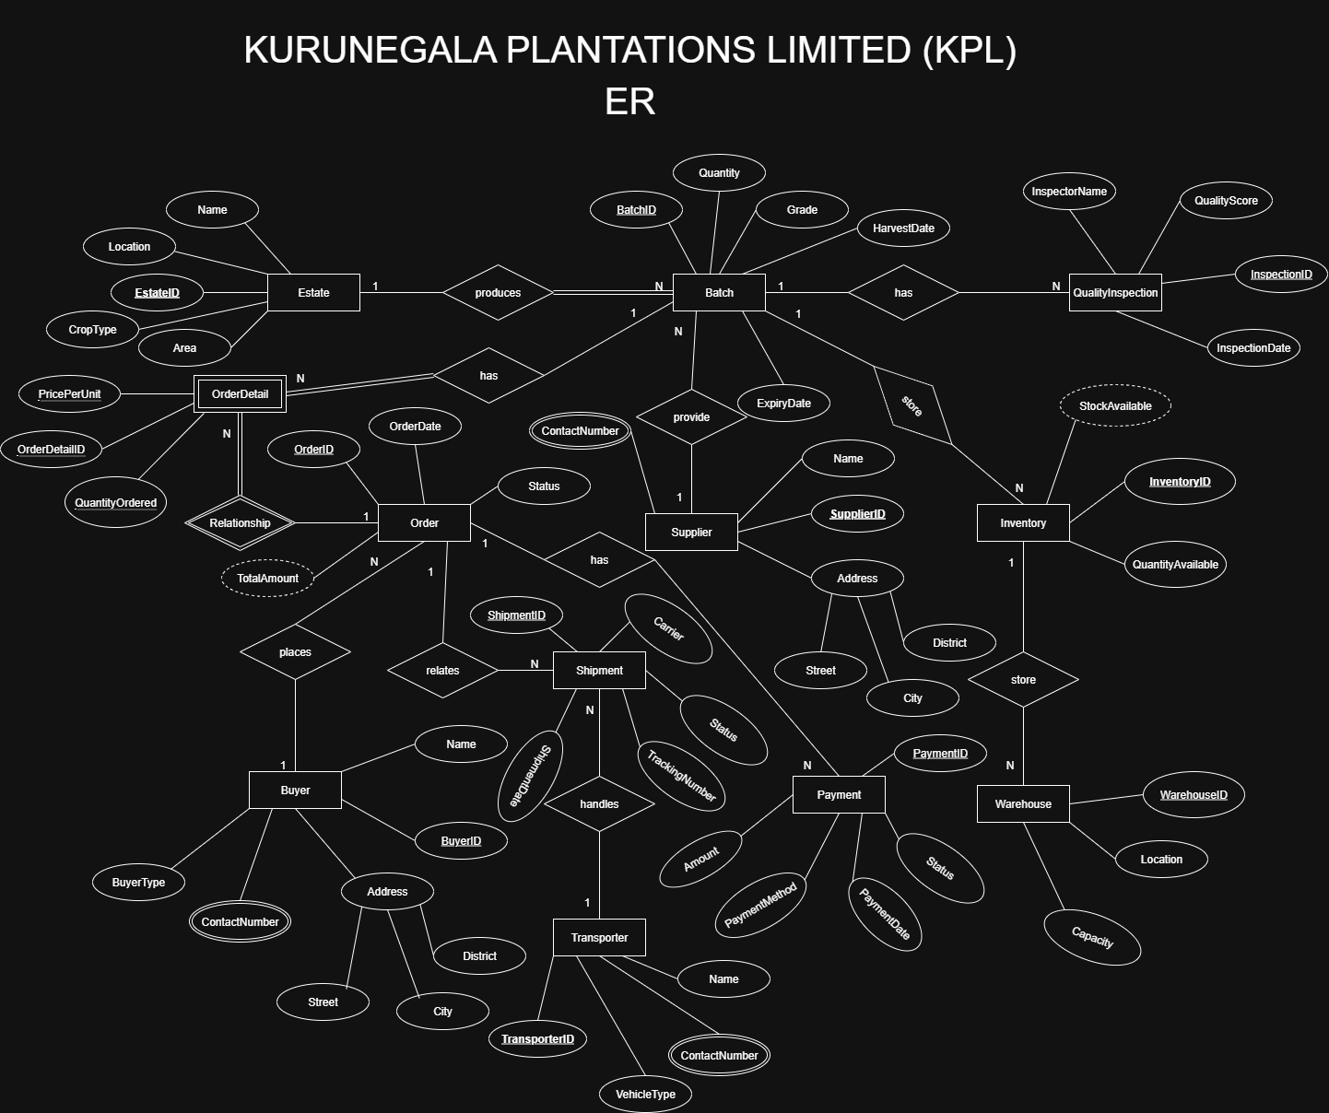
ER Entity-Relationship Model

Slide 4
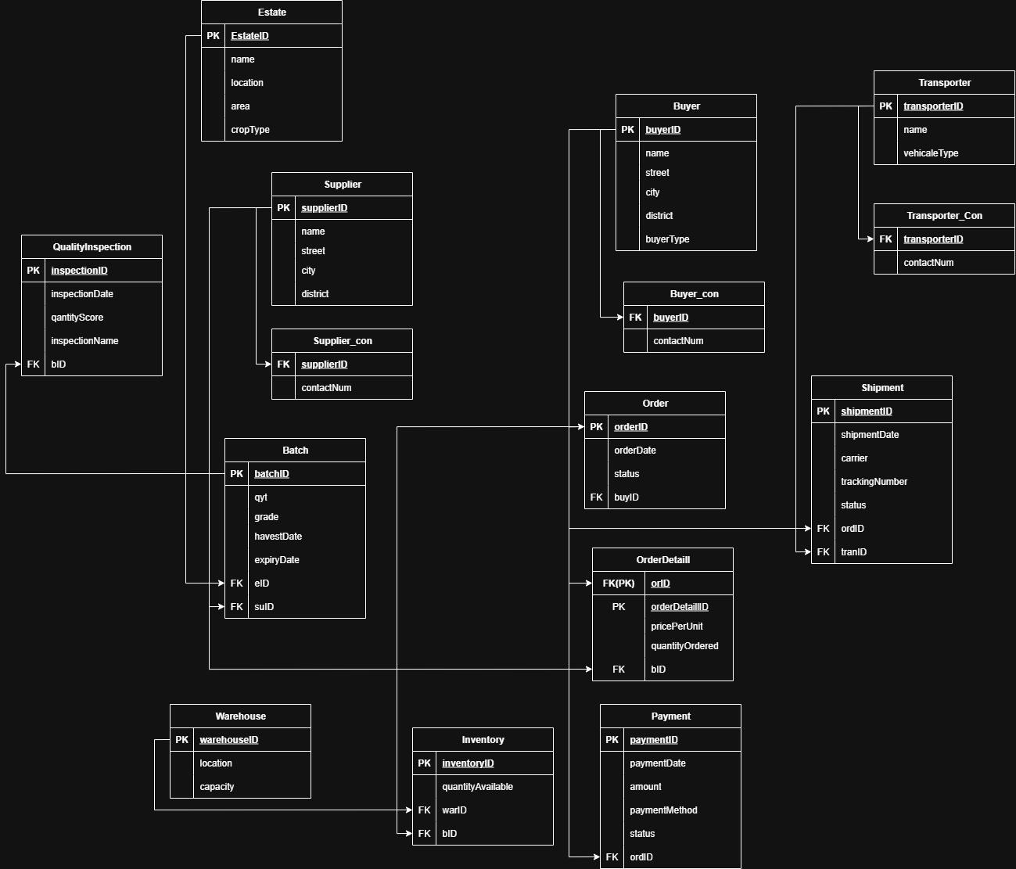
Schema

Slide 5
Physical Design
Sample SQL Code
CREATE DATABASE KPLDB;
USE KPLDB;
-- Create Table Estate
CREATE TABLE Estate (
EstateID VARCHAR(10) PRIMARY KEY,
Name VARCHAR(100),
Location VARCHAR(100),
Area FLOAT,
CropType VARCHAR(50)
);
/**/
In This Database Have 12 Entity’s
15 Tables and history Table

Slide 6
Reports
Our database can generate Grouped Reports.
For example, reporting the Total Quantity (SUM) and Average Quantity (AVG) of coconuts by estate.Reports allow managers to easily track estate progress, order status, payment information, and quality inspection results.
Reporting helps in decision making and improves business efficiency.These reports enable Kurunegala Estates to provide better information on estate management and trading.

Slide 7
Advantages
Stores data accurately and securely.Manages estates, coconut stocks, orders, payments and routes efficiently.Provides a system that keeps track of data changes and provides accountability.
Speeds up decision-making through reporting and analysis facilities.Saves time and resources by speeding up tasks.
Maintains data integrity and relationships accurately.These advantages enable Kurunegala Estates to perform better and more efficient management.

Slide 8

Conclusion
The database system designed for Kurunegala Estates helps in efficient management of estates, suppliers, purchases, orders, payments, warehouses and quality inspections.
Improves data accuracy, security and accountability.Reports and analytics facilitate decision-making.
The system was able to save time and resources and improve performance.

Slide 9
THANK YOU…

