Slide 1
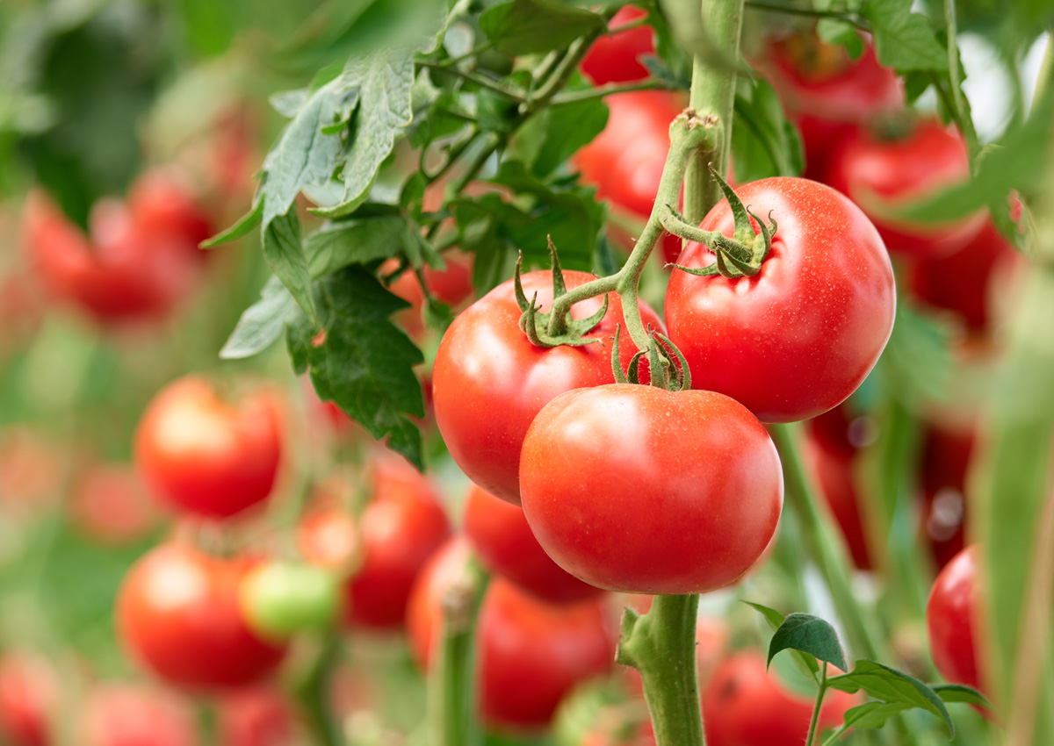
Respiration
By class 7c ,roll no 25-36
This Photo by Unknown Author is licensed under CC BY-NC-ND
Notes:
NOTE: To change images on this slide, select a picture and delete it. Then click the Insert Picture icon
in the placeholder to insert your own image.

Slide 2
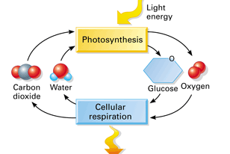
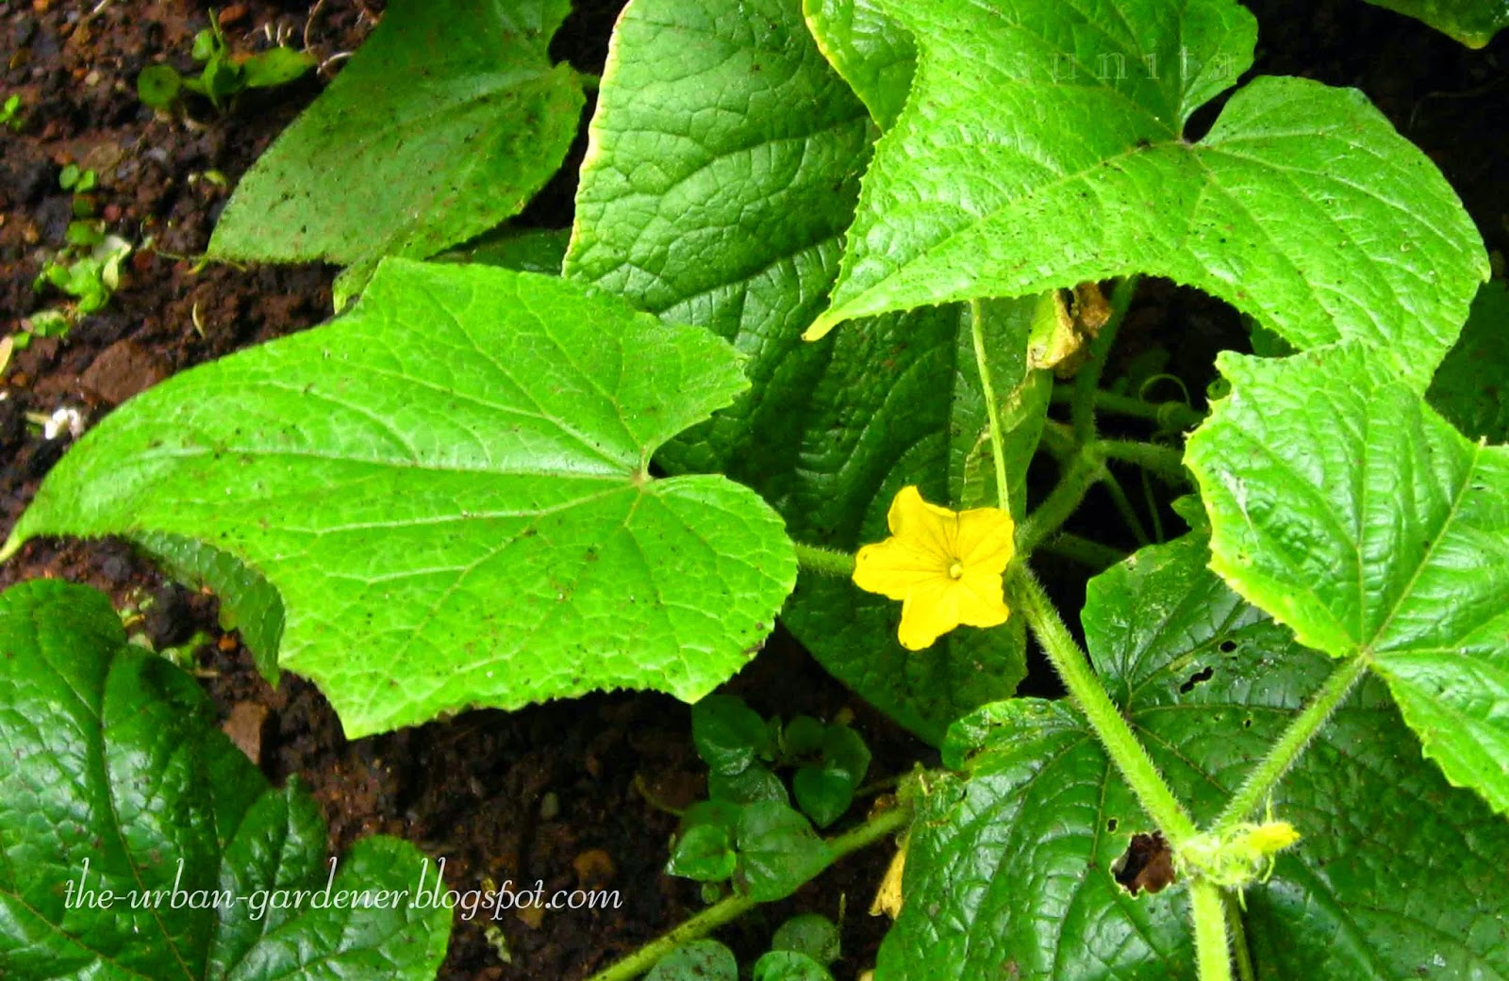
What is Respiration?
The process
This Photo by Unknown Author is licensed under CC BY-SA
This Photo by Unknown Author is licensed under CC BY-NC-ND

Slide 3

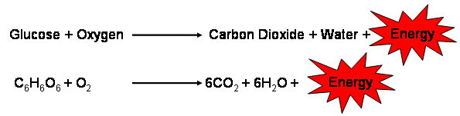
Types of Respiration:
Anaerobic respiration
Aerobic respiration

Slide 4
Difference between Respiration and Combustion:

Slide 5
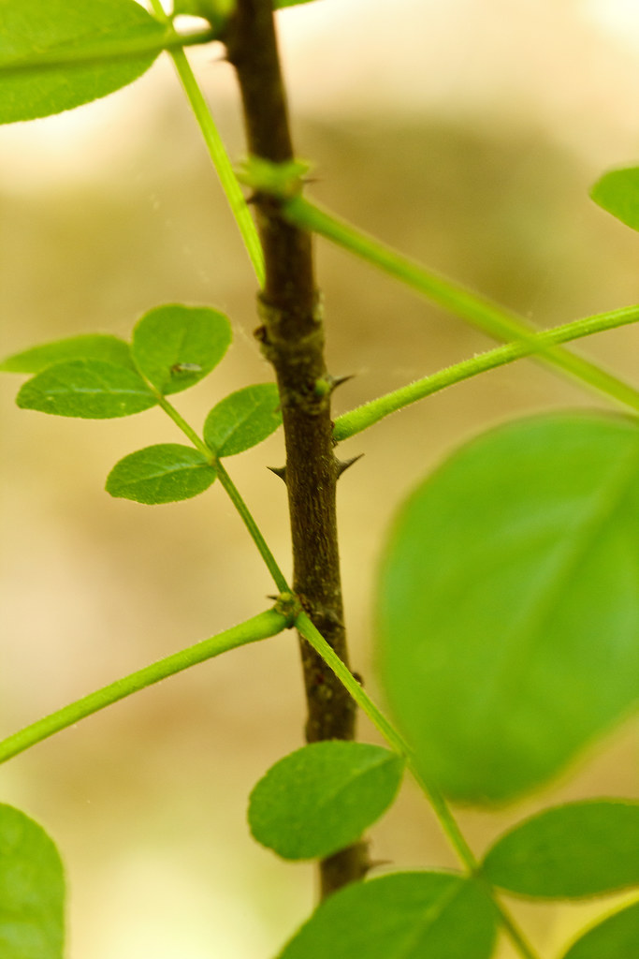
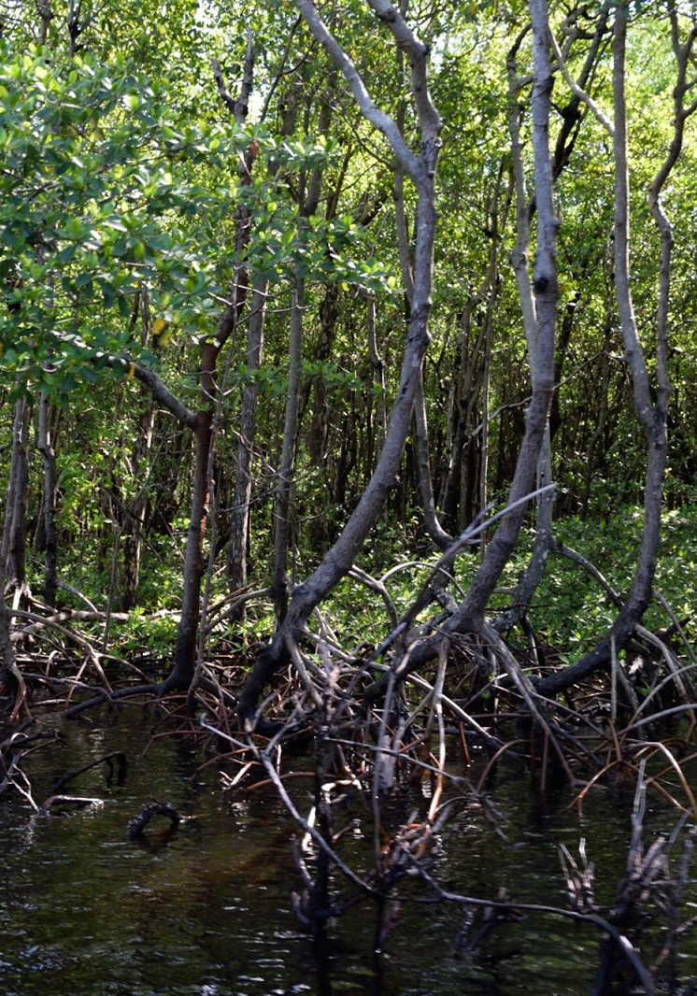
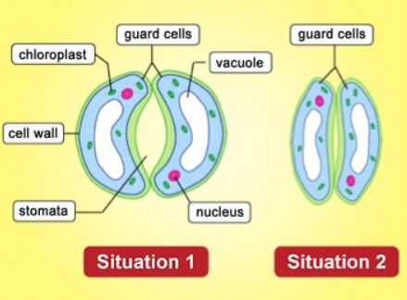
Respiration in leaves , stems and roots
Notes:
NOTE: To change images on this slide, select a picture and delete it. Then click the Insert Picture icon
in the placeholder to insert your own image.

Slide 6
Difference between photosynthesis and respiration:

Slide 7
Respiration in animals and plants:

Slide 8
Question Time:-
The food manufactured by plants is in which form?
When does glucose breaks down?
The equation for respiration.
Where does respiration takes place?
What is cellular respiration? What are its by products?
Products from aerobic and anaerobic respiration ?
Three differences between respiration and combustion?
What helps the stems to respire?
What are pneumatophores?
Where does photosynthesis take place?

Slide 9

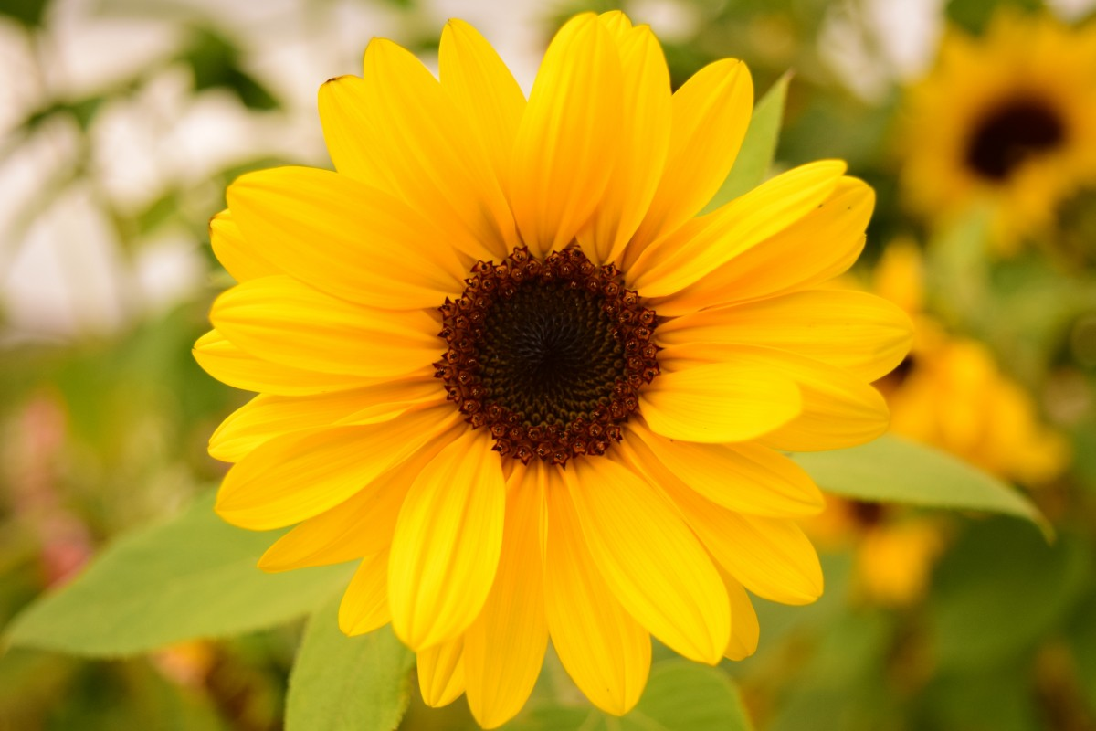
THANK YOU EVERYONE FOR YOUR PATIENCE DURING OUR PRESENTATION.

