Slide 1
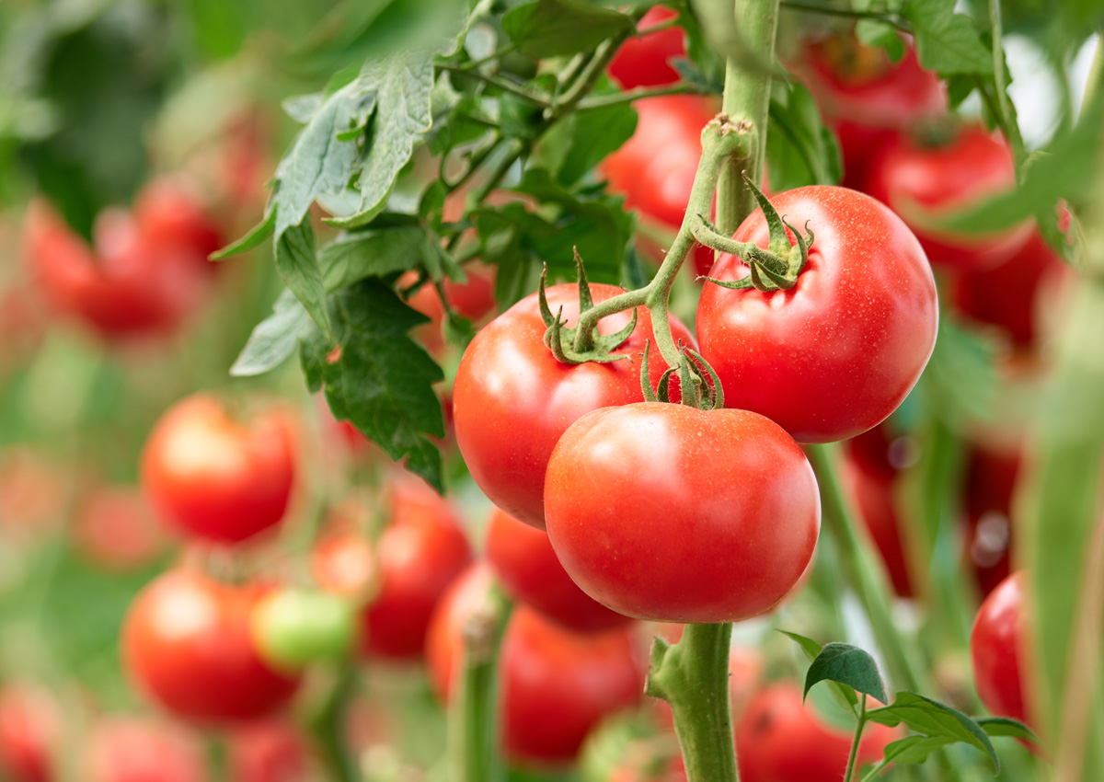
Respiration
By class 7c ,roll no 25-36
This Photo by Unknown Author is licensed under CC BY-NC-ND
Notes:
NOTE: To change images on this slide, select a picture and delete it. Then click the Insert Picture icon
in the placeholder to insert your own image.

Slide 2
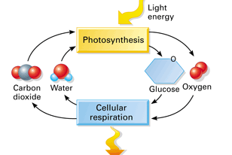
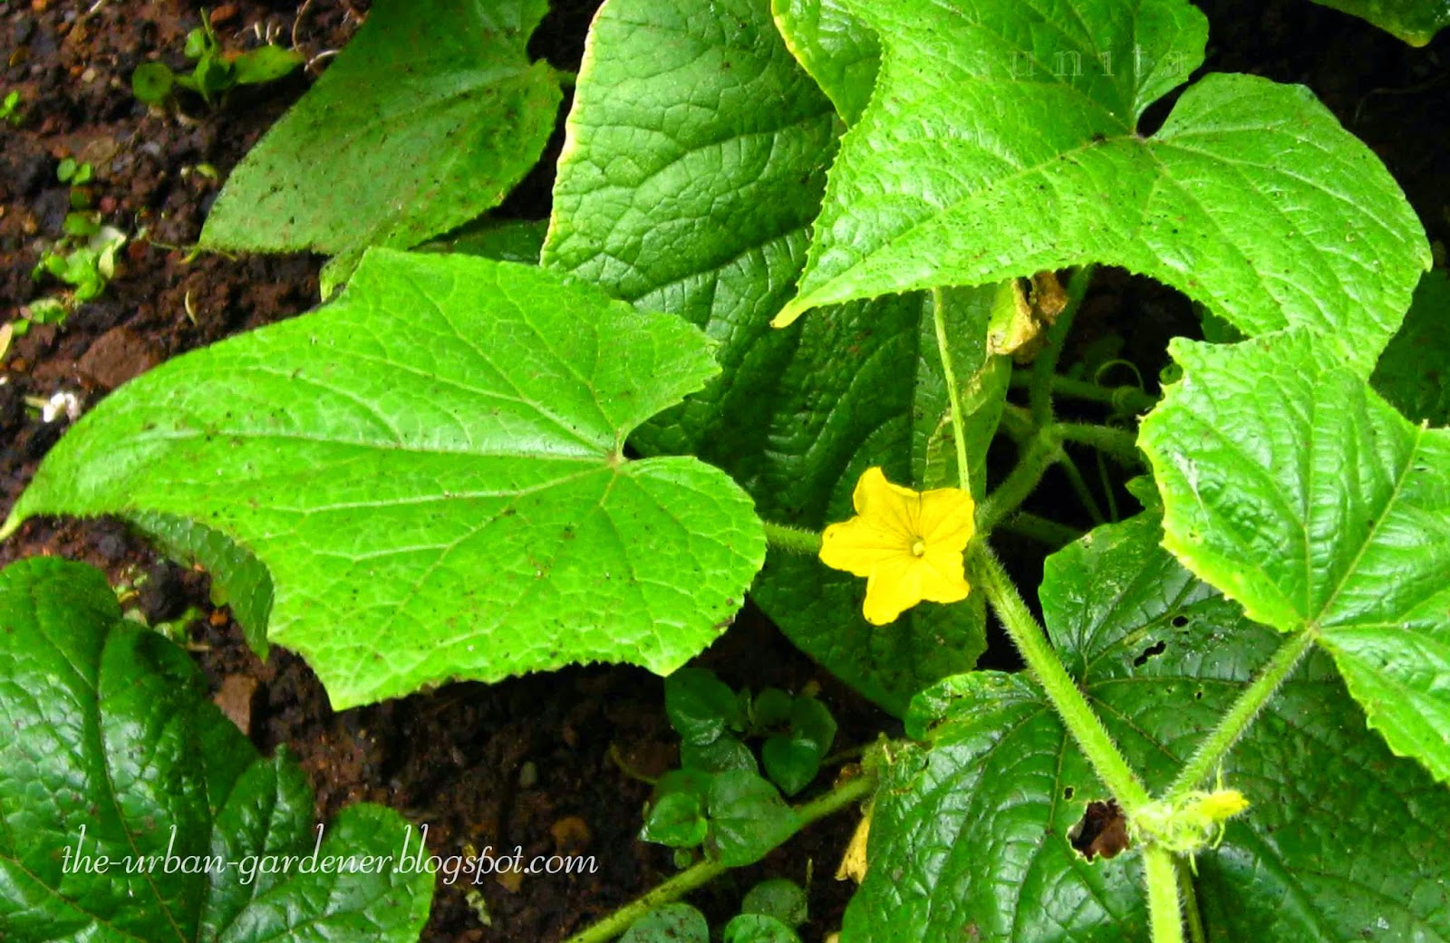
What is Respiration?
The process
This Photo by Unknown Author is licensed under CC BY-SA
This Photo by Unknown Author is licensed under CC BY-NC-ND

Slide 3

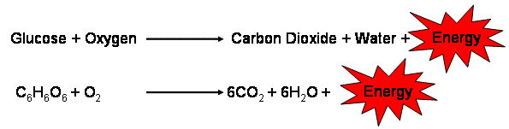
Types of Respiration:
Anaerobic respiration
Aerobic respiration

Slide 4
Difference between Respiration and Combustion:

Slide 5
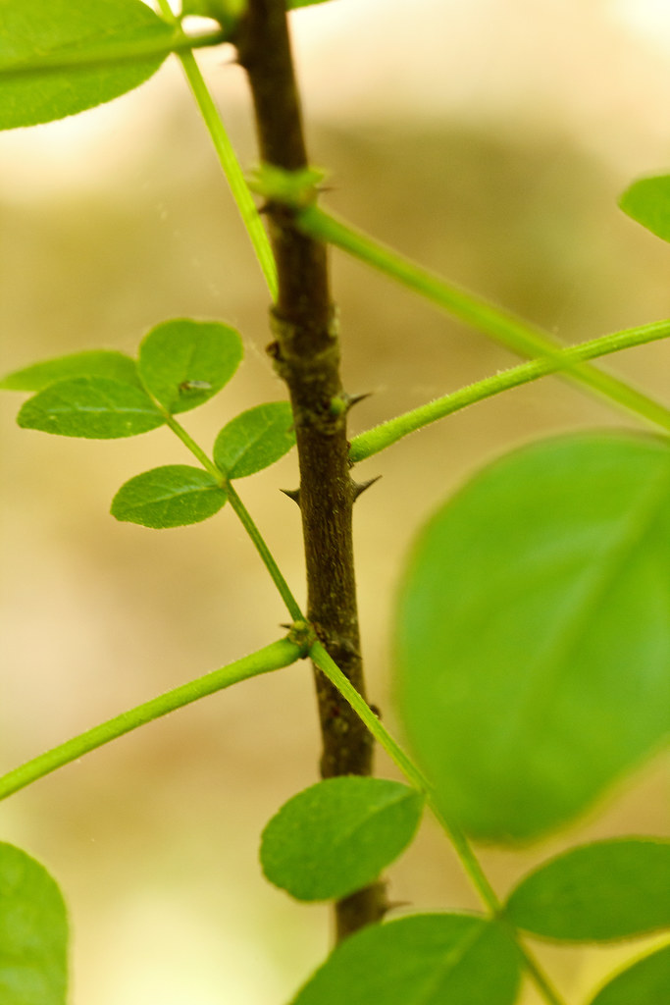
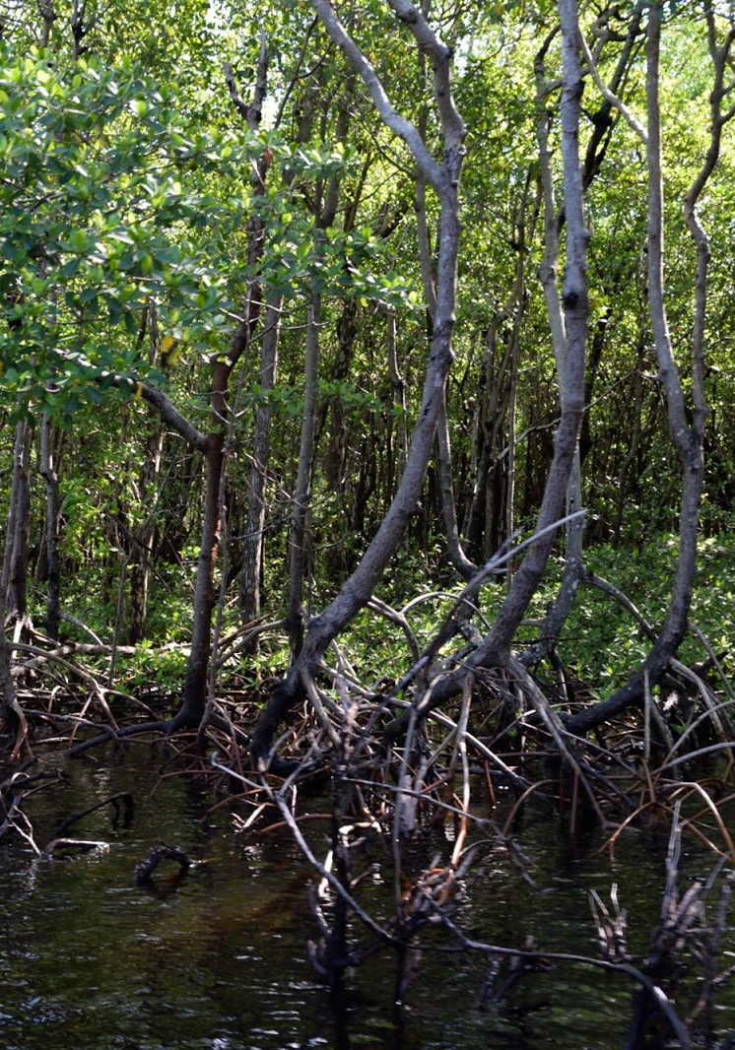
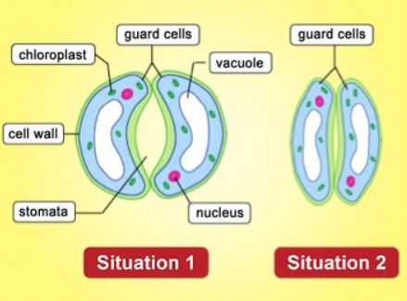
Respiration in leaves , stems and roots
Notes:
NOTE: To change images on this slide, select a picture and delete it. Then click the Insert Picture icon
in the placeholder to insert your own image.

Slide 6
Section break

Slide 7
Add a Slide Title - 6

Slide 8
Add a Slide Title - 7

Slide 9
Add a Slide Title - 8

