Slide 1
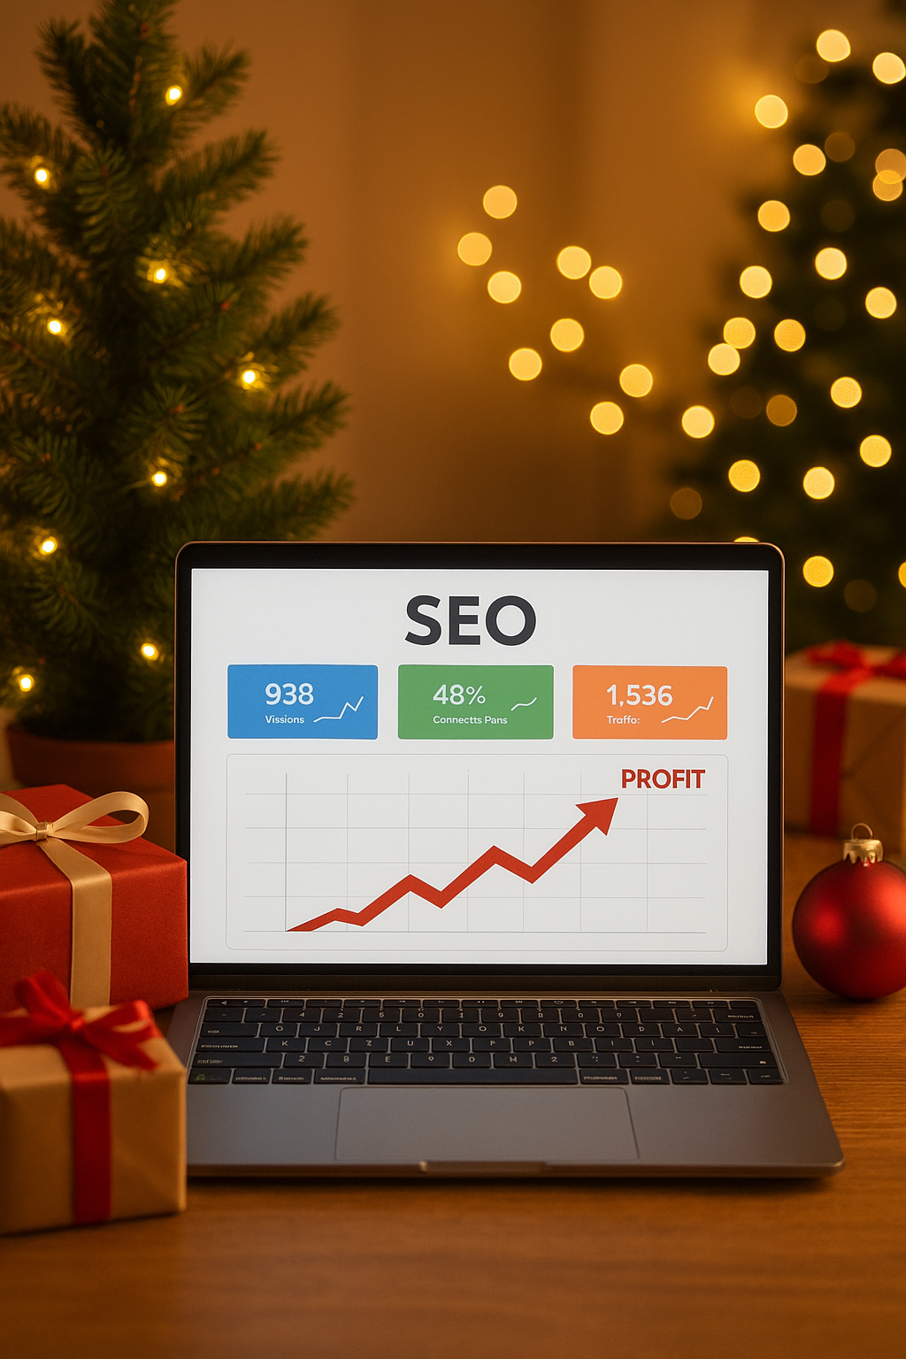

Notes:
Want to make this Christmas your most profitable yet? Discover how KushSEO can boost your holiday sales with digital marketing videos!

Slide 2

Notes:
Video content grabs attention and builds trust. With KushSEO, you can create engaging holiday videos that turn viewers into customers.

Slide 3
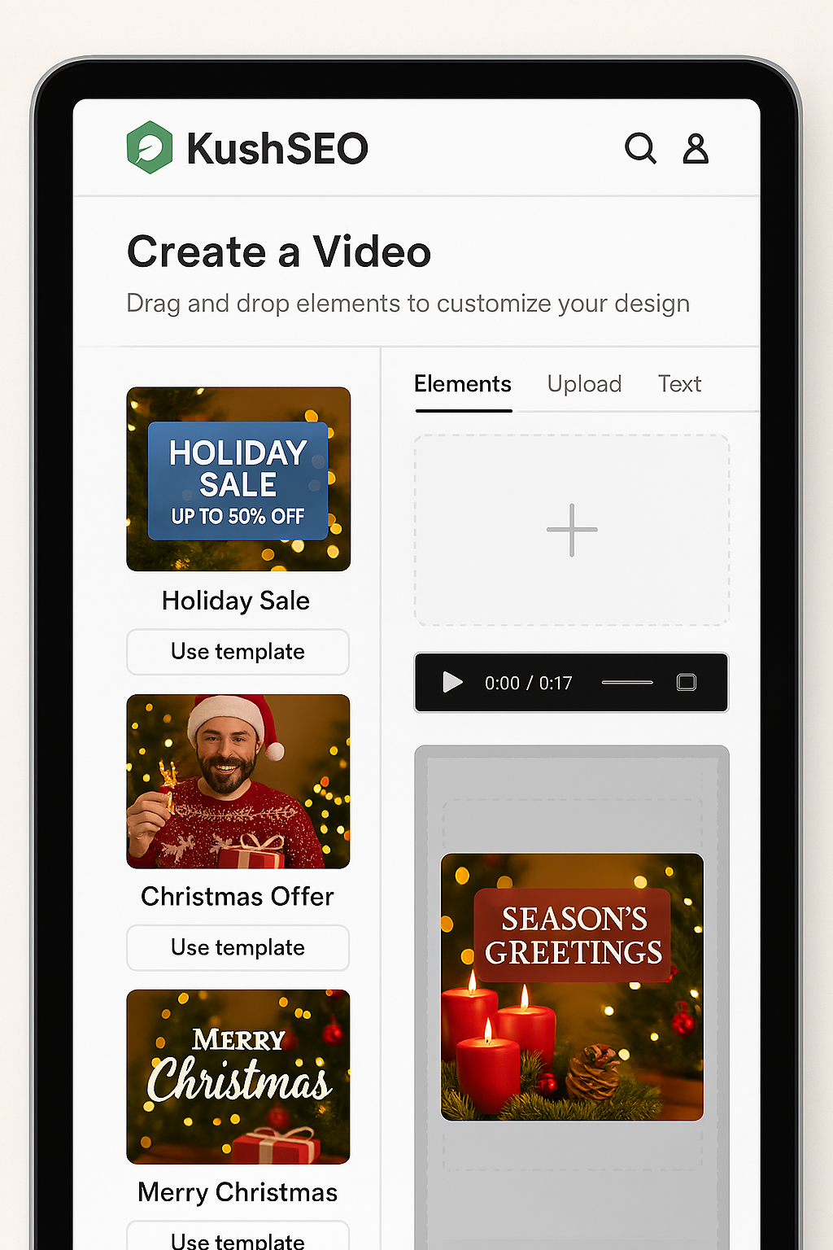
Notes:
No experience? No problem! KushSEO’s AI tools help you script, design, and optimize videos for maximum reach—fast.

Slide 4
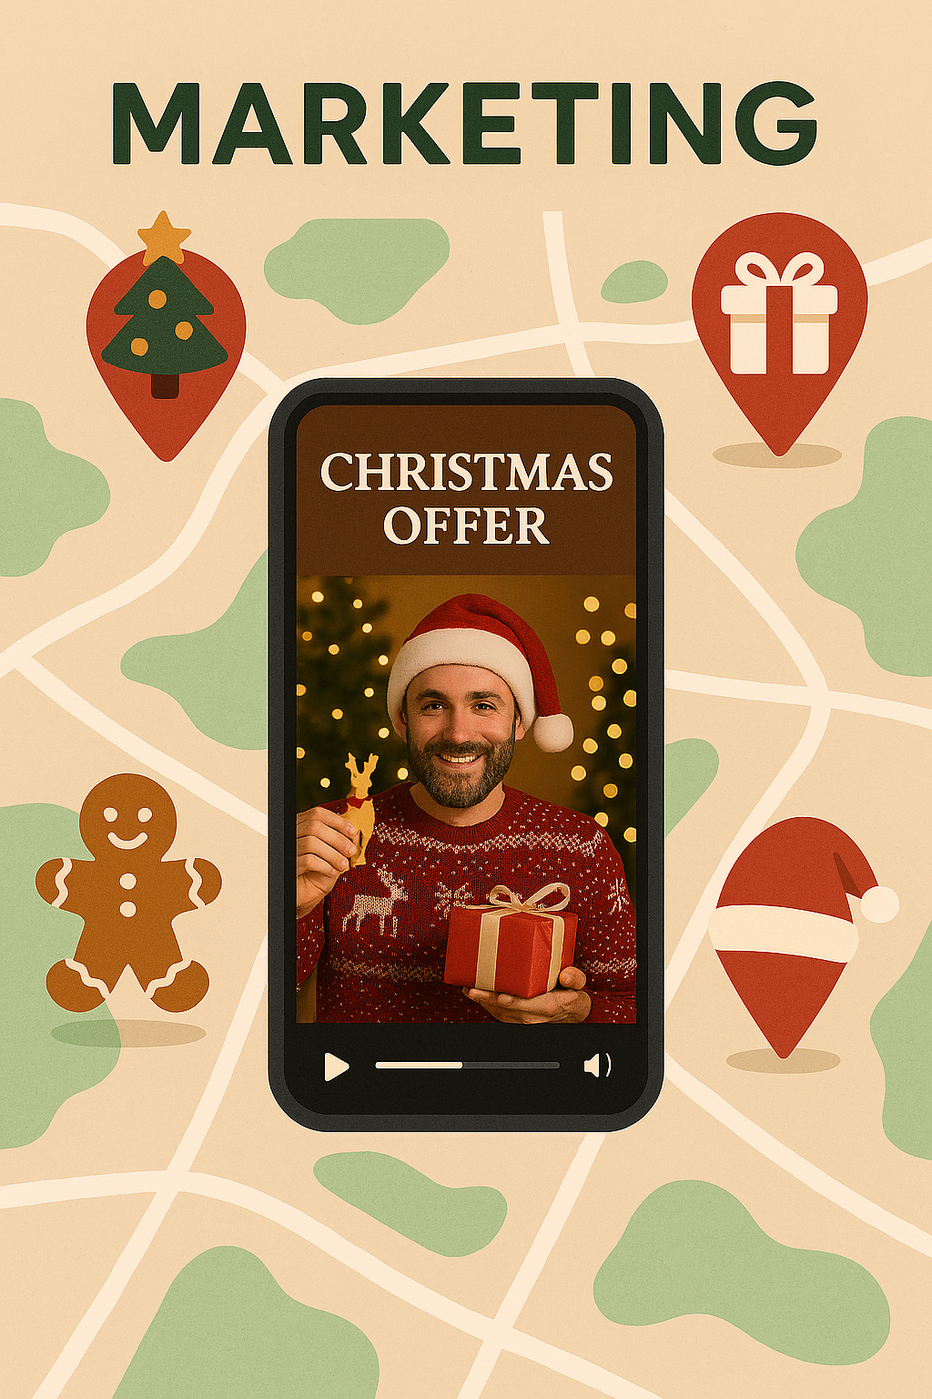
Notes:
KushSEO finds your ideal customers and puts your videos in front of them—on social media, Google, and more.

Slide 5
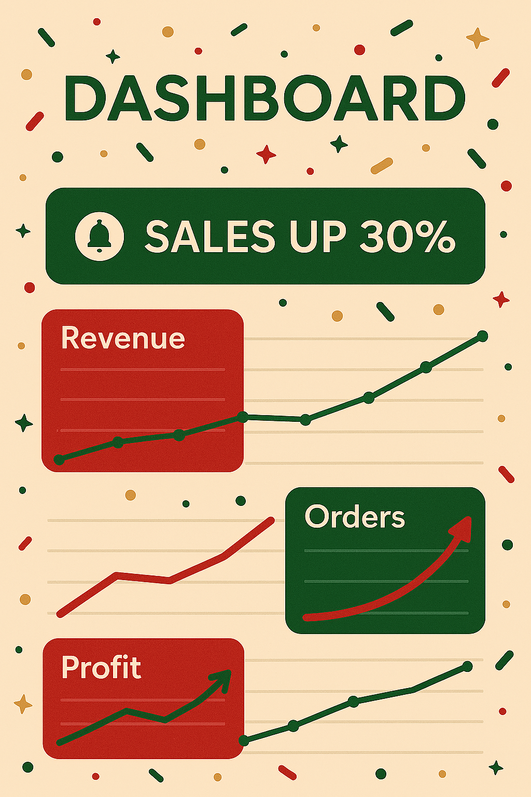
Notes:
See real-time results. Watch your traffic and sales grow with easy-to-read analytics.

Slide 6

Notes:
Don’t miss out this Christmas. Sign up for KushSEO and turn holiday cheer into real profits!

