Slide 2
We are here to present our Discrete Mathematics Project!!

Slide 3
But the main question is that What is the topic???

Slide 4
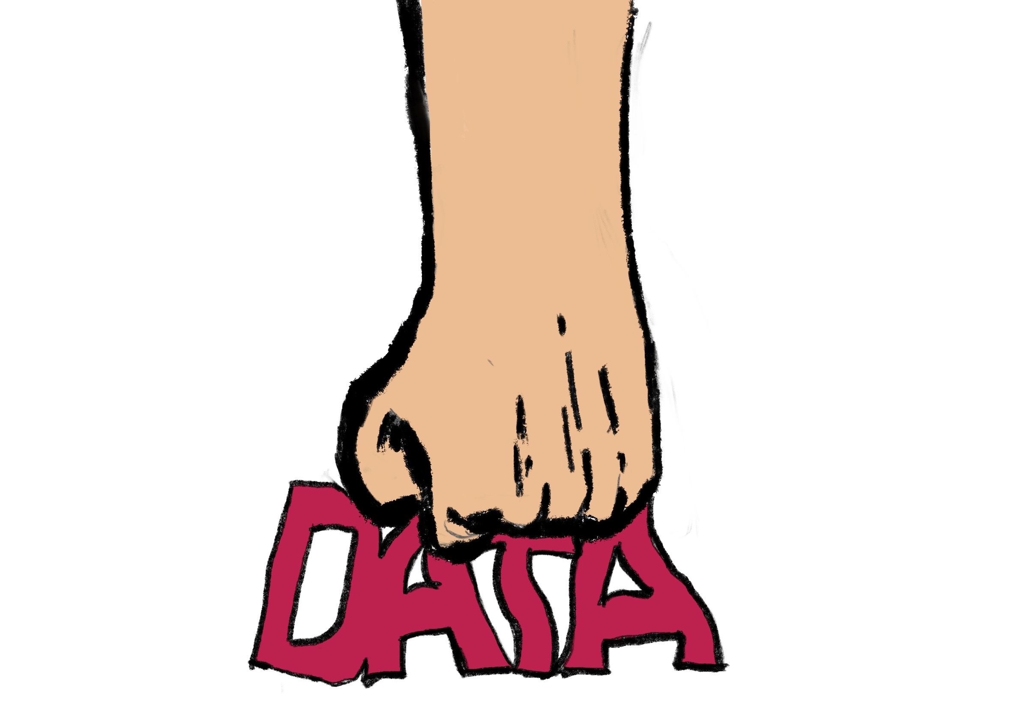

Slide 5
DATA COMPRESSION

Slide 6
Now,
A question arises in our mind!!!

Slide 7
What is Data compression and how it can be performed???

Slide 8
Hence, we will show you our journey of how we came to know about data compression!!!

Slide 9
What is Data Compression?
It is the process of encoding information using fewer bits than the original representation.
It enables sending a data object or file quickly over a network and in optimising storage resources.
In 1949, Claude Shannon and Robert fano created a methodology for allocating codewords based on block probability.
David Huffman later discovered an ideal approach for doing this in 1951 .

Slide 10
There are two types of Data Compression…

Slide 11
DATA COMPRESSION
LOSSLESS
DATA COMPRESSION
LOSSY
DATA COMPRESSION

Slide 12
Types of Data Compression
There are two types of data compression:
Lossless | Lossy
It is a method where the original data can be fully restored without any loss when compressed. | It allows for further reduction in file size, but it involves some loss of information.
It is suitable for the files that require the preservation of all the original data. | It is appropriate for the file types where the missing information is not easily noticeable
For e.g. Software programs, papers and specific media types used by creators like musicians, musicians, filmmakers and photographers. | For e.g. media files downloaded by users, including songs, videos and photos.

Slide 13
Now,
How does Data Compression work??

Slide 14
It depends on the kind of data you wish to compress!!!

Slide 15
in in in
TEXT
Redundancies and patterns in text files are identified and encoded using shorter codes or symbols to reduce the size.
PICTURE
Similar to text compression, patterns and duplication in picture files are detected and encoded using shorter codes or symbols
AUDIO
Audio files are compressed using lossy techiniques to remove background noise and white noise while preserving the main content of the recording.
VIDEO
Video files require a specific compression method as they contain both audio and image data

Slide 16
There are different approaches to perform Data Compression!

Slide 17
Some of them are...
Huffman Coding
Run Length Encoding
Arithmetic Coding
Lempel-Ziv-Welch Compression

Slide 18
We will go through all of them one by one.

Slide 19
Huffman Coding
It is a data compression algorithm developed by David A. Huffman in 1952.
It is used for lossless compression and works by assigning shorter codes to frequently occurring symbols and longer codes to less frequent symbols.
The algorithm involves building a binary tree called the Huffman Tree based on symbol frequencies, and then assigning binary codes to each symbol on the tree structure.
It achieves compression by reducing the average number of bits required to represent the input data.

Slide 20
Uses of Huffman Coding:
It is best for simple graphics and animations with lots of unnecessary pixels.
It works especially well with black-and white images.

Slide 21
Arithmetic Coding
It is a data compression technique that represents symbols using a single real number within a specific range.
It assigns shorter codes to more probable symbols and vice verse.
The compression involves dividing the range into smaller sub-intervals based on symbol probabilities. Each symbol is encoded by selecting the corresponding sub-interval.
Decoding involves mapping the encoded real number back to the original symbols.
It offers high compression ratios but require mare computational resources.

Slide 22
Uses of Arithmetic Coding
It finds application in a wide range of fields that require efficient data compression, including image and video processing, text and speech recognition, network protocols, and bioinformatics.

Slide 23
Lempel-Ziv-Welch Compression
It is a lossless data compression algorithm that replaces repeated patterns or sequences of symbol with shorter codes.
It builds a dictionary as it processes tha input data, mapping sequences of symbols to unique codes.
The algorithm scans for repeated patterns, adds them to the dictionary, and outputs the corresponding codes.

Slide 24
Uses of L-Z-W Compression
It is effective for compressing data with repetitive patterns and is widely used in application like file compression formats(e.g.,GIF) and Unix compression utilities.
It adapts dynamically to the input data, making it versatile and efficient.

Slide 25
Why Huffman Coding over all other methods???

Slide 26
Optimal Compression
Lossless Compression
Variable-Length Codes
Simple Implementation
Wide Support and Compatibility
Fast Encoding and Decoding
,

