Slide 1
Social media followers prediction
​

Slide 2
Team members:
DRISHTY KUMARI (119CS22017)
KUSHBU KUMARI (119CS22027)

Slide 3
AGENDA
Introduction
Resources
Workflow
Problem statement
Problem solution
Market opportunity
conclusion

Slide 4
introduction
There are so many social media platforms today where you will find so many content creators in so many types of fields. As a social media consumer, the number of followers you have may not be of interest to you, but as a content creator or as a businessman, the number of followers you have is important for your content for reaching more audience.

Slide 5
RESOURCES
PANDAS
NUMPY
MATPLOTLIB
SEABORN
AUTOTS

Slide 6
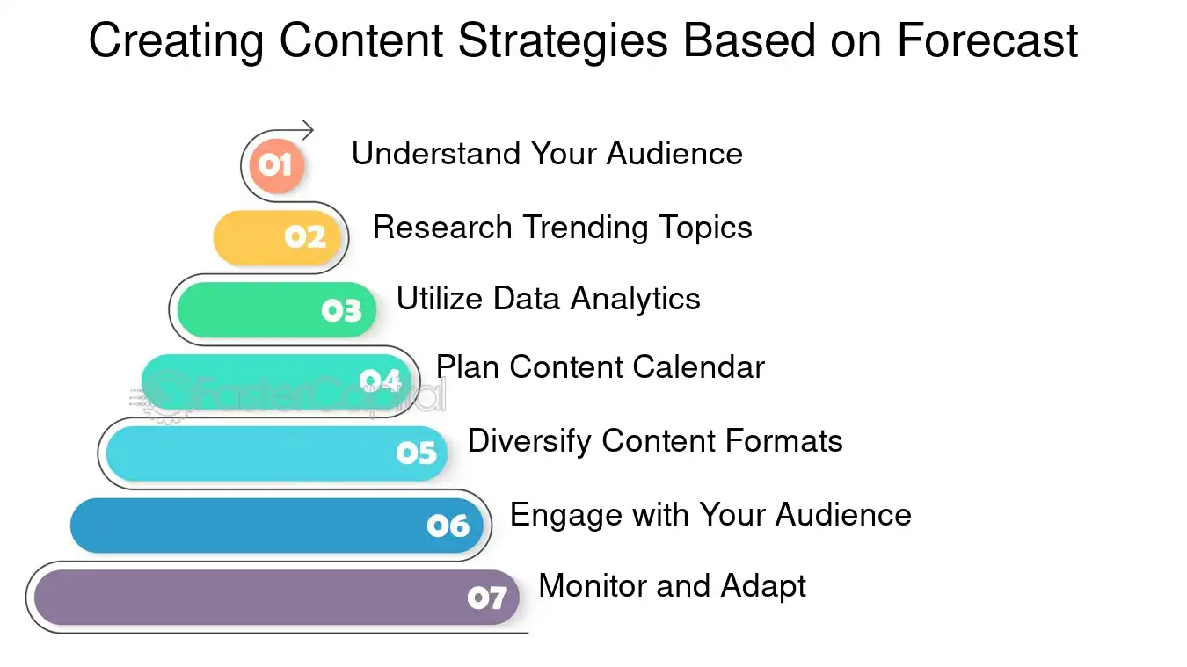
workflow

Slide 7
Problem statement
The system must consider various parameters such as engagement rate, post frequency, and time to make accurate predictions…

Slide 8
Problem solution
Authenticity will be more important than ever
Creators and influencers, and knowing how to work with them, will continue to be important
There will be a renewed focus on social media customer service

Slide 9
Market opportunity
With the ever growing popularity of social media platforms and the increasing number of content creators and businesses relying on social media for marketing, this system will continue to be in high demand.
Social commerce
Social search
Short-form marketing
Influencer marketing
Social media apps

Slide 10
conclusion
In conclusion, the Social Media Followers Prediction System is a useful tool for content creators and businesses to estimate their future number of followers on social media platforms. The system leverages machine learning algorithms and historical data to make accurate predictions based on various factors such as engagement rate, post frequency, and time. The use of this system can aid in the planning of social media strategies and help content creators and businesses reach their target audience more effectively.

Slide 11
How many people use social media?
“
”
…….

Slide 12
thank you
.............

