Slide 2
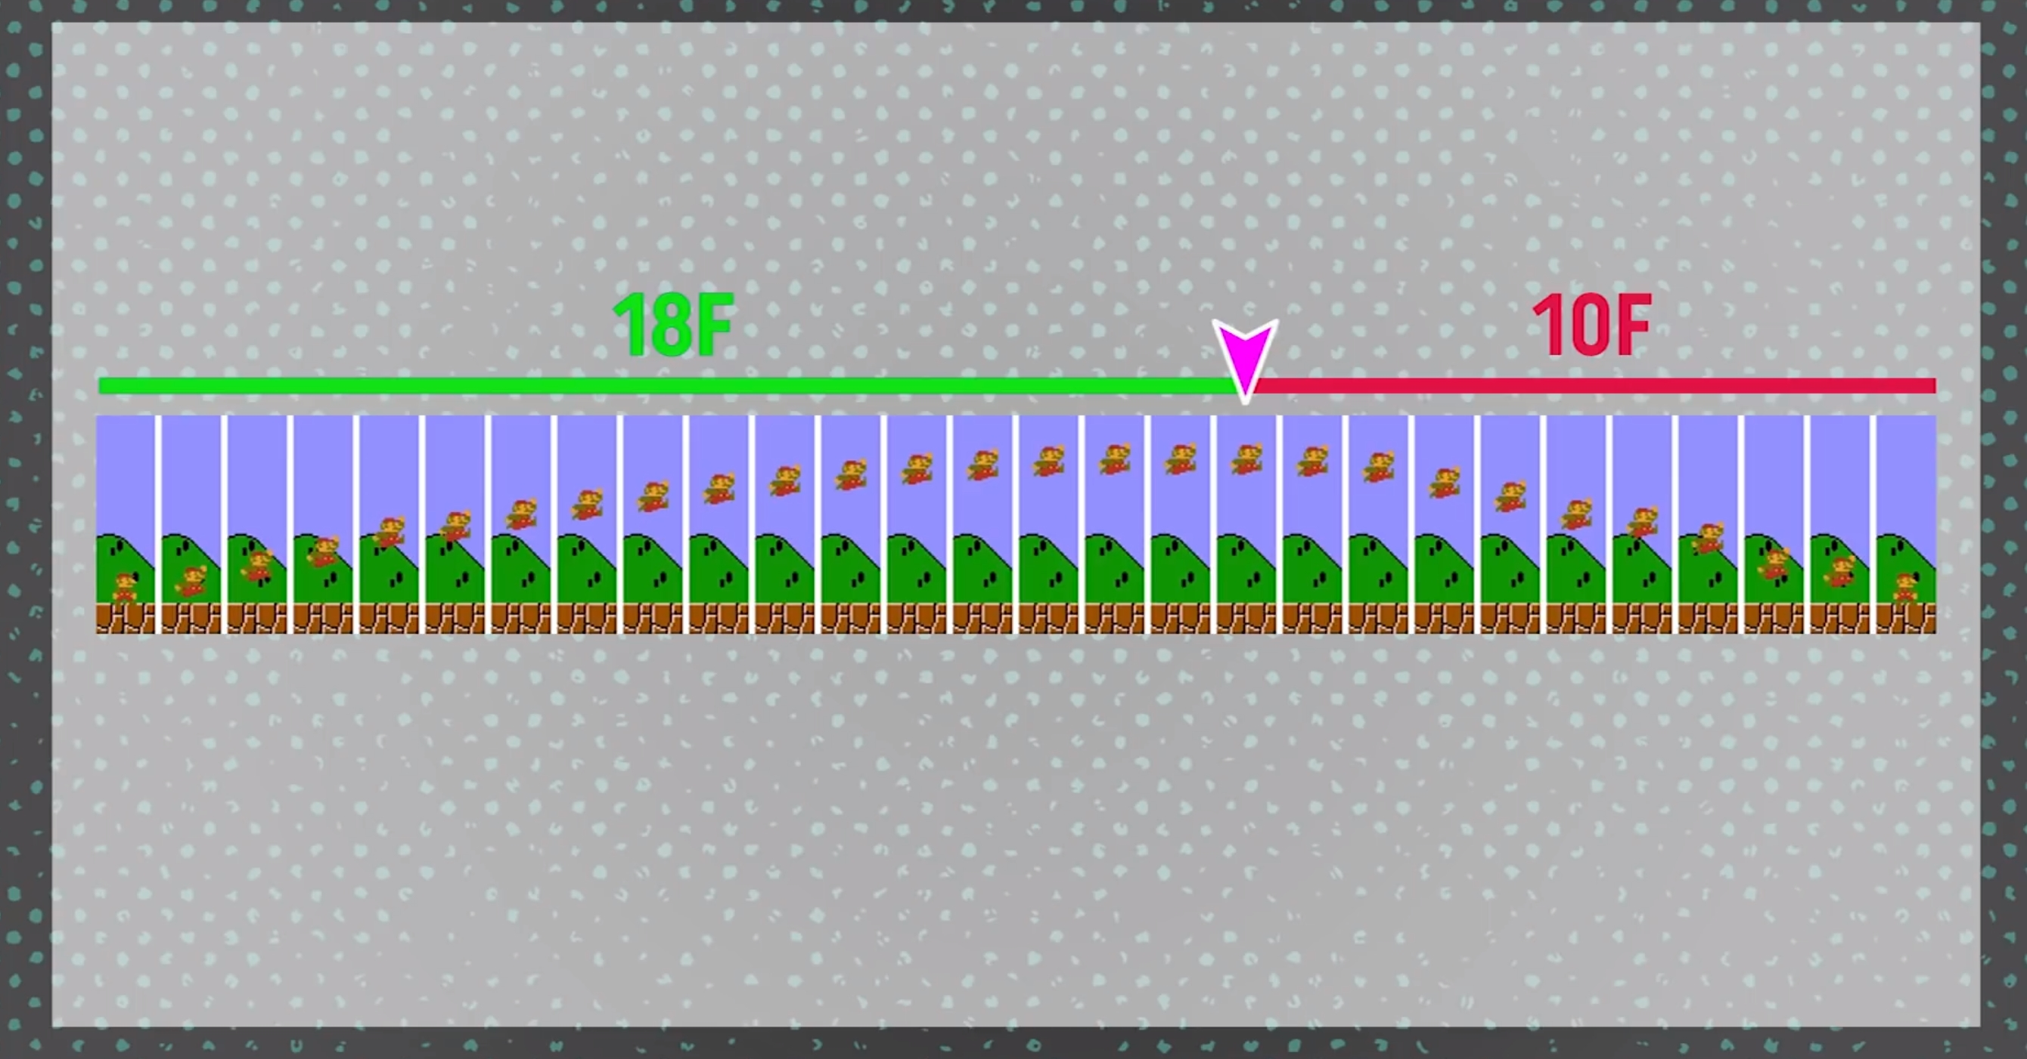
Jumping like a videogame

Slide 3
if (rb.velocity.y < 0){
rb.velocity += Vector3.up * Physics.gravity.y * (fallMultiplier - 1) * Time.deltaTime;
}
else if (rb.velocity.y > 0 && state.Buttons.A == ButtonState.Released){
rb.velocity += Vector3.up * Physics.gravity.y * (fallMultiplier - 1) * Time.deltaTime;
}

Slide 4
IEnumerator spinCooldown(float duration)
{
float t = 0f;
while (t < duration) {
t += Time.deltaTime;
playerRenderer.material.color = Color.HSVToRGB(0.1f, t / duration, 0.95f);
Debug.Log(t / duration);
yield return null; //makes sure there is only one while iteration per frame
}
canSpin = true;
}

