Slide 2
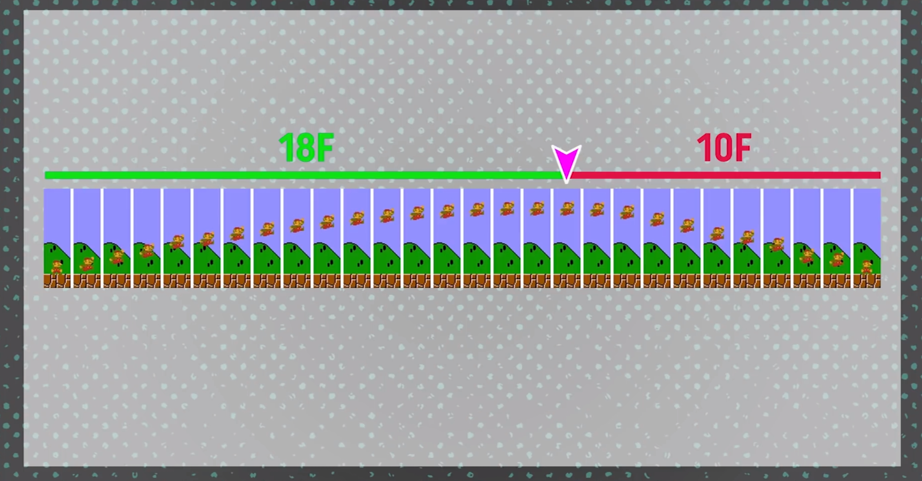
Jumping like a videogame

Slide 3
if (rb.velocity.y < 0){
rb.velocity += Vector3.up * Physics.gravity.y * (fallMultiplier - 1) * Time.deltaTime;
}
else if (rb.velocity.y > 0 && state.Buttons.A == ButtonState.Released){
rb.velocity += Vector3.up * Physics.gravity.y * (fallMultiplier - 1) * Time.deltaTime;
}

