Slide 1

Game feel

Slide 2
Things that are unique to video games
Emergent behaviour
Re-playability (with different outcomes)
Game feel
Cuz games is art

Slide 3
WTF is game feel
A virtual sensation
Game feel is apparent at a prototype stage
Animation (exaggeration, smears etc.) , sound effects
https://www.youtube.com/watch?v=pmSAG51BybY

Slide 4
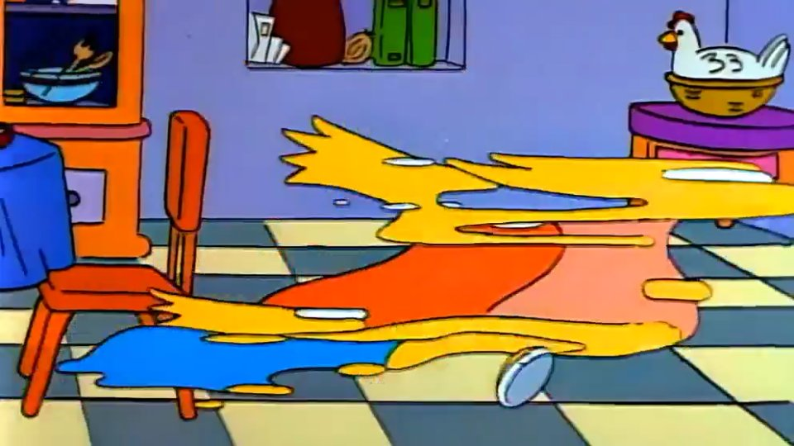
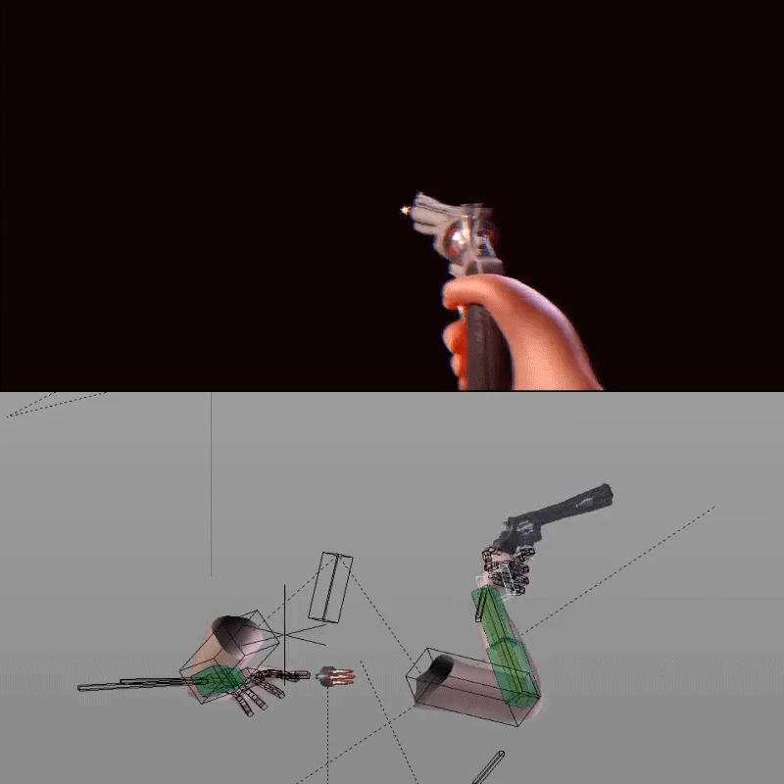
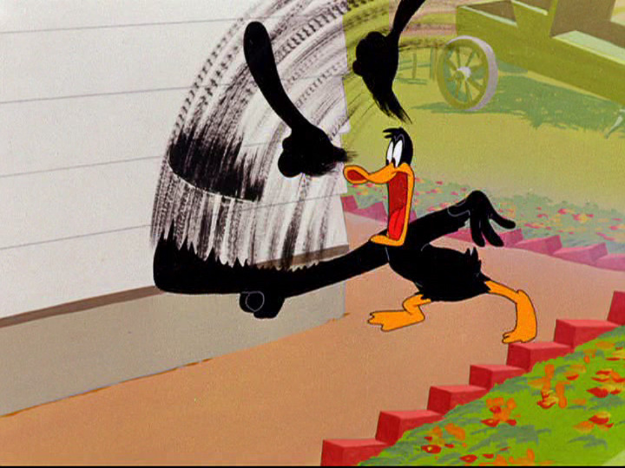

Animation

Slide 5

Spider man 2 and a demo

Slide 6
Portal cubes
Record 2 videos from portal and Portal 2

Slide 7

Controller and Control schemes
Motions controls/Keyboard/controller/fightstick/ddr mat/VR
Dpad vs joystick

Slide 8
Etc. Detroit: Become human revolution options (motion controls)

