Slide 1

POWER BI PROJECT
HR Attrition & Employee Overview
Summer Training — Power BI | CCE, CGC University
Presented by
Course
Guided by
Date
Kushika Sharma | 2405039144
B. Tech — CSE
Mrs. Ashima and Mrs. Mandeep
30 June 2026

Slide 2
01 Problem Statement
What problem does this dashboard solve?
3 / 14

Slide 3
Problem Statement & Objectives
The Problem
Target User
The HR team is missing a clear visual breakdown of employee turnover across different departments and age groups. As a result, critical decisions regarding targeted retention strategies, department-specific interventions, and resource allocation for employee engagement are being delayed.
HR Team who needed a clear visual breakdown of employee turnover across different departments and age groups without manually analyzing raw headcount data.
Project Objectives
Connect & clean the raw dataset using Power Query
Design an interactive dashboard with 5+ visual types
Create key DAX measures including Total Attrition, Attrition Rate, Total Headcount and average employee satisfaction etc.
Publish the final report to Power BI Service
4 / 14

Slide 4
02 Dataset Overview
Source, structure, and key fields
5 / 14

Slide 5
Dataset Overview
Kaggle
Excel
1,471
35
Source
File Type
Rows
Columns
Key Columns Used
Column | Role in Dashboard
Age (Age_group) | Demographic dimension used to group and analyze trends
Attrition | Core target metric used to calculate Total Attrition (KPI card) and Attrition Rate across different dimensions.
Human Resources | Acting as a filter option in the slicer and a segment in the donut chart.
Sales | Revenue — base for SUM measures
Department | Primary categorical dimension used as a dashboard-wide slicer
JobRole | Used to break down Total Headcount and Attrition Rate by specific operational roles.
6 / 14

Slide 6
03 Dashboard Walkthrough
Page, visuals, and interactivity
11 / 14

Slide 7
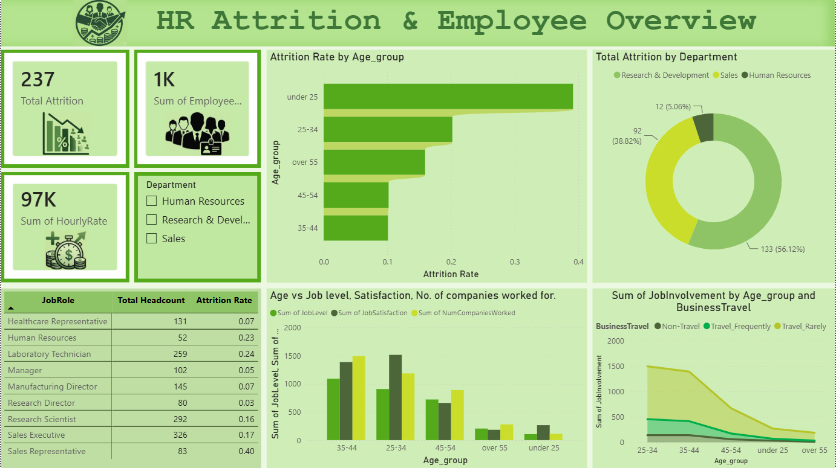
Dashboard : Overview
Visuals on this page
KPI Cards — Total Attrition, Sum of Employee Headcount, Sum of Hourly Rate
Bar Chart — Attrition by Age group
Line Chart — Job involvement by Age group and Business travel
[ Screenshot — Overview Page ]
Donut Chart — Total Attrition by Department
Slicer — Department (Human resources, Research and development, Sales)
Key Insight
This page shows that employee turnover is highest among young staff under 25 and team members in the Research & Development department. In terms of specific roles, Sales Representatives are leaving at the highest rate (40%), pointing out exactly where the company needs to focus on keeping its people.
12 / 14

Slide 8
Key Findings & Insights
Young talent is leaving the fastest, with employees under 25 experiencing the highest overall attrition rate.
The Sales department as a whole makes up nearly 39% of total attrition (92 employees), making it the second hardest-hit area.
01
04
The Research & Development (R&D) department is the largest pain point, accounting for 56% of all company departures.
Overall job involvement peaks among employees aged 35–44 but drops significantly for the youngest (under 25) workforce.
02
05
Sales Representatives face the most critical retention issue, holding a massive 40% attrition rate—the highest of any individual job role.
06
Business travel strongly affects employee engagement, as staff who travel frequently show noticeably higher drop-offs in job involvement as they age.
03
13 / 14

Slide 9
Conclusion & Thank You
Successfully built an end-to-end Power BI solution from raw data to published dashboard
Found that critical turnover is driven by employees under 25 and the R&D department, highlighting exactly where to focus company retention efforts.
Created custom DAX measures to dynamically calculate specific attrition rates across different age groups and job roles.
Future scope: If given more time, I would add predictive modeling to flag employees at high risk of leaving before they decide to quit.
Questions & Feedback Welcome
14 / 14

