Slide 1
Aspect Based Sentiment Analysis on Hotel Reviews
One review, many opinions
Room
Positive
Clean
Positive
Multi-label aspect detection and sentiment classification using TF-IDF, One-vs-Rest Linear SVM and Logistic Regression
Comfort
Positive
Kushita K PES1UG24CS247
Anagha PES1UG24CS058
Staff
Negative
Notes:
Introduce the project and team. One-line summary: our system finds which hotel aspects a review mentions and what sentiment is attached to each.

Slide 2




Introduction
Hotel reviews are free-form text
They discuss room, cleanliness, staff, breakfast, location and more.
One review can mention many aspects
Traditional sentiment analysis falls short
Room
Clean
Comfort
It gives one overall sentiment for the whole review.
Staff
Breakfast
Location
ABSA gives a finer view
Wi-Fi
Pool
Value for money
It finds the aspects mentioned and the sentiment linked to each.
Traditional: 1 review → 1 sentiment
ABSA: 1 review → each aspect, its own sentiment
Our project
ABSA on the HRAST dataset with classical machine learning.
Notes:
Reviews are unstructured. A single overall label hides which aspect the opinion is about. ABSA fixes this by working per aspect.

Slide 3




Problem Statement
“The room was clean and comfortable, but the staff were unfriendly.”
Overall sentiment only
What the system must do
Positive or negative?
Identify multiple aspects in a review
One label cannot tell which aspect the sentiment refers to.
Classify the overall sentiment
Room → Positive
Staff → Negative
Infer sentiment per aspect from its local context
Notes:
Walk through the example sentence. An overall classifier gives one label. We need Room positive and Staff negative.

Slide 4





Objectives
1
2
3
Preprocess & explore
TF-IDF features
Aspect detection
Clean the text; study sentiment, aspects and review length.
Represent reviews with unigrams and bigrams.
Multi-label detection with One-vs-Rest Linear SVM.
4
5
6
Sentiment classification
Aspect-level sentiment
Model evaluation
Positive / Negative / Neutral with Logistic Regression.
Extract local context and infer sentiment per aspect.
Accuracy, Precision, Recall, F1, Micro / Macro F1, Hamming Loss.
Notes:
Six core objectives: preprocessing and EDA, TF-IDF, aspect detection, sentiment classification (with Neutral threshold tuning), aspect-level inference, and evaluation.

Slide 5
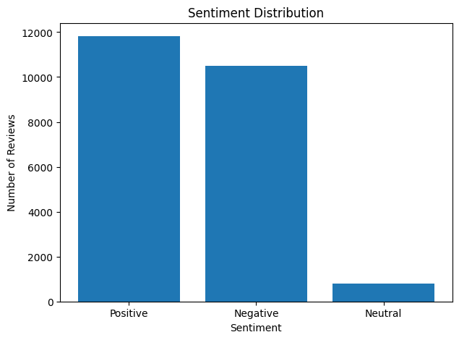
Dataset & Exploratory Analysis
HRAST (Hotel Review Aspect-Based Sentiment Analysis) dataset, after cleaning and duplicate removal
23,105
21
Sentiment distribution
unique reviews
hotel aspects
41.84%
≈ 10.3
reviews with multiple aspects
average words per review
Multi-label annotations: aspect detection is a multi-label problem.
Severe imbalance: Neutral is only 3.44% of reviews.
51.14%
45.45%
3.44%
Positive
Negative
Neutral
Notes:
21 aspects include Clean, Comfort, Staff, Room, Location, Breakfast, Wi-Fi, Pool and Generic. 41.84% of reviews contain multiple aspects, so aspect detection must be multi-label. Neutral is only 3.44%, which becomes important later.

Slide 6
Methodology / System Architecture
1
2
3
4
Hotel Review
Data Cleaning
Text Preprocessing
TF-IDF
raw text input
duplicates removed, binary aspect labels
lowercase, clean, normalise
unigrams + bigrams
8
7
6
5
Final ABSA Output
Aspect-Level Sentiment
Aspect Context Extraction
Aspect Detection + Sentiment Classification
aspects + their sentiments
classifier applied to each context
local sentence / clause per aspect
One-vs-Rest Linear SVM | Logistic Regression
TF-IDF is fitted on training data only. Sentiment labels are sentence-level, so aspect sentiment is inferred from local context.
Notes:
Read the pipeline left to right on the top row, then right to left on the bottom row. After TF-IDF the same features feed two models: aspect detection and sentiment classification. Then context extraction produces aspect-level sentiment and the final output.

Slide 7

Text Preprocessing & TF-IDF
Text preprocessing
TF-IDF configuration
The ROOM was very CLEAN!
the room was very clean
10,000
1–2
max features
n-gram range
Convert text to lowercase
2
True
Remove unnecessary special characters
min document frequency
sublinear TF
Normalise whitespace, trim spaces
Example: “very clean room”
very
clean
room
Keep useful information such as negation words
very clean
clean room
unigrams (teal) + bigrams (dark)
Notes:
Preprocessing is deliberately light so negation words survive. TF-IDF uses 10,000 features, unigrams plus bigrams, min document frequency 2, sublinear TF. Fitted only on training data to avoid leakage.

Slide 8
Aspect Detection
Multi-label, One-vs-Rest Linear SVM: one binary classifier per aspect
F1 by aspect: strongest and weakest
Clean SVM
1
TF-IDF review
A review can switch on several aspects at once
Comfort SVM
1
Staff SVM
0
Test results (3,466 unseen reviews)
85.25%
84.51%
83.54%
87.03%
Micro F1
Macro F1
Precision
Recall
Hamming Loss = 0.0231
Notes:
Each aspect has its own binary SVM, so one review can have several aspects active. Final test: Micro F1 85.25, Macro F1 84.51, precision 83.54, recall 87.03. Pool, Parking, Wi-Fi, Breakfast, Location are strongest; Generic, Restaurant (dinner) and Value for money are weakest.

Slide 9
Sentiment Classification
Three classes: Positive · Negative · Neutral
Models compared
Final test results
Logistic Regression
Selected
89.04%
Accuracy
Balanced Linear SVM
69.43%
Unbalanced Linear SVM
Macro F1
Why Logistic Regression?
89.81%
Linear SVM had higher accuracy
LR gave the best Macro F1 and best Neutral performance on validation
Its class probabilities allow Neutral threshold tuning
Weighted F1
23,101 sentiment samples; 4 ambiguous multi-label reviews excluded
Notes:
Compared Logistic Regression, balanced and unbalanced Linear SVM. SVM had higher accuracy, but LR had the best Macro F1 and best Neutral performance on validation, so LR is the final sentiment model. Test: accuracy 89.04, macro F1 69.43, weighted F1 89.81. 23,101 samples were used; 4 ambiguous reviews were excluded.

Slide 10

Neutral Threshold & Aspect Sentiment
Neutral threshold tuning
Local-context extraction
Neutral is only 3.44% of the data
Picking the highest probability gave poor Neutral detection
Threshold tuned on the validation set
“the room was clean and comfortable”
Room
“the staff were unfriendly”
0.44
Validation results
Staff
Macro F1 0.7106 → 0.7142
Neutral F1 0.3046 → 0.3129
Neutral threshold
Sentiment classifier is applied to each local context.
The dataset provides sentence-level sentiment labels. Aspect-level sentiment is therefore INFERRED from local context, not learned from gold aspect-specific sentiment labels.
Notes:
Neutral is rare, so the plain argmax rule rarely predicts it. We tuned a Neutral probability threshold on validation: 0.44. Then the key honesty point: labels are sentence-level, so aspect sentiment is inferred from local context.

Slide 11




Final ABSA Demonstration
“The room was clean and comfortable, but the staff were unfriendly.”
Detected aspects and inferred sentiment
Clean
Comfort
Room
Staff
Positive
Positive
Positive
Negative
Detected aspect
Local context
TF-IDF
Logistic Regression
Pos / Neg / Neutral
Notes:
Live demo sentence. The system detects Clean, Comfort, Room and Staff, extracts each aspect's local context, and runs the sentiment classifier on it: Clean, Comfort, Room positive; Staff negative.

Slide 12
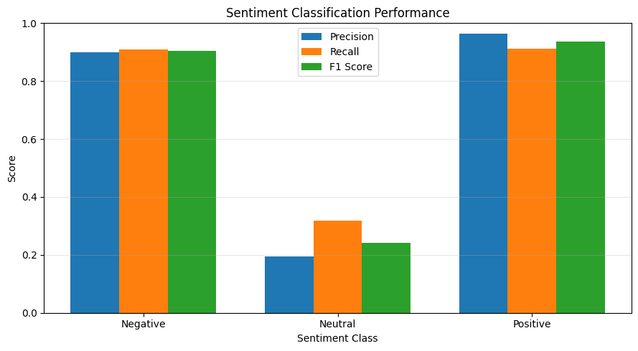
Results & Discussion
Sentiment performance by class (test set)
85.25%
84.51%
Aspect Micro F1
Aspect Macro F1
89.04%
89.81%
Sentiment Accuracy
Sentiment Weighted F1
Positive F1 93.65%
Negative F1 90.44%
Neutral F1 24.20%
Neutral is difficult (F1 24.20%): only 3.44% of reviews are Neutral, a severe class imbalance. Positive and Negative are classified well.
Notes:
Aspect detection performs strongly overall; Positive and Negative sentiment are strong. Neutral F1 is only 24.20%, mainly due to severe class imbalance: Neutral is 3.44% of the data. The chart shows precision, recall and F1 per class from our Colab run; the confusion matrices are in the backup slides.

Slide 13


Limitations & Future Scope
Limitations
Future scope
Sentence-level, not aspect-specific, sentiment labels
BERT / RoBERTa transformer models
Aspect-specific sentiment annotations
Neutral class imbalance (Neutral F1 24.20%)
Better imbalance handling
TF-IDF has limited semantic and context understanding
Context-aware models
Explainable ABSA
Complex or ambiguous language is hard to interpret
Real-time hotel review dashboard
Notes:
Main limitation: dataset sentiment is sentence-level, so aspect sentiment is inferred. Future work: transformers, aspect-specific annotation, imbalance techniques (class weights, focal loss, oversampling), context-aware and explainable models, and a dashboard.

Slide 14


Conclusion
End-to-end ABSA system
Aspect detection
TF-IDF + One-vs-Rest Linear SVM (21 aspects) + Logistic Regression (3-class sentiment).
Micro F1 0.8525 and Macro F1 0.8451 on unseen test data.
Sentiment classification
Aspect-level sentiment
89.04% accuracy, 0.8981 weighted F1; Neutral threshold 0.44, Neutral F1 0.2420.
Local context gives different sentiments for different aspects in one review.
Practical value: turns unstructured hotel reviews into structured insight for customers and hotel management.
Thank you · Questions?
Notes:
Summarise: what we built, aspect and sentiment results, honest note on Neutral, and the practical value. Invite questions.

Slide 15
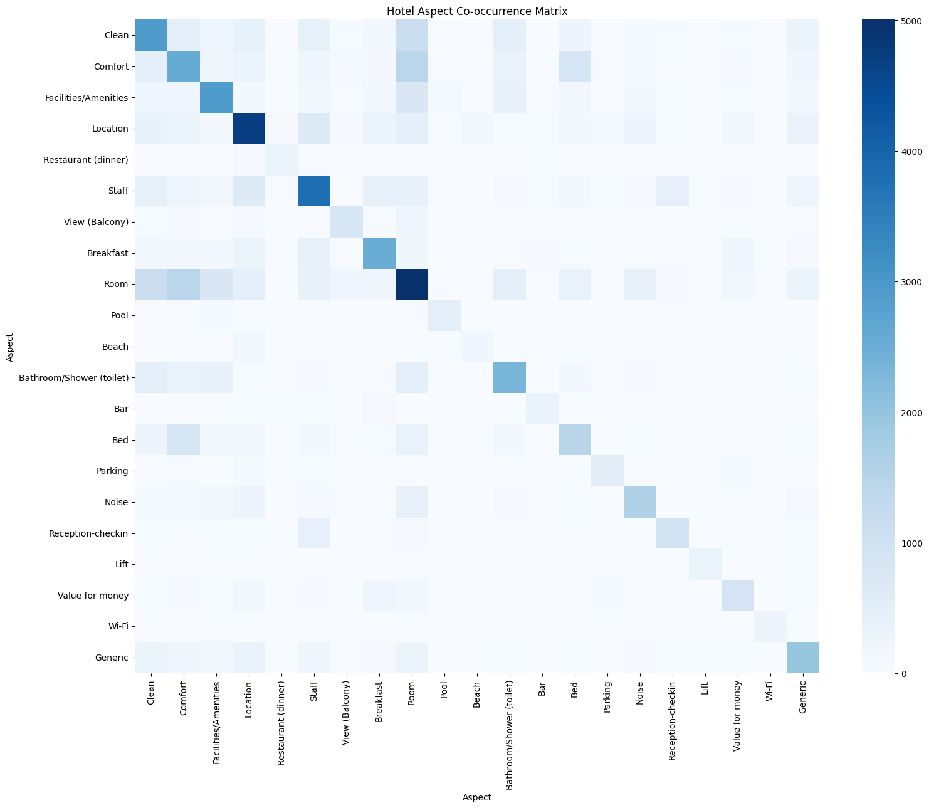
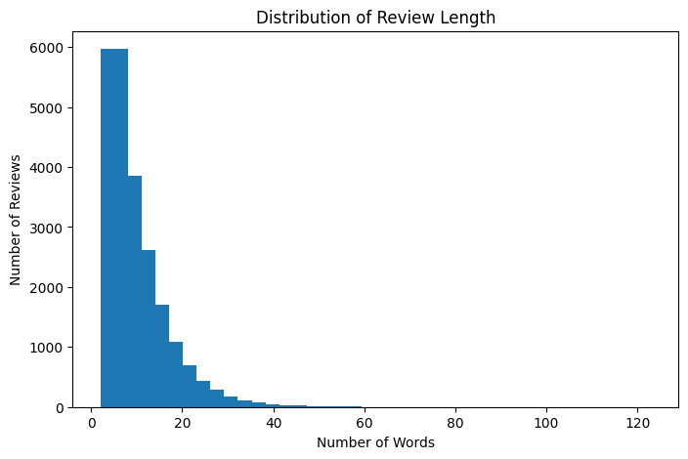
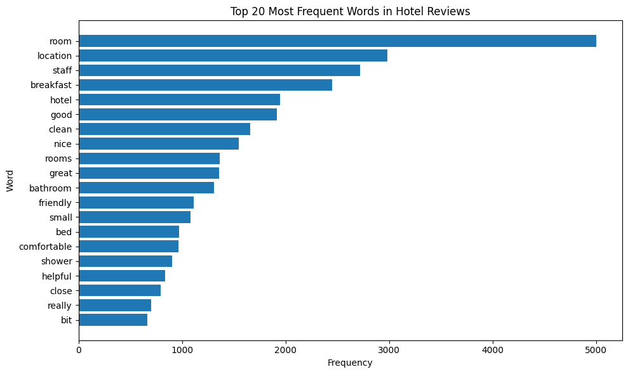
Backup: Additional EDA
BACKUP
Reviews are short: about 10.3 words on average.
Darker diagonal cells = more frequent aspects (Room, Location, Staff).
Most frequent words: room, location, staff, breakfast.
Notes:
Backup EDA: the co-occurrence matrix shows which aspects appear together (supports the multi-label formulation); reviews are short; the most frequent words match the main aspects.

Slide 16
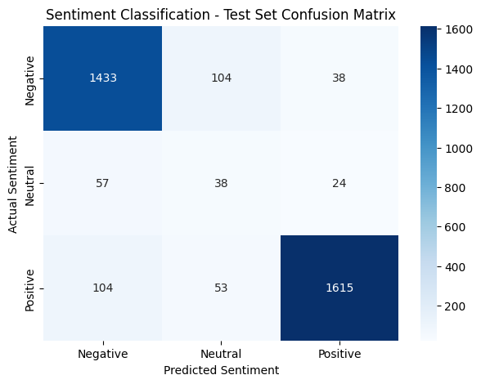
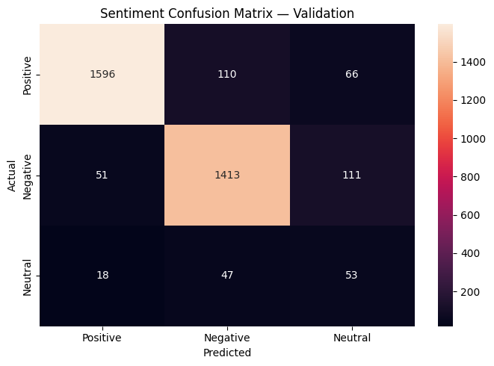
Backup: Sentiment Confusion Matrices
BACKUP
Test set
Validation set
Neutral is confused with Negative and Positive: in the test set only 38 of 119 Neutral reviews are predicted correctly.
Notes:
Positive and Negative are mostly on the diagonal. Neutral rows spread across Negative and Positive because Neutral is rare and linguistically close to both.

Slide 17
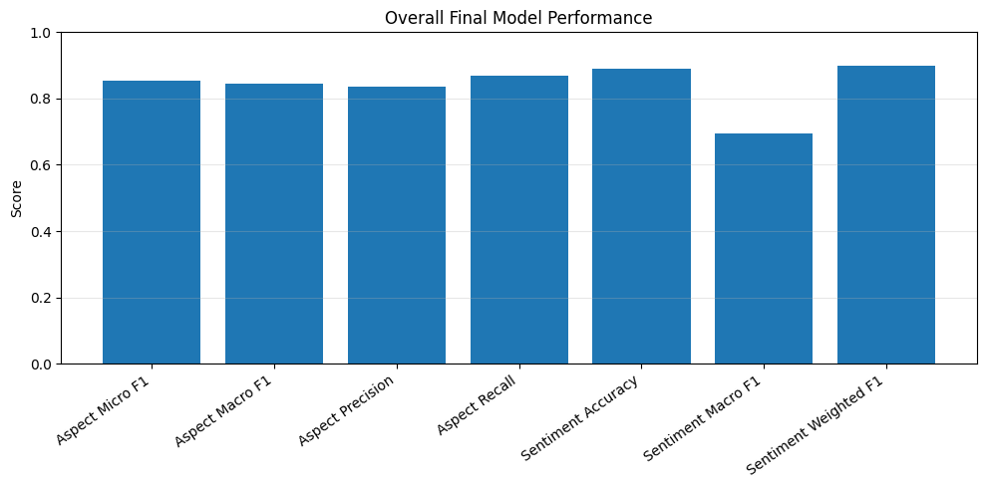
Backup: Overall Final Model Performance
BACKUP
Aspect detection
Micro F1
85.25%
Macro F1
84.51%
Precision
83.54%
Recall
87.03%
Sentiment classification
Accuracy
89.04%
Macro F1
69.43%
Weighted F1
89.81%
Notes:
All headline test metrics in one view. Macro F1 for sentiment is lower because of the Neutral class.

