Slide 1

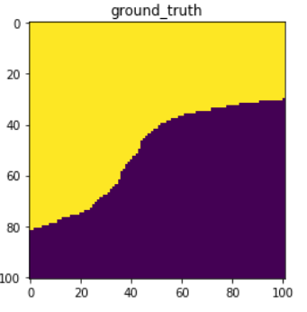
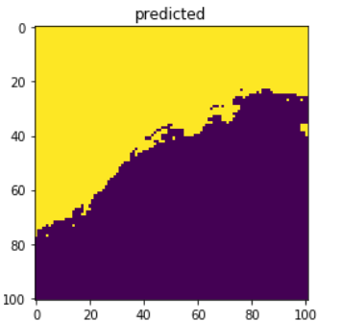

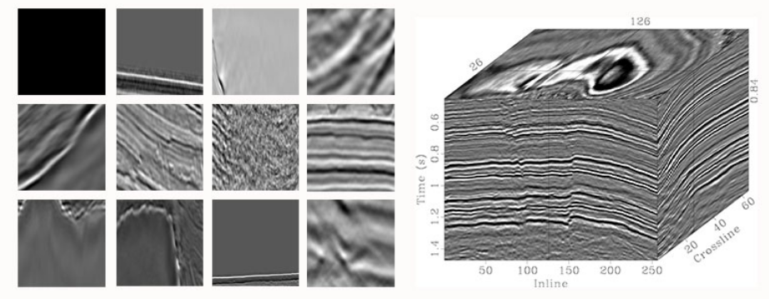
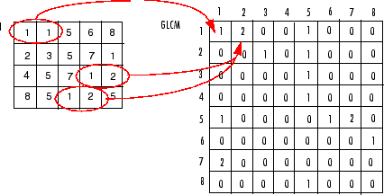
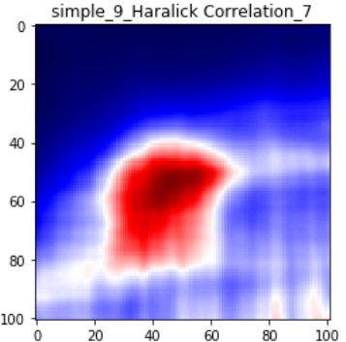
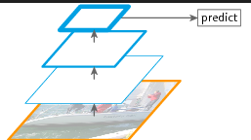
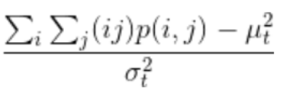
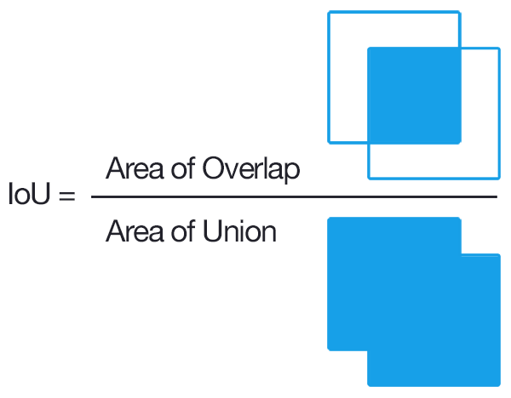
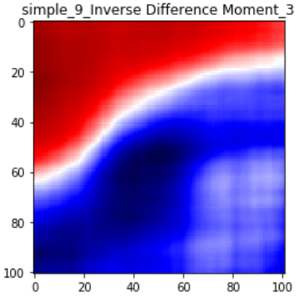

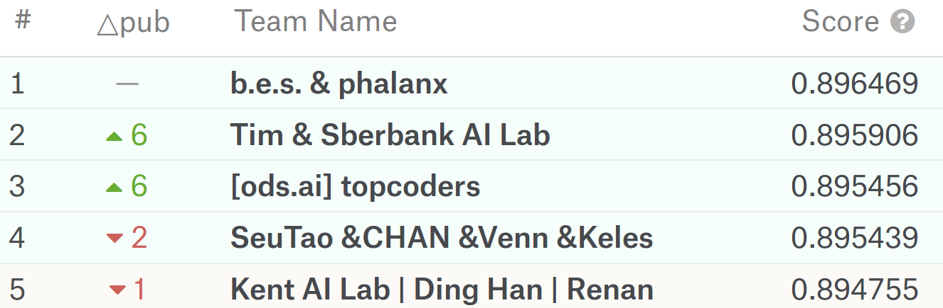
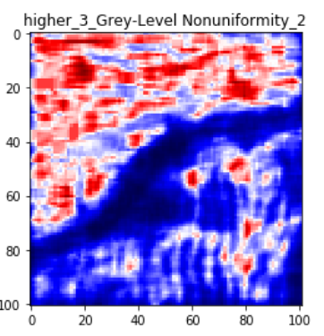
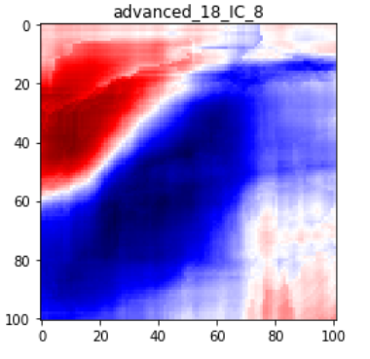
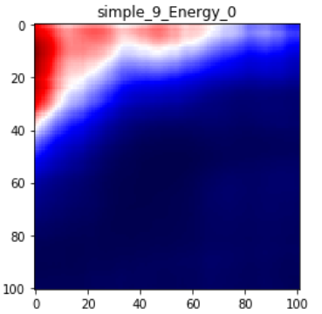
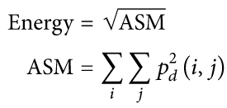
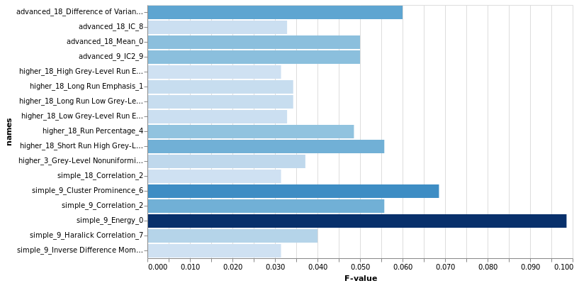
Haralick textural features for geological images segmentation
D. Kushnir¹
Introduction
GLCM & Haralic
Several areas of Earth with large accumulations of oil and gas also have huge deposits of salt below the surface.
But unfortunately, knowing where large salt deposits are precisely is very difficult. Professional seismic imaging still requires expert human interpretation of salt bodies. This leads to very subjective, highly variable renderings. More alarmingly, it leads to potentially dangerous situations for oil and gas company drillers.
The methodology implies the combined use of three steps:
1st : Compute GLCM of the particular image and then extract Haralic features with different window size.
2nd: Use whole set of features on small subsample to estimate features’ F-values.
3rd: Use best features to train final model, as have less features can increase subsample size.
Image texture is a quantification of the spatial variation of grey tone values. Haralick et al. (1973) suggested the use of gray level co-occurrence matrices (GLCM). This method is based on the joint probability distributions of pairs of pixels. GLCM show how often each gray level occurs at a pixel located at a fixed geometric position relative to each other pixel, as a function of the gray level. An essential component is the definition of eight nearest-neighbor resolution cells that define different matrices for different angles (0°,45°,90°,135°) and distances between the horizontal neighboring pixels.
3
Different scale features used for larger perceptive field size
Feature examples:
How graycomatrix calculates several values in the GLCM of the 4-by-5 image I. Element (1,1) in the GLCM contains the value 1 because there is only one instance in the image where two, horizontally adjacent pixels have the values 1 and 1. Element (1,2) in the GLCM contains the value 2 because there are two instances in the image where two, horizontally adjacent pixels have the values 1 and 2. graycomatrix continues this processing to fill in all the values in the GLCM.
Metric used is Jaccard Similarity or so called “Intersection over union”, which is used for comparison of sets as well as image overlapping.
Conclusions
Kaggle-masters with fine-tuned CNN
Category | CNN | GLCM
Data | 4000 images in dataset considered as small | 600 images is way too much.
Preprocessing | Augmenting images to regularize and increase train-set size. Normalizing is crucial for performance. | Creating of Haralic features from GLCM, pretty fast, but takes lot of space
Computing | GPU-farm would be nice | Feasible on PC CPU
Implementation | Trial and fail to find the best configuration, but search is guided by luck | Download libs, read guide, use python API
Batch learning | Batch-size is also hyper-parameter | Impossible, this part is disastrous
Features interpretability | Can visualize layers, but in case of sediments recognition it is useless | Can extract exact solving tree, range your features importance, etc...
Model preparation | The best-of-kind is proven to be U-net arcitecure build on SE-ResNext-50 pretrained on ImageNet | No retraining required, works out-of-box
Postprocessing | Result needs some smoothing of edges of masks to better fit with labeled by human | More random artifacts observed in this experiment, edges look better
… The One some student with cold-runned XgBoost on GLCM
_{0.856856844...}
It showed up that the most important feature is ‘Energy’, it is a sqrt of Angular Second Momentum:
Results
4
Prediction sample
Conclusions
Statistical-based image preprocessing is still great for image
Competitive data science and real-world tasks may not use the same notion of state-of-art
Future work:
- automated postprocessing
- exhaustive search of best parameters for generating features
- XGBoost fine-tuning
Applied Sciences Faculty, Ukrainian Catholic University, Lviv, Ukraine (¹kushnir_d@ucu.edu.ua)
GitHub: https://github.com/KushnirDmytro/salt_recognition_on_raw_images/

