Slide 1
Election for sports Captain
Group Member:-
Pranam Rai
Priya Kushawaha
Student ID no:-
5415
5431

Slide 2
Introduction
“Election for sports captain” is the kind of voting system that allows students to vote their candidates and make their favourite candidates as a sports captain of 2022 and following years. It can also store the number of votes for individual candidates.

Slide 3
Features
Caste single vote at a time.
Lists the total votes counts of each candidate.
Can guess the winning candidate till now.
Helps to view the Leading Candidate.

Slide 4
System Requirement
Minimum Hardware Requirements:-
PC with Pentium II Processor.
32 MB of RAM.
Black and White Monitor.
Hard disk with at least 20 MB of free space.
Minimum Software Requirement:-
OS Windows(Windows XP).

Slide 5
Scope
Scope:
Secured data and security for voters privacy.
Nation wide online voting system
Biometric security implementation
Can be upgraded to advanced voting systems like political voting systems.

Slide 6
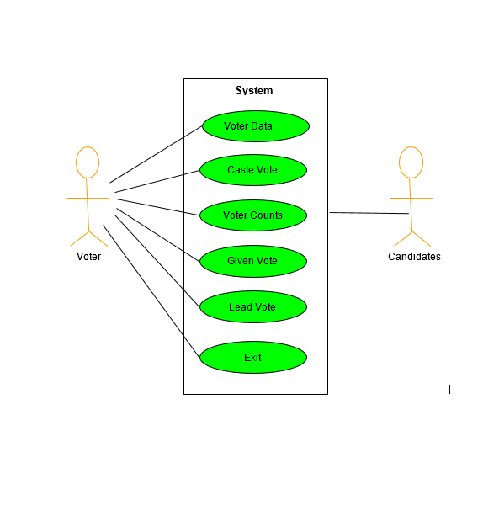
Use Case Diagram

Slide 7
Algorithm for Main MENU
Step 1: Start
Step 2: Press any key to Continue
Step 3: Display Main Menu with different Options like:-
To vote
Votes count
Guess who will win this competition
Leading candidates till now
Press 5 if you want to exit
Step 4: Press 1 to vote
Step 5: Press 2 to see votes count
Step 6: Press 3 to guess who is going to win the competition
Step 7: Press 4 to see the leading candidates untill now
Step 8: Press 5 to exit the program
Step 9: Stop

Slide 8
Algorithm TO VOTE
Step 1: Start
Step 2: Create a data file Voters.dat in append mode
Step 3: Enter your name and faculty to vote
Step 4: Vote your favourite candidates by pressing the right oder number
Step 6: If User vote is 1 then increase counter1 by 1 Elseif User vote is 2 then increase counter2 by 1 Elseif User vote is 3 then increase counter3 by 1 Elseif User vote is 4 then increase counter4 by 1
Step 7: Close the data file Voters.dat
Step 8: Stop

Slide 9
Algorithm TO SEE VOTE COUNTS
Step 1: Start.
Step 2: Display Candidate1 name and counter1.
Step 3: Display Candidate2 name and counter2.
Step 4: Display Candidate3 name and counter3.
Step 5: Display Candidate4 name and counter4.
Step 6: Stop.

Slide 10
Algorithm for Guessing vote
Step 1: Start
Step 2: Input guessno as a variable
Step 3: Get guessno
Step 4: Create an array with counters
Step 5: Swap the counters inside the array in descending order and take the first element of the array after swapping it
Step 6: If guessno is equal to the first element of the array, display Correct! Mr……. is at leading position. or else display Sorry! Mr……… is not the leading candidate
Step 7: Stop

Slide 11
Algorithm TO VIEW Leading Candidate
Step 1: Start
Step 2: Get counters for each and every candidate
Step 3: If counter1>counter2>counter3>counter4 display Candidate1 is the Leading Candidate and goto Step 7
Step 4: If counter2>counter1>counter3>counter4 display Candidate2 is the Leading Candidate and goto Step 7
Step 5: If counter3>counter2>counter1>counter4 display Candidate3 is the Leading Candidate and goto Step 7
Step 6: If counter4>counter2>counter3>counter1 display Candidate4 is the Leading Candidate and goto Step 7
Step 7: Stop

Slide 12
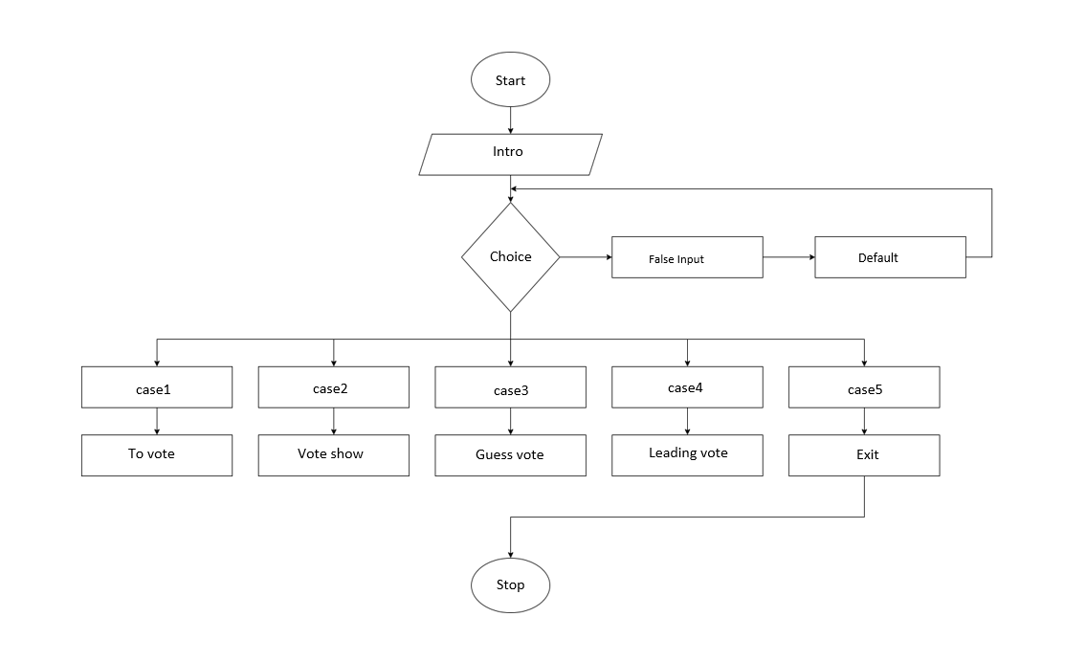
Flowchart of Main Menu

Slide 13
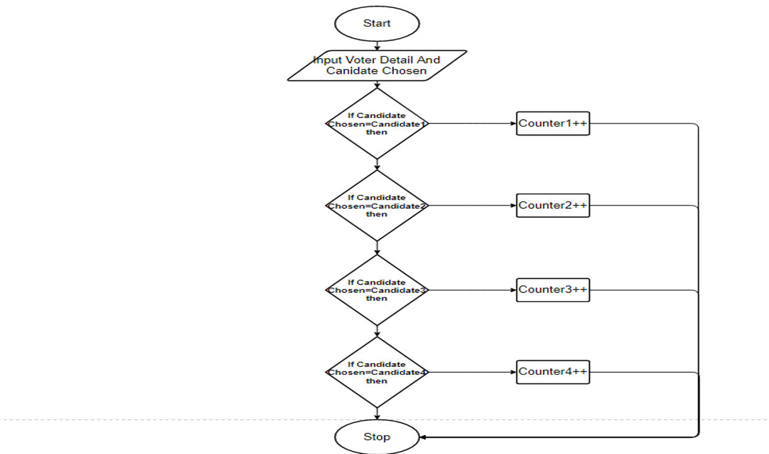
Flowchart To vote

Slide 14
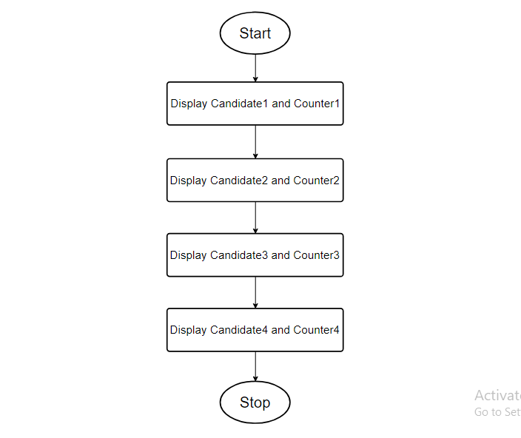
Flowchart for Showing Vote Count

Slide 15
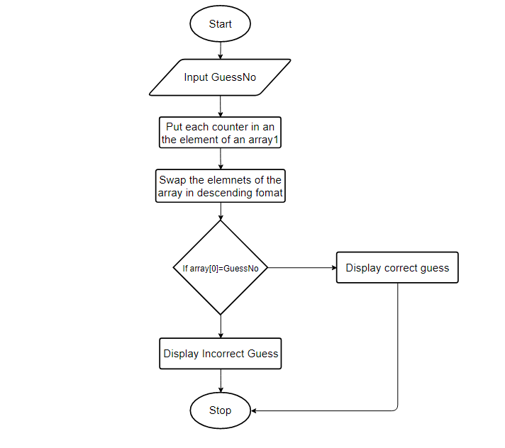
Flowchart of Guess leader

Slide 16
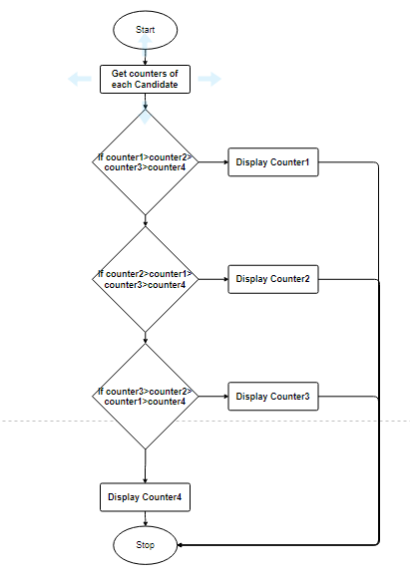
Flowchart of Lead count

Slide 17
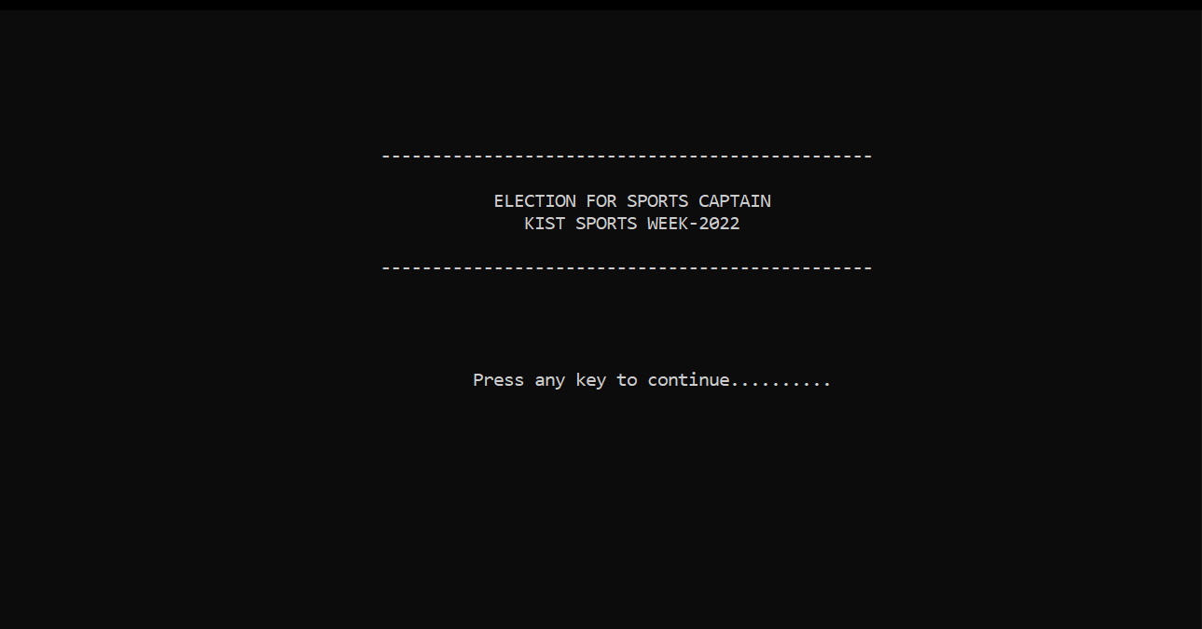
User Interfaces
Intro

Slide 18
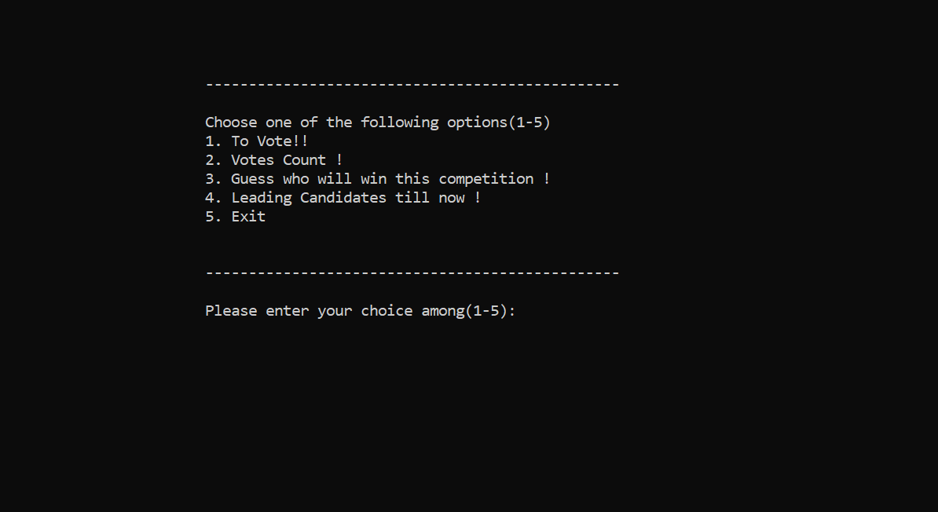
Main Menu

Slide 19
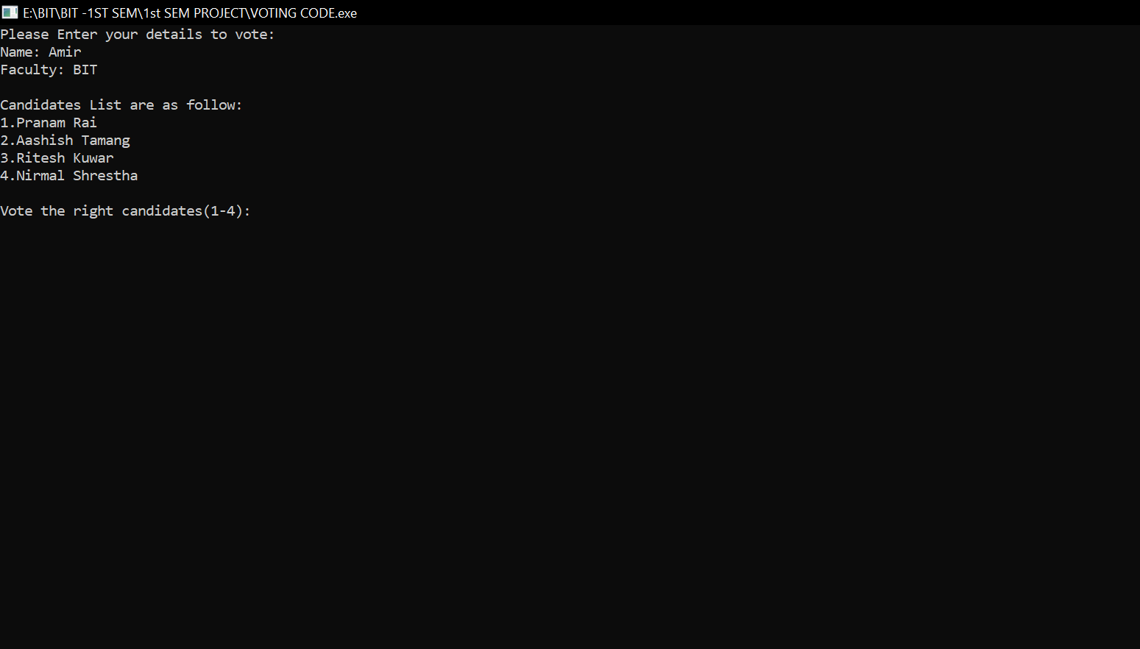
Caste Vote

Slide 20
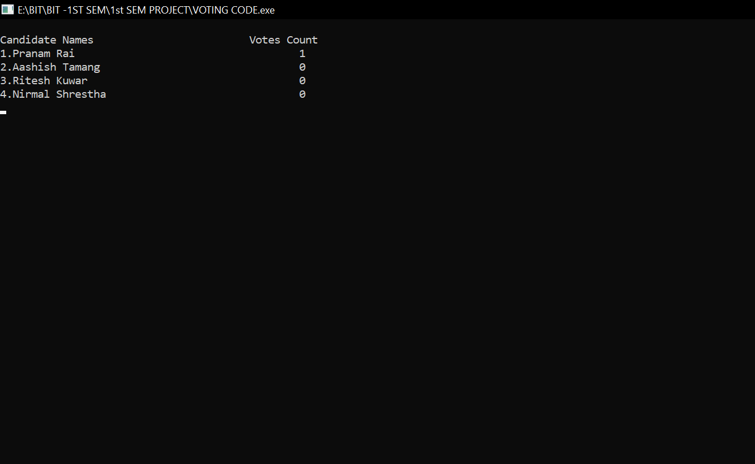
Show Total Vote Count

Slide 21
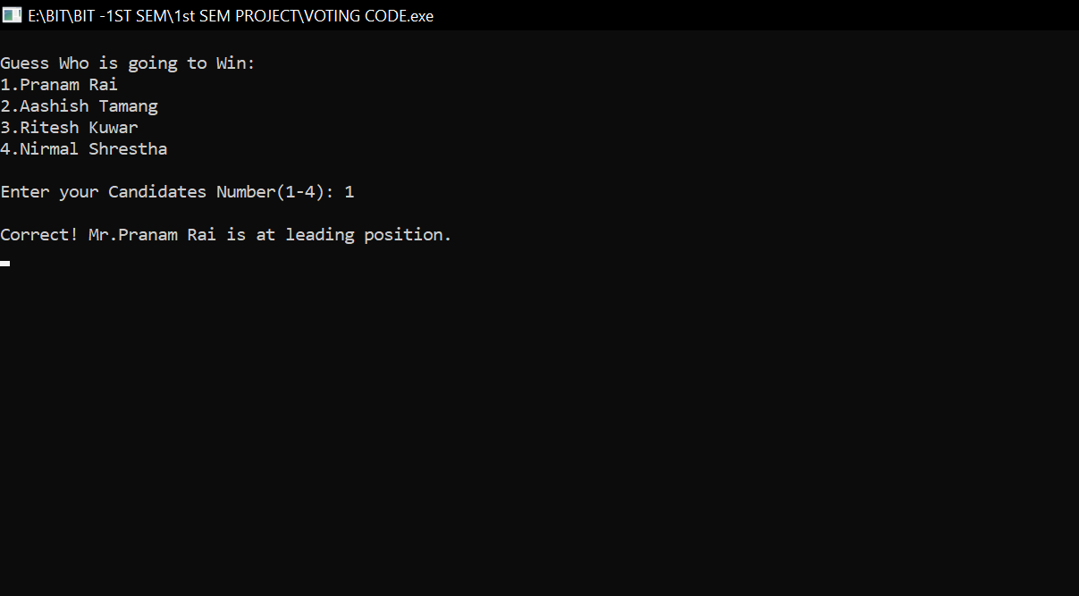
Guessing Who is going to Win

Slide 22
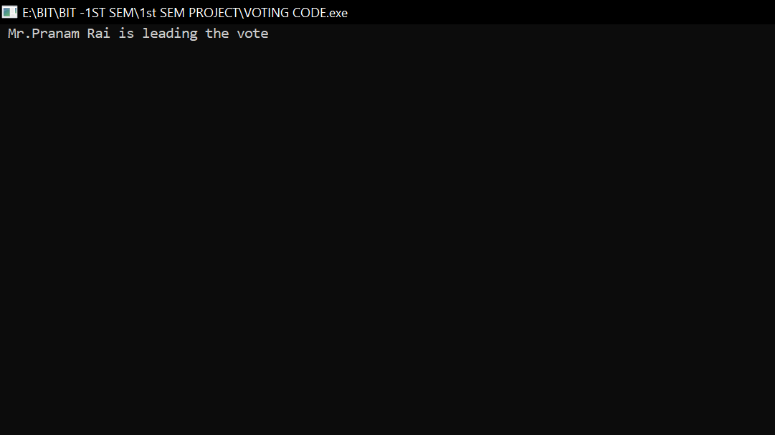
Show Leading Candidate

Slide 23
conclusion
The Voting System helps to choose the candidates in a digital form. There won’t be need of paper ballot for each candidates. Hence, it will save money. It will be also easier for user as well as system admin for casting and counting votes. The voting will be more secure, reliable and inexpensive due to the use of digital devices.

