Slide 1
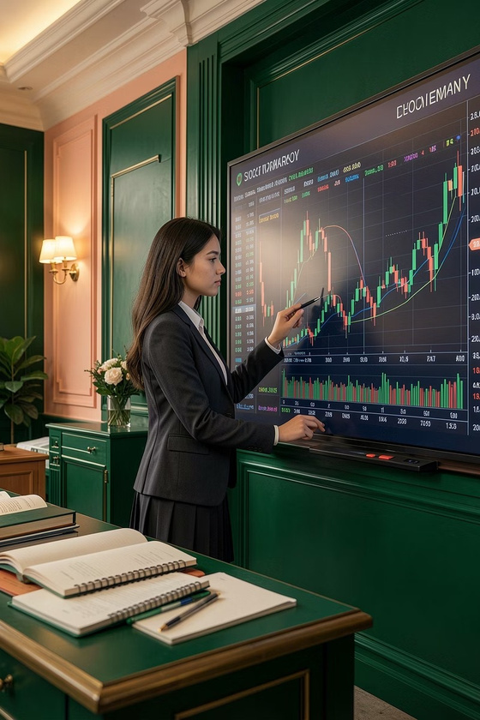
Fnomo Young
Investor
INSTITUTIONAL PARTNERSHIP PROPOSAL
Equipping the next generation with financial literacy, real-world
decision-making, and global opportunity.

Slide 2
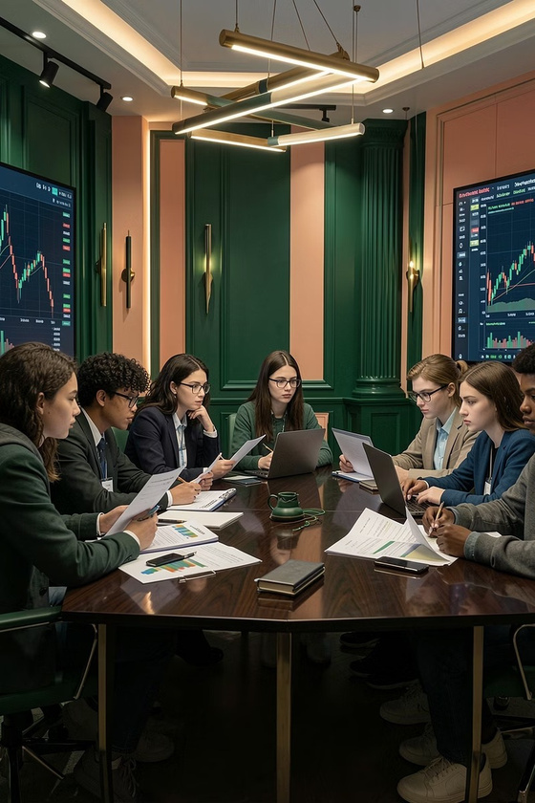
About Fnomo
Fnomo (fnomo.com) a product of Fintoma Technology Limited
(Ireland), is bringing this program to select schools.
Fnomo is a stock analysis tool that lets everyday investors filter through tens of thousands of stocks across the globe — by value, growth, or momentum — without needing a Wall Street team behind them.
We've brought the same rigour into education. Fnomo Young
Investor is a structured learning experience that teaches students to think like investors — to evaluate opportunities, understand consequences, and take ownership of outcomes.

Slide 3
What Students Experience
Real-World Financial Scenarios
Students don't learn theory in isolation. They engage with real market conditions, real data, and real decision-making — within a controlled, supervised environment.
Applied Financial Knowledge
Theory becomes practice. Students apply structured thinking to wealth management, investment analysis, and financial decision-making — developing skills that serve them for decades.
Decision-Making & Responsibility
Students build the mental frameworks and accountability mindset required to manage money confidently and make sound financial choices throughout their lives.
Education Gap: Earners vs. Wealth Managers
There's a critical gap between those who earn money and those who manage wealth. Fnomo Young Investor bridges this divide, enabling students to eradicate the gap between earners of money and wealth managers — transforming passive earners into active wealth builders.
This is not a generic financial awareness session — it's a hands-on, outcome-driven experience.
We intend to make this workshop the most celebrated event in the school amongst students and parents.

Slide 4
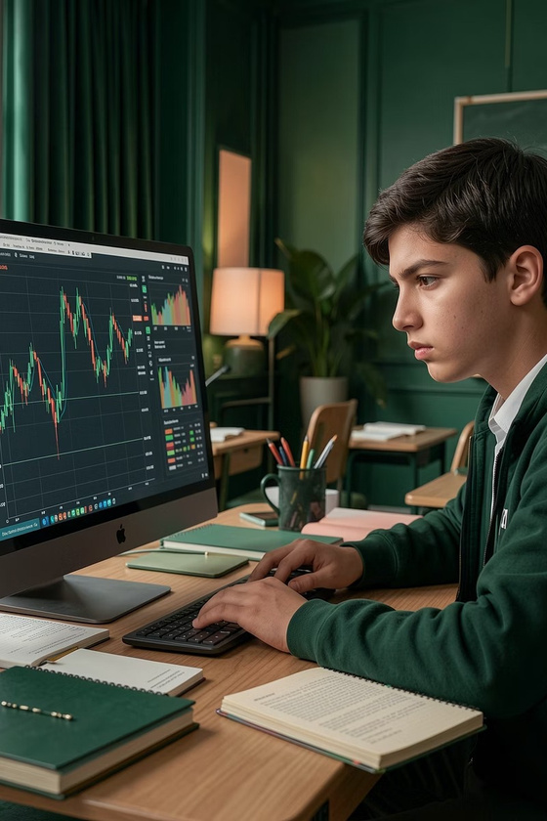
The Challenge (Context)
Your institution has built something exceptional — A world-class
curriculum that develops well-rounded students through rigorous academics, sports, coding, and competitions. Your students are prepared for many things.
But one critical dimension remains: financial literacy and real-world decision-making.

Slide 5
The Evidence
87%
18%
of U.S. adults said high school left them unprepared for handling money (2025 Financial Literacy Crisis in America)
of OECD students lack basic financial proficiency (OECD PISA 2022)
42%
80%
of teens terrified about their financial future (JA Teens & Personal Finance Survey, 2025)
of teens don't understand FICO scores
(JA Teens & Personal Finance Survey, 2025)

Slide 6
Our Approach
FnomoYoungInvestorshiftsstudents from passive learning to active participation. Rather than studying financial theory in isolation, students engage with real market data,
make real decisions, and experience real consequences — all within a structured, supervised environment.
Transitional
Practice
Guidedexercisesand
case studies
Passive
Active
Understanding
Participation
Academic theory,
Real-worldexposure,
limited application
outcome-driven

Slide 7
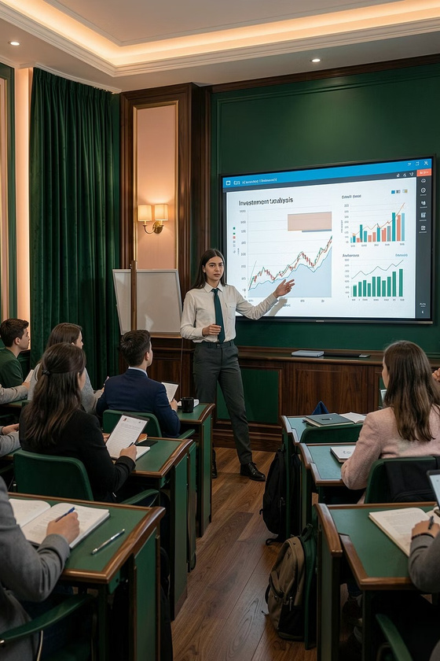
Why This Matters for Students
Studentswho receive financialeducationare5xmorelikelytofeelprepared
for real-world money management.
1
Hands-On Understanding of Value Investing
2
International Visibility & Community Access
Students connect with peers globally, gain exposure to diverse perspectives, and build networks that extend far beyond their institution.
Students learn enduring principles that compound over a lifetime. These aren't academic concepts — they're frameworks that will guide
financial decisions for
decades to come.
3
Ready for 2027 Young Investor Competition
Students can compete on a global stage, earning recognition for real financial thinking and achievement.

Slide 8
Programme Structure
Fnomo is an instructor-led,hands-on real-world learning experience. Students participate, interact, and reflect through structured phases — followed by performance insights and certification. The programme bridges the gap between earning money and understanding how to manage it.
Hands-On
Guided Intro
Reflect & Analyze
Insights & Cert
Each phase is carefully designed to build upon the last — ensuring students develop genuine competence and confidence through progressive, structured engagement.

Slide 9
Programme Highlights
1
Real-World Decision-Making
Students work with actual market data and make decisions with real consequences—building judgment that applies far beyond the classroom.
2
Investment Fundamentals
A simplified, practical, and rigorous introduction to the core principles professional investors use—accessible to every student.
3
Dummy Portfolio
Students build and manage a simulated portfolio with zero financial risk and maximum learning impact.
4
Guided Participation
Structured support ensures every student progresses with confidence and develops genuine competence, not just participation.
5
Peer & International Learning
Students learn alongside peers from different institutions and countries—broadening perspective and building valuable networks.
6
Global Competitions
Students can compete internationally, earning recognition for disciplined financial thinking and achievement.

Slide 10
For Institutions
Fnomo Young Investor is not a generic workshop. It's a structured, high-impact programme designed to create measurable student outcomes and lasting institutional value.
Ready to Deploy
Performance Reports
Full Visibility
Academic Differentiation
Fully structured, professionally designed, and ready for immediate institutional
integration.
Complete transparency into student participation, learning outcomes, and progress
across your cohort.
Detailed student performance insights with measurable
outcomes — shareable
with faculty, leadership,
and families.
A distinctive, celebrated programme that strengthens your
academic offering and
appeals to prospective
families.

Slide 11
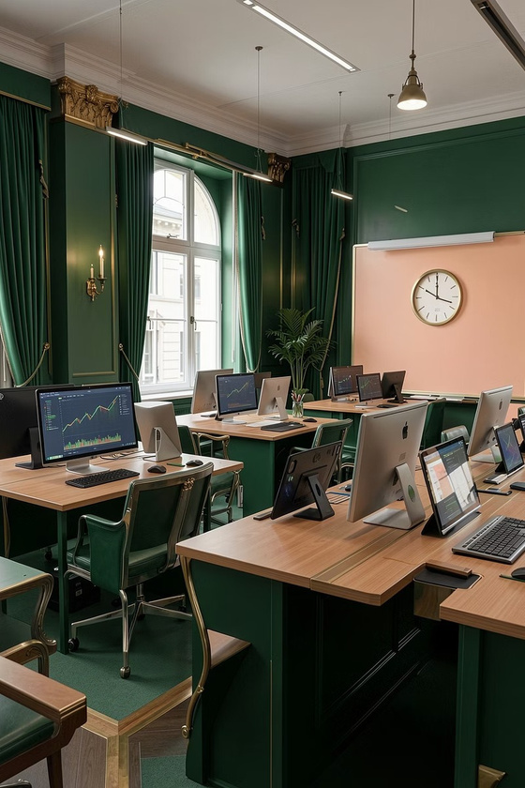
Compliance & Safety
No real money involved
The program is purelyeducational at every stage, removing any
financial risk for students and institutions.
No trading, transactions, or advisory
Fnomo Young Investor operates fully within educational
boundaries, focusing on learning rather than financial operations.
Fully controlled, risk-free learning environment
Weprovide asafe and regulatedspaceforallparticipants,
ensuring a secure and constructive educational experience.

Slide 12
Founder's Note
"I designed Fnomo with simplicity — my 15 and 11 year old can understand financial analysis and wealth management.
If they can, why can't thousands of other kids? Through initiatives like Fnomo Young Investor, we're building a strong financial foundation for the next generation and the country."
— Indu, Founder

Slide 13

Get in Touch
Ready to bring Fnomo Young Investor to your institution?
Contact: fnomo.com | education

