Slide 1

Machine Learning
Project 1
Vessel Trajectory Prediction Models for Marine Traffic Control near Beaumont-Port Arthur Ports, TX
Group Members:
Kushum K C
Rakshya Shrestha
Zaki Ahmed Choudhury

Slide 2
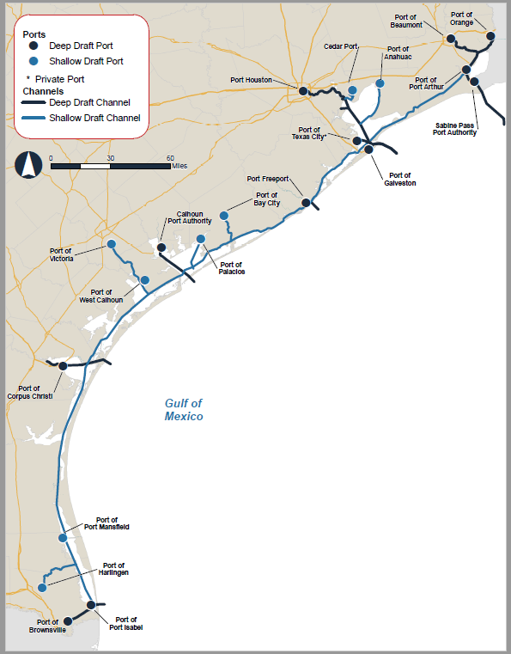
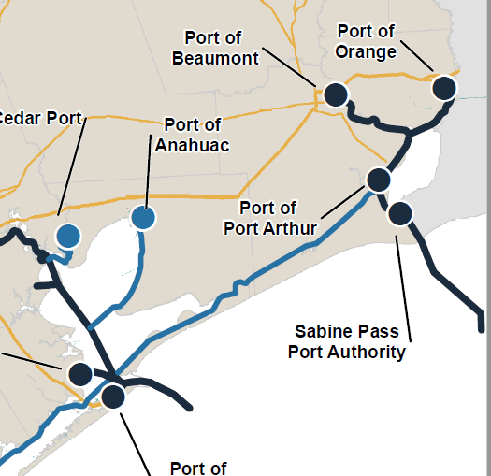
Map of Texas Ports

Slide 3
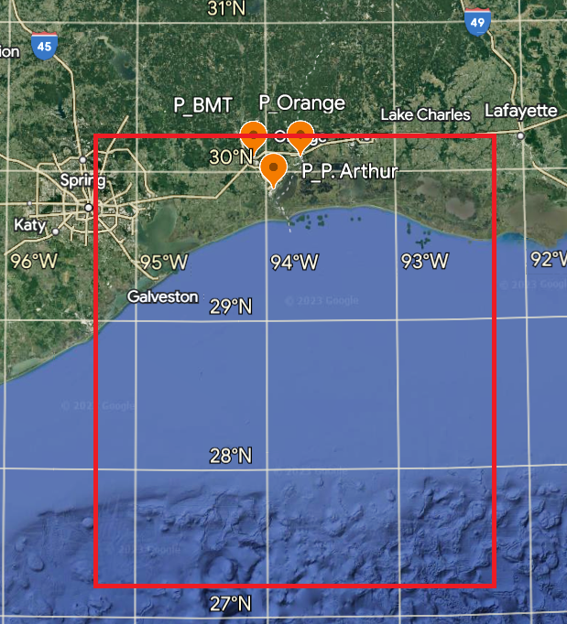
Ships use the Sabine River, Port of Beaumont Channel & the Sabine-Neches Waterway
AIS data filtered for the region between 27º15' N to 30º15' N latitude
& 92º15' W to 95º15' W longitude

Slide 4
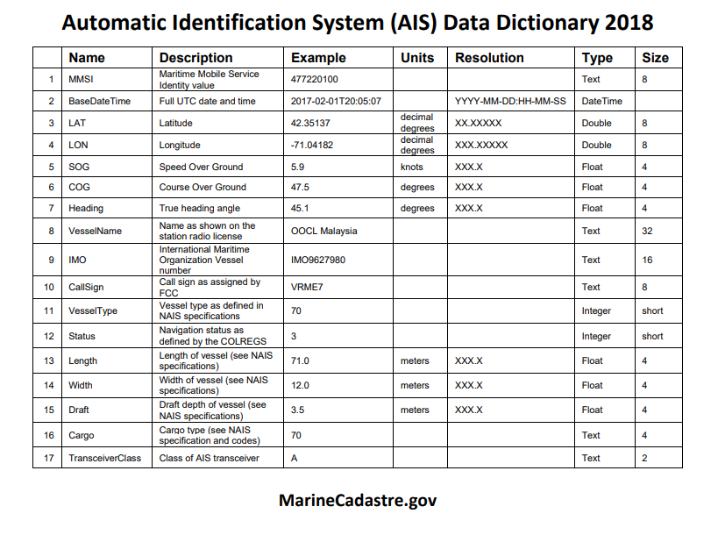
Metadata AIS

Slide 5

Framework
Linear regression: for time t, everything is given,
predict new longitude using variables, predict new latitude using variables.
increase or decrease the variables
logistic regression may be (using the models 1 or 2, best result)
Check for multi-colliniearity,

Slide 6
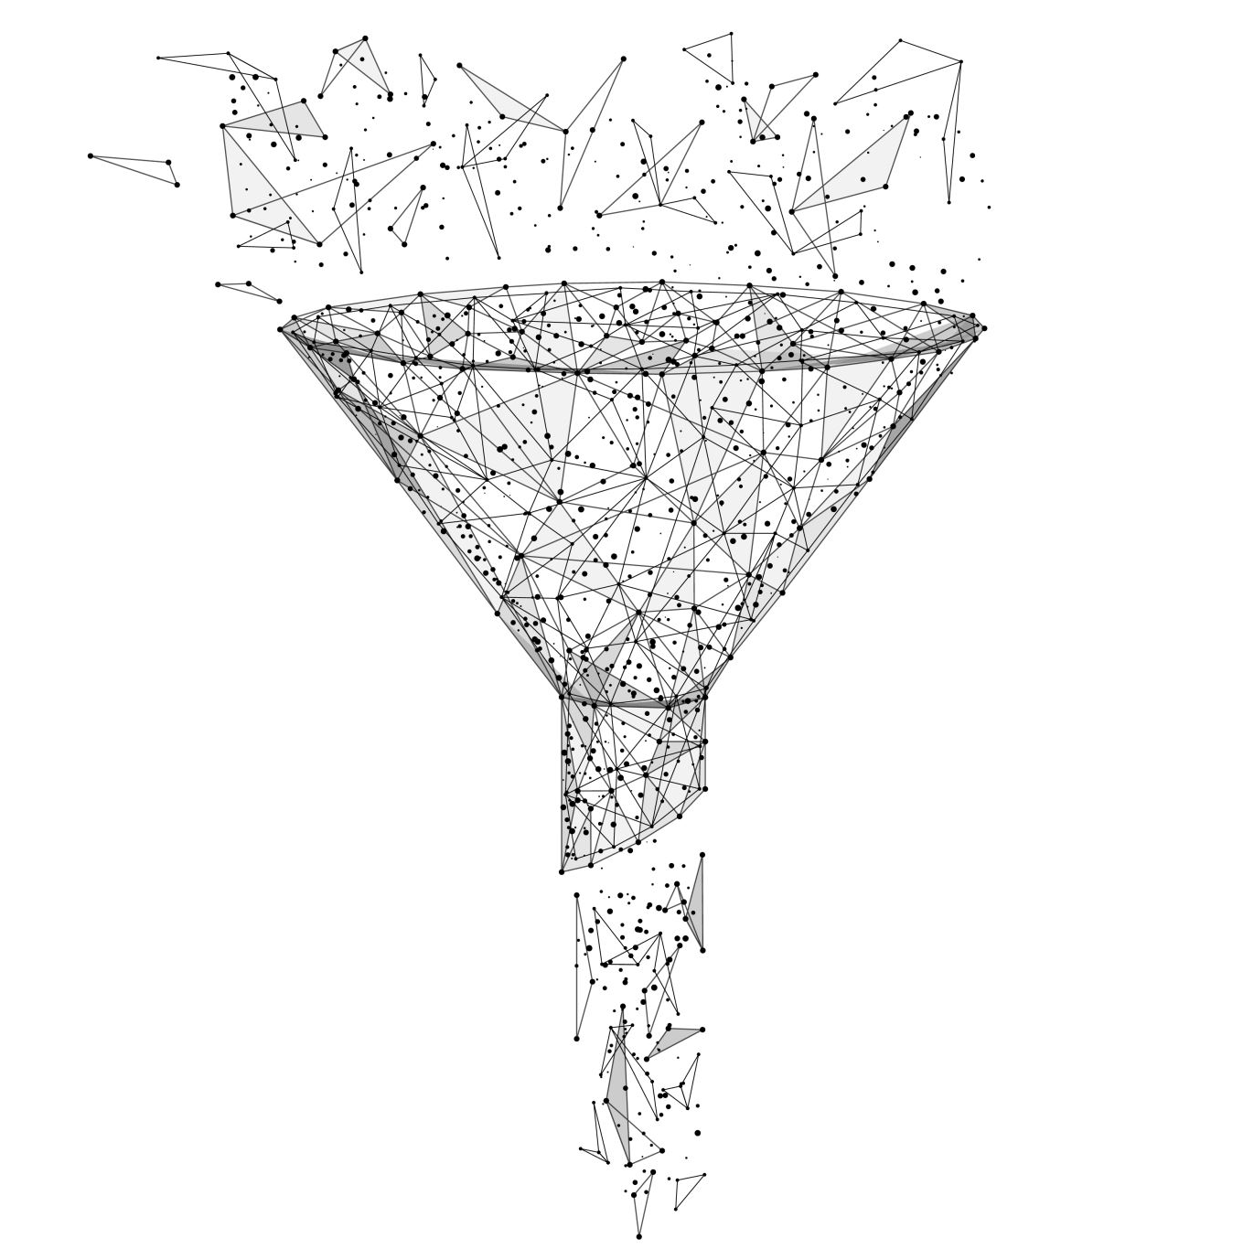
Data Filtering
For the latitude and longitude.
For Nan (not available) data.
For stationary vessels and the vessels with unexpected higher speed.
For missing length data.

Slide 7
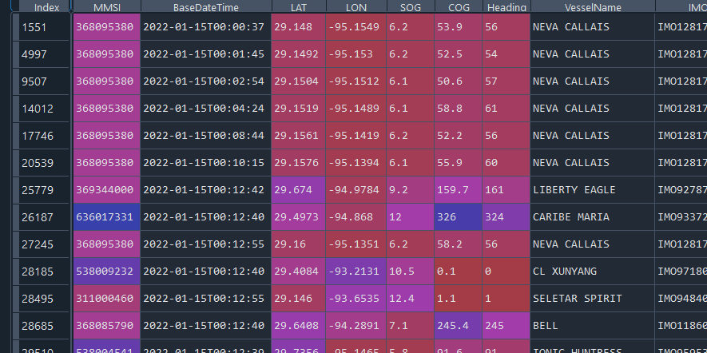
Dataframe
654879 Rows

Slide 8

Data Preprocessing
L_{i+1} columns introduced
LAT_Shift = LAT(n+1)
LON_Shift = LON(n+1)
Indicator columns were introduced based on the direction of trajectory.
0 – North , East
1 – South, West
LAT_diff = LAT(n+1) - LAT(n)
LON_diff = LON(n+1)– LON(n)

Slide 9
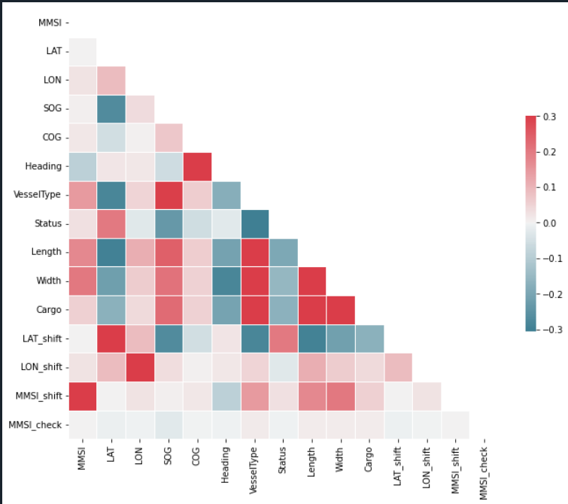
Correlation between Parameters

Slide 10
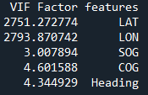
Multicollinearity Check

Slide 11
Final Dataset and Training/Testing dataset
Final dataset contains total: 6,54,879
Testing data: 1,30976 (20% of the dataset)
Training dataset: 5,23,903 (80% of the dataset)

Slide 12
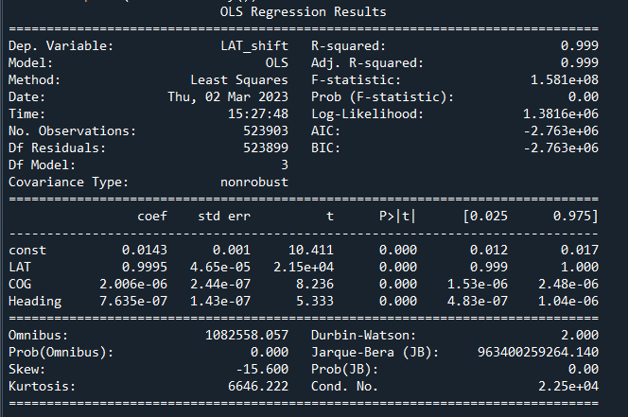

1st model
Variables X:
2. LAT
4. COG
6. Heading
Separate models for Y_LAT and Y_LON
Result Comparison with LAT_shift and LON_shift respectively.

Slide 13
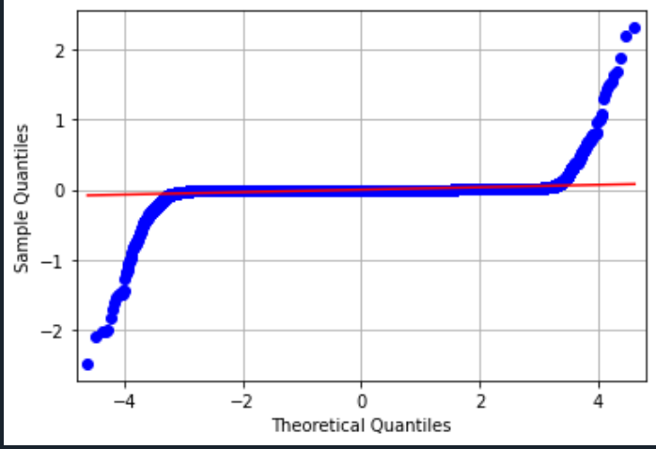
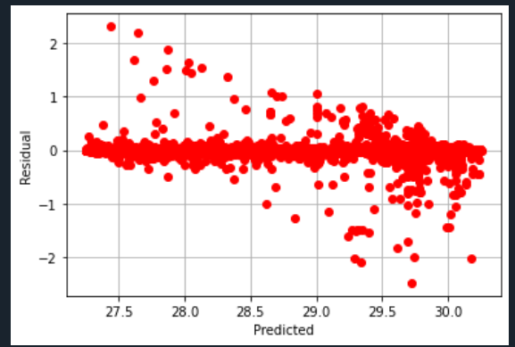
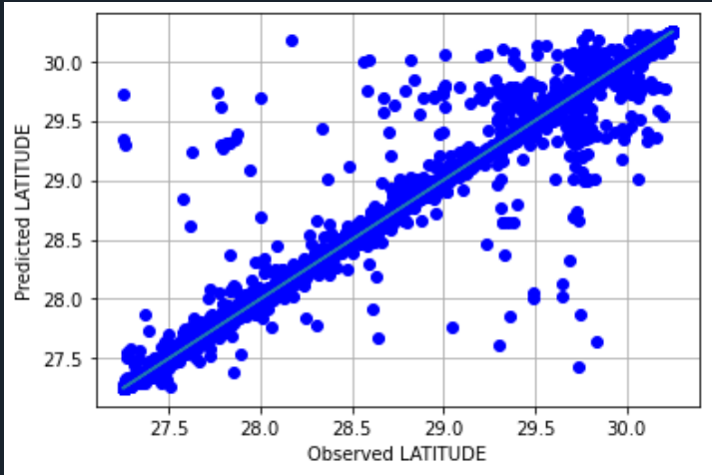
Model for Latitude
Normality Test
Residual Plot
Observed VS Predicted

Slide 14
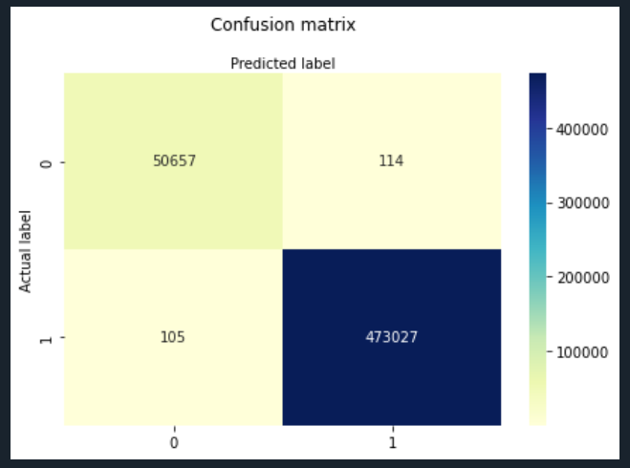
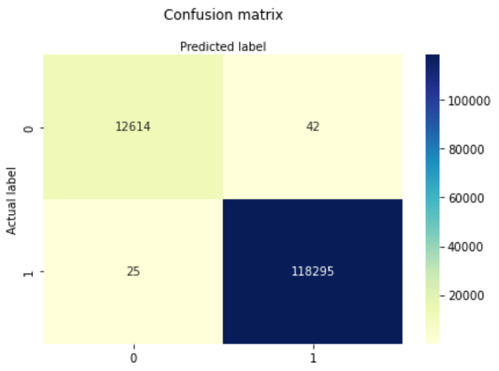
Model for Latitude
Contingency Table
Training Data
Testing data

Slide 15
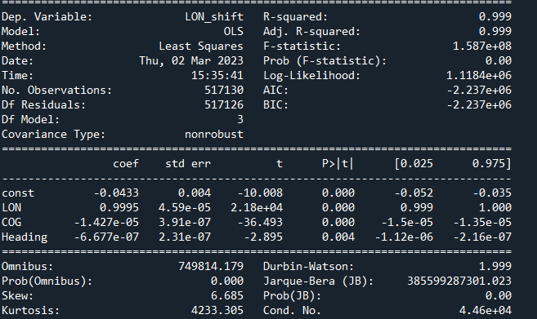
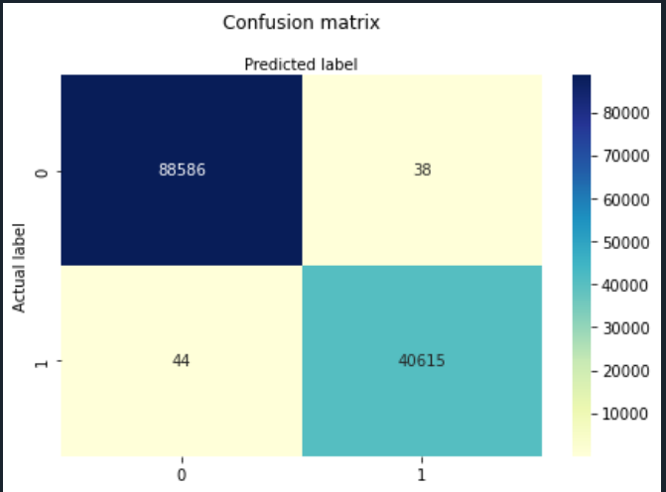
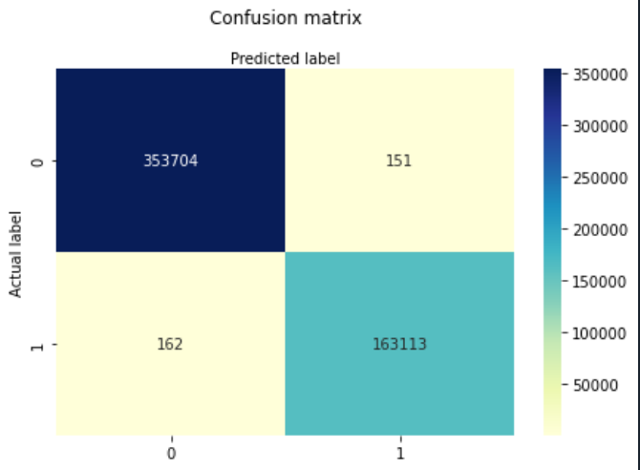
Model for Longitude

Slide 16
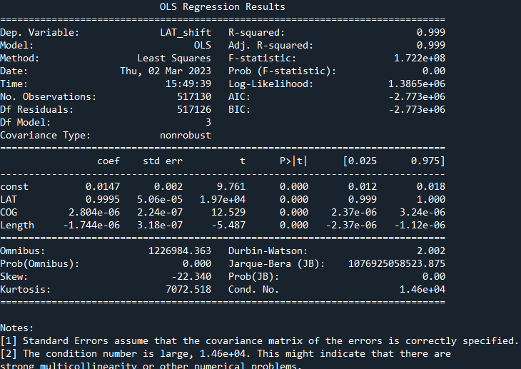
2nd model: Linear Regression
3 Parameter Model
Latitude
COG and
Length

Slide 17

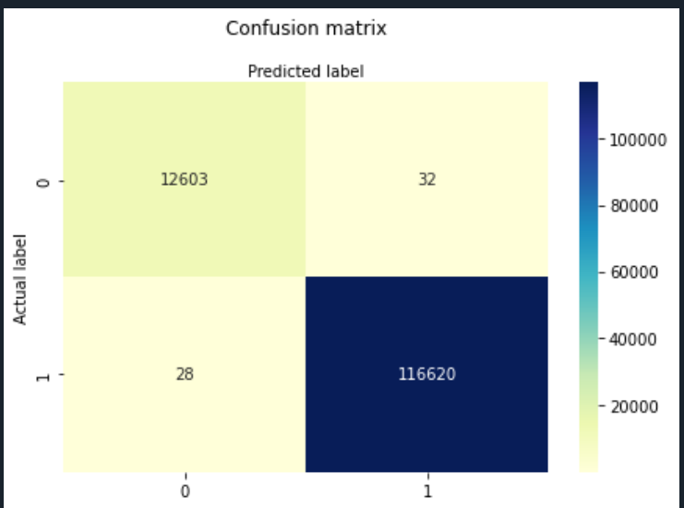
Contingency Table

Slide 18
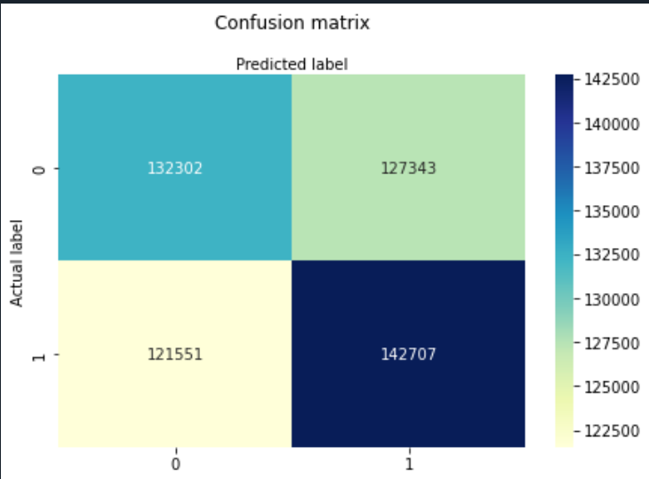
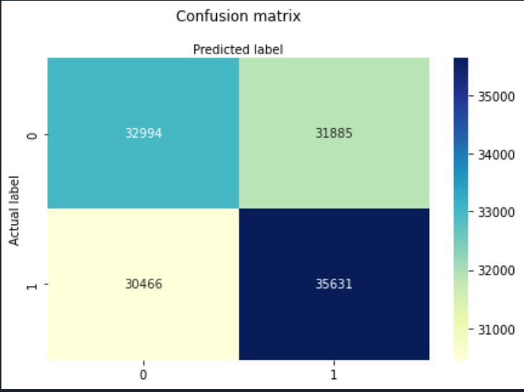

Logistic Regression: LATITUDE

Slide 19
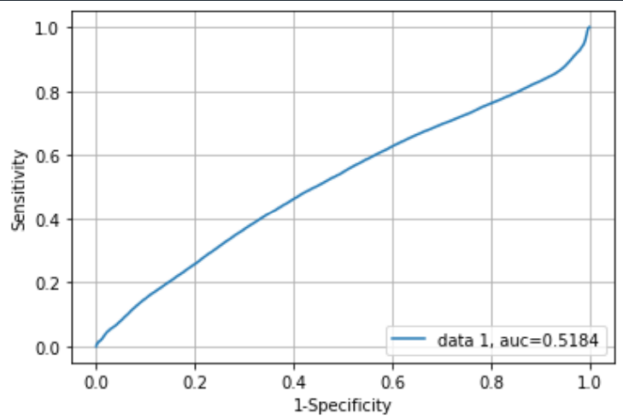
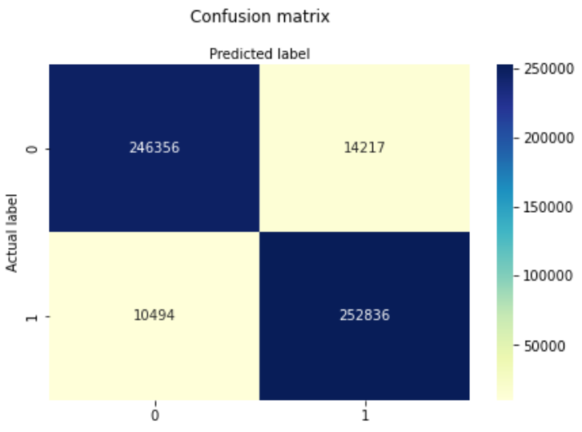
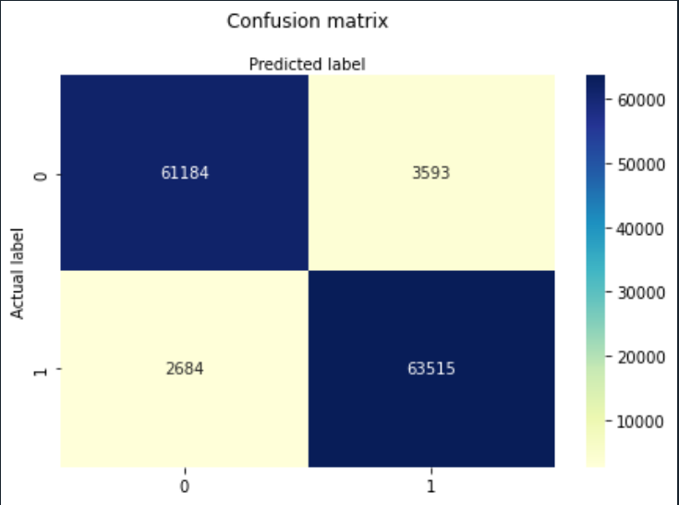

Logistic Regression: LONGITUDE

Slide 20
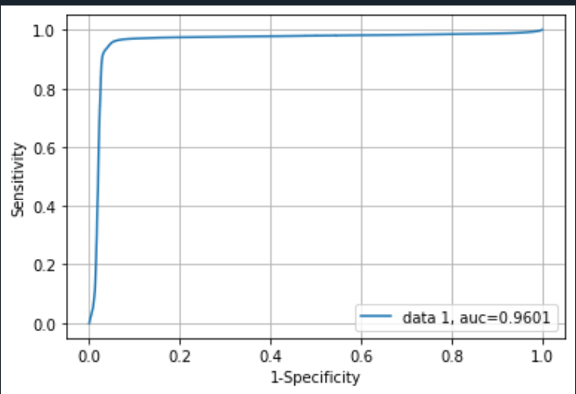
ROC Curve

Slide 21
Closing Statement
Logistic Regression Model and Linear Regression Model were used to predict direction of trajectory
Latitude and Longitude for T_{i+1} are accurately predicted by using Latitude and Longitude for time T_{i}.
Longitude Prediction using Logistic Regression ROC curve gave an auc score of 0.96.

Slide 22
References:
Data Collection: for UTM zone 15
https://marinecadastre.gov/AIS/
Papers for Literature Review:
Burger, C.N., W. Kleynhans, and T.L. Grobler, Extended linear regression model for vessel trajectory prediction with a-priori AIS information. Geo-spatial Information Science, 2022: p. 1-19.
Valsamis, A., K. Tserpes, D. Zissis, D. Anagnostopoulos, and T. Varvarigou, Employing traditional machine learning algorithms for big data streams analysis: The case of object trajectory prediction. Journal of Systems and Software, 2017. 127: p. 249-257.
Burger, C.N., T.L. Grobler, and W. Kleynhans. Discrete kalman filter and linear regression comparison for vessel coordinate prediction. in 2020 21st IEEE International Conference on Mobile Data Management (MDM). 2020. IEEE.

