Slide 1


Maharana Pratap Engineering College
WEATHER WEB APP
Presented by
Under Supervision
Vishal Kumar Kushwaha
Roll No. 2100460100119
Dr. Vijay Singh
Submitted in partial fulfillment
of the requirement for the Award for the degree of
Bachelor of Technology
in
Computer Science and Engineering
Department of Computer science and Engineering
Dec - 2023

Slide 2
Content
Abstract
Introduction
Features
Process
Output
Conclusion
Reference
Weather Web App
Dec - 2023
2

Slide 3
1. Abstract
The Weather Web App is a user-friendly online application designed to provide real-time weather information and forecasts. With a clean and intuitive interface, users can easily access accurate weather data for their location or any specified location globally. The app utilizes advanced meteorological APIs to deliver up-to-date details on temperature, humidity, wind speed. Users can view current conditions to plan their activities effectively. Whether on desktop or mobile devices, the Weather Web App ensures a responsive design for seamless accessibility. The app's robust architecture enables quick data retrieval, ensuring reliable and timely information. In summary, the Weather Web App combines accuracy, interactivity, and user customization, making it a go-to resource for individuals seeking comprehensive and reliable weather updates.
Weather Web App
Dec - 2023
3

Slide 4
2. Introduction
.
The Weather Web App is a convenient and accessible online platform that provides users with instant access to accurate and up-to-date weather information. Offering a user-friendly interface, the app delivers real-time data on temperature , wind speed, and more for any specified location globally.
Users can effortlessly navigate through current conditions, hourly forecasts, and extended outlooks, empowering them to plan activities with confidence. With a responsive design, the Weather Web App seamlessly adapts to various devices, offering a consistent and intuitive experience for users on desktops or mobile devices.
Weather Web App
Dec - 2023
4

Slide 5
Software Requirement
Programming Languages:
Frontend: HTML, CSS, JavaScript
APIs
Integration with weather APIs (such as OpenWeatherMap, Weatherbit, weatherapi or others) for fetching real- time weather data.
Version Control:
Git for version control to track changes in the codebase.
Development Tools:
Code editor (Visual Studio Code)
Hardware Requirement
Processor-intel core i3 and later
Disk space- minimum 50Gb
RAM- minimum 8GB
Network Infrastructure:
Sufficient bandwidth for handling user requests, especially if the app experiences high traffic.
Weather Web App
Dec - 2023
5

Slide 6
3. Features
A simple weather web app typically includes essential features to provide users with basic and relevant weather information. Here are some common features:
Current Weather Information:
Display real-time data on temperature, humidity, wind speed, and atmospheric pressure for the user's current location.
Location Search:
Allow users to enter a location (city or coordinates) to retrieve weather information for that specific area.
Forecast:
Provide hourly and/or daily forecasts to help users plan activities in advance.
Visual Representation:
Include graphical elements like icons or weather animations to visually represent current weather conditions.
Weather Web App
Dec - 2023
6

Slide 7
4. Process
Define Objectives:
Clearly outline the goals and features of your weather web app, considering the target audience and the type of weather information you want to provide.
Choose Technology Stack:
Select the appropriate programming languages, frameworks, and libraries for both the frontend (HTML, CSS, JavaScript, etc.) Weather API Integration:
Integrate with a reliable weather API (e.g., OpenWeatherMap, Weatherbit) to fetch real-time and forecast data.
Design User Interface:
Create a user-friendly and responsive design, focusing on simplicity and easy navigation. Implement visual elements to represent weather conditions.
Weather Web App
Dec - 2023
7

Slide 8
Process
Testing:
Conduct thorough testing to ensure the app functions correctly, is free of bugs, and provides accurate weather information.
Deploy:
Deploy your weather web app to a web server or cloud platform, making it accessible to users.
Monitor and Update:
Implement monitoring tools to track app performance. Regularly update the app to incorporate new features, improvements, or security patches.
User Feedback:
Encourage user feedback to identify areas for improvement and to understand user preferences.
Weather Web App
8
8
Dec - 2023

Slide 9
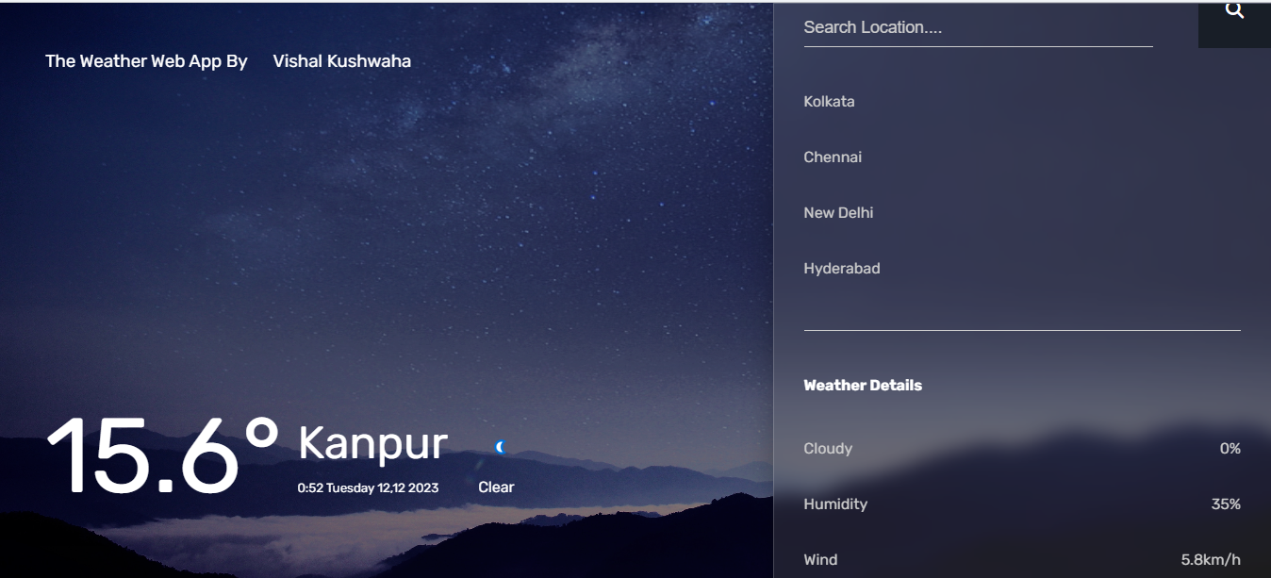
Output:-
Weather Web App
Dec - 2023
9

Slide 10
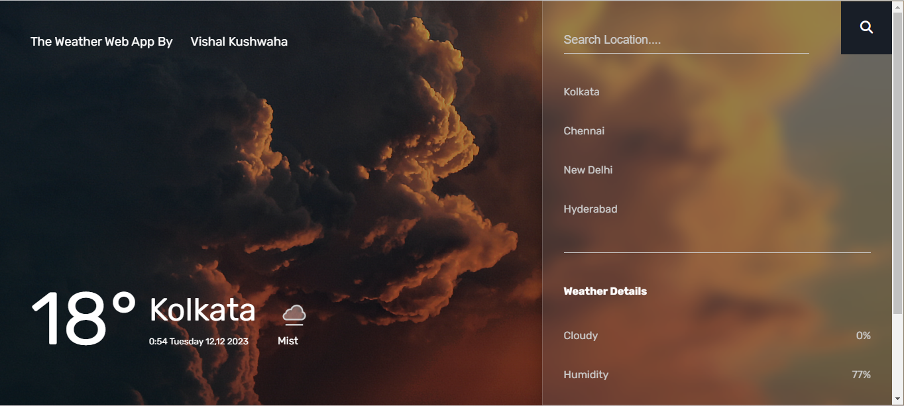
Weather Web App
Dec - 2023
10

Slide 11
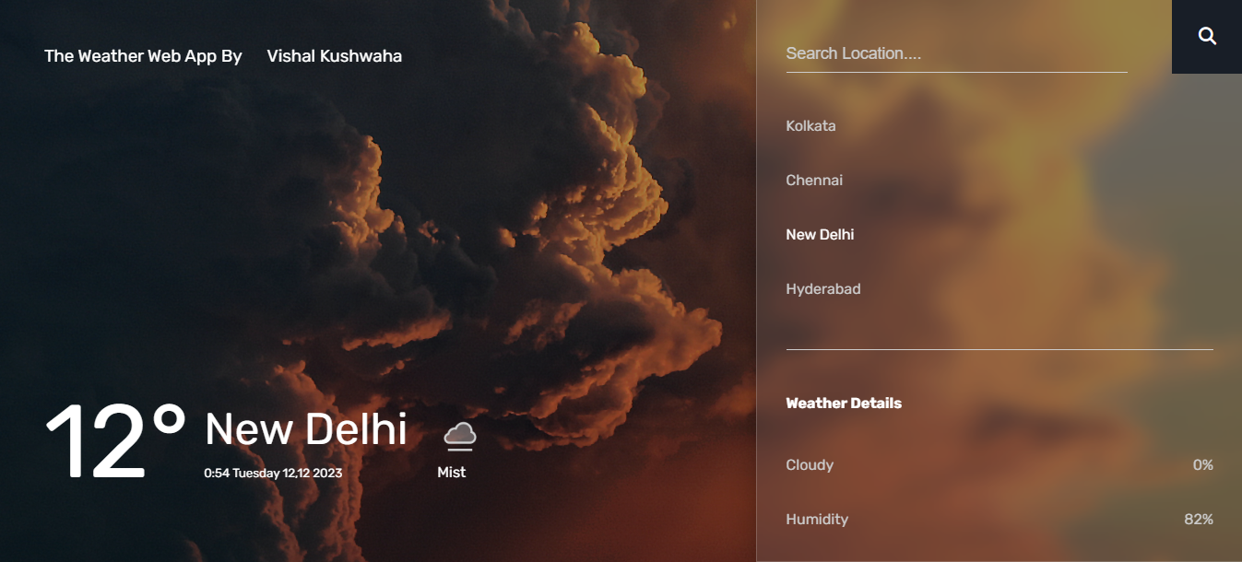
Weather Web App
Dec - 2023
11

Slide 12
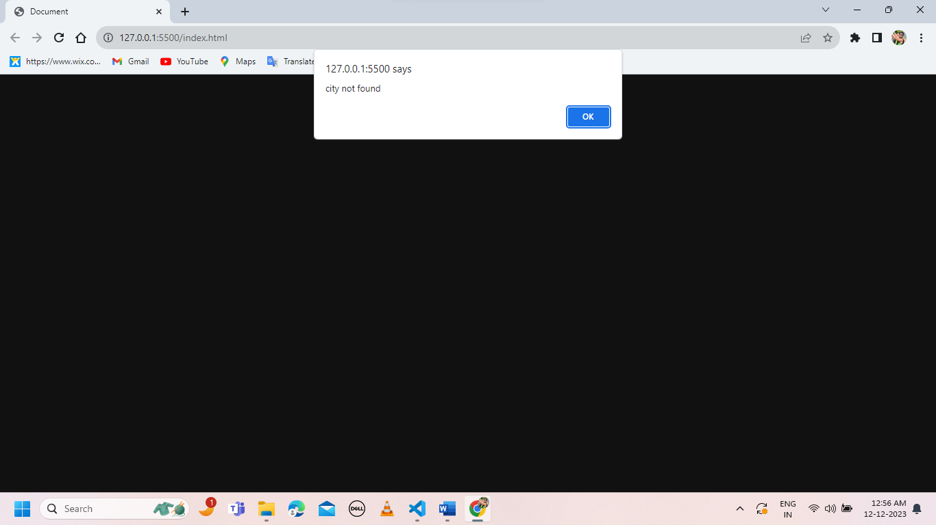

Weather Web App
12

Slide 13
6. Conclusion
In conclusion, developing a weather web app involves a systematic approach, including defining objectives, researching user needs, designing a responsive interface, integrating with reliable weather APIs, and ensuring security measures. By following a well-structured methodology, the development team can create a user-friendly, accurate, and accessible weather web app. Continuous testing, monitoring, and post-launch support are essential for maintaining optimal performance and user satisfaction. As technology advances, incorporating user feedback and staying updated on weather data sources contribute to the app's effectiveness in providing timely and relevant information to users.
Weather Web App
Dec - 2023
13

Slide 14
7. References
http://www.w3schools.com
http:// www .stackoverflow.com
Weatherapi
Fontawesome
Googlefonts
chatgpt
Weather Web App
Dec - 2023
14

Slide 15


