Slide 1
Agri Predictive Analytics Model
Forecasting district-level crop yield at week 20 - and explaining why
Yuva Intern - Junior Data Scientist Internship (Nagpur) - Findings deck
Built on simulated data that reproduces the brief's problems: results show the method, not real Vidarbha yields.
Notes:
Open with the framing: this is a method demonstration on simulated data built to match the brief. The forecast date is the end of week 20, about mid-October.

Slide 2
The model beats the baseline
42% / 31%
1.19 q/ha
82%
better than the 3-year average on validation / test
test error per district-crop (7.2% of yield)
of shortfalls caught on test (precision 61%)
Forecast issued at week 20 (mid-October) from weeks 1-20 plus past seasons only
349,959 raw weekly rows reduced to 5,709 block-crop seasons, 50 features
One goal not met: test error rose 40% above validation, traced mainly to unusually wet seasons
Notes:
Both validation and test beat the baseline by well over the 15% target. The 5% stability goal was not met; the next slides explain why.

Slide 3
Four data problems fixed
5,511
22,372
duplicate rows removed
prices entered per kg
Exact copies, including the record ID.
Found by comparing to other mandis in the same week, then x100 to per quintal.
40,300
18,311
yield values in wrong units
rainfall readings missing
37,336 kg/acre or t/ha converted, 2,964 mislabelled caught by size.
Heavy-rain weeks go missing most, so a plain average would understate rain.
Notes:
Every fix is detected from the data, not hard-coded. Missing rainfall was filled from the same gauge under other crops, then neighbouring blocks.

Slide 4
Leakage makes models lie
Too good to be true
Random splits look 9% better and leaky columns 75% better - neither exists on forecast day.
What I excluded
Production, procurement and crop-cutting estimate (they contain the answer), season-total rainfall, post-harvest prices.
Split
Train on 2006 to 2019, validate on 2020 to 2022, test on 2023 to 2025.
Notes:
Correlations of the post-harvest columns with yield are 0.93 to 1.00. Random cross-validation lets the model see other blocks from the same year, which share weather.

Slide 5
Gradient boosting wins
1.72 -> 1.19
test q/ha: baseline vs final model
42% and 31%
improvement vs baseline, validation and test
Linear model loses to the baseline: yield reacts to rainfall in a curve, not a line.
Notes:
Baseline is the 3-year block-crop rolling mean. Models were compared with expanding-window cross-validation, then on untouched validation years. Tuning added little in CV but helped validation district error from 0.90 to 0.85.

Slide 6
What drives the forecast
Monsoon rainfall, weeks 1-17: extremes in either direction cut yield
Last harvest's price vs now: a market signal of local supply
3-year rain average: soil-moisture memory
Price trend vs last year: farmers invest after good prices
Tur: the crop most hurt by wet monsoons
Caveat: price features are signals, not causes
Notes:
Shapley values were estimated by permutation sampling because the shap package was not installable offline; the notebook uses shap automatically when it is present. Dry-spell length, soil and heat ranked lower than the EDA story suggested.

Slide 7
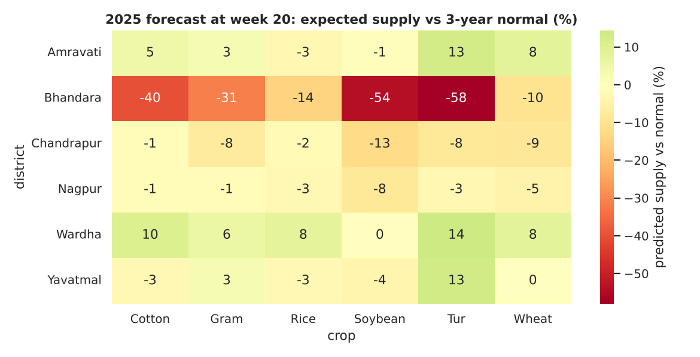
From forecast to action
BOOK EARLY (12)
Supply forecast 4%+ below normal: Bhandara kharif crops, Chandrapur soybean, wheat, gram.
WAIT (9)
4%+ above normal: tur in Wardha, Amravati and Yavatmal (+13 to +14%).
ROUTINE (15)
Within 4% of normal.
Forecast issued at week 20, 2025 season
Hindsight (2025 actuals): direction right in 75% of 36 pairs. Bhandara kharif shortfalls were real (tur forecast -58%, actual -56%); its rabi flags were wrong (gram forecast -31%, actual +10%).
Notes:
Treat rabi crop flags in unusually wet years as low confidence. Priority score combines expected shortfall with price momentum; it is a heuristic, not an optimiser.

Slide 8
Limits and next steps
Scorecard
Beat baseline by 15%: met (42% / 31%)
Test within 5% of validation: not met (+40%; baseline also worsened 17%)
Top drivers sensible: yes, with the price caveat
Main source of the gap: unusually wet seasons doubled (9% to 16% of rows); error 16% vs 10% in normal seasons
Simple recalibration made forecasts worse, so I would not ship it
One wrong prediction
Wardha Block-8, soybean, 2023: forecast 15.2, actual 9.9 q/ha
Monsoon was 1.44x the block's history. Similar seasons landed near 0.69x baseline; this one hit 0.63x.
The model said 0.97x: price features outweighed rainfall, and a good 2021 inflated the baseline.
Next: crop-specific wet-season features and a hybrid model, tested on a fresh hold-out
Notes:
Late-season weather was checked and ruled out for this block-year. A hybrid linear plus boosting model did worse on validation, so it was not selected, though it looked better on test; that needs a fresh hold-out.

