Slide 1

IDEALAB · PRODUCT DEVELOPMENT PROJECT
Automatic Water Dispenser
A touchless water dispensing system developed to improve hygiene, reduce water wastage, and demonstrate practical automation using embedded systems.
Project Team
Kushwanth P — Project Lead, Embedded Systems & System Integration
Likith M — 3D Design Engineer & Product Enclosure Design
Department of Electronics and Communication Engineering
Notes:
1

Slide 2


CHAPTER 1 · PROJECT ORIGIN
Introduction & Inspiration
The Problem We Observed
Why This Problem Matters
The idea for the Automatic Water Dispenser emerged from observing how frequently shared water dispensers require physical contact. In schools, offices, hospitals, and public places, hundreds of people use the same water tap every day, increasing the possibility of contamination and poor hygiene.
Access to clean drinking water is essential, but hygiene during dispensing is equally important. The project was conceived as a simple yet impactful solution that combines sensors, automation, and embedded systems to provide a completely touchless water dispensing experience. By eliminating physical contact, the system helps reduce the spread of germs while providing a more convenient user experience.
Notes:
2

Slide 3
CHAPTER 1 · VISION
What We Are Building
The Automatic Water Dispenser is a compact smart system capable of detecting a user's hand and automatically dispensing water without requiring any physical interaction. The project integrates sensing technology, actuator control, and user feedback through a display interface to create a complete embedded solution.
Design Philosophy
The product is designed around three core principles that guided every engineering decision throughout the project.
🧼 Hygiene
⚡ Simplicity
🤖 Automation
Zero physical contact required. The system eliminates the primary vector for germ transmission at shared water points.
Intuitive operation with no learning curve. Users simply place their hand under the dispenser and water flows automatically.
Fully autonomous sensing and actuation. The system detects, decides, and dispenses without any manual intervention.
Every component was selected to ensure reliable operation while maintaining a low-cost and easily reproducible design.
Notes:
3

Slide 4
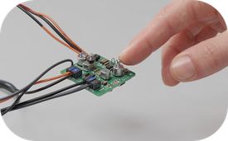
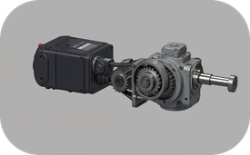
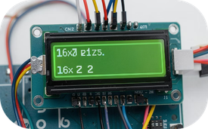
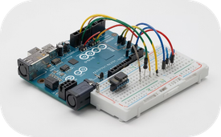
CHAPTER 2 · FEATURES
Product Features
Touchless Operation
Automated Water Dispensing
Real-Time LCD Feedback
Compact Embedded System
The HC-SR04 ultrasonic sensor continuously monitors the area near the dispenser and detects the presence of a user's hand with high accuracy, triggering the system without any physical contact.
A 16×2 LCD provides system information including readiness status, dispensing activity, and user notifications, keeping users informed throughout the interaction.
Once a hand is detected, the SG90 servo motor automatically activates the dispensing mechanism and stops after the required duration, ensuring consistent and controlled water flow.
The complete solution is built around the Arduino Uno platform, making the system simple, reliable, and easy to maintain. The design operates efficiently using a dedicated battery for the actuator and a separate control system for stable operation.
Notes:
4

Slide 5




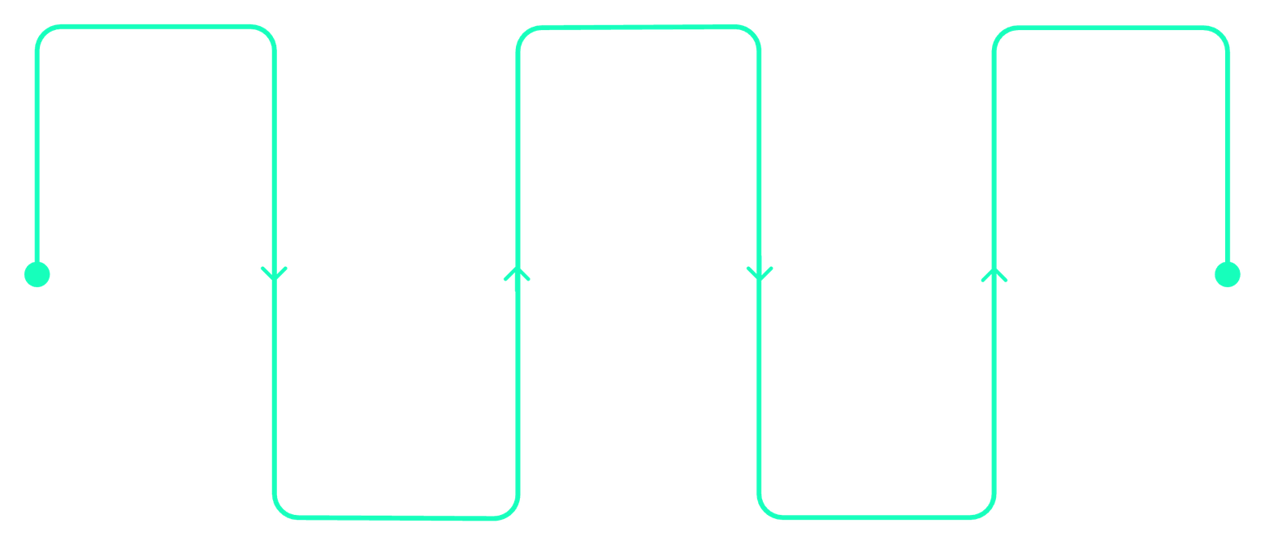
CHAPTER 2 · SYSTEM DESIGN
Functional Architecture
The Automatic Water Dispenser follows a clean input-process-output architecture. Each subsystem has a clearly defined role, ensuring predictable and reliable operation.
Input — Ultrasonic Sensor
Process — Arduino Uno
The HC-SR04 ultrasonic sensor acts as the input device and continuously measures distance to detect hand presence in the dispensing zone.
The Arduino Uno functions as the central controller, processing sensor data and making real-time control decisions based on predefined thresholds.
Output — Servo Motor
Interface — LCD Display
The SG90 servo motor acts as the output actuator responsible for opening and closing the water dispensing mechanism with precise angular control.
The 16×2 LCD module serves as the user interface by displaying operational messages and real-time system status to the user.
System Flow
Hand Detection
Servo Activation
User Feedback
Ultrasonic sensor detects presence
LEDs or sound confirm action
Trigger mechanical actuator
Signal Processing
Water Dispensing
Filter and interpret sensor data
Control valve to release water
This sequential flow ensures that every stage of the dispensing process is triggered only when the previous stage has been successfully completed, maintaining system integrity and user safety.
Notes:
5

Slide 6
CHAPTER 3 · DEVELOPMENT
Development Process
The project followed a structured engineering workflow from problem identification through to a fully integrated prototype.
01
02
03
Concept Development
Component Selection
Prototype Assembly
The project began with the identification of hygiene-related challenges associated with traditional water dispensers, establishing clear design goals and success criteria.
Various sensing technologies were evaluated before selecting the HC-SR04 ultrasonic sensor due to its reliability, simplicity, and affordability for the application.
The electronic components were integrated and tested on a breadboard to validate sensing accuracy and actuator performance before final assembly.
04
05
Software Development
System Integration
Embedded firmware was developed using Arduino IDE to control sensor acquisition, motor actuation, and LCD display functions in a unified program.
All hardware and software modules were combined into a fully functional prototype capable of autonomous, touchless operation without manual intervention.
Notes:
6

Slide 7
CHAPTER 3 · ENGINEERING
Engineering Details
Hardware Subsystem
Software Subsystem
Arduino Uno — Central microcontroller
HC-SR04 — Ultrasonic distance sensor
SG90 — Servo motor actuator
16×2 LCD — Display module
External Battery Supply — Dedicated power source
The firmware continuously monitors distance measurements from the ultrasonic sensor and activates the dispensing mechanism whenever a user enters the predefined sensing range. The control algorithm is designed to debounce sensor readings and prevent false triggers.
Control Logic
The control algorithm ensures that water is dispensed only when required, reducing unnecessary consumption and improving overall system efficiency. Dispensing duration is precisely controlled through servo angle positioning.
Notes:
7

Slide 8






CHAPTER 4 · PROJECT STATUS
Project Status & Prototype Outcome
The Automatic Water Dispenser has successfully completed all planned development milestones. The prototype is fully operational and demonstrates reliable touchless dispensing behavior.
Architecture Finalized
Circuit Assembled
System architecture and component selection completed and validated.
All electronic components integrated and wiring verified for stable operation.
Firmware Complete
LCD Integrated
Embedded software developed, tested, and deployed on the Arduino Uno.
Display module successfully connected and showing real-time system status.
Servo Validated
Sensor Verified
Servo motor control tested and confirmed for precise dispensing actuation.
Ultrasonic sensor performance verified with accurate hand detection range.
The prototype successfully detects user presence, activates the dispensing mechanism, and provides real-time status information through the LCD display — all without any physical contact.
Notes:
8

Slide 9
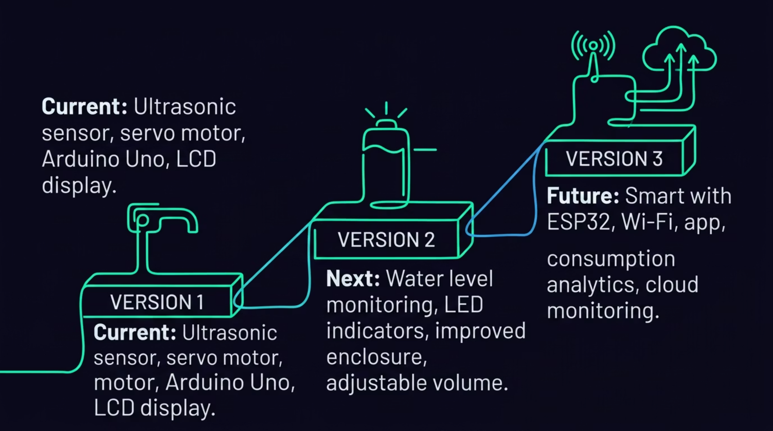
CHAPTER 5 · FUTURE DEVELOPMENT
Roadmap: From Prototype to Smart Platform
The Automatic Water Dispenser is designed to evolve across multiple versions, progressively adding intelligence, connectivity, and data capabilities.
Version 2 — Enhanced Reliability
Version 3 — Smart Connected System
Water level monitoring sensor
LED status indicators for visual feedback
Improved enclosure design for durability
Adjustable dispensing volume control
ESP32 microcontroller integration
Wi-Fi connectivity for remote monitoring
Mobile application support
Water consumption analytics dashboard
Cloud monitoring capabilities
Long-Term Vision
The project aims to evolve into a smart water management platform suitable for deployment across schools, offices, hospitals, and public infrastructure — transforming a simple hygiene solution into an intelligent, data-driven system.
Notes:
9

Slide 10
CHAPTER 6 · CONCLUSION
Conclusion
The Automatic Water Dispenser demonstrates how embedded systems and automation can solve practical real-world problems. By combining sensing technology, actuator control, and user interaction, the project successfully delivers a hygienic and efficient touchless dispensing solution.
What We Achieved
What It Represents
A fully functional, autonomous prototype that detects user presence, dispenses water on demand, and communicates status — all without physical contact.
This prototype serves as the foundation for future smart water management products and showcases the potential of engineering-driven innovation to improve everyday experiences.
"Innovation begins with identifying simple problems and solving them effectively."
Thank You — Kushwanth P & Likith M · Department of Electronics and Communication Engineering
Notes:
10

