Slide 1


W
E
L
C
O
M
E
WELCOME

Slide 2

Exam Seat Management
Team Members
Upasana Khatiwada
Kushal Pathak
Pranam Rai

Slide 3








Table of Contents
Introduction
Problem Statement
Objectives
System Flow
Agile Methodology
Use case diagram
Scope
Significance

Slide 4

Introduction
This system is a sophisticated and efficient software solution designed to streamline the often complex and time-consuming process of assigning seats to candidates during examinations. This system is an invaluable tool for educational institutions, testing centers, and organizations responsible for conducting exams.

Slide 5
Problem Statement
Error-Prone Allocation
Resource Intensiveness
Inefficiency
Security Concerns
Candidate experience

Slide 6
OBJECTIVES
Optimize Resource Utilization
Automate Seat Allocation
Enhance security & Integrity
Improve Candidate Experience

Slide 7
SYSTEM FLOW

Slide 8
Start
Login
Admin
Student
Add Hall
View All Seatplan
Add Room
View Individual Seatplan
Delete Hall
Stop
Delete Room
View All Seatplan
Generate Seatplan
Export From Excel
Logout

Slide 9
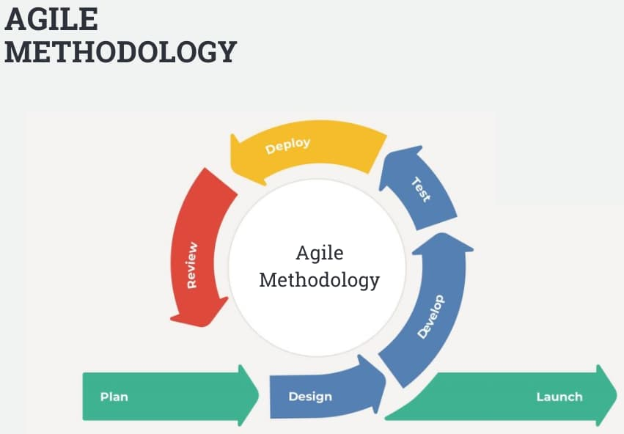
WATERFALL MODEL
Requirement Analysis
System Design
Implementation
Integration and Testing
Deployment and Maintenance

Slide 10
Use Case Diagram

Slide 11
Exam Management
Login
Add Hall
Add Room
Delete Hall
Delete Room
View Seatplan
Admin
Student
Generate Seatplan
Export Excel

Slide 12
Significance
Efficiency & Accuracy
Data Driven Insights
Adaptability & Scalability
Future Proofing

Slide 13
SCOPE

Slide 14
Diversified Examination
Adapting the system to support wide range of examination types
Remote Proctoring Integration
Enhances the system's relevance and security
D
R
Optimize the seat allocation process & enhance security measures.
AI & Machine Learning
Ensuring that the system stays compliant with evolving regulatory and security standards
Regulatory Compliance
A
R

Slide 15

Conclusion

Slide 16
Thankyou

