Slide 1
Karpor: Navigating the Multi-Cluster Maze with Ease Using a Kubernetes Explorer
Forest Chen | KusionStack Maintainer | Ant Group
2025.08.19

Slide 2















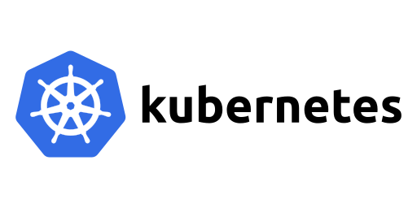






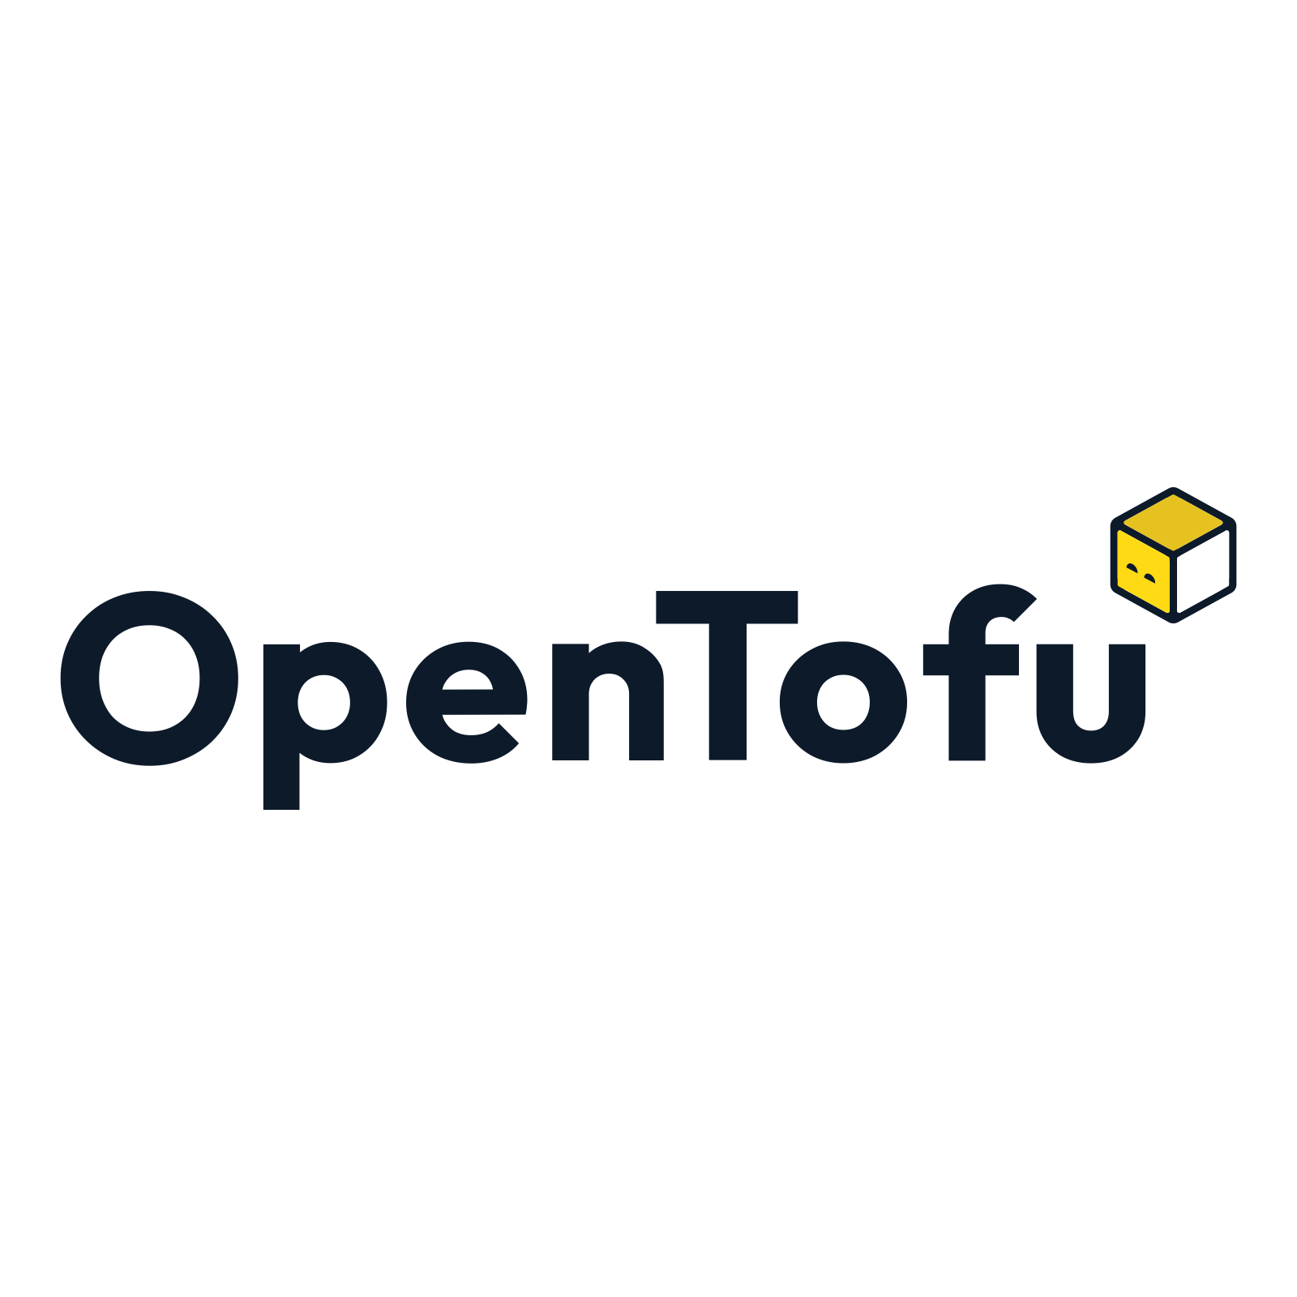









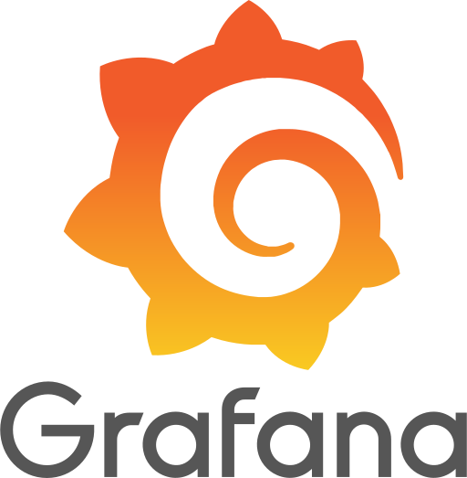



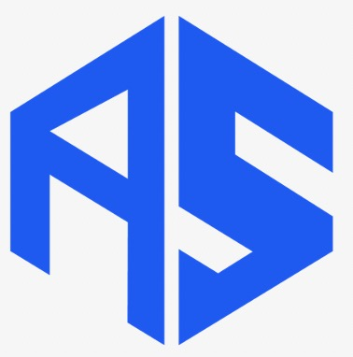
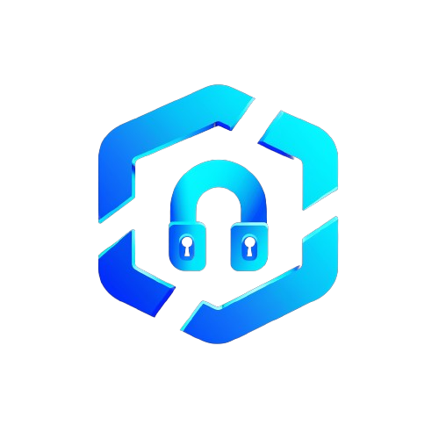



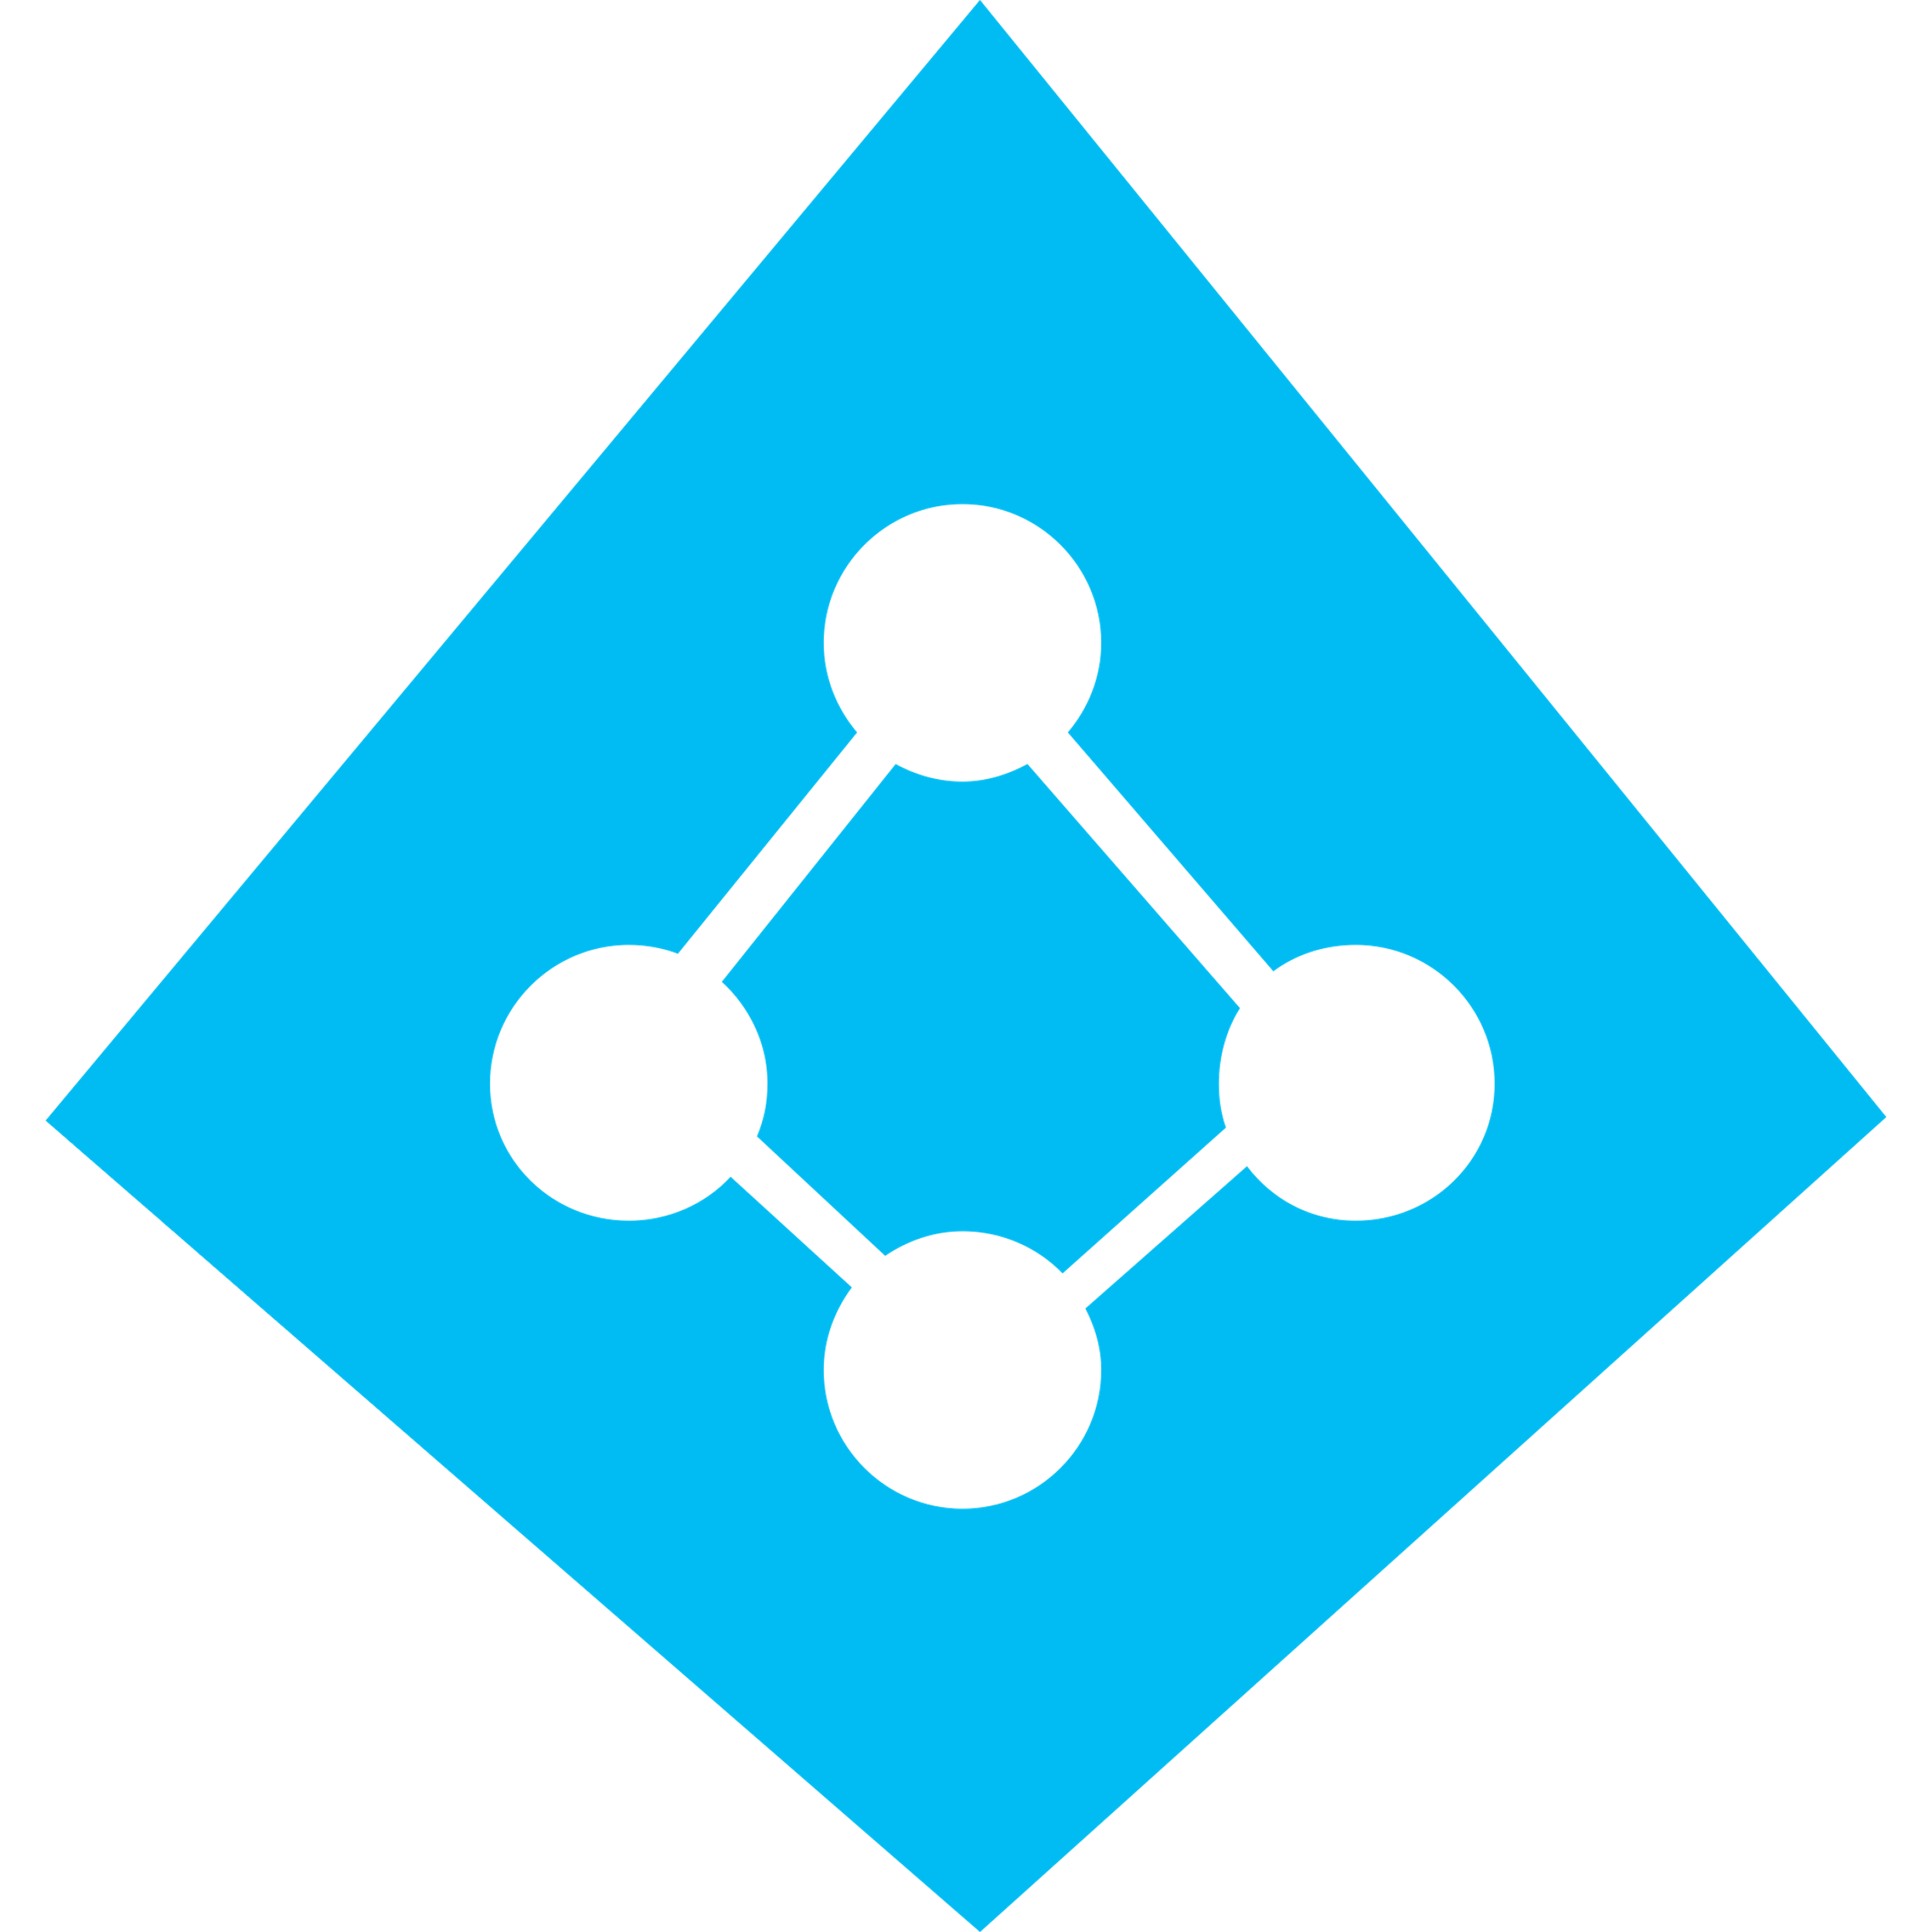


KusionStack: Platform Engineering Stack
KusionStack for Internal Developer Platforms
What is KusionStack?
- Platform Engineering Building Blocks
- Loosely-coupled set of tools
- Voted into CNCF Sandbox in 2024
What does it include?
- Kusion: Intent-Driven Platform Orchestrator
- Kuperator: Set of Kubernetes controller extensions
- Karpor: Multi-cluster Kubernetes Dashboard, focused on search & insight
- …
Kusion Developer Portal
Copilot
Backstage Plugin
Bespoke Portal
Developer Control Plane
IDE
Version Control Systems
Kusion Application Model
Kusion Modules
CI/CD
Resource Plane
Integration
& Delivery
Kusion
K8s Operator
Platform
Orchestrator
Kusion Runtimes
Observability
Logging & Monitoring
Search, Insight, Intelligence
On-prem Drivers
Reliability & Security
Secrets
Identity
(Upcoming)
(Upcoming)

Slide 3
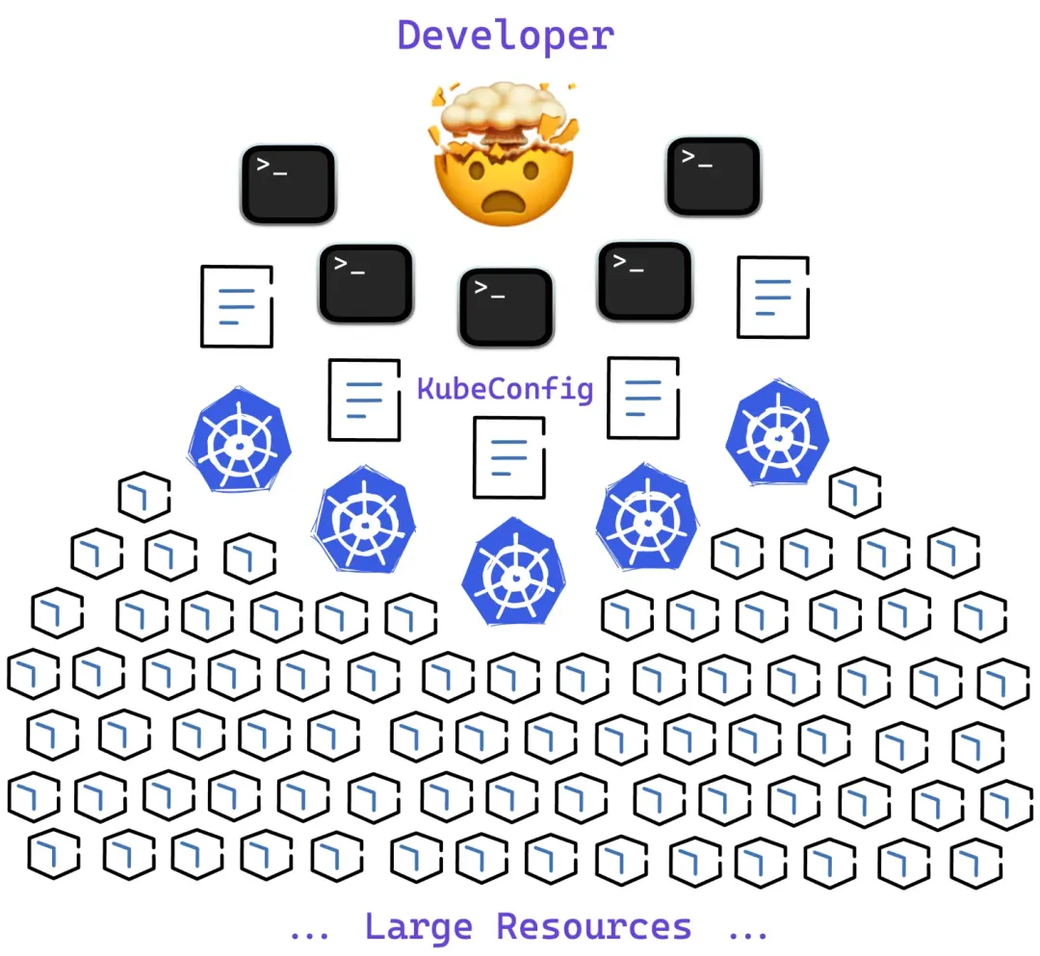
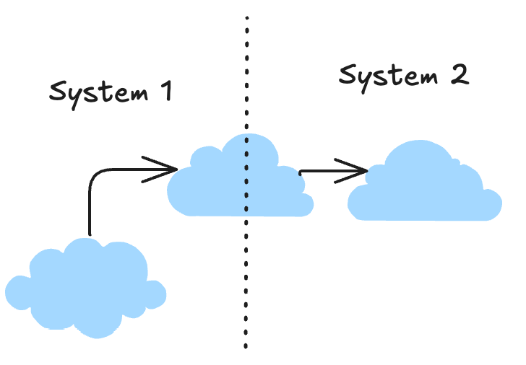

Background in Multi-cluster management
O(M*N) complexity to manage M clusters with N users, systems or platforms, especially in multi-cloud/multi-region settings
The complexity of Kubernetes itself including its upstream and downstream systems grows over time
The need to improve effectiveness of infrastructure and platform engineers by embracing new technologies like LLMs

Slide 4

What do our users need?
【Quickly Locate Resources】How do I find a specific (set of) resource(s) across tens or hundreds of clusters? Where are my applications located? What resources do they include?
【Resource Topologies】How does a group of logically-relevant resources relate to each other?
【Logical View】How to map Kubernetes resources to business-related domain models such as applications or environments？
【Security and Compliance】Are my clusters/resources safe？Are there any unflagged risks, vulnerabilities or attack vectors?
【Troubleshooting】Did someone alter a particular resource? Is there a visualized timeline of changes?
……

Slide 5
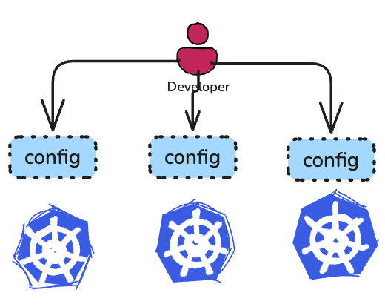
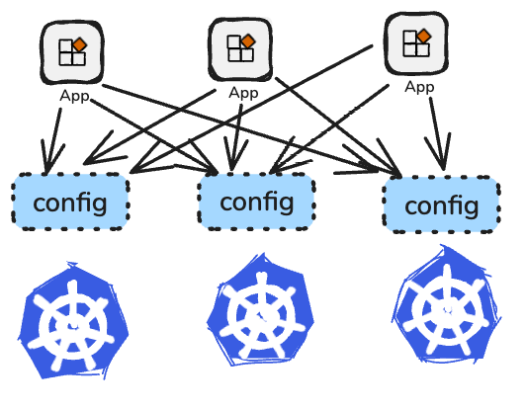
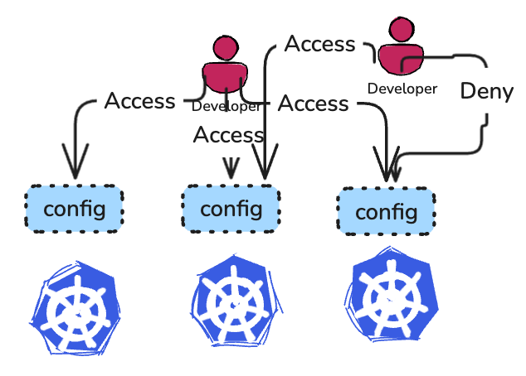
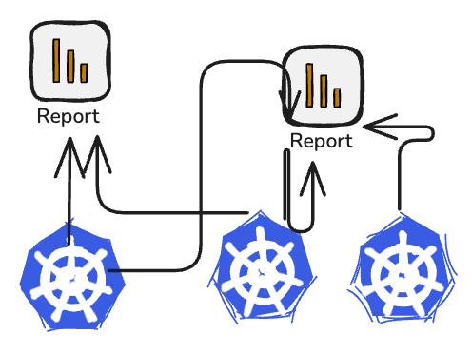
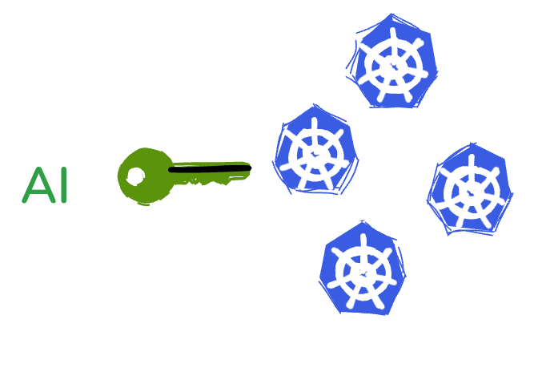
Pain Points
User Credential Management
Complex System Integrations
Convoluted Permissions
Hard to Extract Helpful Insights
Need to improve efficiency

Slide 6

Solutions
Problems with…
⭐️ Ideas
Credential Management
System Integrations
Multi-cluster Proxy，Single Entrance with Unified Permission Management
Complex Permissions
Real-time HA Data Synchronization into storage, w/ Transformations
Cross-cluster Search
Insight Extraction
Search and Insights with single, aggregated and custom views
Empower with AI
AI for Kubernetes. Analyze data, produce reports and search with NL

Slide 7
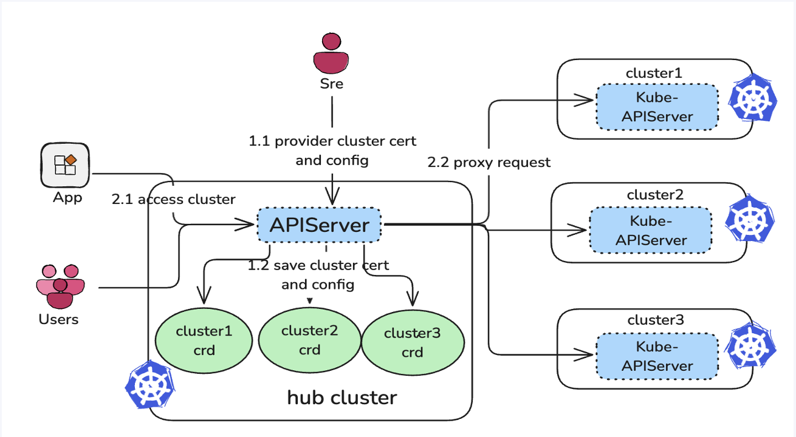
Multi-cluster Gateway Proxy
Register w/ K8s certificate
High performance
RBAC w/ Impersonation supported
IAM for Access Control
K8s-native Requests
Registration: SREs by providing the KubeConfig. The gateway stores them as Cluster CR.
Usage: Direct multi-cluster traffic by sending them to the /proxy endpoint on the gateway.
Example: GET /apis/cluster.addon.open-cluster-management.io/clusterextensions/{cluster1}/proxy/api/v1/pods

Slide 8
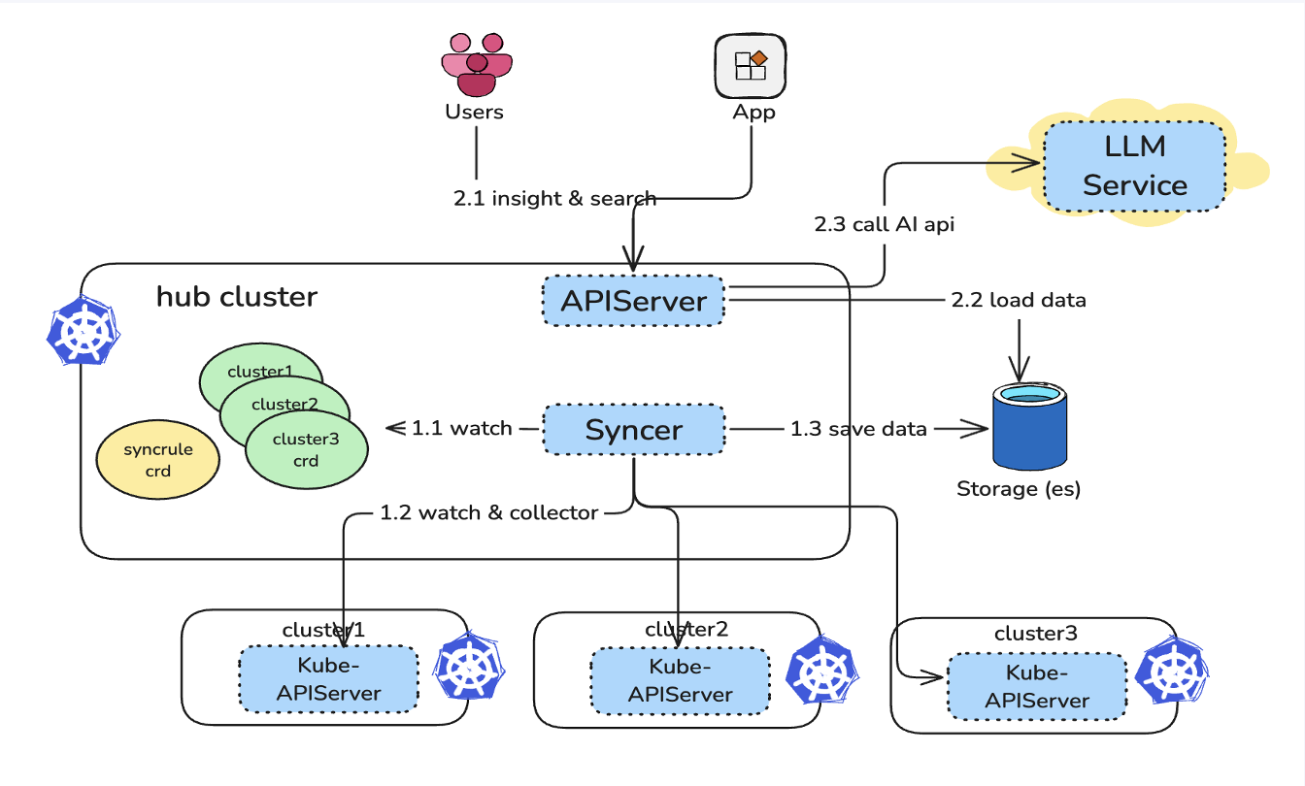
Data Synchronization and Insights
Search with...
🥝 KEY
🎂 SQL
🐥 NLP
Insights on...
🌿 Compliance Reports
🐬 Event Timelines
🦋 Resource Topologies
Sync: Data Synchronization based on SyncRule and Cluster CRs
Consume: Apps and Users perform search and get insights via the APIServer and Dashboard

Slide 9
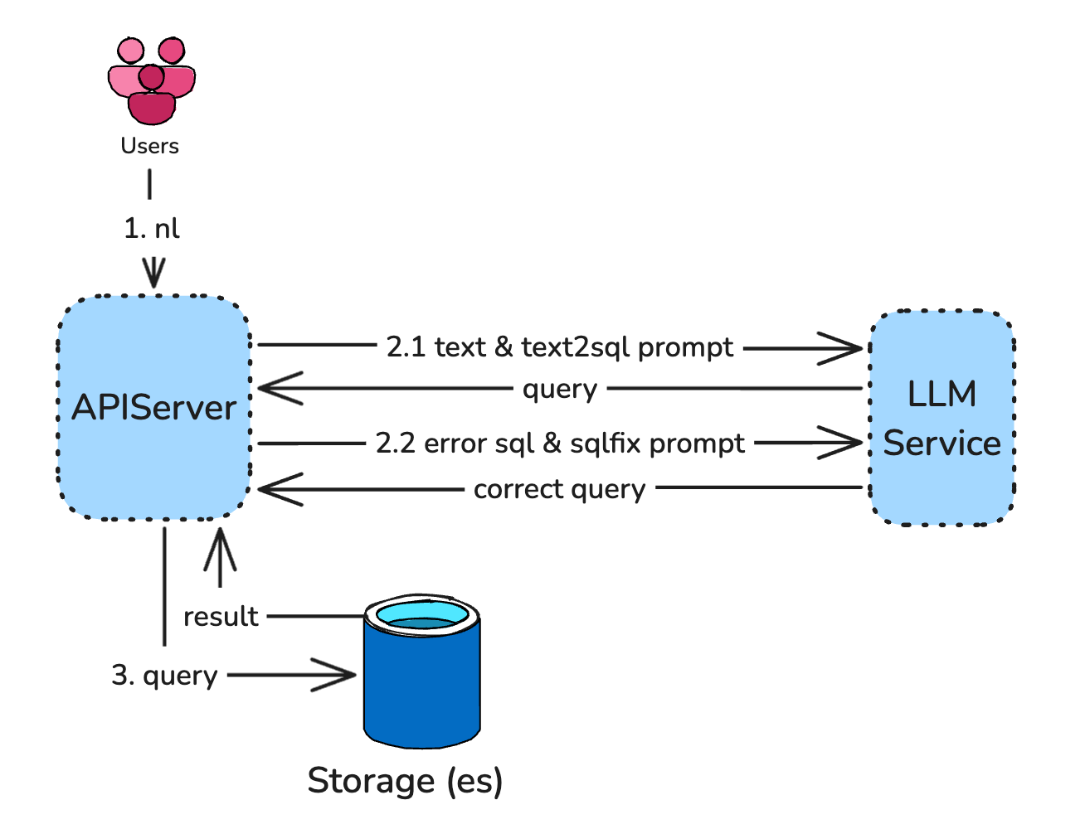
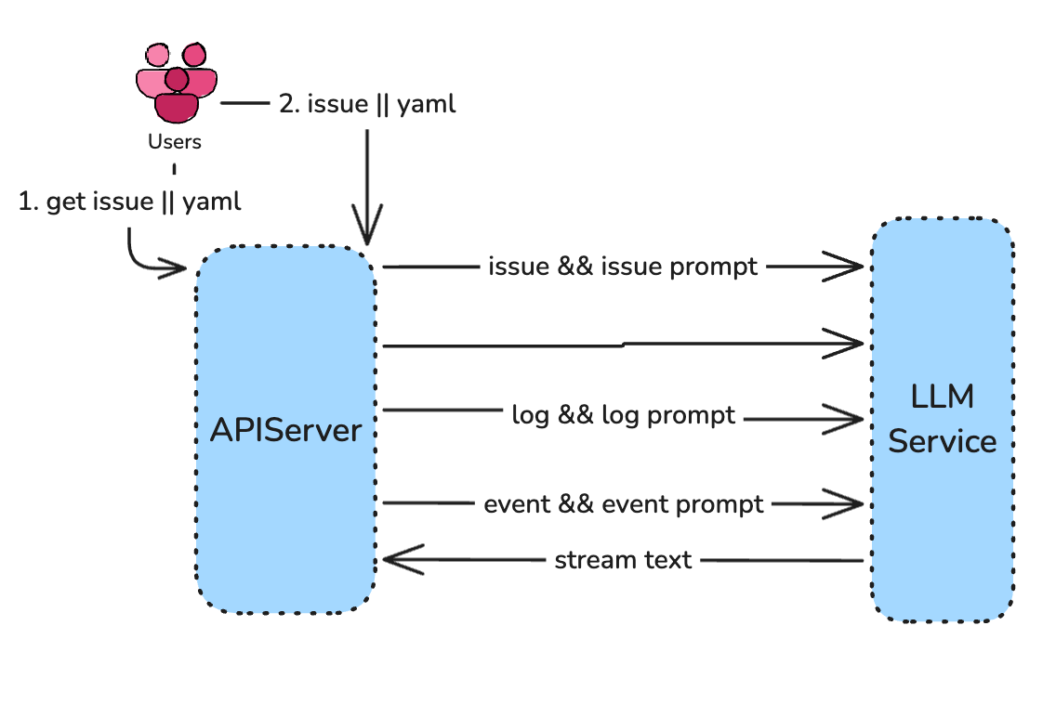
AI For Kubernetes
Convert Input to search query
Search with NL
Use LLM to Analyze YAMLs/logs/events
Identify Issues early and generate fixes

Slide 10
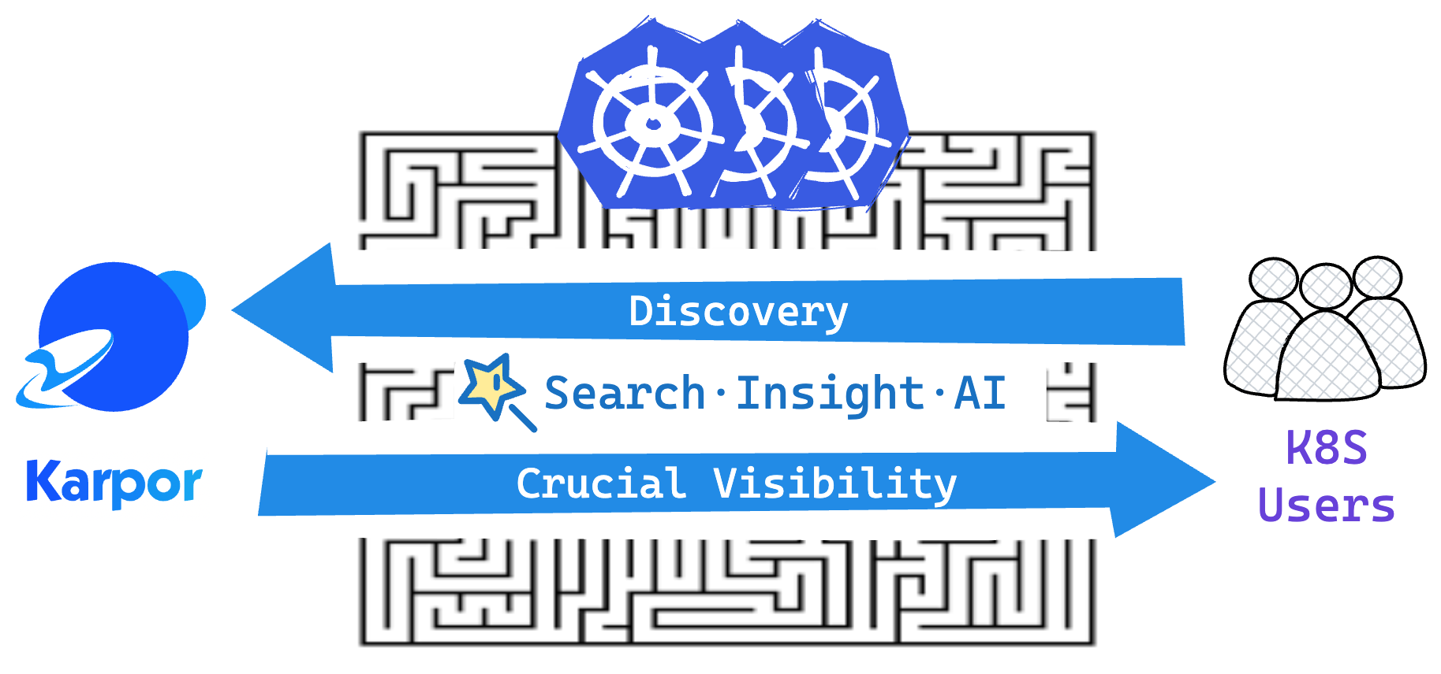
Karpor is all you need
Reliable
Intelligent
Secure
Karpor is all you need

Slide 11
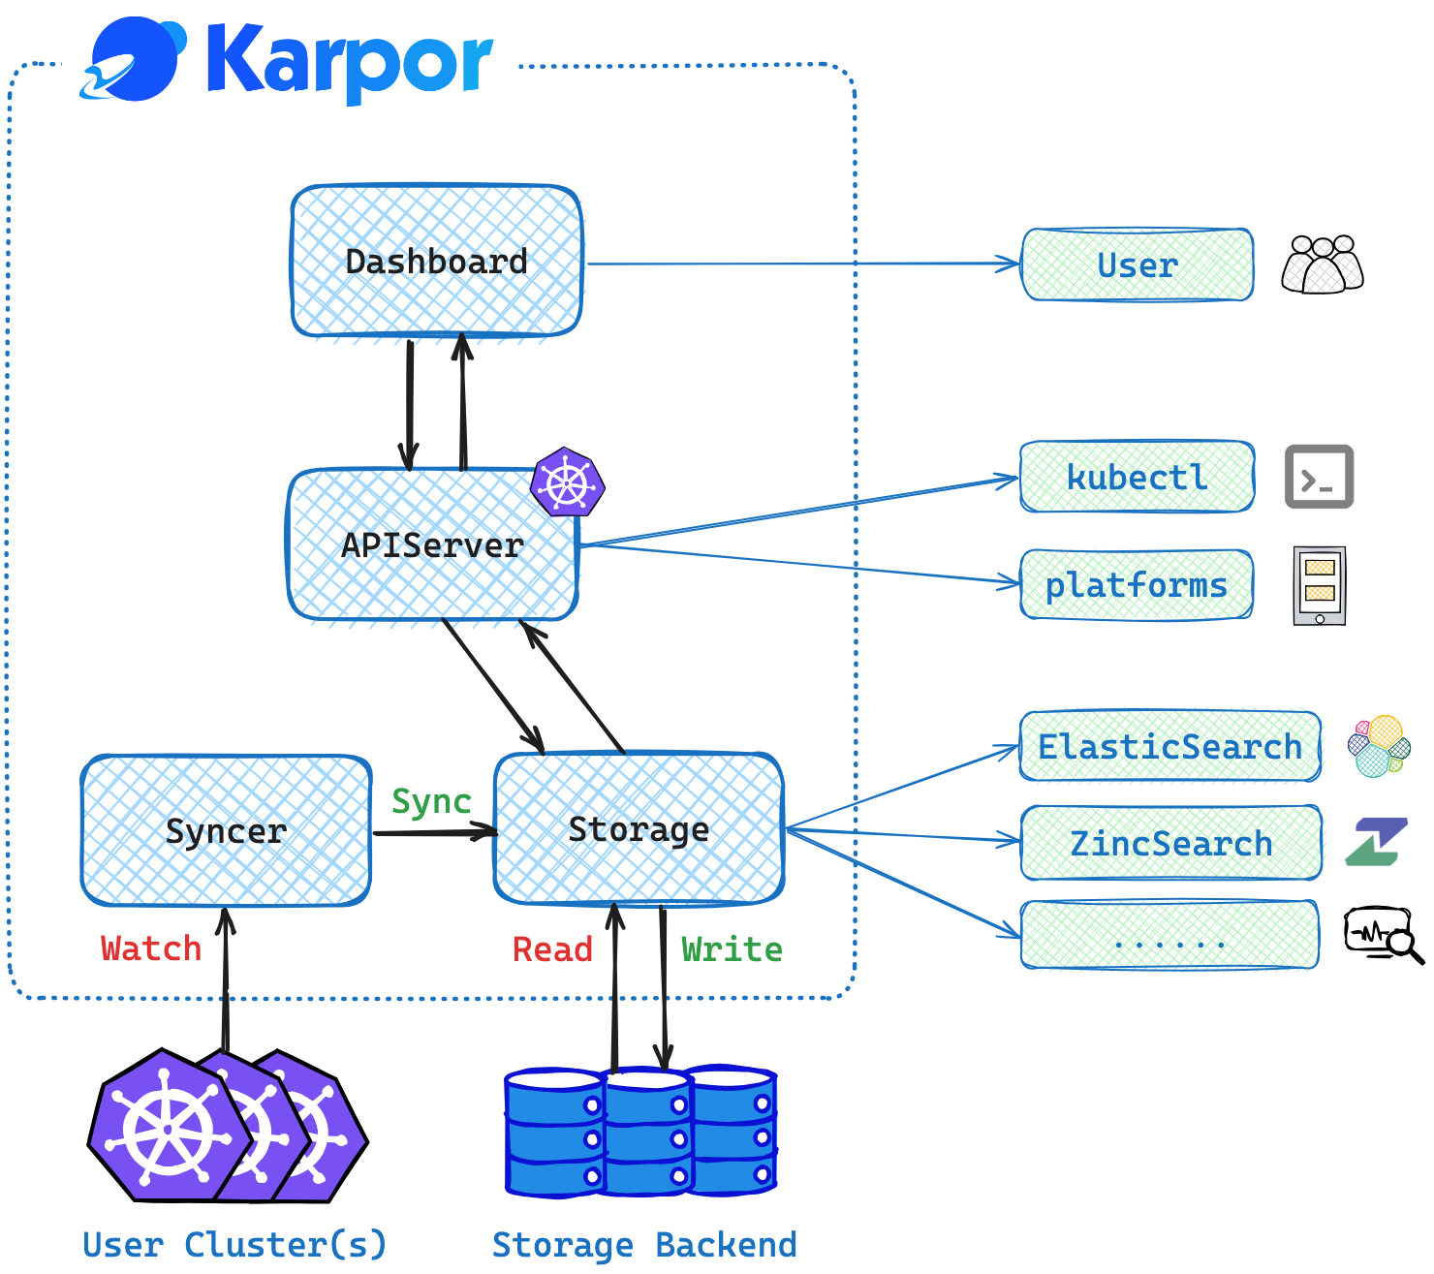
Architecture Overview
Components:
- Dashboard
- Aggregated APIServer
- Syncer
- Storage Adapter

Slide 12
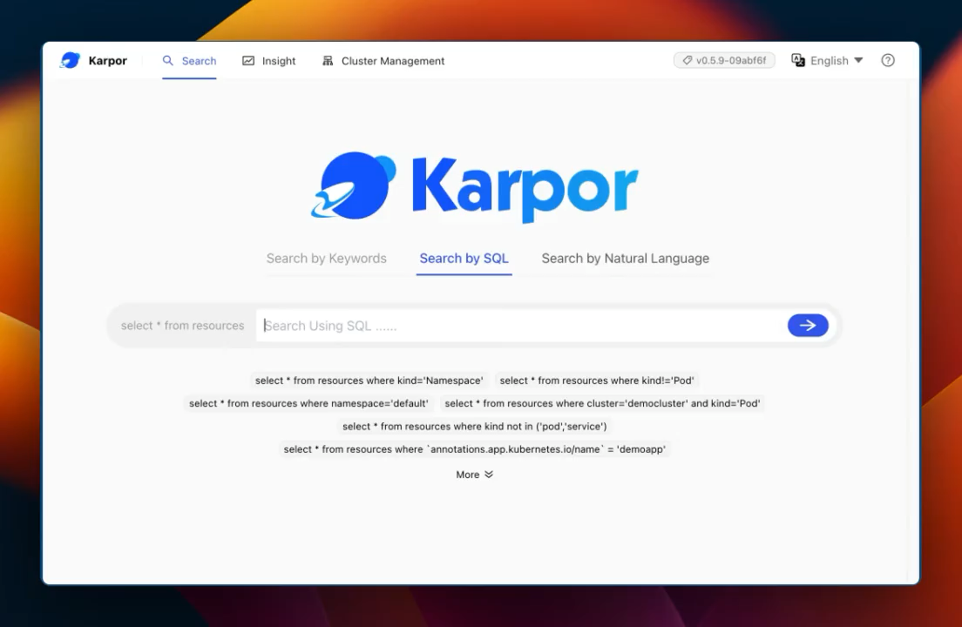
Search-focused: Kubernetes Dashboard
Search with Keywords or SQL, optimized for Kubernetes

Slide 13
Search-focused: Kubernetes Dashboard
More Intuitively Search with Natural Language

Slide 14
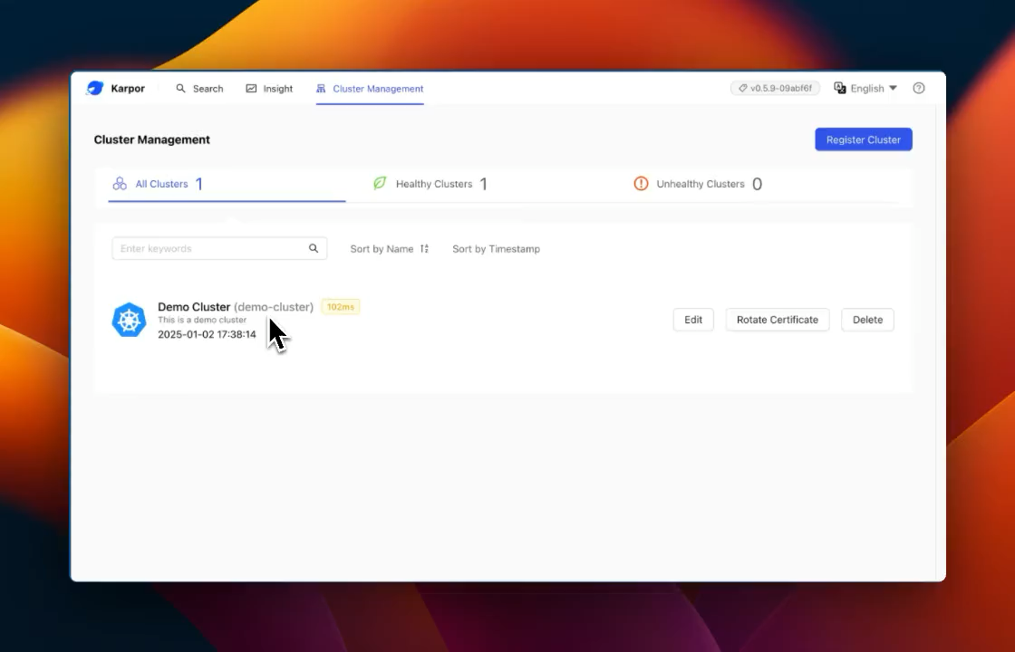
Aggregated Views: Cluster and Namespace
Cluster Health, Resource Topology, Vulnerabilities, Logs and Events, etc.

Slide 15
Aggregated Views: Customized Logical Groups
Customized Resource Groups, e.g. application resources cross clusters

Slide 16
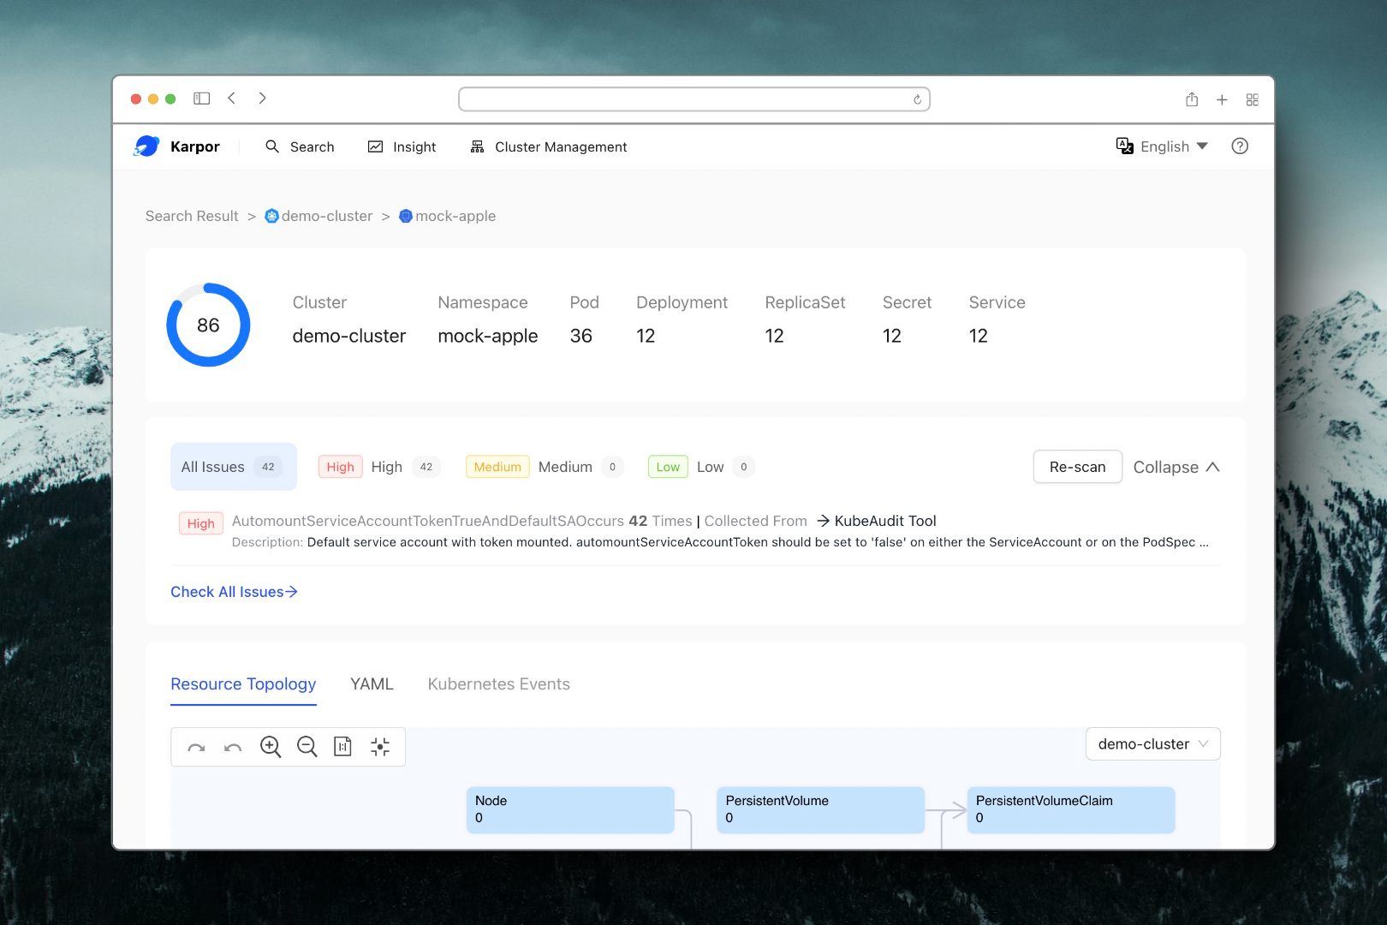
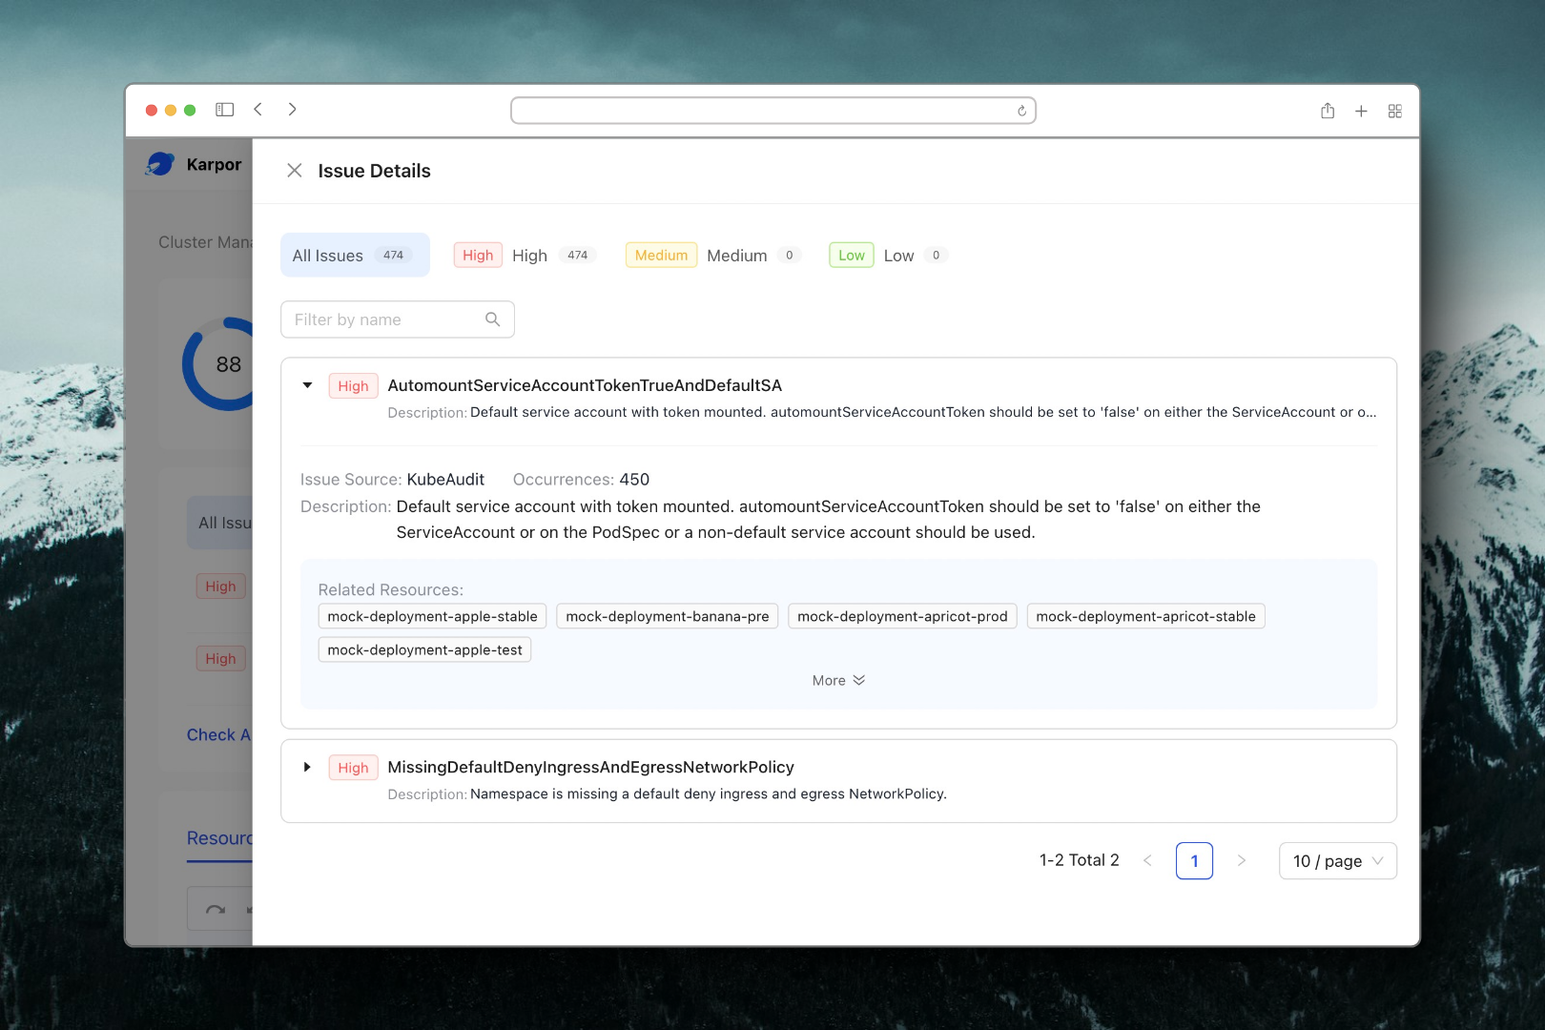
Aggregated Views: Compliance Reports
Analyze and identify security and compliance risks by scanning resources on a regular basis

Slide 17
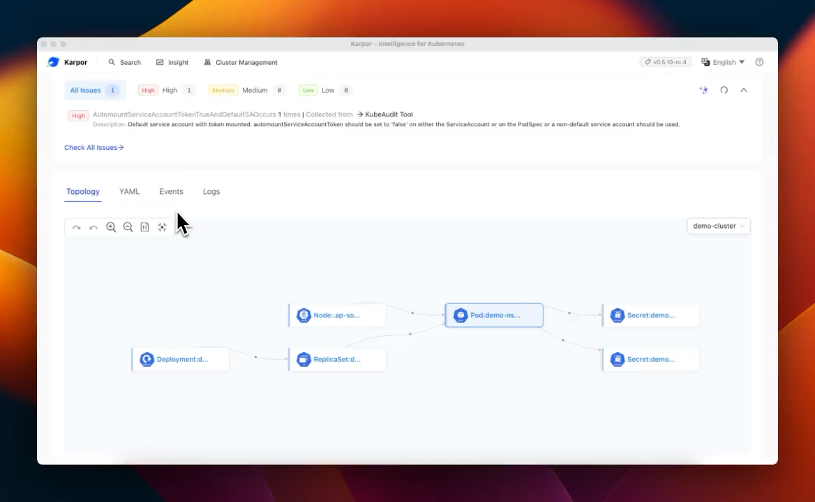
Intelligence for Kubernetes：AI-Empowered Insights
Analyze resource YAMLs, compliance issues, Kubernetes events and logs to excavate deeper insights

Slide 18
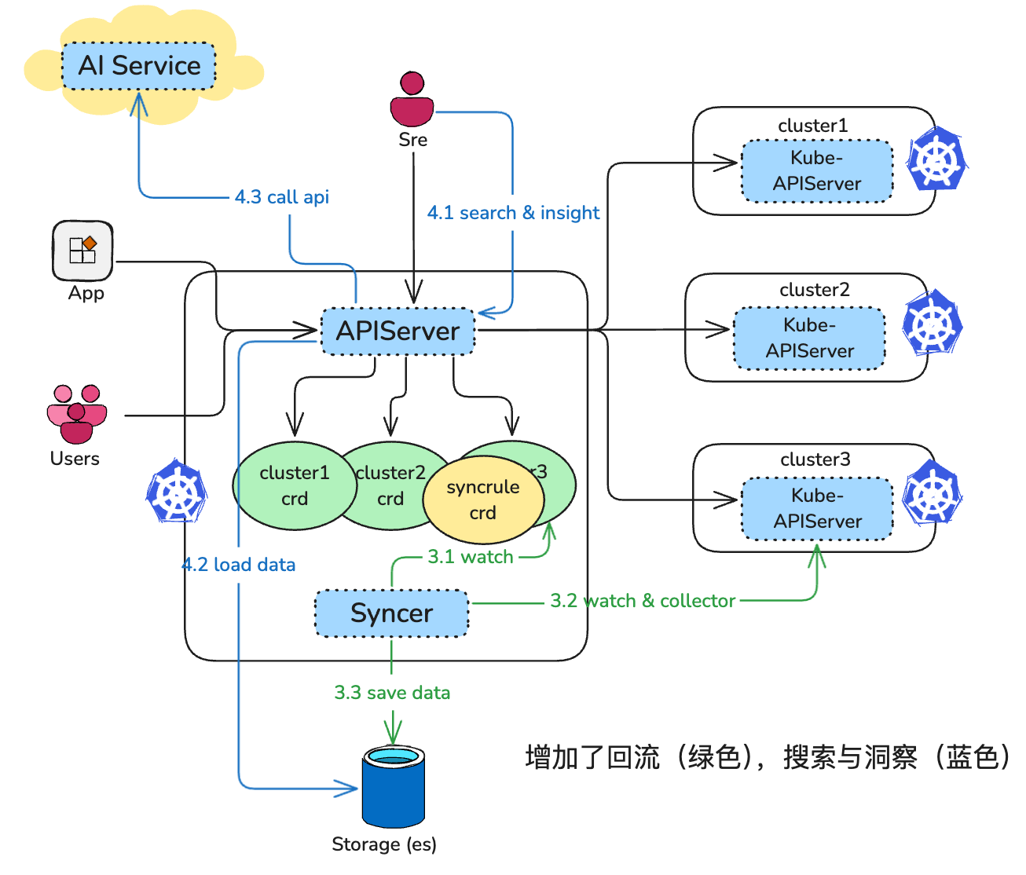
Adoption at Ant Group: From OCM to Karpor
OCM
Karpor
Pain points of Syncer ->
Too many clusters. Syncer becomes a SPOF
Clusters are huge in size. Syncer consumes a ton of resources

Slide 19
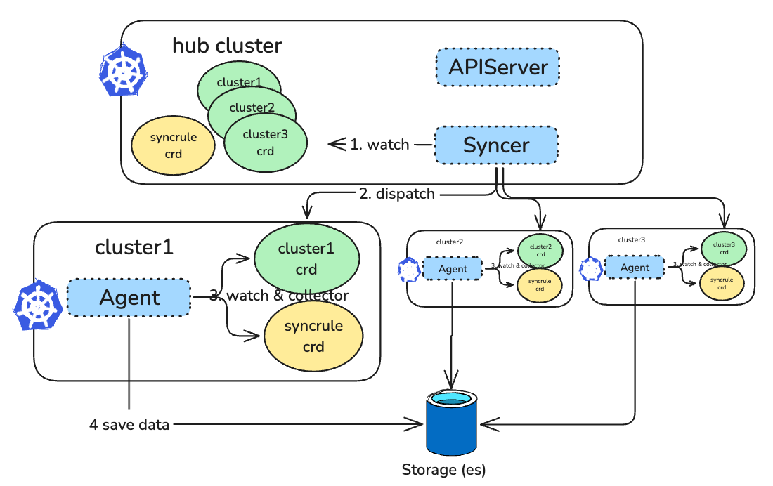
Adoption at Ant Group: Push Mode
Showing Data Flows Only
Syncer Agent in Spoke Clusters with a Push Mode.
This means Karpor needs to get write permissions to create resources in Spoke Clusters.

Slide 20
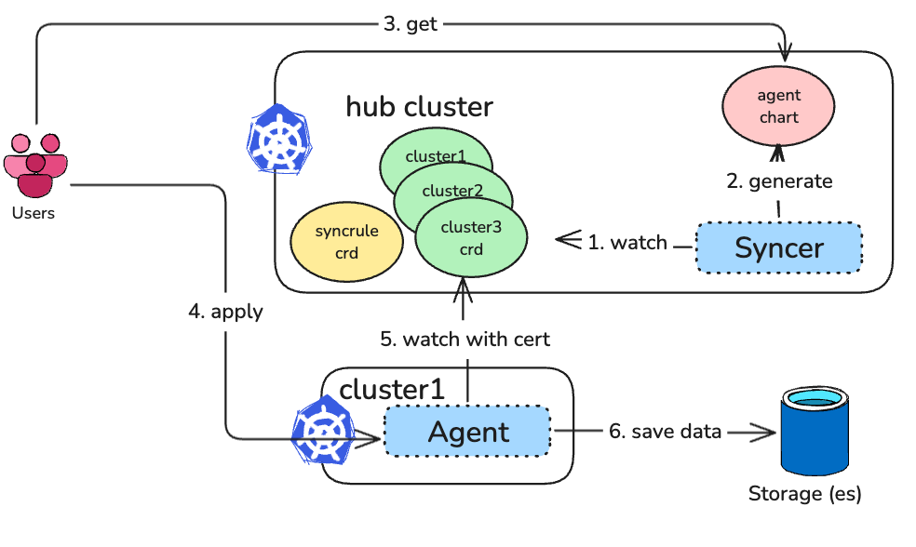
Adoption at Ant Group: Pull Mode
Showing Data Flows Only
Syncer Agent in Spoke Cluster with a Pull Mode.
No need for Karpor to get write permissions.

Slide 21





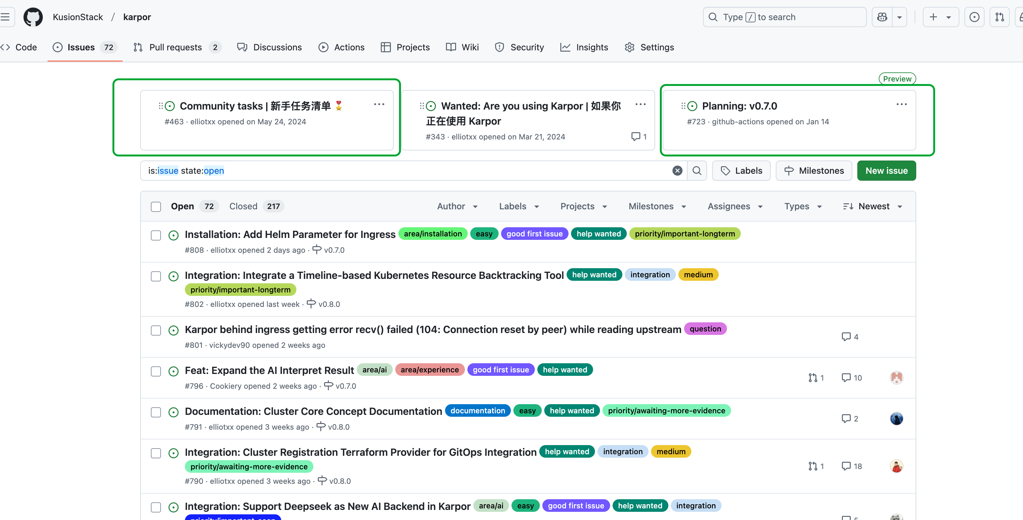
What are we planning?
AI Empowerment: Further embrace AI to provide deeper insights - https://github.com/KusionStack/karpor/issues/634
Support more clouds: Import Managed K8s on public clouds - https://github.com/KusionStack/karpor/issues/458
Cluster registration with GitOps and Terraform: https://github.com/KusionStack/karpor/issues/790
Scaling: Optimizations in large-cluster adoption - https://github.com/KusionStack/karpor/issues/787
Feel free to join us!

Slide 22



Follow us for the latest events!
Website
https://kusionstack.io
Github
https://github.com/KusionStack
Slack
https://kusionstack.slack.com
Medium
https://blog.kusionstack.io
Twitter
@KusionStack
Ding Group Chat
WeChat Group Invitation

Slide 23
Thanks for listening!
THANKS
2025.08.19

