Slide 1

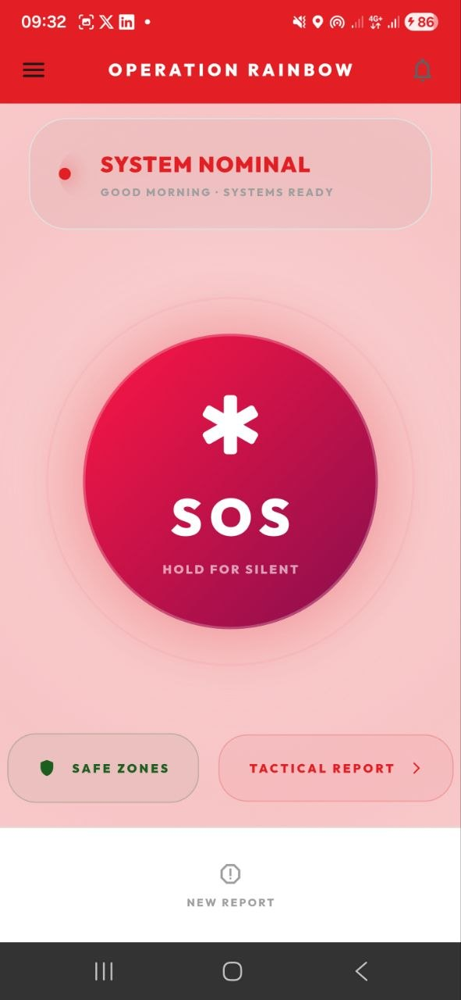
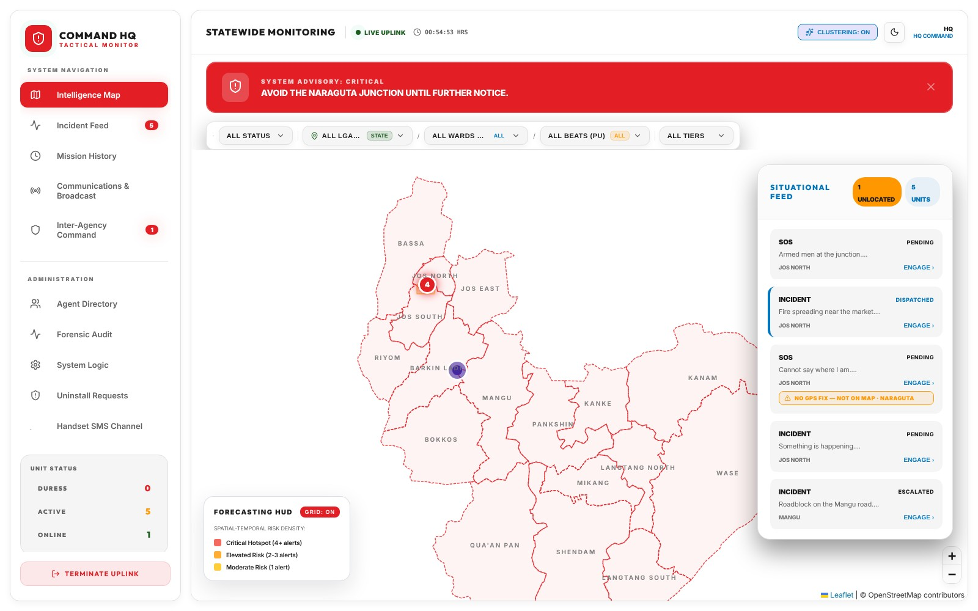
Operation Rainbow
PLATEAU STATE EMERGENCY RESPONSE
App walkthrough, from onboarding to administration
Notes:
Operation Rainbow is the emergency security response system for Plateau State. This walkthrough follows the system in the order people meet it: a citizen signing up and raising an alarm, HQ receiving and acting on it, and the administrators who run the platform.

Slide 2
One system, three parts
THE SYSTEM
1
2
3
Mobile app
HQ command console
Secure backend
Citizens raise SOS and report incidents. Responders receive dispatches, run missions and stream live video.
The operations board: live map, incident feed, dispatch, escalation, agency portal and mass broadcast.
One database with role-based access, live updates and media storage, plus SMS, USSD and Bluetooth mesh when data is down.
Citizen raises the alarm → HQ sees it live → Responders and agencies act
Notes:
The whole system has three parts that share one backend. The mobile app is used by citizens and by field responders. The HQ console is the operations board. The backend holds the data, enforces who can see what, and keeps the alerts flowing even when mobile data is down, through SMS, USSD and a Bluetooth mesh between phones.

Slide 3
The mobile app
01
Signing up, raising an alarm and reporting an incident, as a citizen sees it.
Notes:
Part one follows a citizen through the mobile app: sign-in, onboarding, the SOS button, reporting, safety tools and what happens when there is no data network.

Slide 4
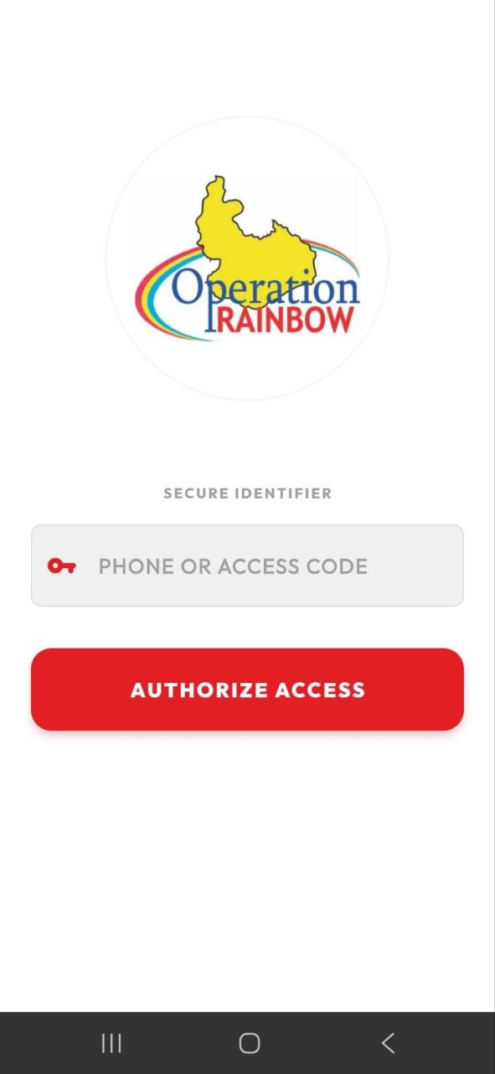
Sign in with a phone number
MOBILE APP · SIGN-IN
No passwords to remember. A citizen enters their phone number and confirms it with a code sent by SMS.
One-time 6-digit code
Sent to the phone on every sign-in, so the number is proven to belong to the person.
Staff use an access code
Responders and officers sign in through the same screen with the access code HQ issues them.
Honest error messages
If sign-in is down on the service side, the app says so instead of asking the person to retry.
Sign-in screen
Notes:
The first screen is sign-in. Citizens use their phone number and a one-time code by SMS; there is no password. Staff accounts use the access code HQ provisions for them. If the SMS service is not available, the app tells the person it is a service problem, not their phone.

Slide 5
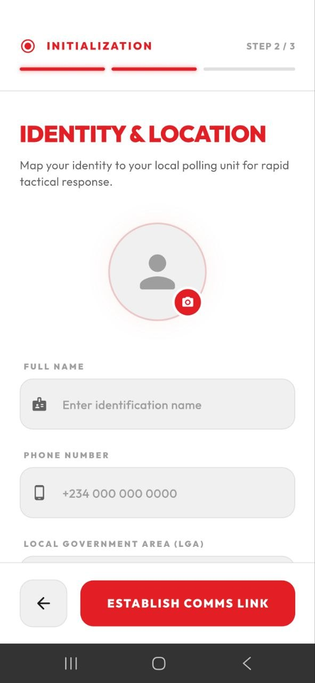
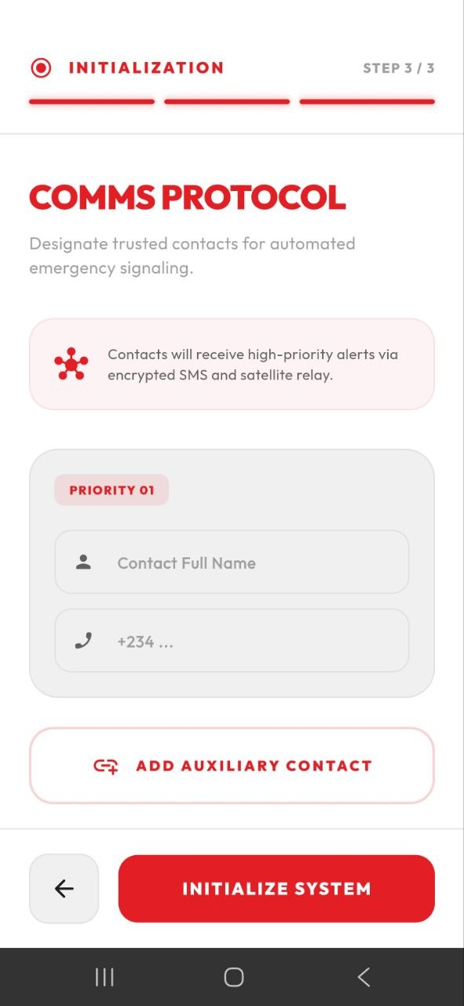
Set up in three steps
MOBILE APP · ONBOARDING
New users are walked through a short setup before they reach the SOS screen.
1 · Permissions
Location (required), SMS and microphone, so an alert carries a position and works offline.
2 · Identity and location
Photo, full name, phone and LGA, mapped to the person's polling unit for faster response.
3 · Trusted contacts
People who are alerted automatically when this user raises an emergency.
Step 2 · Identity
Step 3 · Contacts
Notes:
Onboarding has three steps. Step one asks for the phone permissions the app needs. Step two, shown left, captures the person's identity and their local government area, which ties them to a polling unit so the nearest command level sees their alerts first. Step three, shown right, records trusted contacts who are told automatically when this person raises an emergency.

Slide 6
One button for an emergency
MOBILE APP · HOME
The home screen is built around SOS. One press sends an alert with live location straight to the HQ board.
Silent SOS
Hold the button to send an alert quietly, without leaving the home screen.
Duress PIN
A citizen cancels with their PIN. A second PIN appears to cancel, while HQ keeps tracking them.
Shortcuts
Safe zones and a full incident report are one tap away from the same screen.
Home · SOS
Notes:
The home screen shows the system status and the SOS button. Pressing it sends an alert with the person's live location to HQ. Holding it raises a silent alarm. The duress PIN is the key safety feature: if someone is forced to cancel, a different PIN makes the alarm look cancelled on the phone while HQ keeps tracking.

Slide 7
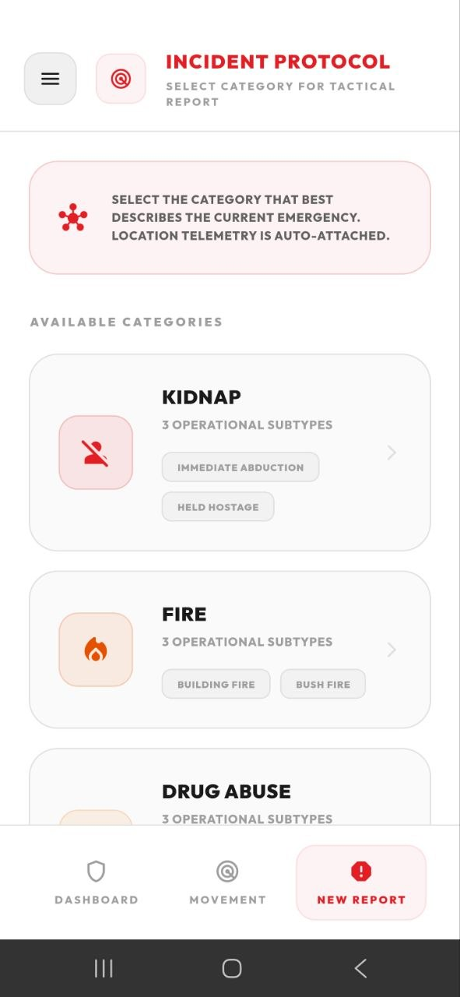
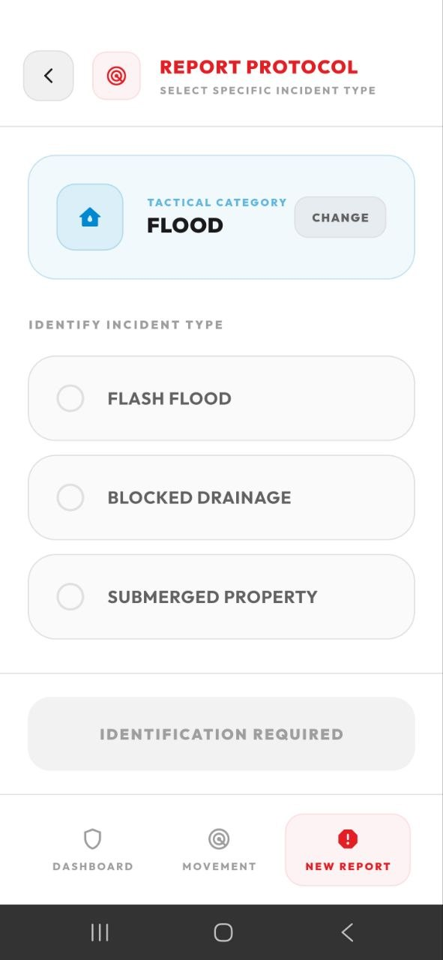
Report an incident in two taps
MOBILE APP · REPORTING
For anything that is not an SOS, a citizen picks what is happening. Their location is attached automatically.
Choose a category
Kidnap, fire, drug abuse, flood and more, each with its own subtypes.
Choose the incident type
For example, a flood is a flash flood, blocked drainage or submerged property.
Category
Incident type
Notes:
A full report starts with two choices. First the category, such as kidnap, fire, drug abuse or flood. Then the specific incident type within it. HQ uses these to route the report and to filter the board, and the phone's location is attached without the person typing it.

Slide 8
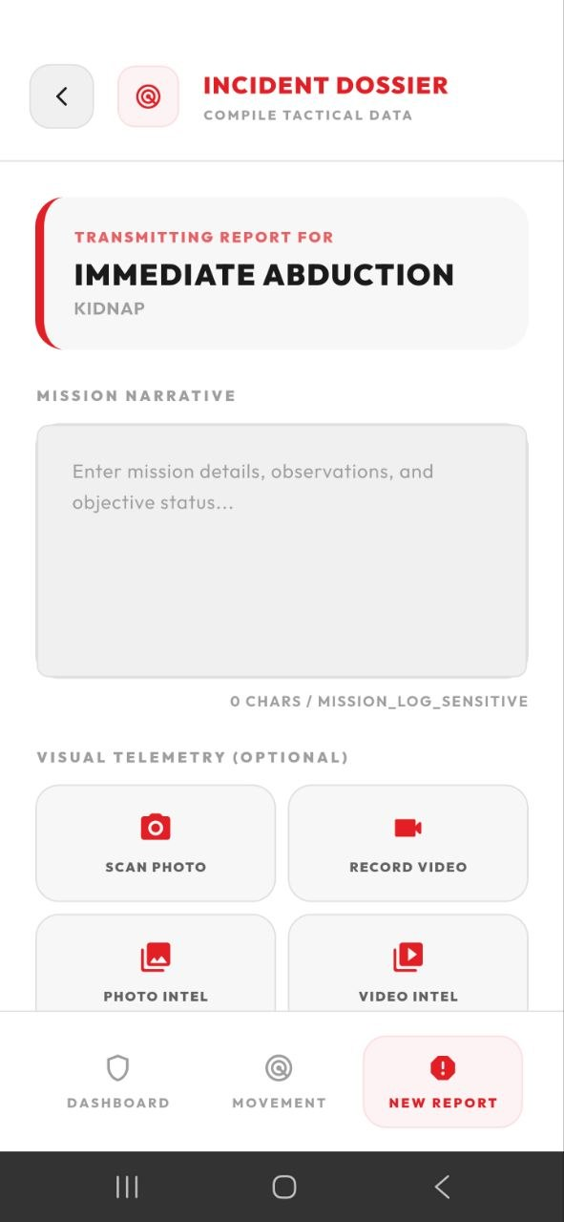
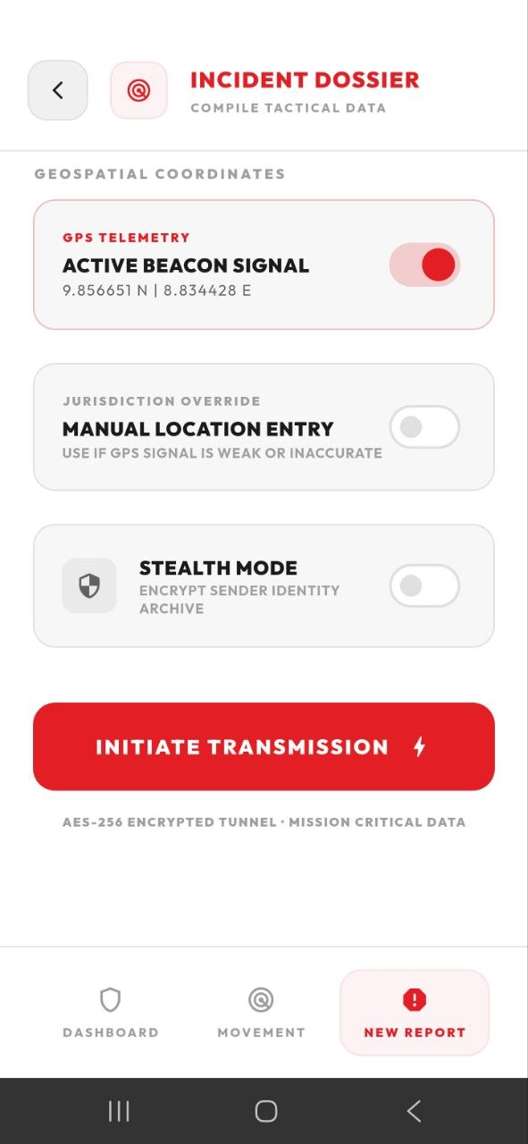
Add detail, evidence and location
MOBILE APP · REPORTING
The report form collects what responders need, then sends it over an encrypted connection.
Description and media
A written account plus photos or video taken on the spot or chosen from the gallery.
GPS or manual location
The phone's position is used by default; the location can be typed if the signal is weak.
Stealth mode
Protects the identity of a reporter who does not want to be named.
Description · media
Location · send
Notes:
The second half of a report collects the detail: a written description, optional photos and video, the location from GPS or typed in by hand, and stealth mode for people who need to report without being identified. Initiate Transmission sends it to HQ.

Slide 9
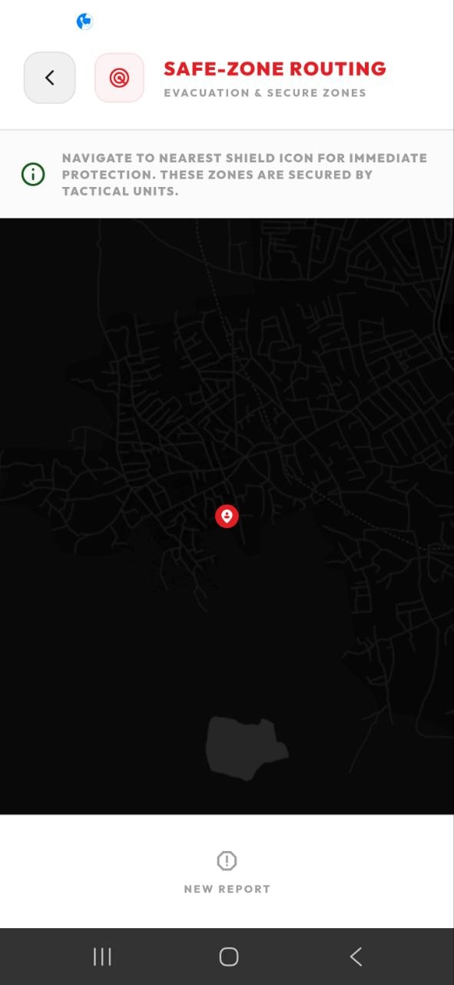
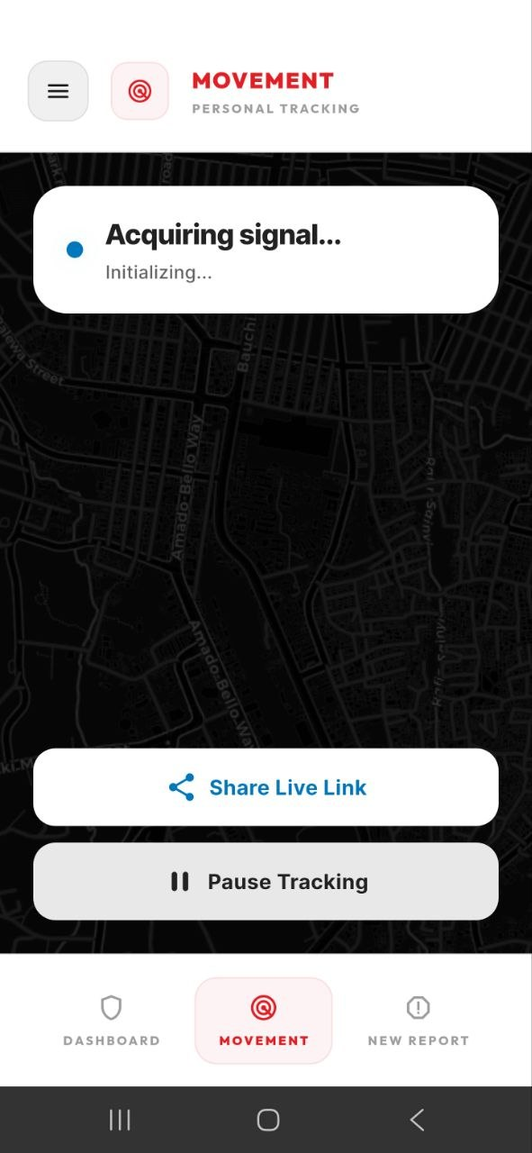
Safe zones and live tracking
MOBILE APP · STAYING SAFE
Two tools for the minutes before help arrives.
Safe-zone routing
A map of secured locations, with directions to the nearest one guarded by security units.
Movement tracking
The person's position streams to HQ while tracking is on, and can be paused.
Share a live link
Family or friends can follow the journey from a link the person shares.
Safe zones
Movement
Notes:
Two safety tools sit alongside reporting. Safe-zone routing shows secured locations and guides the person to the nearest one. Movement tracking streams their position to HQ and lets them share a live link with people they trust, or pause it.

Slide 10
An alert still gets through when data is down
MOBILE APP · NO DATA NETWORK
1
2
3
SMS fallback
USSD menu
Bluetooth mesh
With no data, the app sends the alert as an encrypted SMS. HQ checks each message against the sending phone's key.
Any phone, even without the app, can dial a short code on MTN, Airtel, Glo or 9mobile and report an emergency.
Nearby phones relay a sealed alert until one reaches a network. Relays cannot read what they carry.
Notes:
Emergencies often happen where data coverage is poor. The system has three fallbacks. The app sends an encrypted SMS when data is down. Any phone, including one without the app, can use the USSD menu on all four networks. And the Bluetooth mesh lets nearby phones pass a sealed alert along until one has signal; the phones in between cannot read it. Alerts that arrive this way are marked on the HQ board so operators know which channel they came through.

Slide 11
The HQ console
02
Where every alert lands, and where HQ dispatches, escalates and coordinates with agencies.
Notes:
Part two moves to the HQ command console, the web application used by the operations room, command levels and partner agencies.

Slide 12
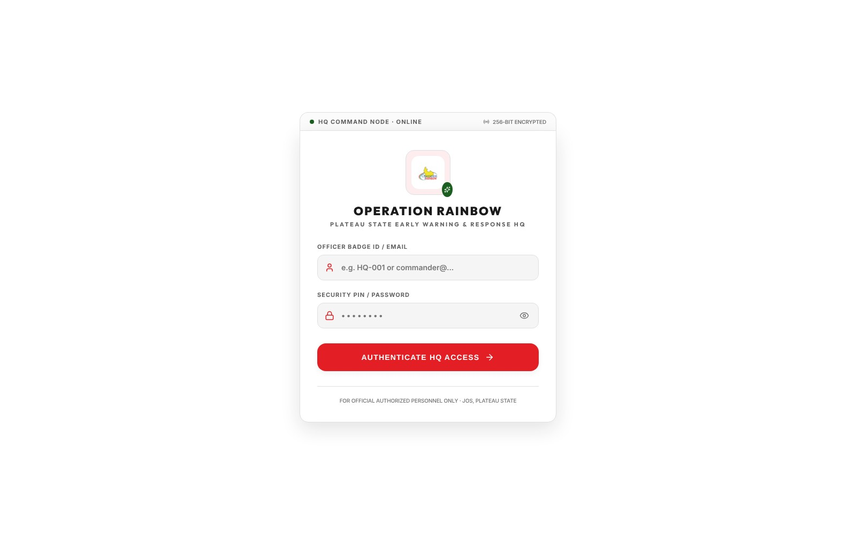
Each officer sees what their role allows
HQ CONSOLE · SIGN-IN
Officers sign in with a badge ID or email and a security PIN.
HQ command
The whole state, every tab and the administration tools.
LGA and ward command
Incidents in their own area of responsibility.
Agency liaisons
Only incidents HQ has handed to their agency.
Notes:
Everyone uses the same sign-in page. What they see afterwards depends on their role, and the database enforces it, not just the screen. HQ command sees the whole state and the administration tools. LGA and ward commanders see their own area. An agency liaison, for example from the Army or Police, sees only the incidents escalated to their agency.

Slide 13
Every incident in Plateau State, live
HQ CONSOLE · INTELLIGENCE MAP
The map is the console's main screen. New alerts appear without refreshing.
Drill down
Filter by status, LGA, ward, polling unit and command tier.
Hotspots
The forecasting panel shades areas by how many alerts they hold.
Nothing hidden
An alert with no GPS fix is flagged in the feed, not dropped or guessed.
Notes:
The intelligence map shows the 17 LGAs of Plateau State with every open incident pinned. Operators can filter down to a single polling unit. The forecasting panel highlights hotspots. On the right, the situational feed lists the latest alerts; an alert without a GPS fix is clearly marked as not on the map, rather than being placed at a guessed location. The banner across the top is a statewide advisory issued from the broadcast tool.

Slide 14
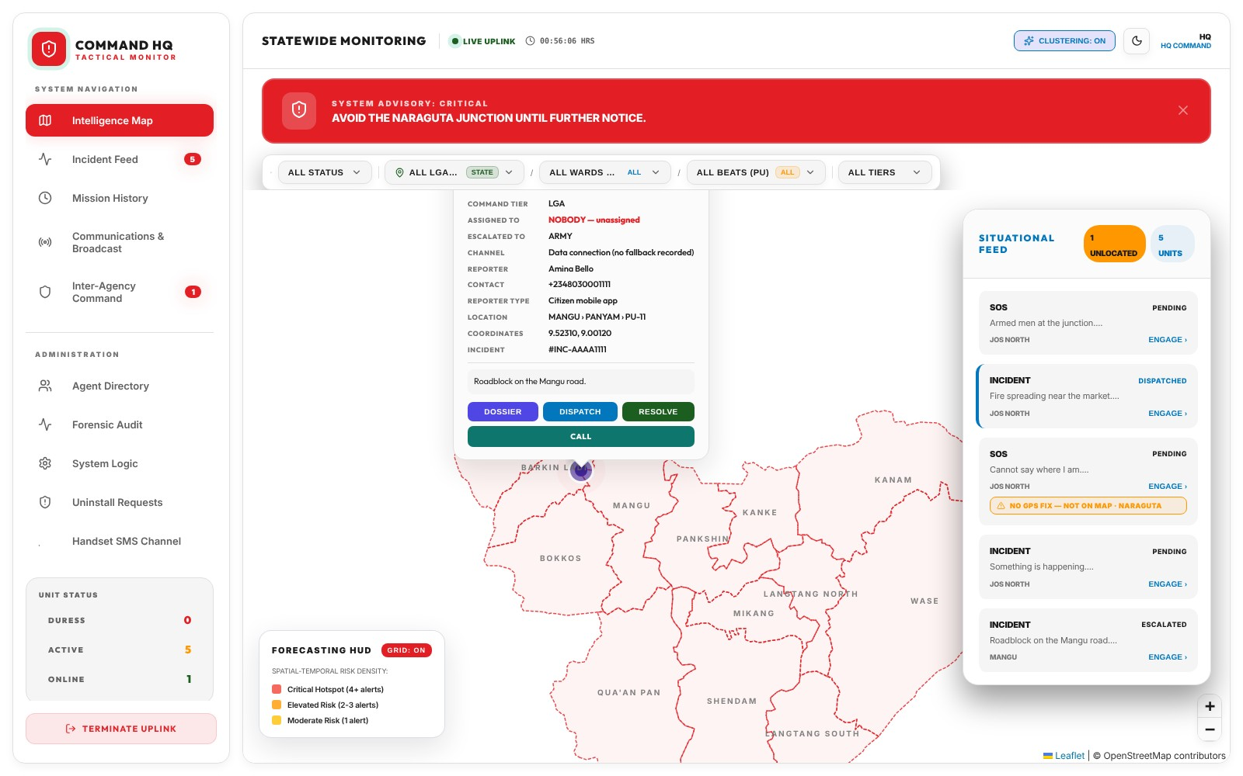
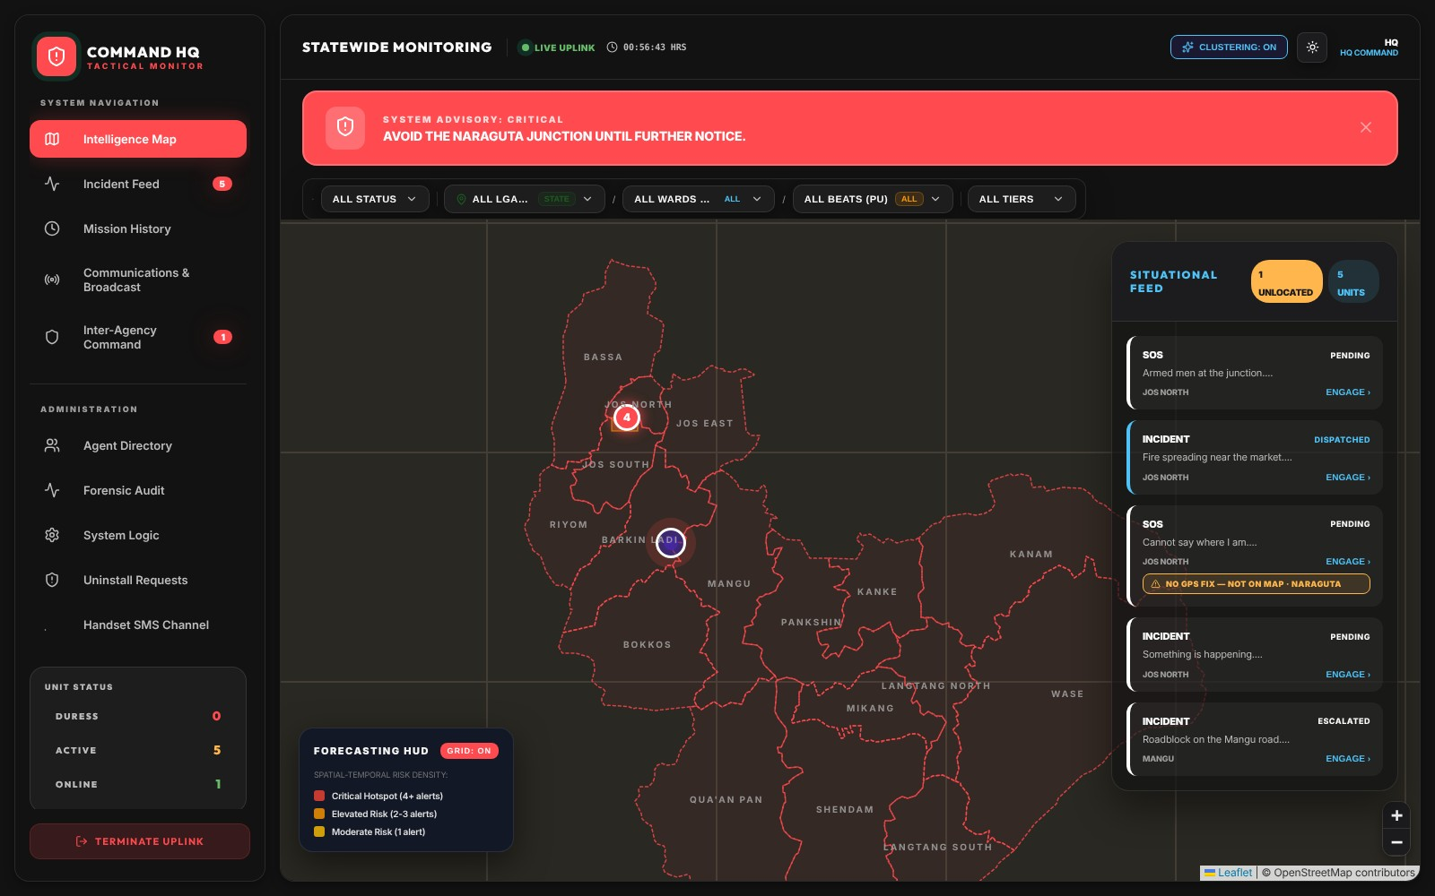
Act straight from the map, day or night
HQ CONSOLE · INTELLIGENCE MAP
Incident card
Night mode
Tier, assignee, reporter and coordinates, with dossier, dispatch, resolve and call.
A dark theme for the operations room during night shifts.
Notes:
Clicking a pin opens the incident card: the command tier handling it, who it is assigned to, who reported it, the channel it came through and its coordinates. From the card an operator can open the full dossier, dispatch responders, resolve it or call the reporter. The whole console also has a dark theme for night shifts.

Slide 15
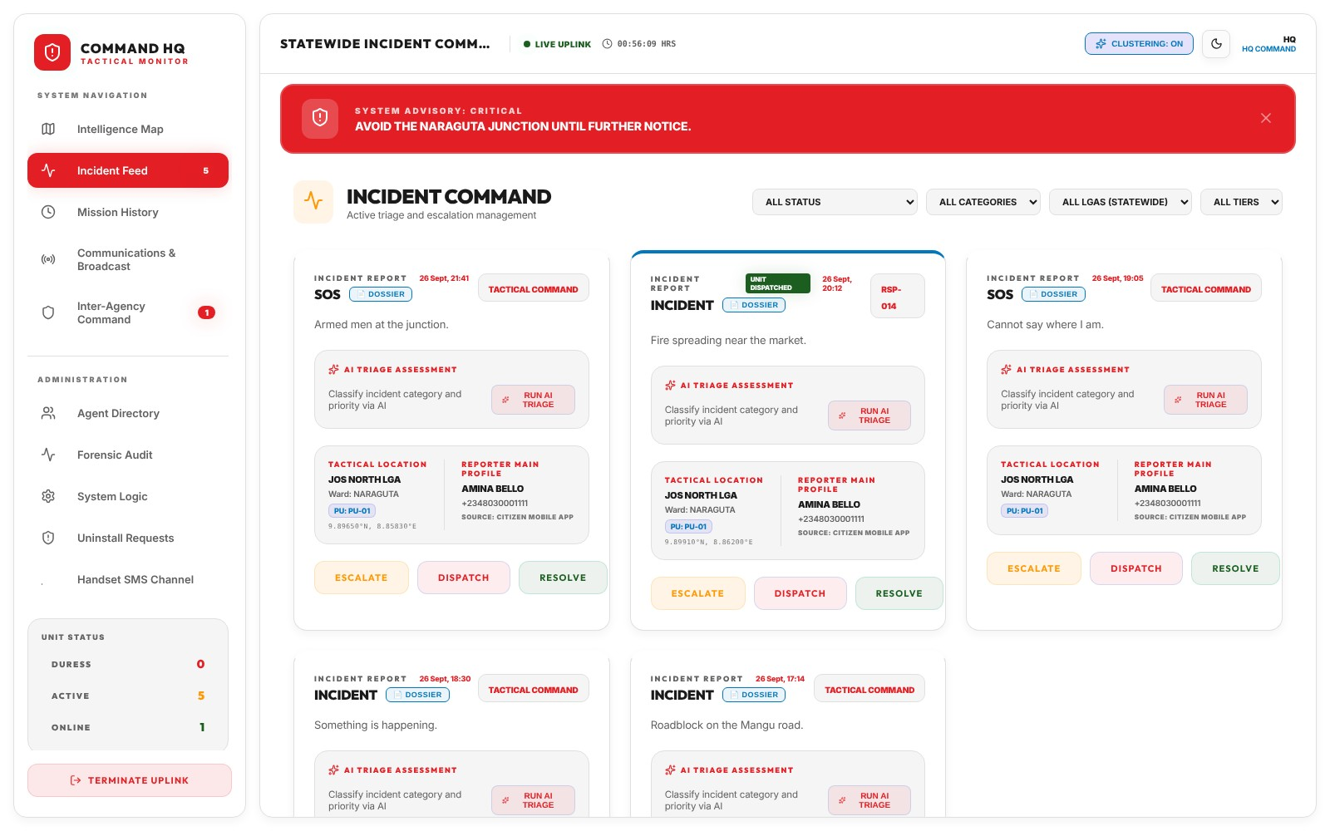
Triage every incident from one feed
HQ CONSOLE · INCIDENT FEED
Each open incident is a card with everything needed to decide the next step.
AI triage
Suggests the category and priority. Rules take over if AI is off.
Location and reporter
LGA, ward and polling unit, plus the reporter's name and number.
Three actions
Escalate, dispatch or resolve, right on the card.
Notes:
The incident feed is the working list. Every open incident is a card showing its type, the reporter, where it is down to the polling unit, and an AI triage button that suggests category and priority; if the AI service is switched off, a rule-based engine is used instead. Operators can filter by status, category, LGA and tier, and act on each card with Escalate, Dispatch or Resolve.

Slide 16
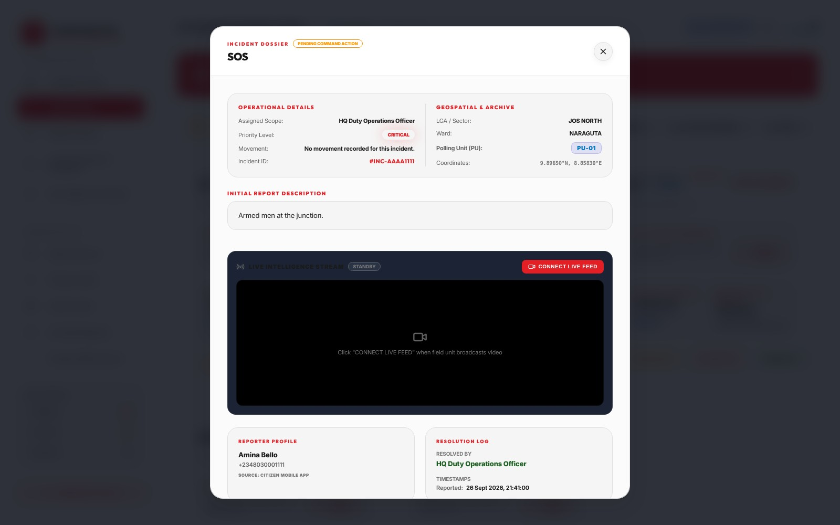
The full record of one incident
HQ CONSOLE · INCIDENT DOSSIER
The dossier gathers everything known about an incident in one place.
Details and location
Scope, priority, movement, LGA, ward, polling unit and coordinates.
Live video
HQ watches a responder's camera when the field unit goes live.
Reply and log
Message the reporter; every action is timestamped and named.
Notes:
Opening the dossier shows the full record: operational details, exact location down to the polling unit, the original report, a live video panel that connects when a field unit starts streaming, the reporter's profile and the resolution log. The dispatcher can reply to the reporter from here, and each reply is recorded under the operator's name.

Slide 17
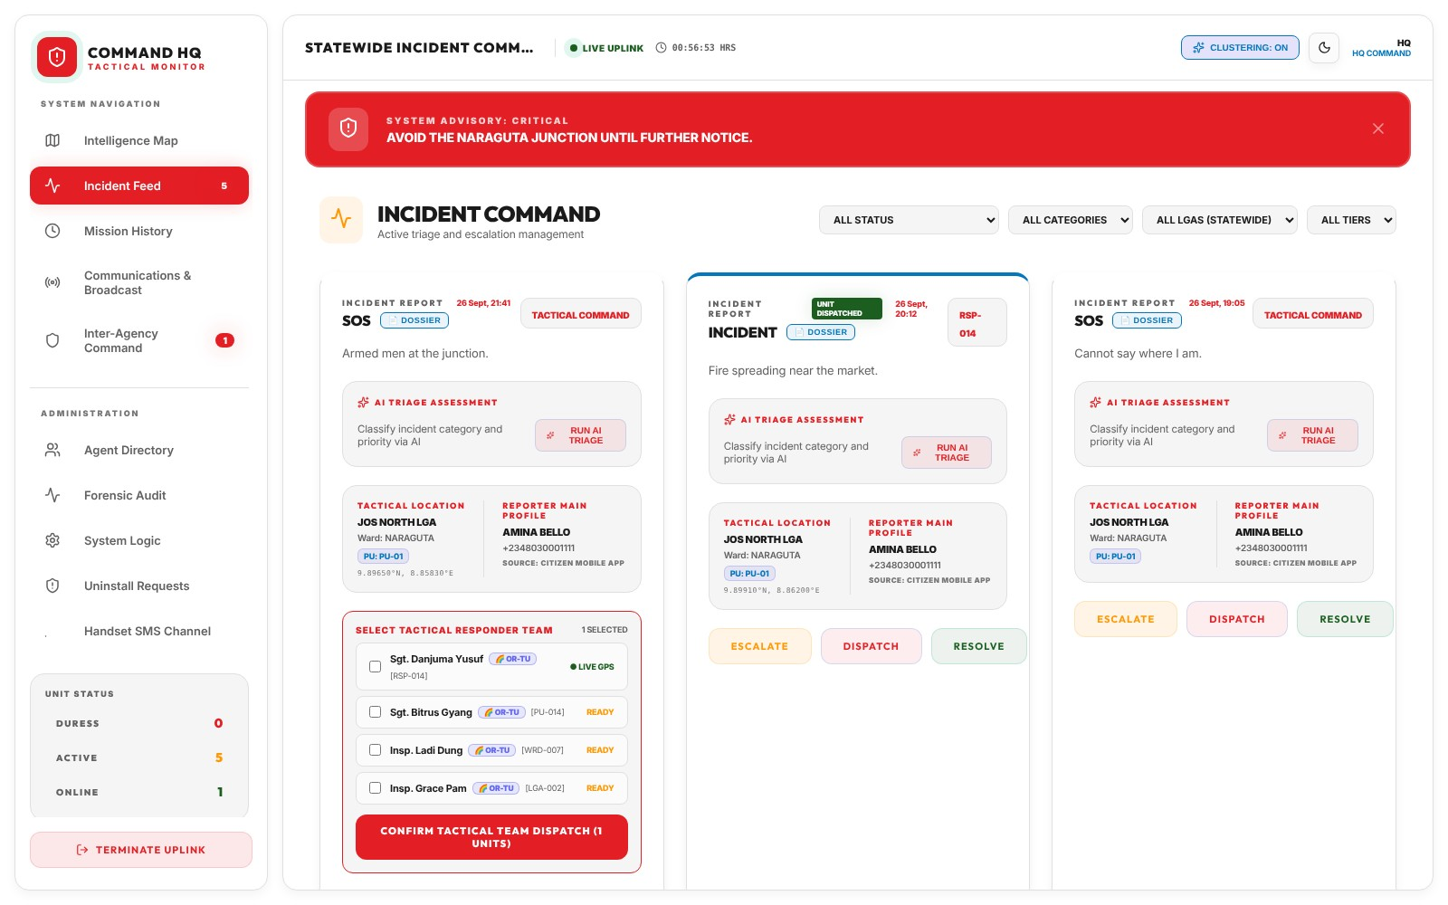
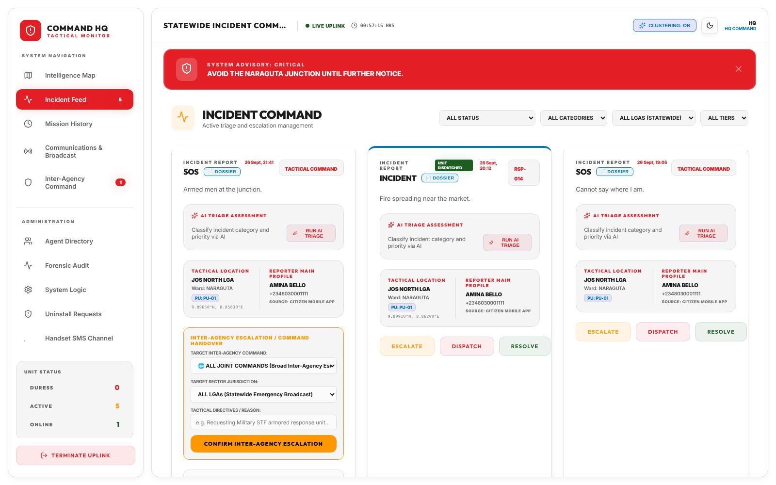
Dispatch responders, or escalate
HQ CONSOLE · RESPONSE
Dispatch
Escalate
Pick one or more responders, with live GPS and readiness shown.
Hand over to Police, Army, DSS, NSCDC, FRSC or Operation Safe Haven.
Notes:
Two ways to respond. Dispatch opens a picker of tactical responders, showing who has a live GPS signal and who is ready; the operator ticks one or more and confirms. Escalate hands the incident to a partner agency: the Nigeria Police Force, the Army, DSS, NSCDC, FRSC or Operation Safe Haven, with the area it covers and written directions. The agency's liaison is notified and the handover is logged.

Slide 18
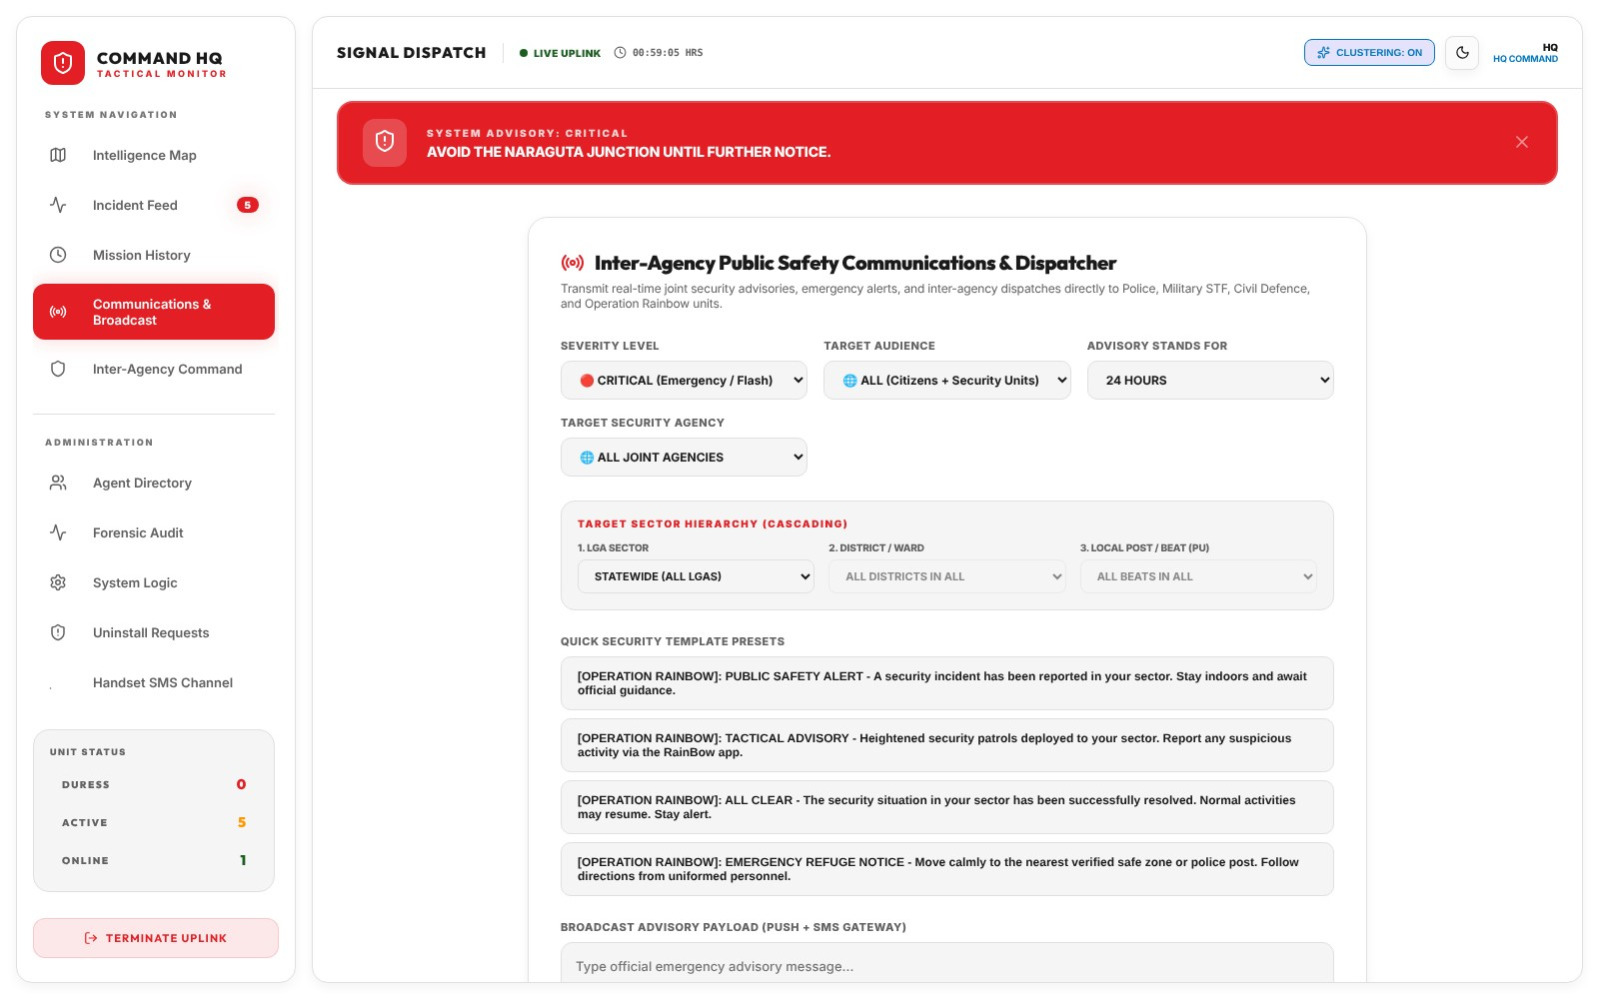
Warn the state, or one polling unit
HQ CONSOLE · BROADCAST
Public safety advisories go out by push notification and SMS.
Who and how urgent
Severity, audience, agency and how long the advisory stands.
Where
Statewide, or narrowed to an LGA, ward or polling unit.
Ready-made messages
Templates for alerts, advisories, all-clear and refuge notices.
Notes:
The broadcast tool sends public safety advisories by push and SMS. HQ sets the severity, the audience (citizens, security units or both), the agency and how long the advisory stands, then targets it statewide or down to one polling unit. Templates cover the common cases: a public safety alert, a tactical advisory, an all-clear and an emergency refuge notice. A critical advisory also appears as the red banner across every console screen.

Slide 19
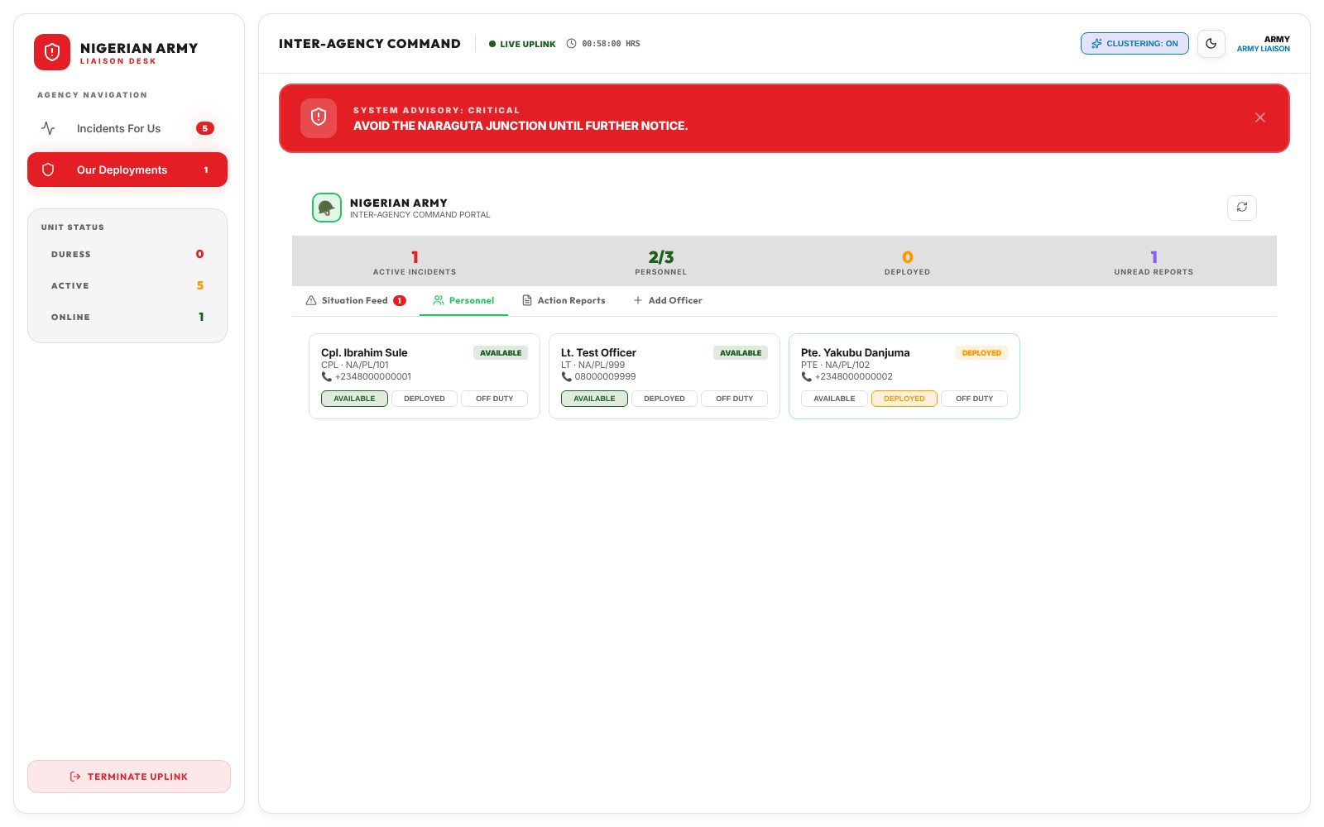
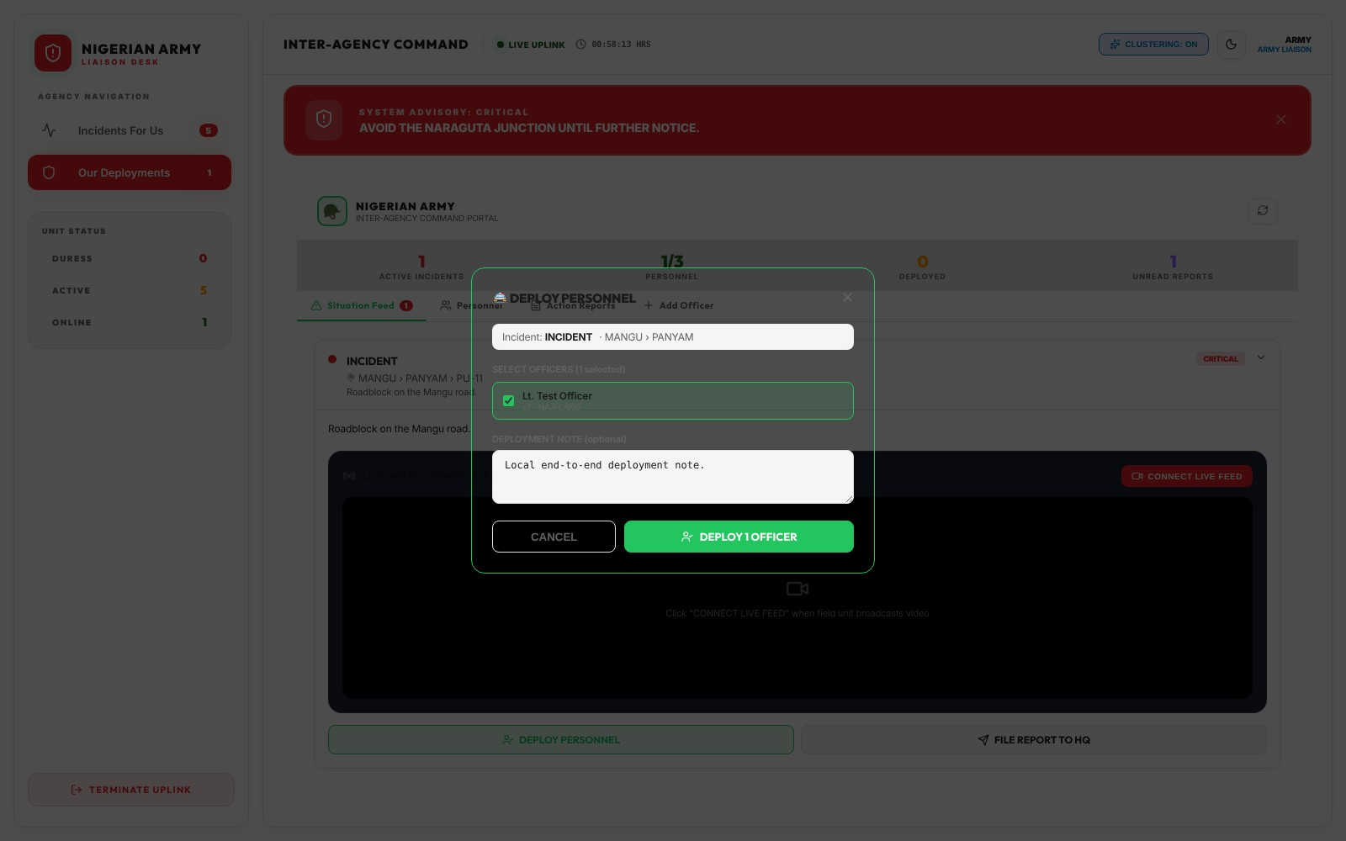
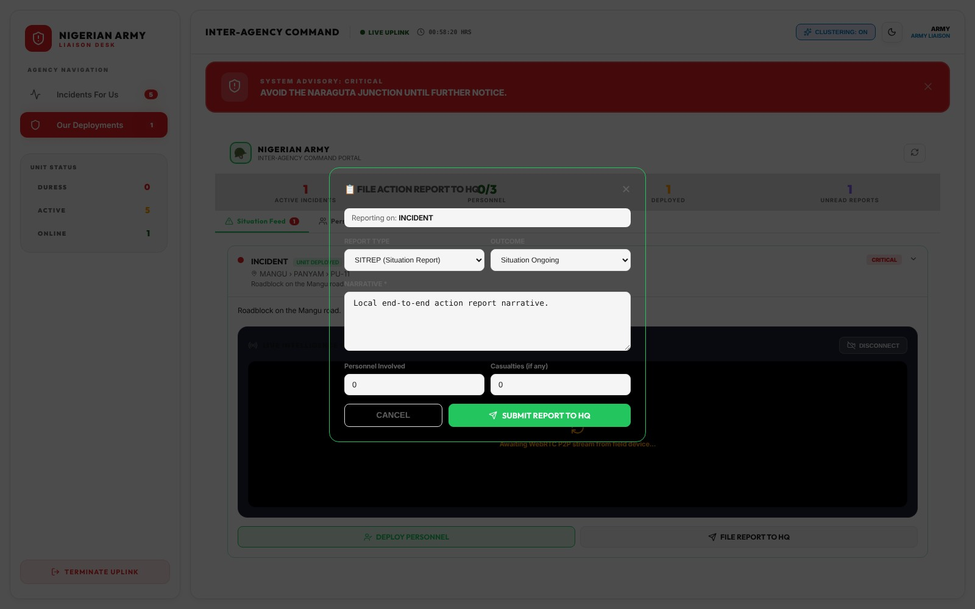
Partner agencies work in their own portal
HQ CONSOLE · AGENCY PORTAL
Each agency liaison sees only the incidents HQ has escalated to them.
1 · Personnel
2 · Deploy
3 · Report back
Add officers and set each one available, deployed or off duty.
Assign officers to an escalated incident, with a note for HQ.
File situation reports to HQ, which acknowledges each one.
Notes:
Partner agencies get their own portal inside the console. A liaison officer, here from the Nigerian Army, sees only incidents HQ has escalated to their agency. They keep their personnel list current, deploy officers to an incident, and file action reports such as situation reports with an outcome and casualty count. HQ sees the reports arrive and acknowledges them, so both sides know the handover was received.

Slide 20
Administration
03
Staff accounts, system rules and approvals, available only to HQ command.
Notes:
Part three covers the administration tools. They sit in their own section of the console menu and appear only for HQ command accounts: the agent directory, forensic audit, system logic, uninstall requests and the handset SMS channel.

Slide 21
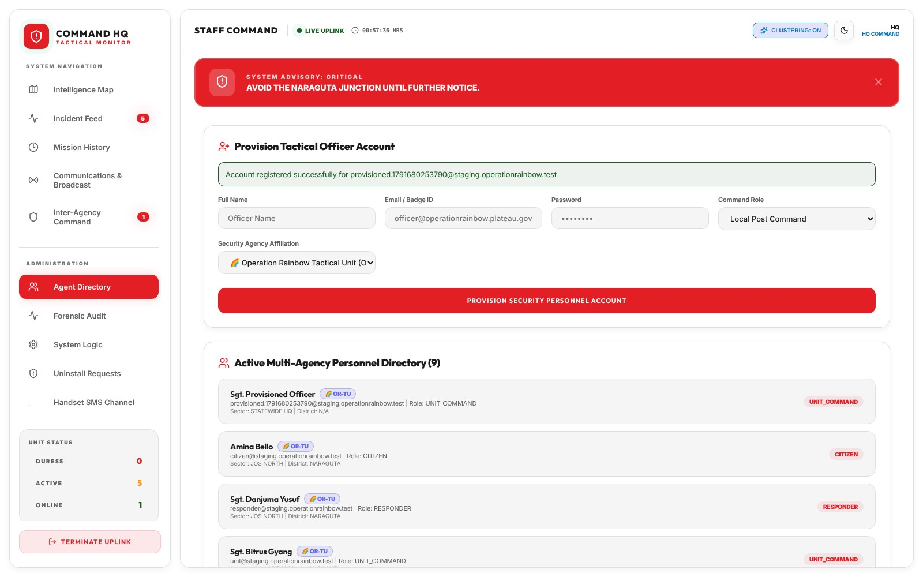
Create and manage staff accounts
ADMINISTRATION · AGENT DIRECTORY
HQ provisions every officer account. Nobody can give themselves a role.
Provision an officer
Name, email or badge ID, password, command role and agency.
Roles set on the server
The role is written by the server, never from the browser.
One directory
Every person across agencies, with role, sector and district.
Notes:
The agent directory is where HQ creates accounts for officers, commanders, responders and agency liaisons. The administrator chooses the command role and the agency, and the server sets the role, so no one can sign up and grant themselves access. Below the form is the multi-agency personnel directory showing everyone's role, sector and district.

Slide 22
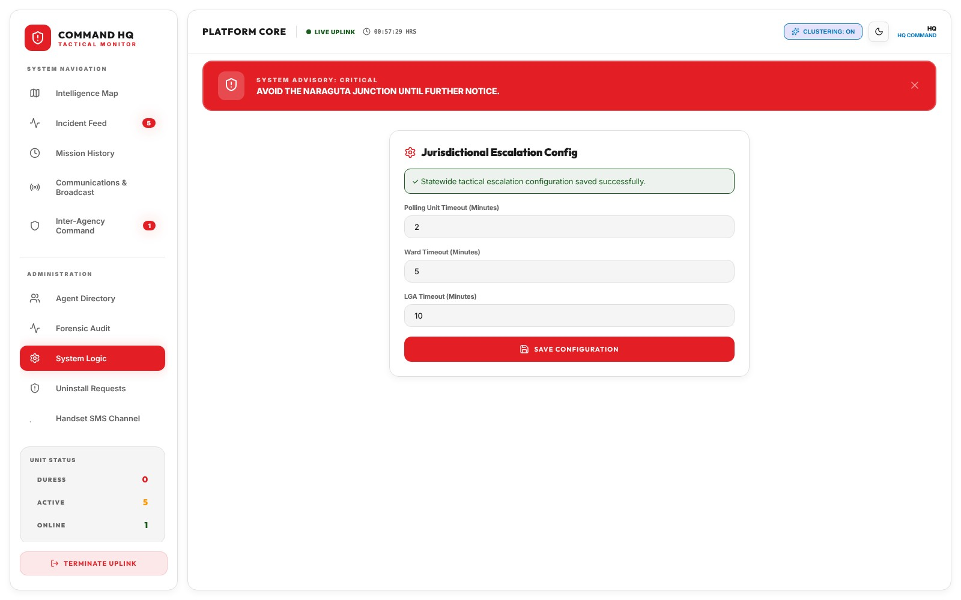
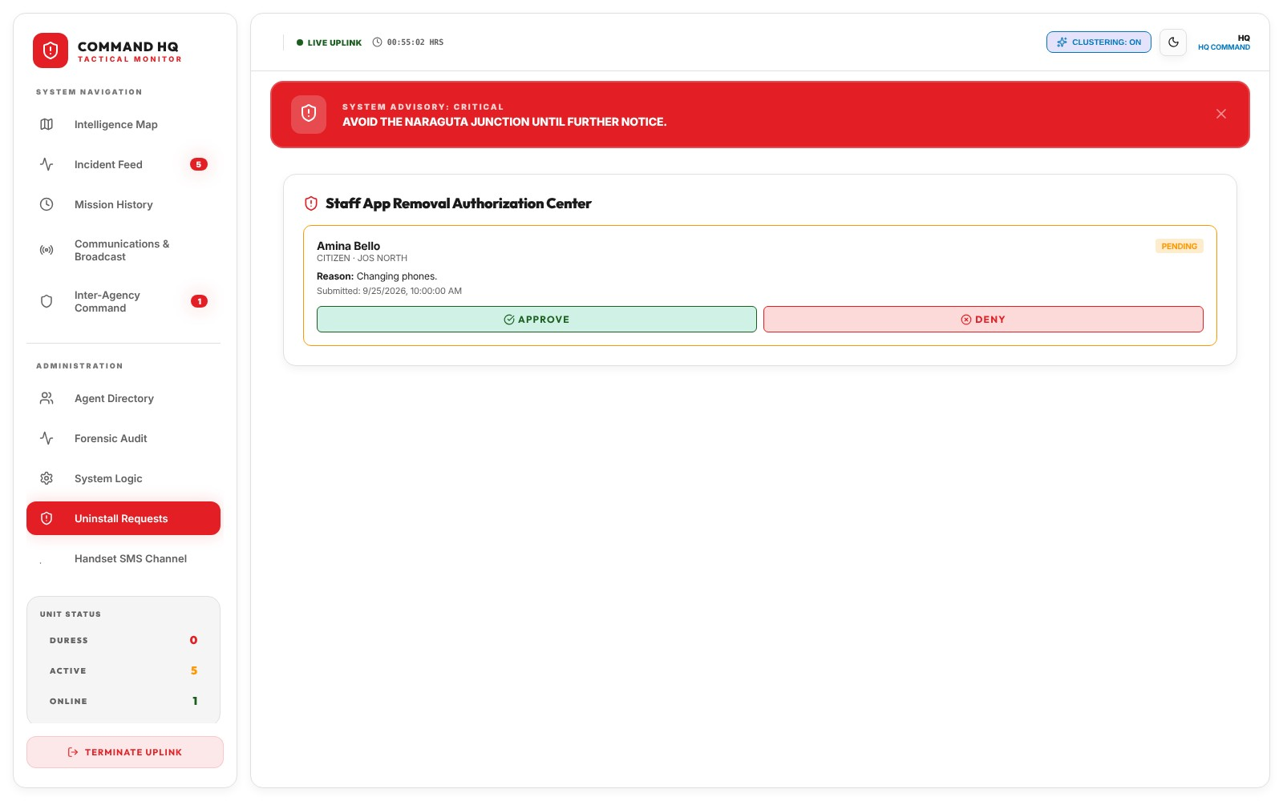
Set the rules, approve the exceptions
ADMINISTRATION · RULES AND APPROVALS
System logic
Uninstall requests
How long each level has before an alert moves up: 2, 5 and 10 minutes.
Removing the app from a registered phone needs HQ approval.
Notes:
System Logic holds the escalation timeouts: by default a polling unit has 2 minutes, a ward 5 and an LGA 10 before an unhandled alert moves up the chain. These run on the server, so an alert still moves up if a commander's console is offline. Uninstall Requests is where HQ approves or denies a request to remove the app, with the reason given. Two further admin screens are not shown here: the Forensic Audit trail of who did what, and the Handset SMS Channel, which lists phones whose SIM card was removed or replaced.

Slide 23
One incident, from phone to resolution
END TO END
Citizen
Polling unit
Ward
LGA
HQ
Response
Raises SOS or files a report
First to act, 2 minutes
Next level, 5 minutes
Next level, 10 minutes
Oversees all, can step in at any time
Responders and agencies act, then report
Moves up on its own
Every step is on record
If a level does not act in time, the server passes the alert up, even if that level is offline.
Who took it, when, and what they did. Resolved incidents move to Mission History.
Notes:
This ties the walkthrough together. An alert starts with a citizen and lands first at their polling unit. If the polling unit does not act within 2 minutes it moves to the ward, then after 5 minutes to the LGA, then after 10 minutes to HQ. HQ can step in at any point. The response comes from dispatched responders or a partner agency, who report back. The escalation runs on the server, so it still happens if a commander's device is offline, and every step is timestamped.

Slide 24
From one tap on a phone to a coordinated response
OPERATION RAINBOW
17
6
3
4
LGAs covered statewide
Partner agencies connected
Ways to reach HQ without data
Mobile networks on USSD
Notes:
To close: Operation Rainbow covers all 17 LGAs of Plateau State, connects HQ with six partner agencies, offers three ways to reach HQ when there is no data, and works on USSD across all four Nigerian mobile networks. Thank you.

