Slide 1

Project Title –SEASONAL AGRICULTURE PERFORMANCE ANALYSIS
Palavalasa Kusuma
Rishi MS Institute of Engineering and technology for women
AICTE STU ID : STU66446800d66971715759104

Slide 2

PROBLEM STATEMENT
Agricultural activities are influenced by seasonal variations in environmental conditions, farming practices, resource availability, and market conditions. As a result, agricultural performance may differ significantly from one season to another. However, raw agricultural data does not clearly explain how performance changes across seasons or what patterns emerge under different seasonal conditions. The problem is to analyze the given agricultural dataset and investigate seasonal differences in agricultural performance by identifying meaningful patterns, trends, relationships, and variations within the available data.

Slide 3
Project Description
This project performs an end-to-end Exploratory Data Analysis (EDA) on a seasonal agriculture performance dataset containing 4,000 farm-level records across 8 Indian states, 8 crops, 3 seasons (Kharif, Rabi, Zaid) and 4 irrigation methods.
The dataset captures environmental conditions (rainfall, temperature, humidity, soil pH & moisture, sunlight), farm inputs (fertilizer, pesticide, nutrients, seed quality), and outcomes (yield, production, cost, revenue, profit, water usage, disease/pest risk).
Using Python (Pandas, Matplotlib, Seaborn) in Jupyter Notebook, the project explores univariate distributions, correlations, and multivariate relationships to answer: Which crops/seasons/states/irrigation methods perform best, and why?
The final output is a fully documented notebook with charts and an auto-generated key-insights summary that can support data-driven agricultural decision-making

Slide 4

WHO ARE THE END USERS?
Farmers & Growers
Researchers & Students
Financial & Insurance Providers
Agri-business & Supply Chain Planners

Slide 5

Technology Used
Python 3
Jupyter Notebook
Pandas & Numpy
Matplotlib & Seaborn
CSV dataset
Github

Slide 6
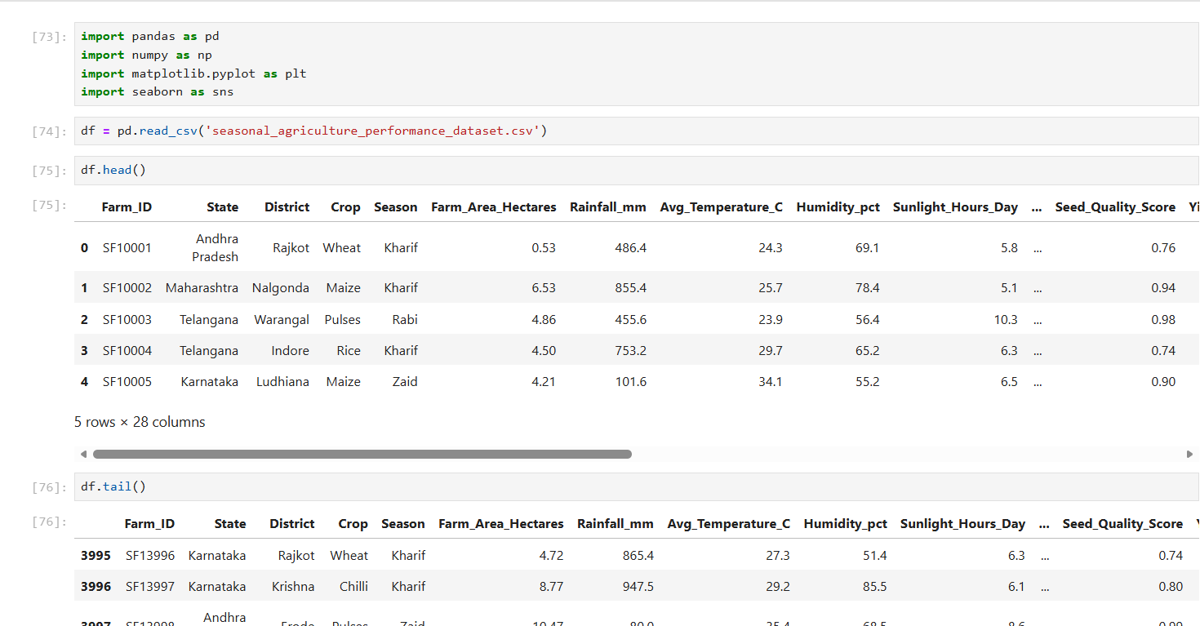
RESULTS
[Add screen shots of your code ]

Slide 7
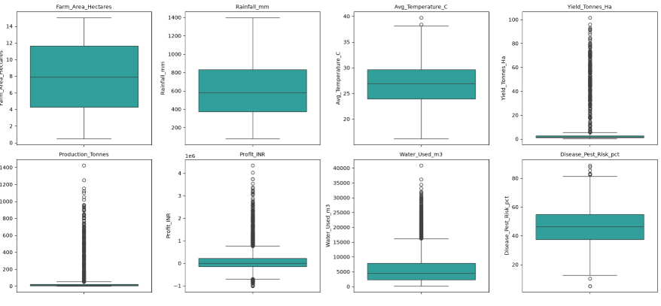
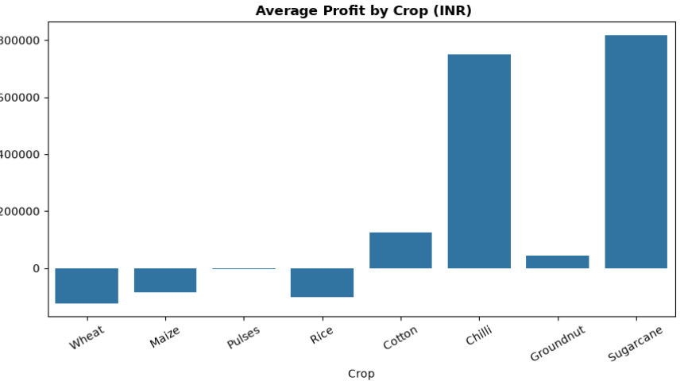
RESULTS
[Add screen shots of your code ]

Slide 8
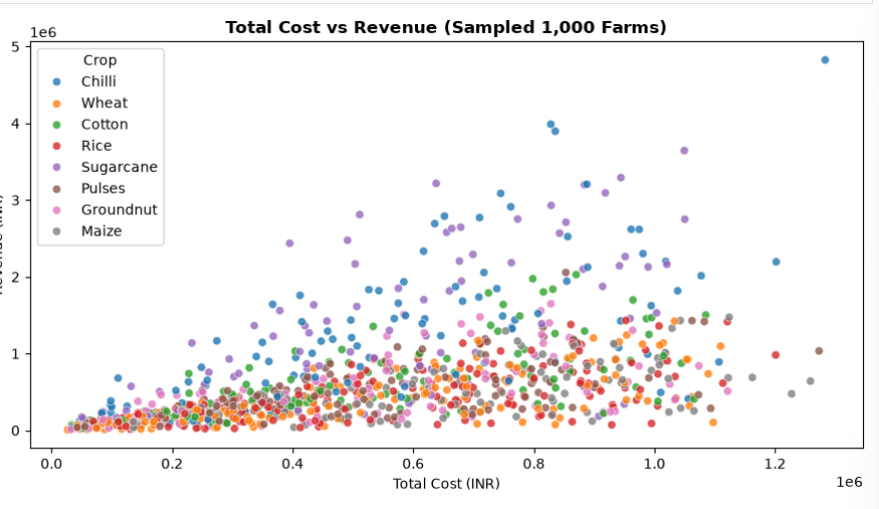
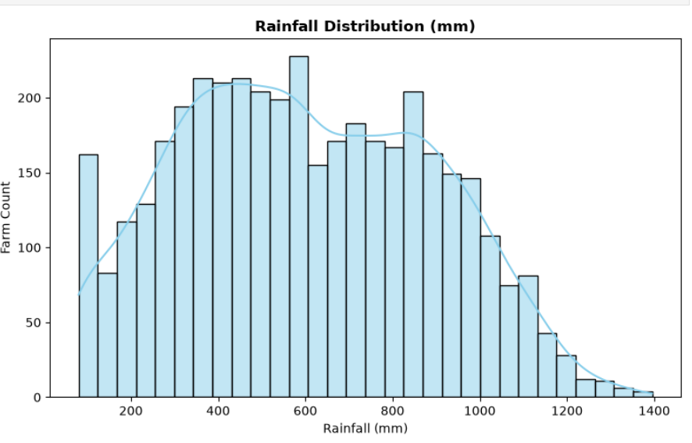
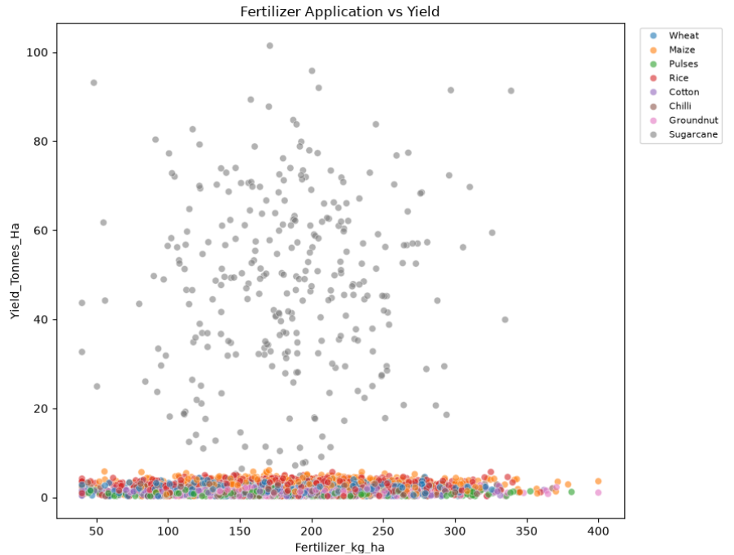
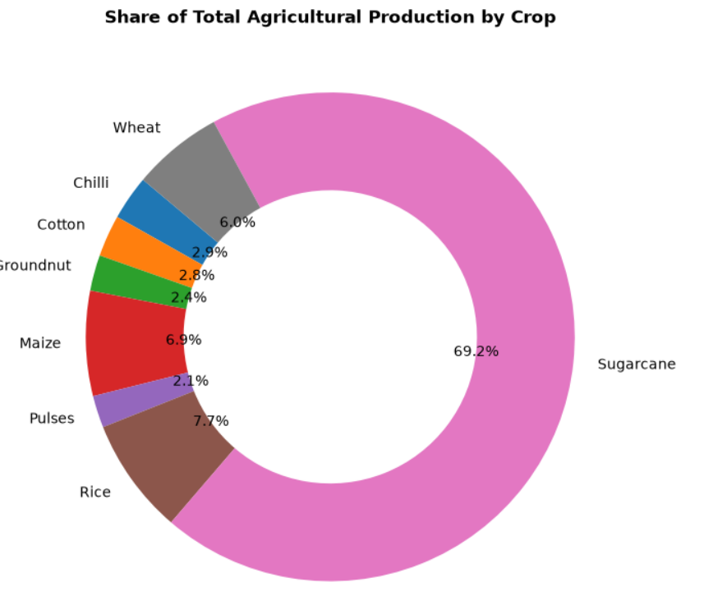
RESULTS
[Add screen shots of your code ]

Slide 9
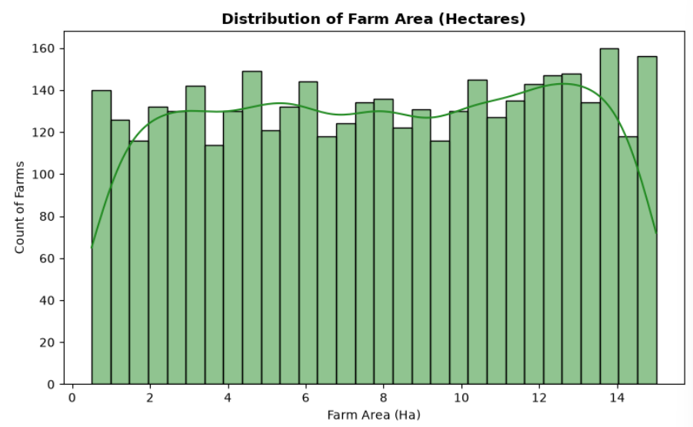
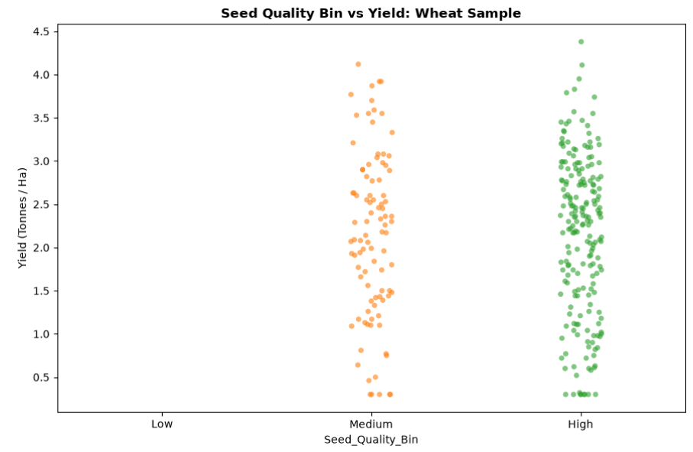
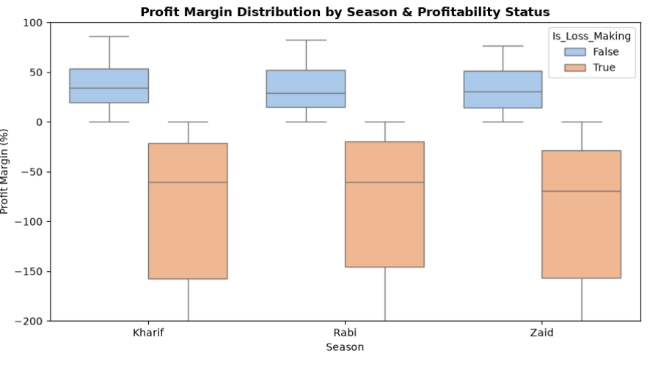
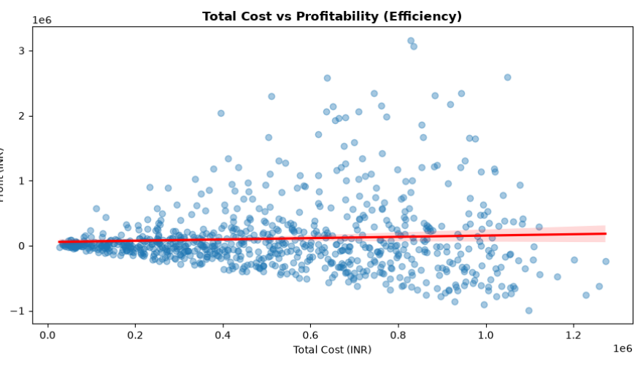
RESULTS
[Add screen shots of your code ]

Slide 10
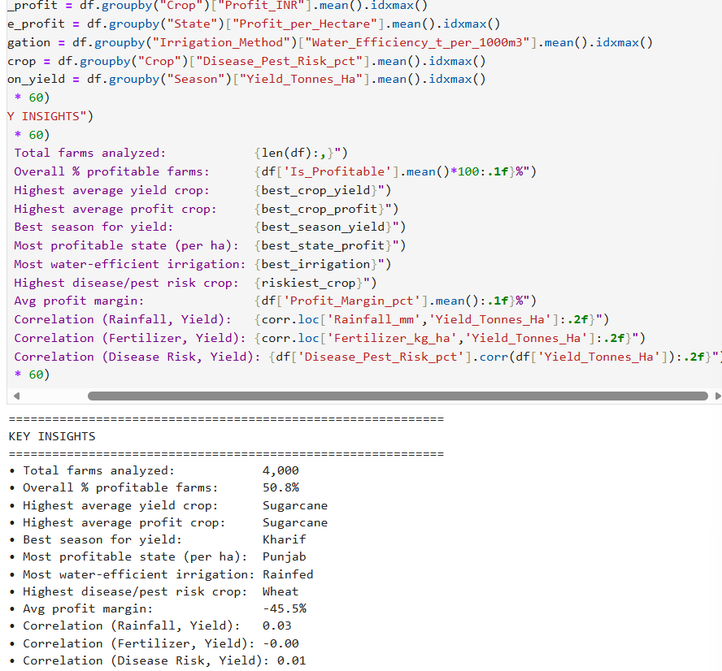
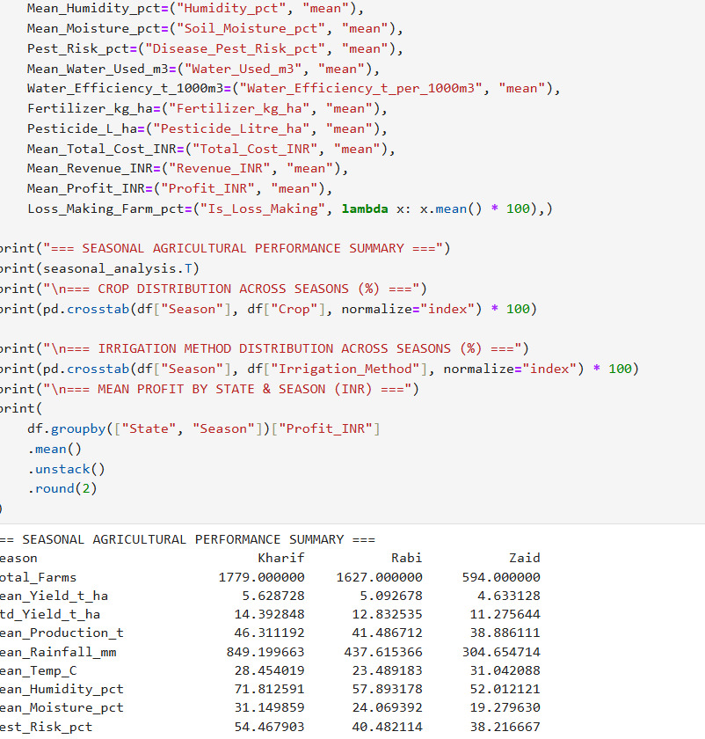
RESULTS
[Add screen shots of your code ]

Slide 11
Future scope
Build a predictive model (Random Forest / XGBoost) to forecast Yield or Profit from environmental & input features.
Cluster farms by input-usage and outcome profiles to identify efficient vs. inefficient farming patterns.
Incorporate multi-year time-series data to study long-term seasonal and climate trends.
Add a district-level drill-down to pinpoint high- and low-performing micro-regions.
Deploy an interactive dashboard (Power BI / Streamlit) for real-time exploration by non-technical stakeholders.
Integrate live weather & market-price APIs for real-time decision support.

Slide 12
GitHub Link
https://github.com/Kusuma-97/Agriculture_DA_VIOS.git

Slide 13
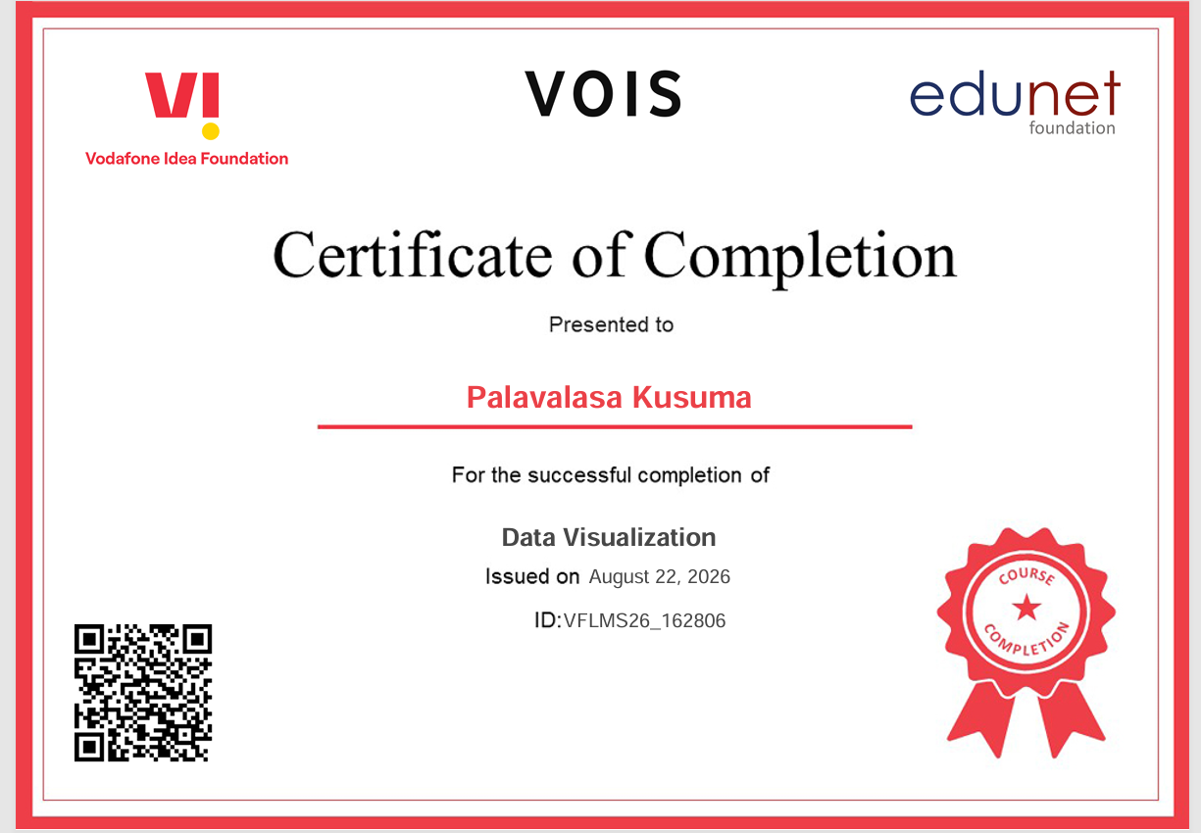
VOIS Course completion certificate - Course name- Data Visualization

Slide 14
Thank you
.
.

