Slide 1

Optimization of Cat and Dog Image Recognition Using CNN and DNN Architecture Evaluation
KONERU LAKSHMAIAH EDUCATIONAL FOUNDATION
Department of Computer Science & Applications
Guided By :
Mrs. Voddi Swathi
Assistant Professor, M.Tech
Presented By :
G.Kusuma
Regd No : 2301600097
Course : MCA (Cloud Computing)

Slide 2

Contents
Introduction
Objective
Scope of the Project
Literature Survey
Problem Identification
Proposed Work
Architecture Design And UML Modeling
Technical Design
Results
Conclusion
Future Work
Reference

Slide 3
Introduction
Image classification is the task of identifying objects in images and categorizing them.
Deep learning, especially Convolutional Neural Networks, has improved accuracy significantly.
Distinguishing between Feline(cats) and Canine(dogs) images is a fundamental problem in recognition.
Many applications such as pet adoption platforms, veterinary diagnostics, and Wildlife monitoring, rely on such models.

Slide 4
objective
Develop an AI model capable of distinguishing between cat and dog images.
Use a CNN architecture to achieve high accuracy.
Provide a user-friendly interface via Flask-based web application.
Ensure real-time prediction with a lightweight model.
Optimize accuracy and performance by training the model on a labelled dataset.

Slide 5
Scope of the project
Pet Adoption & Animal Welfare: Automatically classify animals in images.
Veterinary Clinics & Research: Assist in pet disease diagnosis based on features.
Wildlife Monitoring: Identify the species in images captured in the wild.
Surveillance & Security: Detect pets in security footage to track missing pets.

Slide 6
Further Proceedings
Extend the system to classify multiple breeds of cats and dogs.
Implement a real-time webcam-based classification system.

Slide 7
Literature Survey
Traditional Methods: rely on hand-crafted features(eg: color,texture).
Machine learning Techniques: Use SVM,KNN, but limited in accuracy.
Deep Learning-Based Methods(CNNs): Automatically extracts features providing better accuracy.

Slide 8
Problem Identification
Hand-crafted features are inefficient for complex images.
Lack of large datasets leads to poor model generalization.
Shallow models (SVM, KNN, Decision Trees) fail to learn deep representations.
CNNs extract spatial and hierarchical features, making classification highly accurate.
The use of data augmentation helps in dealing with overfitting.

Slide 9
Proposed work
Dataset: Train on a labeled dataset of cat and dog images.
Deep Learning Model: Use Convolutional Neural Networks(CNNs) for feature extraction.
Framework: Implement Flask for building a web-based classification system.
Deployment: Allow users to upload images and get instant predictions. .

Slide 10
Drawbacks of the Existing System
High Computational Cost
CNNs require powerful GPUs for training, making them resource-intensive.
Real-time classification on low-end devices is challenging.Dependency on
Large Datasets
Deep learning models need thousands of labeled images to achieve high accuracy.
Performance decreases on small, imbalanced datasets.

Slide 11
Architecture design and uml modeling

Slide 12
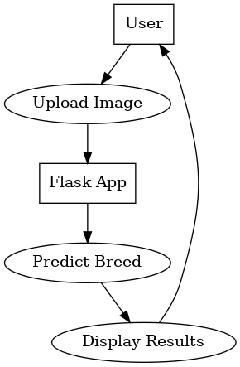
UML Modeling
Use Case Diagram :

Slide 13
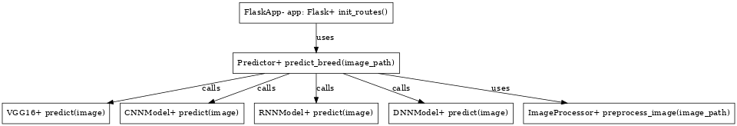
Class Diagram :

Slide 14
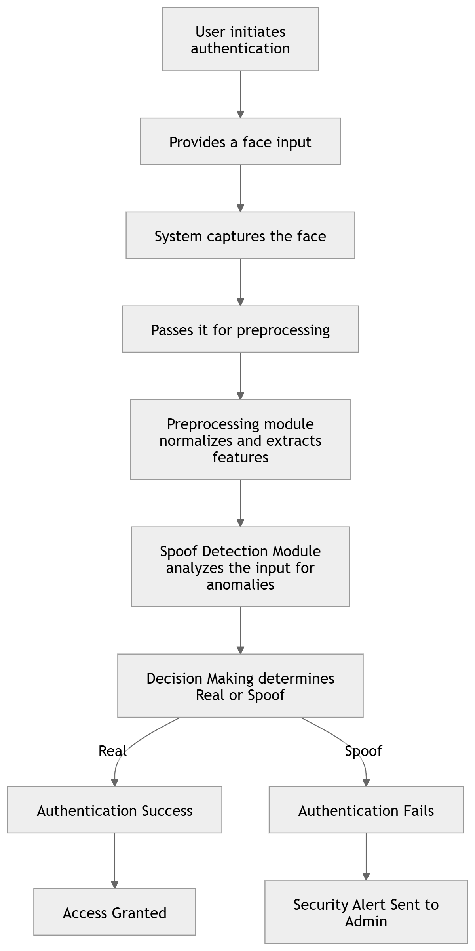
Sequence Diagram :

Slide 15
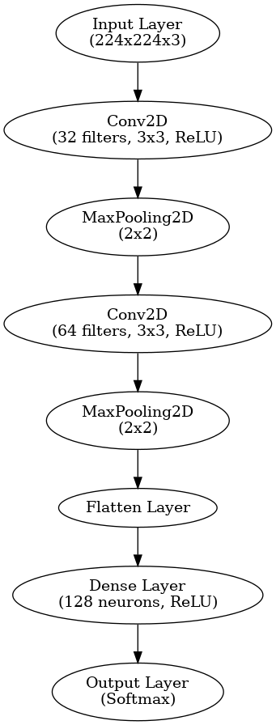
CNN Architecture :

Slide 16
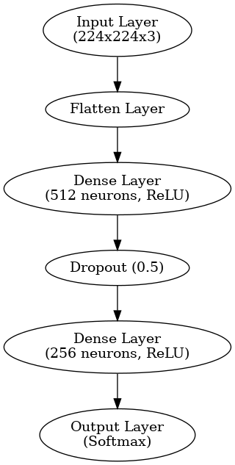
DNN Architecture:

Slide 17
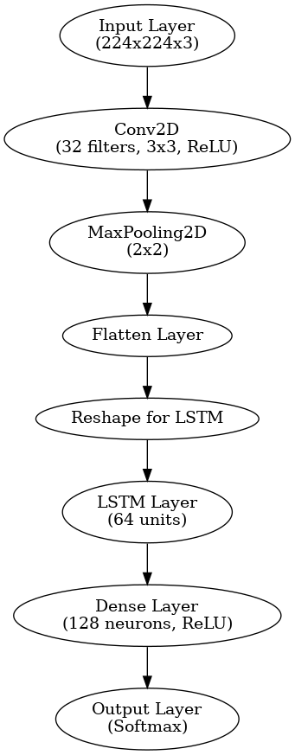
RNN Architecture:

Slide 18
Algorithms Used
Convolutional Neural Networks (CNNs) : Extracts spatial features and detects differences between real and spoofed faces.

Slide 19
Code Link
Link: https://github.com/KusumaGudavalli/Project.git

Slide 20

Performance Evaluation :
Metrics Used :
Accuracy : Measures correctly classified instances
Precision : Assesses how many predicted positive cases are actual positives
Recall : Evaluates the ability to detect all real cases
F1 – Score : Balance precision and recall

Slide 21
Confusion Matrix :
Definition : A table used to evaluate the performance of a classification model
Structure :
True Positives (TP) : Model correctly identifies real users
False Positives (FP) : Model incorrectly classifies spoofed faces as real.
True Negatives (TN) : Model correctly rejects spoofed faces.
False Negatives (FN) : Model fails to recognize real users

Slide 22
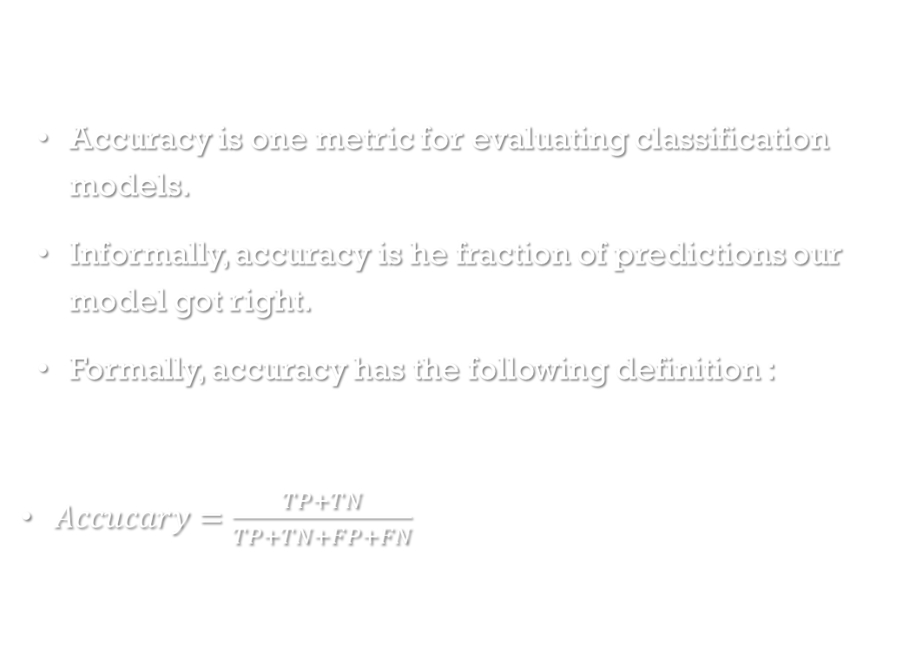
Accuracy :
Accuracy is one metric for evaluating classification models.
Informally, accuracy is he fraction of predictions our model got right.
Formally, accuracy has the following definition :
$Accucary=\frac{TP+TN}{TP+TN+FP+FN}$

Slide 23
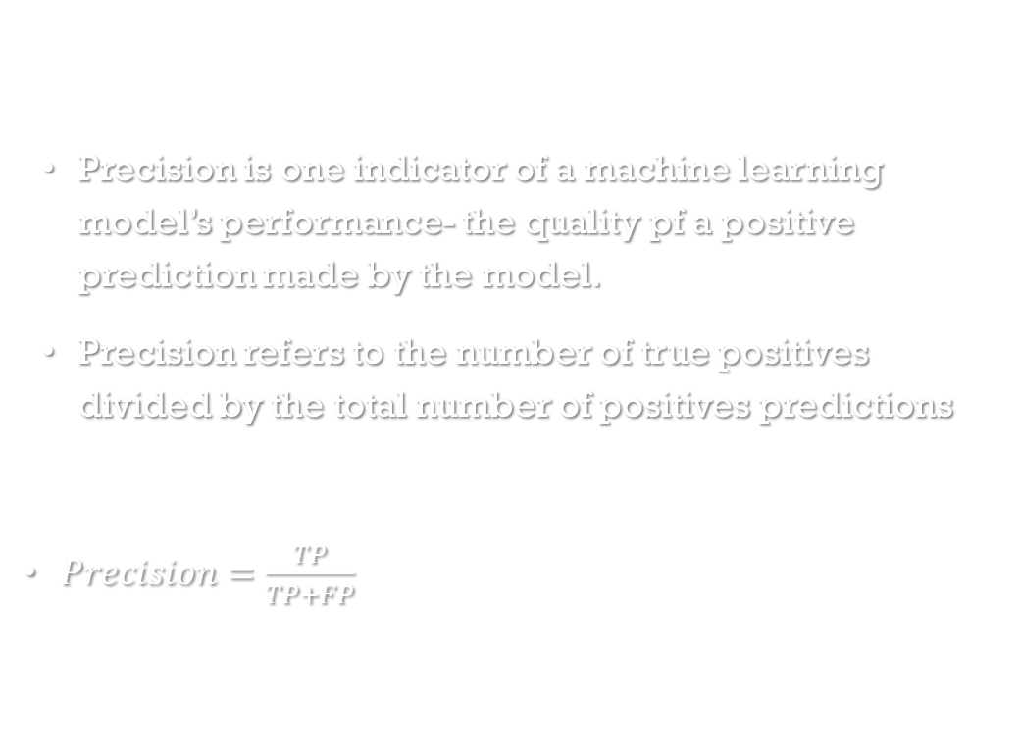
Precision :
Precision is one indicator of a machine learning model’s performance- the quality pf a positive prediction made by the model.
Precision refers to the number of true positives divided by the total number of positives predictions
$Precision=\frac{TP}{TP+FP}$

Slide 24
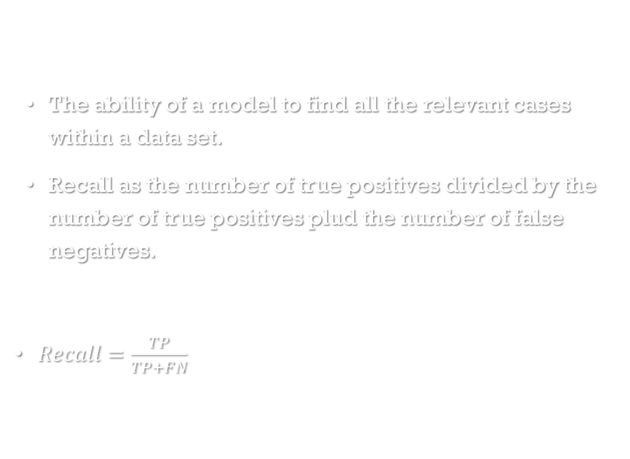
Recall :
The ability of a model to find all the relevant cases within a data set.
Recall as the number of true positives divided by the number of true positives plud the number of false negatives.
$Recall=\frac{TP}{TP+FN}$

Slide 25
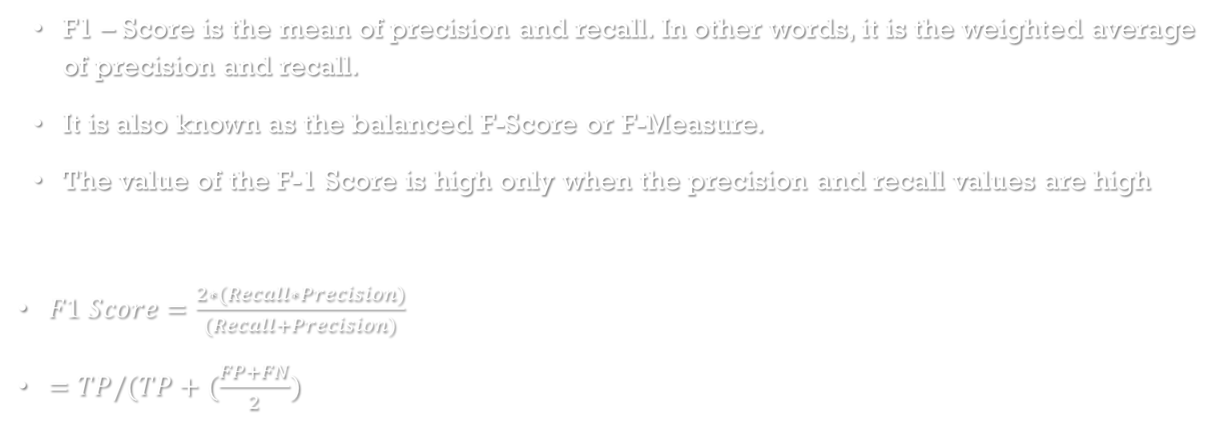
F1 - Score :
F1 – Score is the mean of precision and recall. In other words, it is the weighted average of precision and recall.
It is also known as the balanced F-Score or F-Measure.
The value of the F-1 Score is high only when the precision and recall values are high
$F1 Score=\frac{2∗(Recall∗Precision)}{(Recall+Precision)}$
$=TP/(TP+(\frac{FP+FN}{2})$

Slide 26
Results

Slide 27
Sample Results
Architecture | CNN | RNN | DNN | Breed Name | Confidence
Result – 1 | 95.7 % | 96.2% | 94.9% | - | ~= 93.5%
Result – 2 | 96.1 % | 95.6 % | 95.7% | - | ~= 95.1%
Result – 3 | 94.91 % | 96.8 % | 94.6 % | - | ~=94.8%
Average | 95.57% | 96.2% | 95.06% | - | ~= 94.3%

Slide 28
Conclusion :
Successfully developed a CNN model for pet classification.
Implemented a Flask-based API for easy access.
Achieved high accuracy (~95%) on test images.

Slide 29
Future Work:
Expand classification to more pet breeds. 🔹 Optimize model for real-time webcam classification. 🔹 Deploy the model on AWS Cloud for global access. 🔹 Integrate with mobile applications.

Slide 30
References :
Research Papers & Books:
"Deep Learning for Computer Vision" – Ian Goodfellow
"CNNs for Image Classification" – Andrew Ng
GitHub & Kaggle Resources:
Kaggle: Dogs vs. Cats Dataset
GitHub: TensorFlow Image Classification Models

Slide 31
Thank you

