Slide 1

User Behavior Analysis in Reddit for Product Marketing SMDM Fall 2024
Presented by:
(Group 6)
Kirankumar Kanaje
Haravindan Jain
Amit Prakash Vatyani
Kusuma Shivaramaiah
Atharva Chandras
Induja Ragava

Slide 2

Introduction
Objective:
Enhance engagement and retention on Reddit by analyzing user behavior.
Key Goals:
Track user activities across subreddits (posting, commenting).
Segment users into groups: Lurkers, Regulars, Superusers.
Analyze trends to identify peaks in activity and trending topics.
Significance:
Community Engagement Analysis: Identifies highly active and influential subreddits, enabling better understanding of user interactions and behaviors.
Targeted Marketing: Provides a data-driven framework for pinpointing communities with the highest engagement for efficient resource allocation.

Slide 3

Key Parameters
1. Comments/Post Ratio
Meaning: Average number of comments per post in a subreddit.
Relevance: Identifies active subreddits and measures user interaction; crucial for targeting subreddits with high discussion for feedback or engagement.
2. Engagement Rate
Meaning: Measures user activity relative to subreddit size.
Relevance: Highlights subreddits with active participation, ideal for impactful product marketing.
2. Karma (of users participating in the subreddit)
Meaning: Total link karma of a user (upvotes minus downvotes)
Relevance: Helps identify subreddits with high-karma users(eg: regular & superusers), ideal for placing ads where credible and influential users are more likely to engage with the content.

Slide 4

Implementation
1. Tools Used
Python: Primary language to implement the project
praw: Reddit API interaction
pandas: Data manipulation
matplotlib: Visualizations
2. Reddit API Integration
Registered on Reddit: Created app to get Client ID & Client Secret
Connected via PRAW: Authenticated to access the API using the credentials.
3. Data Extraction
Filtered subreddits with a minimum of 100,000 subscribers for higher relevance
Retrieved top subreddits by relevance
Analyzed 5 "hot" posts per subreddit
Collected user comments and karma for insights

Slide 5
Implementation
4. Metrics Computed
Subreddit Statistics:
Total posts and comments
Comment-to-post ratio for engagement analysis
Engagement rate
User Engagement:
Aggregated user karma to identify top subreddit
5. Data Organization
Two pandas DataFrames:
User Data: Username, karma, subreddit context
Subreddit Stats: Name, subscriber count, post count, comment count, comment/post ratio, and engagement rate
6. Inference
Weighted sum: For each subreddit based on comment/post ratio, engagement rate, regular users count, and superusers count multiplied by respective constants
Analysis: Subreddit wise comparison on various parameters including weighted sum

Slide 6

Experimental Results
Key Findings:
Analyzed topic: 'laptop'.
Data collected from relevant subreddits with ≥100,000 subscribers.
User categories identified: Lurker, Regular, Superuser.
Comment-to-post ratio and user categories used to calculate weighted scores.
Results:
Top subreddits analyzed: 'Laptopdeals', 'GamingLaptops', 'SuggestALaptop'.
Best subreddit for marketing (highest weighted sum): Gadgets.
Visualization and analysis show 'GamingLaptops' has higher engagement.

Slide 7
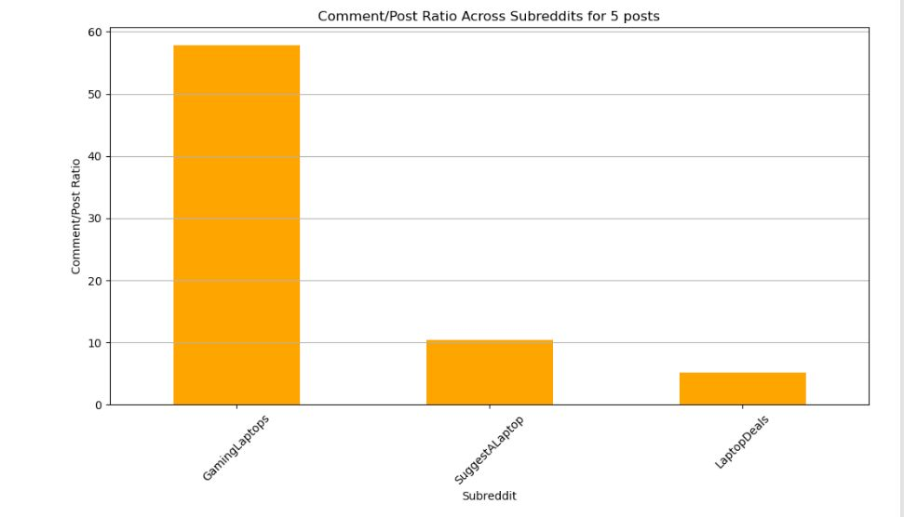
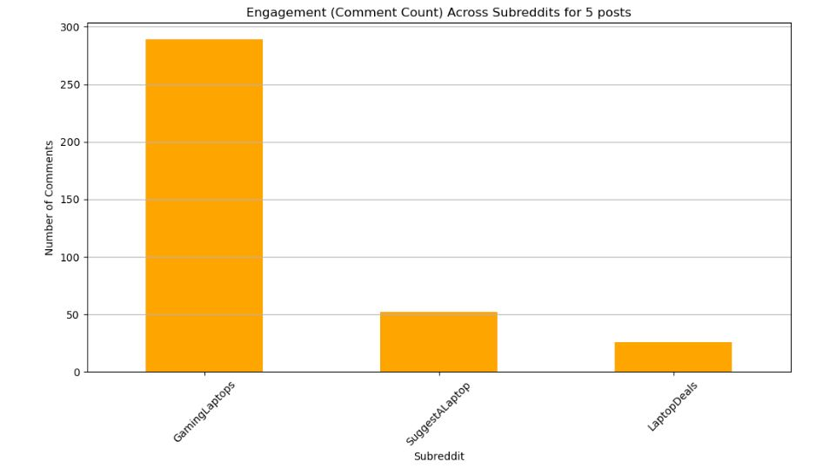
Analysis
Comment/Post ratio across subreddits for 5 posts
Engagement (Comment Ratio) Across Subreddits for 5 posts

Slide 8
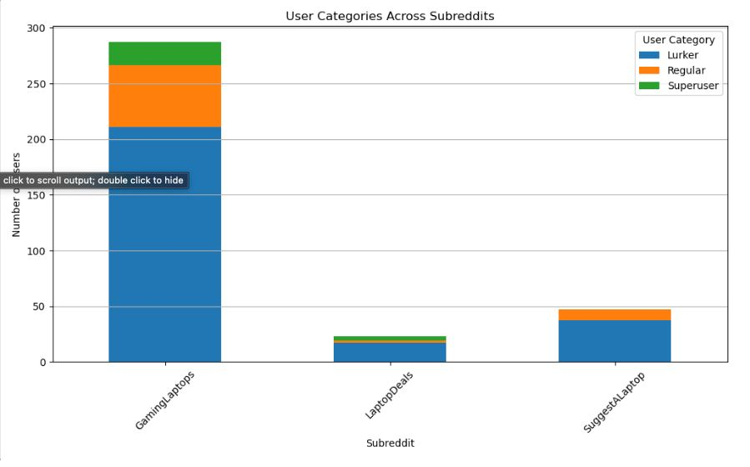
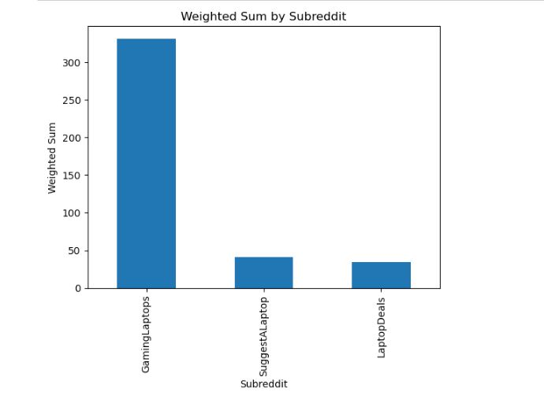
Analysis
User Categories across Subreddits
Weighted Sum of Subreddits

Slide 9

DEMO

Slide 10
Challenges
Data Privacy & Ethics Ensuring compliance with Reddit API policies and safeguarding user privacy.
API Rate Limits Restricted requests may limit comprehensive data collection.
Incomplete or Noisy Data Issues with inactive users, deleted content, or inconsistent formatting.
Engagement Bias Metrics may overemphasize highly active users while neglecting infrequent contributors.

Slide 11
Conclusion
Key Insights Analyzing user behavior on Reddit reveals valuable trends in engagement, user segmentation, and community dynamics.
Applications
Marketing Opportunities
Content Strategy Optimization
Impact A data-driven approach enhances user retention, fosters stronger community connections, and minimizes churn rates.

Slide 12
Future scope
Cross-platform Strategy Alignment: Extend the analysis to align subreddit insights with marketing efforts on platforms like Instagram, Twitter, or YouTube.
Product Launch Optimization: Use subreddit engagement data to choose the best communities for launching new products, ensuring maximum visibility and impact.
Enhanced Personalization Algorithms: Integrate sentiment analysis to gauge community reception of products or campaigns and adjust strategies accordingly.
Trend Prediction: Develop predictive models to identify emerging topics and trends in subreddits, enabling proactive marketing strategies.

Slide 13

Thank you!

