Slide 1

Seasonal Agriculture Performance Analysis
Kusum Verma
Madhav Institute Of Technology & Science, Gwalior, M.P
AICTE STU ID: [STU6a5f03805a1ed1784611712]

Slide 2

PROBLEM STATEMENT
Agricultural activities are influenced by seasonal variations in environmental conditions, farming practices, resource availability and market conditions. This project analyzes the dataset to identify seasonal differences, patterns, trends and relationships in agricultural performance.

Slide 3
Project Description This project performs an end-to-end data analytics study on 4,000 agricultural records across Kharif, Rabi and Zaid seasons. The analysis includes data cleaning, seasonal comparison, crop-level analysis, environmental/resource analysis, profitability analysis and data-driven recommendations.

Slide 4

WHO ARE THE END USERS?
• Farmers – understand seasonal performance and resource requirements • Agricultural planners & policy makers – support evidence-based planning • Agribusiness organizations – assess production and profitability patterns • Researchers & analysts – study crop, climate and resource relationships • Students & educators – use as a real-world analytics case study

Slide 5

Technology Used
Google Colab Python Pandas & NumPy Matplotlib CSV Dataset PowerPoint

Slide 6
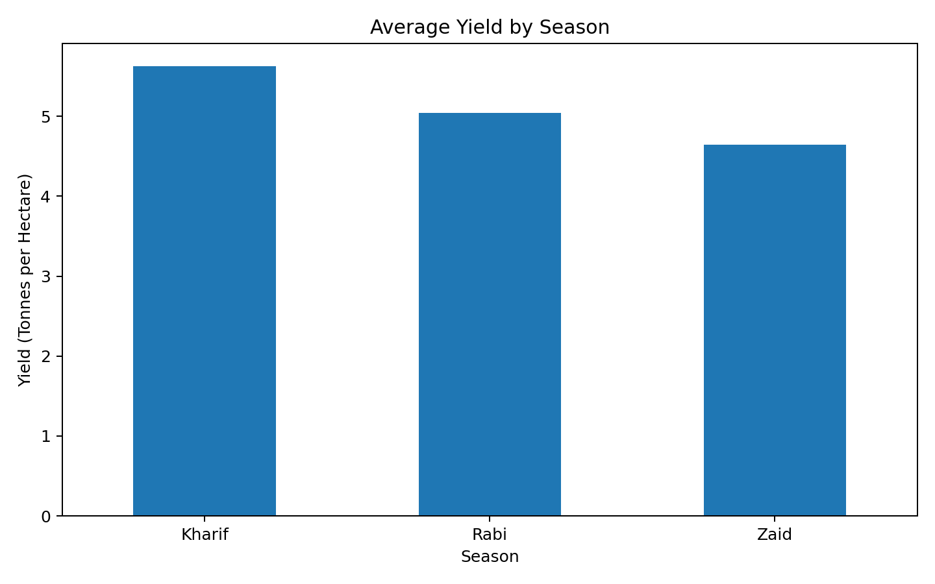
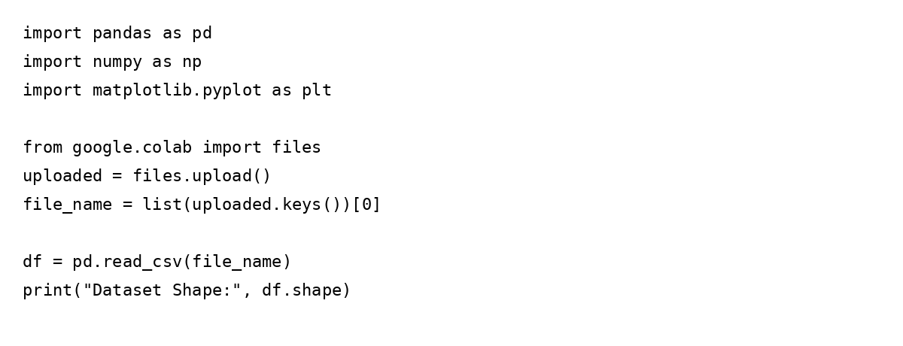
RESULTS
Result 1: Data Understanding & Cleaning
Dataset contains 4,000 records and 28 columns.
120 missing values were found in Rainfall, Soil Moisture and Yield fields.
Numeric missing values were handled using median imputation.
No duplicate records were found.

Slide 7
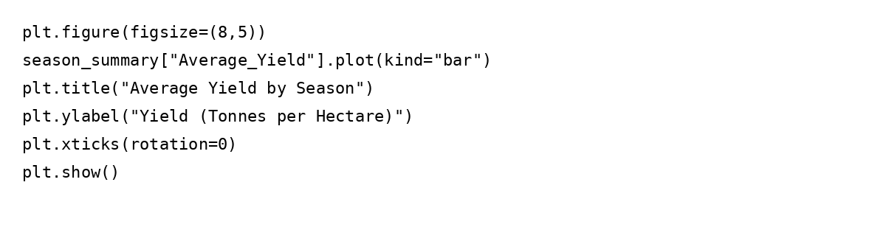
RESULTS
Result 2: Seasonal Yield Performance
Kharif recorded the highest average yield: 5.63 t/ha.
Rabi followed with 5.04 t/ha.
Zaid recorded the lowest average yield: 4.64 t/ha.
Kharif also had the highest median yield.

Slide 8
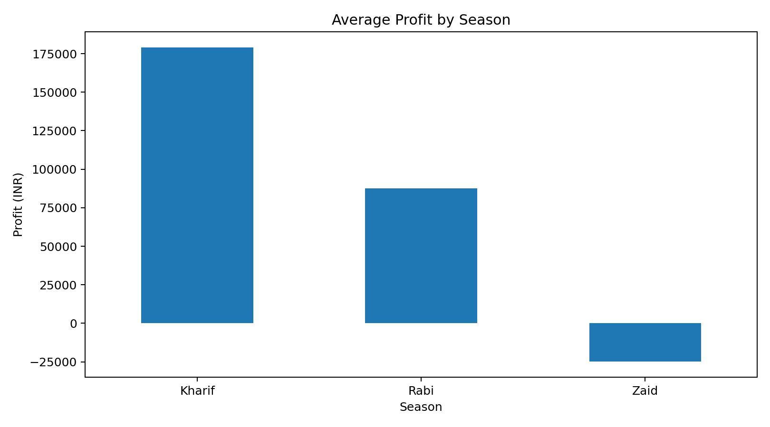
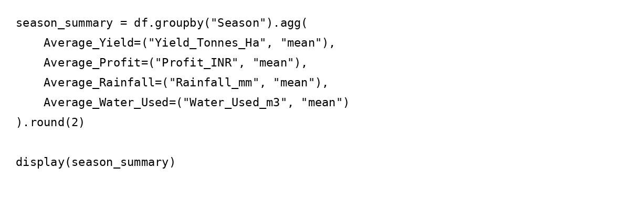
RESULTS
Result 3: Seasonal Economic Outcomes
Average profit was highest in Kharif (₹178.9K), followed by Rabi (₹87.7K).
Zaid showed an average loss of ₹24.8K.
This indicates uneven seasonal economic performance.

Slide 9
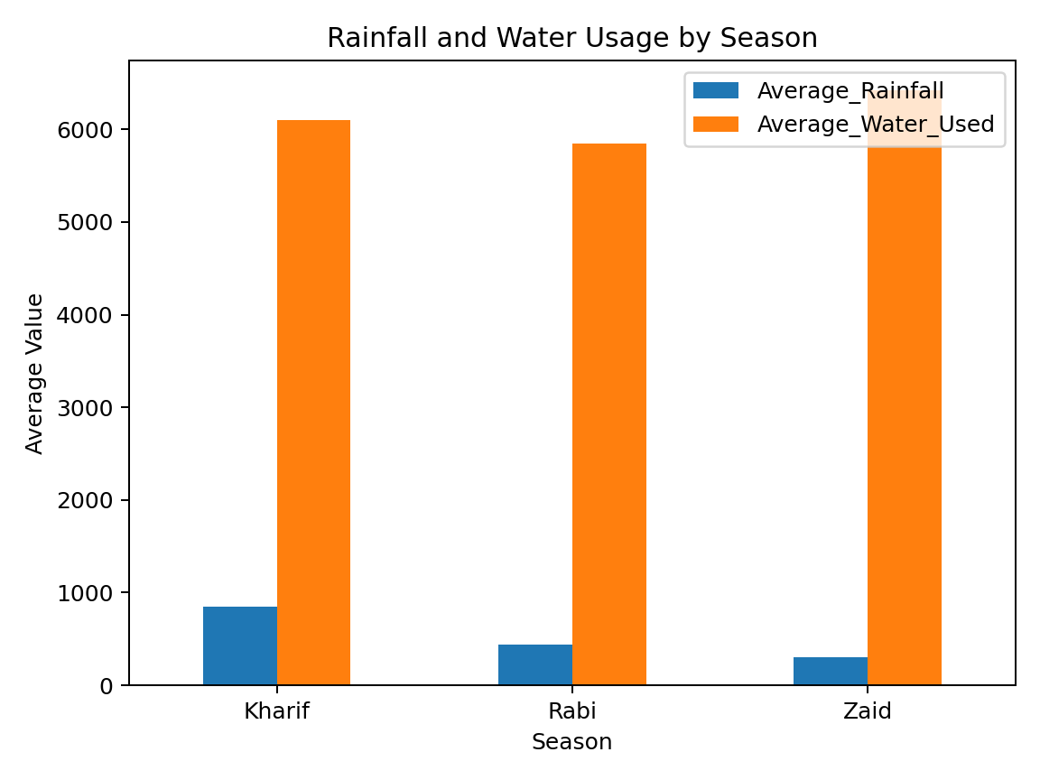
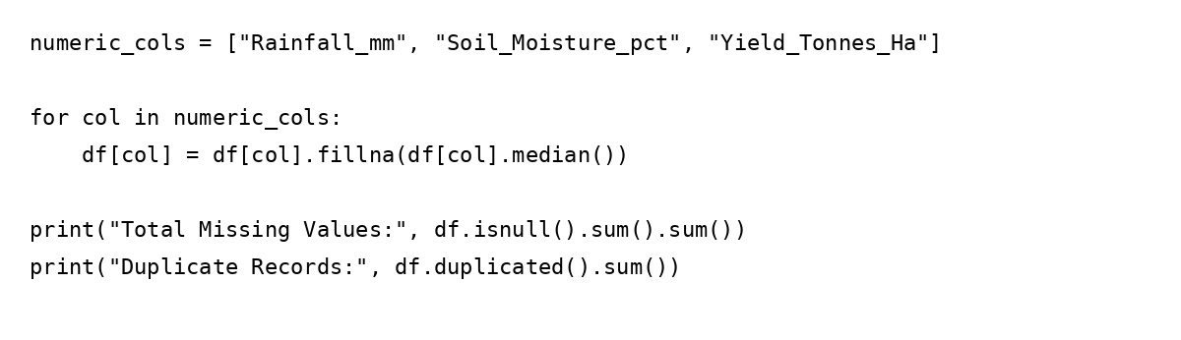
RESULTS
Result 4: Environment & Resource Usage
Kharif received the highest average rainfall (849.2 mm) and had the highest disease/pest risk (54.47%).
Zaid used the most water on average (6419.9 m³) but had the lowest water efficiency (4.41).

Slide 10
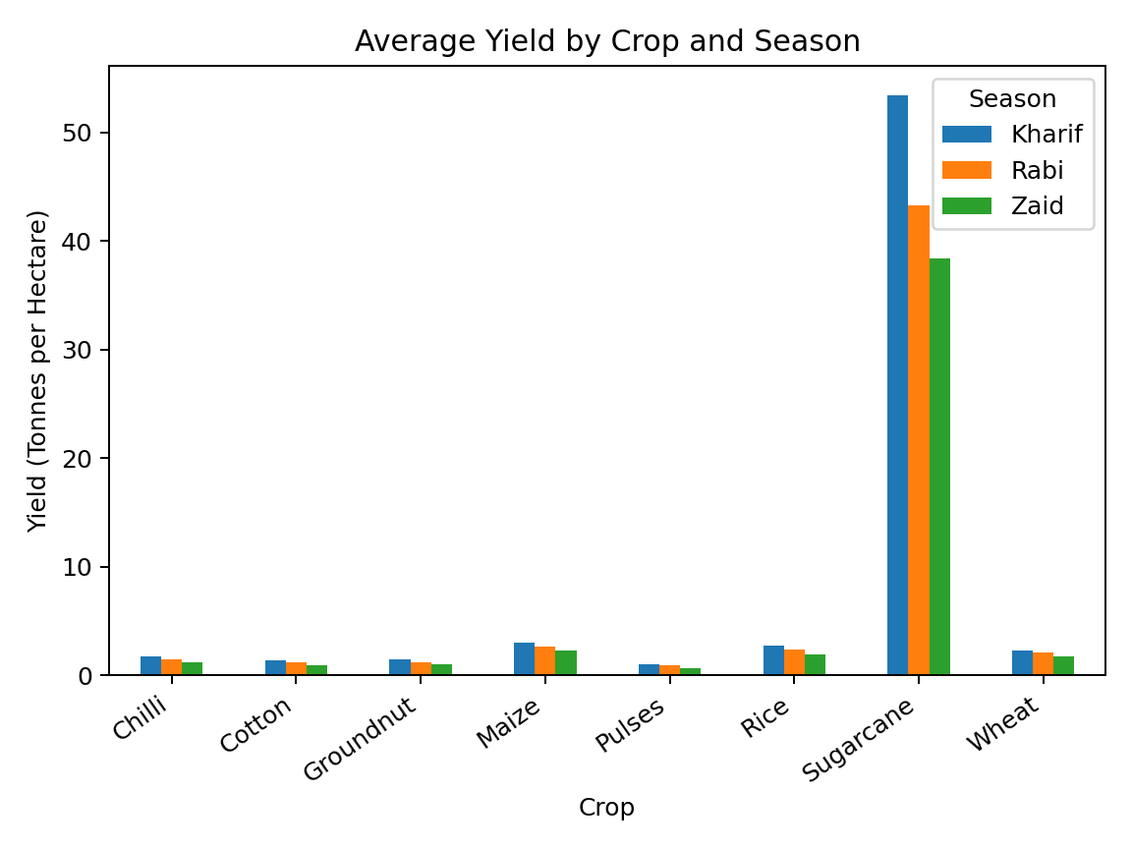
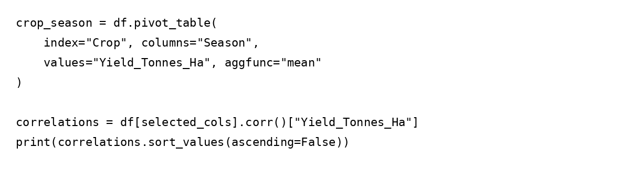
RESULTS
Result 5: Crop-Level & Relationship Insights
Sugarcane showed exceptionally high average yield across all seasons, strongest in Kharif (53.46 t/ha).
Yield had a moderate positive relationship with water used (r≈0.39) and profit (r≈0.49).
Simple environmental correlations with yield were weak.

Slide 11
Future scope
• Build predictive models for yield and profitability • Add real-time weather and satellite data • Develop district or state-level dashboards • Include crop-specific recommendations • Perform anomaly detection for unusual seasonal outcomes • Study long-term trends across multiple years • Optimize water and fertilizer usage

Slide 12
GitHub Link
https://github.com/Kusumv95/Kusum_Seasonal_data

Slide 13

VOIS Course completion certificate - Course name- Data Visualization

Slide 14
Thank you
.
.

