Slide 1
Artificial Intelligence
Huhe
Renmin University of China

Slide 2
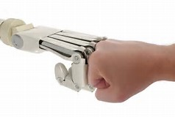
About this course
Textbook
Class Project
Grading
Scheduling

Slide 3
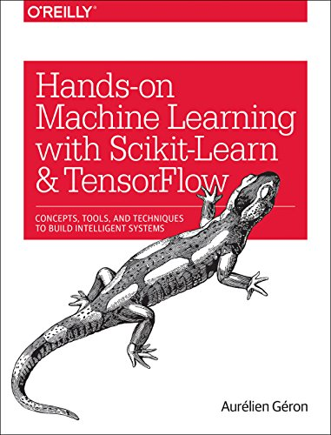
Textbook
Machine Learning
Deep Learning
Scikit
Tensorflow
A 2017 book

Slide 4
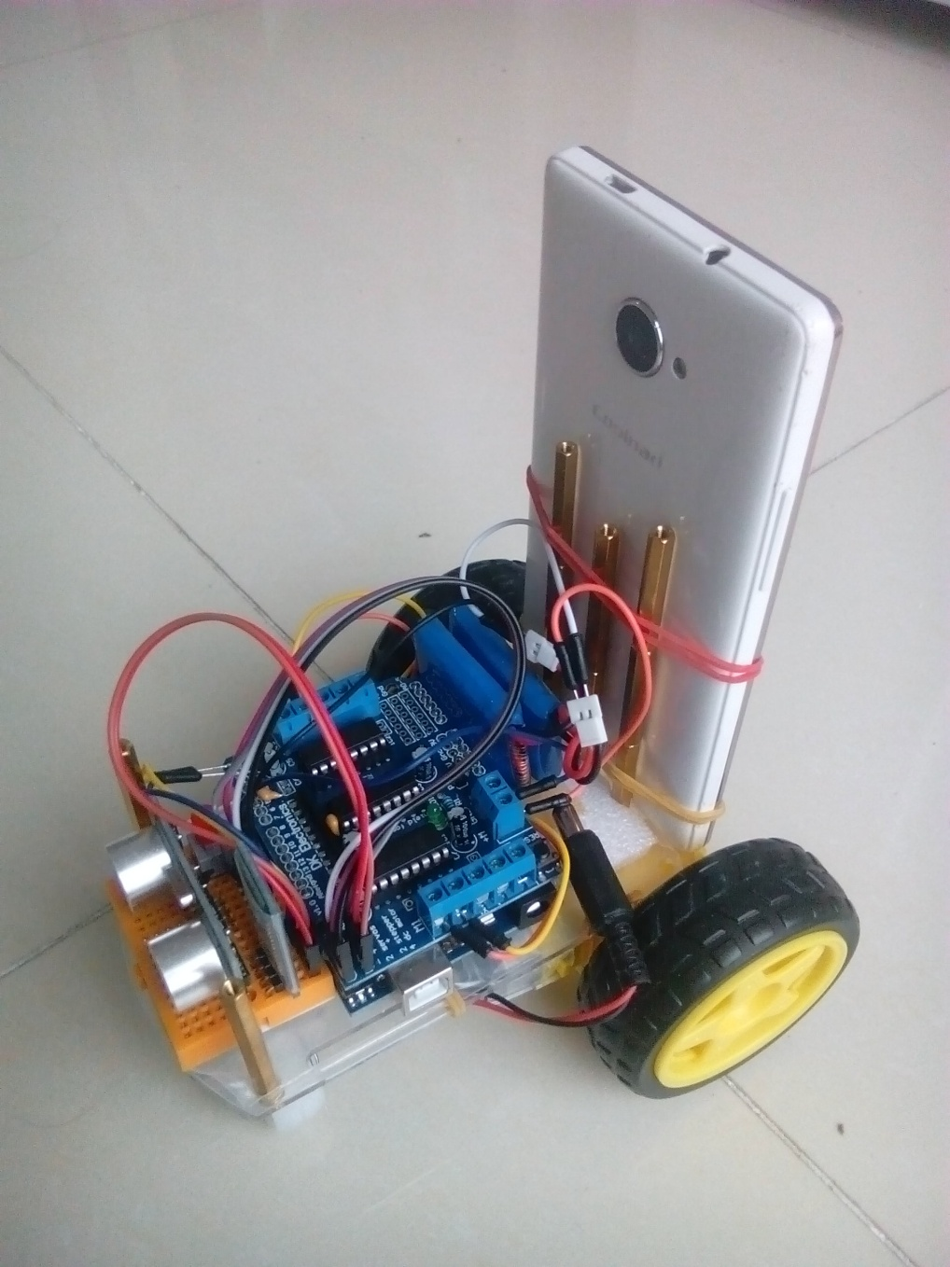
Project
Aicar
A physical agent with …
Two driving wheels
(differentially steered)
Ultrasonic sensor
Video streaming (Phone)
Bluetooth control
LBNL affordable (~ 50￥)

Slide 5
Projects
Three Projects
Random Walker
Sensored Walker
DeepAI Walker

Slide 6
Grading
Projects are arranged in groups (2 ~ 5 members)
Group based grading policy
Bonus point for Group Leaders
60% based on projects presentation (voting)
20% based on projects documentation (github)
20% based on projects participation/contribution

Slide 7
Project Scheduling
Project Presentations
Random Walker 4 weeks later ( Oct. 9)
Sensored Walker 8 weeks later (Nov. 6)
DeepAI Walker end of semester (Dec. 25)

Slide 8
Class Scheduling
Class stages
Introduction, build agent, up and running (3 weeks)
Machine Learning with Scikit (6 weeks)
Deep Learning with Tensorflow (6 weeks)

Slide 9
AI
What is it?

Slide 10
outline
About AI
History
Goals
Approaches
Tools
Applications

Slide 11
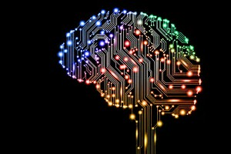
Artificial intelligence
Artificial intelligence (AI, also machine intelligence, MI) is intelligence exhibited by machines, rather than humans or other animals (natural intelligence, NI). In computer science, the field of AI research defines itself as the study of "intelligent agents": any device that perceives its environment and takes actions that maximize its chance of success at some goal. Colloquially, the term "artificial intelligence" is applied when a machine mimics "cognitive" functions that humans associate with other human minds, such as "learning" and "problem solving".

Slide 12
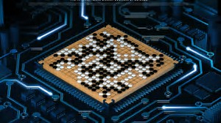
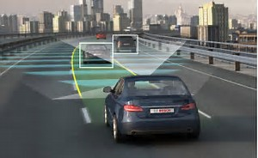
Artificial intelligence
The scope of AI is disputed: as machines become increasingly capable, task considered as requiring "intelligence" are often removed from the definition, a phenomenon known as the AI effect, leading to the quip "AI is whatever hasn't been done yet. " For instance, optical character recognition is frequently excluded from "artificial intelligence", having become a routine technology. Capabilities generally classified as AI, as of 2017, include successfully understanding human speech, competing at a high level in strategic game systems (such as chess and Go), autonomous cars, intelligent routing in content delivery networks, military simulations, and interpreting complex data.

Slide 13
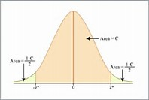
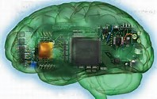
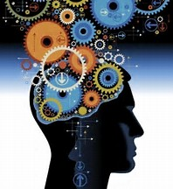
Artificial intelligence
The central problems (or goals) of AI research include reasoning, knowledge, planning, learning, natural language processing (communication), perception and the ability to move and manipulate objects. General intelligence is among the field's long-term goals.
Approaches include statistical methods, computational intelligence, and traditional symbolic AI. Many tools are used in AI, including versions of search and mathematical optimization, logic, methods based on probability and economics. The AI field draws upon computer science , mathematics, psychology, linguistics, philosophy, neuroscience, artificial psychology and many others.

Slide 14
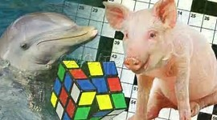
Artificial intelligence
The field was founded on the claim that human intelligence "can be so precisely described that a machine can be made to simulate it". This raises philosophical arguments about the nature of the mind and the ethics of creating artificial beings endowed with human-like intelligence, issues which have been explored by myth, fiction and philosophy since antiquity. Some people also consider AI a danger to humanity if it progresses unabatedly. Attempts to create artificial intelligence have experienced many setbacks, including the ALPAC report of 1966, the abandonment of perceptrons in 1970, the Lighthill Report of 1973, the second AI winter 1987–1993 and the collapse of the Lisp machine market in 1987.

Slide 15
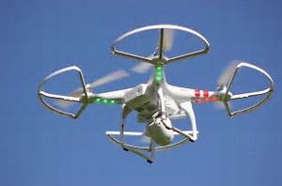
Artificial intelligence
In the twenty-first century, AI techniques, both hard (using a symbolic approach) and soft (sub-symbolic), have experienced a resurgence following concurrent advances in computer power, sizes of training sets, and theoretical understanding, and AI techniques have become an essential part of the technology industry, helping to solve many challenging problems in computer science. Recent advancements in AI, and specifically in machine learning, have contributed to the growth of Autonomous Things such as drones and self-driving cars, becoming the main driver of innovation in the automotive industry.

Slide 16
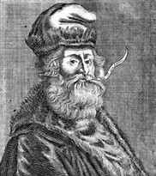
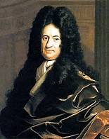
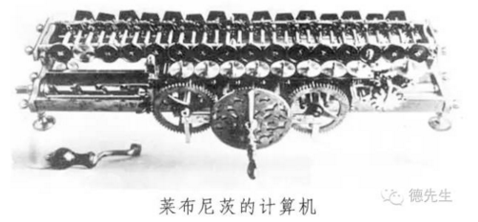

History
While thought-capable artificial beings appeared as storytelling devices in antiquity, the idea of actually trying to build a machine to perform useful reasoning may have begun with Ramon Llull (c. 1300 CE). With his Calculus ratiocinator, Gottfried Leibniz extended the concept of the calculating machine(Wilhelm Schickard engineered the first one around 1623), intending to perform operations on concepts rather than numbers. Since the 19th century, artificial beings are common in fiction, as in Mary Shelley's Frankenstein.

Slide 17
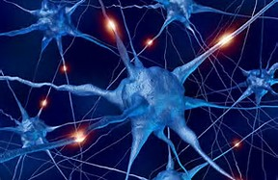
History
The study of mechanical or “formal” reasoning began with philosophers and mathematicians in antiquity. The study of mathematical logic led directly to Alan Turing‘s theory of computation, which suggested that a machine, by shuffling symbols as simple as “0” and “1”, could simulate any conceivable act of mathematical deduction. This insight, that digital computers can simulate any process of formal reasoning, is known as the Church–Turing thesis. Along with concurrent discoveries in neurology, information theory and cybernetics, this led researchers to consider the possibility of building an electronic brain. The first work that is now generally recognized as AI was McCullouch and Pitts’ 1943 formal design for Turing-complete “artificial neurons“.

Slide 18
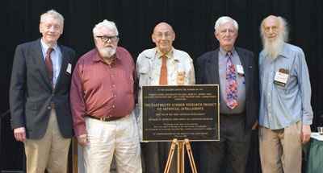
History
The field of AI research was born at a workshop at Dartmouth College in 1956. Attendees Allen Newell (CMU), Herbert Simon (CMU), John McCarthy (MIT), Marvin Minsky (MIT) and Arthur Samuel (IBM) became the founders and leaders of AI research. They and their students produced programs that the press described as "astonishing“: computers were winning at checkers, solving word problems in algebra, proving logical theorems and speaking English. By the middle of the 1960s, research in the U.S. was heavily funded by the Department of Defense and laboratories had been established around the world. AI's founders were optimistic about the future: Herbert Simon predicted, "machines will be capable, within twenty years, of doing any work a man can do". Marvin Minsky agreed, writing, "within a generation ... the problem of creating 'artificial intelligence' will substantially be solved".

Slide 19
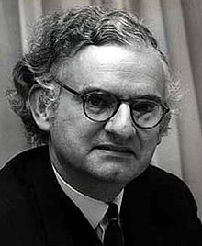
History
They failed to recognize the difficulty of some of the remaining tasks. Progress slowed and in 1974, in response to the criticism of Sir James Lighthill and ongoing pressure from the US Congress to fund more productive projects, both the U.S. and British governments cut off exploratory research in AI. The next few years would later be called an "AI winter“, a period when obtaining funding for AI projects was difficult.

Slide 20
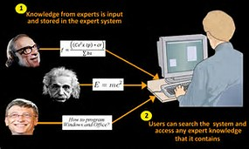
History
In the early 1980s, AI research was revived by the commercial success of expert systems, a form of AI program that simulated the knowledge and analytical skills of human experts. By 1985 the market for AI had reached over a billion dollars. At the same time, Japan's fifth generation computer project inspired the U.S and British governments to restore funding for academic research. However, beginning with the collapse of the Lisp Machine market in 1987, AI once again fell into disrepute, and a second, longer-lasting hiatus began.

Slide 21
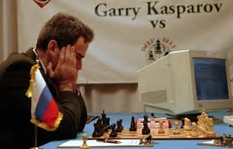
History
In the late 1990s and early 21st century, AI began to be used for logistics, data mining, medical diagnosis and other areas. The success was due to increasing computational power (see Moore's law), greater emphasis on solving specific problems, new ties between AI and other fields and a commitment by researchers to mathematical methods and scientific standards. Deep Blue became the first computer chess-playing system to beat a reigning world chess champion, Garry Kasparov on 11 May 1997.

Slide 22
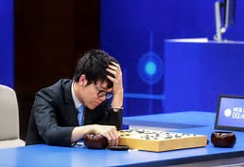
History
Advanced statistical techniques (loosely known as deep learning), access to large amounts of data and faster computers enabled advances in machine learning and perception. By the mid 2010s, machine learning applications were used throughout the world. In a Jeopardy! quiz show exhibition match, IBM‘s question answering system, Watson, defeated the two greatest Jeopardy champions, Brad Rutter and Ken Jennings, by a significant margin. In March 2016, AlphaGo won 4 out of 5 games of Go in a match with Go champion Lee Sedol, becoming the first computer Go-playing system to beat a professional Go player without handicaps. In the 2017 Future of Go Summit, AlphaGo won a three-game match with Ke Jie, who at the time continuously held the world No. 1 ranking for two years.

Slide 23

History
According to Bloomberg's Jack Clark, 2015 was a landmark year for artificial intelligence, with the number of software projects that use AI within Google increased from a "sporadic usage" in 2012 to more than 2,700 projects. Clark also presents factual data indicating that error rates in image processing tasks have fallen significantly since 2011. He attributes this to an increase in affordable neural networks, due to a rise in cloud computing infrastructure and to an increase in research tools and datasets. Other cited examples include Microsoft's development of a Skype system that can automatically translate from one language to another and Facebook's system that can describe images to blind people.

Slide 24
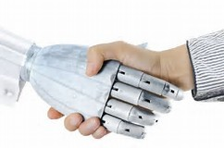
Goals
The overall research goal of artificial intelligence is to create technology that allows computers and machines to function in an intelligent manner. The general problem of simulating (or creating) intelligence has been broken down into sub-problems. These consist of particular traits or capabilities that researchers expect an intelligent system to display. The traits described below have received the most attention.

Slide 25
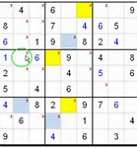
Reasoning, problem solving
Early researchers developed algorithms that imitated step-by-step reasoning that humans use when they solve puzzles or make logical deductions. By the late 1980s and 1990s, AI research had developed methods for dealing with uncertain or incomplete information, employing concepts from probability and economics.
For difficult problems, algorithms can require enormous computational resources—most experience a "combinatorial explosion": the amount of memory or computer time required becomes astronomical for problems of a certain size. The search for more efficient problem-solving algorithms is a high priority.

Slide 26
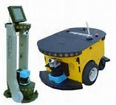
Reasoning, problem solving
Human beings ordinarily use fast, intuitive judgments rather than step-by-step deduction that early AI research was able to model. AI has progressed using "sub-symbolic" problem solving: embodied agent approaches emphasize the importance of sensorimotor skills to higher reasoning; neural net research attempts to simulate the structures inside the brain that give rise to this skill; statistical approaches to AI mimic the human ability to guess.

Slide 27
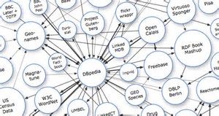
Knowledge representation
Knowledge representation and knowledge engineering are central to AI research. Many of the problems machines are expected to solve will require extensive knowledge about the world. Among the things that AI needs to represent are: objects, properties, categories and relations between objects; situations, events, states and time; causes and effects; knowledge about knowledge (what we know about what other people know); and many other, less well researched domains.

Slide 28
Knowledge representation
A representation of "what exists" is an ontology: the set of objects, relations, concepts, and properties formally described so that software agents can interpret them. The semantics of these are captured as description logic concepts, roles, and individuals, and typically implemented as classes, properties, and individuals in the Web Ontology Language. The most general ontologies are called upper ontologies, which attempt to provide a foundation for all other knowledge by acting as mediators between domain ontologies that cover specific knowledge about a particular knowledge domain. Such formal knowledge representations are suitable for content-based indexing and retrieval, scene interpretation, clinical decision support, knowledge discovery via automated reasoning, etc. Video events are often represented as SWRL rules, which can be used, among others, to automatically generate subtitles for constrained videos.

Slide 29
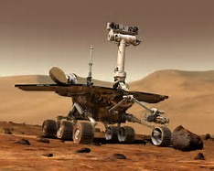
Planning
Intelligent agents must be able to set goals and achieve them. They need a way to visualize the future—a representation of the state of the world and be able to make predictions about how their actions will change it—and be able to make choices that maximize the utility (or "value") of available choices.
In classical planning of problems, the agent can assume that it is the only system acting in the world, allowing the agent to be certain of the consequences of its actions. However, if the agent is not the only actor, then it requires that the agent can reason under uncertainty. This calls for an agent that can not only assess its environment and make predictions, but also evaluate its predictions and adapt based on its assessment.

Slide 30
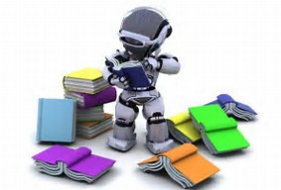
Learning
Machine learning, a fundamental concept of AI research since the field's inception, is the study of computer algorithms that improve automatically through experience.
Unsupervised learning is the ability to find patterns in a stream of input. Supervised learning includes both classification and numerical regression. Classification is used to determine what category something belongs in, after seeing a number of examples of things from several categories. Regression is the attempt to produce a function that describes the relationship between inputs and outputs and predicts how the outputs should change as the inputs change.

Slide 31
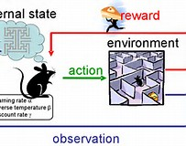
Learning
In reinforcement learning the agent is rewarded for good responses and punished for bad ones. The agent uses this sequence of rewards and punishments to form a strategy for operating in its problem space. These three types of learning can be analyzed in terms of decision theory, using concepts like utility. The mathematical analysis of machine learning algorithms and their performance is a branch of theoretical computer science known as computational learning theory.
Within developmental robotics, developmental learning approaches are elaborated upon to allow robots to accumulate repertoires of novel skills through autonomous self-exploration, social interaction with human teachers, and the use of guidance mechanisms (active learning, maturation, motor synergies, etc.).

Slide 32
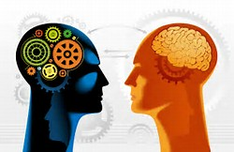
Natural language processing
Natural language processing gives machines the ability to read and understand human language. A sufficiently powerful natural language processing system would enable natural language user interfaces and the acquisition of knowledge directly from human-written sources, such as newswire texts. Some straightforward applications of natural language processing include information retrieval, text mining, question answering and machine translation.
A common method of processing and extracting meaning from natural language is through semantic indexing. Although these indexes require a large volume of user input, it is expected that increases in processor speeds and decreases in data storage costs will result in greater efficiency.

Slide 33
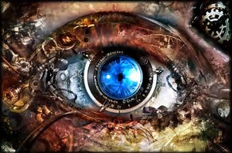
Perception
Machine perception is the ability to use input from sensors (such as cameras, microphones, tactile sensors, sonar and others) to deduce aspects of the world.
Computer vision is the ability to analyze visual input. A few selected subproblems are speech recognition, facial recognition and object recognition.

Slide 34
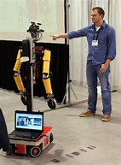
Motion and manipulation
The field of robotics is closely related to AI. Intelligence is required for robots to handle tasks such as object manipulation and navigation, with sub-problems such as localization, mapping, and motion planning. These systems require that an agent is able to: Be spatially cognizant of its surroundings, learn from and build a map of its environment, figure out how to get from one point in space to another, and execute that movement (which often involves compliant motion, a process where movement requires maintaining physical contact with an object).

Slide 35

Social intelligence
Affective computing is the study and development of systems that can recognize, interpret, process, and simulate human affects. It is an interdisciplinary field spanning computer sciences, psychology, and cognitive science. While the origins of the field may be traced as far back as the early philosophical inquiries into emotion, the more modern branch of computer science originated with Rosalind Picard's 1995 paper on "affective computing“. A motivation for the research is the ability to simulate empathy, where the machine would be able to interpret human emotions and adapts its behavior to give an appropriate response to those emotions.

Slide 36
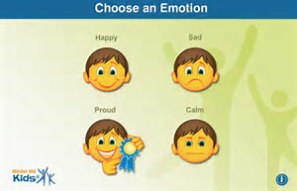
Social intelligence
Emotion and social skills are important to an intelligent agent for two reasons. First, being able to predict the actions of others by understanding their motives and emotional states allow an agent to make better decisions. Concepts such as game theory, decision theory, necessitate that an agent be able to detect and model human emotions. Second, in an effort to facilitate human-computer interaction, an intelligent machine may want to display emotions (even if it does not experience those emotions itself) to appear more sensitive to the emotional dynamics of human interaction.

Slide 37
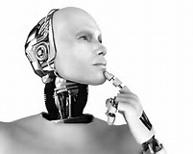
General intelligence
Many researchers think that their work will eventually be incorporated into a machine with artificial general intelligence, combining all the skills mentioned above and even exceeding human ability in most or all these areas. A few believe that anthropomorphic features like artificial consciousness or an artificial brain may be required for such a project.

Slide 38
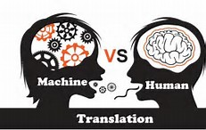
General intelligence
Many of the problems above also require that general intelligence be solved. For example, even specific straightforward tasks, like machine translation, require that a machine read and write in both languages (NLP), follow the author's argument (reason), know what is being talked about (knowledge), and faithfully reproduce the author's original intent (social intelligence). A problem like machine translation is considered "AI-complete", but all of these problems need to be solved simultaneously in order to reach human-level machine performance.

Slide 39
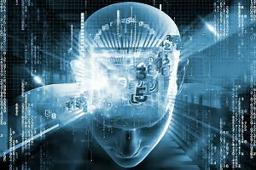
Approaches
There is no established unifying theory or paradigm that guides AI research. Researchers disagree about many issues. A few of the most long standing questions that have remained unanswered are these: should artificial intelligence simulate natural intelligence by studying psychology or neurology? Or is human biology as irrelevant to AI research as bird biology is to aeronautical engineering? Can intelligent behavior be described using simple, elegant principles? Or does it necessarily require solving a large number of completely unrelated problems? Can intelligence be reproduced using high-level symbols, similar to words and ideas? Or does it require "sub-symbolic" processing? John Haugeland, who coined the term GOFAI (Good Old-Fashioned Artificial Intelligence), also proposed that AI should more properly be referred to as synthetic intelligence, a term which has since been adopted by some non-GOFAI researchers.

Slide 40
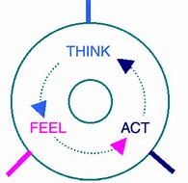
Approaches
Stuart Shapiro divides AI research into three approaches, which he calls computational psychology, computational philosophy, and computer science. Computational psychology is used to make computer programs that mimic human behavior. Computational philosophy, is used to develop an adaptive, free-flowing computer mind. Implementing computer science serves the goal of creating computers that can perform tasks that only people could previously accomplish. Together, the humanesque behavior, mind, and actions make up artificial intelligence.

Slide 41
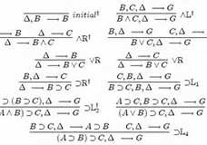
Symbolic
When access to digital computers became possible in the middle 1950s, AI research began to explore the possibility that human intelligence could be reduced to symbol manipulation. The research was centered in three institutions: Carnegie Mellon University, Stanford and MIT, and each one developed its own style of research. John Haugeland named these approaches to AI "good old fashioned AI" or "GOFAI“. During the 1960s, symbolic approaches had achieved great success at simulating high-level thinking in small demonstration programs. Approaches based on cybernetics or neural networks were abandoned or pushed into the background. Researchers in the 1960s and the 1970s were convinced that symbolic approaches would eventually succeed in creating a machine with artificial general intelligence and considered this the goal of their field.

Slide 42
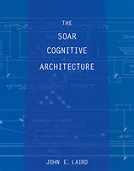
Cognitive simulation
Economist Herbert Simon and Allen Newell studied human problem-solving skills and attempted to formalize them, and their work laid the foundations of the field of artificial intelligence, as well as cognitive science, operations research and management science. Their research team used the results of psychological experiments to develop programs that simulated the techniques that people used to solve problems. This tradition, centered at Carnegie Mellon University would eventually culminate in the development of the Soar architecture in the middle 1980s.

Slide 43
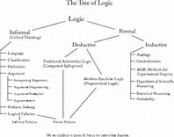
Logic-based
Unlike Newell and Simon, John McCarthy felt that machines did not need to simulate human thought, but should instead try to find the essence of abstract reasoning and problem solving, regardless of whether people used the same algorithms. His laboratory at Stanford (SAIL) focused on using formal logic to solve a wide variety of problems, including knowledge representation, planning and learning. Logic was also the focus of the work at the University of Edinburgh and elsewhere in Europe which led to the development of the programming language Prolog and the science of logic programming.

Slide 44

Anti-logic or scruffy
Researchers at MIT (such as Marvin Minsky and Seymour Papert) found that solving difficult problems in vision and natural language processing required ad-hoc solutions – they argued that there was no simple and general principle (like logic) that would capture all the aspects of intelligent behavior. Roger Schank described their "anti-logic" approaches as "scruffy" (as opposed to the "neat" paradigms at CMU and Stanford). Commonsense knowledge bases (such as Doug Lenat's Cyc) are an example of "scruffy" AI, since they must be built by hand, one complicated concept at a time.

Slide 45
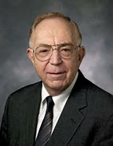
Knowledge-based
When computers with large memories became available around 1970, researchers from all three traditions began to build knowledge into AI applications. This "knowledge revolution" led to the development and deployment of expert systems (introduced by Edward Feigenbaum), the first truly successful form of AI software. The knowledge revolution was also driven by the realization that enormous amounts of knowledge would be required by many simple AI applications.

Slide 46
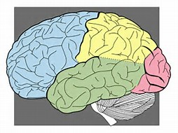
Sub-symbolic
By the 1980s progress in symbolic AI seemed to stall and many believed that symbolic systems would never be able to imitate all the processes of human cognition, especially perception, robotics, learning and pattern recognition. A number of researchers began to look into "sub-symbolic" approaches to specific AI problems. Sub-symbolic methods manage to approach intelligence without specific representations of knowledge.

Slide 47
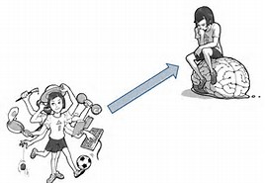
Embodied intelligence
This includes embodied, situated, behavior-based, and nouvelle AI. Researchers from the related field of robotics, such as Rodney Brooks, rejected symbolic AI and focused on the basic engineering problems that would allow robots to move and survive. Their work revived the non-symbolic viewpoint of the early cybernetics researchers of the 1950s and reintroduced the use of control theory in AI. This coincided with the development of the embodied mind thesis in the related field of cognitive science: the idea that aspects of the body (such as movement, perception and visualization) are required for higher intelligence.

Slide 48
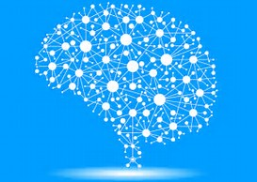
Computational intelligence and soft computing
Interest in neural networks and "connectionism" was revived by David Rumelhart and others in the middle of 1980s. Neural networks are an example of soft computing --- they are solutions to problems which cannot be solved with complete logical certainty, and where an approximate solution is often sufficient. Other soft computing approaches to AI include fuzzy systems, evolutionary computation and many statistical tools. The application of soft computing to AI is studied collectively by the emerging discipline of computational intelligence.

Slide 49

Machine learning and statistics
In the 1990s, AI researchers developed sophisticated mathematical tools to solve specific subproblems. These tools are truly scientific, in the sense that their results are both measurable and verifiable, and they have been responsible for many of AI's recent successes. The shared mathematical language has also permitted a high level of collaboration with more established fields (like mathematics, economics or operations research). Stuart Russell and Peter Norvig describe this movement as nothing less than a "revolution" and "the victory of the neats“. Critics argue that these techniques (with few exceptions) are too focused on particular problems and have failed to address the long-term goal of general intelligence. There is an ongoing debate about the relevance and validity of statistical approaches in AI, exemplified in part by exchanges between Peter Norvig and Noam Chomsky.

Slide 50
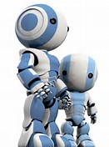
Intelligent agent paradigm
An intelligent agent is a system that perceives its environment and takes actions which maximize its chances of success. The simplest intelligent agents are programs that solve specific problems. More complicated agents include human beings and organizations of human beings (such as firms). The paradigm gives researchers license to study isolated problems and find solutions that are both verifiable and useful, without agreeing on one single approach. An agent that solves a specific problem can use any approach that works – some agents are symbolic and logical, some are sub-symbolic neural networks and others may use new approaches. The paradigm also gives researchers a common language to communicate with other fields—such as decision theory and economics—that also use concepts of abstract agents. The intelligent agent paradigm became widely accepted during the 1990s.

Slide 51

Agent architectures and cognitive architectures
Researchers have designed systems to build intelligent systems out of interacting intelligent agents in a multi-agent system. A system with both symbolic and sub-symbolic components is a hybrid intelligent system, and the study of such systems is artificial intelligence systems integration. A hierarchical control system provides a bridge between sub-symbolic AI at its lowest, reactive levels and traditional symbolic AI at its highest levels, where relaxed time constraints permit planning and world modeling. Rodney Brooks' subsumption architecture was an early proposal for such a hierarchical system.

Slide 52

Tools
In the course of 60+ years of research, AI has developed a large number of tools to solve the most difficult problems in computer science. A few of the most general of these methods are discussed below.

Slide 53

Search and optimization
Many problems in AI can be solved in theory by intelligently searching through many possible solutions: Reasoning can be reduced to performing a search. For example, logical proof can be viewed as searching for a path that leads from premises to conclusions, where each step is the application of an inference rule. Planning algorithms search through trees of goals and subgoals, attempting to find a path to a target goal, a process called means-ends analysis. Robotics algorithms for moving limbs and grasping objects use local searches in configuration space. Many learning algorithms use search algorithms based on optimization.

Slide 54
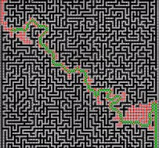
Search and optimization
Simple exhaustive searches are rarely sufficient for most real world problems: the search space (the number of places to search) quickly grows to astronomical numbers. The result is a search that is too slow or never completes. The solution, for many problems, is to use "heuristics" or "rules of thumb" that eliminate choices that are unlikely to lead to the goal (called "pruning the search tree"). Heuristics supply the program with a "best guess" for the path on which the solution lies. Heuristics limit the search for solutions into a smaller sample size.

Slide 55
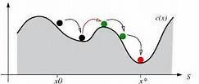
Search and optimization
A very different kind of search came to prominence in the 1990s, based on the mathematical theory of optimization. For many problems, it is possible to begin the search with some form of a guess and then refine the guess incrementally until no more refinements can be made. These algorithms can be visualized as blind hill climbing: we begin the search at a random point on the landscape, and then, by jumps or steps, we keep moving our guess uphill, until we reach the top. Other optimization algorithms are simulated annealing, beam search and random optimization.

Slide 56
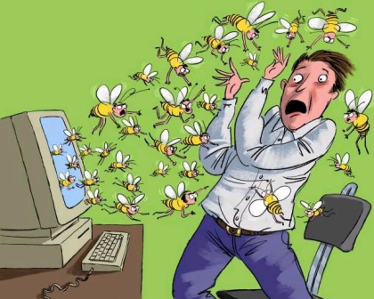
Search and optimization
Evolutionary computation uses a form of optimization search. For example, they may begin with a population of organisms (the guesses) and then allow them to mutate and recombine, selecting only the fittest to survive each generation (refining the guesses). Forms of evolutionary computation include swarm intelligence algorithms (such as ant colony or particle swarm optimization) and evolutionary algorithms (such as genetic algorithms, gene expression programming, and genetic programming).

Slide 57

Logic
Logic is used for knowledge representation and problem solving, but it can be applied to other problems as well. For example, the satplan algorithm uses logic for planning and inductive logic programming is a method for learning.
Several different forms of logic are used in AI research. Propositional or sentential logic is the logic of statements which can be true or false. First-order logic also allows the use of quantifiers and predicates, and can express facts about objects, their properties, and their relations with each other. Fuzzy logic, is a version of first-order logic which allows the truth of a statement to be represented as a value between 0 and 1, rather than simply True (1) or False (0). Fuzzy systems can be used for uncertain reasoning and have been widely used in modern industrial and consumer product control systems.

Slide 58
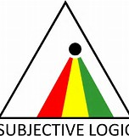
Logic
Subjective logic models uncertainty in a different and more explicit manner than fuzzy-logic: a given binomial opinion satisfies belief + disbelief + uncertainty = 1 within a Beta distribution. By this method, ignorance can be distinguished from probabilistic statements that an agent makes with high confidence.
Default logics, non-monotonic logics and circumscription are forms of logic designed to help with default reasoning and the qualification problem. Several extensions of logic have been designed to handle specific domains of knowledge, such as: description logics; situation calculus, event calculus and fluent calculus (for representing events and time); causal calculus; belief calculus; and modal logics.

Slide 59

Probabilistic methods for uncertain reasoning
Many problems in AI (in reasoning, planning, learning, perception and robotics) require the agent to operate with incomplete or uncertain information. AI researchers have devised a number of powerful tools to solve these problems using methods from probability theory and economics.
Bayesian networks are a very general tool that can be used for a large number of problems: reasoning (using the Bayesian inference algorithm), learning (using the expectation-maximization algorithm), planning (using decision networks) and perception (using dynamic Bayesian networks). Probabilistic algorithms can also be used for filtering, prediction, smoothing and finding explanations for streams of data, helping perception systems to analyze processes that occur over time (e.g., hidden Markov models or Kalman filters).

Slide 60
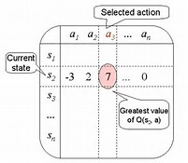
Probabilistic methods for uncertain reasoning
A key concept from the science of economics is "utility": a measure of how valuable something is to an intelligent agent. Precise mathematical tools have been developed that analyze how an agent can make choices and plan, using decision theory, decision analysis, and information value theory. These tools include models such as Markov decision processes, dynamic decision networks, game theory and mechanism design.

Slide 61

Classifiers and statistical learning method
The simplest AI applications can be divided into two types: classifiers ("if shiny then diamond") and controllers ("if shiny then pick up"). Controllers do, however, also classify conditions before inferring actions, and therefore classification forms a central part of many AI systems. Classifiers are functions that use pattern matching to determine a closest match. They can be tuned according to examples, making them very attractive for use in AI. These examples are known as observations or patterns. In supervised learning, each pattern belongs to a certain predefined class. A class can be seen as a decision that has to be made. All the observations combined with their class labels are known as a data set. When a new observation is received, that observation is classified based on previous experience.

Slide 62
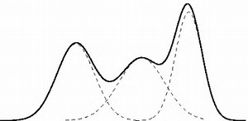
Classifiers and statistical learning method
A classifier can be trained in various ways; there are many statistical and machine learning approaches. The most widely used classifiers are the neural network, kernel methods such as the support vector machine, k-nearest neighbor algorithm, Gaussian mixture model, naive Bayes classifier, and decision tree. The performance of these classifiers have been compared over a wide range of tasks. Classifier performance depends greatly on the characteristics of the data to be classified. There is no single classifier that works best on all given problems; this is also referred to as the "no free lunch" theorem. Determining a suitable classifier for a given problem is still more an art than science.

Slide 63
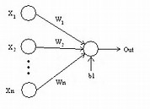
Neural networks
The study of non-learning artificial neural networks began in the decade before the field of AI research was founded, in the work of Walter Pitts and Warren McCullouch. Frank Rosenblatt invented the perceptron, a learning network with a single layer, similar to the old concept of linear regression. Early pioneers also include Alexey Grigorevich Ivakhnenko, Teuvo Kohonen, Stephen Grossberg, Kunihiko Fukushima, Christoph von der Malsburg, David Willshaw, Shun-Ichi Amari, Bernard Widrow, John Hopfield, Eduardo R. Caianiello, and others.

Slide 64

Neural networks
The main categories of networks are acyclic or feedforward neural networks (where the signal passes in only one direction) and recurrent neural networks (which allow feedback and short-term memories of previous input events). Among the most popular feedforward networks are perceptrons, multi-layer perceptrons and radial basis networks. Neural networks can be applied to the problem of intelligent control (for robotics) or learning, using such techniques as Hebbian learning, GMDH or competitive learning.
Today, neural networks are often trained by the backpropagation algorithm, which had been around since 1970 as the reverse mode of automatic differentiation published by Seppo Linnainmaa, and was introduced to neural networks by Paul Werbos.

Slide 65

Deep feedforward neural networks
Deep learning in artificial neural networks with many layers has transformed many important subfields of artificial intelligence, including computer vision, speech recognition, natural language processing and others.
According to a survey, the expression "Deep Learning" was introduced to the Machine Learning community by Rina Dechter in 1986 and gained traction after Igor Aizenberg and colleagues introduced it to Artificial Neural Networks in 2000. The first functional Deep Learning networks were published by Alexey Grigorevich Ivakhnenko and V. G. Lapa in 1965. These networks are trained one layer at a time. Ivakhnenko's 1971 paper describes the learning of a deep feedforward multilayer perceptron with eight layers, already much deeper than many later networks.

Slide 66

Deep feedforward neural networks
In 2006, a publication by Geoffrey Hinton and Ruslan Salakhutdinov introduced another way of pre-training many-layered feedforward neural networks (FNNs) one layer at a time, treating each layer in turn as an unsupervised restricted Boltzmann machine, then using supervised backpropagation for fine-tuning. Similar to shallow artificial neural networks, deep neural networks can model complex non-linear relationships. Over the last few years, advances in both machine learning algorithms and computer hardware have led to more efficient methods for training deep neural networks that contain many layers of non-linear hidden units and a very large output layer.

Slide 67

Deep feedforward neural networks
Deep learning often uses convolutional neural networks (CNNs), whose origins can be traced back to the Neocognitron introduced by Kunihiko Fukushima in 1980. In 1989, Yann LeCun and colleagues applied backpropagation to such an architecture. In the early 2000s, in an industrial application CNNs already processed an estimated 10% to 20% of all the checks written in the US. Since 2011, fast implementations of CNNs on GPUs have won many visual pattern recognition competitions.
Deep feedforward neural networks were used in conjunction with reinforcement learning by AlphaGo, Google Deepmind's program that was the first to beat a professional human Go player

Slide 68

Deep recurrent neural networks
Early on, deep learning was also applied to sequence learning with recurrent neural networks (RNNs) which are general computers and can run arbitrary programs to process arbitrary sequences of inputs. The depth of an RNN is unlimited and depends on the length of its input sequence. RNNs can be trained by gradient descent but suffer from the vanishing gradient problem. In 1992, it was shown that unsupervised pre-training of a stack of recurrent neural networks can speed up subsequent supervised learning of deep sequential problems.

Slide 69

Deep recurrent neural networks
Numerous researchers now use variants of a deep learning recurrent NN called the long short-term memory (LSTM) network published by Hochreiter & Schmidhuber in 1997. LSTM is often trained by Connectionist Temporal Classification (CTC). At Google, Microsoft and Baidu this approach has revolutionised speech recognition. For example, in 2015, Google's speech recognition experienced a dramatic performance jump of 49% through CTC-trained LSTM, which is now available through Google Voice to billions of smartphone users. Google also used LSTM to improve machine translation, Language Modeling and Multilingual Language Processing. LSTM combined with CNNs also improved automatic image captioning and a plethora of other applications.

Slide 70

Evaluating progress
In 1950, Alan Turing proposed a general procedure to test the intelligence of an agent now known as the Turing test. This procedure allows almost all the major problems of artificial intelligence to be tested. However, it is a very difficult challenge and at present all agents fail.
Artificial intelligence can also be evaluated on specific problems such as small problems in chemistry, hand-writing recognition and game-playing. Such tests have been termed subject matter expert Turing tests. Smaller problems provide more achievable goals and there are an ever-increasing number of positive results.

Slide 71

Evaluating progress
For example, performance at draughts (i.e. checkers) is optimal, performance at chess is high-human and nearing super-human (see computer chess: computers versus human) and performance at many everyday tasks (such as recognizing a face or crossing a room without bumping into something) is sub-human.
A quite different approach measures machine intelligence through tests which are developed from mathematical definitions of intelligence. Examples of these kinds of tests start in the late nineties devising intelligence tests using notions from Kolmogorov complexity and data compression. Two major advantages of mathematical definitions are their applicability to nonhuman intelligences and their absence of a requirement for human testers.

Slide 72

Evaluating progress
A derivative of the Turing test is the Completely Automated Public Turing test to tell Computers and Humans Apart (CAPTCHA). As the name implies, this helps to determine that a user is an actual person and not a computer posing as a human. In contrast to the standard Turing test, CAPTCHA administered by a machine and targeted to a human as opposed to being administered by a human and targeted to a machine. A computer asks a user to complete a simple test then generates a grade for that test. Computers are unable to solve the problem, so correct solutions are deemed to be the result of a person taking the test. A common type of CAPTCHA is the test that requires the typing of distorted letters, numbers or symbols that appear in an image undecipherable by a computer.

Slide 73

Applications
AI is relevant to any intellectual task. Modern artificial intelligence techniques are pervasive and are too numerous to list here. Frequently, when a technique reaches mainstream use, it is no longer considered artificial intelligence; this phenomenon is described as the AI effect.
High-profile examples of AI include autonomous vehicles (such as drones and self-driving cars), medical diagnosis, creating art (such as poetry), proving mathematical theorems, playing games (such as Chess or Go), search engines (such as Google search), online assistants (such as Siri), image recognition in photographs, spam filtering, prediction of judicial decisions and targeting online advertisements.

Slide 74

Healthcare
Artificial intelligence is breaking into the healthcare industry by assisting doctors. According to Bloomberg Technology, Microsoft has developed AI to help doctors find the right treatments for cancer. There is a great amount of research and drugs developed relating to cancer. In detail, there are more than 800 medicines and vaccines to treat cancer. This negatively affects the doctors, because there are way too many options to choose from, making it more difficult to choose the right drugs for the patients. Microsoft is working on a project to develop a machine called "Hanover". Its goal is to memorize all the papers necessary to cancer and help predict which combinations of drugs will be most effective for each patient. One project that is being worked on at the moment is fighting myeloid leukemia, a fatal cancer where the treatment has not improved in decades.

Slide 75

Healthcare
Another study was reported to have found that artificial intelligence was as good as trained doctors in identifying skin cancers. Another study is using artificial intelligence to try and monitor multiple high-risk patients, and this is done by asking each patient numerous questions based on data acquired from live doctor to patient interactions.
According to CNN, there was a recent study by surgeons at the Children's National Medical Center in Washington which successfully demonstrated surgery with an autonomous robot. The team supervised the robot while it performed soft-tissue surgery, stitching together a pig's bowel during open surgery, and doing so better than a human surgeon, the team claimed.

Slide 76

Automotive
Advancements in AI have contributed to the growth of the automotive industry through the creation and evolution of self-driving vehicles. As of 2016, there are over 30 companies utilizing AI into the creation of driverless cars. A few companies involved with AI include Tesla, Google, and Apple.
Many components contribute to the functioning of self-driving cars. These vehicles incorporate systems such as braking, lane changing, collision prevention, navigation and mapping. Together, these systems, as well as high performance computers are integrated into one complex vehicle

Slide 77

Automotive
One main factor that influences the ability for a driver-less car to function is mapping. In general, the vehicle would be pre-programmed with a map of the area being driven. This map would include data on the approximations of street light and curb heights in order for the vehicle to be aware of its surroundings. However, Google has been working on an algorithm with the purpose of eliminating the need for pre-programmed maps and instead, creating a device that would be able to adjust to a variety of new surroundings. Some self-driving cars are not equipped with steering wheels or brakes, so there has also been research focused on creating an algorithm that is capable of maintaining a safe environment for the passengers in the vehicle through awareness of speed and driving conditions.

Slide 78

Finance
Financial institutions have long used artificial neural network systems to detect charges or claims outside of the norm, flagging these for human investigation.
Use of AI in banking can be tracked back to 1987 when Security Pacific National Bank in USA set-up a Fraud Prevention Task force to counter the unauthorised use of debit cards. Apps like Kasisito and Moneystream are using AI in financial services

Slide 79

Finance
Banks use artificial intelligence systems to organize operations, maintain book-keeping, invest in stocks, and manage properties. AI can react to changes overnight or when business is not taking place. In August 2001, robots beat humans in a simulated financial trading competition.
AI has also reduced fraud and crime by monitoring behavioral patterns of users for any changes or anomalies.

