Slide 1
Hands-On Machine Learning with Scikit-Learn and TensorFlow
Concepts, Tools, and Techniques to Build Intelligent Systems

Slide 2
Organization
This book is organized in two parts.
Part I：The Fundamentals of Machine Learning,
Part II：Neural Networks and Deep Learning,

Slide 3
Part I
• What is Machine Learning? What are the main categories and fundamental concepts of Machine Learning systems?
• The main steps in a typical Machine Learning project.
• Learning by fitting a model to data.
• Optimizing a cost function.
• Handling, cleaning, and preparing data.
• Selecting and engineering features.
• Selecting a model and tuning hyperparameters using cross-validation.
• The main challenges of Machine Learning, in particular underfitting and overfitting (the bias/variance tradeoff).
• Reducing the dimensionality of the training data to fight the curse of dimensionality.
• The most common learning algorithms: Linear and Polynomial Regression, Logistic Regression, k-Nearest Neighbors, Support Vector Machines, Decision Trees, Random Forests, and Ensemble methods.

Slide 4
Part II
• What are neural nets? What are they good for?
• Building and training neural nets using TensorFlow.
• The most important neural net architectures: feedforward neural nets, convolutional nets, recurrent nets, long short-term memory (LSTM) nets, and autoencoders.
• Techniques for training deep neural nets.
• Scaling neural networks for huge datasets.
• Reinforcement learning.

Slide 5
CHAPTER 1 The Machine Learning Landscape
Machine Learning is the science (and art) of programming computers so they can learn from data.
Here is a slightly more general definition:
[Machine Learning is the] field of study that gives computers the ability to learn without being explicitly programmed. —Arthur Samuel, 1959

Slide 6
CHAPTER 1
For example, your spam filter is a Machine Learning program that can learn to flag spam given examples of spam emails and examples of regular emails. The examples that the system uses to learn are called the training set. Each training example is called a training instance (or sample). In this case, the task T is to flag spam for new emails, the experience E is the training data, and the performance measure P needs to be defined; for example, you can use the ratio of correctly classified emails. This performance measure is called accuracy and it is often used in classification tasks.

Slide 7
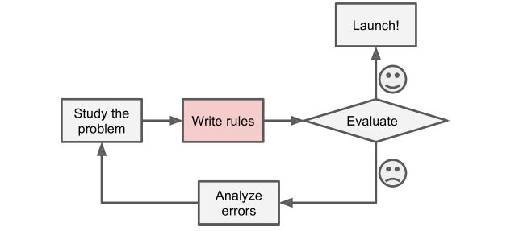
CHAPTER 1
Traditional methods

Slide 8
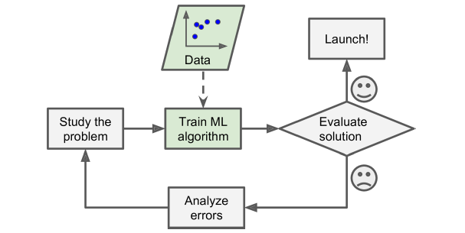
CHAPTER 1
Machine learning methods

Slide 9
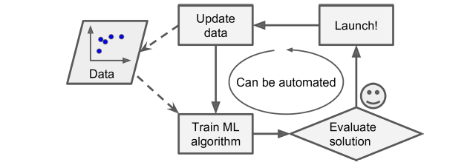
CHAPTER 1
Machine learning methods (adapting to change)

Slide 10
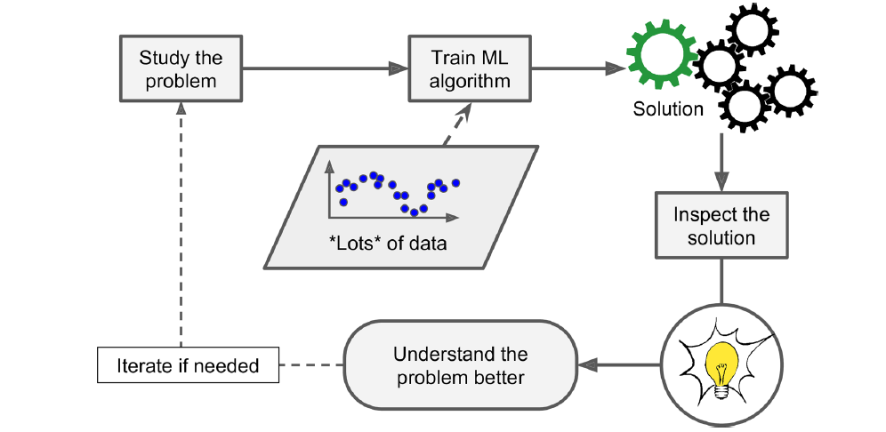
CHAPTER 1
Machine learning methods (help people learn)

Slide 11
CHAPTER 1
To summarize, Machine Learning is great for:
Problems for which existing solutions require a lot of hand-tuning or long lists of rules: one Machine Learning algorithm can often simplify code and perform better.
Complex problems for which there is no good solution at all using a traditional approach: the best Machine Learning techniques can find a solution.
Fluctuating environments: a Machine Learning system can adapt to new data.
Getting insights about complex problems and large amounts of data.

Slide 12
Types of Machine Learning Systems
Whether or not they are trained with human supervision (supervised, unsupervised, semisupervised, and Reinforcement Learning)
Whether or not they can learn incrementally on the fly (online versus batch learning)
Whether they work by simply comparing new data points to known data points, or instead detect patterns in the training data and build a predictive model, much like scientists do (instance-based versus model-based learning)

Slide 13
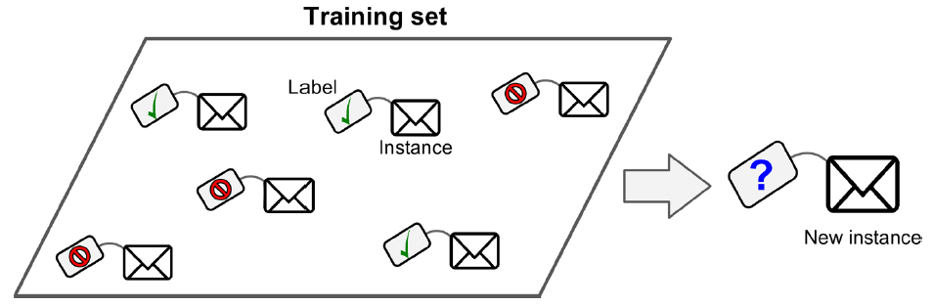
Supervised/Unsupervised Learning
Supervised learning (classification)

Slide 14
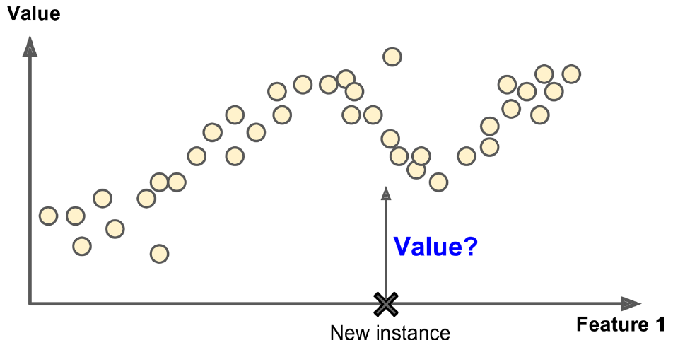
Supervised/Unsupervised Learning
Supervised learning (regression)

Slide 15
Supervised/Unsupervised Learning
Some of the supervised learning algorithms
k-Nearest Neighbors
Linear Regression
Logistic Regression
Support Vector Machines (SVMs)
Decision Trees and Random Forests
Neural networks

Slide 16
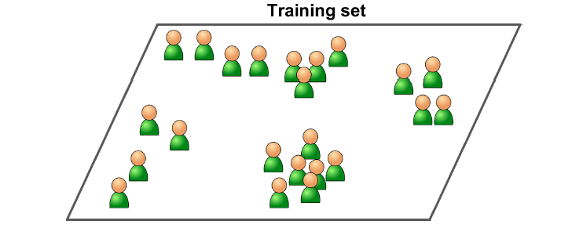
Supervised/Unsupervised Learning
Unsupervised learning (classification)

Slide 17
Supervised/Unsupervised Learning
Some of the unsupervised learning algorithms
Clustering
k-Means
Hierarchical Cluster Analysis (HCA)
Expectation Maximization
Visualization and dimensionality reduction
Principal Component Analysis (PCA)
Kernel PCA
Locally-Linear Embedding (LLE)
t-distributed Stochastic Neighbor Embedding (t-SNE)
Association rule learning
Apriori
Eclat

Slide 18
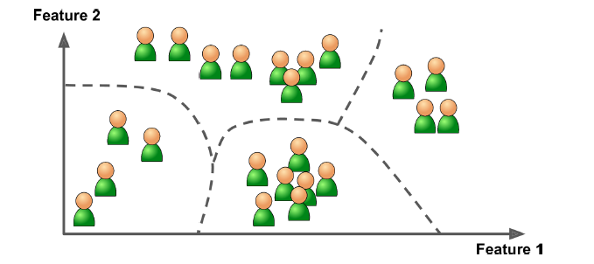
Supervised/Unsupervised Learning
Clustering

Slide 19
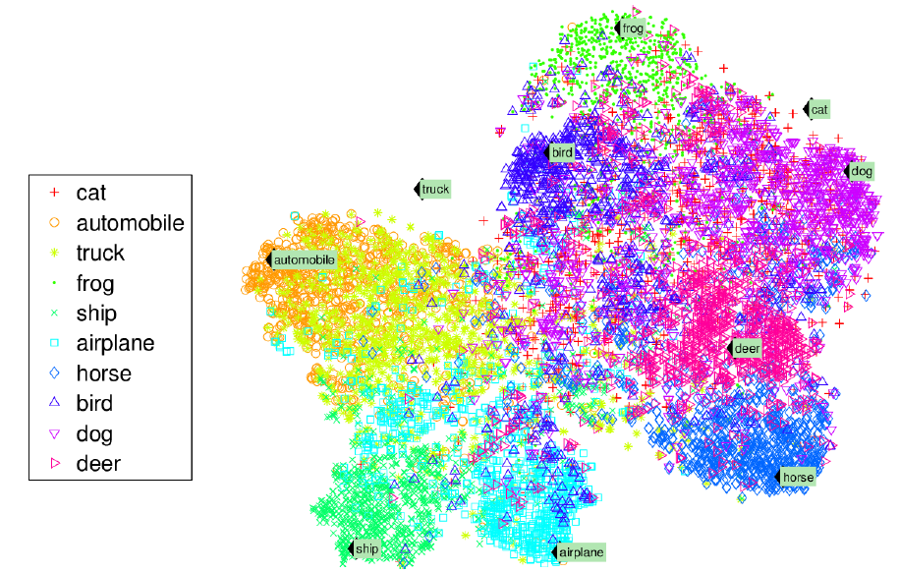
Supervised/Unsupervised Learning
Visualization

Slide 20
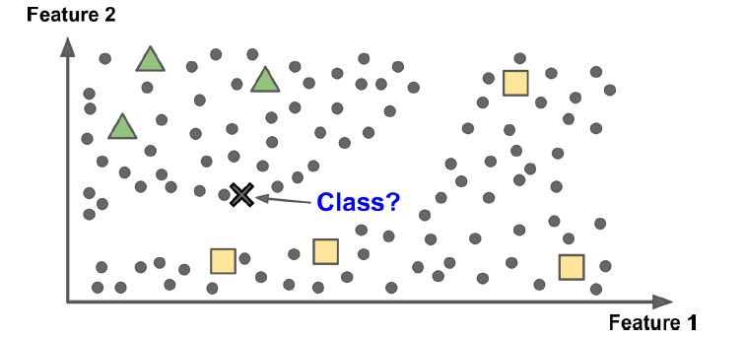
Semisupervised learning

Slide 21
Reinforcement Learning
The learning system, called an agent, can observe the environment, select and perform actions, and get rewards in return (or penalties in the form of negative rewards). It must then learn by itself what is the best strategy, called a policy, to get the most reward over time. A policy defines what action the agent should choose when it is in a given situation.

Slide 22
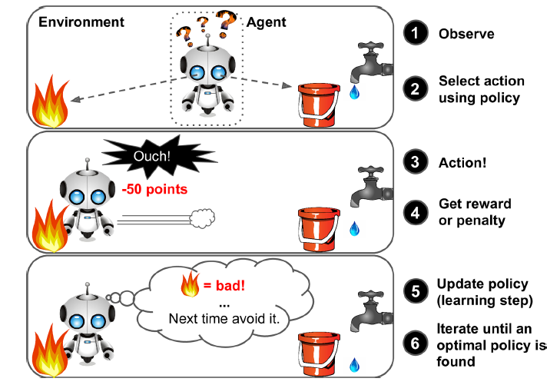
Reinforcement Learning
The learning system, called an agent, can observe the environment, select and perform actions, and get rewards in return (or penalties in the form of negative rewards). It must then learn by itself what is the best strategy, called a policy, to get the most reward over time. A policy defines what action the agent should choose when it is in a given situation.

Slide 23
Batch and Online Learning
Batch learning
In batch learning, the system is incapable of learning incrementally: it must be trained using all the available data. This will generally take a lot of time and computing resources, so it is typically done offline. First the system is trained, and then it is launched into production and runs without learning anymore; it just applies what it has learned. This is called offline learning.

Slide 24
Batch and Online Learning
Online learning
In online learning, you train the system incrementally by feeding it data instances sequentially, either individually or by small groups called mini-batches. Each learning step is fast and cheap, so the system can learn about new data on the fly, as it arrives.

Slide 25
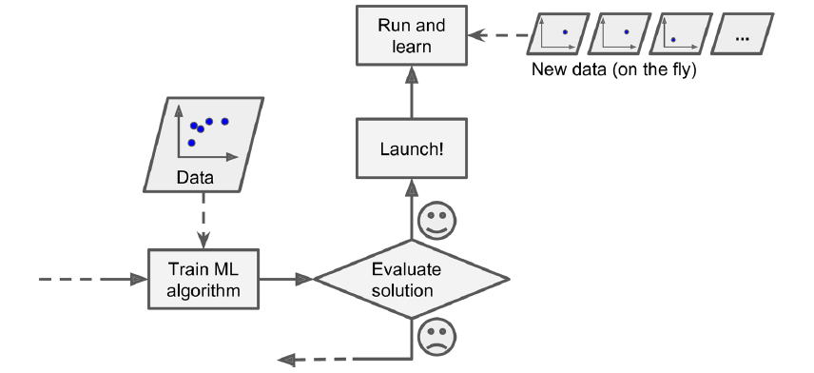
Batch and Online Learning
Online learning
In online learning, you train the system incrementally by feeding it data instances sequentially, either individually or by small groups called mini-batches. Each learning step is fast and cheap, so the system can learn about new data on the fly, as it arrives.

Slide 26
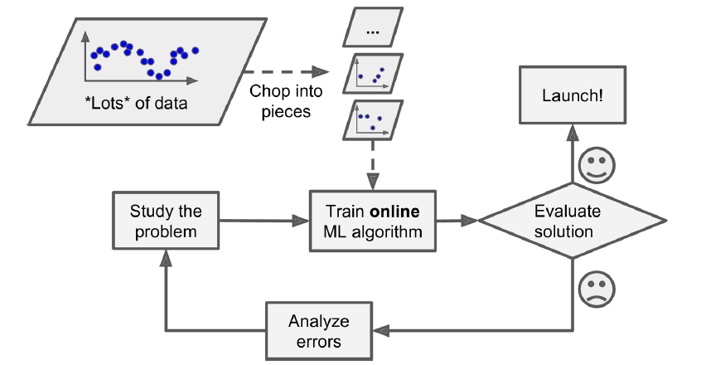
Batch and Online Learning
Online learning
In online learning, you train the system incrementally by feeding it data instances sequentially, either individually or by small groups called mini-batches. Each learning step is fast and cheap, so the system can learn about new data on the fly, as it arrives.

Slide 27
Instance-Based Versus Model-Based Learning
Instance-based learning
Possibly the most trivial form of learning is simply to learn by heart. If you were to create a spam filter this way, it would just flag all emails that are identical to emails that have already been flagged by users—not the worst solution, but certainly not the best.

Slide 28
Instance-Based Versus Model-Based Learning
Instance-based learning
Instead of just flagging emails that are identical to known spam emails, your spam filter could be programmed to also flag emails that are very similar to known spam emails. This requires a measure of similarity between two emails. A (very basic) similarity measure between two emails could be to count the number of words they have in common. The system would flag an email as spam if it has many words in common with a known spam email.

Slide 29
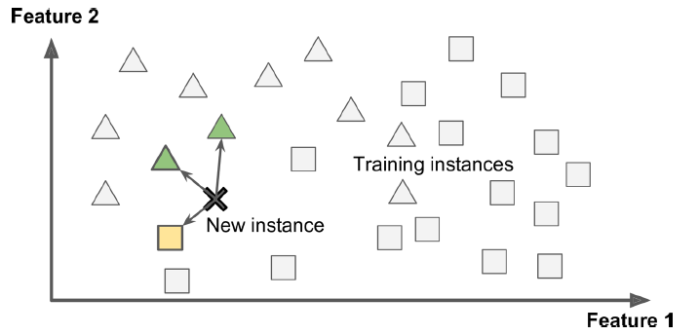
Instance-Based Versus Model-Based Learning
Instance-based learning
Instead of just flagging emails that are identical to known spam emails, your spam filter could be programmed to also flag emails that are very similar to known spam emails. This requires a measure of similarity between two emails. A (very basic) similarity measure between two emails could be to count the number of words they have in common. The system would flag an email as spam if it has many words in common with a known spam email.

Slide 30
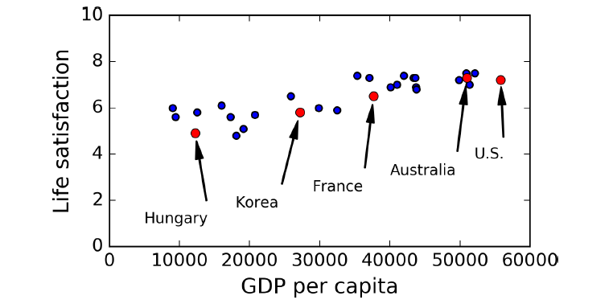
Instance-Based Versus Model-Based Learning
Model-based learning

Slide 31
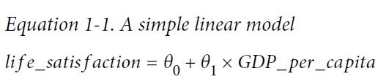
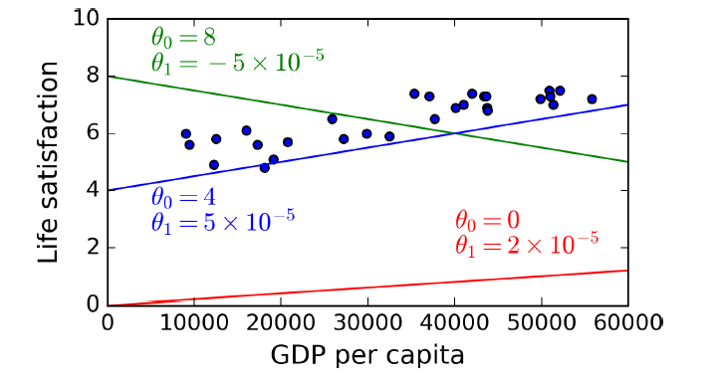
Instance-Based Versus Model-Based Learning
Model-based learning

Slide 32
Instance-Based Versus Model-Based Learning
Before you can use your model, you need to define the parameter values θ0 and θ1. How can you know which values will make your model perform best?
You can either define a fitness function that measures how good your model is, or you can define a cost function that measures how bad it is.
For linear regression problems, people typically use a cost function that measures the distance between the linear model’s predictions and the training examples; the objective is to minimize this distance.

Slide 33
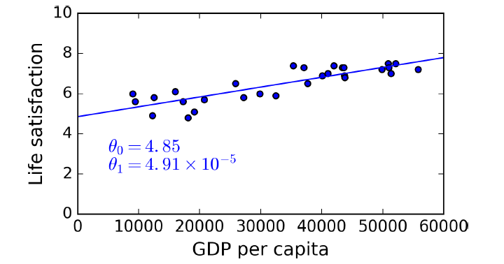
Instance-Based Versus Model-Based Learning
This is called training the model. In our case the algorithm finds that the optimal parameter values are θ0 = 4.85 and θ1 = 4.91 × 10^{–5}.

Slide 34
import matplotlib
import matplotlib.pyplot as plt
import numpy as np
import pandas as pd
import sklearn
oecd_bli = pd.read_csv("oecd_bli_2015.csv", thousands=',')
gdp_per_capita = pd.read_csv("gdp_per_capita.csv",thousands=',',delimiter='\t',
encoding='latin1', na_values="n/a")
country_stats = prepare_country_stats(oecd_bli, gdp_per_capita)
X = np.c_[country_stats["GDP per capita"]]
y = np.c_[country_stats["Life satisfaction"]]
country_stats.plot(kind='scatter', x="GDP per capita", y='Life satisfaction')
plt.show()
lin_reg_model = sklearn.linear_model.LinearRegression()
lin_reg_model.fit(X, y)
X_new = [[22587]] # Cyprus' GDP per capita
print(lin_reg_model.predict(X_new)) # outputs [[ 5.96242338]]

Slide 35
Model-based learning
In summary:
You studied the data.
You selected a model.
You trained it on the training data (i.e., the learning algorithm searched for the model parameter values that minimize a cost function).
Finally, you applied the model to make predictions on new cases (this is called inference), hoping that this model will generalize well.

Slide 36
Main Challenges of Machine Learning
Two things that can go wrong are “bad algorithm” and “bad data.”

Slide 37
Bad data
Insufficient Quantity of Training Data
It takes a lot of data for most Machine Learning algorithms to work properly. Even for very simple problems you typically need thousands of examples, and for complex problems such as image or speech recognition you may need millions of examples

Slide 38
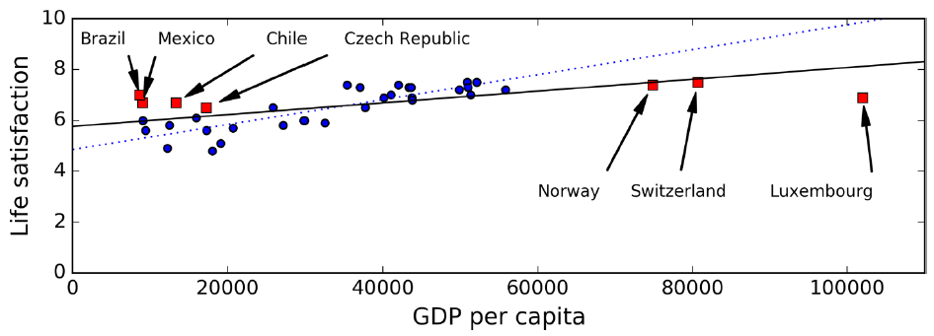
Bad data
Nonrepresentative Training Data

Slide 39
Bad data
Irrelevant Features
As the saying goes: garbage in, garbage out. Your system will only be capable of learning if the training data contains enough relevant features and not too many irrelevant ones. A critical part of the success of a Machine Learning project is coming up with a good set of features to train on. This process, called feature engineering.

Slide 40
Bad algorithm
Overfitting the Training Data
Overgeneralizing is something that we humans do all too often, and unfortunately machines can fall into the same trap if we are not careful. In Machine Learning this is called overfitting: it means that the model performs well on the training data, but it does not generalize well.

Slide 41
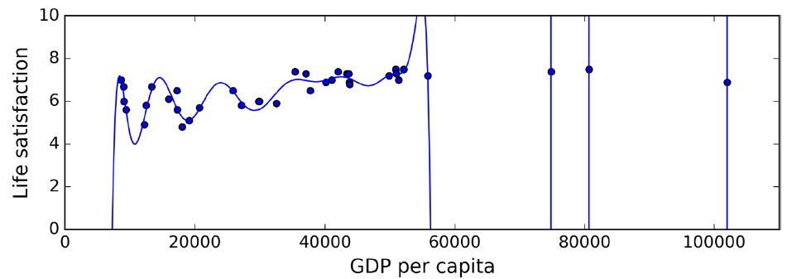
Bad algorithm
Overfitting the Training Data
Overgeneralizing is something that we humans do all too often, and unfortunately machines can fall into the same trap if we are not careful. In Machine Learning this is called overfitting: it means that the model performs well on the training data, but it does not generalize well.

Slide 42
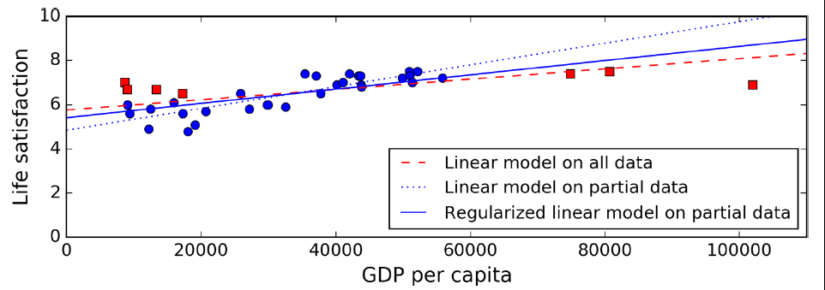
Bad algorithm
Constraining a model to make it simpler and reduce the risk of overfitting is called regularization.

Slide 43
Bad algorithm
The amount of regularization to apply during learning can be controlled by a hyperparameter. A hyperparameter is a parameter of a learning algorithm (not of the model). As such, it is not affected by the learning algorithm itself; it must be set prior to training and remains constant during training. If you set the regularization hyperparameter to a very large value, you will get an almost flat model (a slope close to zero); the learning algorithm will almost certainly not overfit the training data, but it will be less likely to find a good solution.

Slide 44
Bad algorithm
Underfitting the Training Data
underfitting is the opposite of overfitting: it occurs when your model is too simple to learn the underlying structure of the data. For example, a linear model of life satisfaction is prone to underfit; reality is just more complex than the model, so its predictions are bound to be inaccurate, even on the training examples.

Slide 45
One last important topic
once you have trained a model, you don’t want to just “hope” it generalizes to new cases. You want to evaluate it, and finetune it if necessary. Let’s see how.

Slide 46
Testing and Validating
The only way to know how well a model will generalize to new cases is to actually try it out on new cases. One way to do that is to put your model in production and monitor how well it performs. This works well, but if your model is horribly bad, your users will complain—not the best idea.

Slide 47
Testing and Validating
A better option is to split your data into two sets: the training set and the test set. As these names imply, you train your model using the training set, and you test it using the test set. The error rate on new cases is called the generalization error (or out-of-sample error), and by evaluating your model on the test set, you get an estimation of this error. This value tells you how well your model will perform on instances it has never seen before.

Slide 48
Testing and Validating
A common solution to regularization hyperparameter tuning is to have a second holdout set called the validation set. You train multiple models with various hyperparameters using the training set, you select the model and hyperparameters that perform best on the validation set, and when you’re happy with your model you run a single final test against the test set to get an estimate of the generalization error.

Slide 49
Testing and Validating
To avoid “wasting” too much training data in validation sets, a common technique is to use cross-validation: the training set is split into complementary subsets, and each model is trained against a different combination of these subsets and validated against the remaining parts. Once the model type and hyperparameters have been selected, a final model is trained using these hyperparameters on the full training set, and the generalized error is measured on the test set.

